Slide 1
ICES-2020-199
Analysis and Optimization of
Test Plans for Advanced
Exploration Systems Reliability and Supportability
Andrew Owens and William Cirillo
NASA Langley Research Center
Nicole Piontek, Chel Stromgren, and Jason Cho
Binera, Inc.
July 13, 2021
50th International Conference on Environmental Systems
12-15 July 2021

Slide 2
Overview
Future crewed exploration missions will face greater logistical challenges than ever before
Accurate/precise failure rate estimates are critical for crewed missions beyond Low Earth Orbit (LEO); current risk mitigation strategies (quick abort/resupply) will not be available
Testing is a critical element of system development, providing the opportunity to:
  Identify and resolve unexpected issues before they become a problem in flight
  Identify and mitigate failure modes to improve reliability
  Gather data required to reduce uncertainty and verify failure rate estimates
Long-duration testing takes time and requires test resources; these schedule and resource requirements need to be incorporated into program planning
This paper presents an integrated reliability/supportability test plan analysis and optimization methodology developed to inform Advanced Exploration Systems (AES) Life Support Systems (LSS) ground test planning
  Balances test resources across all items, including both reliability growth and uncertainty reduction testing
  Applies formal mathematical optimization to enable systematic exploration of a much larger trade space of test plans than could be examined manually
7/13/2021

Slide 3
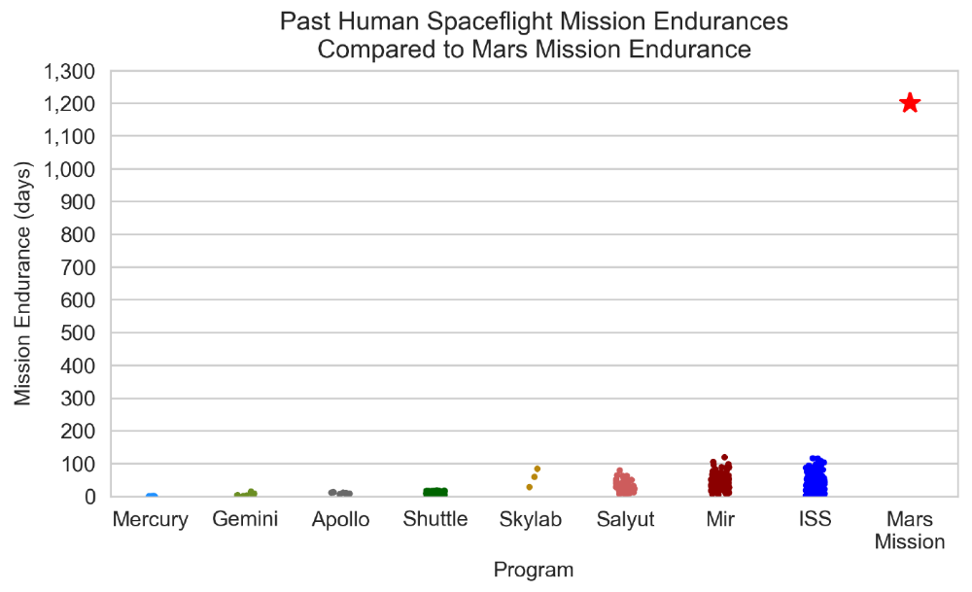
Beyond-LEO Missions Present Unique Supportability Challenges
Future human spaceflight missions beyond Low Earth Orbit (LEO) will operate in a logistically isolated environment for 6-10x longer than any previous crewed missions
Current/past operations rely on abort capability and regular resupply to mitigate risk
Abort/resupply not feasible for Mars missions
Supportability is a
first-order driver of mass and risk
Accurate failure rate estimates are necessary for crew safety
Endurance, the crewed time between resupply flights, will be an order of magnitude greater challenge for future crewed Mars missions
Supportability describes the system characteristics, such as reliability and maintainability, that drive logistics and support requirements necessary for safe and effective operations
Absence of logistics resupply opportunities, combined with extremely limited abort capability, drives the need for an updated logistics strategy to ensure a high level of crew safety
Mars missions:
750-1,200 days without logistics resupply
Maximum previous on-orbit experience:
up to 119 days without logistics resupply
Each dot represents a time period where a crew remained in space between launch/landing or a new vehicle arrival at stations. Includes missions up to November 19, 2018.
7/13/2021
Owens, A. C. Multiobjective Optimization of Crewed Spacecraft Supportability Strategies. Doctoral Thesis. Massachusetts Institute of Technology, Cambridge, MA, 2019.

Slide 4
Reliability Testing is Critical for Future Missions
Failure rates are critical parameters for assessing risk, reliability, spares requirements, and other important factors for system and mission design
Failure rates cannot be measured directly, but must be estimated based on analogy to previous experience and/or statistical analysis of operating data
Long-duration reliability testing provides the data required for good failure rate estimates, which enables good risk, reliability, and spares mass estimates
Testing also provides opportunity to identify/resolve issues before they impact operations
An effective reliability and supportability testing program can require years of operations and resource investment, and must be incorporated into program planning
Two major types of reliability testing:
  Reliability Growth Testing: test to identify failure modes and make design changes to remove them, thereby improving system reliability (i.e. reducing the failure rate)
  Uncertainty Reduction Testing: test without making design changes in order to gather data, and improve/verify failure rate estimates
7/13/2021

Slide 5
Reliability Testing is Resource-Constrained
Key test planning questions:
  Which items should be tested, and for how long?
  For each item, how much testing should be dedicated to reliability growth vs. uncertainty reduction?
  For each item, how many test units should be purchased to test in parallel?
Ideally (ignoring resource constraints), all items would be tested for as long as possible to maximize reliability growth and generate high-reliability items with low uncertainty in the failure rate estimates
However, technology and system development activities are fundamentally resource-limited
Quantitative analysis and optimization can handle the large number of variables and constraints that impact test plans to help programs make informed decisions about how to efficiently allocate limited resources in order to achieve mission objectives
Optimization problem formulation presented here is one approach to identifying efficient test plans and making the best use of limited program resources
7/13/2021

Slide 6
Problem Statement
What reliability test plan – i.e. a specified reliability growth test duration, uncertainty reduction test duration, and number of test units for each item in the system – results in the lowest projected spares mass for a given mission, under given cost and schedule constraints?
7/13/2021

Slide 7
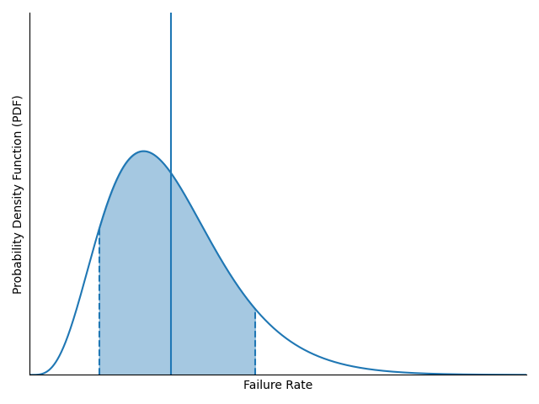
Assumptions / Modeling Approach
Reference mission defined by
  Mission endurance (i.e. time between resupply)
  Probability of Sufficiency (POS)
  Set of items considered for sparing (e.g. ORUs)
Uncertain failure rate estimates modeled using gamma distribution
For each item, all reliability growth testing completed before uncertainty reduction testing begins
Schedule constraints include max reliability growth test duration and max total test duration
Test duration (calendar time) includes actual test operating time as well as downtime:
  Test unit procurement delay
  Modifications
  Refurbishments
Expected Value
Probability Density Function (PDF)
Credible Interval
A candidate solution to the problem (“test plan”) consists of the following for each unit:
  Number of test units
  Reliability growth test duration
  Uncertainty reduction test duration
7/13/2021

Slide 8
Problem Definition
End of Reliability Growth Window (Design Freeze)
Test Units
Start of Test Window
End of Test Window
Items
Cost
A
Test cost associated with each item is the sum of the cost of test units and expected modifications and refurbishments during testing
CONSTRAINT: Maximum calendar time for reliability growth testing. No more design changes planned after this time period.
B
C
CONSTRAINT: Maximum calendar time for testing.
D
Test Calendar Time
Total cost is the sum of test costs across all items
Decision variables (number of units, reliability growth test duration, uncertainty reduction test duration) defined for each item
Total Cost:
CONSTRAINT: Maximum total cost
Max Cost:
7/13/2021

Slide 9

Example Solution
End of Reliability Growth Window (Design Freeze)
Test Units
Start of Test Window
End of Test Window
Items
Cost
A
3
38
Procurement delay included before testing can begin
B
1
13
C
0
Reliability Growth Test Duration
(including testing and downtime for modification and refurbishment)
Uncertainty Reduction
Test Duration
(including testing and downtime for refurbishment)
0
D
2
22
Reliability Growth Schedule Constraint
Total Schedule Constraint
Total Cost:
73
Cost Constraint
Max Cost:
75
7/13/2021

Slide 10
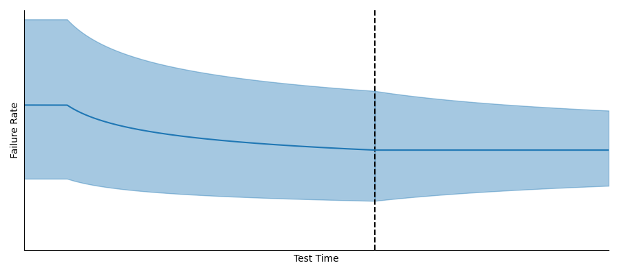
Example Test Impacts
End of Reliability Growth Window (Design Freeze)
Test Units
Start of Test Window
End of Test Window
Items
A
3
Reliability Growth Testing: Identify failure modes and implement design changes to lower the failure rate
Uncertainty Reduction Testing: Gather data to improve failure rate estimate and reduce uncertainty
B
1
13
Initial Failure Rate Estimate (Before Testing)
C
0
0
Projected Failure Rate Estimate
(After Testing)
D
2
22
Note: there is a minimum required reliability growth test time before the test is projected to provide benefits, explained in more detail in paper
Reliability Growth Schedule Constraint
✓
Total Schedule Constraint
✓
…
Total Cost:
73
Testing results in potential changes to each item’s failure rate and uncertainty; these changes impact required spares mass for the reference mission
Cost Constraint
✓
Max Cost:
75
7/13/2021

Slide 11
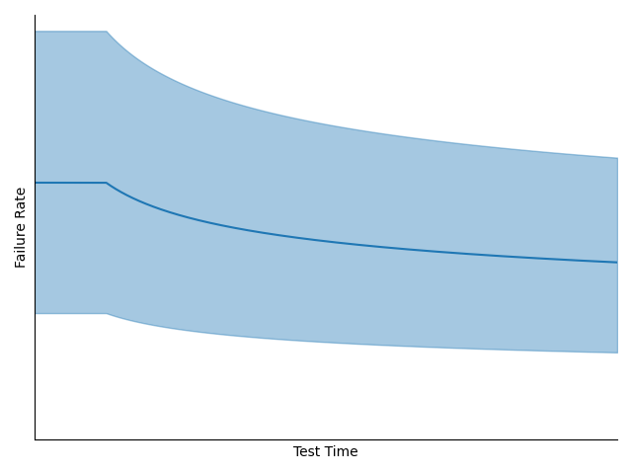
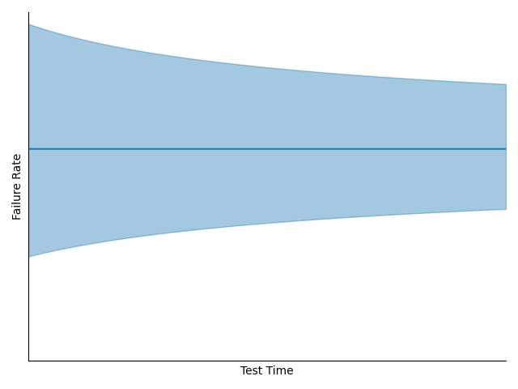
Test Models
Reliability growth modeled using Extended Reliability Growth Planning Model
  Parametric model based on empirical observation of past reliability growth tests
  Failure rate follows “learning curve” model
  Model adjusted to include minimum test before failure rate is reduced
Assumed to only affect expected failure rate, not uncertainty
Uncertainty reduction modeled via Bayesian update, with assumption that the expected number of failures occurs during test
Assumed to only affect uncertainty, not expected failure rate
These models are only projections based on assumed behavior, used to forecast potential test benefits. They are not precise predictions or guarantees. There is no way to know the outcome of a test without performing the test.
See paper for more detail on reliability growth and uncertainty reduction models
7/13/2021
Dezfuli, H., Kelly, D., Smith, C., Vedros, K., and Galyean, W. Bayesian Inference for NASA Probabilistic Risk and Reliability Analysis. Publication NASA/SP-2009-569. National Aeronautics and Space Administration, Washington, DC, 2009.
Crow, L.H. “Planning a Reliability Growth Program Utilizing Historical Data.” Presented at the Reliability and Maintainability Symposium, Lake Buena Vista, FL, 2011.

Slide 12
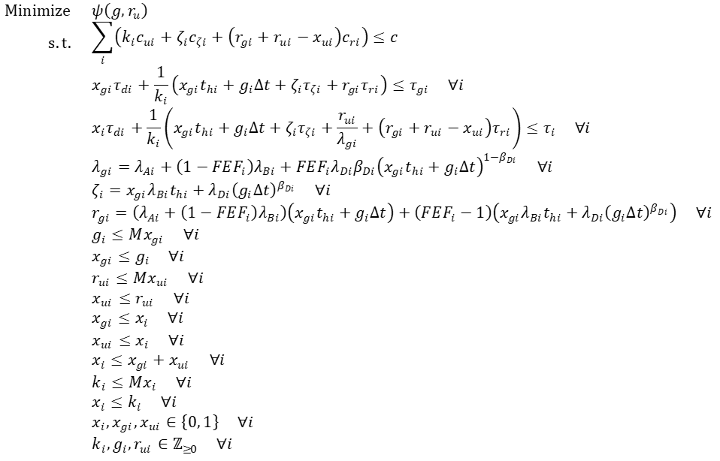
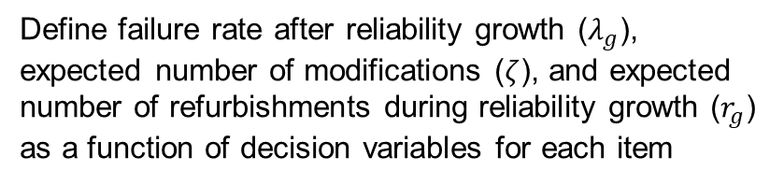
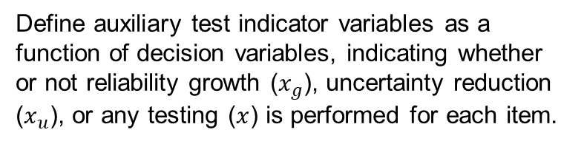
Optimization Problem Formulation
Objective: Minimize spares mass
Cost Constraint: total cost must be less than maximum cost
Schedule Constraint: for each item, reliability growth test duration must be less than maximum reliability growth test duration
Schedule Constraint: for each item, total test duration must be less than maximum test duration
Define failure rate after reliability growth ($λ_{g}$), expected number of modifications ($ζ$), and expected number of refurbishments during reliability growth ($r_{g}$) as a function of decision variables for each item
Define auxiliary test indicator variables as a function of decision variables, indicating whether or not reliability growth ($x_{g}$), uncertainty reduction ($x_{u}$), or any testing ($x$) is performed for each item.
Formulated as single-objective integer optimization
  Test times discretized; can adjust granularity
  Test plan defined by decision variable values
Solved via branch-and-bound approach, using bounds propagation (see paper for more details)
Define variable domains
Nomenclature defined in backup
7/13/2021

Slide 13
Discussion
Integrated approach balances resources across all items and across both reliability growth and uncertainty reduction testing
  Space system development is resource-limited, need to make best use of limited budget/schedule
  Integrated analysis will typically produce better solutions than a siloed or individual approach
Formal mathematical optimization enables systematic exploration of large number of options
  Can explore tens of thousands of potential solutions to identify optimal cases
  Analysis can be rerun with different parameters to explore “what if” scenarios
Results from optimization are not the final answer, but are informative
  These models are useful abstractions of reality, not a crystal ball
  Optimization results should be combined with expert knowledge and other factors outside the model
  Test plan should be responsive, and update based on actual test results as they become available
Model outputs are only as good as model inputs
Future work:
  Explore use of other metrics in objectives and constraints (e.g. minimize cost subject to mass/risk/schedule constraints, minimize risk subject to cost/schedule/mass constraints)
  Improve efficiency of optimizer
7/13/2021
Notes:
The map is not the territory

Slide 14
Conclusions
Reliability and supportability testing will be critical for future crewed exploration missions due to the new and more challenging logistical environment
Long duration testing requires careful budget and schedule planning to be effective, and these resource requirements must be considered during program planning
The test plan analysis and optimization method presented here provides a quantitative, formal approach to explore options and inform test planning
7/13/2021

Slide 15
References
Owens, A., De Weck, O., Stromgren, C., Goodliff, K. E., and Cirillo, W. Supportability Challenges, Metrics, and Key Decisions for Future Human Spaceflight. 2017.
Cirillo, W., Aaseng, G., Goodliff, K., Stromgren, C., and Maxwell, A. Supportability for Beyond Low Earth Orbit Missions. Presented at the AIAA SPACE 2011 Conference & Exposition, Long Beach, CA, 2011.
Owens, A. C. Multiobjective Optimization of Crewed Spacecraft Supportability Strategies. Doctoral Thesis. Massachusetts Institute of Technology, Cambridge, MA, 2019.
Stromgren, C., Goodliff, K. E., Cirillo, W., and Owens, A. The Threat of Uncertainty - Why Using Traditional Approaches for Evaluating Spacecraft Reliability Are Insufficient for Future Human Mars Missions. Presented at the AIAA SPACE 2016, Long Beach, CA, 2016.
Owens, A. C., de Weck, O. L., Stromgren, C., Goodliff, K., and Cirillo, W. Accounting for Epistemic Uncertainty in Mission Supportability Assessment: A Necessary Step in Understanding Risk and Logistics Requirements. Presented at the 47th International Conference on Environmental Systems, Charleston, SC, 2017.
Owens, A., and de Weck, O. International Space Station Operational Experience and Its Impacts on Future Mission Supportability. Presented at the International Conference on Environmental Systems, Albuquerque, NM, 2018.
Owens, A., and de Weck, O. How Much Testing Is Needed to Manage Supportability Risks for Beyond-LEO Missions? Presented at the International Conference on Environmental Systems, Boston, 2019.
Owens, A., Piontek, N., Cirillo, W. M., Stromgren, C., and Cho, J. More Data Needed for Failure Rate Estimation, Validation, and Uncertainty Reduction. Presented at the International Conference on Environmental Systems, 2021.
Crow, L. H. Planning a Reliability Growth Program Utilizing Historical Data. Presented at the Reliability and Maintainability Symposium, Lake Buena Vista, FL, 2011.
Duane, J. T. “Learning Curve Approach to Reliability Monitoring.” IEEE Transactions on Aerospace, Vol. 2, No. 2, 1964, pp. 563–566. doi:10.1109/TA.1964.4319640.
Dezfuli, H., Kelly, D., Smith, C., Vedros, K., and Galyean, W. Bayesian Inference for NASA Probabilistic Risk and Reliability Analysis. Publication NASA/SP-2009-569. National Aeronautics and Space Administration, Washington, DC, 2009.
Barton, P. I. Mixed-Integer and Nonconvex Optimization. Massachusetts Institute of Technology, Cambridge, MA, 2011.
Bradley, S. P., Hax, A. C., and Magnanti, T. L. Applied Mathematical Programming. Addison-Wesley Pub. Co, Reading, Mass, 1977.
Hillier, F. S., and Lieberman, G. J. Introduction to Operations Research. McGraw-Hill, Boston, 2001.
Owens, A., Jones, C. A., Cirillo, W., Klovstad, J., Judd, E., Chai, P., Merrill, R. G., Piontek, N., Stromgren, C., and Cho, J. Integrated Trajectory, Habitat, and Logistics Analysis and Trade Study for Human Mars Missions. Presented at the ASCEND 2020, Virtual Event, 2020.
7/13/2021

Slide 16
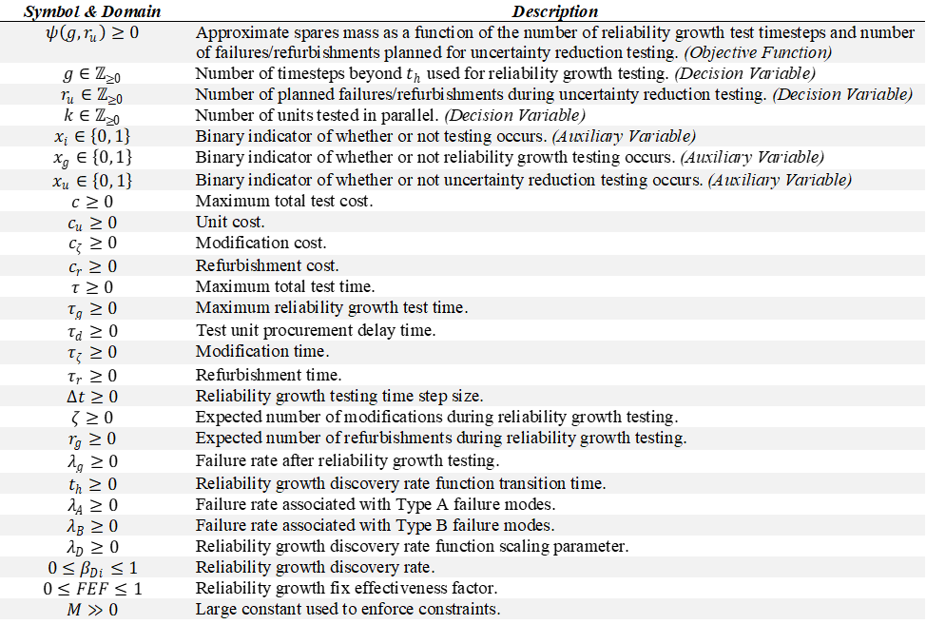
Optimization Problem Nomenclature

Slide 17
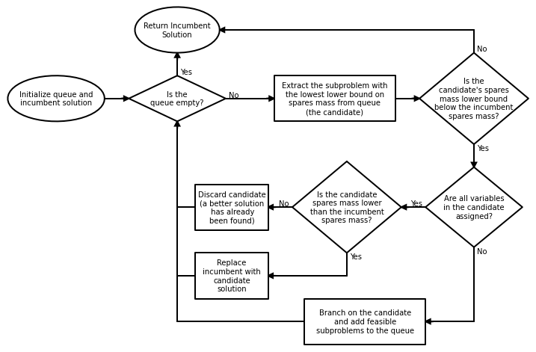
Solution Approach: Branch and Bound
7/13/2021

