Slide 1
Computational Model Uncertainty
Quantification and Model Validation
Tom West
NASA Langley Research Center

Slide 2
Motivation
To assess the measure of feasibility for computational fluid dynamics (CFD) as a surrogate for wind tunnel testing, uncertainty quantification (UQ) is used to assess predictive capability
Model-form uncertainty needs to be quantified in order to determine the CFD accuracy when compared to measured data
Measuring predictive capability of CFD requires UQ to isolate numerical and input uncertainty from model-form uncertainty

Slide 3


Quantifying Prediction Uncertainty in Computational Models
Four steps:
Identify sources of uncertainty
  This is the hard part!
Classify and characterize each source of uncertainty
  Inherent (Aleatory) vs epistemic uncertainty
  Often subjective
  Data sources often sparse and/or uncertain
  Must be defensible!
Quantify impact of uncertainty on quantities of interest
  Propagate input uncertainties
  Append verification errors
  Computationally expensive
Compute Model-Form Uncertainty
  Direct validation
  Extrapolation from a validation domain
Model Input Uncertainty
Verification
Validation
Total Prediction Uncertainty
Probabilistic
Model
+
+
Probability Density
Probability Density
Non-probabilistic
$$Response$$
$$Response$$

Slide 4
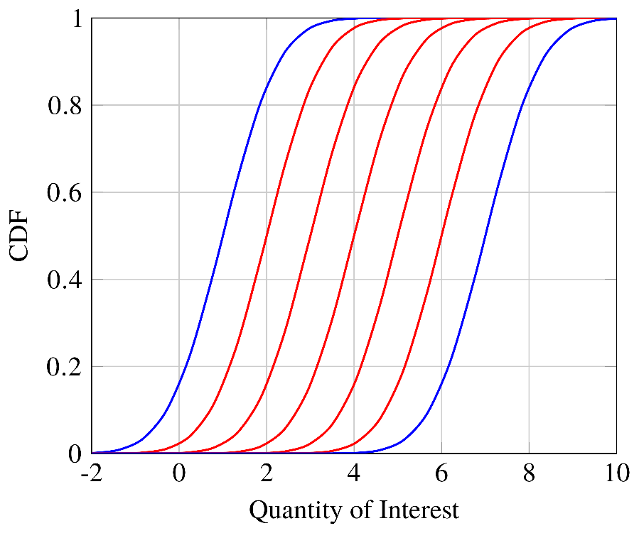
Uncertainty Representation and Communication: Probability Boxes
Mixed input uncertainty propagation requires separation of inherent uncertainty from the possible realizations of epistemic uncertainty.
Epistemic Sampling
Aleatory UQ
“Black Box” Simulation
Produces a family of probability or cumulative distribution functions (PDFs/CDFs)
Bounding CDFs constitutes a probability box or “P-box”
Read horizontally: “Range of possible outcomes at a select probability level”
Read vertically: “Range of probabilities for a possible outcome”
Epistemic
Aleatory

Slide 5
Solution Verification
Process of estimating numerical errors of predictions
Three sources of numerical error:
  Spatial and temporal discretization error
    Richardson Extrapolation or Roache’s Grid Convergence Index (GCI)
    Adjoint or error transport equation, if available
  Iterative convergence and sampling error
    Measure of solution convergence with iterations
    Accounts for unsteadiness and “ringing”
  Round-off error
Source of epistemic uncertainty (true errors often unknown)
  Error magnitude applied as uncertainty band to prediction
Computationally expensive and tedious, but critical
  Verification must be completed for each quantity of interest
  Grid convergence estimates are challenging for complex models/physics

Slide 6
Validation Framework
Pre-Test Analysis to Inform Test Design
Computational Model
Experiment
Post-Test Inputs with Uncertainty
Uncertainties not bookkept in the experiment must be propagated through the CFD.
Measurement and Uncertainty
Prediction and Verification Error
Validation Metric
Model Calibration
Acceptable?
Validation is largely a bookkeeping problem!

Slide 7
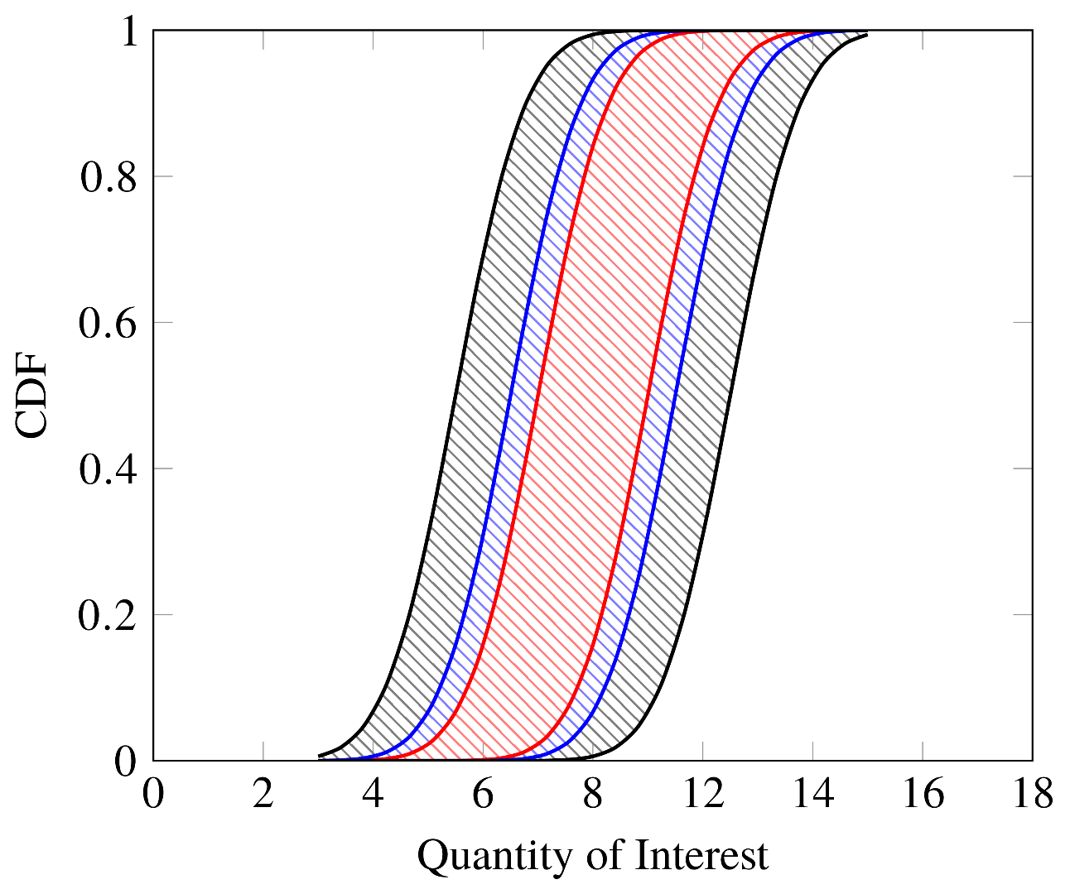
“CFD as a Surrogate” Process
At a test condition, obtain solutions on different codes/models (numerical scheme, inviscid fluxes, turbulence models, time accuracy, etc.)
  Assume each prediction is a discrete possibility, one is not more “correct” than another (Without the test data, how would you know?)
  Based on analyst's best judgement, physics, and historical data
  More is better
Quantify numerical errors for each grid/solver type
Identify and propagate input uncertainty through one or two codes/models with a surrogate-based approach
Append numerical error to the input uncertainty estimate
Compute model-form uncertainty by comparing to measured data
Repeat this process as needed throughout test matrix
Computational Model Uncertainty Build-up
Model-Form Uncertainty
Input
Uncertainty
Verification
Error
Model-Form Uncertainty

Slide 8
Questions?

