Slide 1
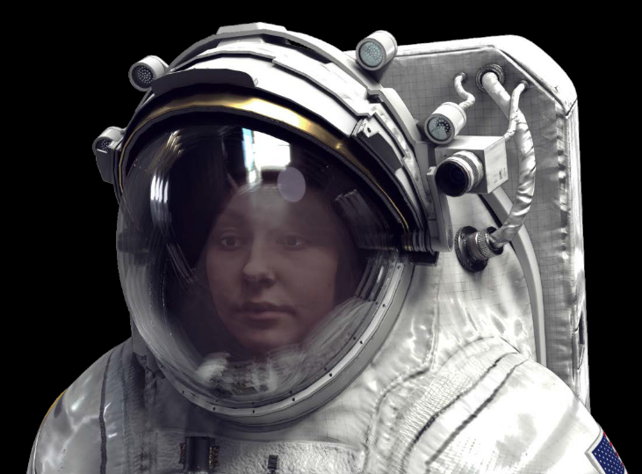
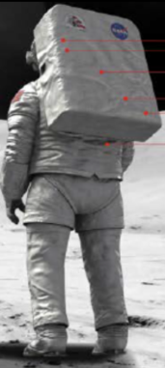
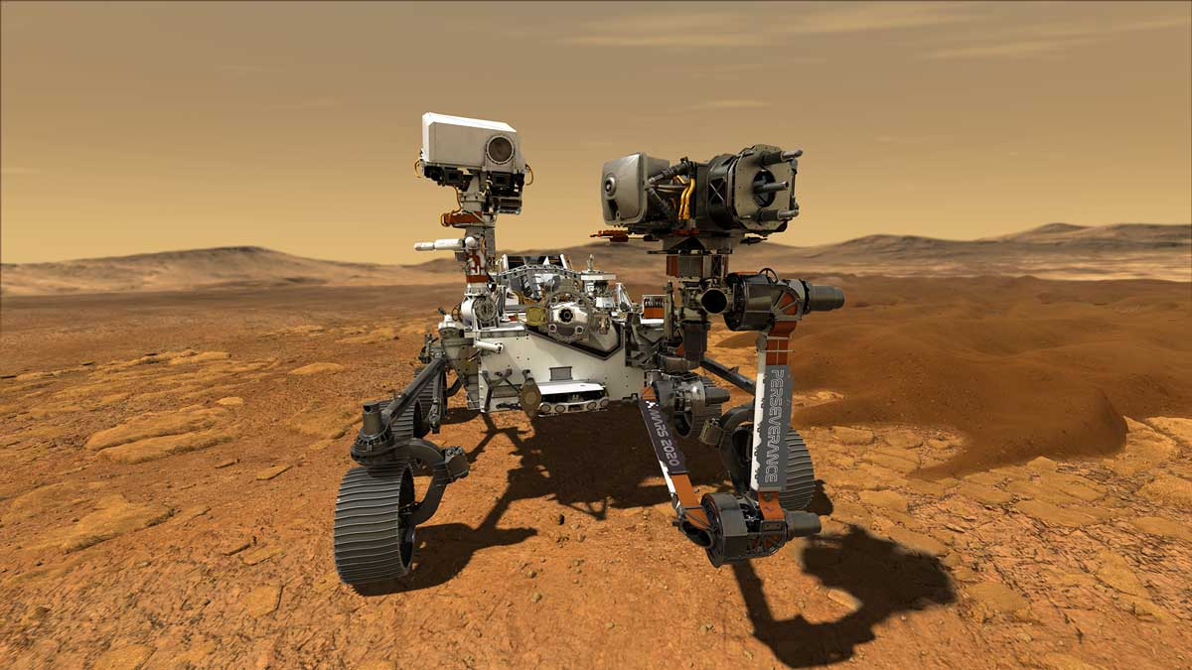

Monitoring Human Performance on Future Deep Space Missions
Kritina Holden
Leidos
Brandin Munson
University of Houston
Jerri Stephenson
NASA
NASA Johnson Space Center
July, 2021

Slide 2
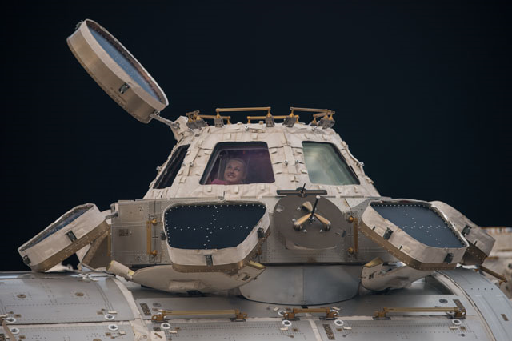
Key Spaceflight Hazards
Radiation
  Higher levels and more dangerous
Isolation and confinement
  Longer missions, greater isolation
Hostile/closed environment
  Known and unknown hazards
Gravity
  Gravitational transitions and adaptation
Distance from Earth
  Communication delays and blackouts
Notes:
What is deep space – we are talking beyond the Earth Moon system – for example – Mars.
And in a journey that long and far away – we have great concern about several key spaceflight hazards.
All of these stressors will affect crew physical and mental health and performance in difficult-to-anticipate ways.

Slide 3
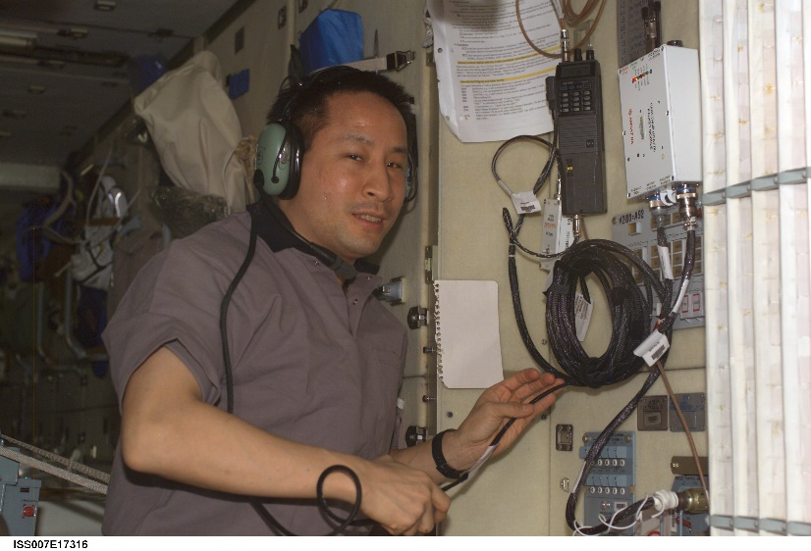
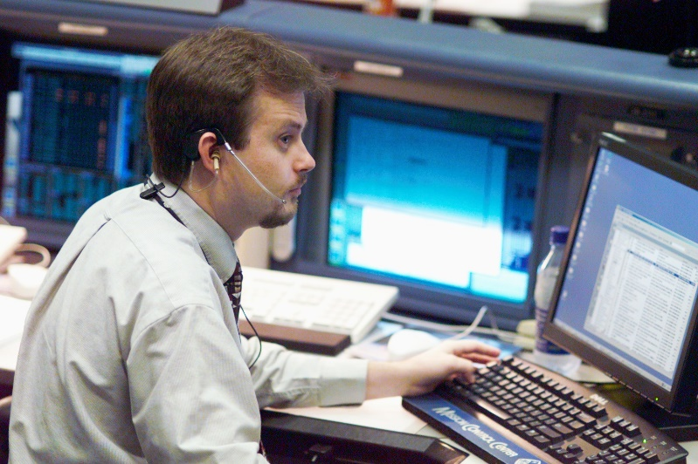
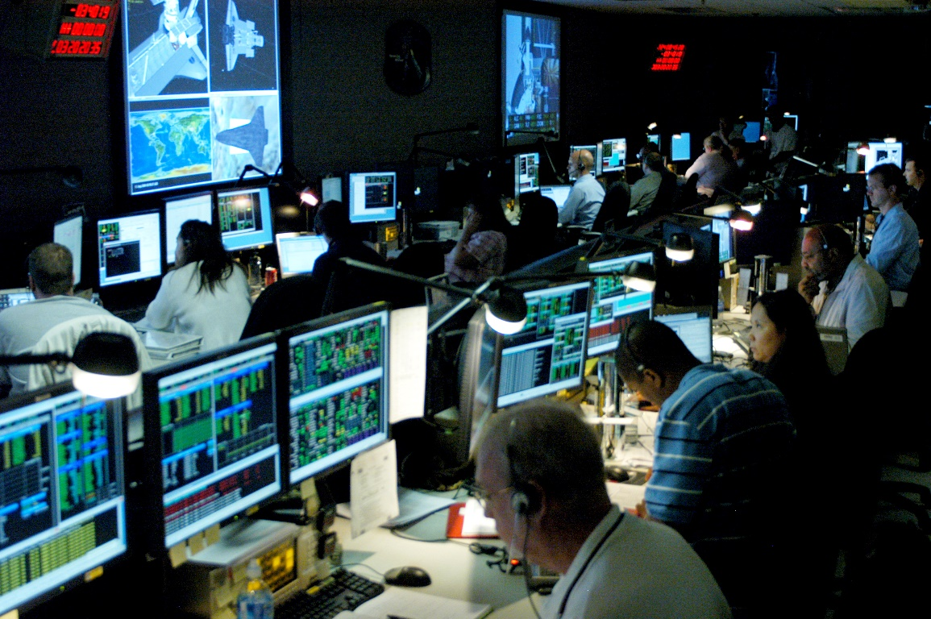
Flight Controller / Crew Partnership
Current ISS Operations
Flight controllers:
  Have near-constant contact with onboard crew
  Command and control ISS
  Assist crew with procedures
  Monitor operations and check for errors
  Troubleshoot and problem solve
  Monitor crew health and performance
Notes:
Let’s start by talking about how the ISS functions.

Slide 4
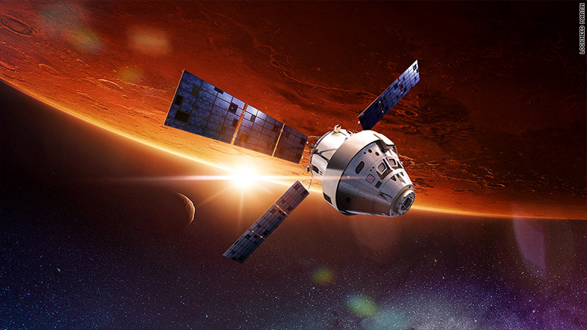
Deep Space Missions will Demand a Different Model
Communication delays and potential blackouts will increase crew autonomy
  Four crew must be able to do what crew + MCC currently does
  They must be able to identify when their performance drops significantly, and then apply countermeasures available onboard.
In Deep Space missions, crew will need to rely on:
  Intelligent systems and virtual assistants
  Unobtrusive health and human performance monitoring tools
  Adaptive cognitive/job aids
  Just-in-Time training systems
Deep Space crew will have to monitor their own health and performance – relying on each other and the available information onboard.
Notes:
Crew must be made aware when their cognitive workload is too high, when they have lost situation awareness, or when they are too stressed or too fatigued to perform well.
The bottom line is that Deep Space Crew will have…

Slide 5
NASA Solution Exploration
A number of self-monitoring technologies are presently being explored by NASA – some well-developed and others in a prototype stage
    Real-Time Physiological State Monitoring
    Exploration Medical Monitoring
    Crew Location Tracking
    EVA Operations
    Physical and Cognitive Exploration Simulations (PACES)
Notes:
NASA is exploring a variety of monitoring solutions – some are well developed, some based on commercial products and some are in a prototype stage.
I’ll be presenting a brief survey of some of the exploratory work going on at NASA

Slide 6
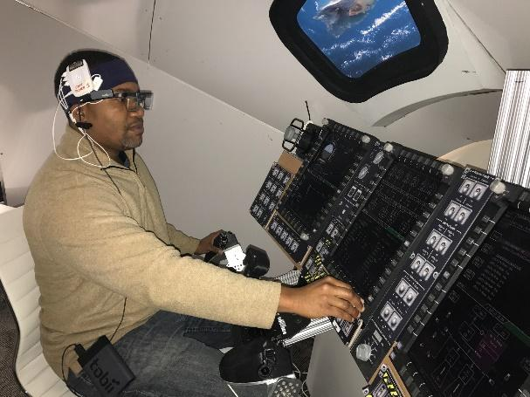
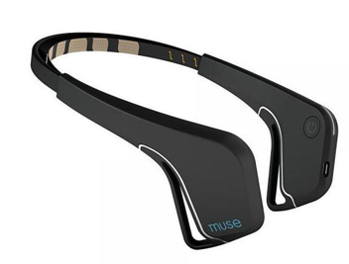

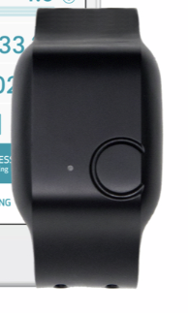
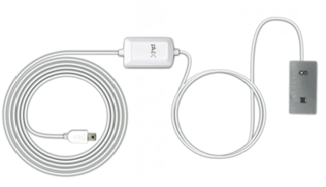
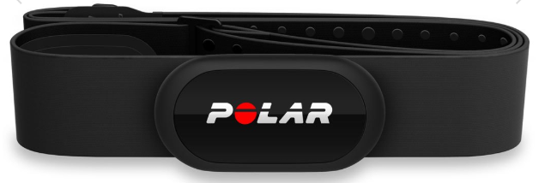
Real-Time Physiological State Monitoring
Cognitive Workload (NASA Human Research Program)
  fNIRS ‘Pioneer’ sensor, developed by Charles River Analytics
    Assesses brain activity as a measure of workload
    Promising as a continuous measure of workload during task performance
State Integration (JSC Hybrid Reality Lab)
  EEG, heart rate, fNIRS, respiration, GSR, among others
  Integrated into a machine learning algorithm that outputs metrics of human readiness to perform
  Long-term goal to incorporate these metrics into adaptive systems
Joint NASA/Charles River Analytics evaluation of ‘Pioneer” fNIRs sensor
Biometric Sensors
Muse Headband (EEG)
Tobii Pro Glasses 2 (Pupil Diameter)
Empatica E4 (GSR)
fNIRS Pioneer sensor
Polar Heart Rate Monitor
Notes:
First we will discuss real-time physiological state monitoring, which will be very important for crew health and performance.
The NASA HRP funded research in situation awareness and workload, and we partnered with Charles River to measure cognitive workload using their Pioneer fNIRS sensor device
The JSC Hybrid Reality Lab is looking at integrating data from a number of commercial devices to measure the human state. These include…..
The data are being integrated

Slide 7
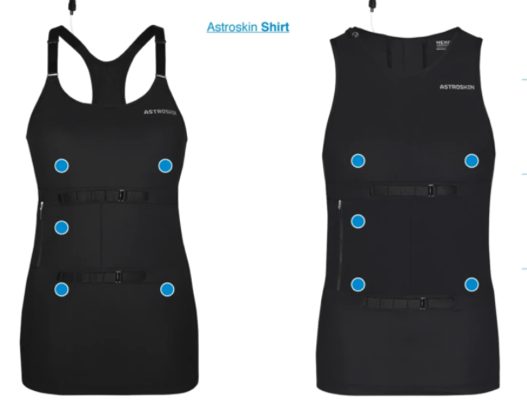
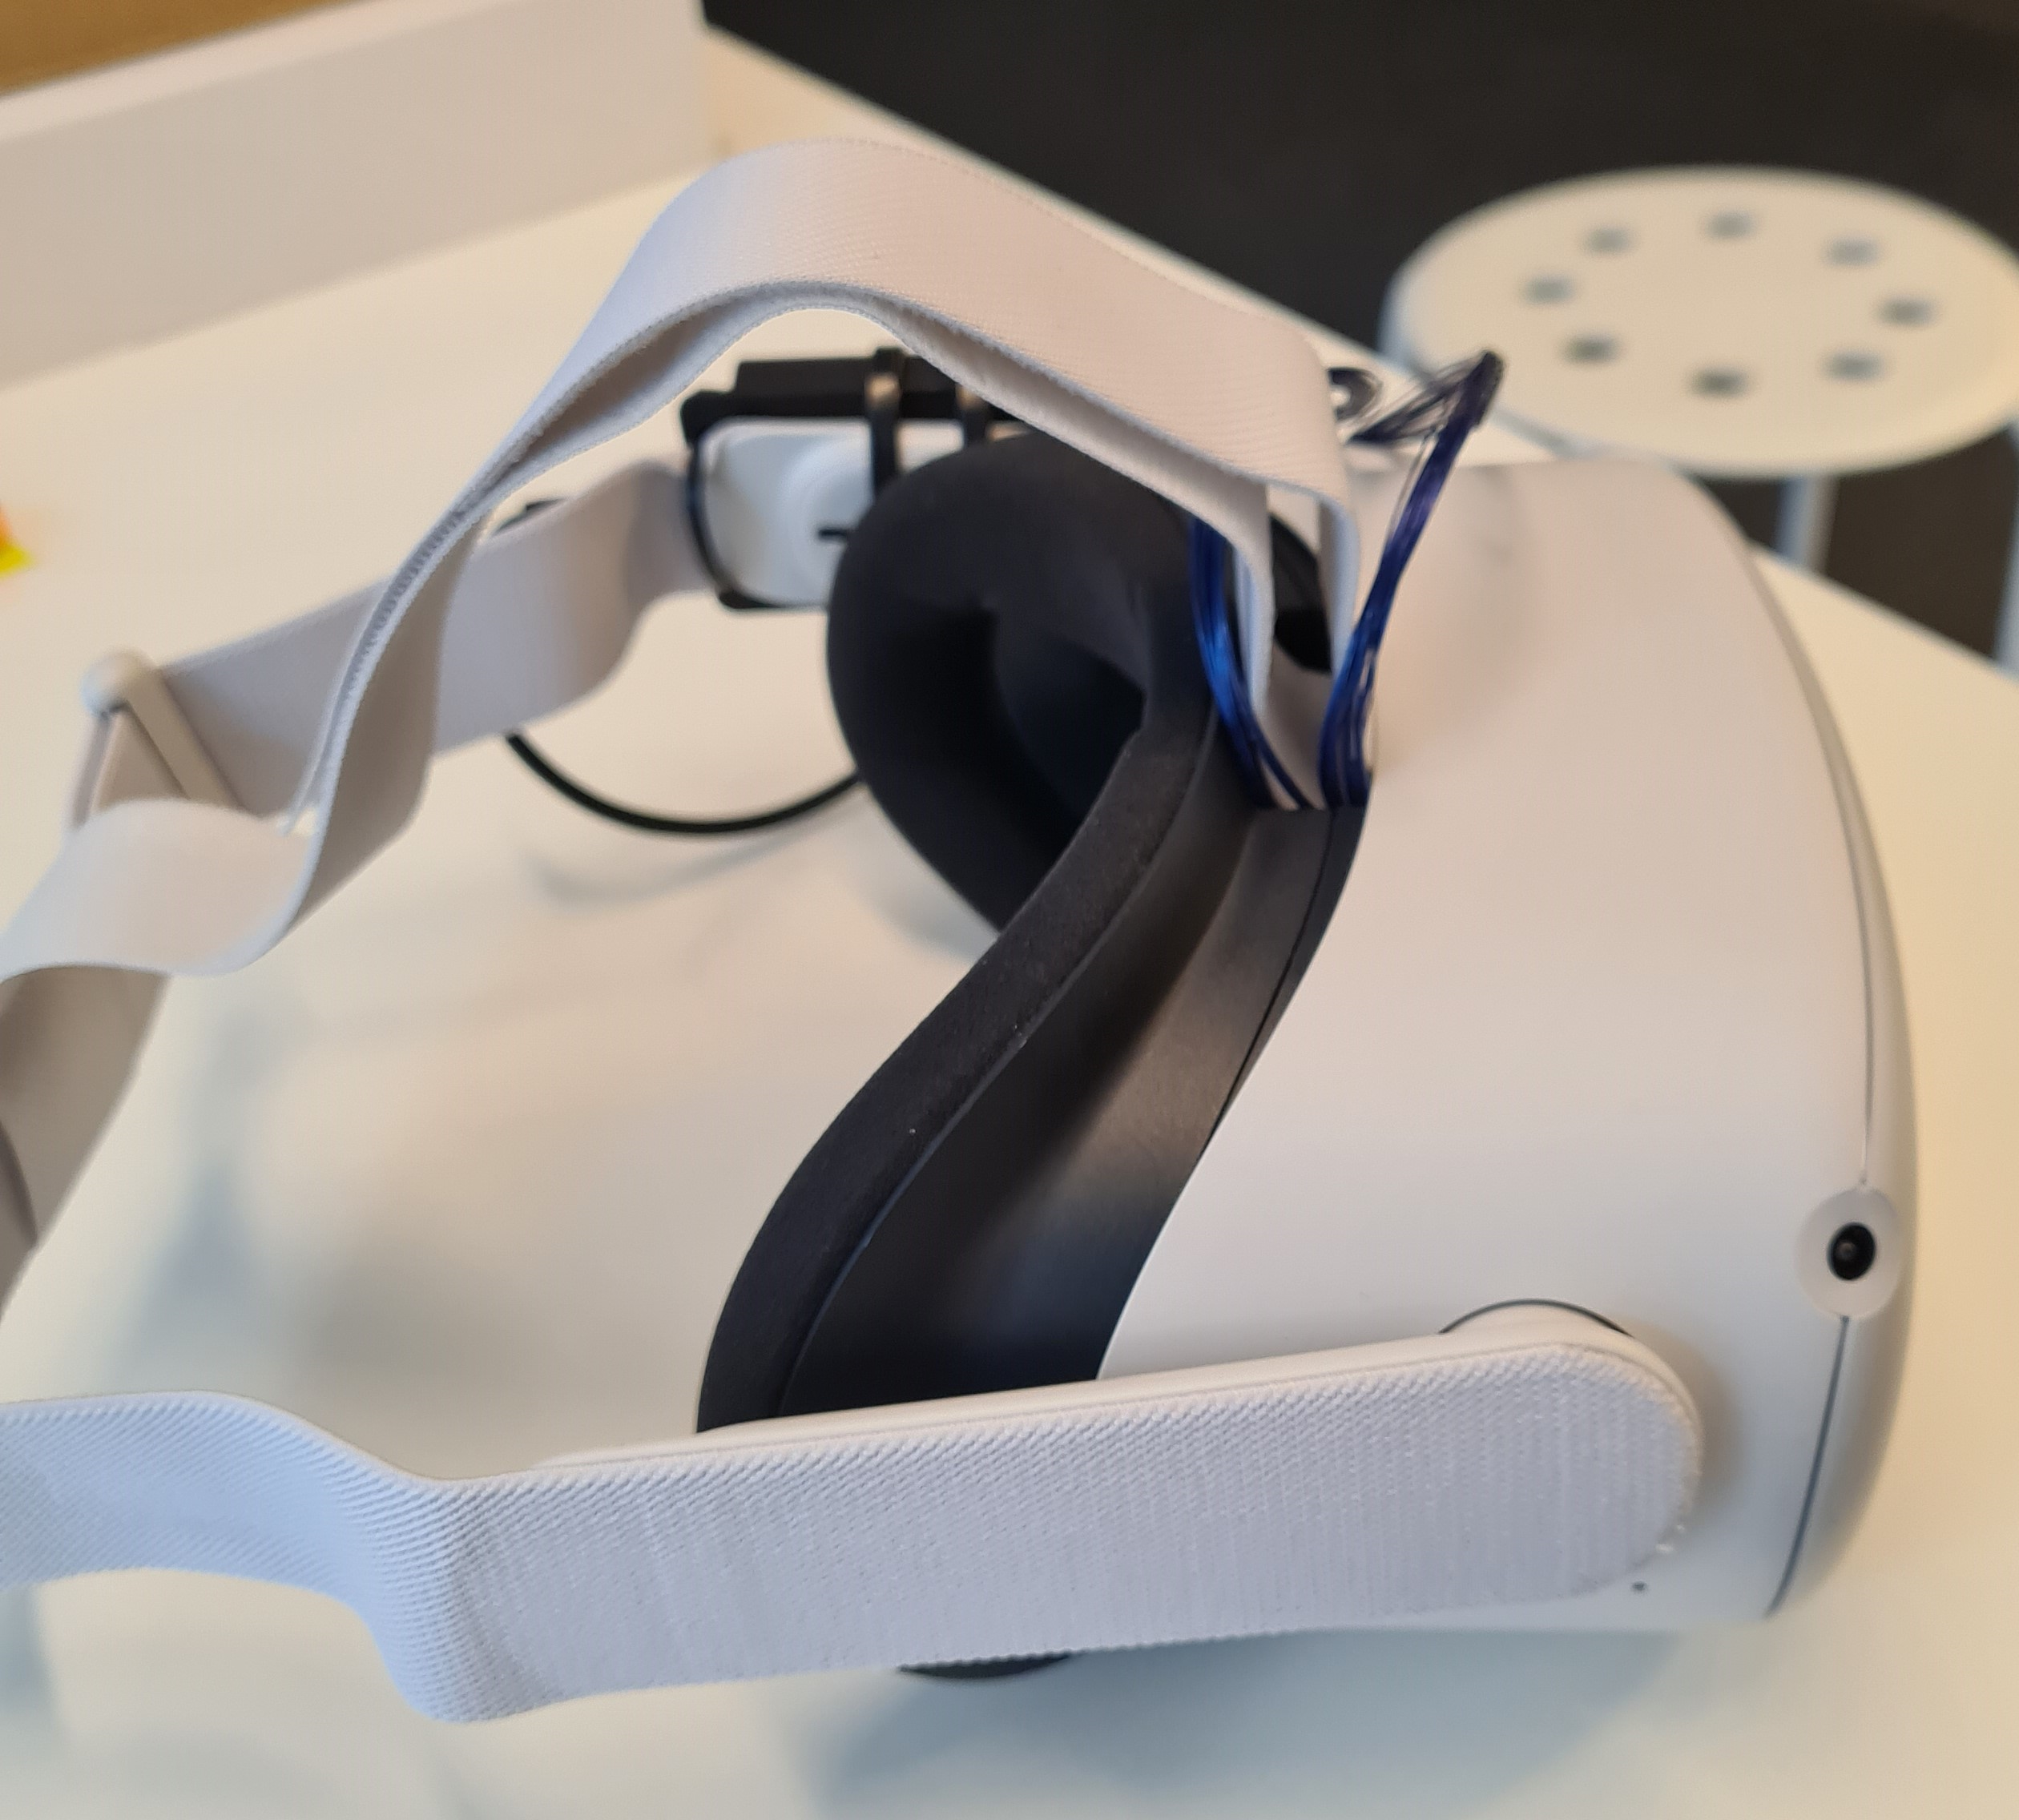
Exploration Medical Monitoring
Wearable Biomonitor (Canadian Space Agency and Hexoskin)
  On-Astronaut Wireless Sensor System (“Astroskin”) measures:
    Heart rate
    Respiration
    Skin temperature
  Astronauts have been using/testing the system aboard the International Space Station
Oculometrics (ARC Visuomotor Control Lab in collaboration with Occam Interactive, formerly Z3VR)
  Eye-movement testing (“COBRA”) is being used to detect/distinguish mild neural impairments, such as occurs with sleep deprivation, ultra-low alcohol intake, mild TBI, and retinal pathology.
  Current efforts:
      extend visual response testing to include vestibular responses
      create a portable, VR-based system (“OCTAVE”) that could be used in operational spaceflight settings.
Notes:
In terms of medical monitoring, the Canadian Space Agency funded development of a wearable vital signs monitor that measures heart rate, respiration, and skin temperature. The technology is now being matured by Hexoskin and astronauts have been using/testing the system on ISS for several years now.
The Ames Research Center Visuomotor Control Lab and Occam Interactive are researching occulometrics – eye movements that can indicate mild impairments caused, for example, by sleep deprivation or other conditions.
They are currently working to extend

Slide 8
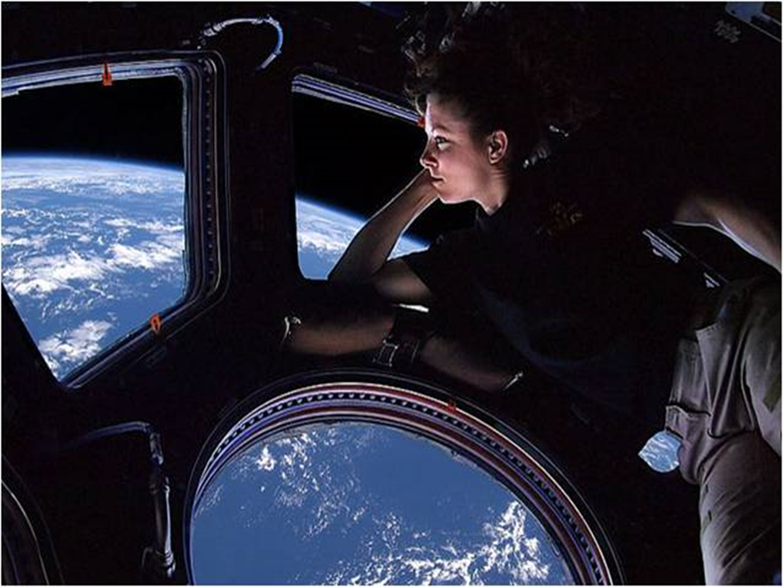
Crew Location Tracking
Team Interactions (NASA Human Research Program)
  Proximity badge used to indicate frequency and duration of interaction with team members
  Bluetooth and microphones to capture proximity and speech
Future Habitat Design (NASA Human Research Program)
  Visualization/characterization of astronaut movement through their living/working environment to inform the design of future habitats
      Amount of time spent in various spaces gives clues to the value and necessity of those areas
      Translation paths between areas can indicate that they may need to be located more closely in future habitats.
Notes:
Tracking of crewmembers within a space station or habitat can be important for several reasons. To maintain behavioral and mental health, is important to know when crew in a space vehicle/habitat may be isolating themselves or minimizing contact with others.
The HRP has funded work to investigate team interactions through proximity badges, and is now looking at Bluetooth and microphones, along with artificial intelligence to determine how often and how long individuals interact with one another.
In terms of habitat design, the ability to characterize crewmember movement throughout their living/working environment can help identify areas of higher vs lower utility, and translation paths can indicate areas that should be located more closely in the future.

Slide 9
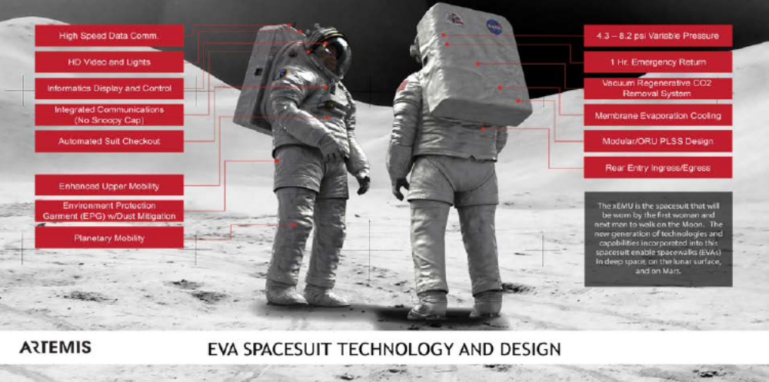
EVA Operations
Notes:
The Exploration EVA System is a new spacesuit being designed to allow crewmembers to conduct excursions outside a habitable vehicle in order to perform exploration, research, construction, servicing, and repair operations.
The xEVA System will also enable and help accomplish the science goals for future lunar surface missions.
There have been some challenges with spacesuit fit, and an improper fitting spacesuit can cause injury to the wearer.
Researchers are looking into the incorporation of sensors into the spacesuit to measure human-suit interactions (forces, kinematics, pressures):
These sensors can:
Inform crew of real-time suit adjustments that would help with workload and performance
Inform future suit design improvements
Allow Development of training procedures for improved suited crew performance

Slide 10
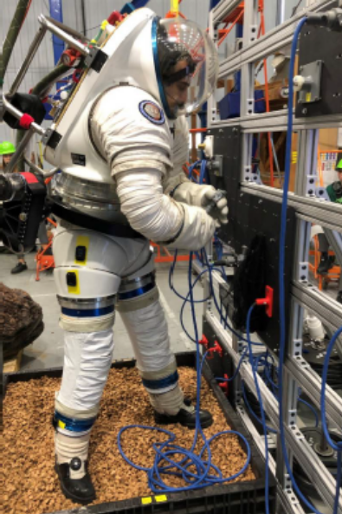
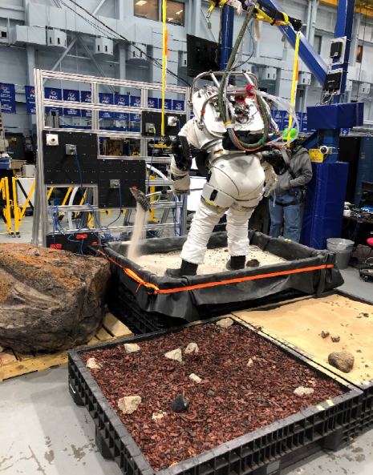
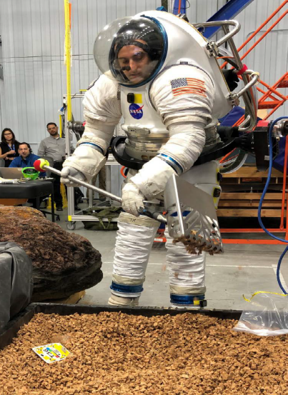
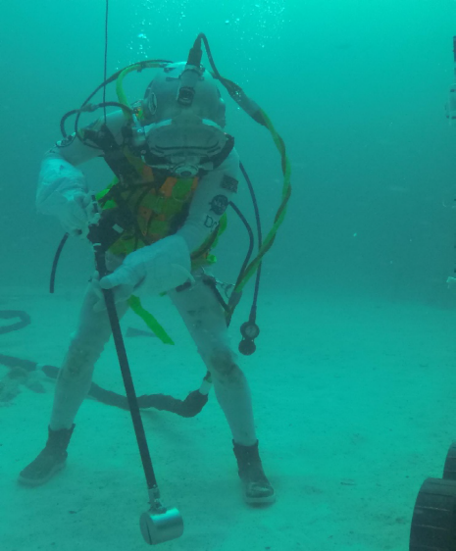
Physical and Cognitive Exploration Simulations (PACES)
Platform for the development of simulation capabilities and performance measurement methods
Simulates the physical and cognitive workload associated with exploration operations to aid in the understanding of:
    timelines
    procedures
    informatics
    communications protocols
Each of these scenarios is composed of PACES Tasks, and includes specific objectives, performance metrics, and outcomes of performing them.
Tasks can be implemented across a wide variety of analog and training environments.
Notes:
One of NASA’s current projects – called PACES – Physical and Cognitive Exploration Simulations – involves development of a platform for simulating realistic suited tasks and performance measurement methods. The simulations will aid in development of timelines, procedures, informatics, and communications protocols. Each scenario is composed of tasks, objectives, and performance metrics. This platform can be used across a wide variety of analog and training environments.

Slide 11
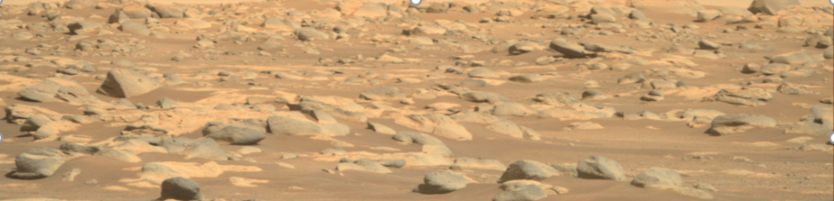
Conclusions and Future Work
As astronauts move toward Earth independence, and away from the safety net of MCC, they will have to be supported by new monitoring and countermeasure technologies:
  Detected decreases in performance may allow for adaptive displays that declutter or simplify content or may drive crew decisions to modify the task or terminate an EVA early.
  Detected decreases in sociability and crew-to-crew interaction may signal mental health issues, the need for rest and restorative activities like recreation, or computer-based counseling.
                Research and development in the area of unobtrusive human health and performance monitoring is needed to meet this challenge.
Mars surface taken by Perseverance
Notes:
It their performance is decreasing, and we have a system in place to detect that – adaptive systems may be able to declutter complex displays or a virtual assistant may advise that an EVA be postponed or terminated early. An intelligent system may consider sensed human state data and recommend additional crew rest and recreation. But in order to apply these advanced countermeasures – crew self monitoring or system monitoring must be available.
We will need sensors, displays, interfaces, and software distributed across the vehicle, spacesuit, and ground control systems. This level of system functionality will not be feasible without significant investment in sensing technologies and intelligent decision support systems.
Research and development in these areas are needed in order to ensure the success of future deep space missions.

Slide 12
THANK YOU!

