Slide 1
Noise Exposure Map of Urban Air Mobility
Jinhua Li, Hok K. Ng, Yun Zheng, and Sebastian Gutierrez Aviation Systems Division, NASA Ames Research Center Presented at 2021 AIAA Aviation Forum, August 2-6, Virtual Event
This material is a work of the U.S. Government agency and is not subject to copyright protection in the United States.

Slide 2
Outline
Urban Air Mobility (UAM) Noise Management
FAA’s Airport Noise Compatibility Planning
Noise Exposure Map of Urban Air Mobility
Examples with NASA’s UAM Engineering Simulations
Software Demonstration
Summary and Future Work

Slide 3
Urban Air Mobility Noise Management
Public perception of UAM is primarily influenced by vehicle safety and noise.
The NASA-led UAM noise working group with the FAA and industry partners has identified gaps and barriers from four categories: Tools and technologies, Ground and flight testing, Human response and metrics, and Regulation and policy.
This paper is to address the gaps in community engagement under regulation and policy.

Slide 4
Noise Exposure Maps of UAM
Airport Noise exposure map
A noise exposure map is “a scaled geographic depiction of an airport, its noise exposure contours, noise- sensitive facilities, and land uses in the airport surrounding area” (FAA 14 CFR Part 150).
65dB DNL is generally used as the land use compatibility threshold .
Noise exposure map is developed by subject matter experts in a static map. The process may take days.
UAM noise exposure map
Strictly follows the FAA’s Part 150 with the similar map elements for UAM operations
Data collection, pre-processing and map generation processes were all automated by algorithms; the process takes less than a minute
Interactive digital map saved in the HTML format developed using Python’s Bokeh library
Real-time noise impact analyses by Python’s data analysis algorithms

Slide 5
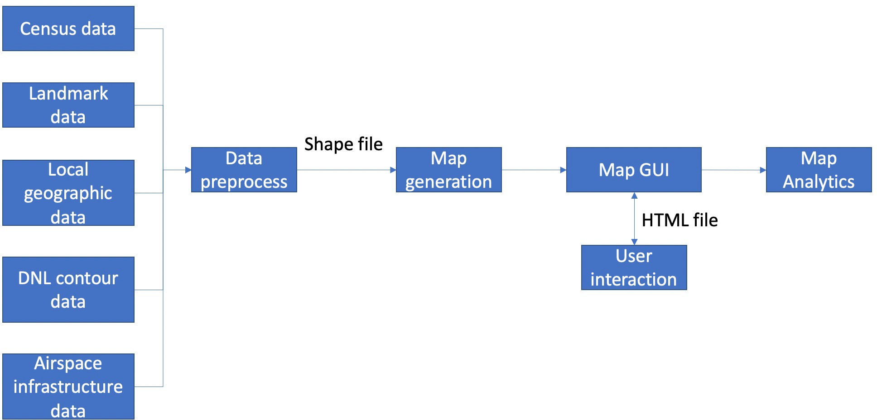
Map Generation Process

Slide 6
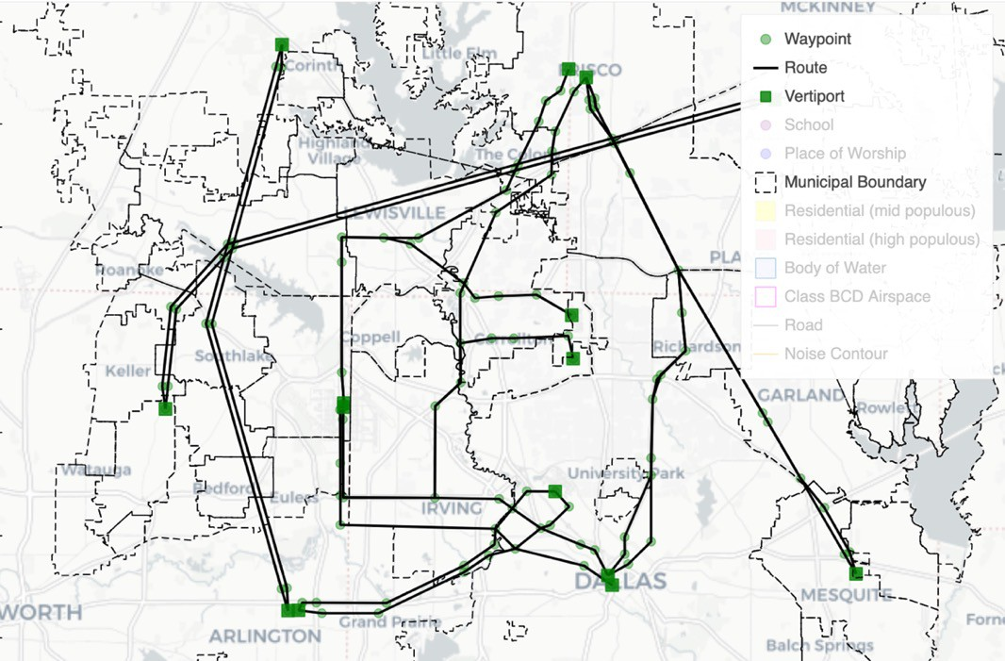
NASA UAM Engineering Simulation Airspace
The NASA UAM
Engineering Simulations consisted of 16
routes between 15 vertiports near the Dallas/Fort Worth area
6
Underlying map data is ©OpenStreetMap contributors. https://www.openstreetmap.org/copyright

Slide 7
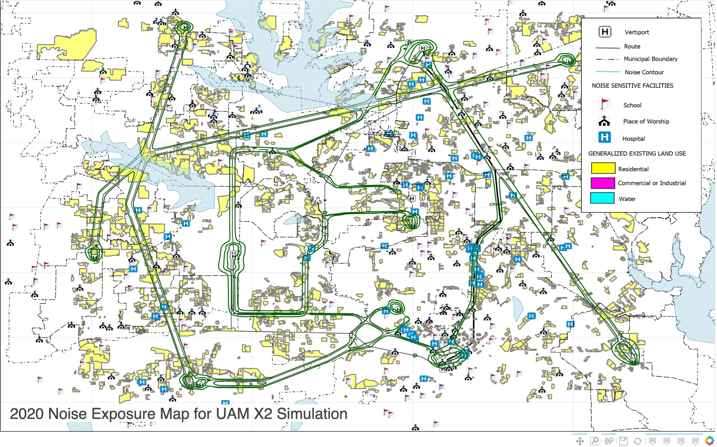
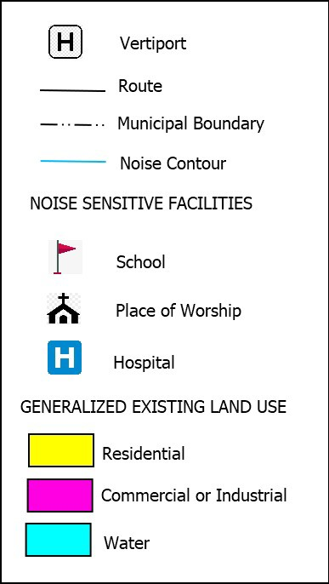
Noise Exposure Map for UAM Simulations
The DNL contour here is under the assumption of 600 daytime operations per route with a NASA prototype six- passenger quadrotor vehicle.
Underlying map data is ©OpenStreetMap contributors. https://www.openstreetmap.org/copyright

Slide 8
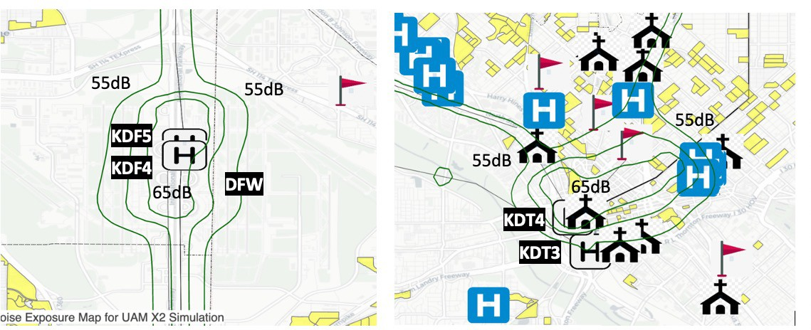
Noise Exposure Map near Selected Locations
DFW airport
Vertiport KDT3 and KDT4
Underlying map data is ©OpenStreetMap contributors. https://www.openstreetmap.org/copyright

Slide 9
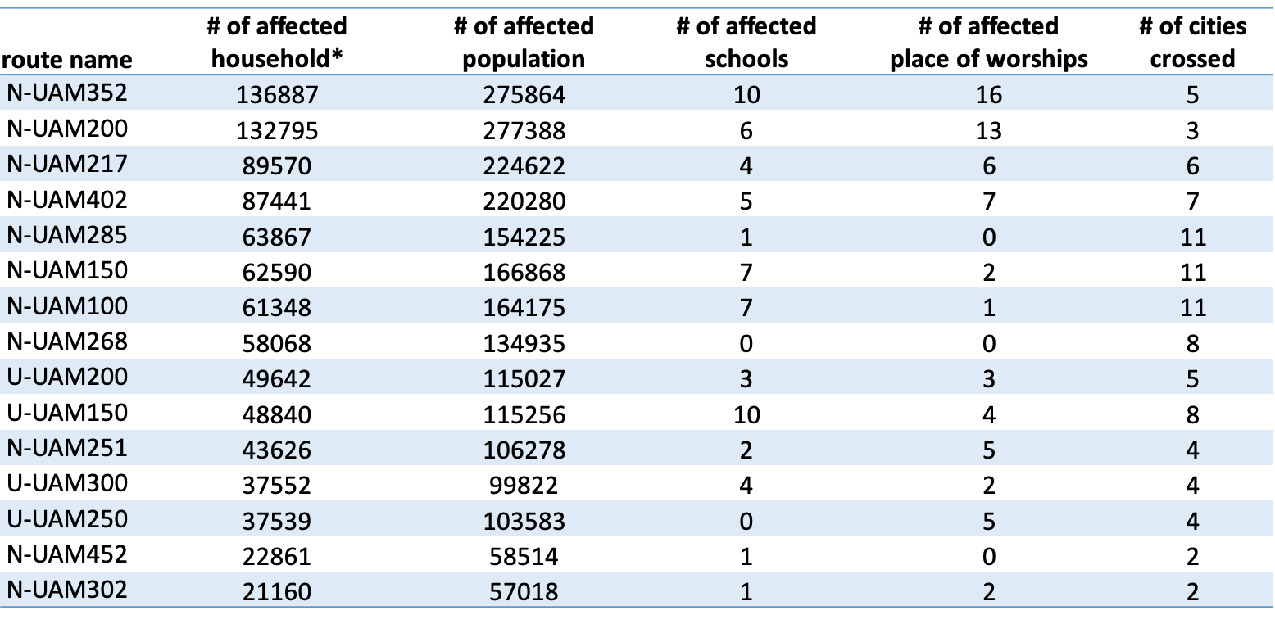
UAM Noise Local Community Impact Analysis
The affected residences and noise sensitive facilities is defined as those within one mile along the flight route and departure/arrival vertiports.
9

Slide 10
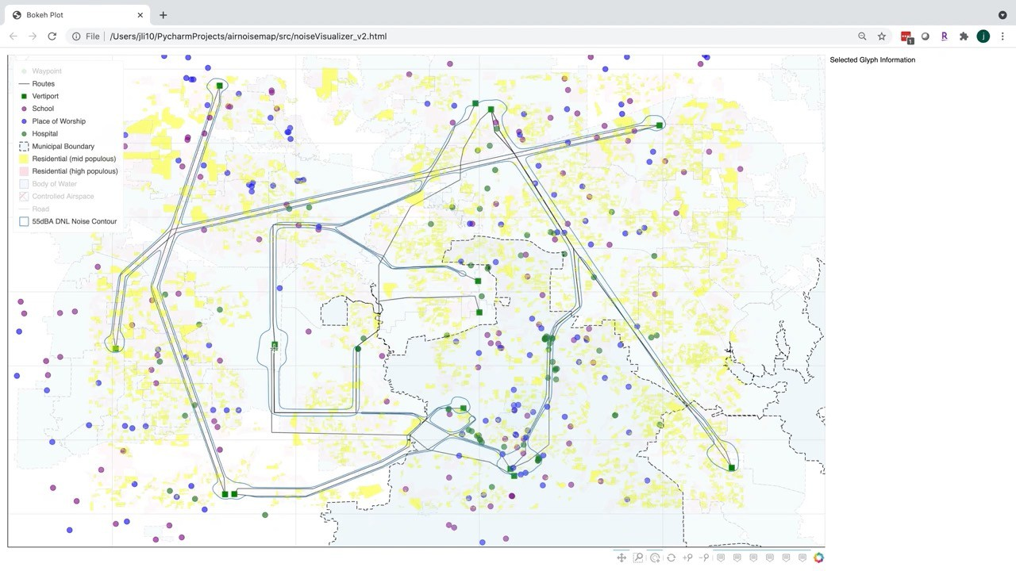
Demonstration
10

Slide 11
Summary
This paper is the first to explore the applicability of the FAA’s airport noise compatibility planning to urban air mobility.
We developed a dynamic noise exposure map of urban air mobility. The map is created automatically in minutes.
We show an example with NASA’s UAM engineering simulation data at the Dallas/Fort Worth area. The noise exposure contours are predicted using the AIRNOISEUAM tool [1].
Analyses were conducted to quantify UAM operations’ noise impact on the local communities.
[1] Jinhua Li, et. al., “AIRNOISEUAM: an urban air mobility noise exposure prediction tool”, Inter-Noise Conference, 2021
11

Slide 12
Future Work
We are integrating the DNL contours by AIRNOISEUAM software into the noise exposure map for local noise impact analysis.
We plan to conduct large-scale noise impact analyses for NASA’s serial UAM engineering simulations using new data analysis and machine learning algorithms.
We plan how the community (e.g., local government, industry, the FAA) might use the results.
Contact the author at jinhua.li at nasa.gov
12

