Slide 1
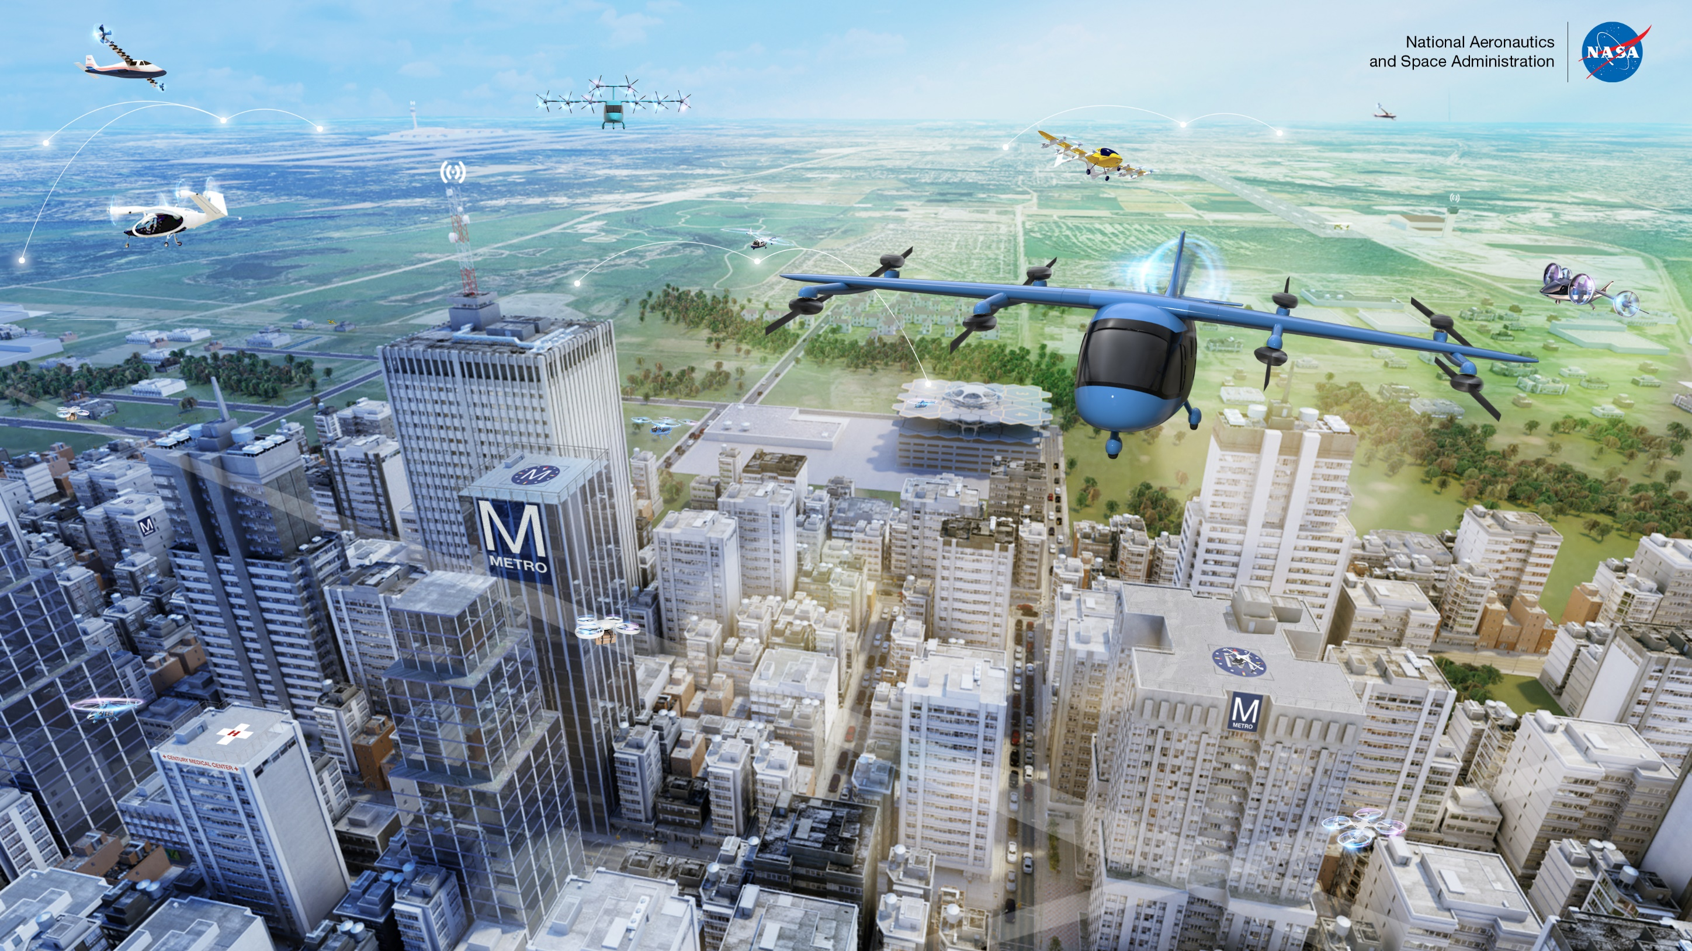
What are UAVs, UAS and drones?

Slide 2
Unmanned aerial vehicles, or UAVs, are aircraft that can fly without a pilot on board, either by being autonomous or being controlled on the ground
An UAV is one piece of a bigger concept of an unmanned aircraft system (UAS)

Slide 3
Unmanned Aircraft System (UAS)
Remember, UAVs can fly remotely or autonomously!
UAV

Slide 4
What about drones?
These vehicles are sometimes referred to as “drones”, though UAV is a more technical description

