Slide 1
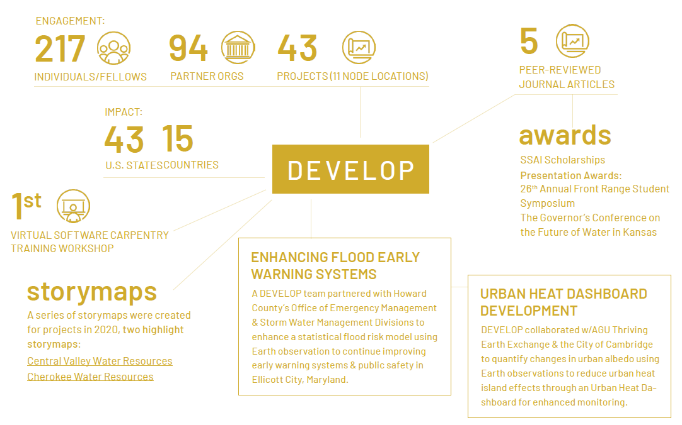
2021 SUMMER PREVIEW
DISASTERS
WATER RESOURCES
AGRICULTURE
TRANSPORTATION & INFRASTRUCTURE
HEALTH &
AIR QUALITY
ECOLOGICAL FORECASTING
URBAN DEVELOPMENT

Slide 2
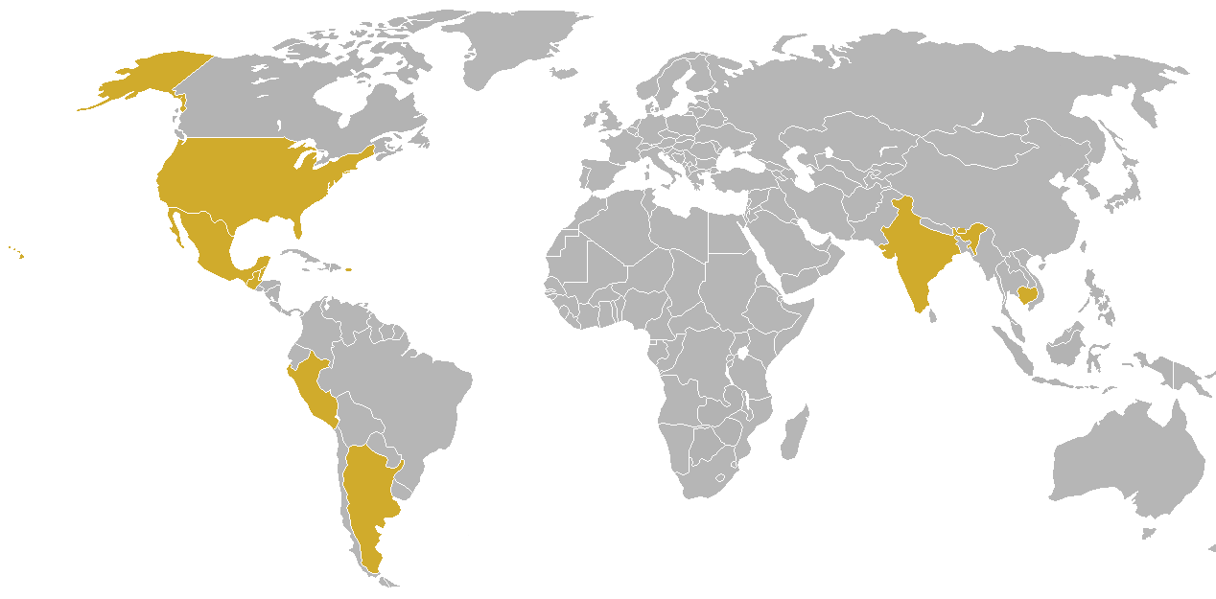
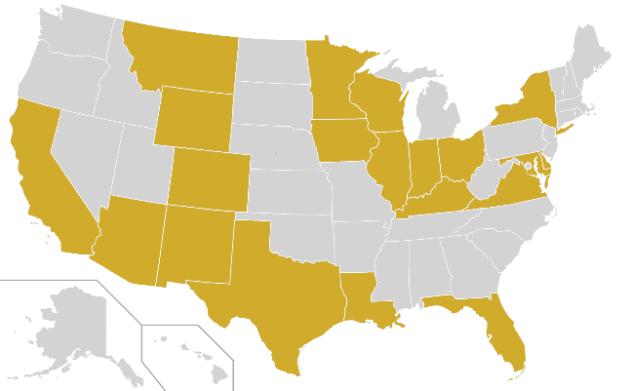
*Impacts and partners are tentative
2021 SUMMER PORTFOLIO
ENGAGEMENT:
108
64
21
PARTICIPANTS
PARTNER ORGS
PROJECTS
TERM I: 15
IMPACT:
TERM II: 4
20
1
9
TERM III: 2
U.S. STATES
U.S. TERRITORY
COUNTRIES
ACADEMIC
DISASTERS
AGRICULTURE & FOOD SECURITY
CONSORTIUM
LOCAL GOVERNMENT
WATER RESOURCES
STATE GOVERNMENT
INSTITUTIONAL SECTOR
THEMATIC AREA
URBAN DEVELOPMENT
FEDERAL GOVERNMENT
ECOLOGICAL FORECASTING
FOR-PROFIT
HEALTH & AIR QUALITY
NON-PROFIT
TRANSPORTATION & INFRASTRUCTURE
INTERNATIONAL

Slide 3
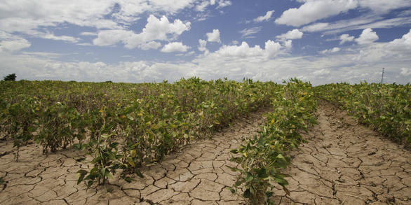
Illinois Disasters
Community Concern: In Illinois, drought is a natural disaster that can come on quickly and cause substantial economic, agricultural, and ecological damage. Soil moisture is a key drought indicator that can forewarn of impending drought before other more standard indicators are triggered.
North Carolina – NCEI & Alabama – Marshall
Earth Observations:
SMAP L-band
Aqua/Terra MODIS
Image Credit: USGS
Partners:
Illinois State Water Survey
USDA Midwest Climate Hub
NOAA, Regional Climate Services, Central Region
NOAA, National Integrated Drought Information System, Midwest Drought Early Warning System
Impact: The results of this project will demonstrate the suitability of satellite-derived soil moisture products for drought monitoring in Illinois. Project partners will use this information to enhance in situ monitoring with spatially comprehensive soil moisture observations and make data-informed recommendations in their drought risk assessments.
Notes:
------------------------------Image Information Below ------------------------------
Image Credit: USGS
Image Source: https://www.usgs.gov/core-science-systems/eros/droughtstress/science/vegdri

Slide 4
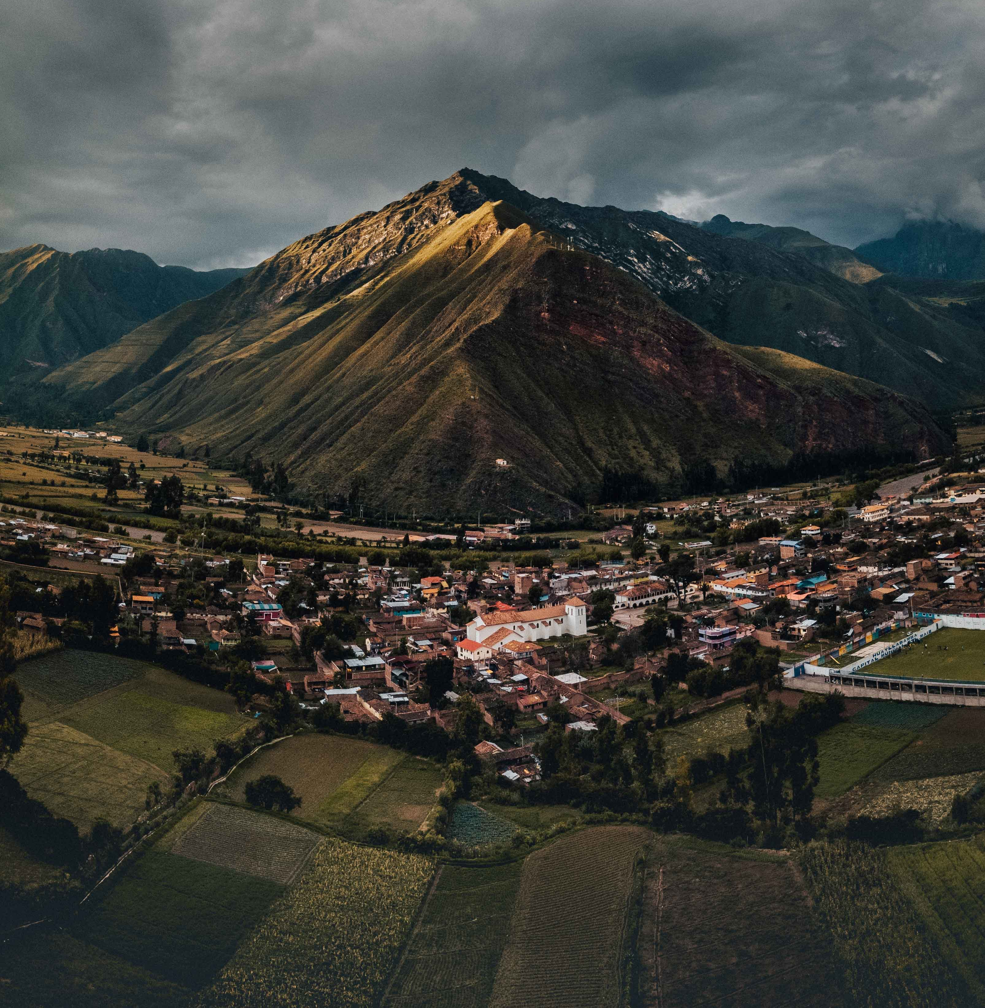
Peru Health & Air Quality
Community Concern: Rural development in the Peruvian Amazon presents a public health risk when communities and their livestock are far from hospitals and public health infrastructure and border forests filled with zoonotic disease vectors. These communities face hazards including elevated cases of malaria and dengue fever.
Georgia– Athens
Earth Observations:
Landsat 5 TM
Landsat 8 OLI
SRTM
PlanetScope
Partners:
Ministry of Health (Peru)
Ministry of the Environment (Peru)
Universidad Peruana Cayetano Heredia, Lab for EcoHealth and Urban Ecology
Asociación para la Conservación de la Cuenca Amazónica
Peruvian Service for Natural Protected Areas, Ministry of Environment (Peru)
Instituto del Bel Común
Image Credit: Eduardo Flores
Impact: Outbreak risk maps will inform the Ministry of Health's decisions around placement of public health research and infrastructure.
Notes:
------------------------------Image Information Below ------------------------------
Image Credit: Eduardo Flores
Image Source: https://unsplash.com/photos/QuLrL-ERUnc

Slide 5
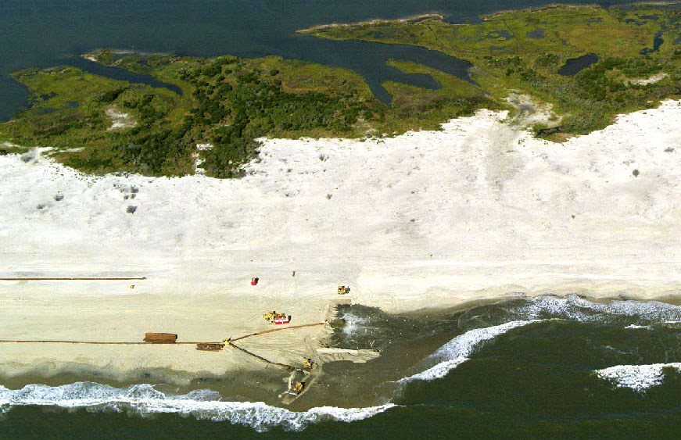
Assateague Island Ecological Forecasting
Community Concern: Assateague Island National Seashore is home to sensitive habitat for wildlife and serves as a protective buffer to the mainland shoreline. Every year, sediment bypassing operations aim to restore the natural sediment supply, but these treatments may not provide the intended benefits.
Partners:
National Park Service, Assateague Island National Seashore
US Army Corps of Engineers
NPS, Ocean and Coastal Resources Branch, Water Resources Division
NPS Natural Resources Stewardship and Science Directorate
Idaho – Pocatello
Earth Observations:
Landsat 7 ETM+
Landsat 8 OLI
Sentinel-2 MSI
Aqua MODIS
Suomi NPP VIIRS
Image Credit: NPS
Impact: Time series analyses of nearshore suspended sediments and land cover change from 2004 – 2021 will help park partners determine long-term island volume and sediment trends and assess the impact and effectiveness of the sediment bypass operations. Land cover change time series and forecasted maps to 2031 will inform management and restoration decisions to protect threatened and endangered species.
Notes:
------------------------------Image Information Below ------------------------------
Image Credit: NPS Photo/pubic domain
Image Source: https://www.nps.gov/articles/beach-nourishment.htm

Slide 6
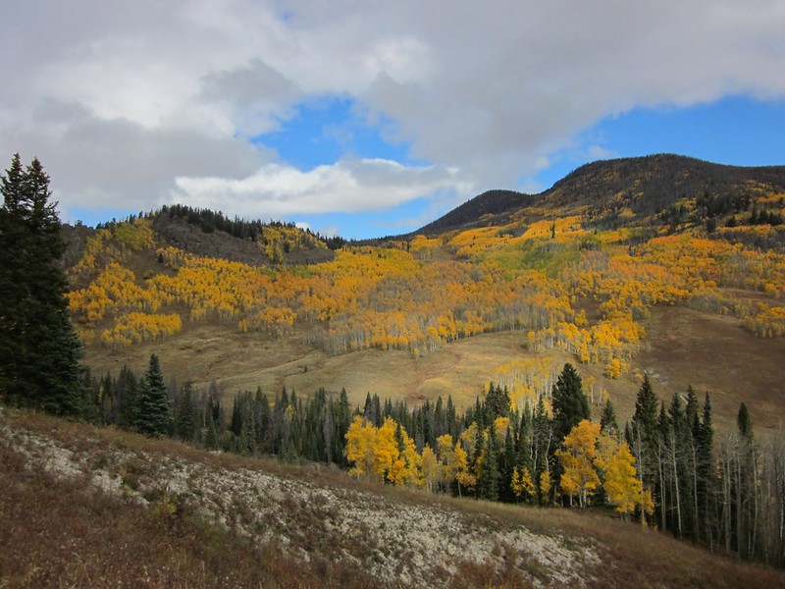
Colorado Ecological Forecasting
Community Concern: Cheatgrass is a rapidly-spreading invasive that thrives after disturbances, such as wildfires, and is a threat to native biodiversity in the American West. After the Cameron Peak fire in the fall of 2020, landowners are concerned cheatgrass may outcompete native recovering vegetation.
Partner:
US Forest Service, Arapaho and Roosevelt National Forests and Pawnee National Grassland
Colorado – Fort Collins
Earth Observations:
Landsat 8 OLI
Sentinel-2 MSI
SRTM
Impact: Partners need to make rapid and informed decisions regarding monitoring and treatment. Occurrence and habitat suitability maps, along with analysis of regrowth, will allow partners to more effectively and efficiently treat cheatgrass.
Image credit: US Department of Agriculture
Notes:
------------------------------Image Information Below ------------------------------
Image Credit: US Department of Agriculture/public domain
Image Source: https://www.flickr.com/photos/usdagov/6244421871/

Slide 7
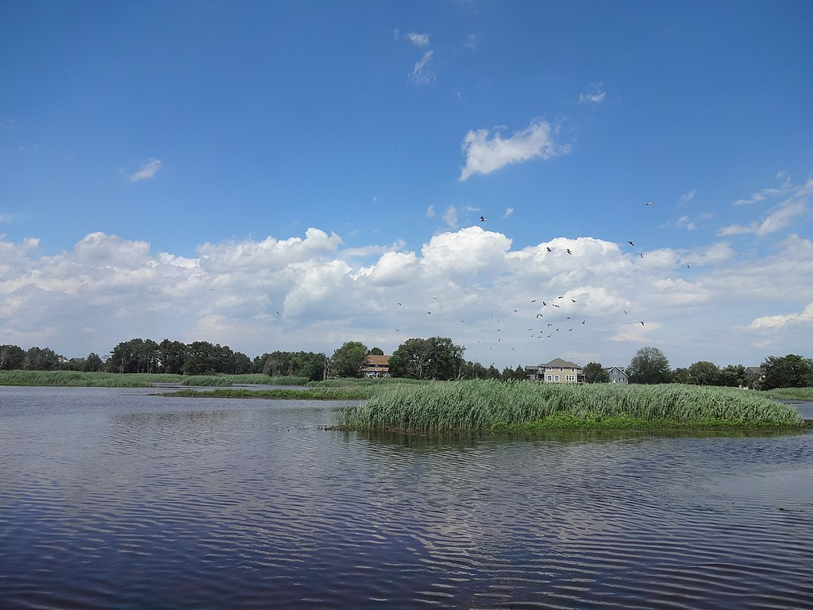
Delaware Ecological Forecasting
Community Concern: Over the last 30 years, ~ 5,000 acres of Delaware’s wetlands have been lost. These losses are due to human activities such as development and converting to agriculture, and natural loss due to severe weather events, sea-level rise, and erosion.
Partners:
Delaware Department of Natural Resources and Environmental Control; Division of Climate, Coastal and Energy
Delaware Department of Natural Resources and Environmental Control, Division of Watershed Stewardship
Alabama – Marshall
Earth Observations:
Landsat 5 TM
Landsat 7 ETM+
Landsat 8 OLI
SMAP
GPM IMERG
Image Credit: USFWS
Impact: A better spatial understanding of areas where landward marsh migration is happening would be a powerful tool to inform and prioritize marsh conservation, and to aid the partner in the trial of novel methods to facilitate marsh migration. Map products could also be used to initiate conversations with other state and federal landowners on the future value and importance of lands that could be transitioned into tidal marsh habitat.
Notes:
------------------------------Image Information Below ------------------------------
Image Credit: US Fish and Wildlife Service Northeast Region
Image Source: https://upload.wikimedia.org/wikipedia/commons/thumb/9/9f/Marsh_near_Prime_Hook_community_%2829954772314%29.jpg/1024px-Marsh_near_Prime_Hook_community_%2829954772314%29.jpg
Image License: Public Domain

Slide 8
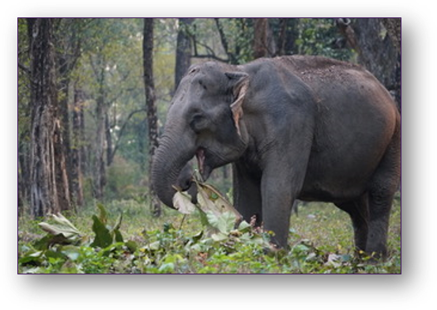
Southern Bhutan Ecological Forecasting III
Impact: This third term project will assess land use over time and forecast future habitat change for the Asian elephant (Elephas maximus) in southern Bhutan. Land Use Land Cover maps and refined biological corridor maps will inform elephant conservation efforts.
Partners:
Bhutan Tiger Center
Bhutan Foundation
Bhutan Ecological Society
Maryland – Goddard
Earth Observations:
Landsat 8 OLI
Landsat 5 TM
Sentinel-2 MSI
SRTM
PlanetScope
Image Credit: Bhutan Foundation
Community Concern: Elephants, a keystone species, are integral to the functioning of forest ecosystems in southern Bhutan. However, the Asian elephant is an Endangered species and their conservation has been complicated by expanding human settlements and increased negative human-elephant interactions.
Notes:
------------------------------Image Information Below ------------------------------
Image Credit: Bhutan Foundation
Image Source: Provided by the partner (Summer 2020) with permission to use

Slide 9
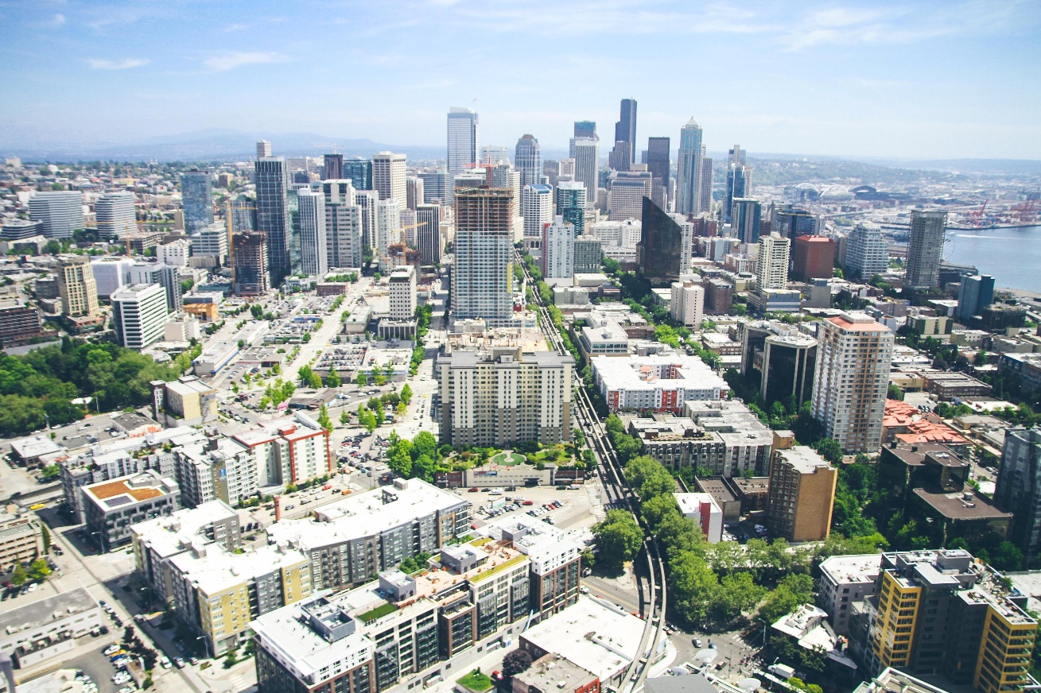
Fairfax County Urban Development
Community Concern: Fairfax County residents want to contribute to urban heat island mitigation, especially where certain populations in the county may be disproportionally exposed. The OEEC is exploring increasing tree canopy, incorporating green infrastructure as well as quantifying current climate risks and vulnerabilities for future mitigation strategies.
Virginia – Langley
Partner:
Fairfax County Office of Environmental & Energy Coordination (OEEC)
Earth Observations:
Landsat 8 OLI
Landsat 8 TIRS
ISS ECOSTRESS
Suomi NPP VIIRS
Impact: This project will contribute to the proposed Resilient Fairfax: Climate Adaptation and Resilience Plan by helping partners better understand how environmental factors contribute to urban heat, identifying high risk areas, and assisting communities in planning for climate adaptation.
Photo by Abigail Keenan on Unsplash
Notes:
------------------------------Image Information Below ------------------------------
Image Credit: Photo by Abigail Keenan on Unsplash
Image Source: https://unsplash.com/photos/RaVcslj475Y

Slide 10
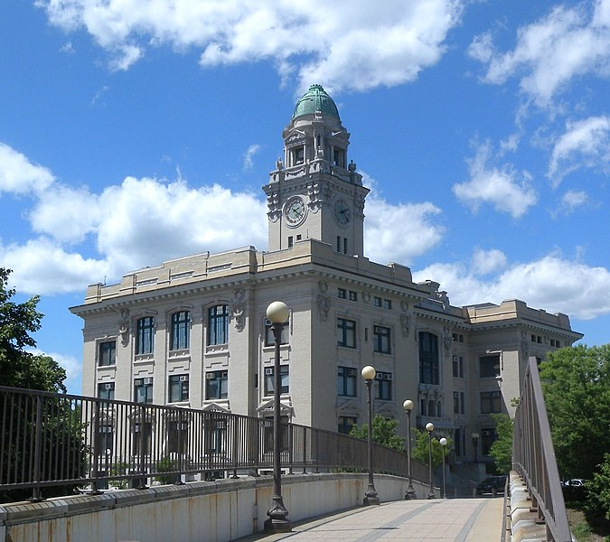
Yonkers Urban Development
Community Concern: The urban heat island effect (UHI) in Yonkers, NY has contributed to excess heat in certain areas of the city and is expected to intensify with projected climate changes. The UHI contributes to heat-related illness and morbidity in response to hot-weather episodes and has been especially prominent in neighborhoods subjected to historical race-based housing segregation where little green infrastructure exists.
Arizona – Tempe
Partners:
Groundwork USA
Groundwork Hudson Valley
Credit: Jim Henderson
Impact: Utilizing environmental parameters and combining them with sociodemographic data will provide social vulnerability maps and help Groundwork determine areas in need of green infrastructure improvement. Additional maps will help partners identify what type of infrastructure can allow for greater cooling capacity in vulnerable areas.
Earth Observations:
Landsat 8 OLI
Landsat 8 TIRS
ISS ECOSTRESS
ISS GEDI
Notes:
------------------------------Image Information Below ------------------------------
Image Credit: Jim Henderson
Image Source: https://commons.wikimedia.org/wiki/File:Yonkers_City_Hall_south_jeh.jpg Creative Commons CC0 1.0 Universal Public Domain Dedication.

Slide 11
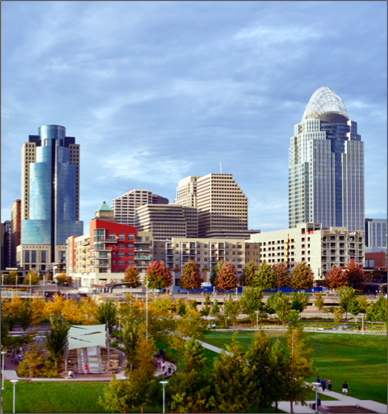
Cincinnati & Covington Urban Development II
Community Concern: Cincinnati, Ohio and Covington, Kentucky are both densely populated urban environments nearby major bodies of water. These conditions make the local communities vulnerable to both potential flooding and landslides.
Earth Observations:
SRTM
Landsat 8
Sentinel-1
Sentinel- 2
GPM IMERG
Partners:
Groundwork USA
Groundwork Ohio River Valley
Massachusetts – Boston
Impact: Provided products such as a Flood Risk Mitigation map package and landslide susceptibility and exposure maps will allow partners to better understand flood- and landslide-related vulnerabilities in the region. Additionally, methodology standard operating procedures will allow Groundwork USA to generate consistent and reproducible vulnerability maps for any of its nationwide partner cities.
Image Credit: Carol M. Highsmith
Notes:
------------------------------Image Information Below ------------------------------
Image Credit: Carol M. Highsmith
Image Source: https://www.flickr.com/photos/vintage_illustration/44436783010/ https://creativecommons.org/licenses/by/2.0/

Slide 12
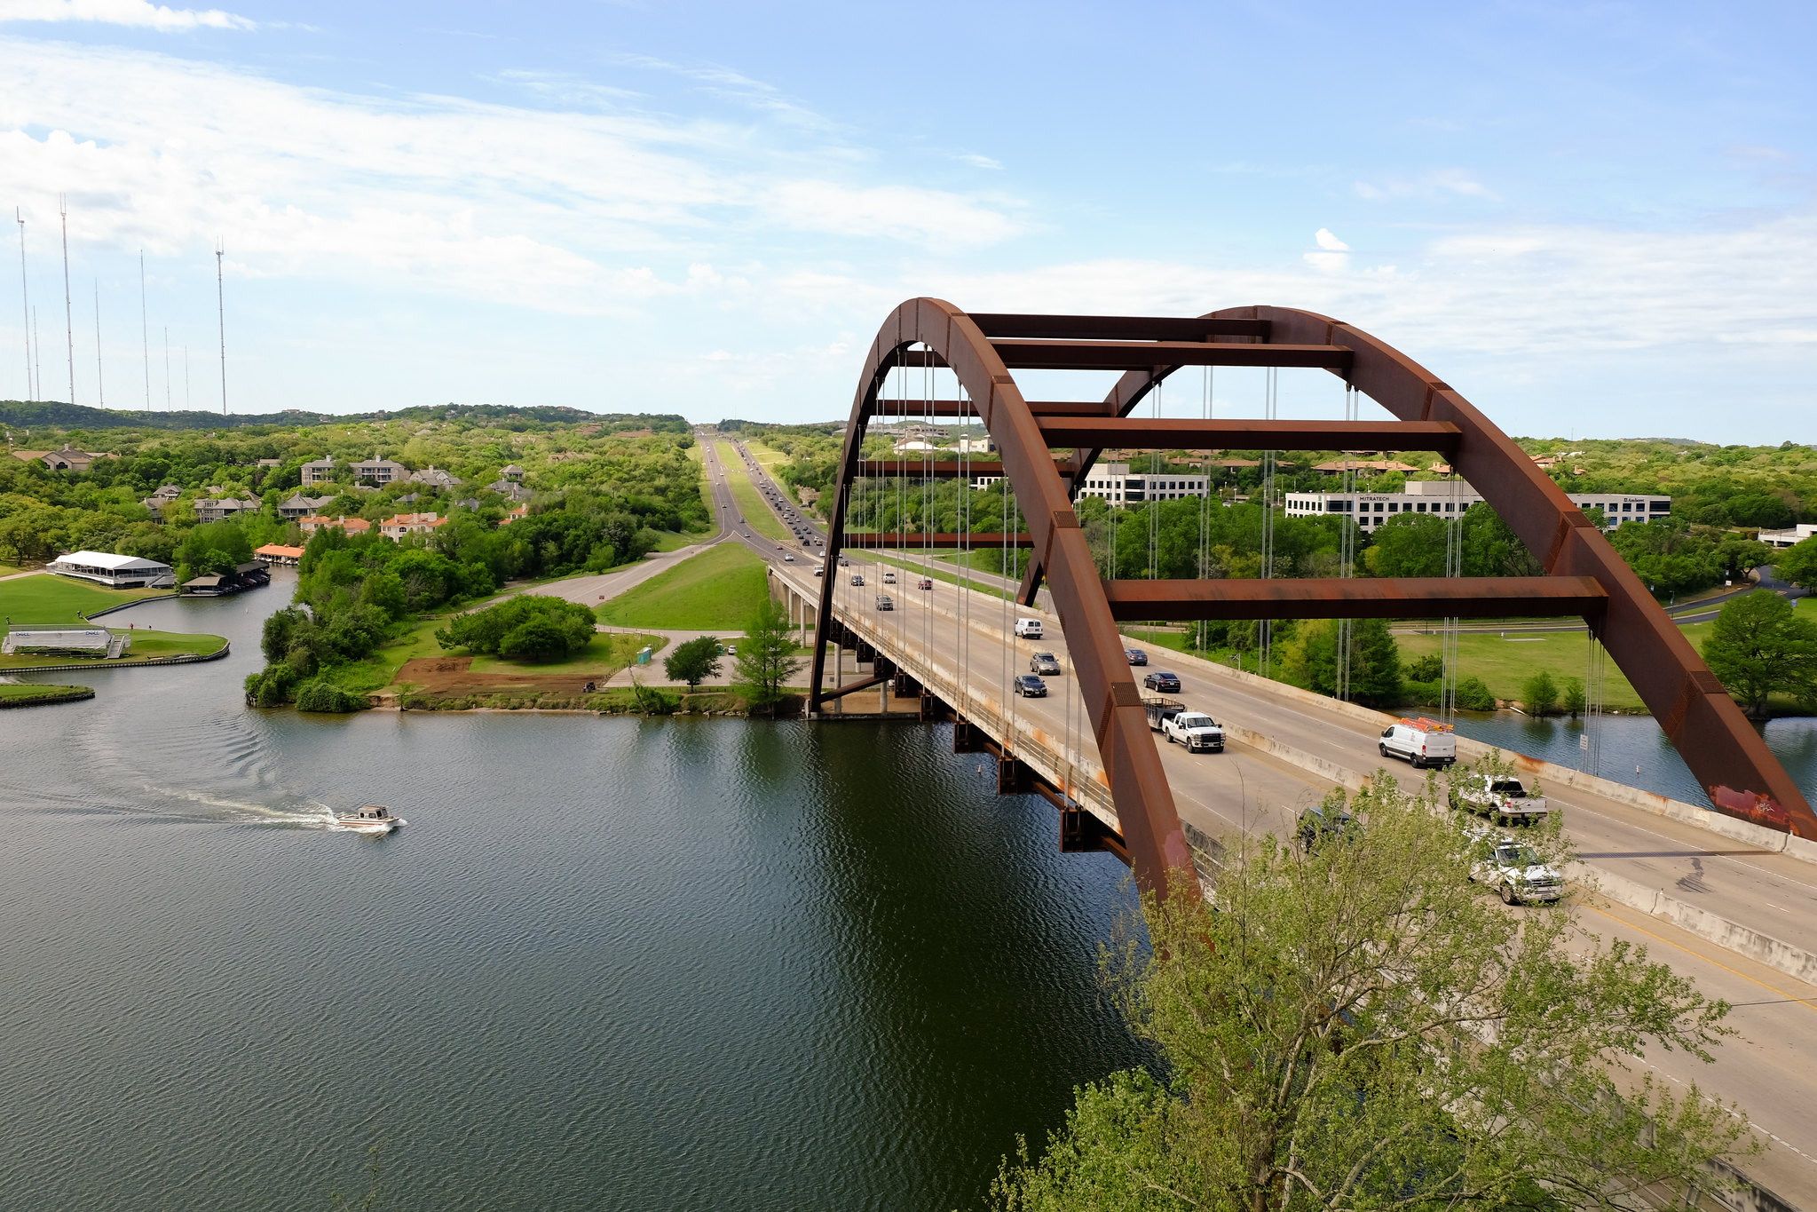
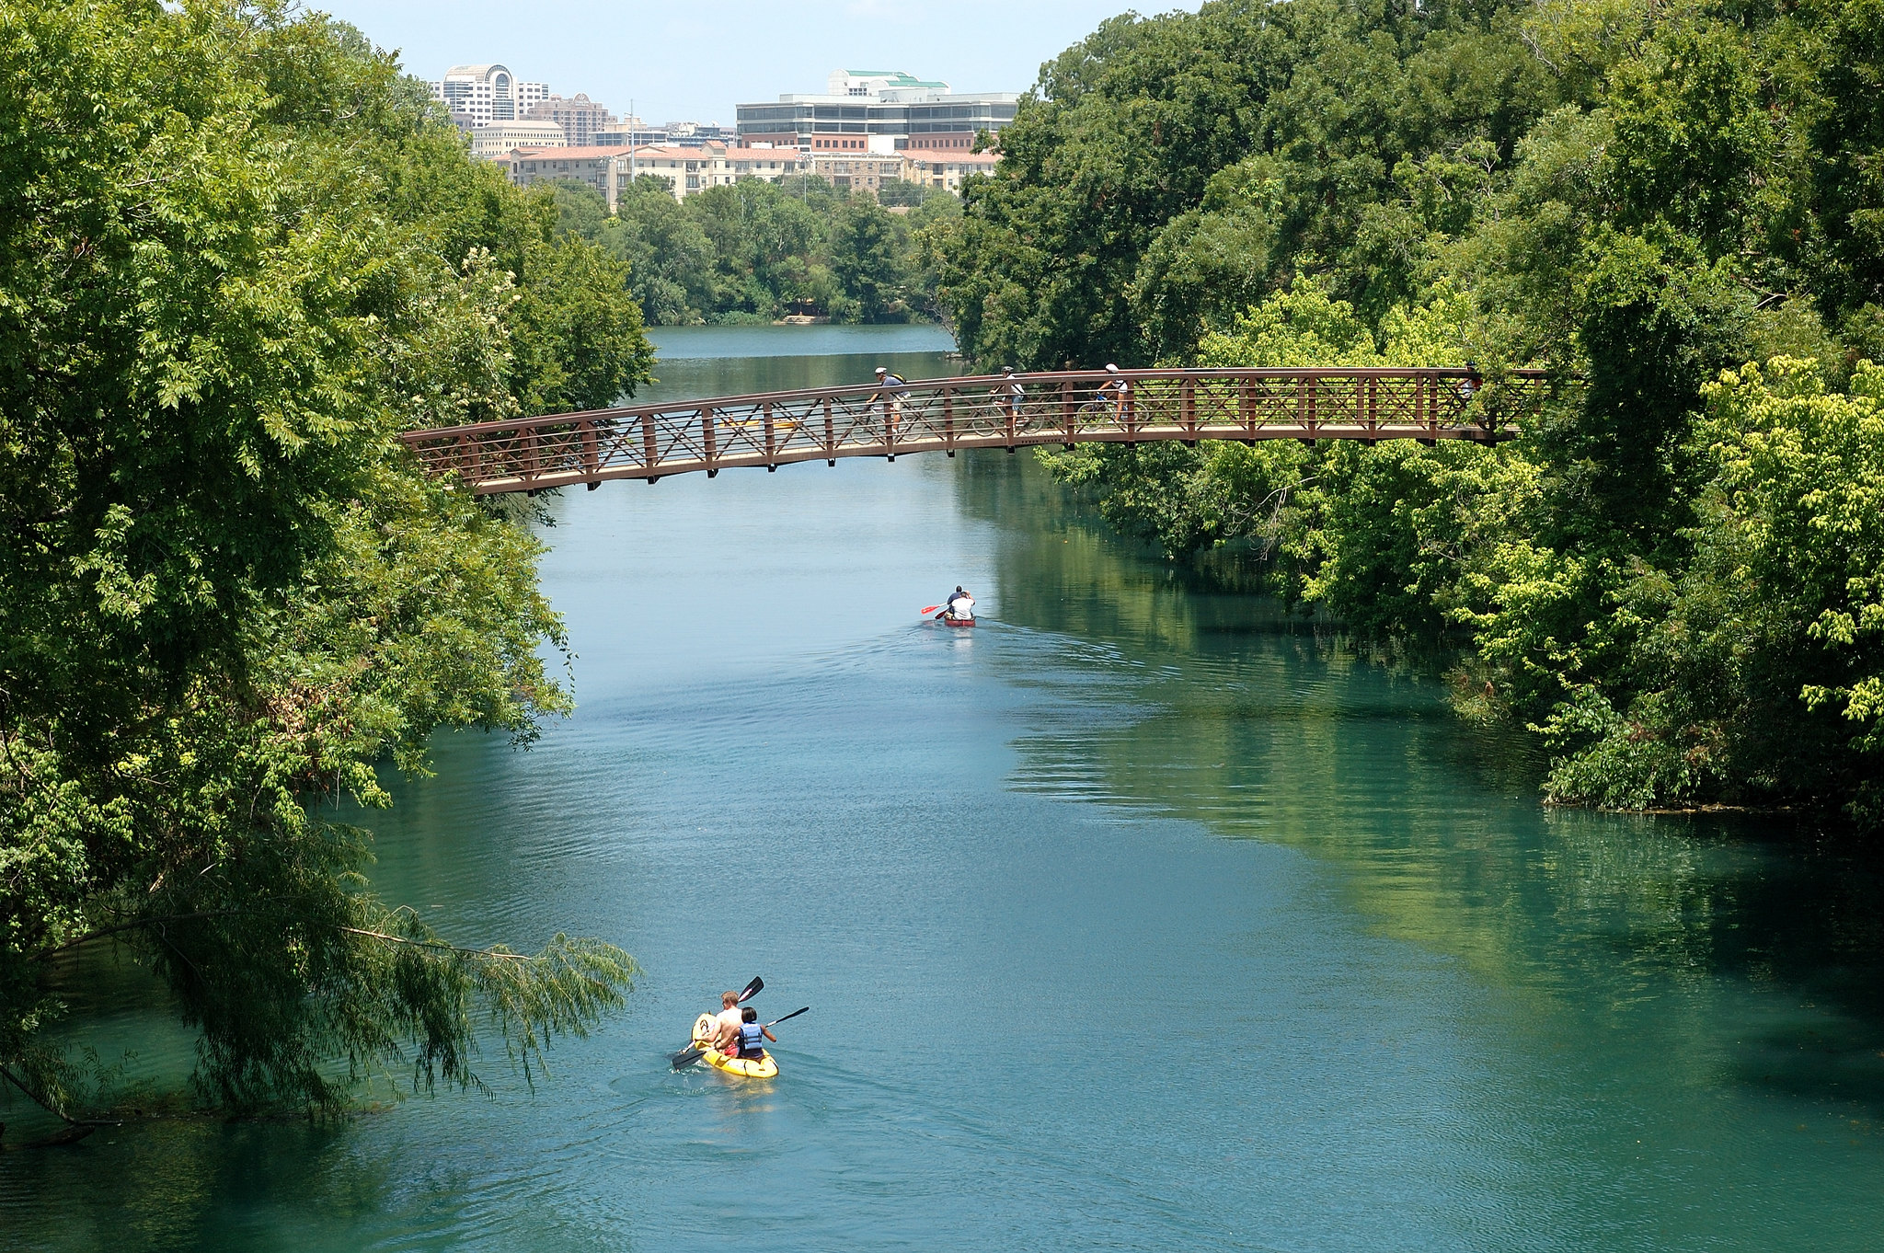
Highland Lakes Water Resources
Community Concern: Algal toxins produced during harmful algal blooms (HABs) or proliferations (HAPs) have become prevalent within the Highland Lakes Chain within the Colorado River near Austin, TX. Starting in August 2019, toxins in the lakes have threatened ecosystem services, recreational use of waterways, and have caused canine deaths.
Arizona – Tempe
Partners:
City of Austin, Department of Watershed Protection
Lower Colorado River Authority
The University of Texas at Austin, Department of Molecular Biosciences
Austin Water Utility
Credit: City of Austin
Earth Observations:
Landsat 8 OLI
Terra/Aqua MODIS
Sentinel-2 MSI
Sentinel-3 OCLI
PlanetScope
Impact: The DEVELOP team will create a spatial time series of the HABs/HAPs to identify areas for water sampling locations. The team will contribute to an early identification system to determine when HABs/HAPs are likely to be present in the Highland Lakes.
Notes:
------------------------------Image Information Below ------------------------------
Image Credit: City of Austin, Office of Sustainability (With Permission)
Image Source: https://www.flickr.com/photos/156180758@N08/40496354185/in/album-72157689766377300/
https://www.flickr.com/photos/156180758@N08/41348616912/in/album-72157689766377300/

Slide 13
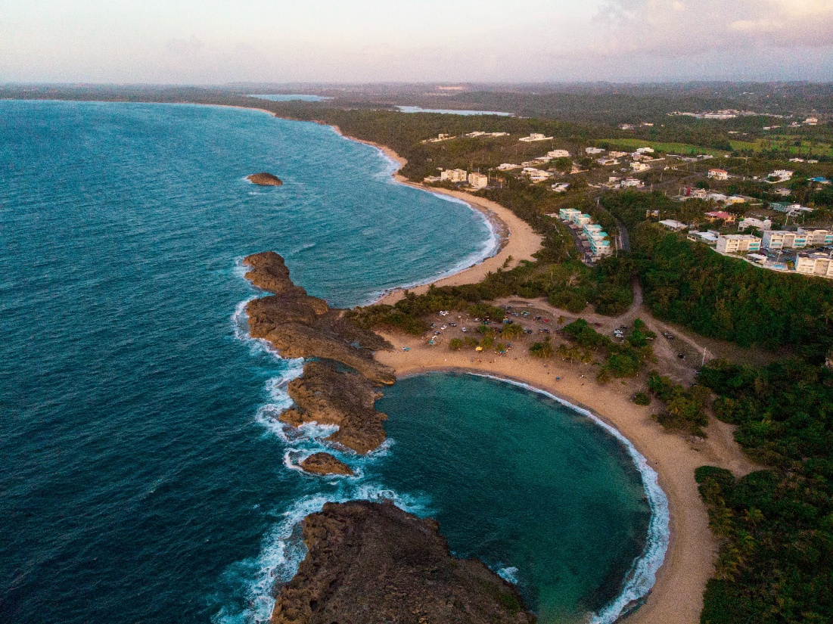
Jobos Bay Water Resources
Community Concern: Increased frequency of extreme events have escalated the vulnerability of Puerto Rico’s coastlines to waves, storm surges, and sea level rise (SLR). SLR could cause seawater intrusion into freshwater catchments, migration of mangrove forests, and deepening of coastal reefs, which could reduce coastal protection of Jobos Bay.
Virginia – Langley
Earth Observations:
Landsat 8 OLI
Landsat 7 ETM+
Sentinel-2 MSI
SMAP
Partners:
Jobos Bay National Estuarine Research Reserve (JBNERR)
Impact: End products can be incorporated into JBNERR’s resilience and monitoring efforts and enhance the partner’s understanding of how the southern shoreline has changed over the past decade.
Photo by MJ Tangonan on Unsplash
Notes:
------------------------------Image Information Below ------------------------------
Image Credit: Photo by MJ Tangonan on Unsplash
Image Source: https://unsplash.com/photos/_iErJAM7tMM

Slide 14
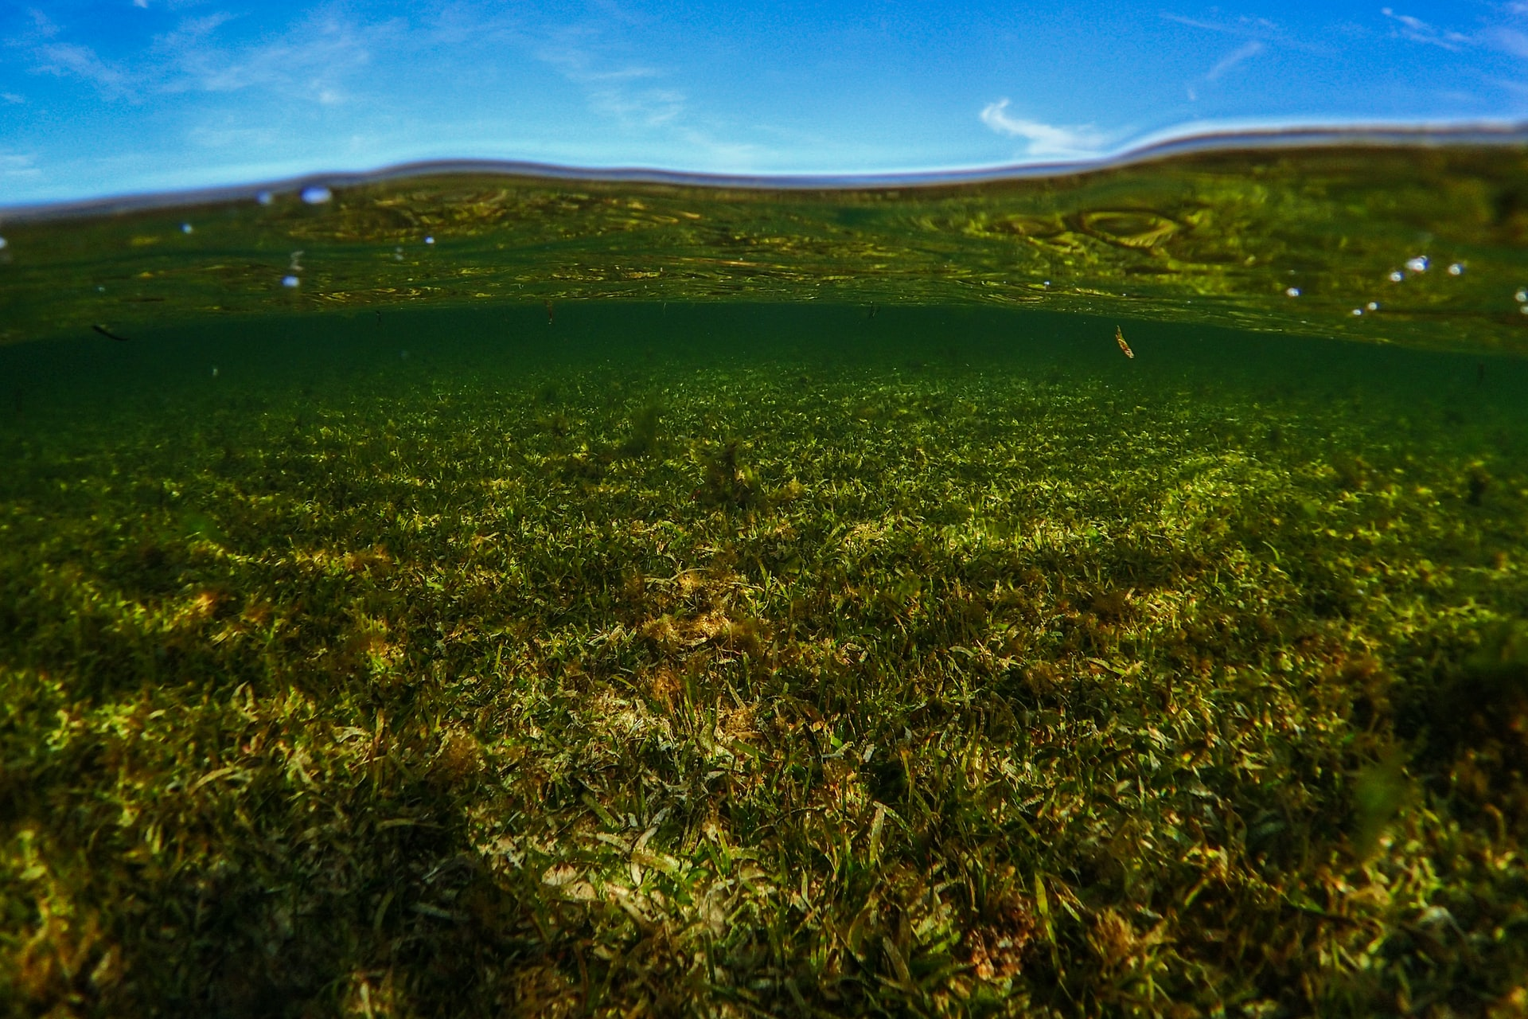
Louisiana Water Resources
Community Concern: The Breton National Wildlife Refuge has been negatively affected by several detrimental forces over the past two decades, including Hurricane Katrina and the Deepwater Horizon Oil Spill.
Partners:
Coastal Protection and Restoration Authority
Louisiana Department of Natural Resources, Office of Coastal Management
California – Ames
Earth Observations:
Landsat 8 OLI
Landsat 5 TM
Landsat 7 ETM+
Sentinel-2 MSI
Aqua MODIS
SMAP L-band Radiometer
Image Credit: Benjamin L. Jones
Impact: Understanding the extent to which seagrass meadows have changed throughout Louisiana’s waters is critical in the preparation and response to impending climate disturbances. Project end products can contribute to the partners’ initiatives to locate and monitor seagrass meadows throughout Louisiana’s waters.
Notes:
------------------------------Image Information Below ------------------------------
Image Credit: Benjamin L. Jones
Image Source: Unsplash (https://unsplash.com/photos/Yu2yDKRXv8U), Creative Commons License

Slide 15
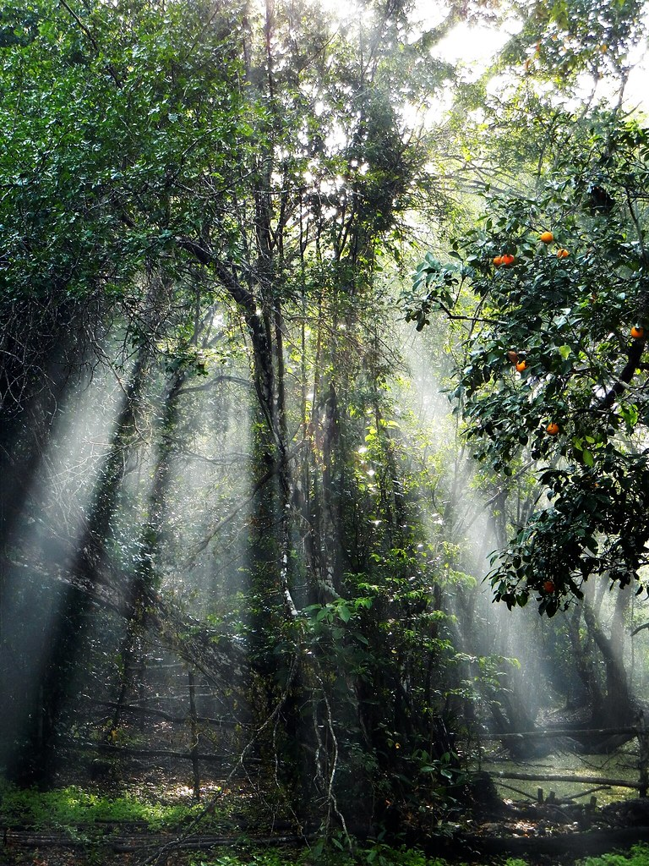
Maya Forest Water Resources
Community Concern: Extreme weather events in relation to climate change are impacting wetland ecosystems, altering the frequency and levels of inundation which threaten water resource availability and land stability in these systems. These changes have negative impacts for surrounding community infrastructure and agriculture that rely on forested wetlands in the Maya Tri-National Forest.
California – JPL
Partners:
Forest Department (Belize)
Land Information Center (Belize)
Center for Monitoring and Evaluation (Guatemala)
El Colegio de la Frontera Sur (Mexico)
UCSB MesoAmerican Research Center
Boles Environmental Consulting
NASA SERVIR
Earth Observations:
ICESat GLAS
ICESat-2 ATLAS
ISS GEDI
ALOS PALSAR
ALOS PALSAR-2
Sentinel-2 MSI
Impact: End users can use these products to identify areas prone to highly variable inundation, monitor forested wetland extent, and evaluate sustainable forest management activities and/or agricultural practices.
Image Credit: USAID Guatemala
Notes:
------------------------------Image Information Below ------------------------------
Image Credit: USAID Guatemala
Image Source: https://search.creativecommons.org/photos/bf647ddf-39d1-4081-806a-45a65358b38b (CC BY-NC-ND 2.0)

Slide 16
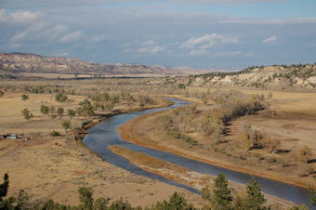
Powder River Basin Water Resources
Community Concern: The Powder River is a crucial source of water for local residents and supports a disproportionate share of the region's biodiversity. Russian Olive is a fast-spreading invasive that has invaded riparian areas in the basin, affecting soil health, streamflow, and native vegetation health. Locals are motived to remove Russian Olive, but current extent/distribution is unclear.
Colorado – Fort Collins
Partners:
Powder River County Weed Board
Gay Ranch
USGS Water Resources Mission Area
University of Northern Colorado
Earth Observations:
Landsat 8 OLI
Landsat 5 TM
Sentinel-2 MSI
SRTM
PlanetScope
Impact: Maps and analysis of Russian Olive occurrence in relation to the Powder River will help partners understand the plant's current extent, its relationship with riparian dynamics, and how best to treat it.
Image Credit: USGS
Notes:
------------------------------Image Information Below ------------------------------
Image Credit: United States Geological Survey/public domain
Image Source: https://www.usgs.gov/media/images/powder-river-southeastern-montana

Slide 17
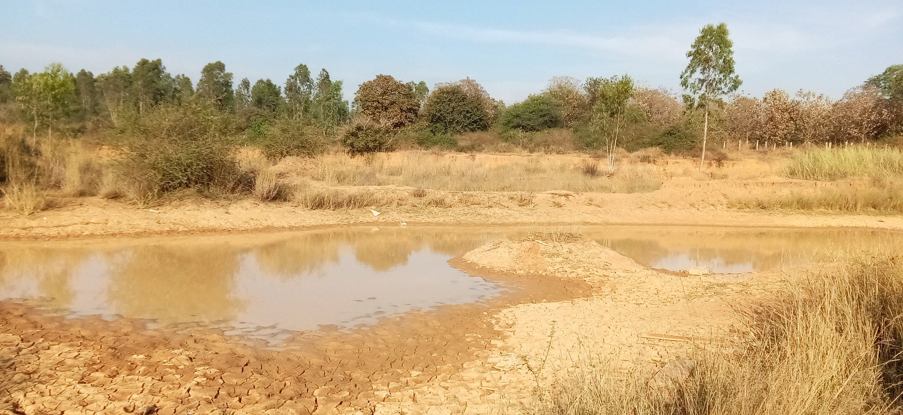
Southwest Water Resources
Community Concern: Drought conditions are increasing in frequency and severity in the southwest. Stock ponds and tanks are critical water resources that need to be monitored but are often remote, which makes them time-intensive and cost-prohibitive to assess as regularly as necessary.
Partners:
US Forest Service, Kaibab National Forest, Range Management Program
Arizona Department of Game and Fish
Diablo Trust
USFS Rocky Mountain Research Center
Idaho – Pocatello
Earth Observations:
Landsat 8 OLI
Sentinel-1 SAR
Sentinel-2 MSI
Image credit: Birobrata Deb from Pixabay
Impact: The maps and tool generated by this project will help partners at land management agencies as well as cattle producers and other stakeholders integrate remotely sensed data into their monitoring practices. This will allow them to track general changes in stock pond and tank fill levels more efficiently and cost-effectively.
Notes:
------------------------------Image Information Below ------------------------------
Image Credit: Birobrata Deb from Pixabay (Pixabay License)
Image Source: https://pixabay.com/photos/deserted-dry-land-pond-water-6117891/

Slide 18
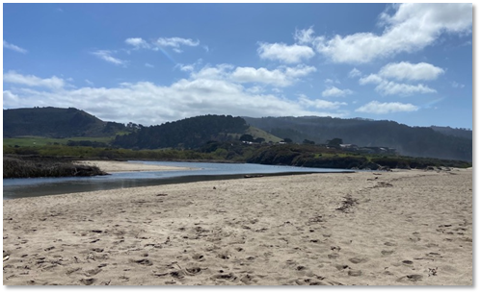
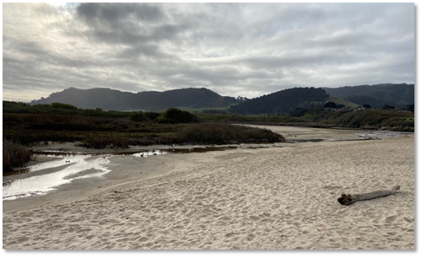
Coastal California Water Resources II
Community Concern: Anthropogenic activity is altering the timing and magnitude of natural estuarine processes, such as breaching. This increases the variability of ecosystems that are already highly dynamic, which have negative implications for the habitat and wildlife in these systems.
California – JPL
Partners:
Ocean Protection Council
Southern California Coastal Water Research Project
Moss Landing Marine Labs, Central Coast Wetlands Group
UCLA Institute of the Environment & Sustainability
UC Davis Coastal and Marine Sciences Institute
Earth Observations:
Landsat 8 OLI
Sentinel-2 MSI
Sentinel-1 C-SAR
PlanetScope & RapidEye Imagery
Image Credit: Kevin O'Connor, Moss Landing Marine Labs, Central Coast Wetlands Group
Impact: End products can be used to better understand the impacts of estuarine mouth closure dynamics, inform existing predictive models, and monitor changes in estuarine composition and health.
Notes:
------------------------------Image Information Below ------------------------------
Image Credit: Kevin O’Connor, Central Coast Wetlands Group, Moss Landing Marine Labs
Image Source: Provided by Kevin O’Connor (project partner) with permission

Slide 19
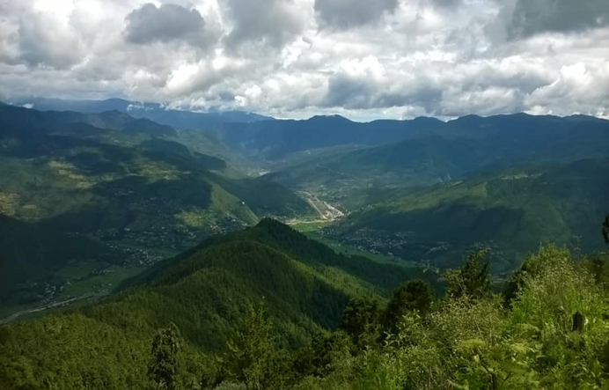
Bhutan Water Resources III
Community Concern: With a changing climate in Bhutan there is great concern for human and economic activities such as changes to agricultural timing, forest change, and changes in seasonality. The Bhutan HEROES project employs a combination of weather data collection (through a network of weather stations) and citizen science to help understand climate change.
Alabama – Marshall
Earth Observations:
Aqua MODIS
Terra MODIS
Sentinel 2 MSI
Landsat 5 TM
Landsat 7 ETM+
Landsat 8 OLI
NOAA AVHRR
Partners:
Ugyen Wangchuck Institute for Conservation and Environmental Research (Bhutan)
Karuna Foundation
Bhutan Foundation
Image Credit: Chuki Gyeltshen
Impact: The project will bolster UWICER’s efforts to understand changes in climate over all of Bhutan and to assess potential impacts of climate change on the environment. It will also assist the HEROES project in recognizing changes to vegetation phenology and climatology over the past 40 years.
Notes:
------------------------------Image Information Below ------------------------------
Image Credit: Chuki Gyeltshen
Image Source: Chuki Gyeltshen
Image License: Permission to use

Slide 20
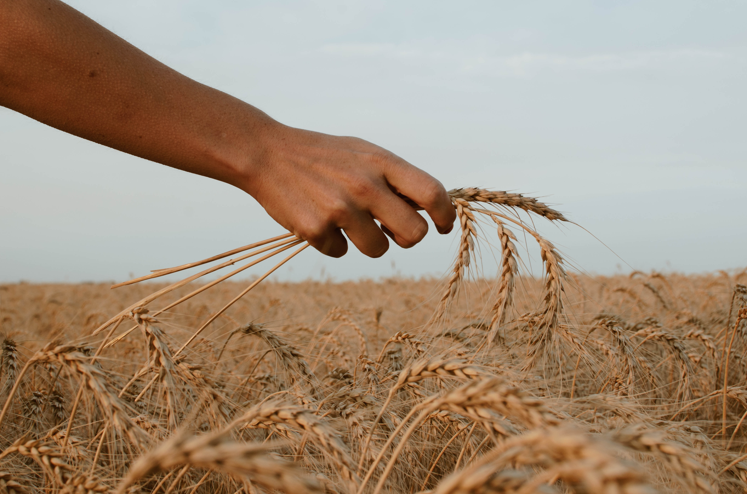
Argentina Food Security & Agriculture
Impact: This project will build Google Earth Engine tools for estimating and forecasting agricultural yield for corn, wheat, and soybeans in Argentina. Time series plots and spatial maps of temperature, precipitation, soil moisture, and vegetation indices will provide valuable information on growing conditions throughout the country.
Community Concern:
Crop monitoring and crop yield forecasting are important for identifying market trends, food insecure regions, and irrigation demand; especially during times of drought. In situ soil moisture and crop measurements are often sparsely-distributed or unavailable in the region can potentially support more precise crop yield and irrigation demand forecasts. Satellite data is an efficient and accurate way to acquire large-scale observations to identify crop yield gaps.
Maryland – Goddard
Image Credit: Paz Arando
Earth Observations:
Terra MODIS
Aqua MODIS
SMAP
Landsat 8 OLI
GPM IMERG
Partner:
The Buenos Aires Grain Exchange
Notes:
------------------------------Image Information Below ------------------------------
Image Credit: Paz Arando
Image Source: Unsplash (https://unsplash.com/photos/zwZusrYAGoM?utm_source=unsplash&utm_medium=referral&utm_content=creditShareLink), Creative Commons License

Slide 21
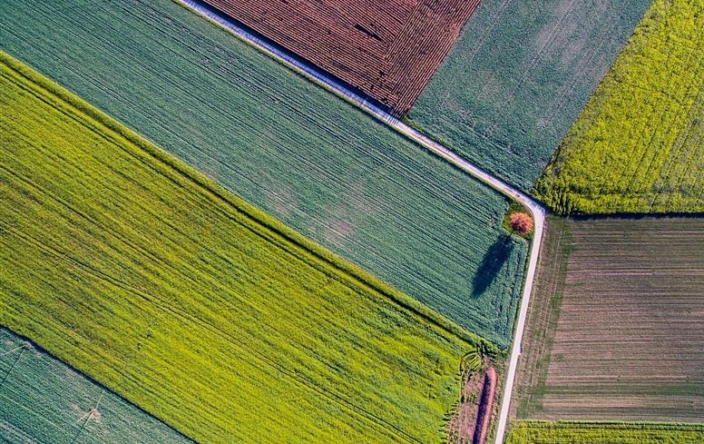
Midwest Food Security & Agriculture II
Community Concern: Crop insurance protects farmers, who can file claims for losses when weather events or anomalies destroy their prevalent, large-grain crops such as corn. Although they counter the negative effects of monoculture farming, small-grains crops like oats, wheat, barley, and rye cannot be insured as easily because of a lack of data, leading many farmers to avoid planting these crops.
Georgia – Athens
Partners:
Practical Farmers of Iowa
USA National Phenology Network
USDA Agricultural Research Service
Earth Observations:
Landsat 7+ ETM
Landsat 8 OLI
SMAP L-Band radiometer
GPM IMERG
Image Credit: Jim Wimmerling
Impact:
An interactive Google Earth Engine tool to explore crop phenology and weather variables will allow the partners to advocate for data-backed insurance coverage, empowering them to diversify farmlands and eliminate monocultures and their associate environmental problems.
Notes:
------------------------------Image Information Below ------------------------------
Image Credit: Jim Wimmerling
Image Source:https://unsplash.com/photos/RUj5b4YXaHE?utm_source=unsplash&utm_medium=referral&utm_content=creditShareLink

Slide 22
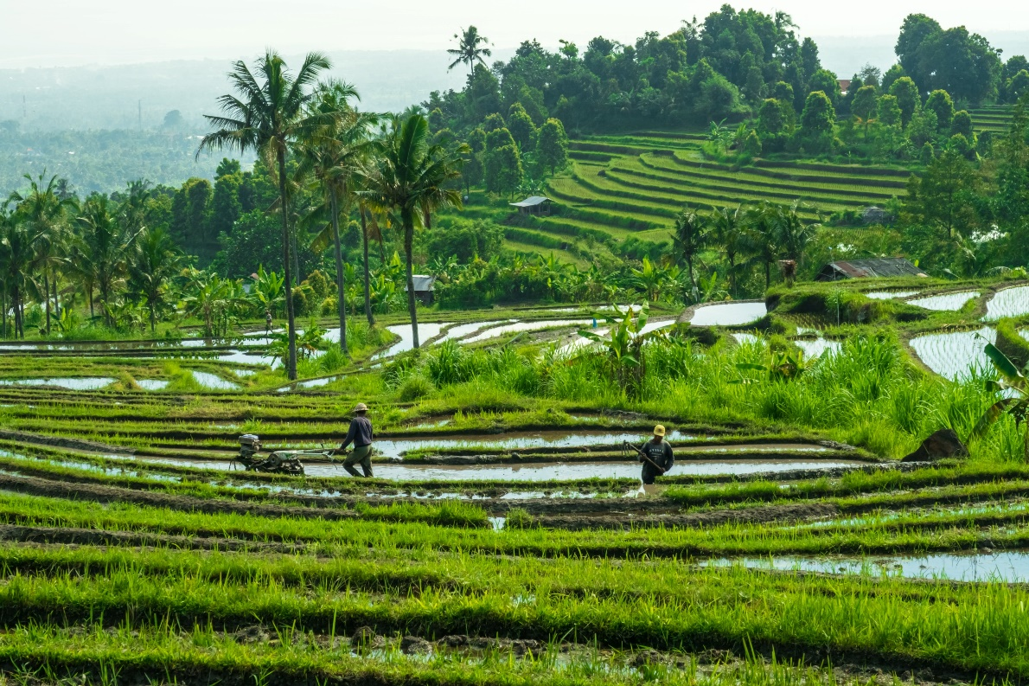
Tonlé Sap Food Security & Agriculture II
Community Concern: Tonlé Sap, located in Cambodia’s Lower Mekong Basin, is the largest freshwater lake in Southeast Asia and provides fisheries and freshwater to nearby agricultural communities. Increased pumping and shifts in global climate threaten the ecosystem’s water quality and fish habitat.
Virginia – Langley
Impact: This project will be used to understand the implications of water quality changes within the region. End users will use these analyses to guide future resource allocation in the Tonlé Sap Basin.
Partners:
Ministry of Water Resources, Tonlé Sap Authority (Cambodia)
Conservation International
GEOAquaWatch
Earth Observations:
GRACE
Landsat 8 OLI
Terra & Aqua MODIS
GPM IMERG
Photo by Sebastian Pena Lambarri on Unsplash
Notes:
------------------------------Image Information Below ------------------------------
Image Credit: Photo by Sebastian Pena Lambarri on Unsplash
Image Source: https://unsplash.com/photos/Ke8EuI2xOUc

Slide 23
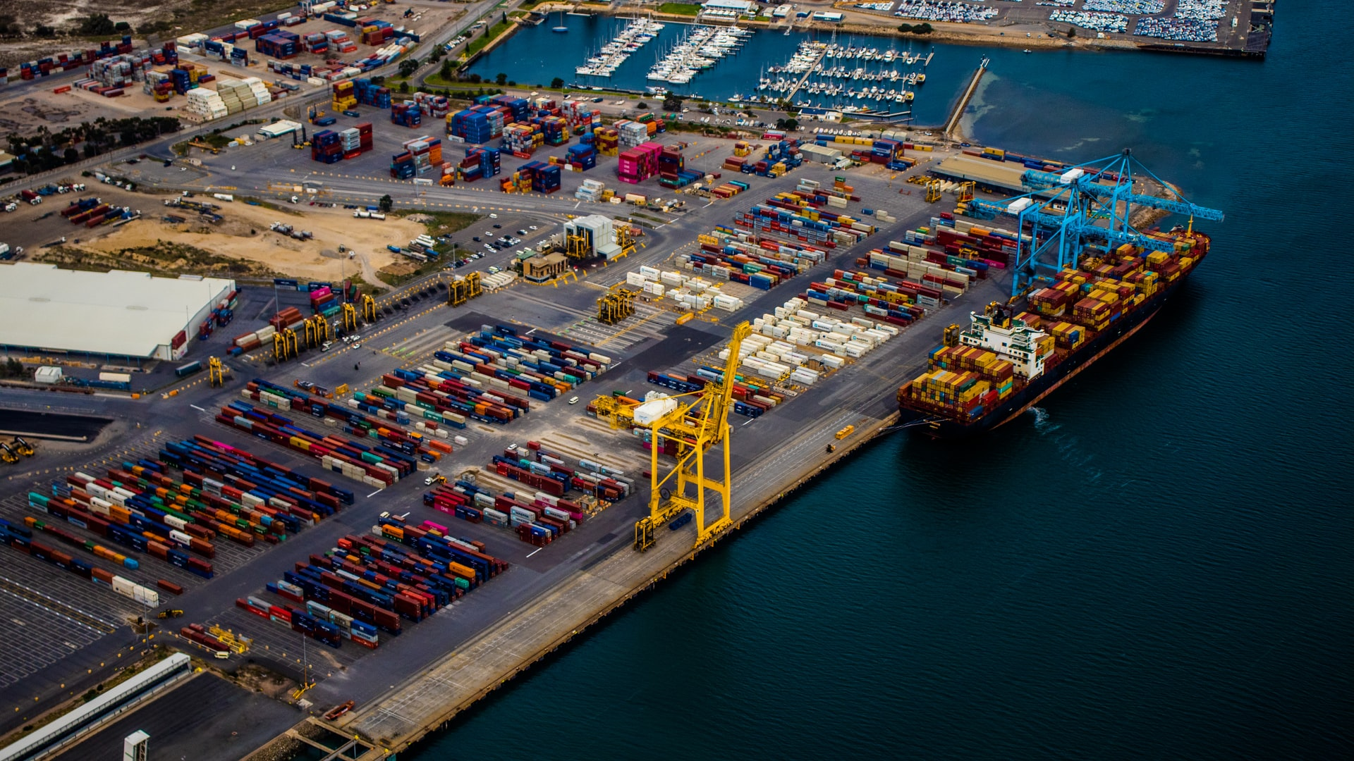
Florida Transportation & Infrastructure
Community Concern: In early 2022, the U.S. Army Corps of Engineers will begin a harbor deepening project on the Port Everglades seaport in Fort Lauderdale, Florida. The anticipated direct impacts to Florida’s Reef Tract surrounding the port are 29 acres, with the anticipated indirect impacts up to 564 acres of seabed.
California – Ames
Partners:
U.S. Army Corps of Engineers, Jacksonville District
NOAA Marine Fisheries Service, Habitat Conservation Division
Earth Observations:
Landsat 8 OLI
Landsat 5 TM
Sentinel-2 MSI
Aqua MODIS
Image Credit: Alex Duffy
Impact: The project end products will provide partners with a 20-year time series analysis of water quality changes to understand the seaport’s historical conditions and better inform future decisions for the harbor deepening project.
Notes:
------------------------------Image Information Below ------------------------------
Image Credit: Alex Duffy
Image Source: Unsplash (https://unsplash.com/photos/a-E__y8y5Wo), Creative Commons License

