Slide 1
Human System Risk Framework
Workshop on Artificial Intelligence & Modeling for Space Biology
Supporting the Next Phase of Space Exploration and Discovery
June 24-25, 2021
Sponsoring Org/Office Code: Human Health and Performance Directorate, Johnson Space Center
Date: June 24, 2021
Mary Van Baalen, PhD
Acting Assistant Director, Human System Risk Management
Johnson Space Center

Slide 2
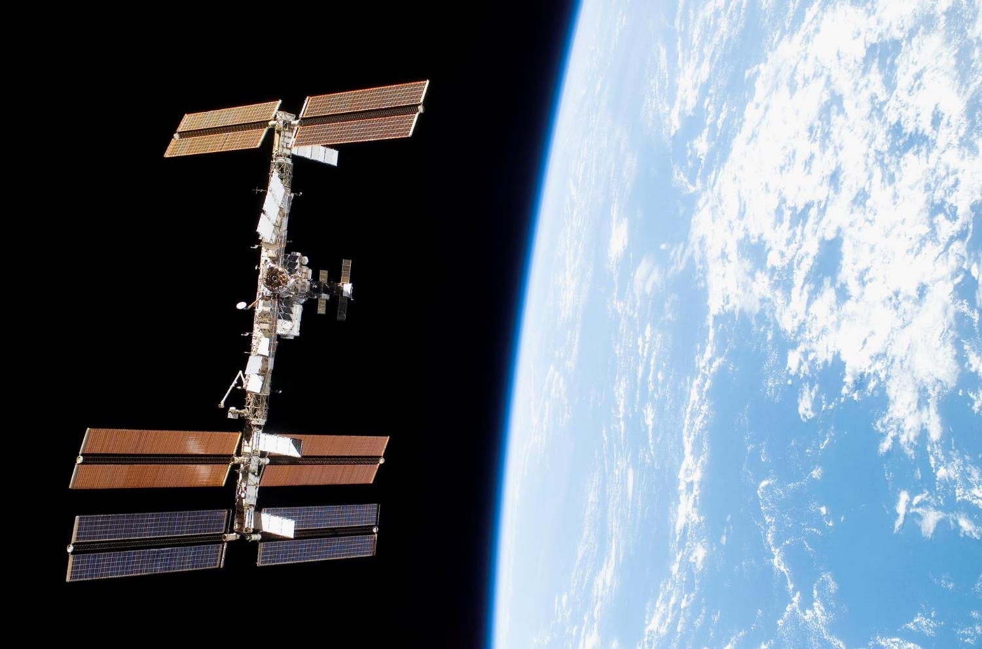
20
580
1 billion

Slide 3
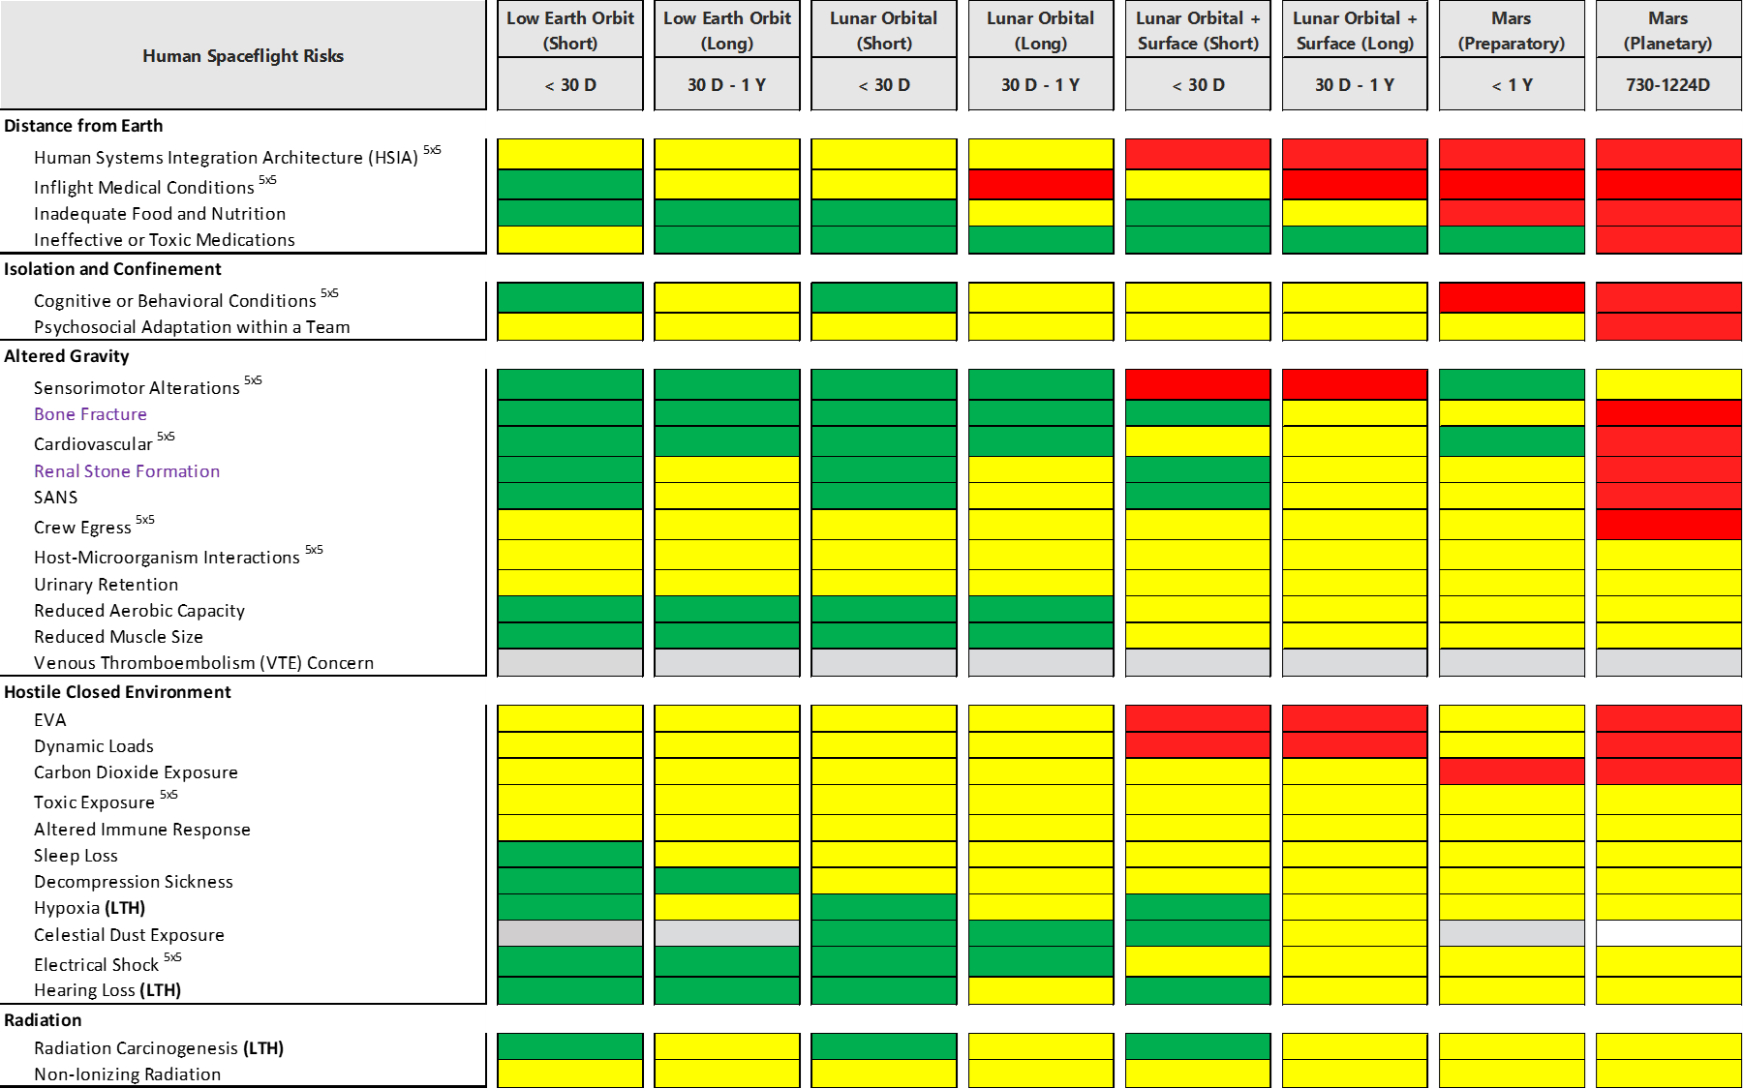
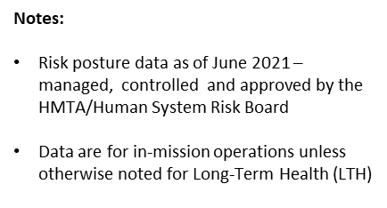

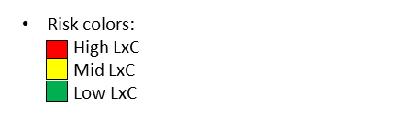
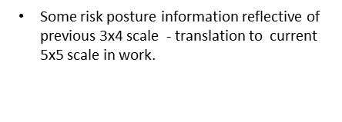
Human System Risk Summary – Risks by Hazard
(as of June 2021)
^{5x5} item - Risk has been updated using 5x5 scale
3

Slide 4
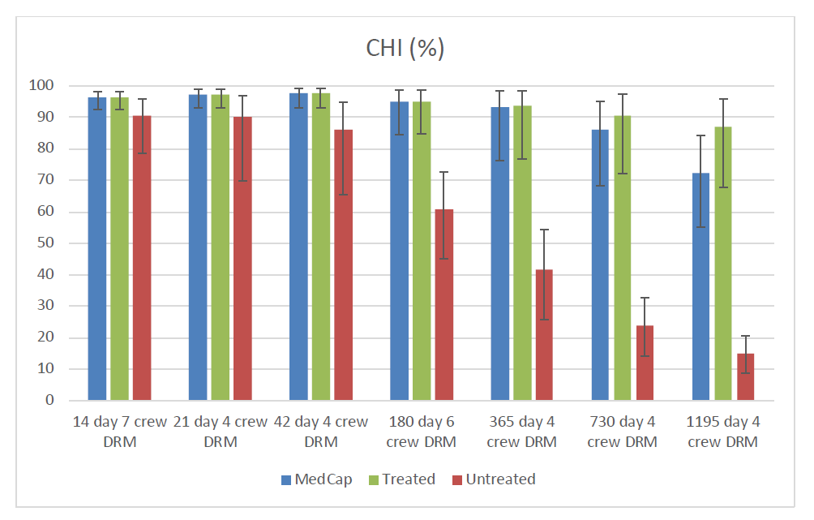
Performance Decrement Consequences
Selection Standards see diminishing risk returns as mission duration increases
No Medical Capability
Crew Health Index
Unlimited ISS Medical Capability
Mission medical risk is bounded by the medical capability that is available in mission
Single ISS Medical Capability
(i.e. No Resupply)
IMM Run S-20180531-405, 100,000 simulations
The level of performance risk we carry depends on what we design into the vehicles, NOT how healthy the crew is at the start of a mission

Slide 5
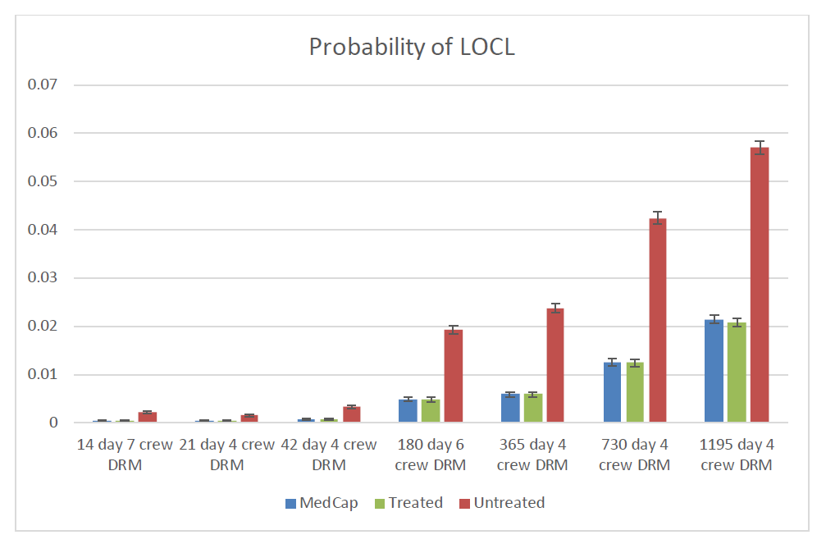
Loss of Crew Life Consequence
These results are from medical events only
No Medical Capability
Mission Medical Risk is bounded by the medical capability designed into the vehicle
Unlimited ISS Medical Capability
Single ISS Medical Capability
(i.e. No Resupply)
1/90 is where the Space Shuttle total LOC risk fell at the end of the program.
IMM Run S-20180531-405, 100,000 simulations
Estimated Mars mission medical risk alone for LOCL is higher than all risk on the space shuttle, even with the best medical capability ever fielded (ISS). How much risk is carried is strongly dependent on an effective CHP system.

Slide 6
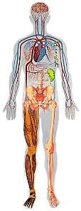
Why does performance matter?
Humans in Extreme Environments
Mitigating Impacts on Human Health & Performance
Enabling Unique Human Capabilities for Earth-Independent Ops
Exposure Sources
Carbon dioxide
Celestial dust
Toxic
Sunlight
Radiation
Isolation
Cognitive, behavioral, psychiatric disorders
Cooperation, coordination, psychosocial adaptation
Anomaly Response
Causal Diagnostics
Altered body function
Immune response
Hypobaric hypoxia
Decompression
Renal stone
Bone fracture
Host-microorganism interactions
Urinary retention
Orthostatic intolerance
Cardiac rhythm
Back pain
Next Worst Outcome Analysis
Work
Sleep loss
Circadian desynchronization
Work overload
Knowledge Integration
Preparedness
Food and nutrition
Inflight medical conditions
Medication
Contingency Planning
Complex Procedure Execution
Reduced capacities
Hearing loss
Intracranial hypertension/vision alteration
Vestibular/sensorimotor alteration
Muscle mass, strength, endurance
Aerobic capacity
Injury sources
Dynamic loads
EVA
Electrical shock
Risk Assessment / Time to Criticality
How Crew Is Impacted by Mission
How Crew Is Impacting Mission

Slide 7
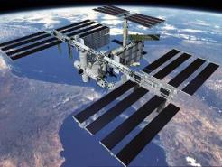
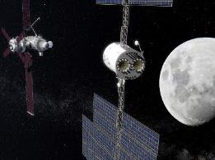
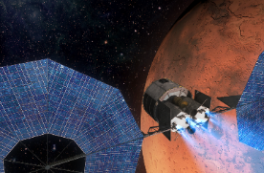
Progressive Earth Independence
Real Time Communications
Evacuation Capability (1.5 – 36 hrs)
Strong Consumables Resupply
Near Real Time Communications
Evacuation Capability (3-11 days)
Limited Consumables Resupply
As missions move further from Earth, Medical Risk increases
No Real Time Communications
No Evacuation Capability
No Consumables Resupply
Increasing exposure to hazards
Increasing need for autonomy in problem response

Slide 8
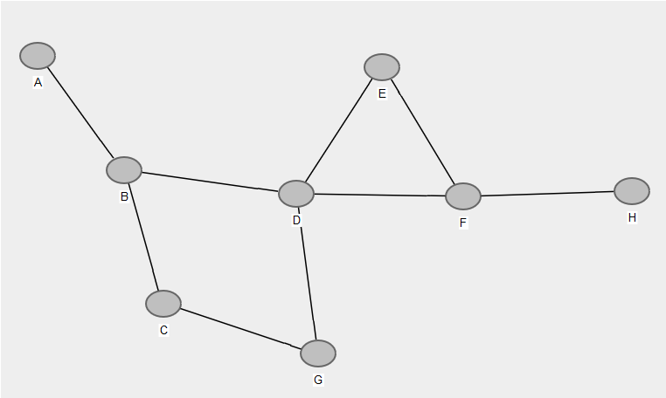
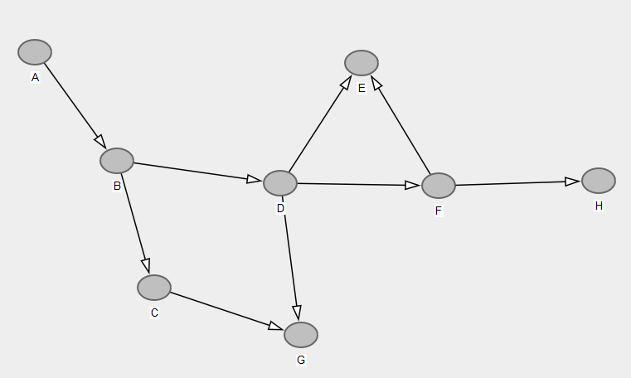
Use of Directed Acyclic Graphs (DAG)
Visual representation of causality in a network graph format; causal relationships are the basis for connection between nodes (contributing factors, countermeasures, other risks) based on SME’s current understanding.
  Directed: single-headed arrows show direction of relationship
  Acyclic: no ‘cycles’ (feedback loops); relationship goes one way and there are no directed paths back to a node once we’ve left it
General network representation
DAG

Slide 9
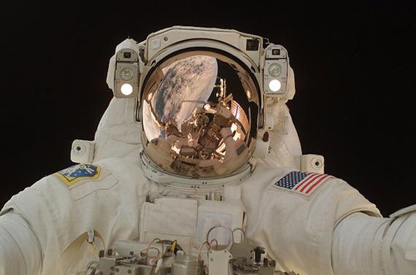
A simple risk example

Slide 10
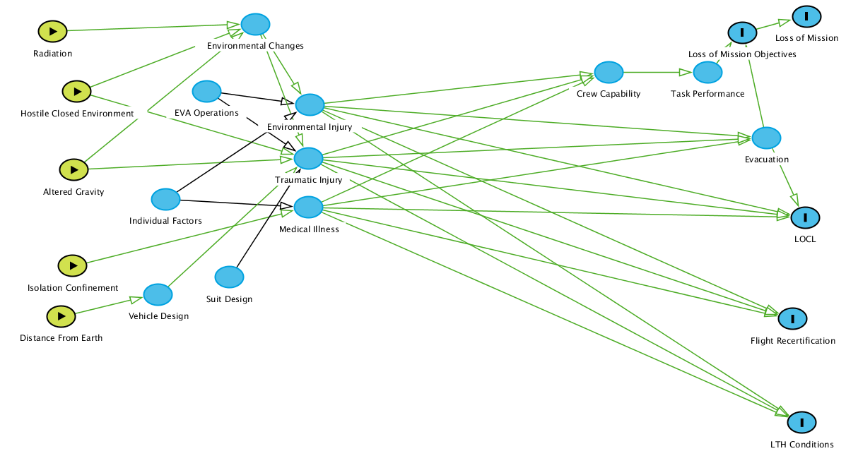
What about a more complicated Risk?
Medical DAG Starting Point
Total Medical Events
Portion of Medical Risk affected by Selection Standards

Slide 11
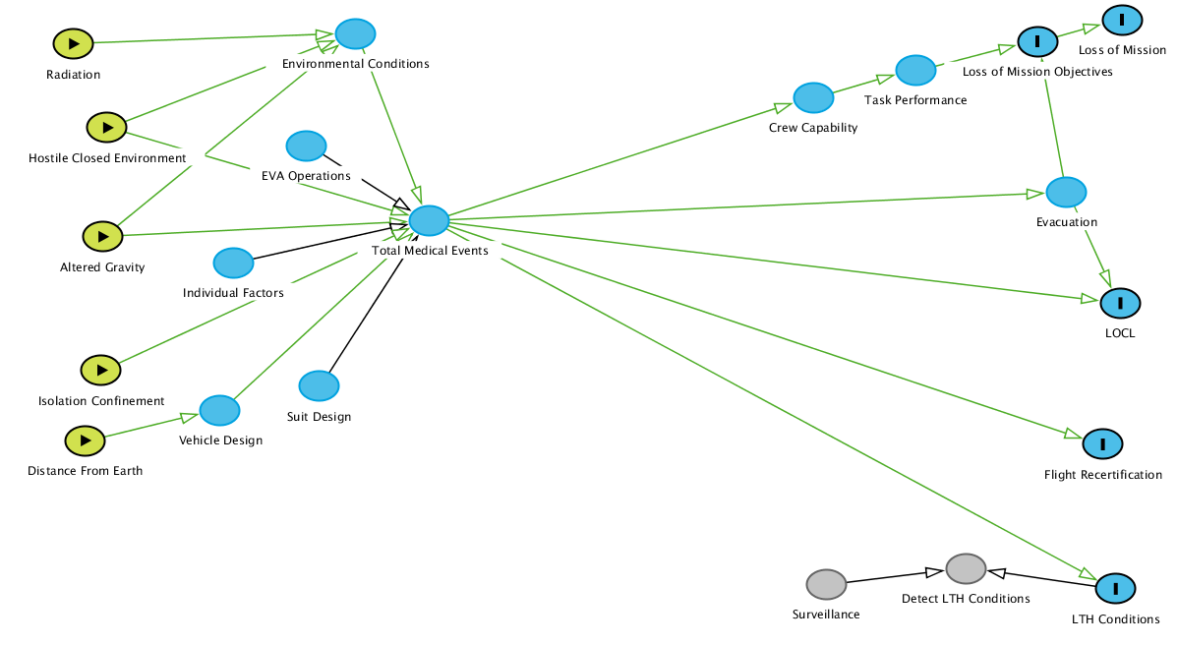
Medical DAG - making it easier to view
Collapsing for Clarity

Slide 12
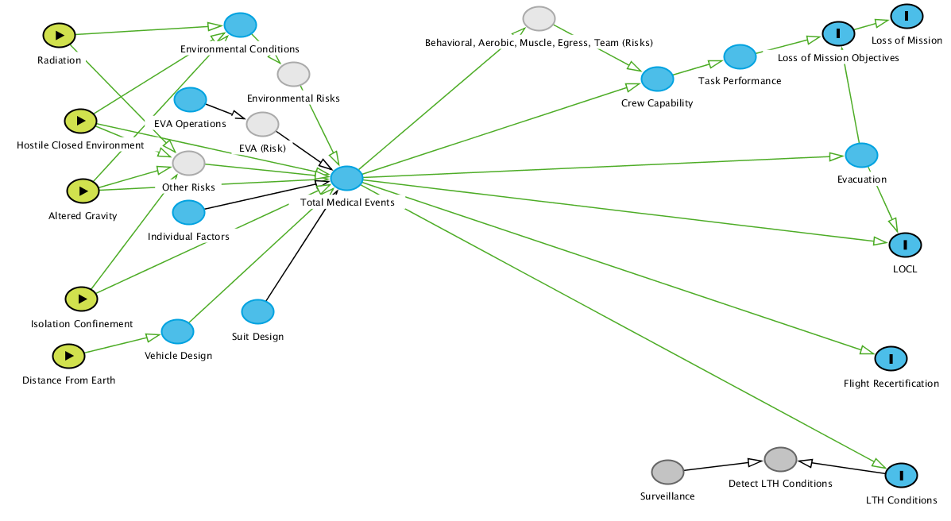
Medical DAG - Other Risk Interactions
‘Environmental Risks’ Node
  Tox
  SANS
  DCS
  Hypoxia
  CO2
  Dust
  Sensorimotor
  Acoustics
  Electric Shock
  Dynamic Loads
  NIR
‘Other Risks’ Node
  Immune
  Micro
  Food-Nutrition
  VTE
  CV
  Renal Stone
  Urinary Retention
  Bone Fracture
  Sleep/Workload

Slide 13
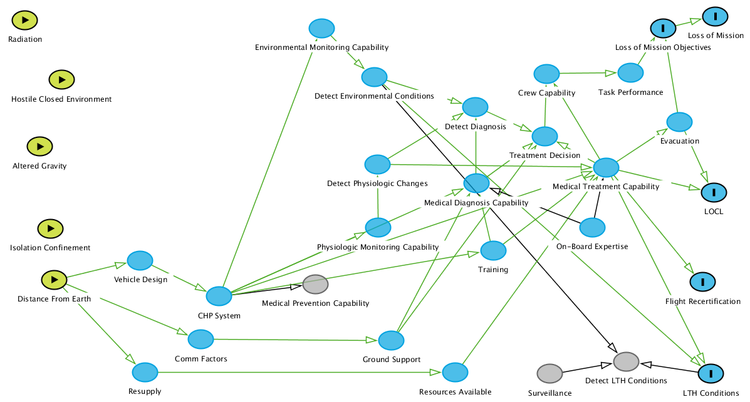
Medical DAG - Medical Capability and LTH Risk
LTH Risk Characterization depends on both Exposure monitoring and surveillance

Slide 14
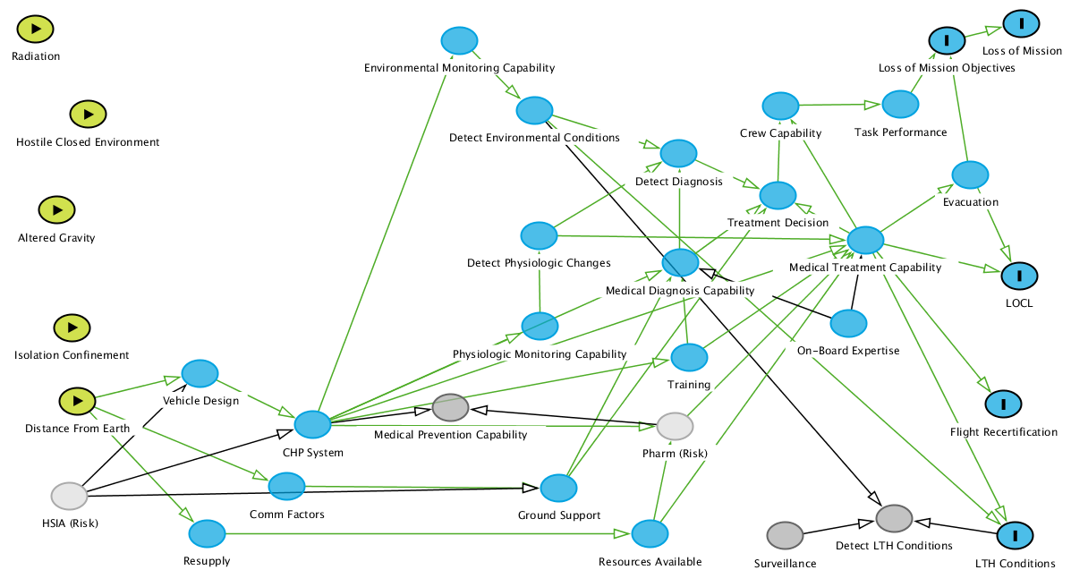
Medical DAG - Other Risks Affecting Medical Capability
Medical Levels of Care Standards Affect

Slide 15
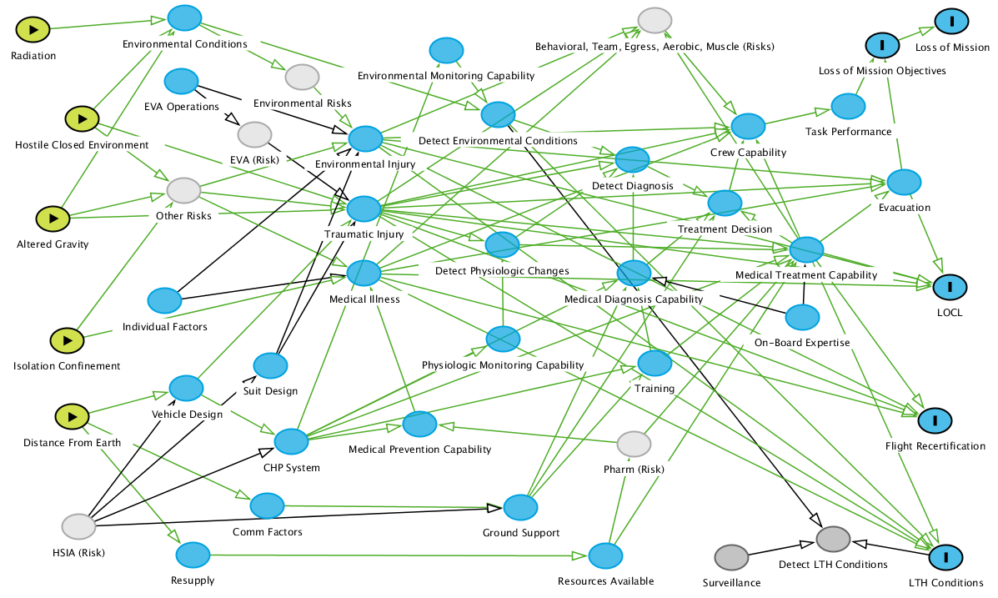
Risk Complexity
How do we identify where the knobs are to turn to most effectively mitigate all of this risk?
AI/ML are likely to help us figure this out.

Slide 16
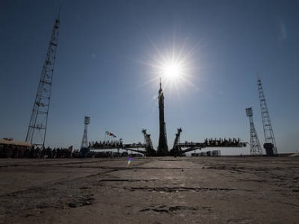
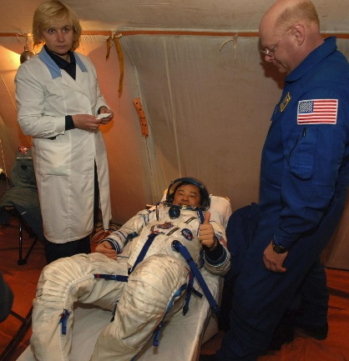
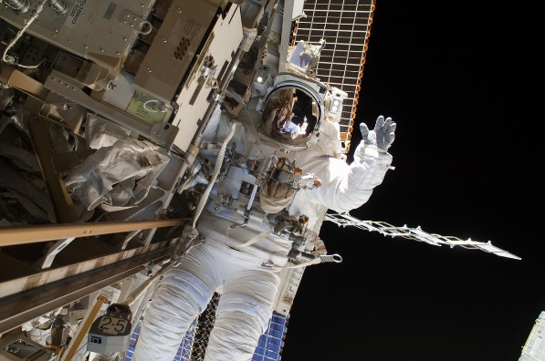
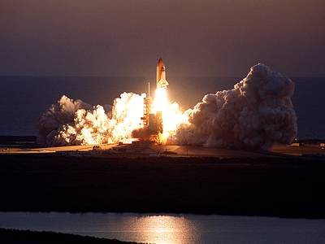
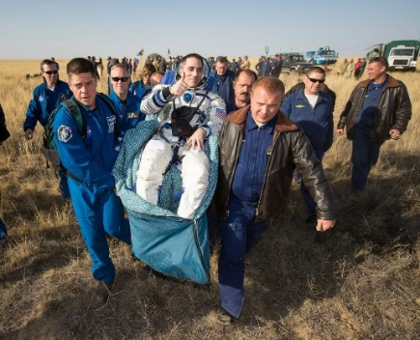
Conclusions
Space travel is an inherently risk endeavor and the nature of the risk is complex
Human exploration requires optimum functioning of both spacecraft and astronauts. Failure of either could result in loss of crew or mission objectives.
Current human system risk framework provides opportunities for machine learning techniques to explore the risk relationships

