Slide 1
Navigating and utilizing Space Biology data
Jonathan Galazka
GeneLab Project Scientist
Space Bioscience Division
NASA Ames Research Center
A description of how data flows from space biology experiments to data repositories.

Slide 2
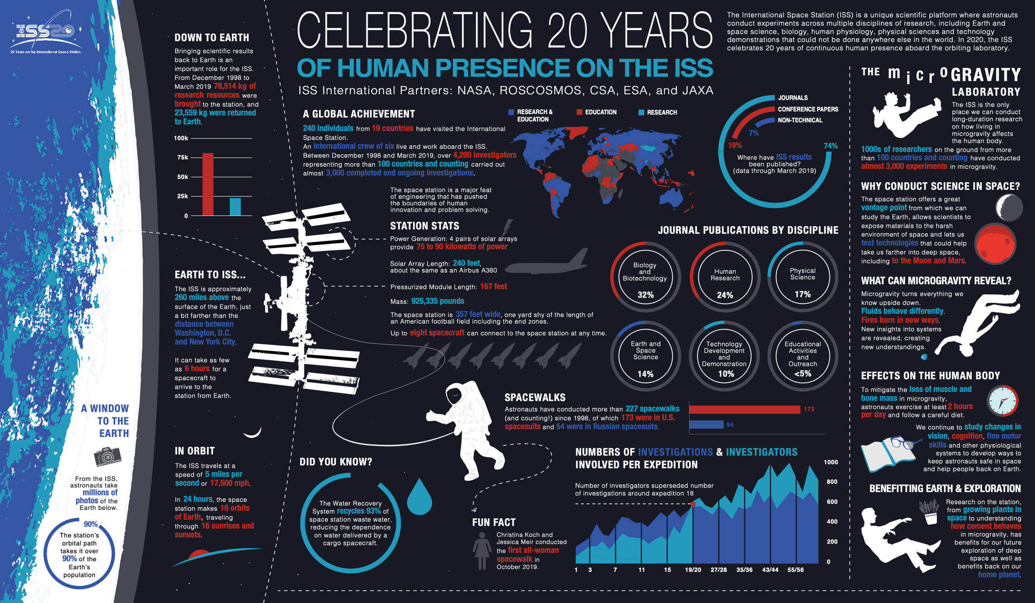

Slide 3
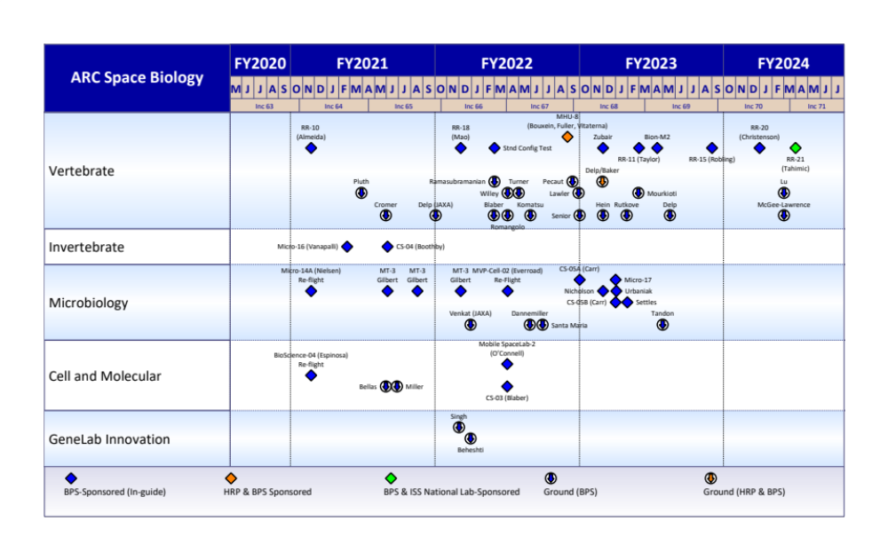
Ames Space Biology “Fly-off” Plan

Slide 4
Space Biology experimentation, sample and data archiving
Data generator
Data Repositories
Sample source
Primary PI
GeneLab (”omics”)
PI designed spaceflight and ground analogue experiments
Tissue Sharing Program PI (BSP, ISS-NL, NBISC)
Ames Life Science Archive
GeneLab (Open Science Data)
NBISC (NASA Biological Institutional Science Collection
Other (non-NASA)
Reference spaceflight and ground analogue experiments
Sample repositories

Slide 5
Space Biology experimentation, sample and data archiving
Data generator
Data Repositories
Sample source
Primary PI
GeneLab (”omics”)
PI designed spaceflight and ground analogue experiments
Tissue Sharing Program PI (BSP, ISS-NL, NBISC)
Ames Life Science Archive
GeneLab (Open Science Data)
NBISC (NASA Biological Institutional Science Collection
Other (non-NASA)
Reference spaceflight and ground analogue experiments
Sample repositories

Slide 6

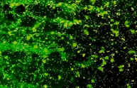


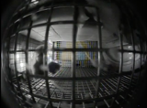

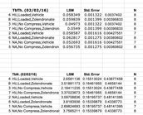






ALSDA Sample Metadata, Assay Metadata, Assay Data
HRP and SB Primary
Investigators submit their Data
Data, Descriptions from ~930 Experiments
  Flight and Ground-based PI Data
  Shuttle, ISS, Ground Experiments (HU, PWB, HyperG)
  Gravity, Radiation,
  Cognitive/Behavioral
  Countermeasures
Raw Data from Assays
Subjects
- Mouse, Rat, Quail, Chicken, Gecko, Rhesus Monkey, Bacteria, Fungus, more
Data Imagery, Video
Science Disciplines and Assays
Bone Physiology
  MicroCT, histology, histomorphometry, biochem measures, Biomech
Cardiovascular/Cardiopulmonary
  Microscopy, imaging, myocardial perfusion, cardiac output, ECG, hemodynamics, myography,
Developmental Biology & Repro
  Microscopy, egg/embroyo counts, histology, endocrine
Behavior
  Video surveillance/sampling, photometry, electrophysiological, novel object recognition, established behavioral tests (quantifiable)
Immunology
  IHC, Microscopy
Microbial Growth and Virulence
Muscle Physiology
  Muscle Fiber typing, Geometric, Biomech
Neurophysiology & Ophthalmology
  Tonometry, IHC, cell counting, optic nerve, mCT, CSF measures
Chronobiology
  Data related to circadian rhythms
Endocrinology
  Glucose levels, hormones, TSH, ACTH, pituitary-related, etc
Hematology
  Plasma contents, erythropoiesis measures, WBC assays
Metabolism and Nutrition
ALSDA
Processed
Data
Publications
Challenges:
- Small ‘n’ - Data Tools - FAIRness
- Sparsity, Volume of Datasets
- Heterogeneous - Across Mission Confounds
- Legacy data (1970 - ~2010)

Slide 7




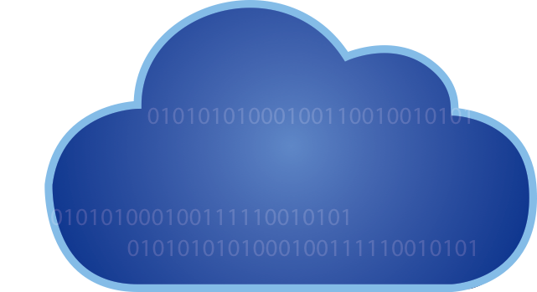

- Place in Bioinformatics, Data Mining, Meta-analyses, AI/ML
ALSDA part of Open Science with Genelab
Greater Ease for PIs: Single point of entry data submission
ALSDA Science Curation: FAIR & OPEN datasets to enable broader science discovery
Greater breadth of data: Omics AND physiological data to science communities for re-use & meta-analyses
Data Mining Enabling: Multi-hierarchical biological data enables: Meta-analyses, Artificial Intelligence, Machine Learning, Knowledge Graph Theory
Rapid Knowledge Discovery: GeneLab Data Science Modeling portal will lead to more rapid discovery and publications (i.e. Cell Press Nov. 2020)
NASA Biological Institutional Scientific Collection (NBISC)
Data
Portal
Raw Data
Processed Data
Metadata
Environmental
Portal
PI/Missions/
Experiments
Data
GeneLab Sample Processing
Analysis
Toolshed
Visualization
Portal
BPS Submission
Portal
Pipelines
Interactive
Tutorial
Ames Life Sciences Data Archive (ALSDA)
GeneLab Modeling
Portal
AI/ML/KG
Tools
New
Knowledge
Next Generation LSDA (JSC)
Notes:
Publication graphic from ISC-BSP

Slide 8
ALSDA Data Systems Transition: FAIR & Open
Enable FAIR for databases: Findable – Accessible – Interoperable – Reusable
Data Management Plan
Data Submission Agreement
Data Submission Portal
Data Migration to AWS Cloud
Metadata Configuration
Machine-Readable Data Transformation
Automate the experiment-related DMP tool
Automate the DSA to improve collection of data, higher compliance. Ease for PIs. End-to-end PI awareness
ISATab model based. Structured sample and assay-level data.
AWG for consensus of science curation
ALSDA Data Processing Protocol with original submitted data becoming ‘Tidy’
Single point-of-entry for Principal Investigator data submission
All data within ALSDA platform to utilize the cloud. Secure and long-term
End-to-End Data Curation: From Grant, to Experiment, to Analysis, to Submission for Sharing
Secure Preserved Data in Cloud: ALSDA established in 1992
Submission Portal: Single point for PIs
Automated systems: Ease of submission agreements, and clarifies data to be submitted
TidyData: Enables greater machine-readability/re-usability

Slide 9
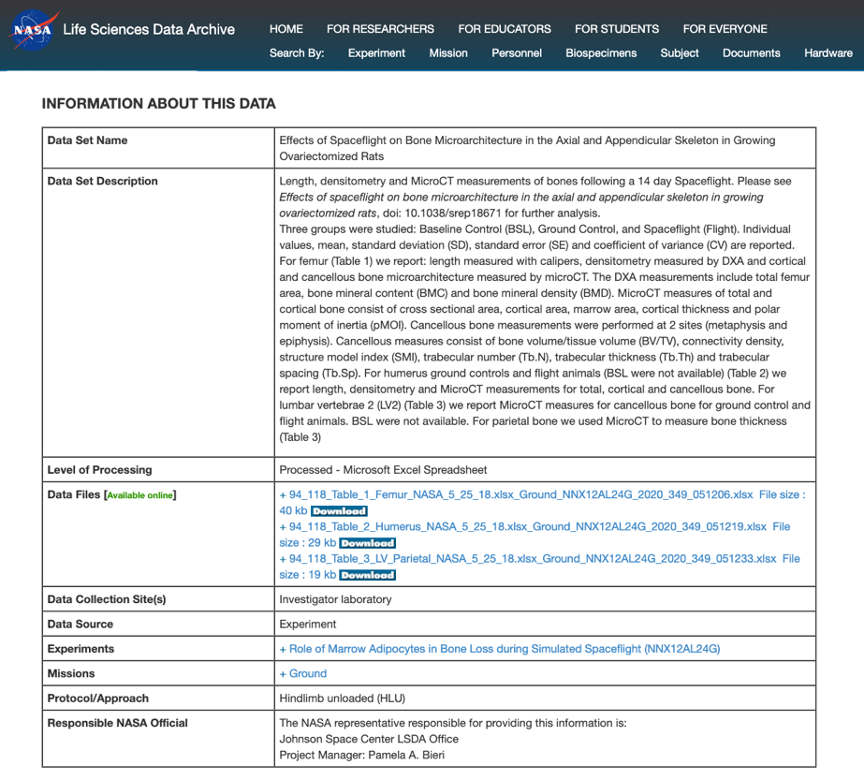
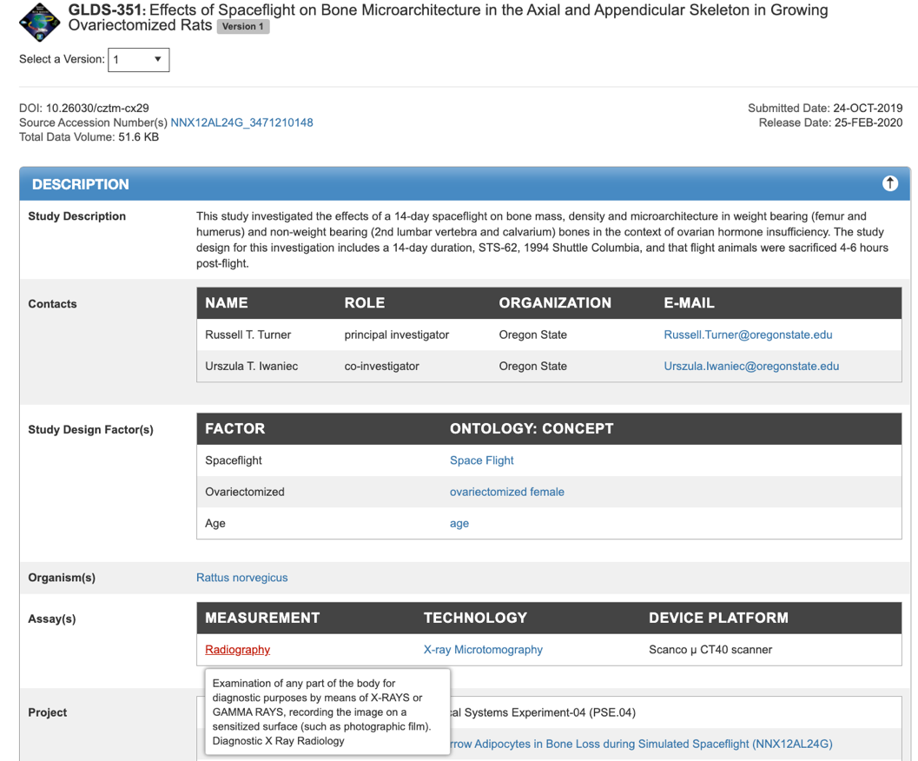
Past Dataset Version
New Curated & FAIR Dataset
ALSDS-1:
Provenance
Permanence
Findable
Interoperable

Slide 10
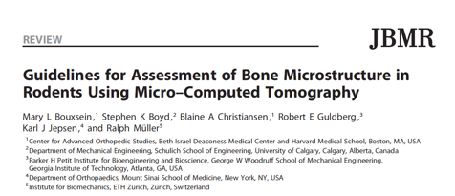
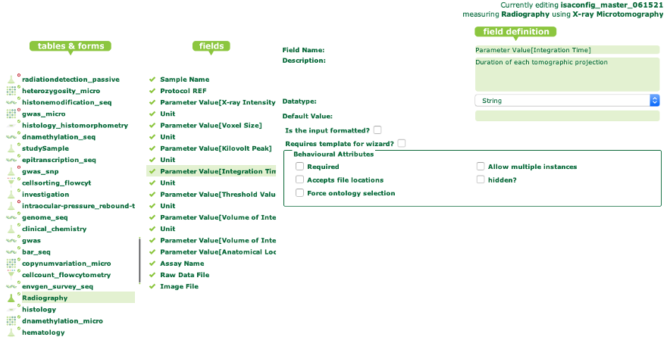
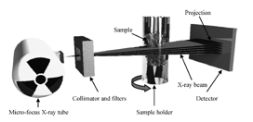
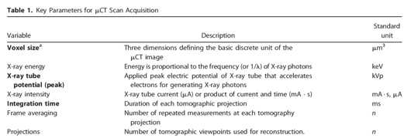
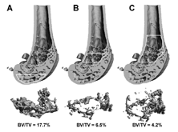
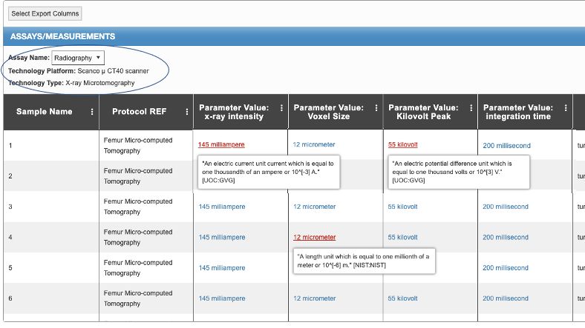
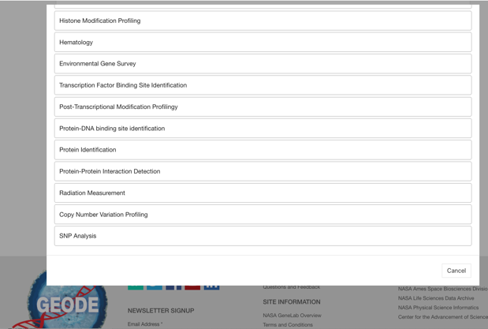
GEODE and New ALSDA Submissions
Assay Metadata Standards
Built According to SMEs
Concurrence and Gold Standards:
- ALSDA AWG
Organized Metadata
By Sample and Assay
in ISAtab structure
Histone Modification Profiling
Novel Object Recognition
Environmental Gene Survey
Transcription Factor Binding Site Identification
Post-Transcriptional Modification Profiling
Histomorphometry
New Assay Datasets
to be uploaded by PI
Protein Identification
Protein-Protein Interaction Detection
Radiation Measurement
Copy Number Variation Profiling
Radiography

Slide 11
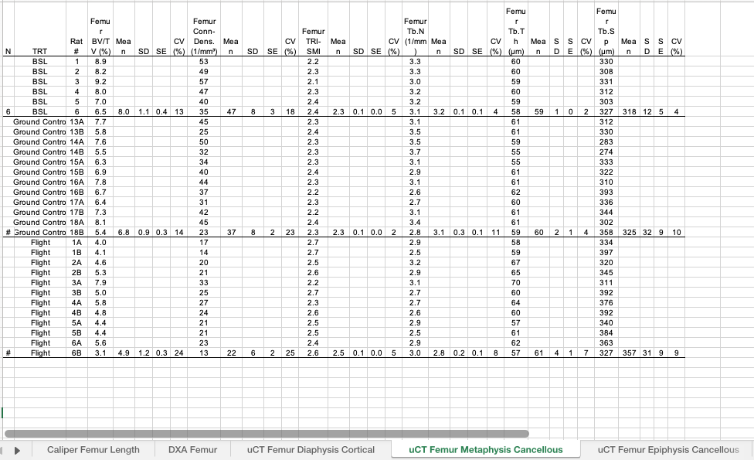
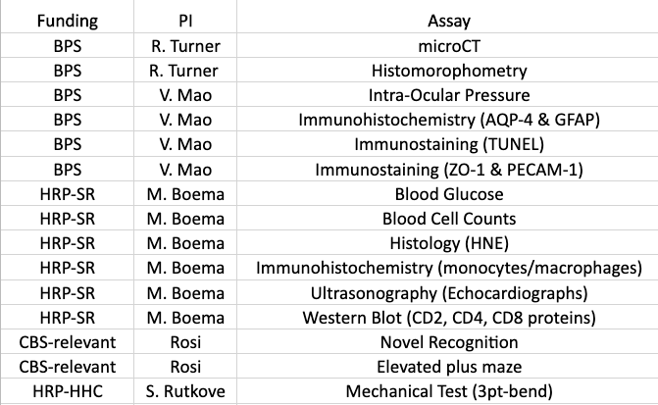
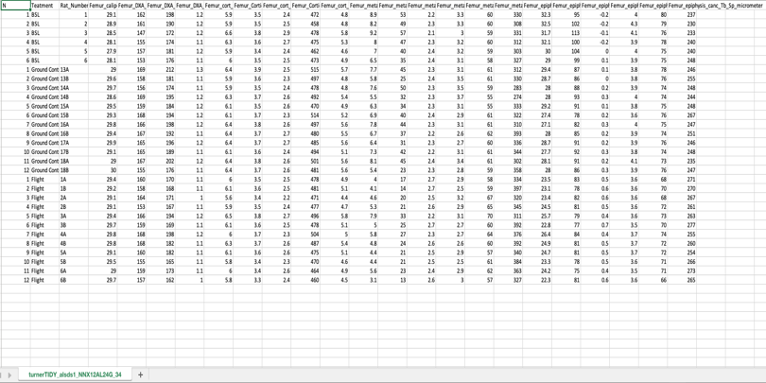
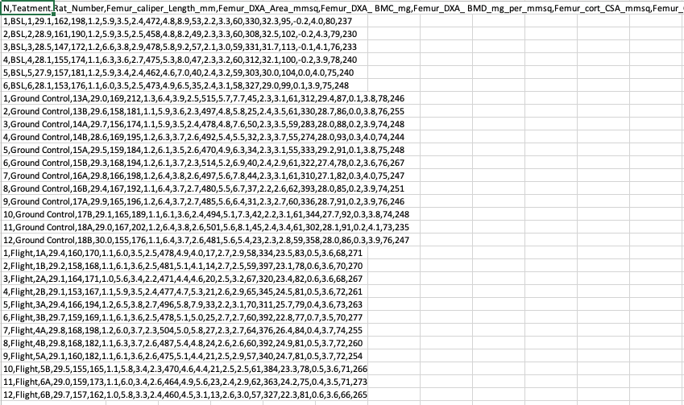
Data Reusability & Tidy
Data Curation
ALSDA Assay Metadata ‘Configurations’
Original Submitted
Tabs, spaces, naming convention ☹
Reusable
‘TidyData’ format for R, python, .csv

Slide 12
Space Biology experimentation, sample and data archiving
Data generator
Data Repositories
Sample source
Primary PI
GeneLab (”omics”)
PI designed spaceflight and ground analogue experiments
Tissue Sharing Program PI (BSP, ISS-NL, NBISC)
Ames Life Science Archive
GeneLab (Open Science Data)
NBISC (NASA Biological Institutional Science Collection
Other (non-NASA)
Reference spaceflight and ground analogue experiments
Sample repositories

Slide 13
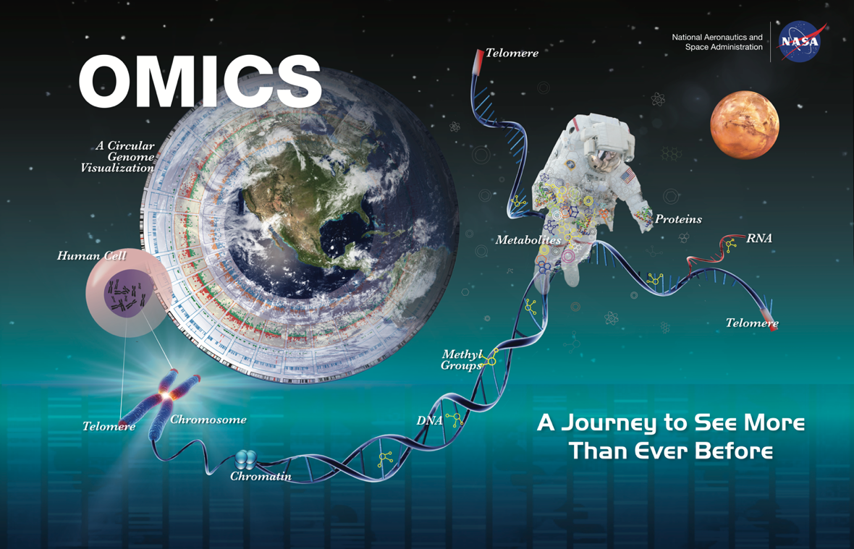
GeneLab overview: Biological complexity
Humans body: 79 organs, 200 cell types, 20,000 protein coding genes, Many more mRNA splice isoforms, Many more protein isoforms, 16,000 endogenous metabolites (22,000 from food), Plus…DNA, RNA, and protein modifications, histone modifications, protein-protein interaction, etc., etc., etc., We’re complicated!
Kamisoglu et al. Front. Pharmacol., 27 February 2017

Slide 14
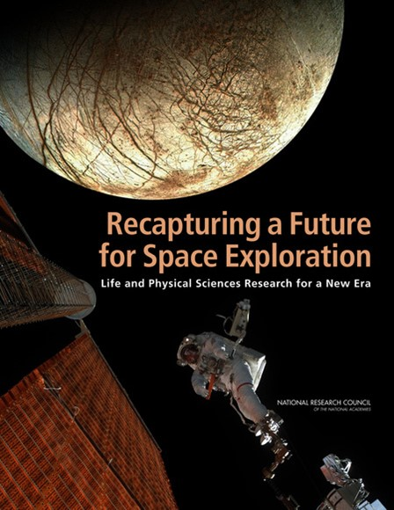
GeneLab overview: 2011 NRC Decadal Survey
Shift
Another log10 since 2011
“…genomics, transcriptomics, proteomics, and metabolomics offer an immense opportunity to understand the effects of spaceflight on biological systems…”
“…Such techniques generate considerable amounts of data that can be mined and analyzed for information by multiple researchers…”

Slide 15
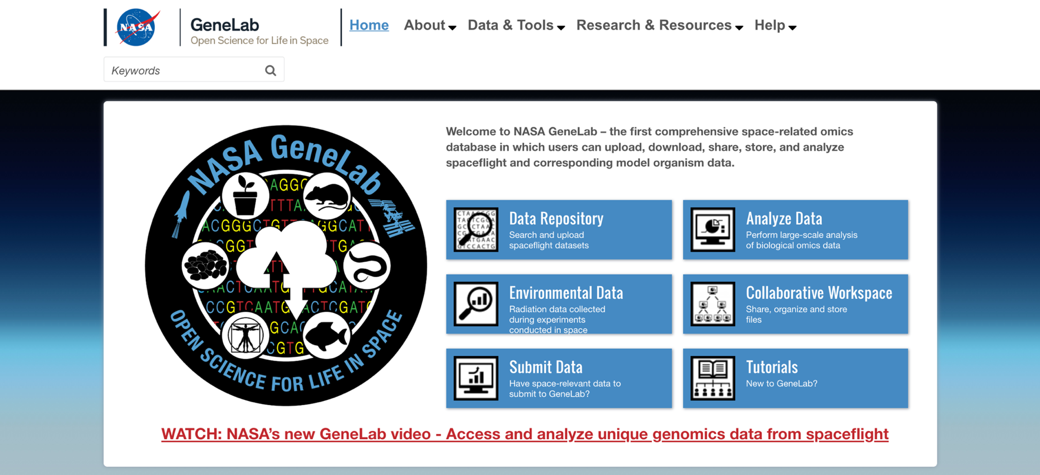
GeneLab: Adding value to Space Biology data
Mission: To enable scientific discovery and space exploration through multi-omics data-driven research.
Currently funded by SLPSRA Space Biology program. Previously received funding from the ISS program.

Slide 16
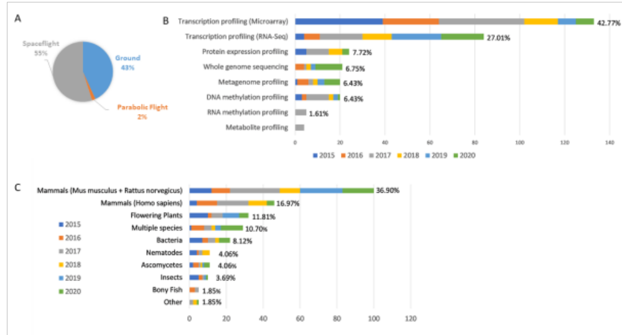
Adding value: Curation for increased discoverability

Slide 17
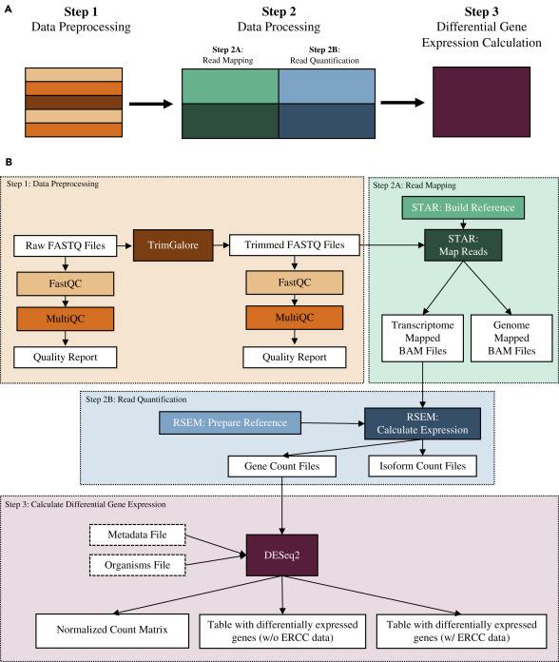
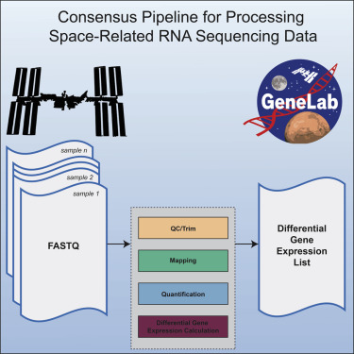
Adding Value: Standardized processing of raw data
Overbey EG, Saravia-Butler AM, Zhang Z, Rathi KS, Fogle H, da Silveira WA, Barker RJ, Bass JJ, Beheshti A, Berrios DC, Blaber EA, Cekanaviciute E, Costa HA, Davin LB, Fisch KM, Gebre SG, Geniza M, Gilbert R, Gilroy S, Hardiman G, Herranz R, Kidane YH, Kruse CPS, Lee MD, Liefeld T, Lewis NG, McDonald JT, Meller R, Mishra T, Perera IY, Ray S, Reinsch SS, Rosenthal SB, Strong M, Szewczyk NJ, Tahimic CGT, Taylor DM, Vandenbrink JP, Villacampa A, Weging S, Wolverton C, Wyatt SE, Zea L, Costes SV, Galazka JM. NASA GeneLab RNA-seq consensus pipeline: standardized processing of short-read RNA-seq data. iScience. 2021 Mar 26;24(4):102361. doi: 10.1016/j.isci.2021.102361. PMID: 33870146; PMCID: PMC8044432.

Slide 18
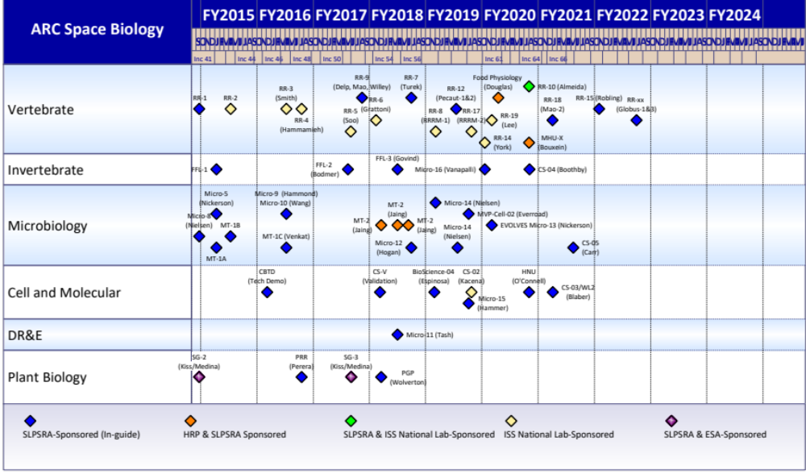
Adding value: Data generation
Heart
Flies
Bric-23
Bric-20
Bric-19
= GeneLab data generation (actual and planned)

Slide 19
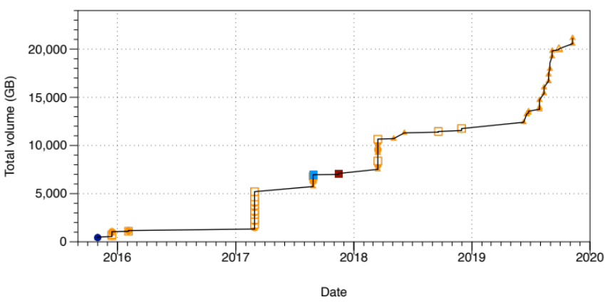
Adding value: Data generation
Rodent Research Reference Mission-1 (RRRM-1):
Background
GeneLab has generated >20 TB of open science data from unused spaceflight tissues.
Tissue | Groups | Assays
Adrenal glands | FLT, GC, basal, VIV from LAR & ISS-T young and old | Bulk RNA-seq
Brain | Same as above | Spatial and Single-cell RNA-seq, Single-cell ATAC-seq (profiles chromatin accessibility), etc.
Kidney | Same as above | Bulk RNA-seq
Liver | Same as above | Bulk RNA-seq
Dorsal skin | Same as above | Bulk RNA-seq
Spleen | Same as above | Bulk RNA-seq
Head skin with whiskers | Same as above | Bulk RNA-seq
GeneLab generated datasets (up to Nov. 2019)
Rodent Research Reference Mission-2 (RRRM-2) scRNA-seq:
Shapes: Assay type
Triangle: Transcriptional profiling
Open square: DNA methylation profiling
Closed square: Metabolite profiling
Circle: Protein expression profiling
Diamond: RNA methylation profiling
Color: Species
Dark blue: Arabidopsis thaliana
Light blue: Bacillus subtilis
Green: Drosophila melanogaster
Orange: Mus musculus
Red: Staphylococcus aureus
Tissue | Groups
Femur marrow (loaded bone) | n=4 of FLT, GC, LAR young and old
Humerus marrow (”unloaded” bone) | n=4 of FLT, GC, LAR young and old
Splenocytes | n=4 of FLT, GC, LAR young and old
PBMCs (peripheral blood mononuclear cells) | n=4 of FLT, GC, LAR young and old
Data has been used to generate new knowledge (e.g.):
Overbey EG, Paul AM, da Silveira WA, et al. Mice Exposed to Combined Chronic Low-Dose Irradiation and Modeled Microgravity Develop Long-Term Neurological Sequelae. Int J Mol Sci. 2019.
Morrison MD, Fajardo-Cavazos P, Nicholson. Comparison of Bacillus subtilis transcriptome profiles from two separate missions to the International Space Station. NPJ Microgravity. 2019.
Beheshti A, Chakravarty K, Fogle H, et al. Multi-omics analysis of multiple missions to space reveal a theme of lipid dysregulation in mouse liver [published correction appears in Sci Rep. 2020.
Rodent Research Reference Mission-2 (RRRM-2) bulk RNA-seq and metagenomics:
Mesenteric lymph nodes, spleen, intestinal epithelia, brain endothelia, dorsal skin, adrenals, liver, kidney, brains, heart, eyes, lung

Slide 20
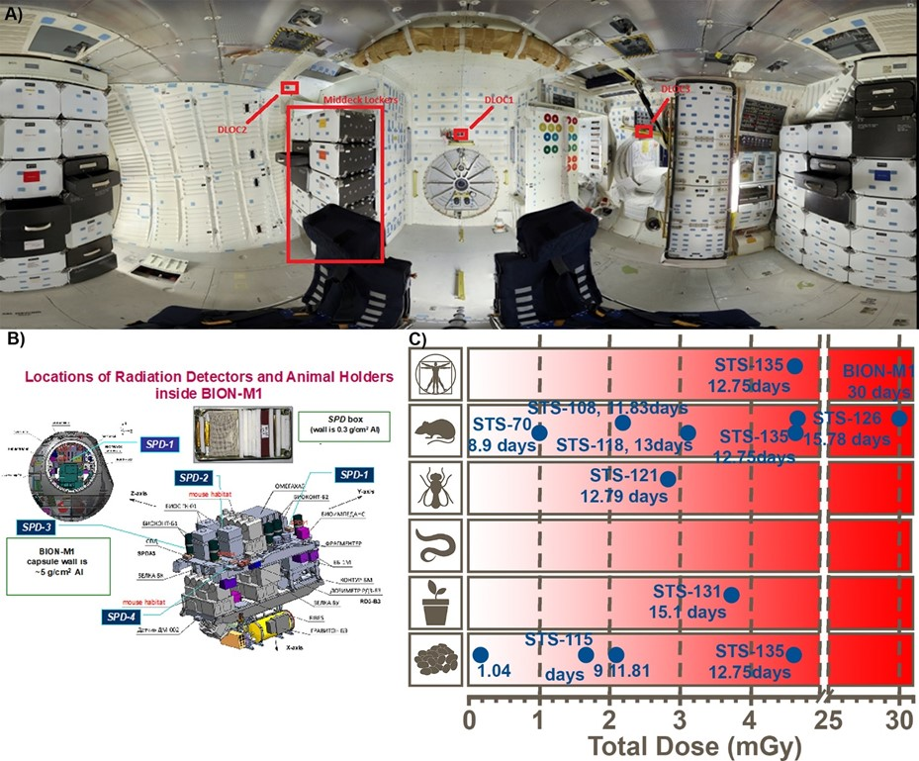
Adding value: Spaceflight metadata
Beheshti et al., Radiation Research 2018
STS = Space Transportation System (Shuttle Program)

Slide 21
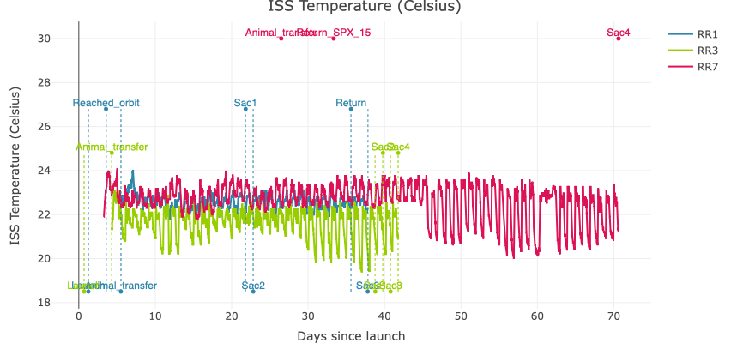
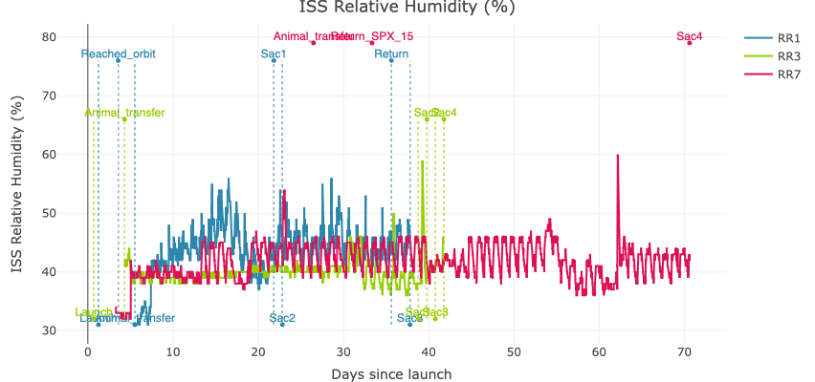
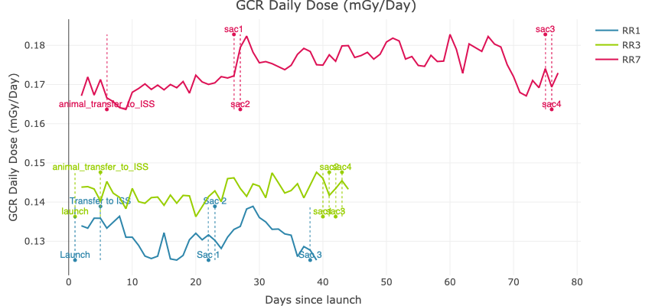
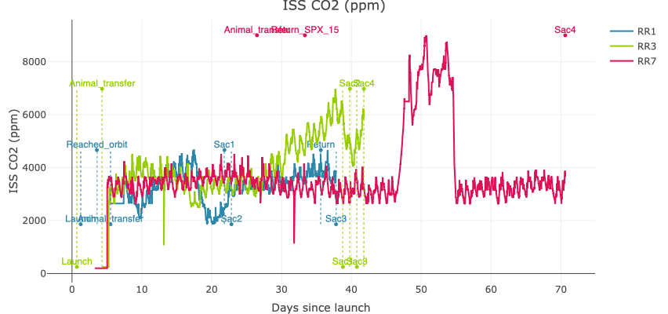
Adding value: Spaceflight metadata

Slide 22
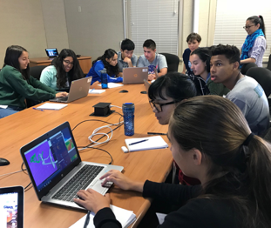

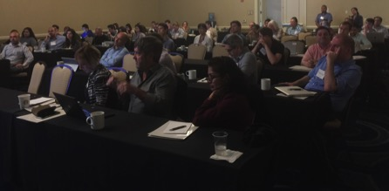
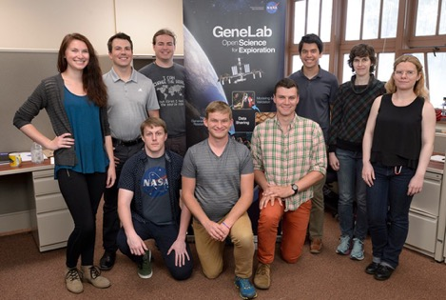
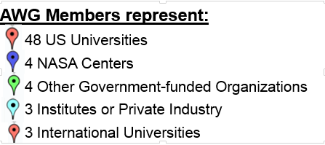
Adding value: Fostering community
Total AWG Members: ~120
Members are now group leads
AWG Members Per Group:
Animal 30
Multi-Omics/System Biology 45
Plants 15
Microbes 17
*Some members are in multiple groups
GeneLab Analysis Working Groups (AWGs) consist of 120+ scientists from multiple space agencies, international institutions, and industry. Scientists meet monthly with each group to analyze data in the GeneLab repository. Majority of members are non-NASA PI’s – many have applied for NASA funding following AWG interactions.
https://genelab.nasa.gov/awg/join
Educational Working Work (EWG) consists of educators and scientists spanning across high school and college, focusing on developing content to learn about spaceflight OMICS, promoting the use of GeneLab’s database via the repository, and the visualization and analytical portals.
Contact us for more information.
GeneLab included in Bioinformatics curriculum of degree granting university
GeneLab for High School
(Tutorial + Tools)
GeneLab Interns
Undergrads, Grads, Postdoc
Annual AWG Workshop

Slide 23
Space Biology experimentation, sample and data archiving
Data generator
Data Repositories
Sample source
Primary PI
GeneLab (”omics”)
PI designed spaceflight and ground analogue experiments
Tissue Sharing Program PI (BSP, ISS-NL, NBISC)
Ames Life Science Archive
GeneLab (Open Science Data)
NBISC (NASA Biological Institutional Science Collection
Other (non-NASA)
Reference spaceflight and ground analogue experiments
Sample repositories

Slide 24
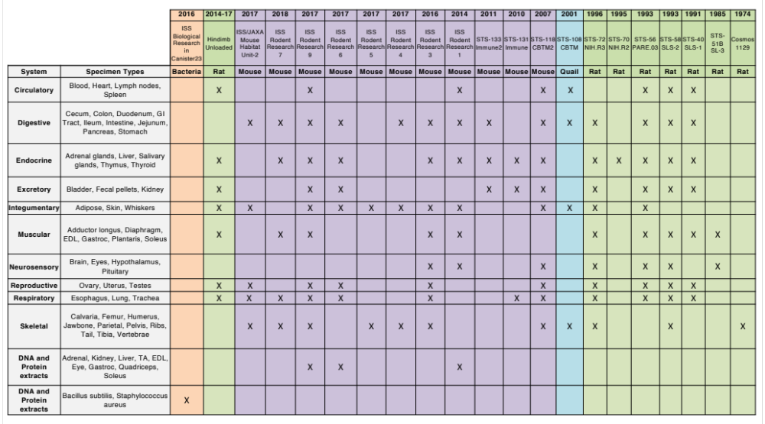
NASA Biological Institutional Scientific Collection (NBISC)
Over 32,037 Non-Human Biospecimens
  Spaceflight investigations and related ground controls
  Tissue request process managed by ALSDA
  Tissue request proposal reviewed by appropriate funding organization (SB or HRP)
  Housed in ARC Biospecimen Storage Facility (BSF)
  Curated by ALSDA
Collection Management
Secure database
Metadata: Conditions, Tissue type, Descriptions, Species, Fixations, Chain of Custody Record, Telemetry
Storage: -80ºC, -20ºC, +4ºC, Ambient
Features: Power backup, Alarm system for power failure (24-7 staff on-call)

Slide 25
Tissue Sharing Programs
Data generator
Data Repositories
Sample source
Primary PI
GeneLab (”omics”)
PI designed spaceflight and ground analogue experiments
Tissue Sharing Program PI (BSP, ISS-NL, NBISC)
Ames Life Science Archive
GeneLab (Open Science Data)
NBISC (NASA Biological Institutional Science Collection
Other (non-NASA)
Reference spaceflight and ground analogue experiments
Sample repositories

Slide 26

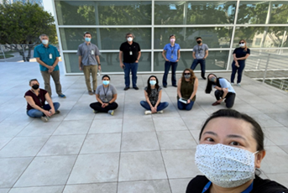
NASA Space Biology Biospecimen Sharing Program
Rodent Research BSP distributes unused tissues to participating PIs
RR-10 BSP dissection (May 2021):
  International team of 15+ investigators.
  More than 20 tissue-types were collected from mice that were launched on SpX21 and maintained in microgravity for 30 days.
  Collected tissues will contribute to multiple areas of scientific research, including cardiovascular remodeling, gastrointestinal dysbiosis, immune function, and reproductive physiology.

