Slide 1
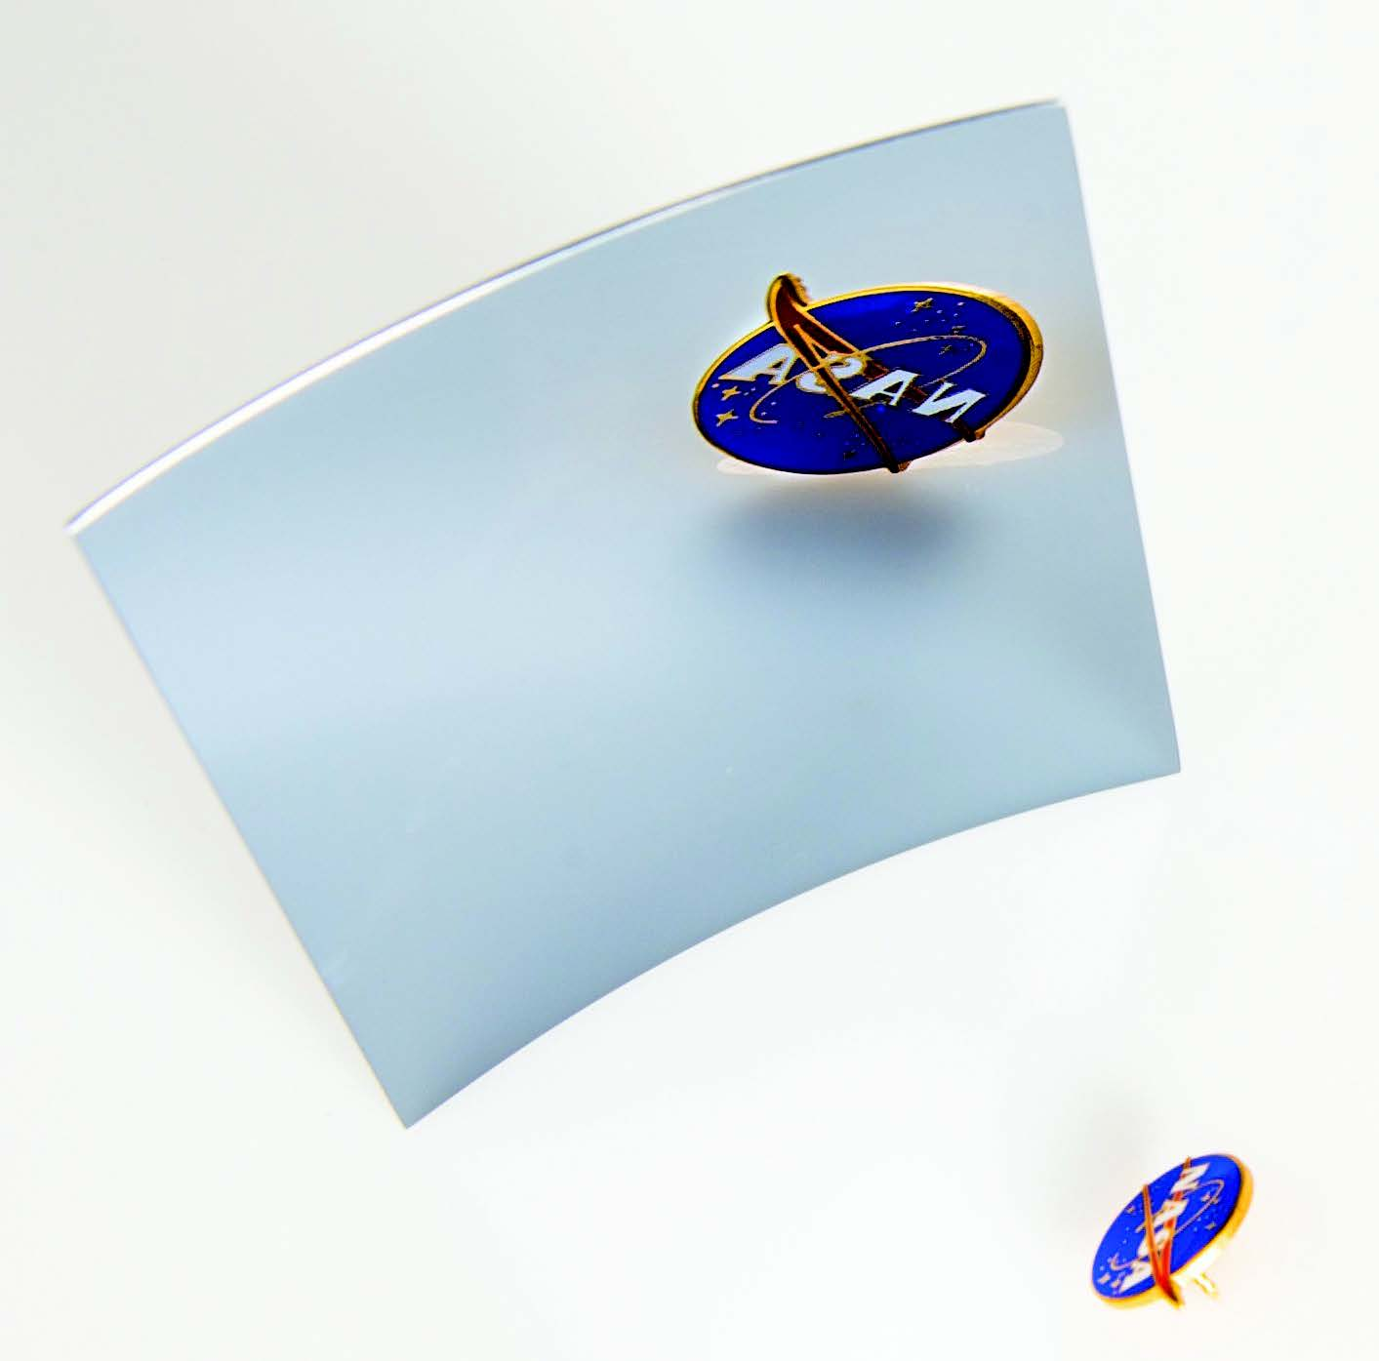


Focusing in on the
High Energy Universe
II: Introduction to X-ray Optics
Credit: NASA (Bill Hrybyk)
Dr. Oliver J. Roberts
USRA/NASA Marshall Space Flight Center
National Space Science and Tech. Center
Huntsville, AL, USA.
oroberts@usra.edu
A 100 mm² Wolter-I mirror segment

Slide 2
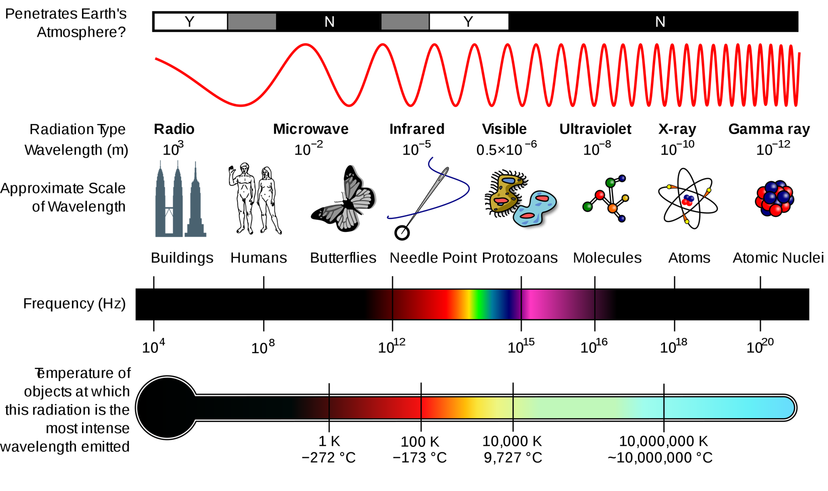
Light – Electromagnetic (EM) Radiation
Credit: NASA / Wiki CC Inductiveload
Wave-particle duality
  Propagates as waves
  Energy imparted by waves absorbed like particles at single sites: photon (quanta of light)
Optics is the study of light.

Slide 3
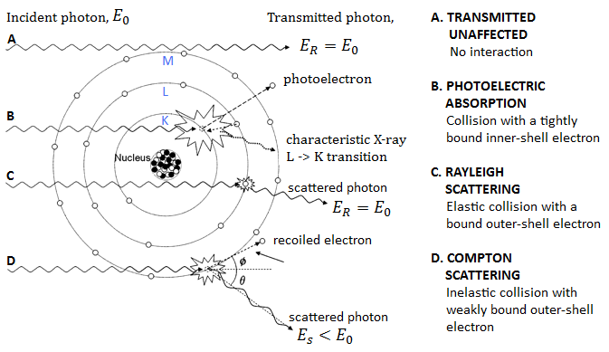
X-rays and Atoms
Image Credit: O’Hea, I., MSc Thesis, Open University (UK), 2015

Slide 4
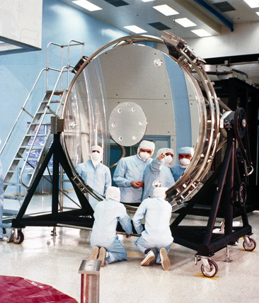
Optics
“Optics” (from the Greek word for appearance - “οπτική”)
Lenses made from quartz as early as 2000 BC (i.e. Nimrud lens from 700 BC Assyria).
Branch of physics that focuses on the behavior and properties of light (incl. manipulation, detection, etc).
Two branches of (Classical) Optics:
  Geometrical (Ray) Optics
    Light propagates as straight lines
  Physical (Wave) Optics
    Light propagates as an electromagnetic wave
The main mirror of the HST (Credit: NASA)

Slide 5
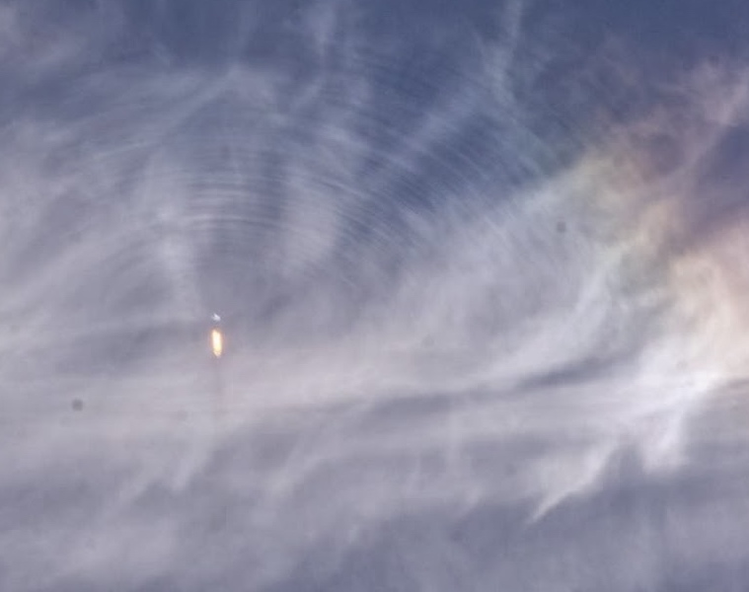
Geometrical
(Ray/Particle) Optics
Credit: NASA/ Goddard/ Anne Koslosky

Slide 6
Why do we see things?
Objects are a source of light rays that originate from everywhere on the object with each point sending rays omnidirectionally.
Some wavelengths are reflected, others absorbed giving colour which can be detected with correct sensor.
Objects can be self-luminous (i.e. Sun, flames, lightbulb) or reflective. Most objects are reflective.
Self-luminous object (active)
It emits light
Self-luminous object (passive)
It reflects light

Slide 7
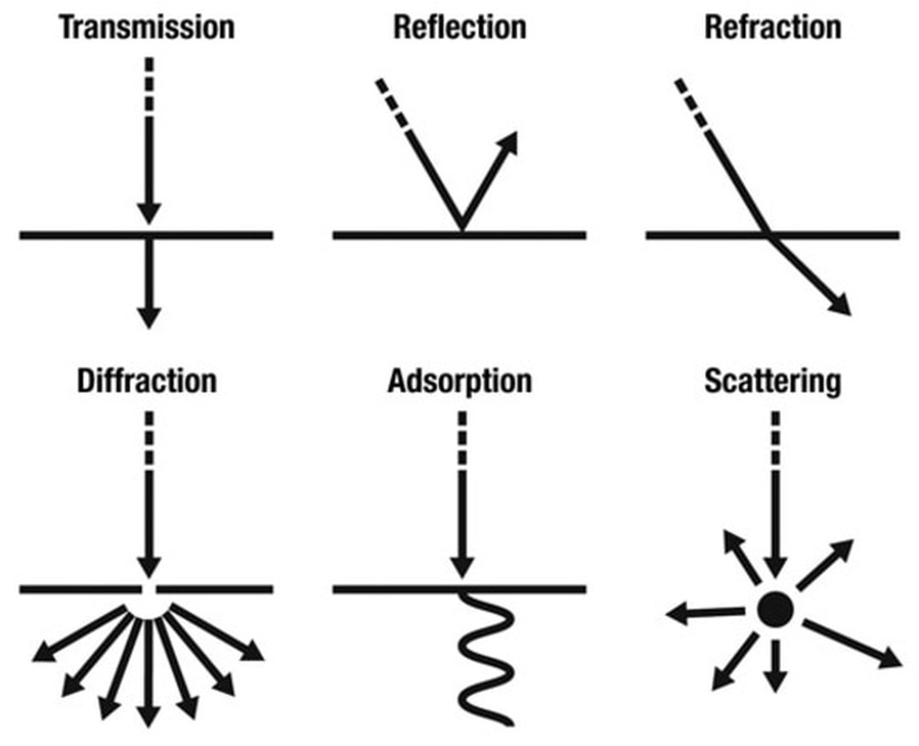
The “Ray” Model of Light
Light interacts with matter in different ways:
  Between two materials, it can be reflected or refracted
  Within a material, light can be scattered or absorbed
  Or, it can be transmitted or diffracted through the medium.
How incident light interacts with matter depends on how transparent the material/medium is to the wavelength of light and the surrounding material.
Absorption

Slide 8
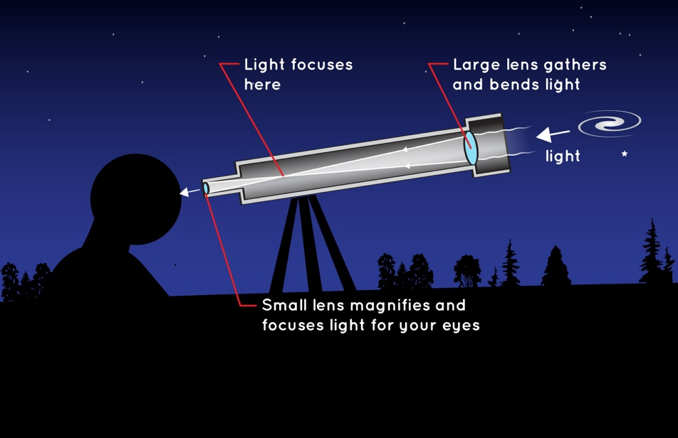
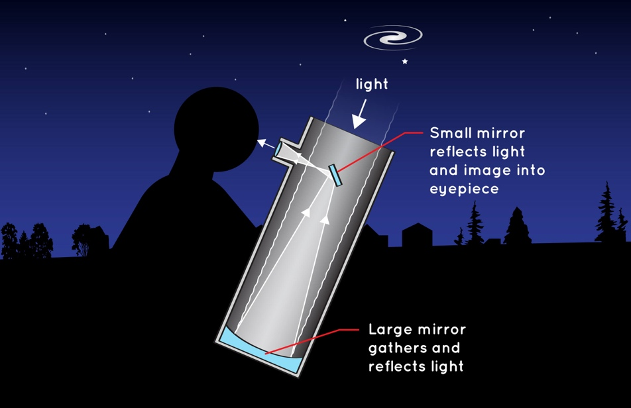
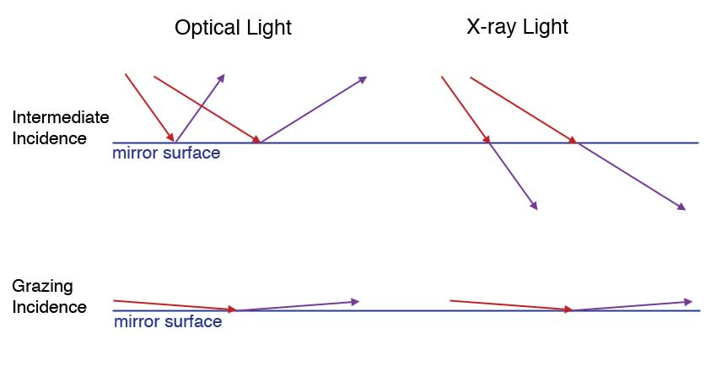
Mirrors and Telescopes
Conventional telescopes use reflection or refraction at normal/intermediate incidence (i.e. visible light).
Not applicable for X-rays as rays travelling perpendicular to mirror are absorbed or transmitted (no reflection).
X-ray telescope work use grazing incidence optics (mirror reflection at shallow angles) for total external reflection.
Scattering of any wave by electrons is coherent only if the angle of incidence equals the angle of reflection; $φ_{i}=φ_{o}$
Refractor
Reflector
All Image Credit: NASA

Slide 9
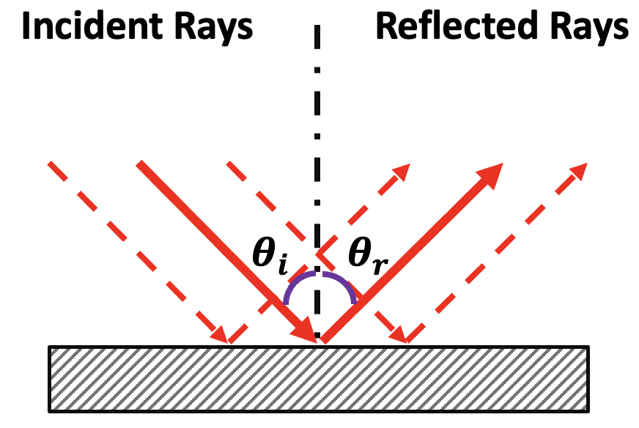
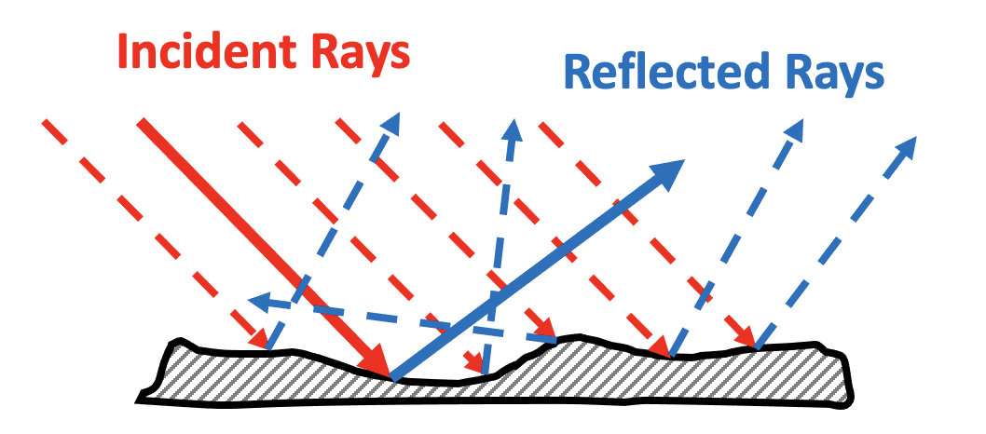

Specular Reflection
(Smooth Surface)
Diffuse Reflection
(Rough Surface)
$$θ_{i}=θ_{r}$$
For a rough surface, the irregularities on the surface at each point cause light to be reflected randomly in many different directions
Examples: The wall, hands, etc.
Law of reflection:
  Incident & reflected about a normal line, rays are in the same plane
  Angle of incidence (𝛉_{i}) = angle of reflection (𝛉_{r})

Slide 10
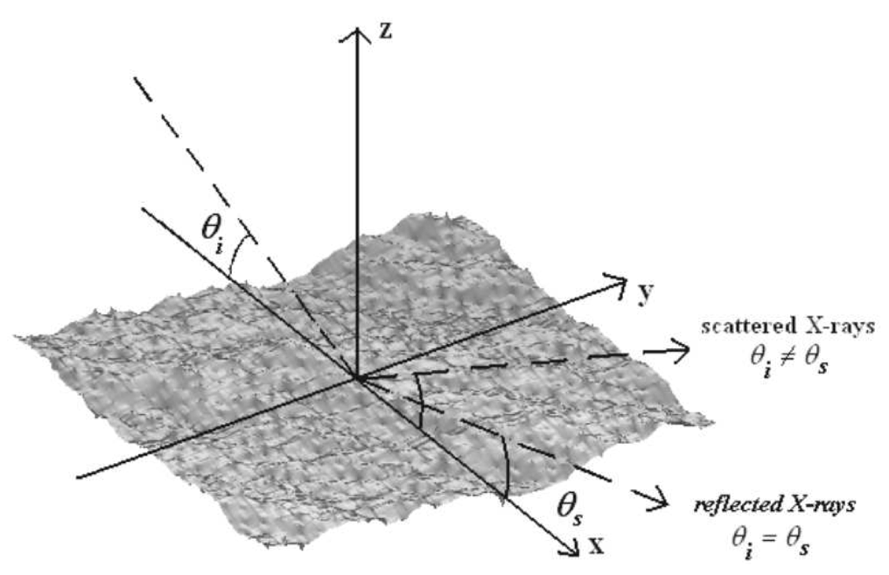
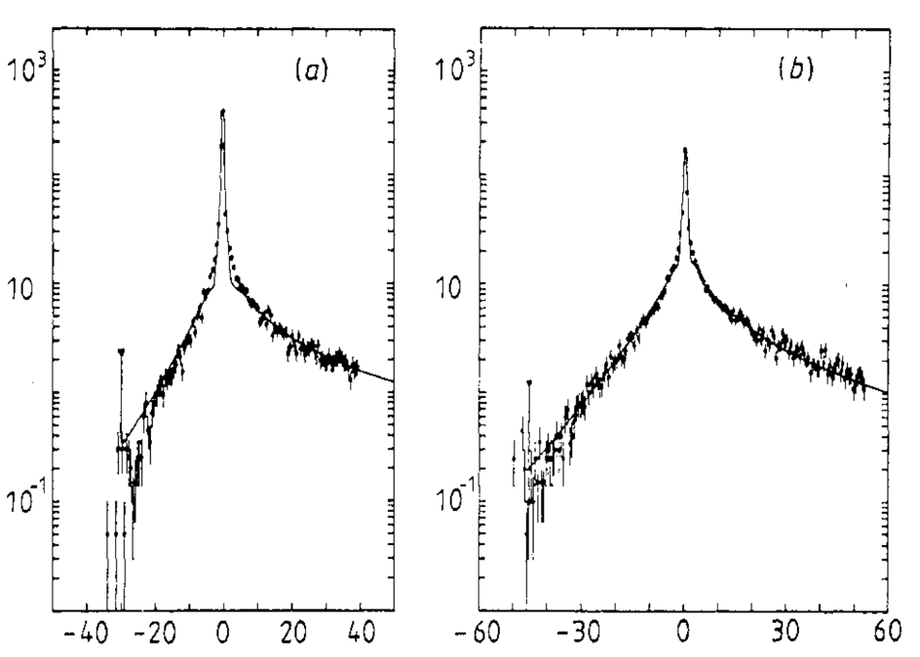
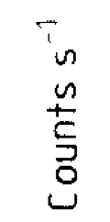
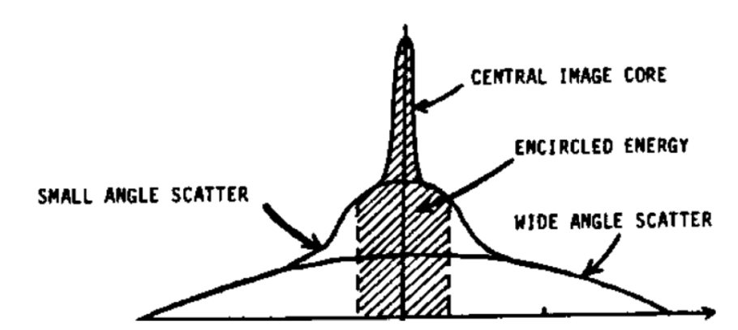

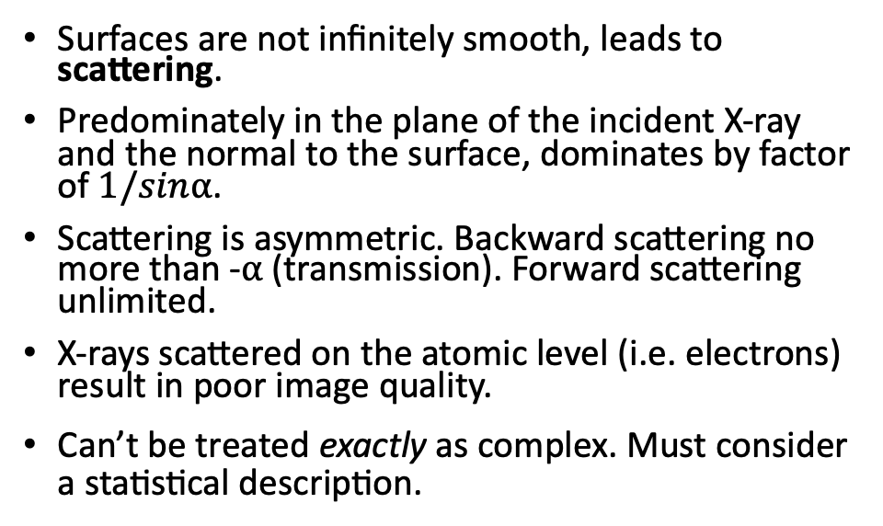


D.Spiga A&A, 7228, 2007 https://arxiv.org/pdf/0704.1612.pdf
Reflection - Scattering
X-rays:
Surfaces are not infinitely smooth, leads to scattering.
Predominately in the plane of the incident X-ray and the normal to the surface, dominates by factor of $1/sin$⍺.
Scattering is asymmetric. Backward scattering no more than -$⍺$ (transmission). Forward scattering unlimited.
X-rays scattered on the atomic level (i.e. electrons) result in poor image quality.
$\text{Can}\text{’}\text{t} \text{be} \text{treated} \text{exactly} \text{as} \text{complex}\text{. }\text{Must} \text{consider} \text{a} \text{statistical} \text{description}\text{.}$
$θ$_{i} = ⍺
Scattering Distributions at 9.3 keV on “Kanigen” (90% Ni, 10% P)
Adapted from: Lenzen,R.,1978
PhD Thesis Universitat Munchen
$⍺$=0.5°
$⍺$=0.75°

Slide 11
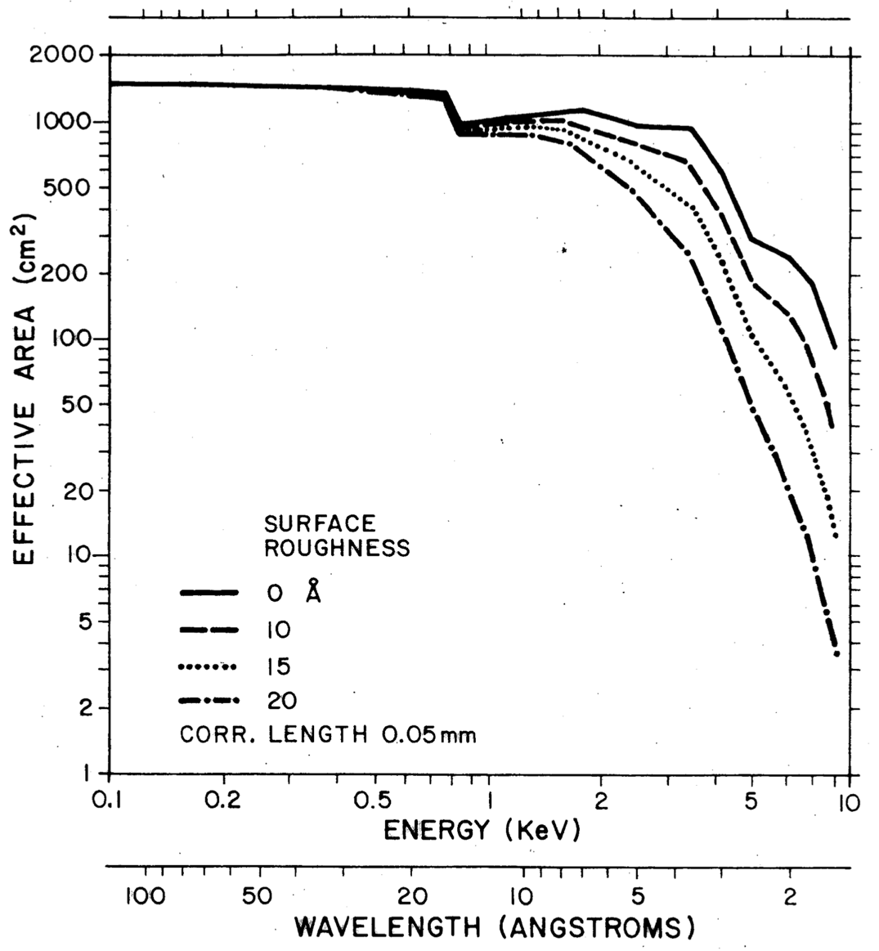
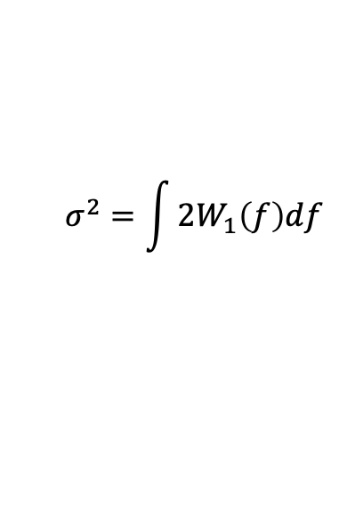
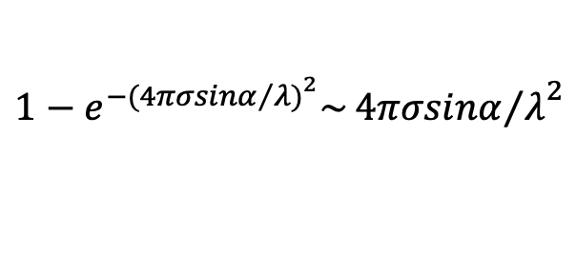
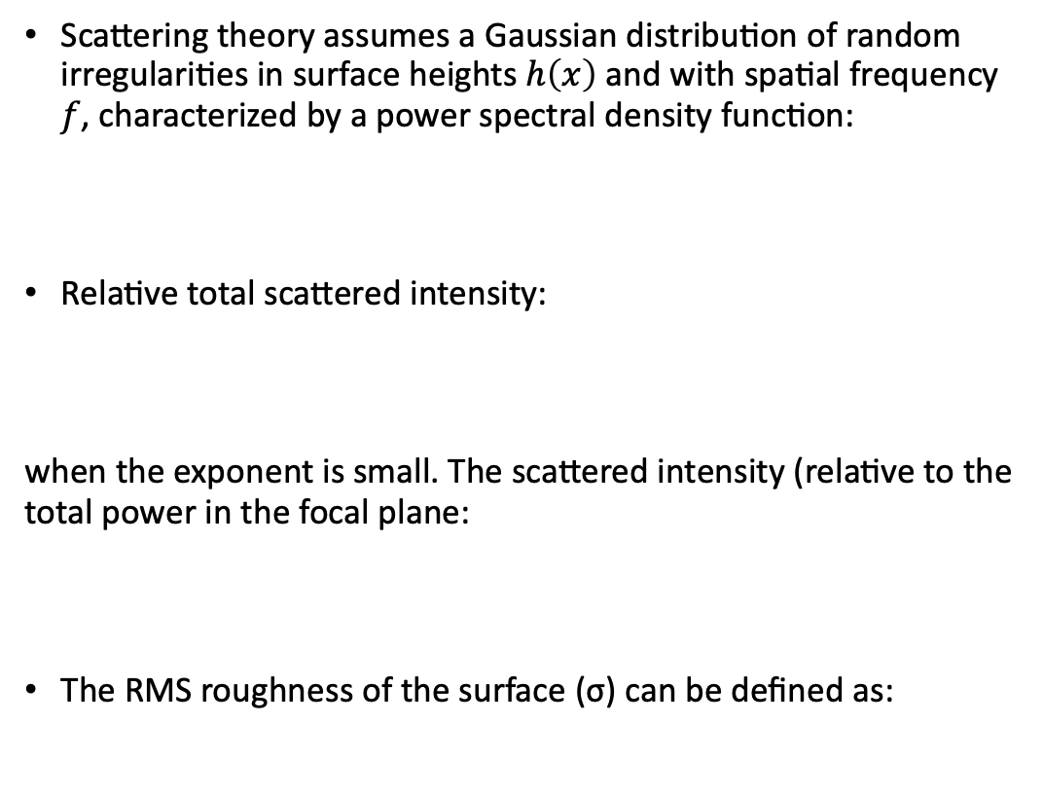

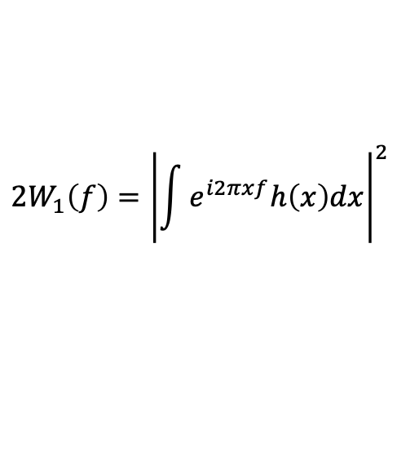
Reflection - Scattering
Scattering theory assumes a Gaussian distribution of random irregularities in surface heights $h\left(x\right)$ and with spatial frequency 𝑓, characterized by a power spectral density function:
Relative total scattered intensity:
when the exponent is small. The scattered intensity (relative to the total power in the focal plane:
The RMS roughness of the surface (σ) can be defined as:
$$2W_{1}\left(f\right)={\left|\int{e^{i2πxf}h\left(x\right)dx}\right|}^{2}$$
$$1−e^{−{{(4πσsinα}/{λ)}}^{2}}\sim {{4πσsinα}/λ}^{2}$$
$ψ\left(ε\right)=2W_{1}\left(f\right)$8$π{(sinα)}^{4}/fλ^{4}$
$$σ^{2}=\int{2W_{1}\left(f\right)df}$$
More info:
Aschenbach, B. 1985, Rep. Prog. Phys. 48, 579;
https://doi.org/10.1088/0034-4885/48/5/001

Slide 12
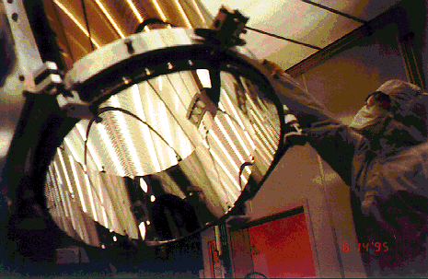
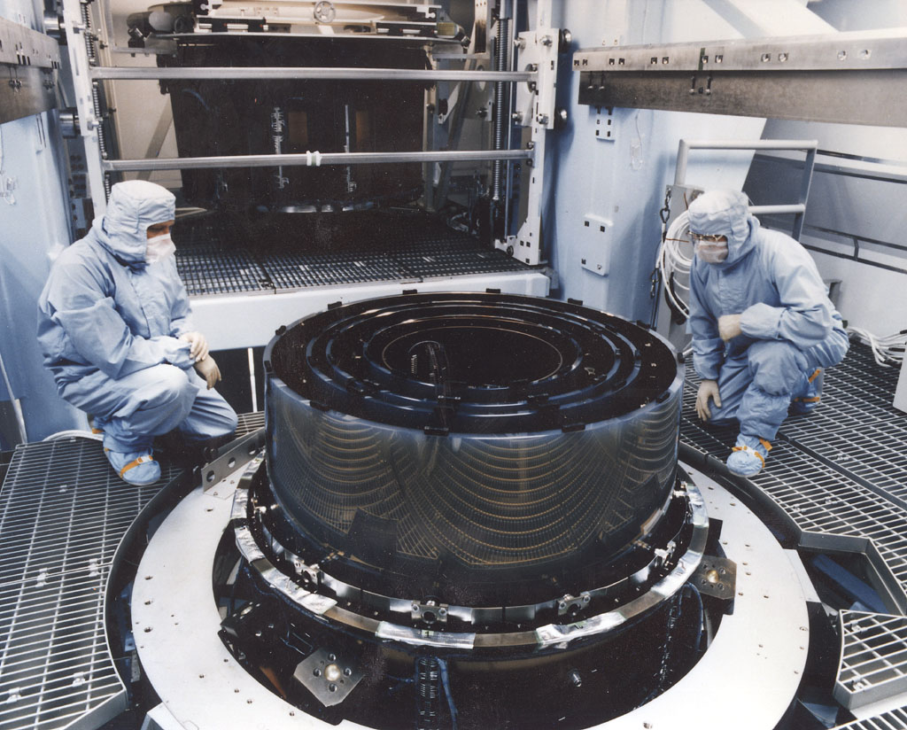
Reflection - Scattering
No perfect interface from a vacuum to infinitely thick reflecting layer
  i.e. Chandra mirrors. Cr to hold Ir reflecting layer to Zerodur glass mirror substrate.
  Unwanted but inadvertent overcoat of contamination!
More on telescopes in the next presentation…
Credit: CXC/SAO/NASA

Slide 13






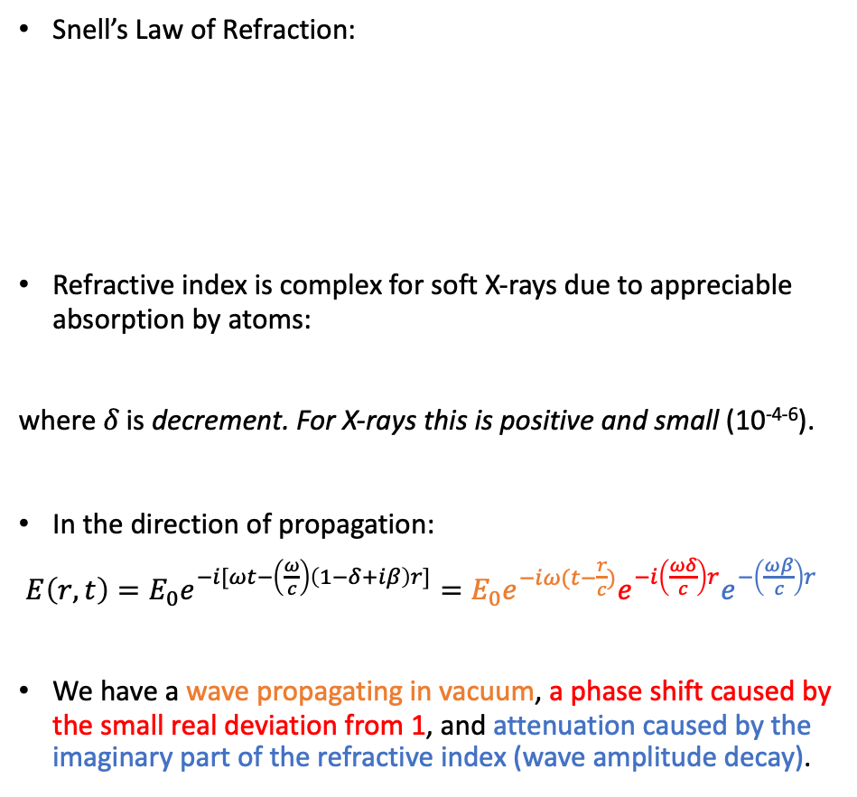

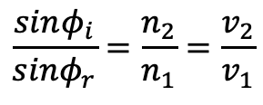






Refraction
$θ$ is the grazing angle, < $θ_{c}$
z
Refracted
wave
Snell’s Law of Refraction:
Refractive index is complex for soft X-rays due to appreciable absorption by atoms:
where 𝛿 is decrement. For X-rays this is positive and small (10⁻⁴⁻⁶).
In the direction of propagation:
$E\left(r,t\right)=E_{0}e^{−i[ωt−\left(\frac{ω}{c}\right)\left(1−δ+iβ\right)r]}=E_{0}e^{−iω(t−\frac{r}{c})}e^{−i\left(\frac{ωδ}{c}\right)r}e^{−\left(\frac{ωβ}{c}\right)r}$
We have a wave propagating in vacuum, a phase shift caused by the small real deviation from 1, and attenuation caused by the imaginary part of the refractive index (wave amplitude decay).
$$φ^{′}$$
k’
$$\frac{sinφ_{i}}{sinφ_{r}}=\frac{n_{2}}{n_{1}}=\frac{v_{2}}{v_{1}}$$
$$n=1−δ+iβ$$
n=1
Vacuum
$$θ$$
x
$$φ$$
Where $n_{i}=\frac{c}{v_{i}} and<1 (X−rays).$
$${φ′}^{′}$$
k’’
k
Reflected
wave
Incident
wave
$$n=1−δ+iβ,$$
Incident Wave:
Reflected Wave:
Refracted Wave:
$$E=E_{0}e^{−i(ωt−k∙r)}$$
$$E^{′}=E_{0}^{′}e^{−i(ωt−k^{′}∙r)}$$
$$E^{′′}=E_{0}^{′′}e^{−i(ωt−k^{′′}∙r)}$$
All the waves have same frequency (ω) and |k| as:
$$\left|k\right|=\left|k^{′′}\right|=\frac{ω}{c}$$
Refracted wave has phase velocity:
$$V_{φ}=\frac{ω^{′}}{k^{′}}=\frac{c}{n}, thus \left|k\right|=\left|k^{′′}\right|=\frac{ω}{c}(1−δ+iβ)$$

Slide 14
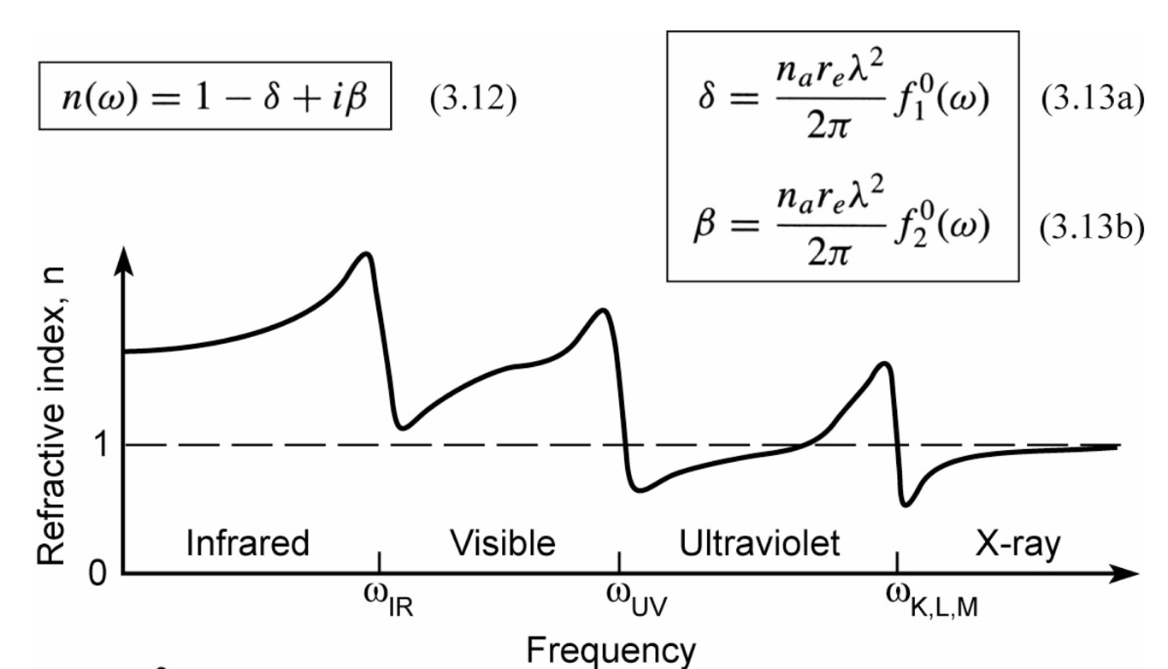
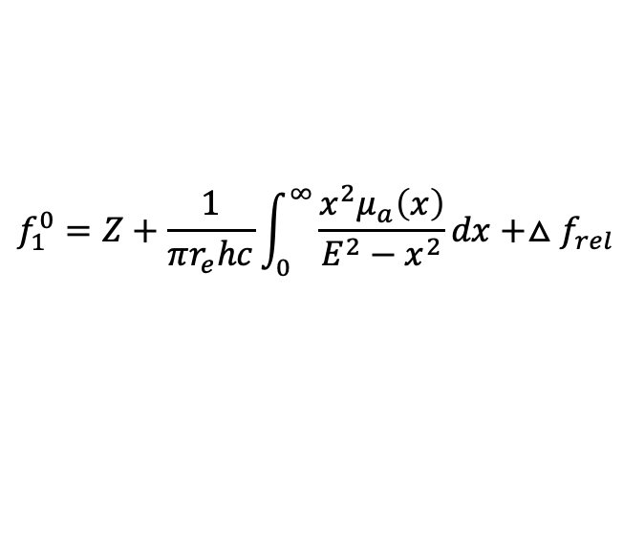
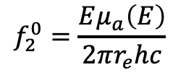
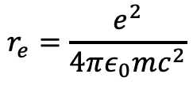
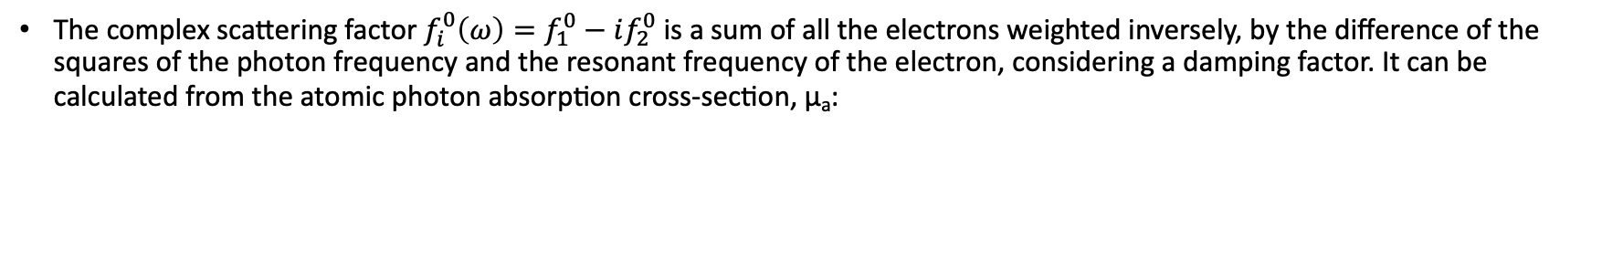
Refraction
Where, n_{a} is Avogadro’s number and r_{e} is the classical electron radius, defined as:
$$r_{e}=\frac{e^{2}}{4πε_{0}mc^{2}}$$
The complex scattering factor $f_{i}^{0}\left(ω\right)=f_{1}^{0}−if_{2}^{0}$ is a sum of all the electrons weighted inversely, by the difference of the squares of the photon frequency and the resonant frequency of the electron, considering a damping factor. It can be calculated from the atomic photon absorption cross-section, µ_{a}:
$$f_{1}^{0}=Z+\frac{1}{πr_{e}hc}\int_{0}^{∞}{\frac{x^{2}μ_{a}\left(x\right)}{E^{2}−x^{2}}dx+△f_{rel}}$$
$$f_{2}^{0}=\frac{Eμ_{a}\left(E\right)}{2πr_{e}hc}$$
Kramer-Kronig Relations
where $∆f_{rel}$ is a relativistic correction term which is negligible in the soft X-ray range
D. Attwood, UC Berkeley (2009) https://people.eecs.berkeley.edu/~attwood/sxr2009/lecnotes/04_Reflection_And_Refraction_2009.pdf
Aschenbach, B. 1985, Rep. Prog. Phys. 48, 579; https://doi.org/10.1088/0034-4885/48/5/001

Slide 15
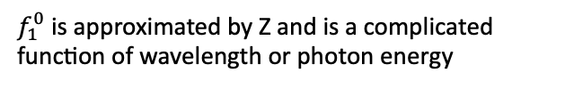

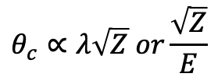

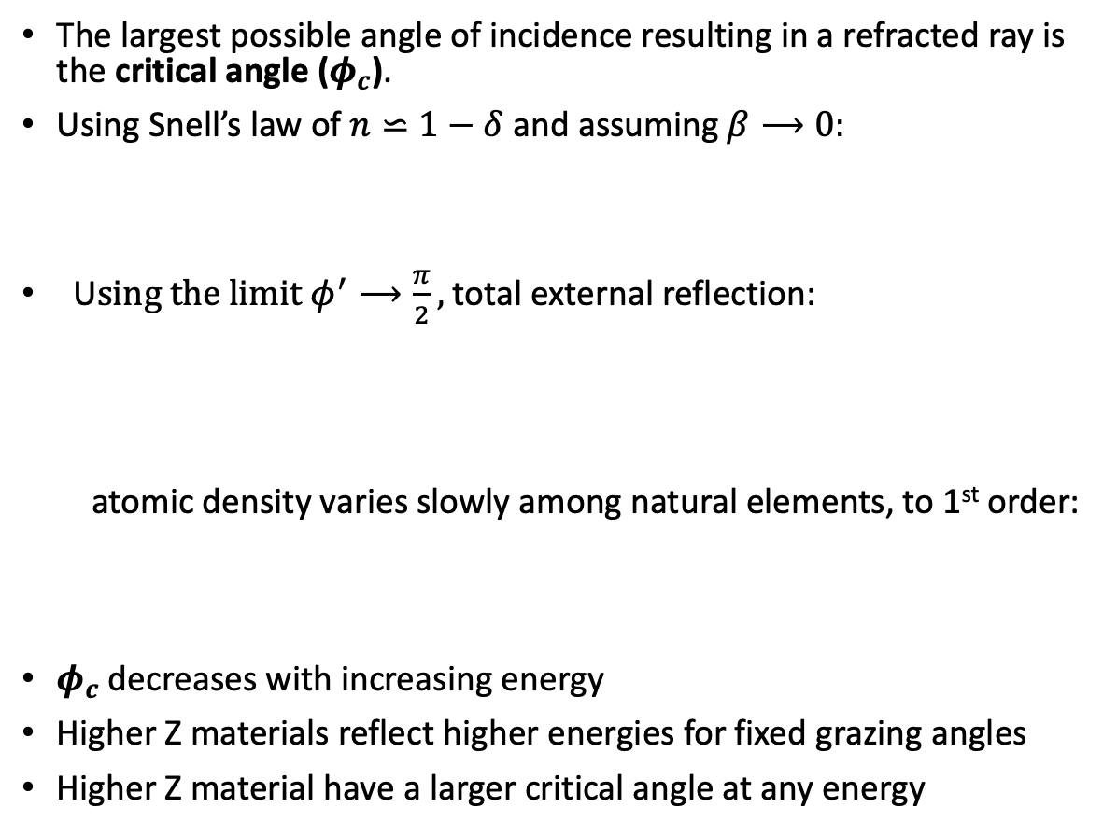

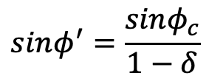



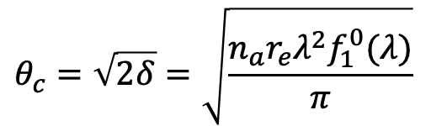

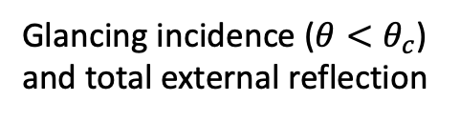
Critical Grazing Angle
z
$φ^{′}>$ $φ$
Refracted
wave
The largest possible angle of incidence resulting in a refracted ray is the critical angle ($φ_{c}$).
Using Snell’s law of $n⋍1−δ$ and assuming $β⟶0:$
U$sing the limit φ^{′}⟶\frac{π}{2},$ total external reflection:
  atomic density varies slowly among natural elements, to 1st order:
$φ_{c}$decreases with increasing energy
Higher Z materials reflect higher energies for fixed grazing angles
Higher Z material have a larger critical angle at any energy
$$φ^{′}$$
$$θ+φ=90°$$
$$θ$$
x
$$sinφ^{′}=\frac{sinφ_{c}}{1−δ}$$
$$φ$$
k
Incident
wave
$$θ_{c}=\sqrt{2δ}=\sqrt{\frac{n_{a}r_{e}λ^{2}f_{1}^{0}(λ)}{π}}$$
$$θ<θ_{c}$$
$$θ_{c}$$
Totally
reflected
wave
$$θ_{c}∝λ\sqrt{Z} or\frac{\sqrt{Z}}{E}$$
Critical ray
$f_{1}^{0}$ is approximated by Z and is a complicated function of wavelength or photon energy
Glancing incidence ($θ<θ_{c}$) and total external reflection

Slide 16
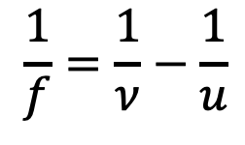
Lenses
Concave “Converging” mirror
Wolter-I telescope like a positive convex lens.
Normal incidence optical telescopes concave mirrors.
Lens Maker’s Equation:
Magnification is just the ratio of the image distance to object distance.
F
Converging (Convex) lens
$$\frac{1}{f}=\frac{1}{ν}−\frac{1}{u}$$
F
𝑓
𝑓
Source
Detector/Image
Optic
Magnification =V/U
i.e. 7200/720=10x
U (i.e. 720 mm)
V (i.e. 7200 mm)

Slide 17
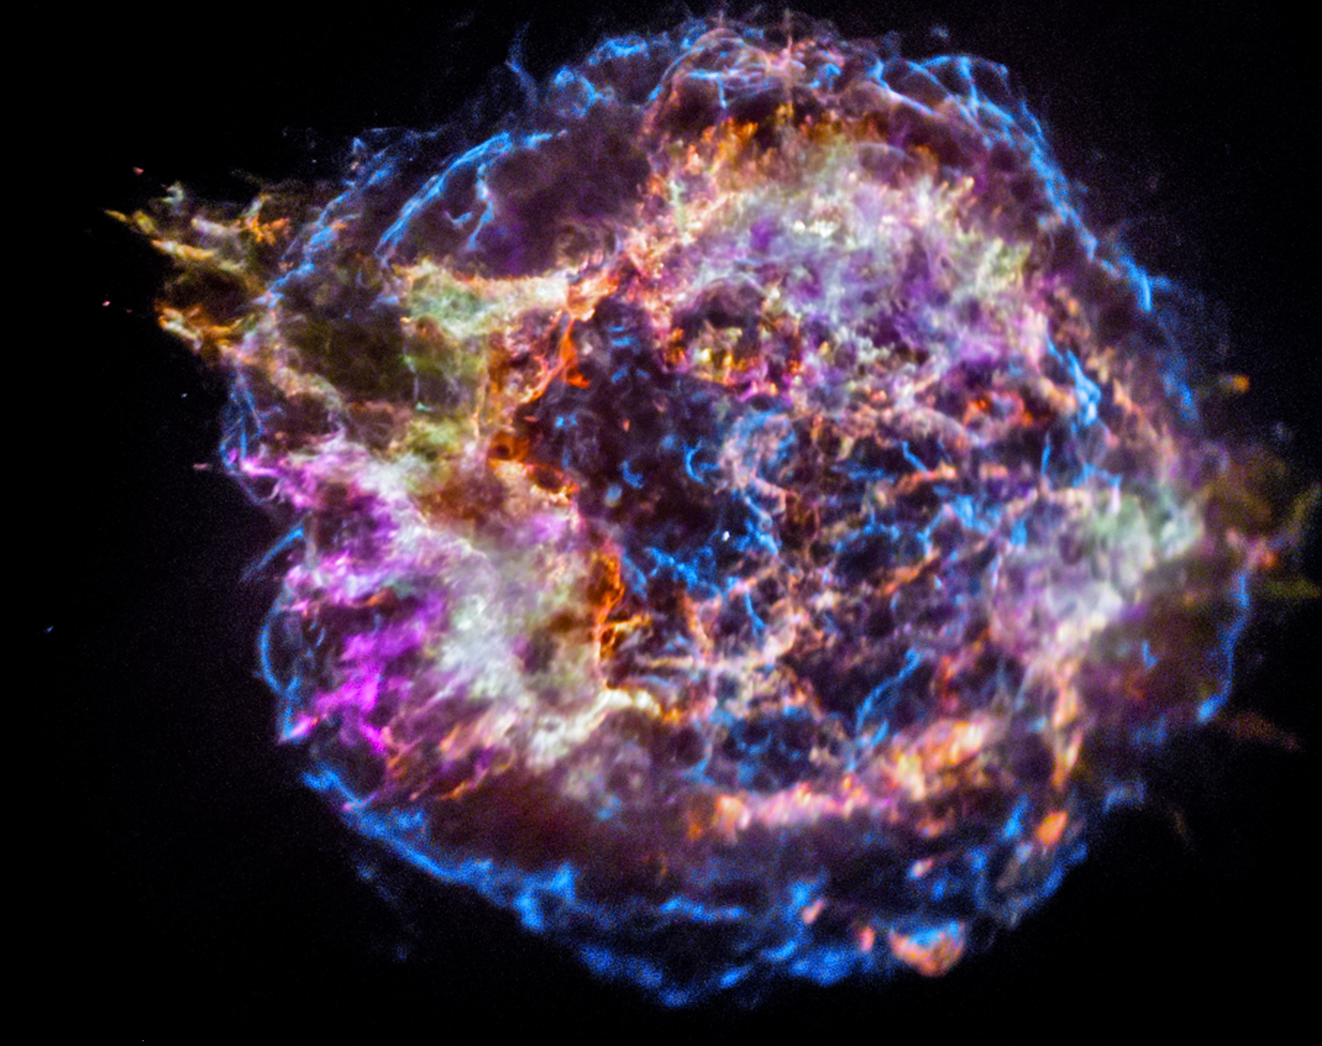
Physical
(Wave) Optics
Credit: Nasa

Slide 18
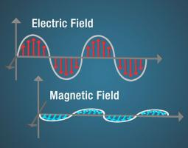
Physical (Wave) Optics
Particle theory of light doesn’t work when understanding phenomena like interference, diffraction and polarization. We need to treat light like a wave.
Light as an electromagnetic wave with oscillating electrics (E) and magnetic (B) fields perpendicular to each other propagating through space with equal amounts of stored energy.
Credit: NASA
For interactions with matter, the electric component does most the work

Slide 19
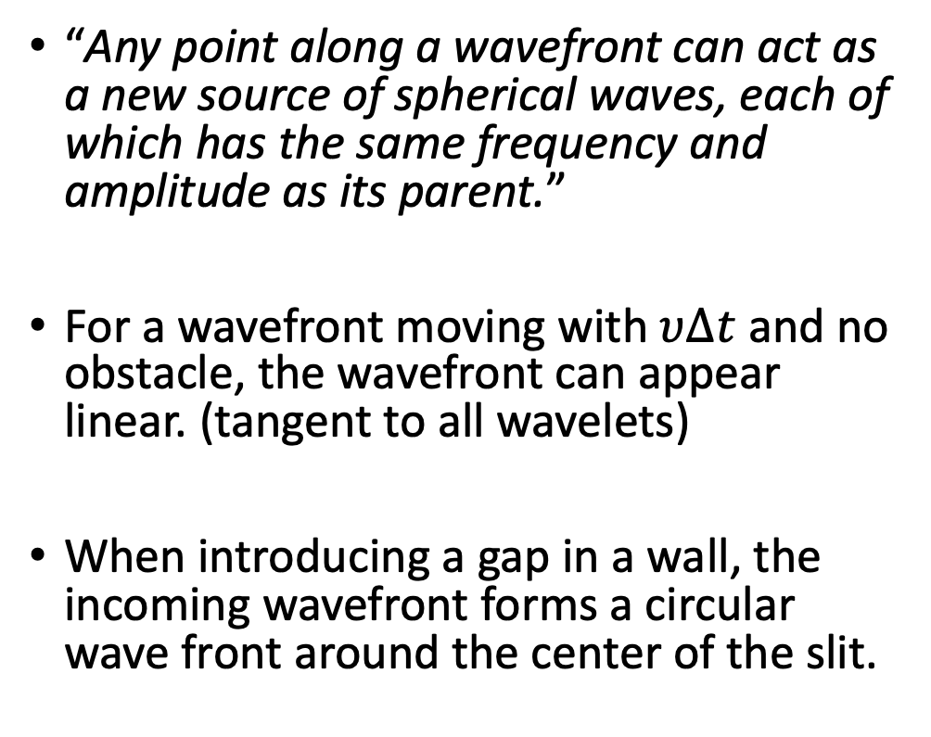
Wave Optics: Huygen’s Principle
“Any point along a wavefront can act as a new source of spherical waves, each of which has the same frequency and amplitude as its parent.”
For a wavefront moving with $υ∆t$ and no obstacle, the wavefront can appear linear. (tangent to all wavelets)
When introducing a gap in a wall, the incoming wavefront forms a circular wave front around the center of the slit.
Propagation
Propagation

Slide 20
Wave Optics: Interference
Screen
Interference of 2 light waves:
  must be in phase with each other (coherent)
  identical wavelengths
Waves through S₁ and S₂ spread out and interfere with each other, producing bright and dark fringes.
Constructive Interference:
  Superposition of waves (from S₁ and S₂) in phase – bright fringe
Destructive Interference:
  Superposition of waves (from S₁ and S₂) out of phase (180°) – dark fringe
S₁
P
Bright
S₂
Screen
S₁
P
S₂
Bright
Q
Screen
S₁
P
S₂
Dark
R

Slide 21
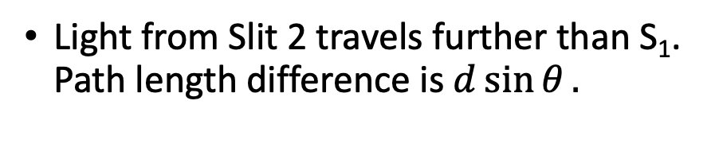
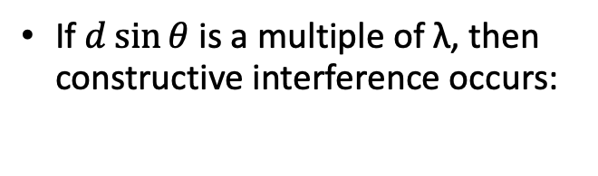

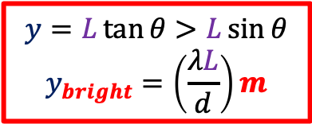
Wave Optics: Constructive Interference
Light from Slit 2 travels further than S₁. Path length difference is $d\sin{θ}.$
$$y=L\tan{θ}>L\sin{θ}$$
$$y_{bright}=\left(\frac{λL}{d}\right)m$$
P
Monochromatic
Light
r₁
𝛉
r₂
y
$$δ=r_{2}−r_{1}=d\sin{θ}$$
λ
S₁
r₁
d
Q
𝛉
𝛿
O
S₂
𝛉
d
r₂
If $d\sin{θ}$is a multiple of λ, then constructive interference occurs:
L
𝛿
Viewing Screen
$$d\sin{θ=mλ m=0,±1,±2,…}$$

Slide 22
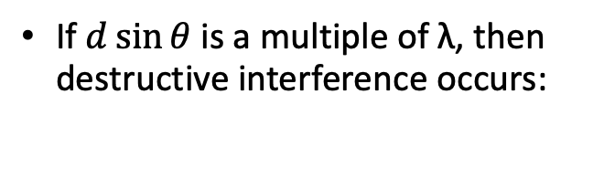
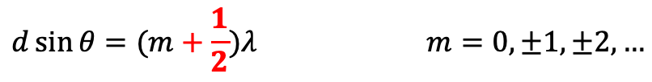
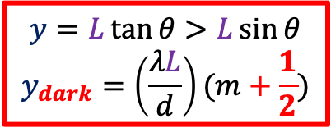
Wave Optics: Destructive Interference
Light from Slit 2 travels further than S₁. Path length difference is $d\sin{θ}.$
$$y=L\tan{θ}>L\sin{θ}$$
$$y_{dark}=\left(\frac{λL}{d}\right)(m+\frac{1}{2})$$
P
Monochromatic
Light
r₁
𝛉
r₂
y
$$δ=r_{2}−r_{1}=d\sin{θ}$$
λ
S₁
r₁
d
Q
𝛉
𝛿
O
S₂
𝛉
d
r₂
If $d\sin{θ}$is a multiple of λ, then destructive interference occurs:
L
𝛿
Viewing Screen
$$d\sin{θ=(m+\frac{1}{2})λ m=0,±1,±2,…}$$

Slide 23
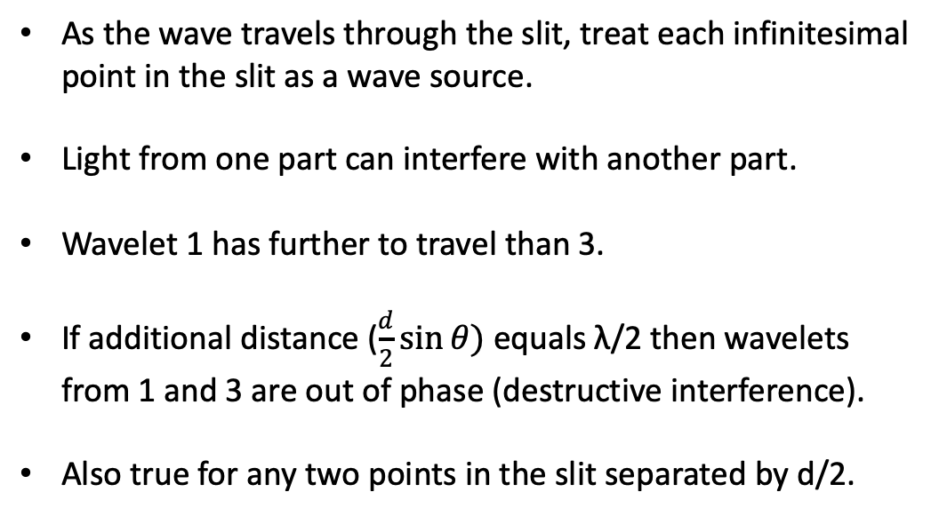

Wave Optics: Diffraction
No-one has ever been able to define the difference between interference and diffraction satisfactorily. It is just a question of usage, and there is no specific, important physical difference between them. The best we can do, roughly speaking, is to say that when there are only a few sources, say two, interfering, then the result is usually called interference, but if there is a large number of them, it seems that the word diffraction is more often used.
– Richard Feynman.
As the wave travels through the slit, treat each infinitesimal point in the slit as a wave source.
Light from one part can interfere with another part.
Wavelet 1 has further to travel than 3.
If additional distance ($\frac{d}{2}\sin{θ)}$ equals λ/2 then wavelets from 1 and 3 are out of phase (destructive interference).
Also true for any two points in the slit separated by d/2.
5
4
λ
3
2
d
d/2
𝛉
1
d/2
$$\frac{d}{2}sin θ$$

Slide 24

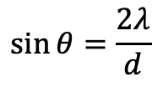
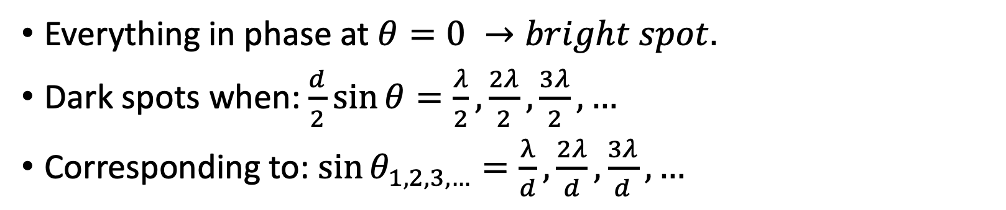
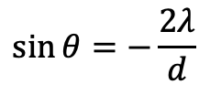


y₂
$$\sin{θ=\frac{2λ}{d}}$$
𝛉 _{MAX,0} =0
y₁
$$\sin{θ=\frac{λ}{d}}$$
d
$$\sin{θ=0}$$
𝛉
𝛿
𝛉
-y₁
𝛉 _{MIN,0}
$$\sin{θ=−\frac{λ}{d}}$$
λ
𝛉 _{MAX,1}
L
$$\sin{θ=−\frac{2λ}{d}}$$
-y₂
Everything in phase at $θ=0 →bright spot.$
Dark spots when: $\frac{d}{2}\sin{θ=\frac{λ}{2},\frac{2λ}{2},\frac{3λ}{2},…}$
Corresponding to: $\sin{θ_{1,2,3,…}}=\frac{λ}{d},\frac{2λ}{d},\frac{3λ}{d},…$

Slide 25





Wave Optics: Diffraction
Multiple slits is a diffraction grating.
Interference between each diffracted wave.
Path length difference between light passing through different slits.
  Results in bright/darks spots.
The more slits in the grating, the sharper the interference peaks.
$$m −2 −1 0 1 2$$
$$−\frac{2λ}{d}−\frac{λ}{d} 0 \frac{λ}{d} \frac{2λ}{d}$$
$$δ=r_{2}−r_{1}=d\sin{θ}$$
$$\sin{θ ⟶}$$

Slide 26



Interference - Multilayers
n_{a}(z)
A
Satisfies Braggs Equation:
B
d
$$\sin{θ=\frac{\frac{k_{d}}{2}}{k_{i}}}$$
A
B
$$mλ=2d\sin{θ}$$
A
B
k_{i}
A
$$k_{d}=\frac{2π}{d}z_{0}$$
𝜽
2𝜽
k_{i}
k_{s}
k_{s}
z

Slide 27


Periodic Grading
Interference - Multilayers
High reflectivity multilayer coatings require:
  Change in refractive index at layer edges (sharp interface for scattering- absorption edge/glancing angle)
  Minimal absorption in low-Z material
  Thin high-Z layer (minimize absorption)
  Chemical and thermal stability for each layer
  Minimal roughness and diffusion at interfaces
  No outgassing in vacuum
  Uniform coating
Non-periodic (depth) Grading
λ_{max} -------------- λ_{min}
𝛉
d_{max}
d_{min}

Slide 28


Interference – Coating Multilayers
D. Attwood, UC Berkeley (2009)
DC Magnetron sputtering reliably deposits coatings with excellent uniformity and predictable center wavelength
Changing table velocity provides precision control of radial thickness distribution and absolute film thickness
Substrate spins independently and quickly about its own axis for azimuthal uniformity.
Bajt, S. et al. (2001). Improved reflectance and stability of Mo/Si multilayers. Proc SPIE. 4506. 65-75. DOI: 10.1117/12.450946.

Slide 29






λ
Interference – Mo/Si
n=1
Ru Capping Layer
Si
B₄C
$$n=1−δ_{Si}+iβ_{Si}$$
d
$$n=1−δ_{Mo}+iβ_{Mo}$$
λ = 13.4 nm
Molybdenum as the “scattering layer”
Silicon as the non-absorbing “spacer”
Complex refractive index of each material plays a role in the reflection process
Higher photon energies are absorbed in Si, lower photon energies (longer λ) are not.
For Mo/Si, typically >13.4 nm (>92.5 eV)
$Γ=\frac{∆t_{Mo}}{∆t_{Mo}+∆t_{Si}}=\frac{∆t_{H}}{d}$
Mo
Ru (1.70 nm)
Si (4.14 nm)
B₄C (0.2 5 nm)
Mo (2.09 nm)
B₄C (0.40 nm)
d = 6.88 nm
𝚪 = 0.34
Substrate
$$n_{Si}=1−6.6×{10}^{−5}+i 1.8×{10}^{−3}$$
$$n_{Mo}=0.924+i 7.4×{10}^{−3}$$
Bajt et al. (2001). Improved reflectance and stability of Mo/Si multilayers.
Proc SPIE. 4506. 65-75. 10.1117/12.450946.

Slide 30



Polarization
Longitudinal Wave (i.e. Sound)
Rarefaction
Compression
Polarization is a property of a transverse wave (oscillation direction perpendicular to direction of motion), such as electromagnetic (EM) waves.
EM waves consist of a coupled, oscillating electric field, always perpendicular to each other.
Polarized EM waves: vibrations of the E-field lie along one single plane.
Unpolarized EM waves: superposition of many beams in the same direction of propagation but each with random polarization.
λ
Energy/Time
Displacement
λ
Transverse Wave (i.e. Light)
Peak
E
Amplitude
Energy/Time
E
Trough

Slide 31

Polarization
Credit: Siblini, Ali. (2017). Optimization of Antenna ARMA (Agile Matrix Antenna radiating by pixel elaborated with Meta-material) For beam forming for the RFID and Radar Applications.

Slide 32





Linear Polarization
Linear polarization
  Pane of the electric field doesn’t change as the wave propagates.
  characterized by polarization angle (χ) and fraction (π)
Consider a wave moving along the z-axis, and the electric field lies in the y-z plane. The wave is linearly polarized along the y-axis.
Smith, D.G., (2013),
https://doi.org/10.1117/3.883971.ch9
The electric field components along the x and y axes are:
where, $ω=2πν$ (angular frequency) and $β=\frac{2π}{λ}$ (wave number)
y
$$E_{x}=0$$
E₂
$$\vec{E}$$
$$E_{y}=E_{2}cos⁡(ωt−βz)$$
E₁=0
z
x

Slide 33







Linear Polarization
Electric field vector E is the vector sum of the E_{x} and E_{y} components:
where,
Consider a case where E lies in a plane between y-z and x-z at inclination ⍺, w.r.t to the x-axis. E_{x} and E_{y} become:
The ratio of E_{y} to E_{x} is:
Credit: NASA
$$\vec{E}=\vec{E_{x}}+\vec{E_{y}}$$
$$E_{x}=E_{1}\sin{(ωt−βz)}$$
$$E_{y}=E_{2}\sin{(ωt−βz)}$$
$$E_{x}=E cos⁡(α)$$
Green: Magnetic field
Yellow: Electric field
$$E_{y}=E\sin{(α)}$$
NB: For linear polarization:
  Phase difference between E_{x} and E_{y} = 0
  Magnitudes of E_{x} and E_{y} can be different
$$\frac{E_{y}}{E_{x}}=\tan{α}$$

Slide 34









Circular Polarization
If magnitudes of E_{x} and E_{y} are the same, but there is a phase difference of $\frac{π}{2}$ or $−\frac{π}{2},$ the tip of $\vec{E}$ vector traces a circle. Wave is circularly polarized (either right-handed or left-handed (E_{y} is -ve).
Phase shift of $\frac{λ}{4}$. Quarter-wave plate converts polarization from linear to circular and vice versa. Electric fields expressed as:
Miller, J.L., Physics Today 72, 4, 17 (2019);
https://doi.org/10.1063/PT.3.4178
$$E_{x}(z,t)=E_{1}\sin{(ωt−βz)}$$
$$E_{y}(z,t)=E_{2}\sin\left(ωt−βz + δ\right), δ=±\frac{π}{2}$$
y
E₂
$$→E(z,t)=E_{2}\cos\left(ωt−βz\right)$$
$$\vec{E}$$
$Axial ratio=$ $\frac{Major axis}{Minor axis}=\frac{\left|E_{y}\right|}{\left|E_{x}\right|}=\frac{E_{2}}{E_{1}}=1$
x
z
E₁
NB: Axial ratio always unity
$$∴ \vec{E}=\vec{e_{x}}E_{1}\sin\left(ωt−βz\right)+\vec{e_{y}}E_{2}\sin\left(ωt−βz±\frac{π}{2}\right)$$

Slide 35







Elliptical Polarization
If the magnitudes of Ex and Ey are not equal, and there is a phase difference between the two components, the tip of $\vec{E}$ maps an ellipse. The wave is elliptically polarized (linear + circular polarization).
The electric fields are:
*
$$E_{x}=E_{1}\sin{(ωt−βz)}$$
$$E_{y}(z,t)=E_{2}\sin\left(ωt−βz + δ\right), δ≠0$$
$Axial ratio=$ $\frac{Major axis}{Minor axis}=\frac{\left|E_{y}\right|}{\left|E_{x}\right|}=\frac{E_{2}}{E_{1}}≠1$
y
E₂
$$\vec{E}$$
NB: $\left|E_{y}\right|≠\left|E_{x}\right|,∴E_{2}≠E_{1}$
$$∴ \vec{E}=e_{x}E_{1}\sin\left(ωt−βz\right)+e_{y}E_{2}\sin\left(ωt−βz+δ\right)$$
x
z
E₁
Circular polarization is similar to elliptical polarization, where $E_{2}=E_{1},δ=±\frac{π}{2}$ and the axial ratio is unity.
* Image Credit: Laurent Ferro-Famil, Eric Pottier, Microwave Remote Sensing of Land Surface, Figure 2a, 2016, Elsvier

Slide 36

Polarization Ellipse
y
E₀
Any complete polarization resulting from a coherent source can be analysed using a polarization ellipse, drawn by tip of E-Field.
$χ or ε$ is the angle of ellipticity
$ψ or τ$ is the tilt or orientation angle
E₂
A
E_{y}
E
𝛆
O
𝜏
𝛾
x
E_{x}
E₁
Semi-Minor Axis
B
Tilt angle, 𝜏
Semi-Major Axis
Polarization Ellipse

Slide 37











y
E₀
Polarization Ellipse
E₂
E_{y}
A
E
Generic form of E:
𝛆
$$\vec{E}=e_{x}E_{1}\sin\left(ωt−βz\right)+e_{y}E_{2}\sin\left(ωt−βz+δ\right)$$
O
𝜏
At z=0 in x-y plane:
𝛾
x
E_{x}
E₁
$$E_{x}=E_{1}\sin\left(ωt\right) or \sin{ωt=\frac{E_{x}}{E_{1}}}$$
Semi-Minor Axis
B
Tilt angle, 𝜏
$$E_{y}=E_{2}\sin\left(ωt+δ\right) or \sin{ωt\cos{δ+\cos{ωt\sin{δ}}} =\frac{E_{y}}{E_{2}}}$$
Semi-Major Axis
Polarization Ellipse
Substituting:
NB:
$$β=\frac{2π}{λ}$$
$$\frac{E_{y}}{E_{2}}=\frac{E_{x}}{E_{1}}\cos{δ+\sqrt{1−{\left(\frac{E_{x}}{E_{1}}\right)}^{2}}\sin{δ →\sqrt{1−{\left(\frac{E_{x}}{E_{1}}\right)}^{2}}\sin{δ= \frac{E_{y}}{E_{2}}−\frac{E_{x}}{E_{1}}\cos{δ}}}}$$
$ω=2πν$
$δ$=phase shift
Can be rewritten:
Simplify and square:
$$aE_{x}^{2}+bE_{x}E_{y}+cE_{y}^{2}=1, where:$$
${\left(\frac{E_{x}}{E_{1}}\right)}^{2}−2\left(\frac{E_{x}}{E_{1}}\right)$ $\left(\frac{E_{y}}{E_{2}}\right)\cos{δ}+{\left(\frac{E_{y}}{E_{2}}\right)}^{2}=\sin^{2}δ$
$$a=\frac{1}{E_{1}^{2}\sin^{2}δ},$$
$$b=\frac{2\cos{δ}}{E_{1}E_{2}\sin^{2}δ},$$
$$c=\frac{1}{E_{2}^{2}\sin^{2}δ},$$

Slide 38



y
E₀
Polarization Ellipse
E₂
A
E_{y}
E
Any complete polarization resulting from a coherent source can be analysed using a polarization ellipse, drawn by tip of E-Field.
$χ or ε$ is the angle of ellipticity
$ψ or τ$ is the tilt or orientation angle
𝛆
O
𝜏
𝛾
x
E_{x}
E₁
Semi-Minor Axis
Tilt angle, 𝜏
B
Semi-Major Axis
Polarization Ellipse
$$Axial Ratio \left(AR\right)=\frac{OA}{OB}= \frac{\left|E\right|\frac{\sqrt{1+\sqrt{1−\sin^{2}\left(2θ\right)\sin^{2}β}}}{2}}{\frac{\sqrt{1−\sqrt{1−\sin^{2}\left(2θ\right)\sin^{2}β}}}{2}}, 1≤AR≤∞$$
$γ=\arctan\left(\frac{E_{2}}{E_{1}}\right), 0°≤γ≤90°$
$$ε=\operatorname{arccot}{(±AR)}, −45°≤ε≤+45°$$

Slide 39













Poincare Sphere
V
M(𝜀,𝜏)
P(𝛾,𝛿)
Right Cir. Pol.
$2ε=−90$
Spherical surface occupied by completely polarized states, where the longitude and latitude are related to the polarization ellipse.
$Ip, 2τ and 2ε$are spherical coordinates of the 3D vector of cartesian coordinates (S₁, S₂, S₃).
I is the total beam intensity
p is the polarization degree
Linear polarization (90)
$$ε=0, 2τ=180$$
Linear polarization (0)
$ε=τ=0$
2𝛾
Latitude
U
2𝜀
Linear polarization (45)
$$ε=0, 2τ=90$$
Q
2𝜏
Longitude
Equator
Pole
Adapted from Ainouz, Samia et al.. (2006).
Optics express. 14. 5916-27. 10.1364/OE.14.005916.
Longitude = 2𝜏
Latitude = 2𝜀
Great circle angle = 2𝛾
Equator to GCA = 𝛿
$$p=\frac{\sqrt{S_{1}^{2}+S_{2}^{2}+S_{3}^{2}}}{S_{0}}$$
$$S_{0}=I$$
$$S_{1}=Ip\cos{2τ\cos{2ε}}$$
$$S_{2}=Ip\sin{2τ\cos{2ε}}$$
$$2ε=\arctan{\frac{S_{2}}{S_{1}}}$$
$$2τ=\arctan{\frac{S_{3}}{\sqrt{S_{1}^{2}+S_{2}^{2}}}}$$
$$S_{3}=Ip\sin{2ε}$$

Slide 40




Polarization: Stokes Parameters
Stokes Parameters describe the polarization state of EM radiation in terms of total intensity (I), degree of polarization (p) and the shape parameters of the polarization ellipse.
For a classical EM wave that is 100% polarized over short time intervals during the wave period (but whose polarization changes on longer timescales), the Stokes parameters are defined by time averages of the E-field strength. Assuming wave propagation along the z-axis:
E_{x} (E_{y}) is proportional to the E-field along the x-axis (y-axis), and 𝛿 is the lag of E_{y} behind E_{x}.
$$S_{0}=I=\left\langle E_{x}^{2}+E_{y}^{2}\right\rangle$$
$$S_{1}=Q=\left\langle E_{x}^{2}−E_{y}^{2}\right\rangle$$
I is the Intensity/flux of the wave
Q and U depend on the linear polarization properties
$$S_{2}=U=\left\langle 2E_{x}E_{y}\cos{δ}\right\rangle$$
V depends on circular polarization properties
$$S_{3}=V=\left\langle 2E_{x}E_{y}\sin{δ}\right\rangle$$

Slide 41











Stokes Parameters
Adapted from Ainouz, Samia et al.. (2006).
Optics express. 14. 5916-27. 10.1364/OE.14.005916.
V
M(𝜀,𝜏)
P(𝛾,𝛿)
3
Right Cir. Pol.
$2ε=−90$
For a 100% linear polarized wave with an E-field vector along the x-axis (y-axis):
  Q = I (-I)
For a 100% linear polarized wave with an E-field vector along the diagonal between the x- and y-axes (negative x- and y-axes ):
  U = I (-I)
For a 100% circularly right-handed (left-handed) polarized:
  V = I (-I)
Linear polarization (90)
$$ε=0, 2τ=180$$
Linear polarization (0)
$ε=τ=0$
2𝛾
Latitude
U
1
2𝜀
Linear polarization (45)
$$ε=0, 2τ=90$$
Q
2𝜏
2
Longitude
Equator
Pole
1
LP (Hori.)
$$=$$
Q>0, U=0, V=0
Q<0, U=0, V=0
U>0, Q=0, V=0
U<0, Q=0, V=0
V>0, Q=0, U=0
V<0, Q=0, U=0
3
$$=$$
RHCP
2
$$=$$
LP (+45°)
F. Kislat, et al., (2015) Astroparticle Physics, 68, 45-51 https://doi.org/10.1016/j.astropartphys.2015.02.007 .

Slide 42





Stokes Parameters
V
Adapted from Ainouz, Samia et al.. (2006).
Optics express. 14. 5916-27. 10.1364/OE.14.005916.
For a 100% polarized wave:
  $I=\sqrt{Q^{2}+U^{2}+V^{2}}$
For a linearly polarized wave (V=0):
  $I=\sqrt{Q^{2}+U^{2}}$
Q and U given by the polarization direction $ψ$ (angle between the x-axis and E-field direction) by:
  $Q=\cos{2τ}$
  $U=\sin{2τ}$
Implying:
  $\tan{2τ=\frac{U}{Q}}$
Polarization fraction (polarized wave flux):
  $p=\frac{\sqrt{Q^{2}+U^{2}+V^{2}}}{I}$
For V=0, linear polarization fraction is:
  $p=\frac{\sqrt{Q^{2}+U^{2}}}{I}$
M(𝜀,𝜏)
P(𝛾,𝛿)
Right Cir. Pol.
$2ε=−90$
Linear polarization (90)
$$ε=0, 2τ=180$$
Linear polarization (0)
$ε=τ=0$
2𝛾
Latitude
U
2𝜀
Linear polarization (45)
$$ε=0, 2τ=90$$
Q
2𝜏
Longitude
Equator
Pole
$$S_{0}=I=\left\langle E_{x}^{2}+E_{y}^{2}\right\rangle$$
$$S_{1}=Q=\left\langle E_{x}^{2}−E_{y}^{2}\right\rangle$$
$$S_{2}=U=\left\langle 2E_{x}E_{y}\cos{δ}\right\rangle$$
$$S_{3}=V=\left\langle 2E_{x}E_{y}\sin{δ}\right\rangle$$

Slide 43






Polarization
Modulated Term (B)
Response
$$\cos^{2} φ$$
Fit function:
Modulation:
Polarization:
$$M\left(φ\right)=A+B \cos^{2}(φ−φ_{0})$$
Flat Term (A)
$$\frac{M_{max}−M_{min}}{M_{max}−M_{min}}=\frac{B}{B+2A}$$
0
$$2π$$
$$φ$$
$$\frac{1}{μ} \frac{B}{B+2A}$$
µ is the modulation factor, i.e. the modulation for 100% polarized radiation

Slide 44


Polarization: MDP
Polarimeter deals with counting rate statistics
  mainly depends on the modulation factor, µ (response of a polarimeter to a 100% polarized source)
Minimum Detectable Polarization (MDP) at 99% confidence level:
where M is the variation in the signal as a function of azimuthal angle produced by a 100% polarized signal with R_{B} =0, R_{B} is the background count rate. R_{S} is the source count rate and t is the integration time.
If the background is negligible then: $MDP=\frac{4.29}{μ\sqrt{N_{ph}}}$
To reach MDP=1% with µ=0.5: $N_{ph}={\left(\frac{4.29}{( μ × MDP)}\right)}^{2}=7.36 × {10}^{5} ph$
NB: confidence level equivalent is 4.29 → 7.58 for 5σ Gaussian.
$${MDP}_{99}\left(\%\right)=\left[\frac{4.29}{μ{ R}_{s} }\right]×{\left[\frac{(R_{S}+R_{B})}{(t)}\right]}^{1/2}$$
Source detection > 10 photons
Source spectral slope > 100 photons
Source polarization > 100,000 photons

Slide 45




X-ray Polarization (Astronomy)
1972: First astronomical X-ray polarization measurement (Aerobee 350 rocket, Crab Nebula)
  p=15 ± 5%, $θ$=156 ± 10°
1978: Last astronomical X-ray polarization measurement (8th Orbiting Solar Observatory, Crab Nebula)
  Highly significant
  p=19 ± 1%, $θ$=156.4 ± 1.4° (2.6 keV)
2021/2: IXPE (many targets)
  Imaging capabilities will allow to measure pulsar polarization from nebula
Weisskopf, M.C. et al., (1978), 220, L117-121; 10.1086/182648

Slide 46

X-ray Polarization (Astronomy)
Theoretical X-ray polarization
  Cyclotron (Rees, 1975)
  Synchrotron (Westfold, 1959)
  Non-thermal Bremsstrahlung (Brown, 1971)
  Scattering (Sunyaev & Titarchuk, 1985)
  General Relativity (Stark & Connors, 1977)
  Magnetic fields (Gnedin & Sunyaev, 1974)
X-ray polarization highly sensitive tool for:
  Morphology of the source
  geometry of (re-)accreting material
  magnetic field strength
  Spacetime and X-ray propagation
Meyer-Hofmeister, E. et al. A&A, 2005, 431:1, 181-187

Slide 47



Polarization - Instrumentation
Missions in the 70s used Thomson/Bragg polarimeters.
  Bragg polarimetry is dispersive (1 angle at a time)
  Thomson polarimetry is non-imaging and for E𝛾 > 5 keV.
Jump to photoelectric (effect) polarimeters made (more sensitive to polarization).
Electron is ejected from an inner shell. Emission direction is non-uniform, but peaks around the E-field of the photon. Slowed by ionizing collisions and scattered by Coulomb diffusion of nuclei, leaves a string of election-ion pairs in the absorber.
By measuring the angular distribution (modulation curve) of the ejected photo-electron “tracks” (and their direction), we can retrieve the original electron information and the polarization of the photon can be derived.
Cross-section of s-electrons:
Costa, E., Soffitta, P., Bellazzini, R. et al.. Nature 411, 662–665 (2001).
https://doi.org/10.1038/35079508
Credit: NASA
$$\frac{∂σ}{∂Ω}=r_{0}^{2}\frac{Z^{5}}{{137}^{4}}{\left(\frac{mc^{2}}{hν}\right)}^{7/2}\frac{4\sqrt{2\sin^{2}θ\cos^{2}φ}}{{(1−β\cos{θ)}}^{4}}$$
Credit: https://ixpe.msfc.nasa.gov/for_scientists/presentations/Muleri_IXPE_Catiadas.pdf
https://ixpe.msfc.nasa.gov/for_scientists/papers/2017spie_0829_sgro.pdf

Slide 48





Fresnel Equations
The amplitude coefficients of transmission and reflection for s and p polarization (Transverse-Electric [TE] and Transverse-Magnetic [TM]) around infinitely smooth interface of two materials, given by Fresnel equations.
Use Maxwell’s equations, keeping $E_{∥}$ and $H_{∥}$, $D_{⊥}$ and $B_{⊥}$ continuous across the interface.
NB:
E = electric field,
D = electric displacement field,
B = magnetic field,
H = magnetic field strength
Dan Schwartz, NASA/SAO/CXC/ 2007
https://www.astro.umd.edu/~richard/ASTR680/schwartz_optics.pdf

Slide 49




Fresnel Equations
We need to consider polarization to apply the boundary conditions.
The reflected wave amplitude of the parallel component:
The perpendicular component of the electric vector:
The squared amplitudes of the complex numbers $r_{p}$and $r_{s}$ are the reflectivities, such that for unpolarized X-rays the reflectivity becomes:
and $r_{p}≃r_{s}$ for X-rays, since $n≃1.$
$$r_{p}=\frac{{\left|n^{2}\cos{θ}−\sqrt{n^{2}−\sin^{2}θ}\right|}^{2}}{{\left|n^{2}\cos{θ}+\sqrt{n^{2}−\sin^{2}θ}\right|}^{2}}$$
$$r_{s}=\frac{{\left|\cos{θ}−\sqrt{n^{2}−\sin^{2}θ}\right|}^{2}}{{\left|\cos{θ}+\sqrt{n^{2}−\sin^{2}θ}\right|}^{2}}$$
$$\frac{{\left|r_{p}\right|}^{2}+{\left|r_{s}\right|}^{2}}{2}$$
Dan Schwartz, NASA/SAO/CXC/ 2007
https://www.astro.umd.edu/~richard/ASTR680/schwartz_optics.pdf

