Slide 1


CFD Analysis of Space Launch System Solid Rocket Booster Separation within the Langley Unitary Plan Wind Tunnel
James Robert Lee Koch, Ercan Dumlupinar, Jeffrey A. Housman, Cetin C. Kiris
NASA Ames Research Center, Moffett Field, CA, 94035, USA
Mihirkumar M. Patel, Bil Kleb, Greg J. Brauckmann, Stephen J. Alter
NASA Langley Research Center, Hampton, VA, 23681, USA
AIAA Aviation, Aug 02-06 2021
This material is a work of the U.S. Government and is not subject to copyright protection in the United States.

Slide 2
Motivation
Determine capability of CFD to model experimental setups within the high-speed leg of the Langley Unitary Plan Wind Tunnel (LUPWT).
Assess if CFD can predict experimental uncertainty for Space Launch System (SLS) Solid Rocket Booster (SRB) separation.
Two teams (LAVA, FUN3D) unaffiliated to the SLS team perform blind study:
  Find best practices for simulating LUPWT, validating against 1913 flow survey tests.
    Jackson, C. M., Corlett, W. A., and Monta, W. J., “Description and Calibration of the Langley Unitary Plan Wind Tunnel," NASA LARC TP-1905, Hampton, VA, 1981 **
    Childs, R., Stremel, P., Hawke, V., Garcia, J., Alter, S., Hunter, C., Kleb, W., Parikh, P., Patel, M., Rhode, M., and Salari, K., “Flow Characterization of the NASA Langley Unitary Plan Wind Tunnel, Test Section 2: Computational Results,” AIAA Aviation Conference, AIAA, 2021
    Hubbard, E. P. and Houlden, H. P., “Evaluation of CFD as a Surrogate for Wind Tunnel Testing: Experimental Uncertainty Quantification for the UPWT Flow Survey Test," AIAA Aviation Conference, AIAA, 2021
  Find best practices for simulating and SLS SRB separation, run uncertainty quantification database, validating against 1901 test data.
    Wilcox, F. J., Pinier, J. T., Chan, D. T., and Crosby, W. A., “Space Launch System Booster Separation Aerodynamic Testing at the NASA Langley Unitary Plan Wind Tunnel," 54th AIAA Aerospace Sciences Meeting, No. 0796, AIAA, 2016 **
    Winski, C. S., Danehy, P. M., Watkins, N. A., Shea, P. R., Meeroff, J. G., Lowe, T. K., and Houlden, H. P., “Space Launch System Booster Separation Supersonic Powered Testing with Surface and O-body Measurements," AIAA Aviation 2019 Forum, No. 3505, AIAA, 2019 **
    Brauckmann, G. J. and West, T. K., “Booster Separation Environment: Experiment and CFD Uncertainty Estimation Framework," AIAA Aviation Conference, AIAA, 2021
Notes:
This research was motivated by the desire to assess CFD's capability to model the flow inside supersonic wind tunnels such as the Langley Unitary Plan, and predict the uncertainty of experimental results produced by them: in this case from the 1901 test concerning Solid Rocket Booster Separation from the Space Launch System.

Slide 3
CFD Solvers
* Spalart Allmaras with negative turbulence variable provisions,
rotation and curvature correction, and quadratic constitutive relation.
LAVA Curvilinear
  Structured overset
  Modified Roe with Koren limiter and upwind blending
  SA neg RC QCR2000 *
FUN3D
  Unstructured multi-element via ‘Fixed’ or ‘Sketch to Solution’ refinement/adaption
  Combination of dissipative LDFSS and LDRoe
  SA neg RC QCR2000 *

Slide 4
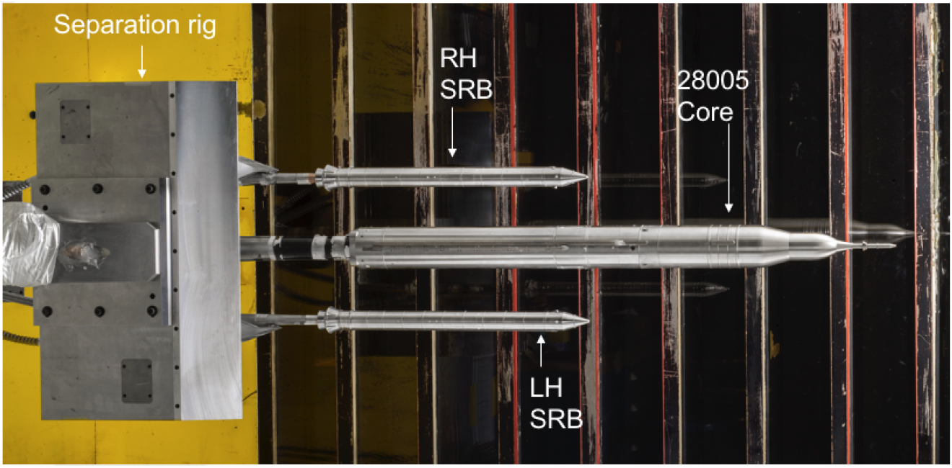
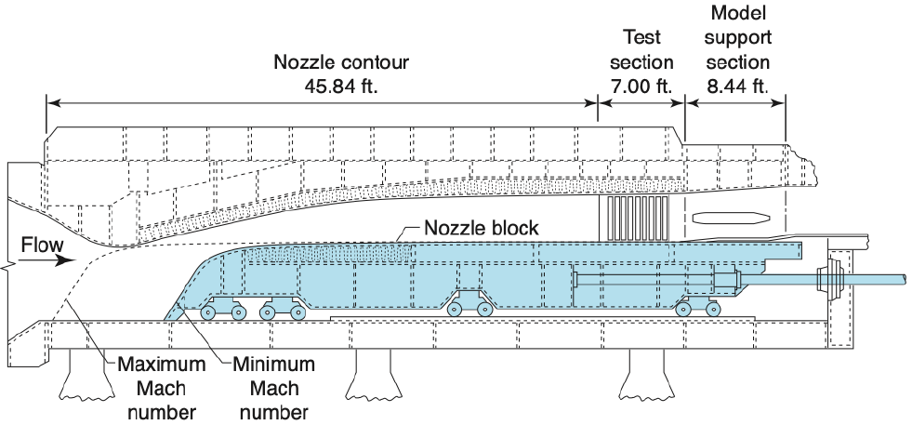
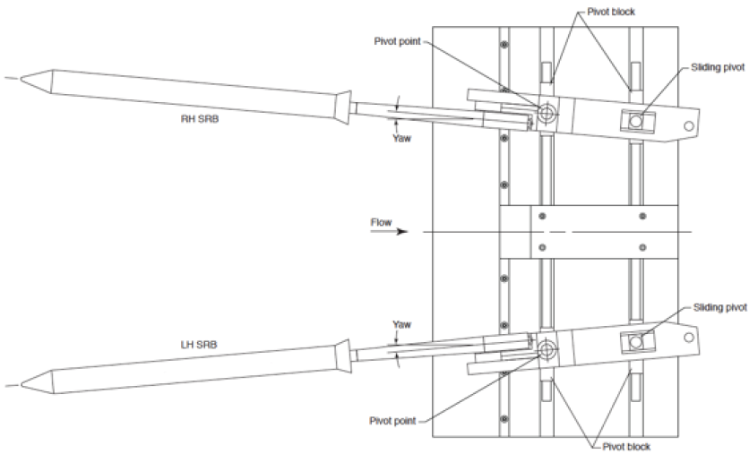
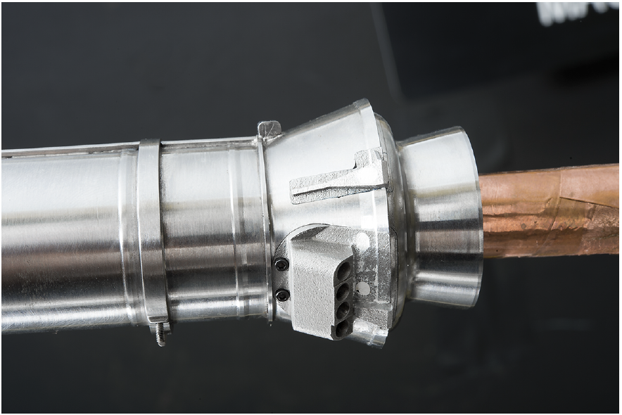
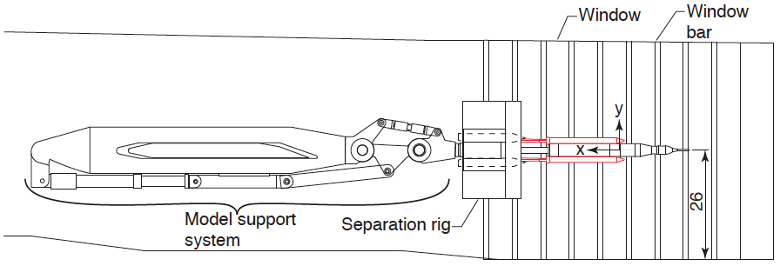
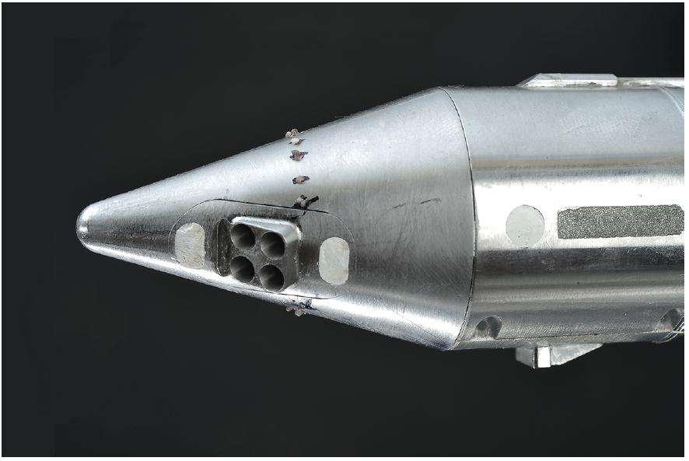
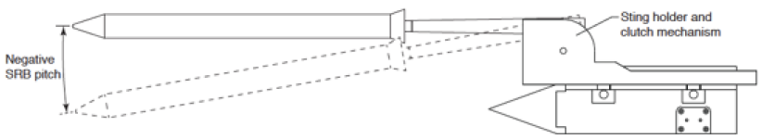
Experimental Setup
SRB separation test article with crew 1B 28005 configuration core used in the 1901 test within test section 2 of the LUPWT’s high-speed leg.
(Figures taken from ** on slide 2)

Slide 5
LUPWT High-Speed Leg
Supersonic
Nozzle Block
Diffuser
Test Section 2
Settling
Chamber
T-Rail
Ladder Rungs
Cavities

Slide 6
LUPWT Best Practice Determination
LAVA studies performed on high-speed leg to determine:
  First Cell Height
  Refinement Stretching Ratios: 105 grids, 310 million pts, 18.67% blanked, 0 orphans
  URANS Unsteady Effects: do not affect test section center
  Convective Flux Scheme: can use HSUW (a HLLE+-based modified third-order upwind) for the SLS Test Article if the dswitch shock sensor is chosen well
FUN3D Studies performed to determine:
  ‘Fixed’ Grid Level for High-Speed Leg: 50 million pts
  ‘Sketch to Solution’ Complexity Level for Test Section 2 : 56 million pts
  ‘Fixed’ or ‘Sketch to Solution’ Grid: ‘Sketch to Solution’ captures shocks better
Notes:
Each team performed a series of studies to determine their best practices when simulating the high speed leg.
The LAVA team first looked into first cell height and the stretching ratios determining grid resolution, then ran URANS to see if unsteady effects existed, and they did, but did not significantly effect the center of the test section where the test article was to be inserted. Finally, various convection flux schemes were assessed, and while the Roe was determined to be best for simulating the high speed leg, the study found that the High Speed Up Wind (or HSUW) scheme could be used just as accurately if the shock sensor dswitch was chosen well. This is relevant as the HSUW scheme was required when simulating the test article to combat the carbuncle phenomenon.
Meanwhile, the FUN3D team ran a pair of grid refinement studies, first on the high speed leg using the fixed grid generation method, and then just on test section 2 with the 'sketch to solution' process, and then compared findings of the two to determine which was better.

Slide 7
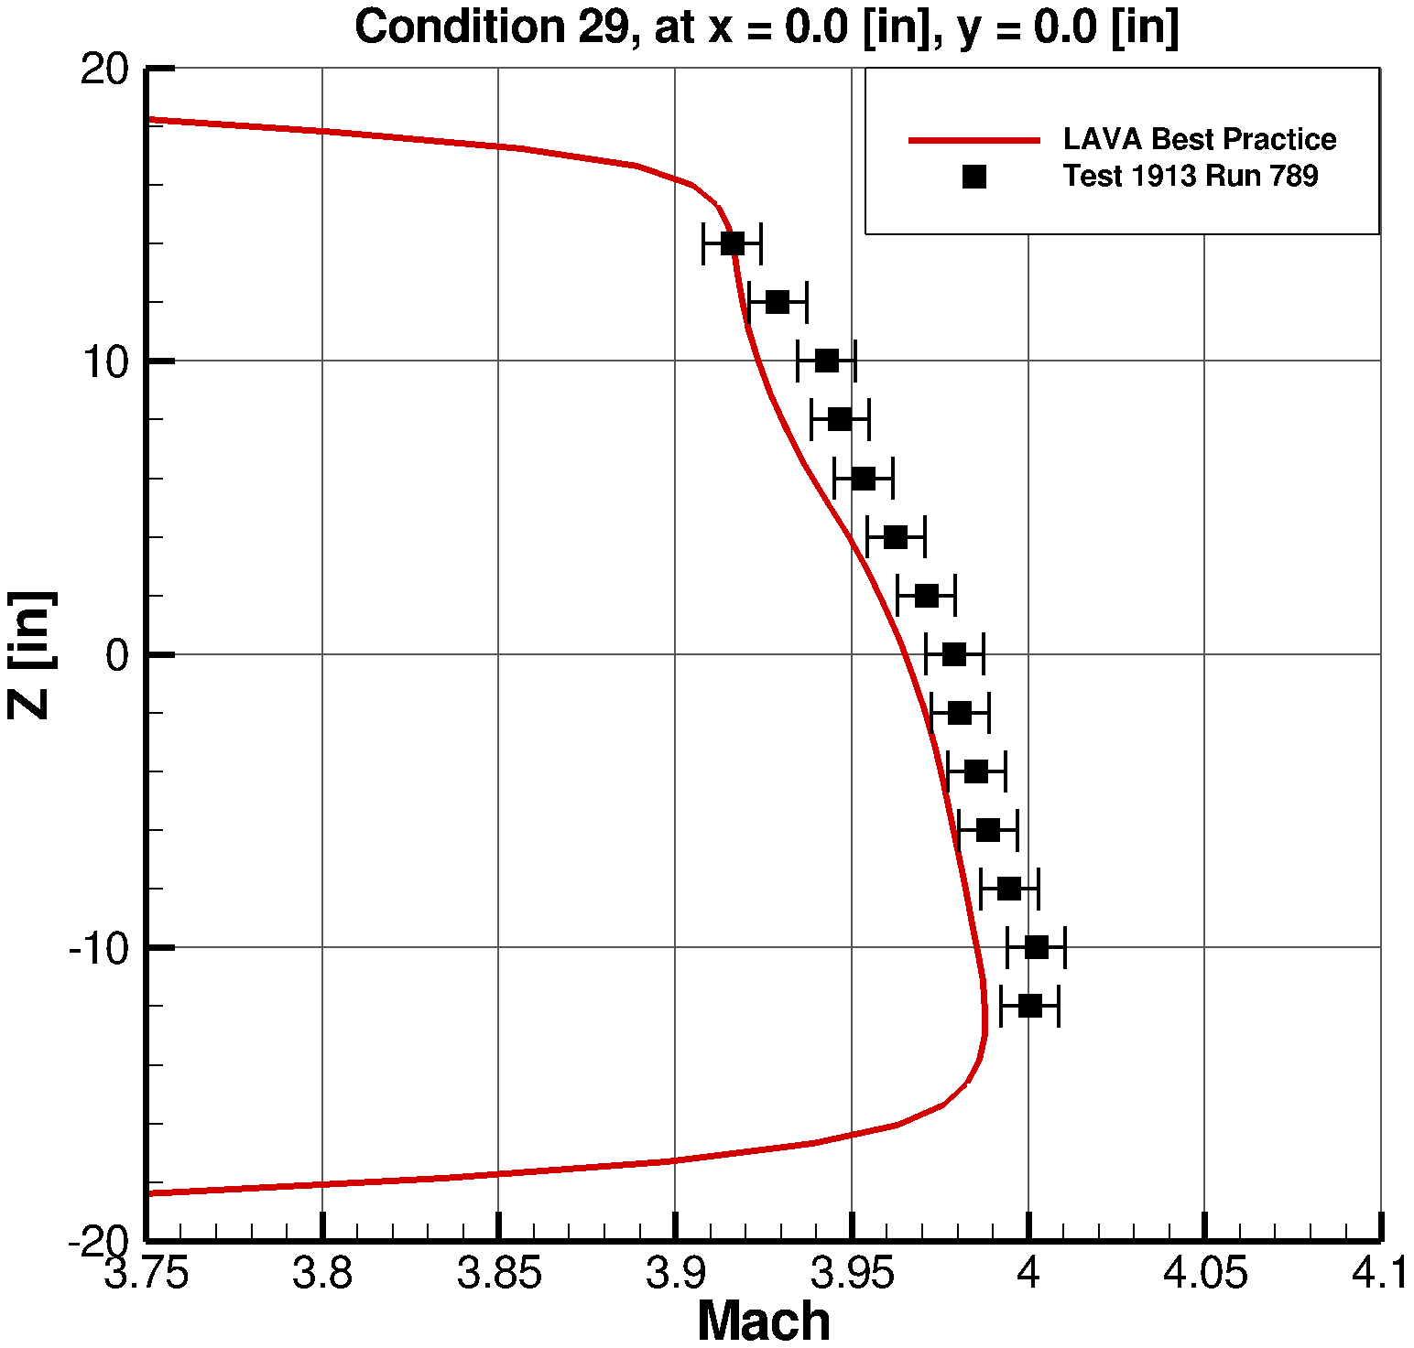
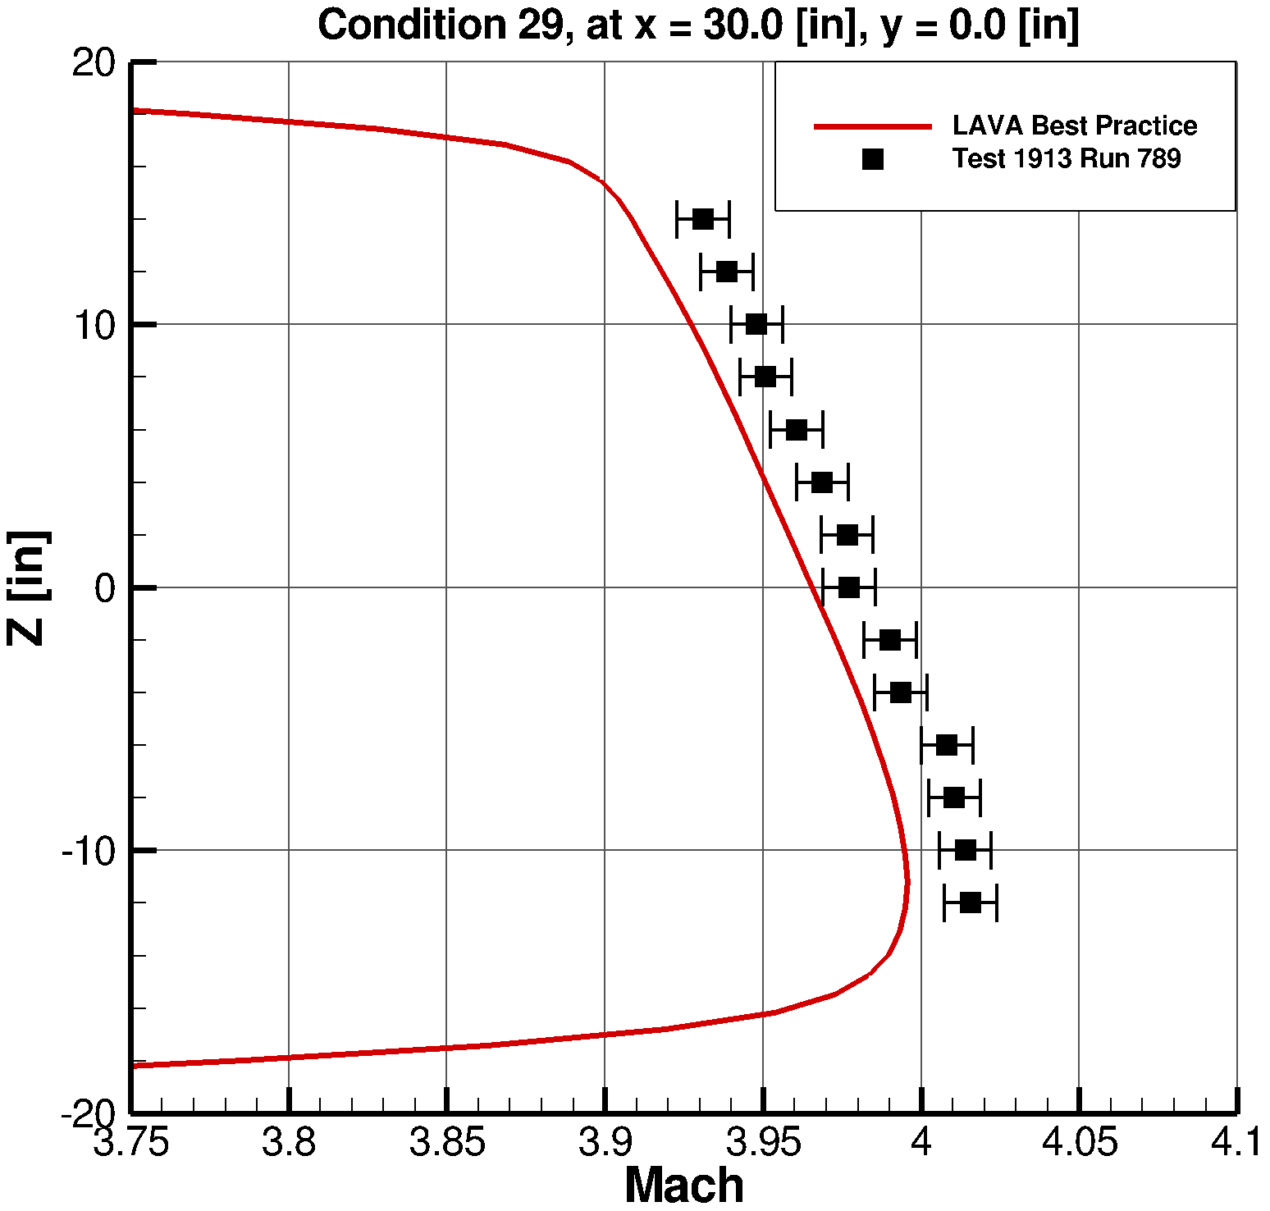
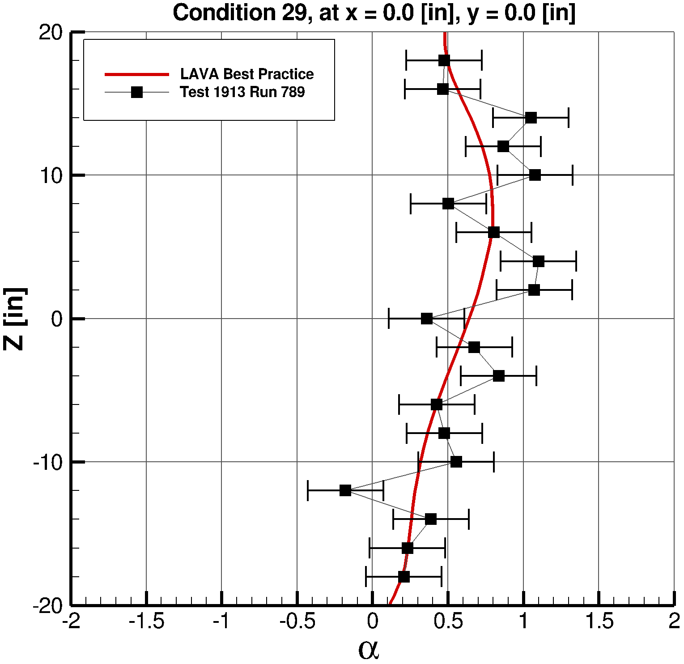
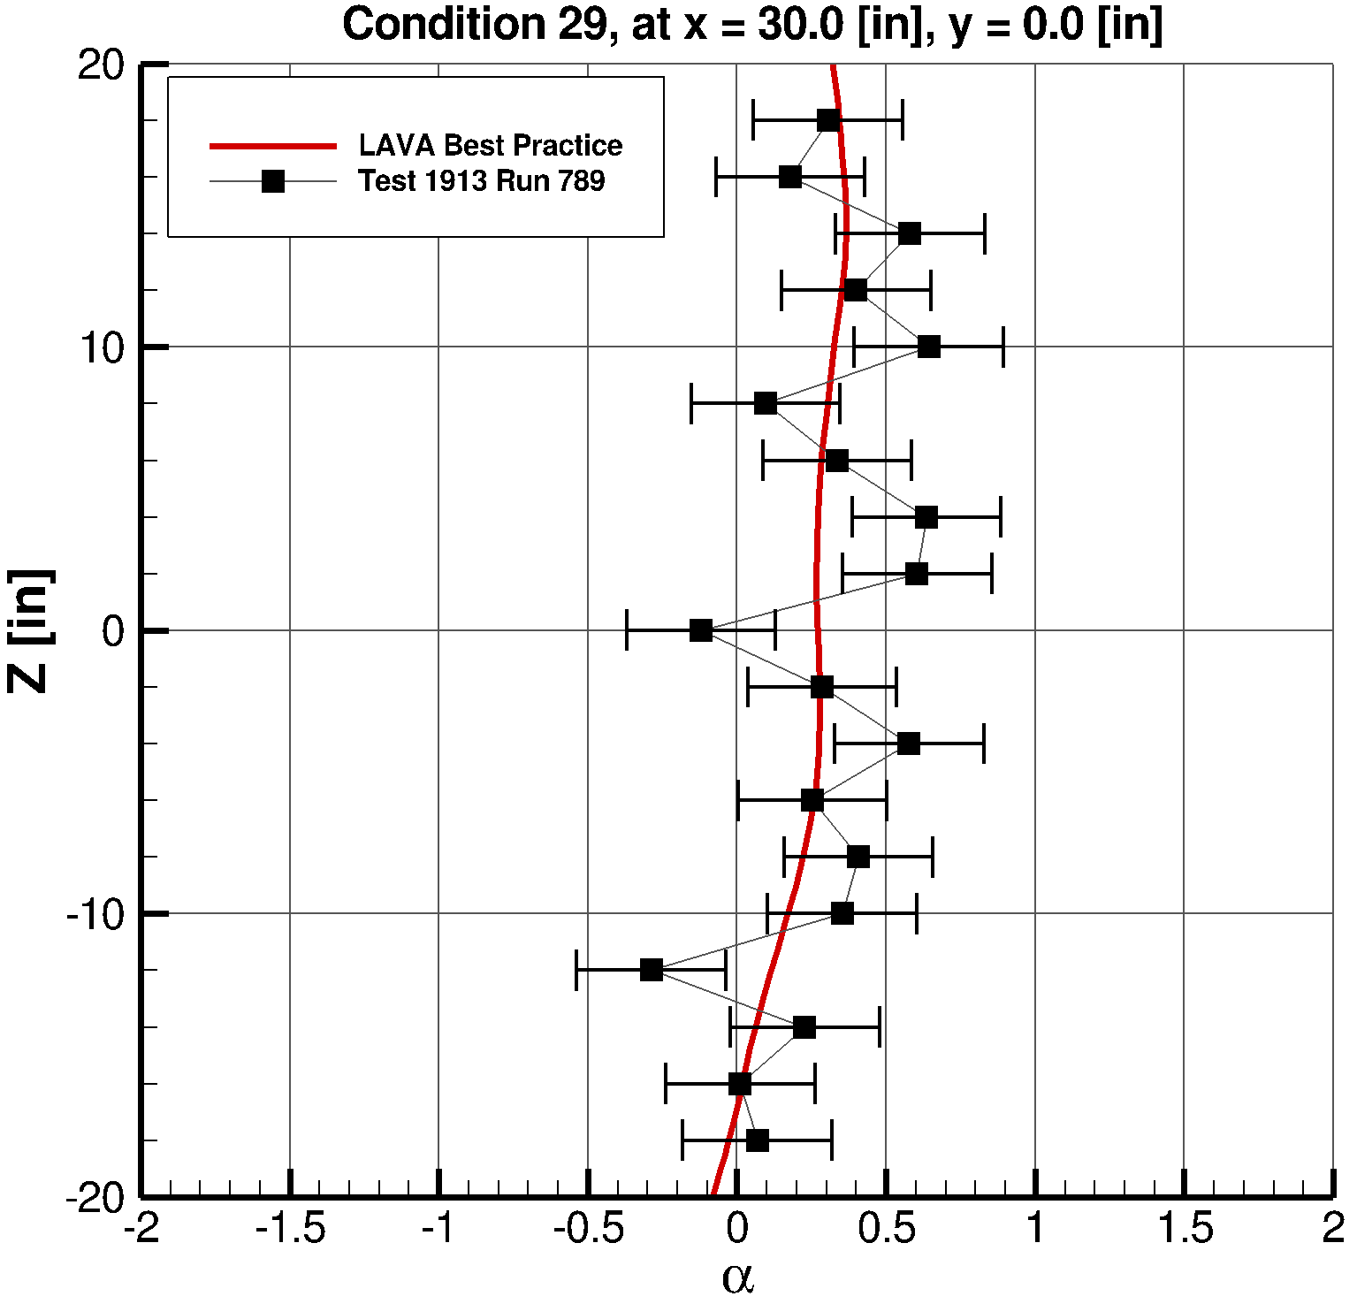
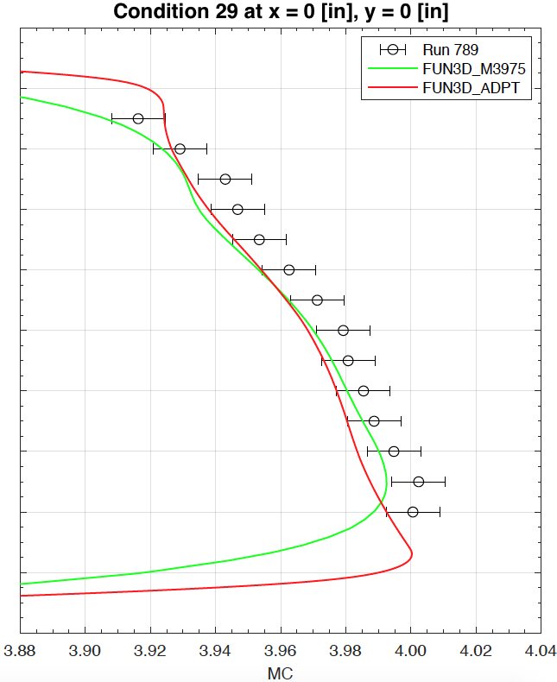
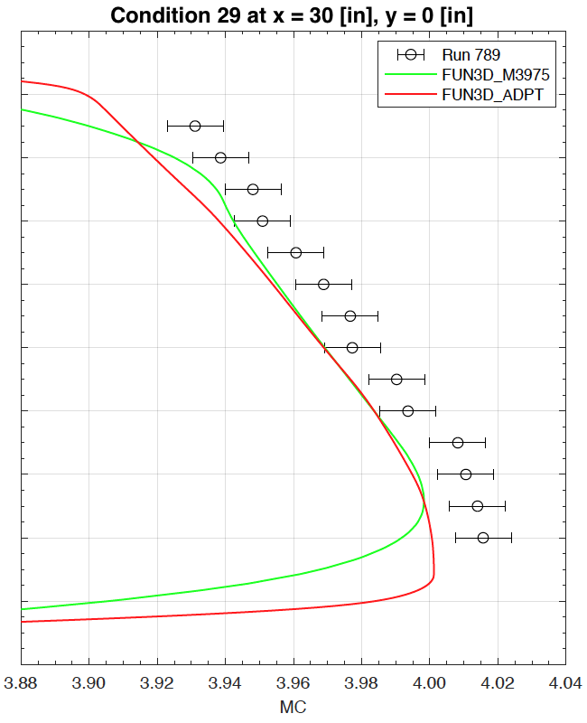
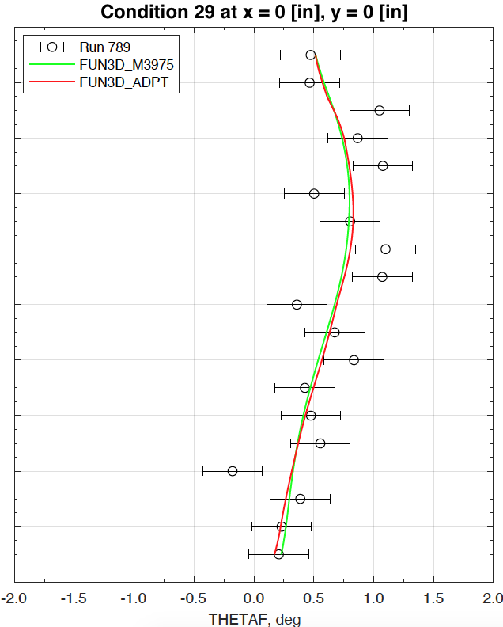
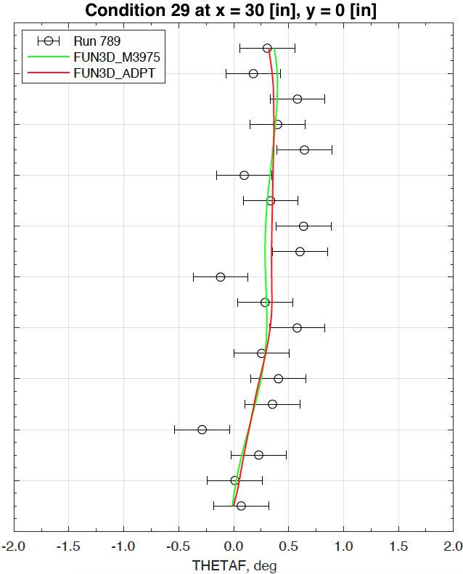
Validation Against Condition 29 of 1913 Test
X=0 Mach
X=30 Mach
X=0 Upwash
X=30 Upwash
LAVA
FUN3D
Notes:
constant total

Slide 8
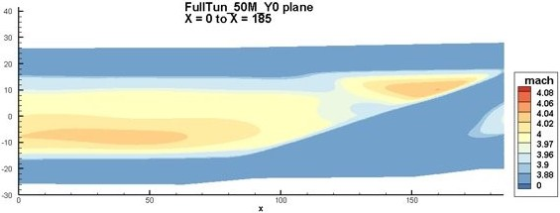
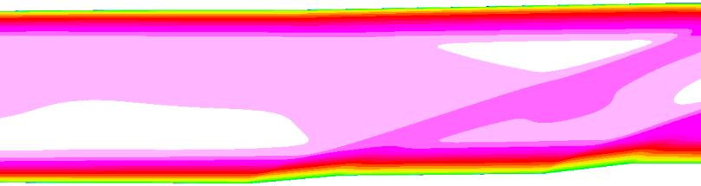
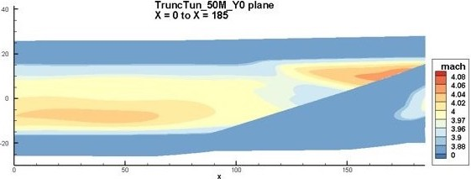
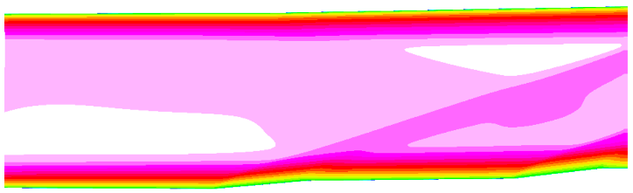
Extraction of LUPWT’s Test Section 2
LAVA
FUN3D
Best Practice ‘Fixed’ Grid
High- Speed Leg
Best Practice ‘Sketch To Solution’ Grid
Test Section 2
Inflow conditions for test section 2
were extracted from the high-speed leg

Slide 9
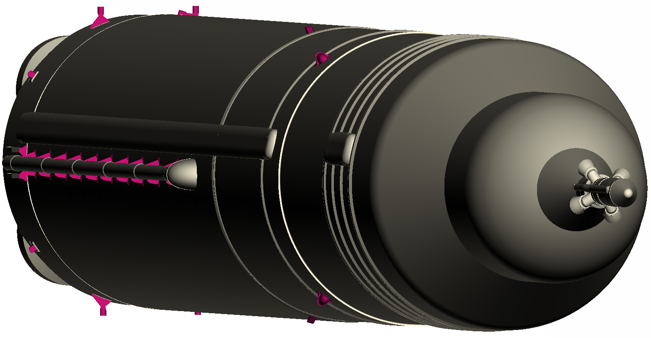
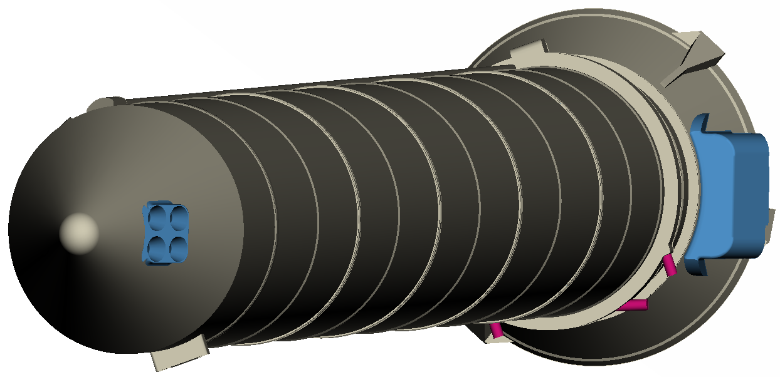
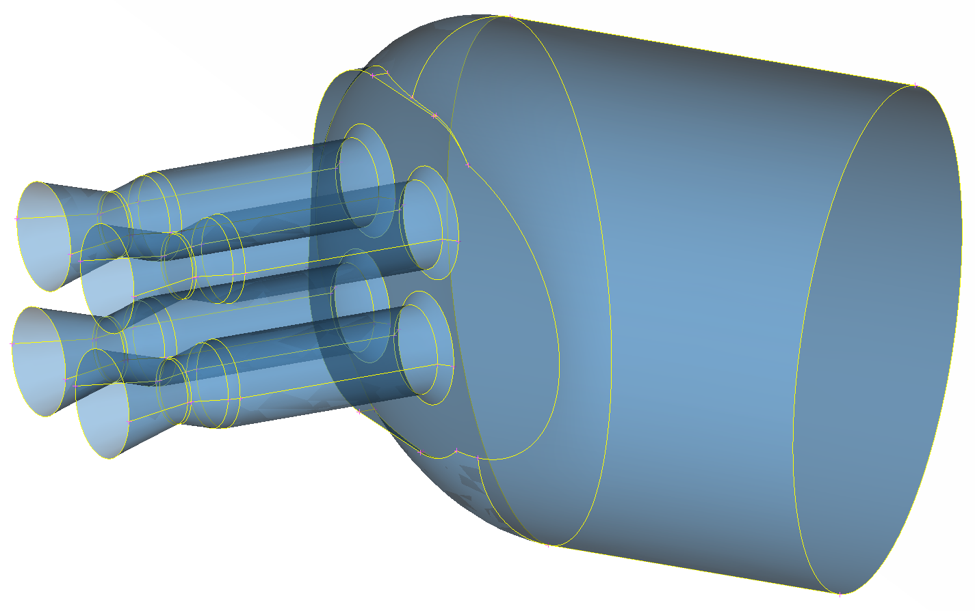
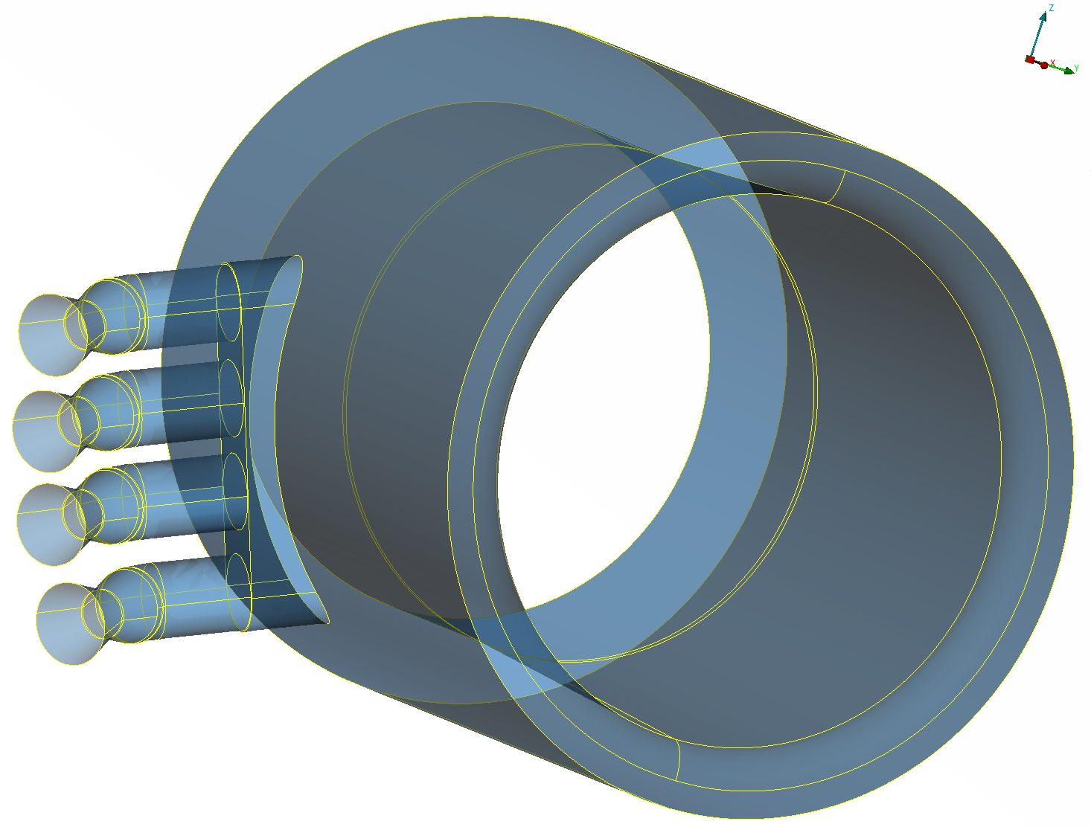
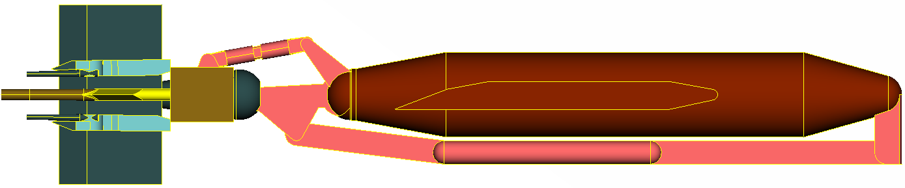
SLS SRB Separation Test Article

Slide 10
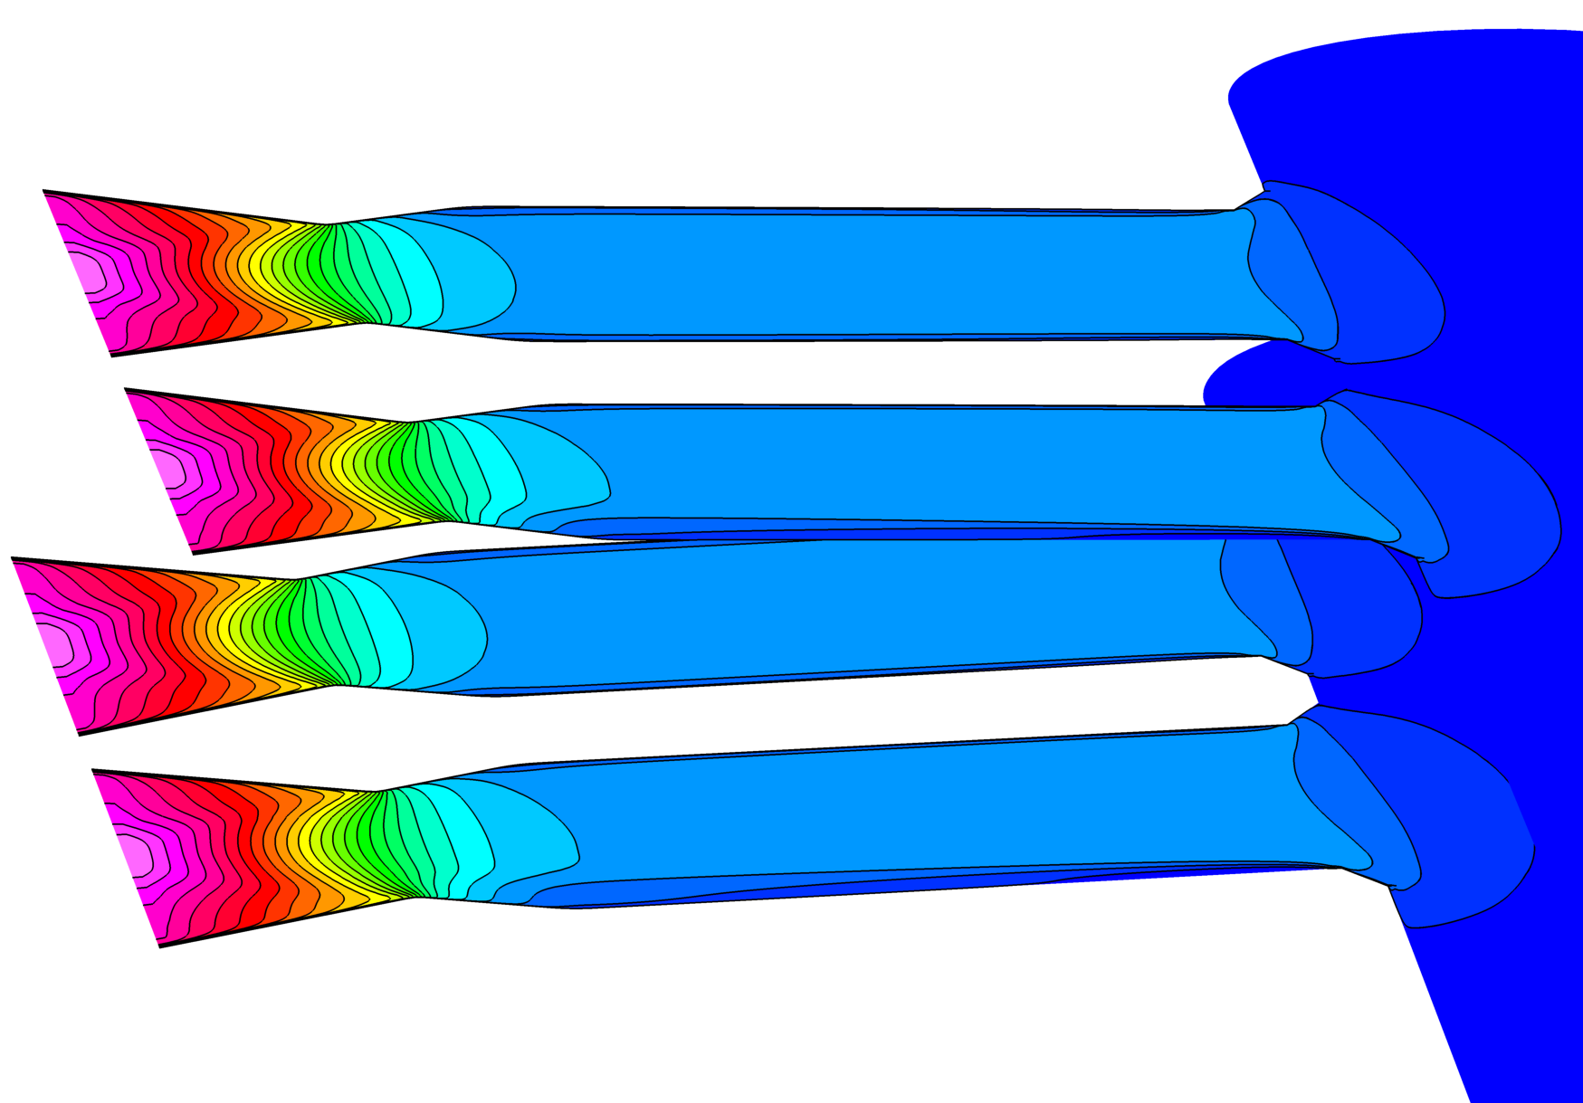
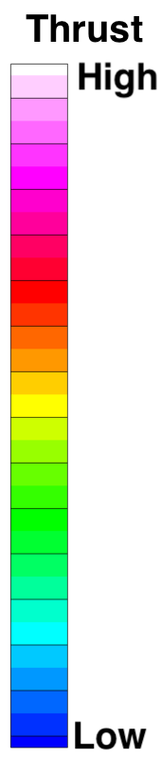
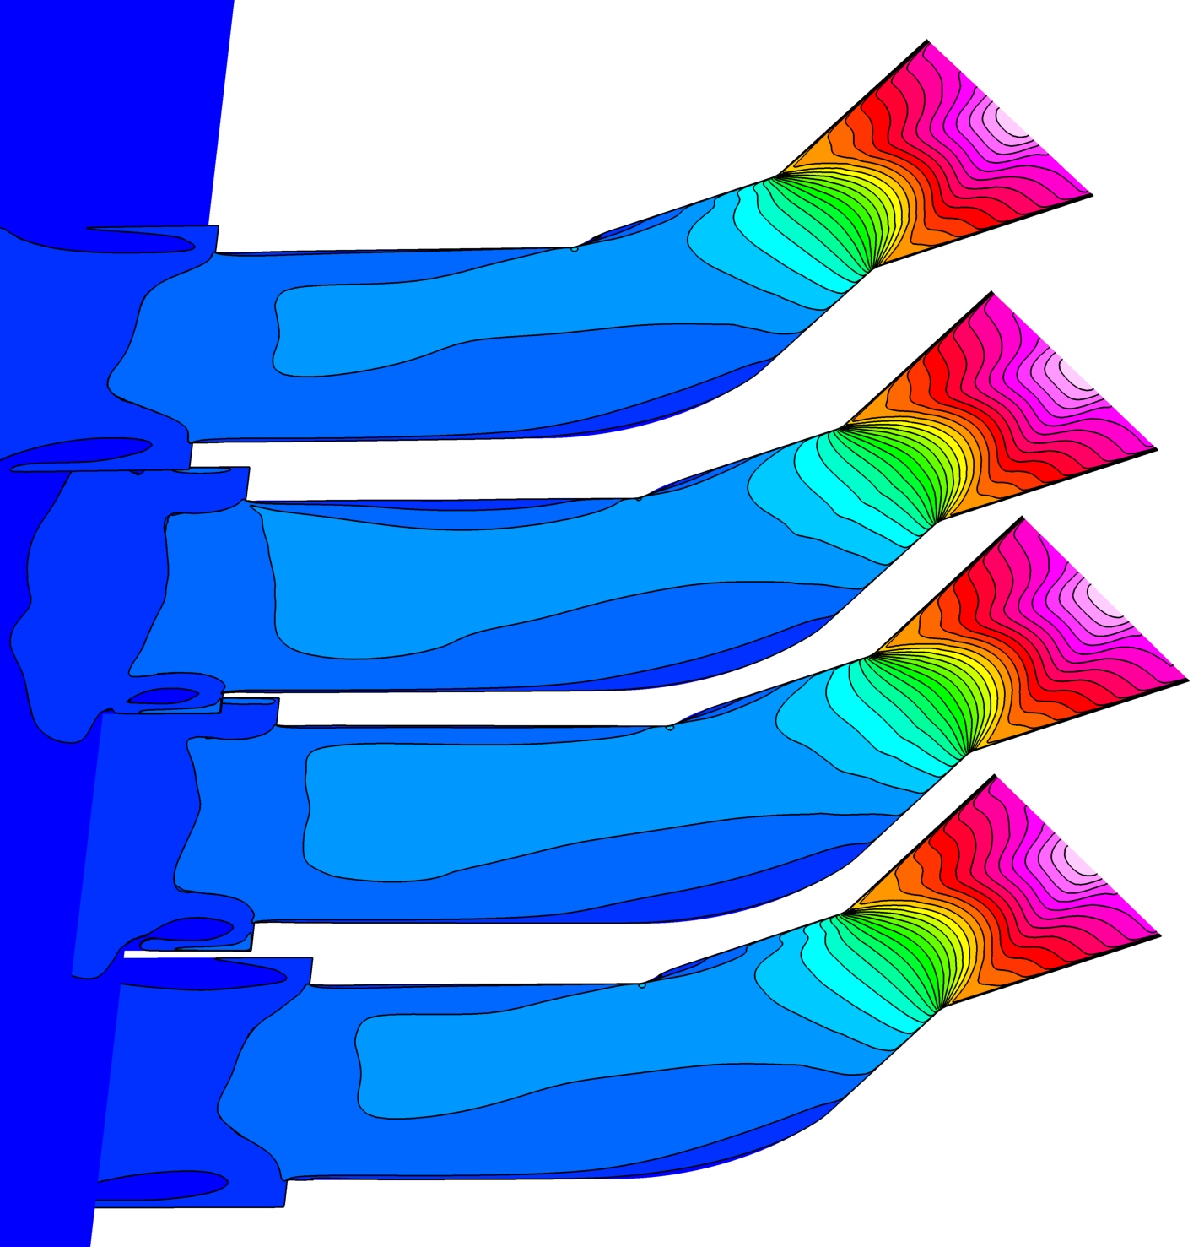
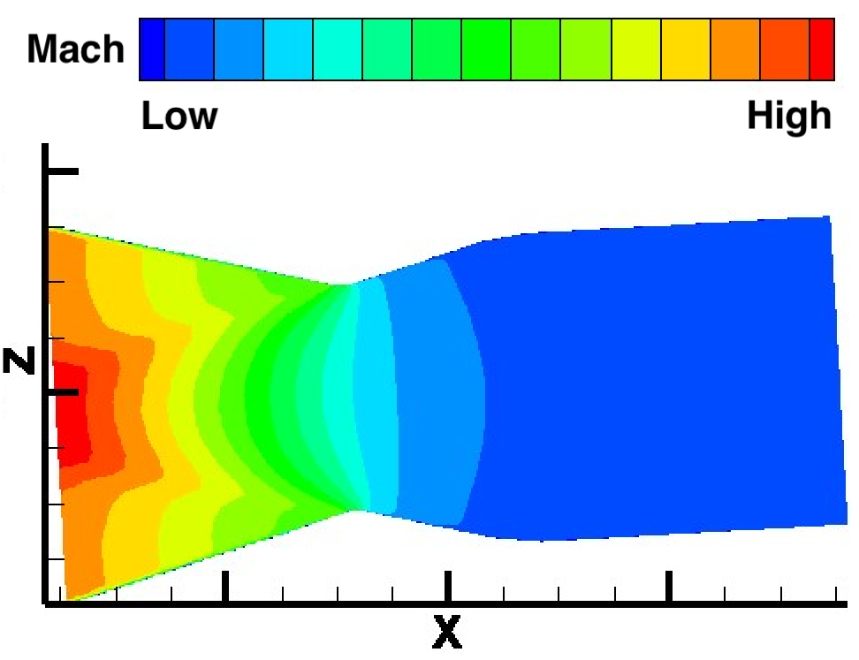
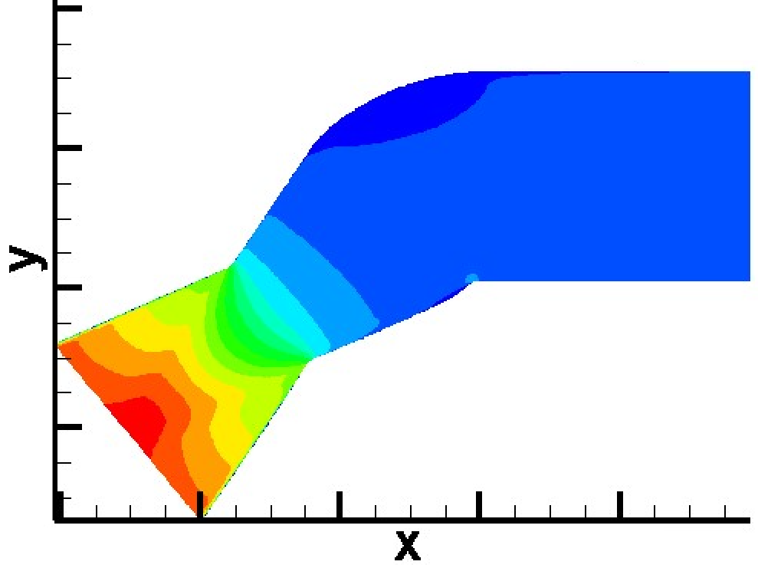
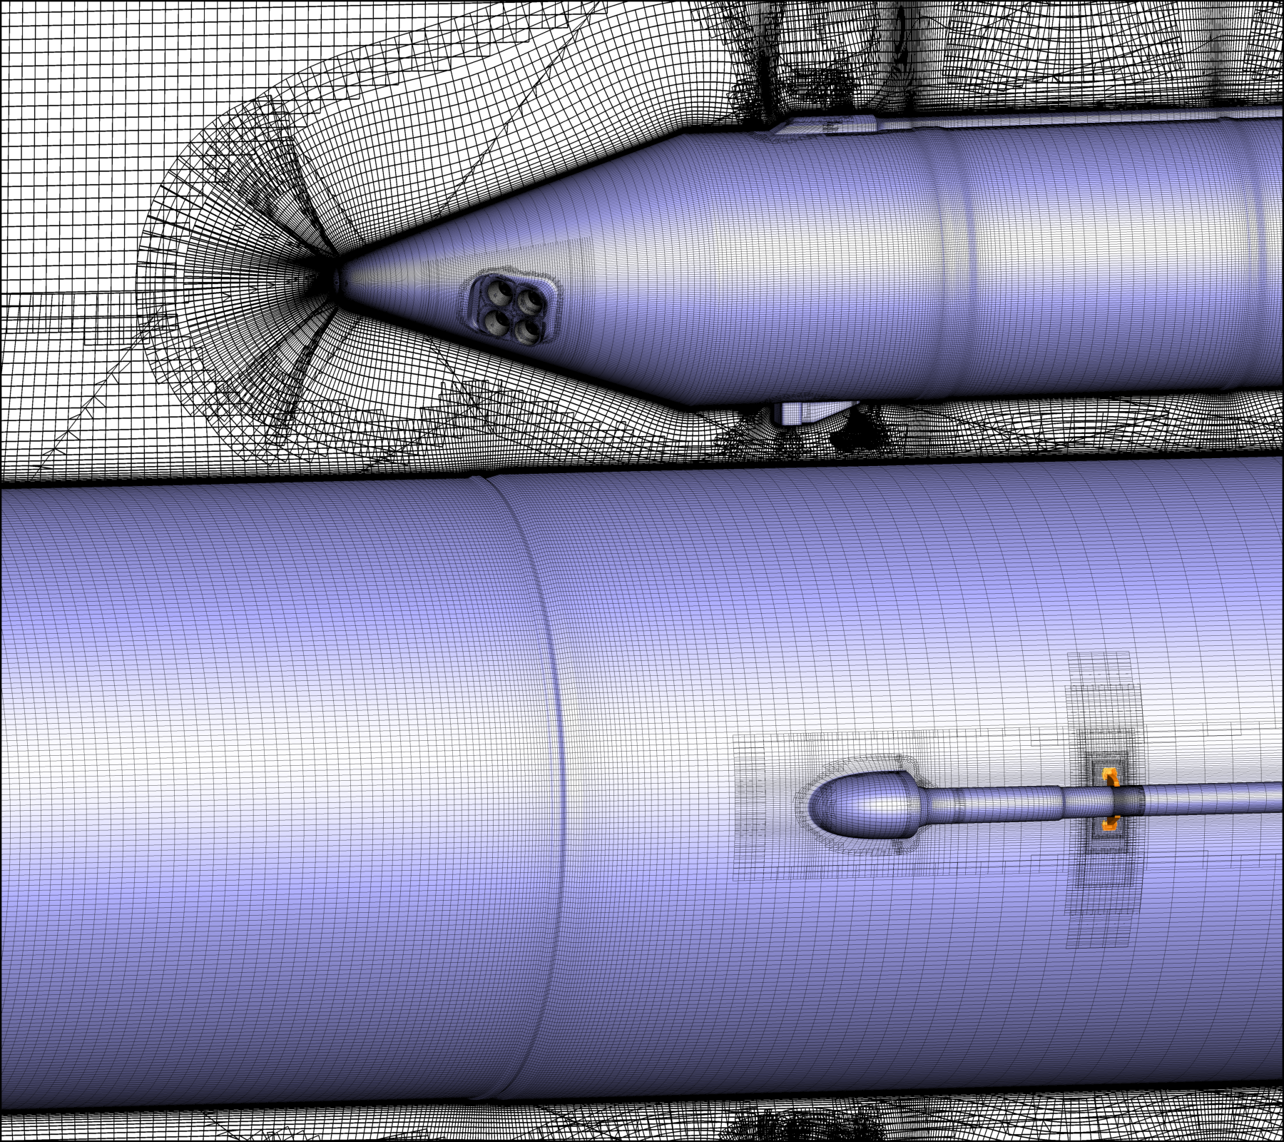
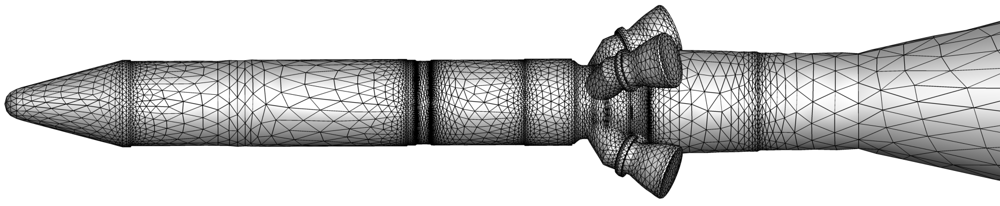
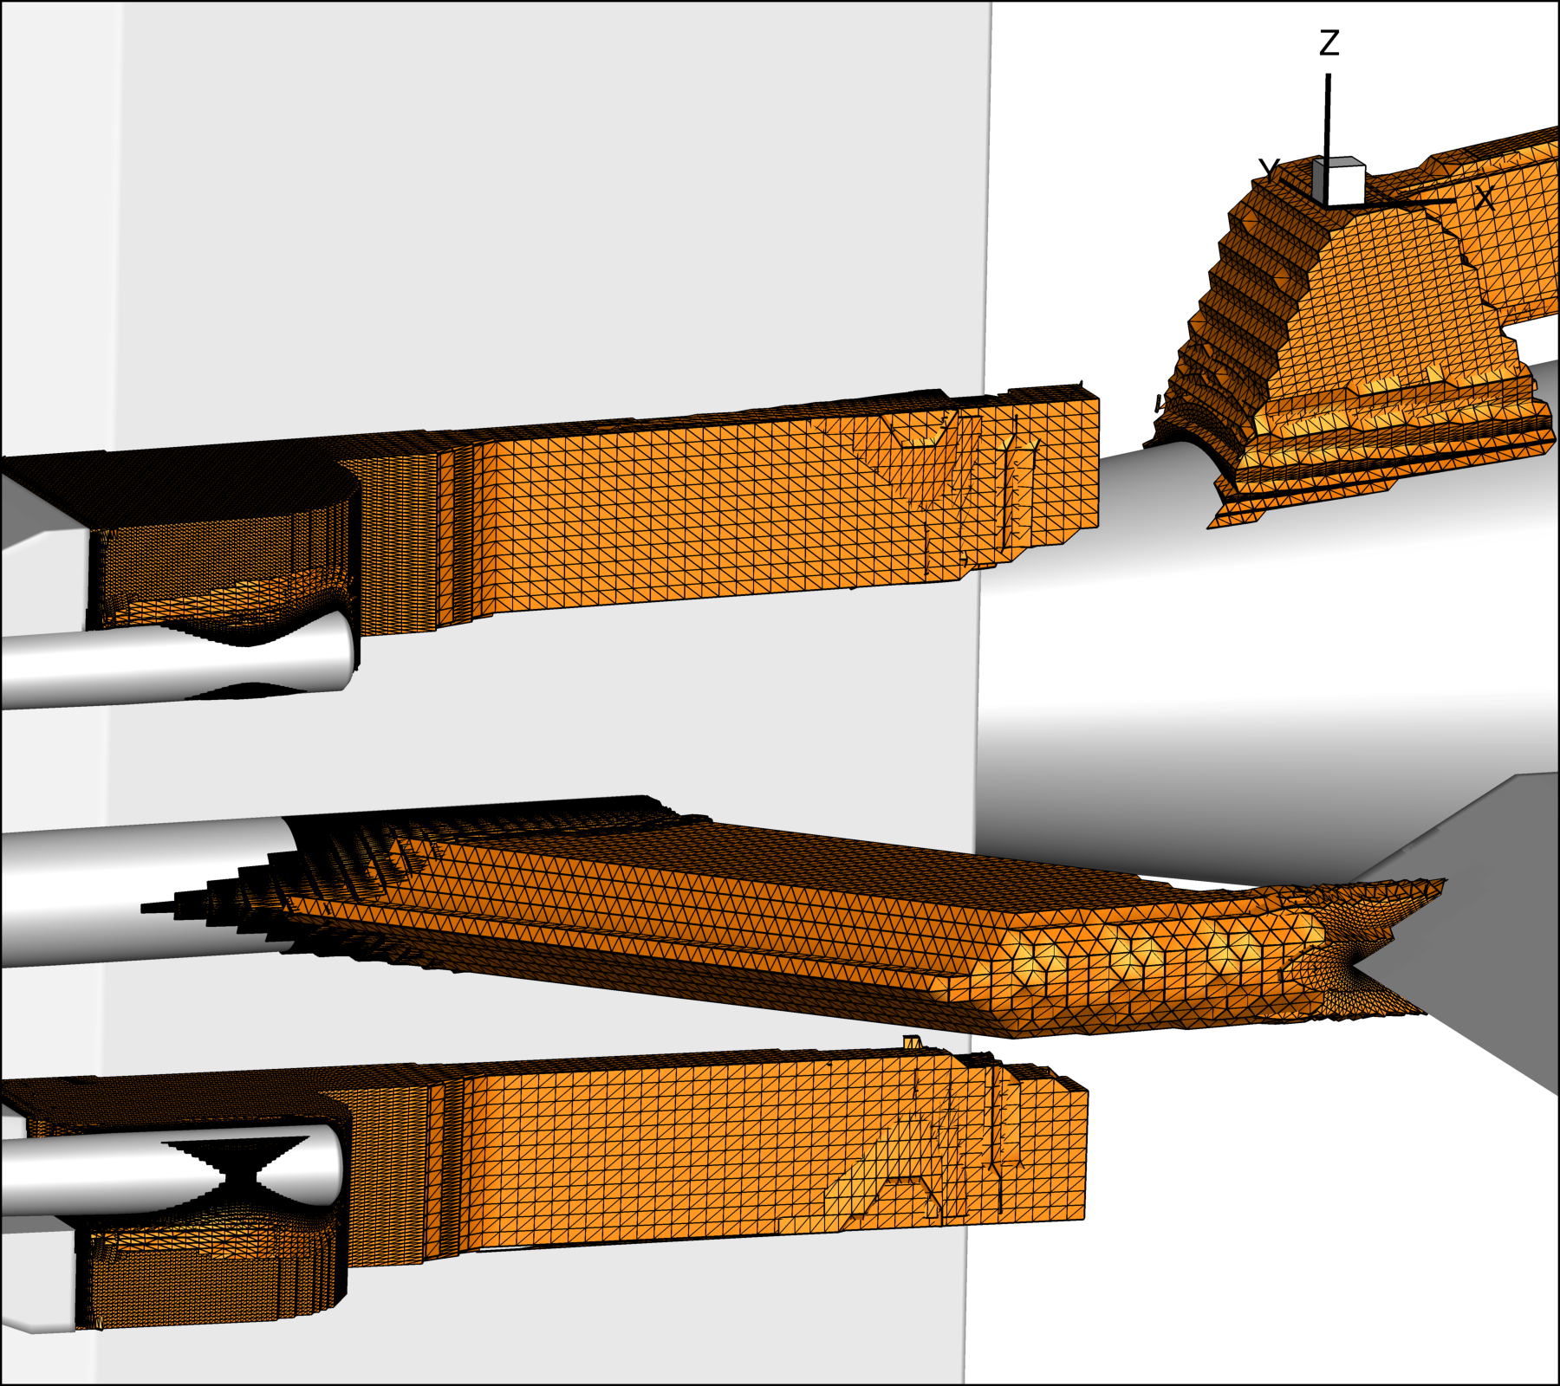
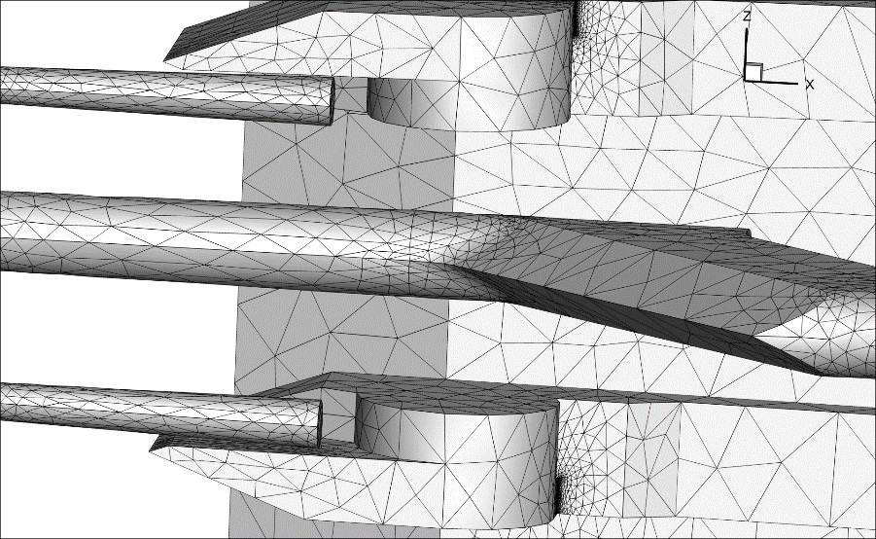
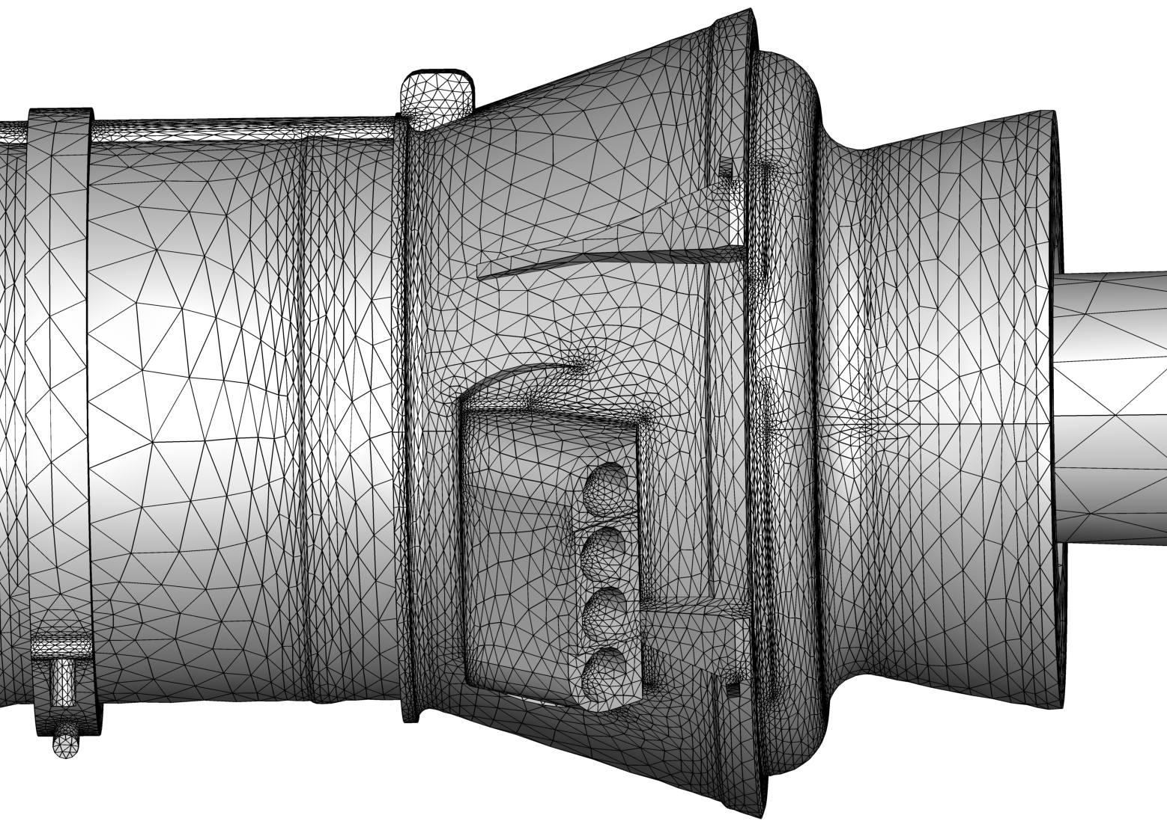
SLS Simulation Strategy
LAVA
FUN3D

Slide 11
LAVA SLS Best Practice Determination
LAVA Studies performed on SLS test article to determine:
  First Cell Height
  Refinement Stretching Ratios: 950 grids, 358 million pts, 15.73% blanked, 0 orphans
  URANS Unsteady Effects: not found for produced turbulent eddy viscosity
  Convective Flux Scheme: HSUW with dswitch of 0.1
  Turbulence Model Corrections: retained despite differences when RC and QCR2000 were removed
FUN3D Studies performed on SLS test article to determine:
  Relevant Support Geometry: kept core attach and separation rig
  Switch-to-DDES Effect: BSM plumes turned unsteady
  Number of Adaption Iterations: cheaply increased bow shock resolution
  Effect of ‘Buffer’ Coarsening: reduced point allocation to downstream wakes

Slide 12
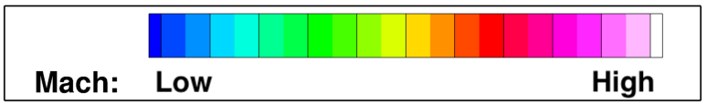
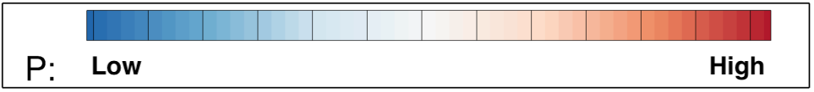
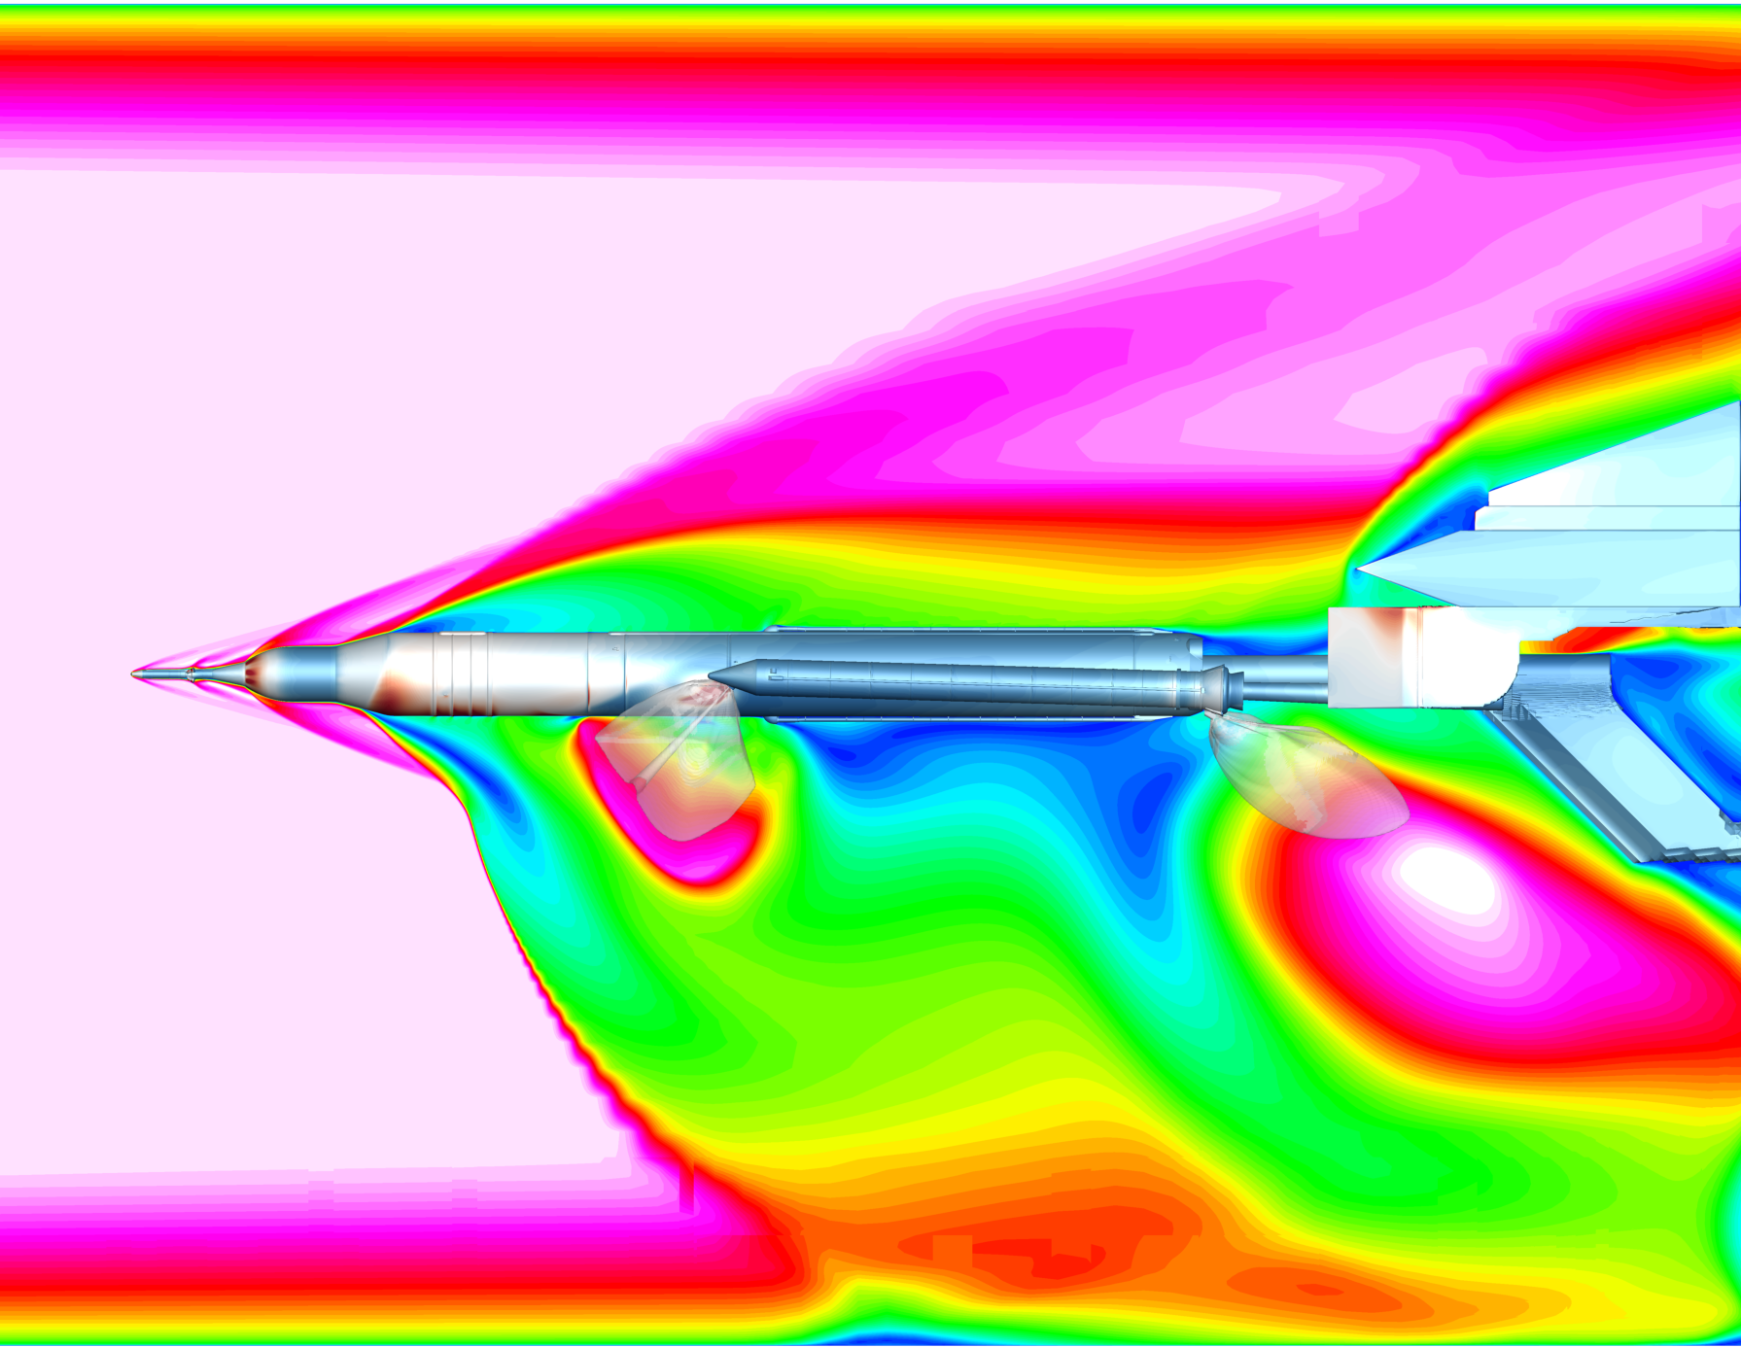
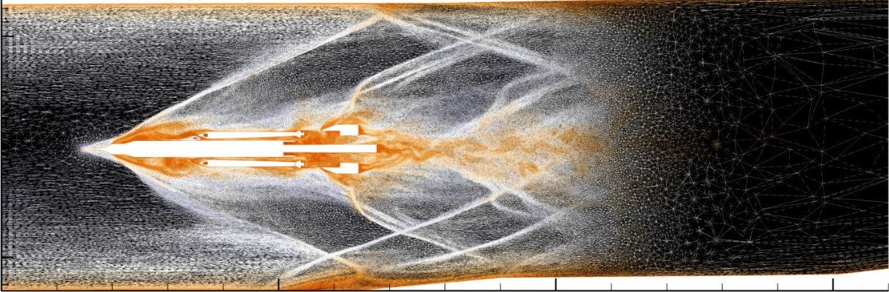
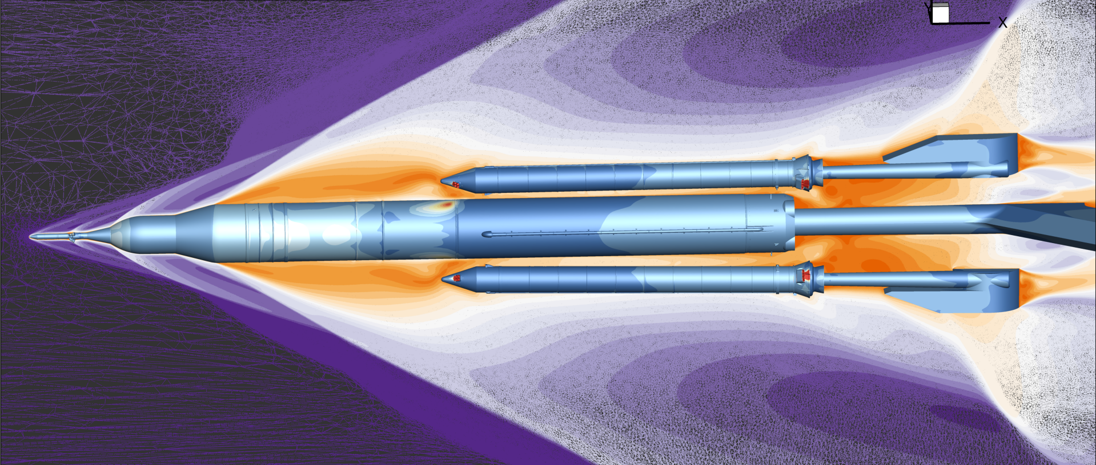
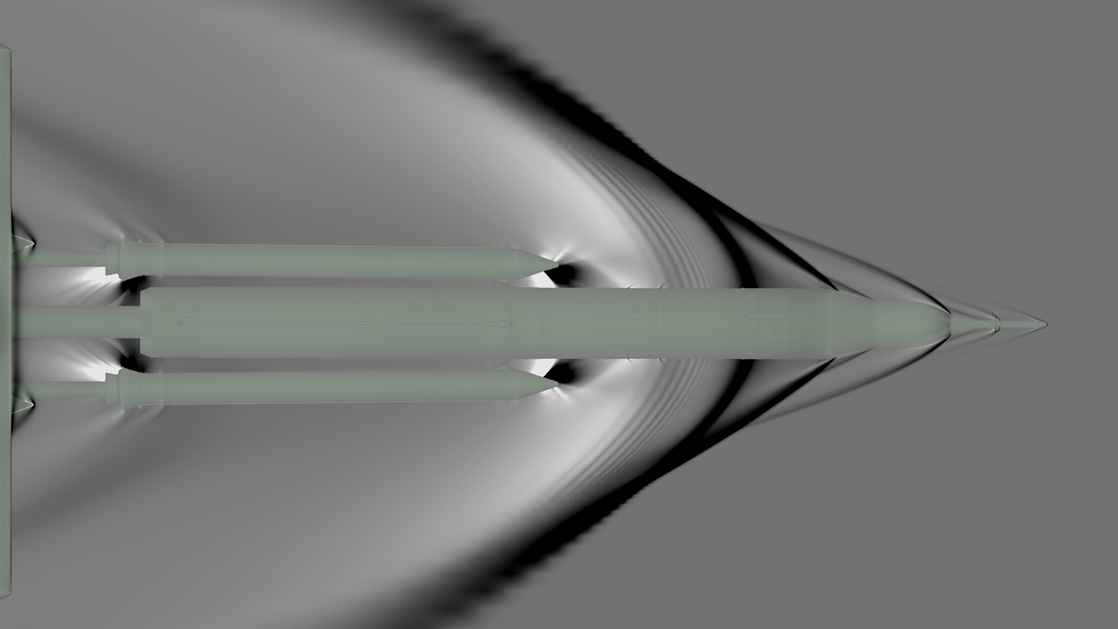

SLS Set 01 Case 01 (Nominal) Case Solution
LAVA
FUN3D
~815 SBUs
~15750 SBUs

Slide 13
Conclusions
LAVA’s curvilinear overset and FUN3D’s ‘Sketch to Solution’ required very different studies to determine best practices.
LUPWT high-speed leg results compared well to condition 29 experiment.
Test section 2 was simulated for database, with inflow extracted from high-speed leg.
Support hardware near the test article was deemed relevant.
Uncertainty quantification database:
  LAVA used their developed best practices to run the 231 cases of the database.
  FUN3D used Set 01 case 01 (nominal) to find best practices for their ‘Sketch to Solution’ process.
Further studies suggested to:
  assess effects of turbulence model for both solvers.
  better assess unsteadiness effects in LAVA simulations using Hybrid RANS-LES or Wall Modeled LES.
Notes:
Both teams developed unique best practice methodologies due to the differing natures of their solvers, which compared well with experimental data when simulating the high speed leg and allowed accurate inflow conditions to be extracted for simulating test section 2.
When simulating the test article, both teams found that support hardware near the test article was relevant to the solution.
The LAVA team used their developed best practices to run all cases of the uncertainty quantification database, while the FUN3D team used the nominal case of Set 01 to inform development of their 'Sketch to Solution' process. Refer to the paper for more information on the cost-requirements of the database.
Further studies are suggested to assess the effects the turbulence model has on simulating the SRB separation problem within the LUPWT, as well as to better assess unsteadiness effects within LAVA simulations using Hybrid RANS-LES or Wall Modeled LES.

Slide 14
Acknowledgments
This research has been funded by the Aerosciences Evaluation and Test Capabilities (AETC) Portfolio Office.
Resources supporting this work were provided by the NASA High-End Computing (HEC) Program through the NASA Advanced Supercomputing (NAS) Division at Ames Research Center.
The authors would like to thank and acknowledge Emre Sozer, Jacob Wagner and Paresh Parikh for simulation assistance, James Jensen, Jared Duensing and Daniel Maldonado for overset gridding assistance, Gaetan Kenway for LAVA Curvilinear solver development, and Michael Piotrowski for internal review.
Notes:
Need to redo , Said Supercomputer not supercomputing

