Slide 1
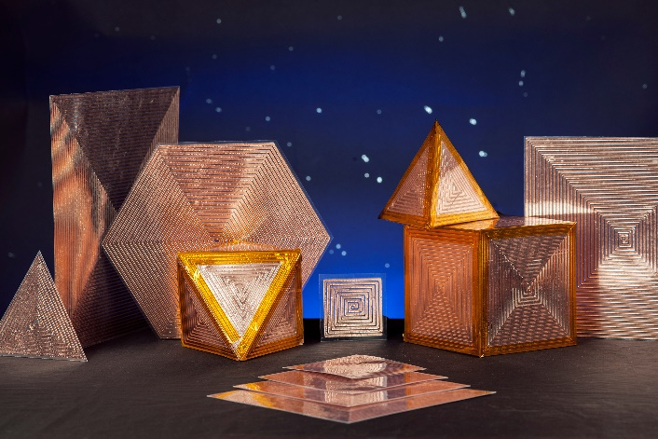
NESC Sensors & Instrumentation Webinar - July 20, 2021
Open Circuit Resonant (SansEC) Sensor Technology Applications
George Szatkowski
NASA Langley Research Center

Slide 2
Outline
Introduction to SansEC Sensors
  Description & Theory
  Computational Electromagnetic Modeling
  Sensor Fabrication
  Detectable Phenomena
Applications
  Composite Aircraft Smart Skin for Lightning Environments
  Wearables
Detectable Phenomena
Conclusions
Reference Publications

Slide 3
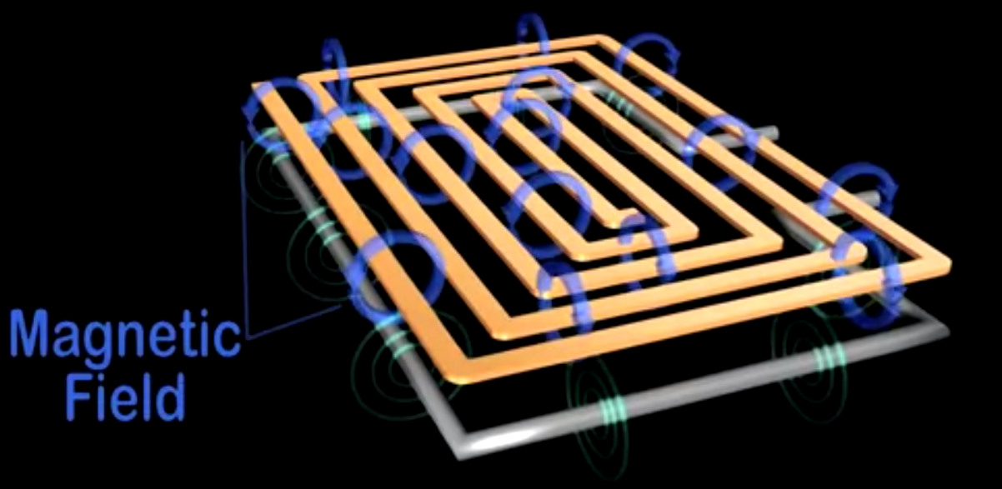
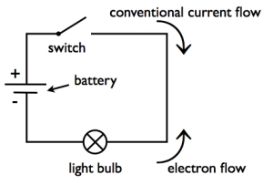
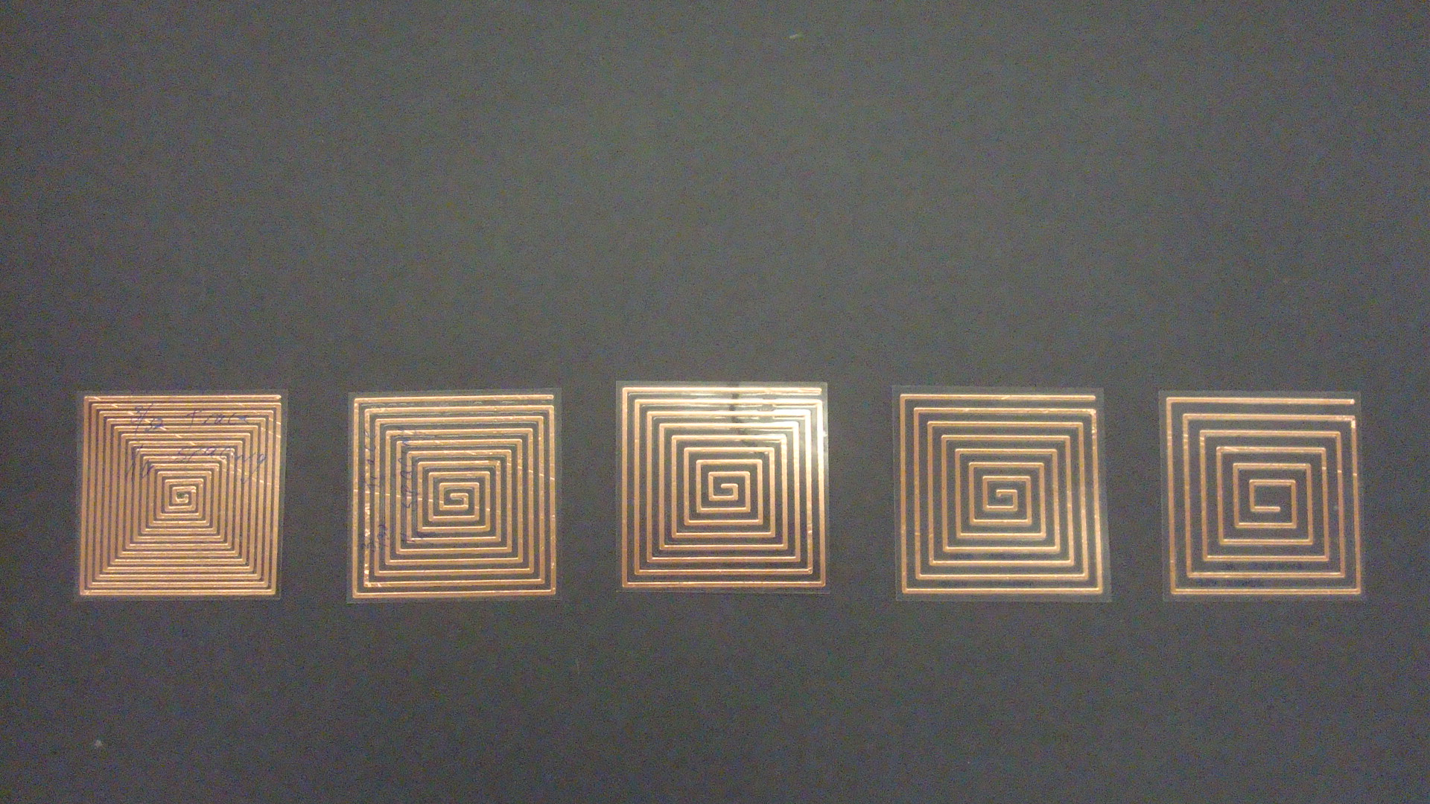
Introduction to SansEC Sensors
SansEC
Sans Electric Connection
Wireless – No physical electrical connections
Passive – No battery required;
Non-Contact – EM Fields permeate out from sensor surface
Electromagnetic Resonator – naturally oscillates with greater amplitude at some frequencies based on Inductance (L), Capacitance (C) & Resistance (R) of the total circuit
Closed Circuit Open Circuit
Electric
field
SansEC Sensor
Loop Antenna

Slide 4
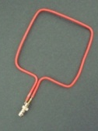
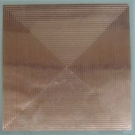
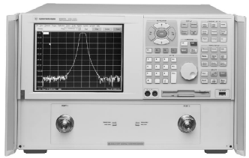
Introduction to SansEC Sensors
Components of the Measurement System
1. SansEC Sensor - Conductive coil designed to resonate at desired frequencies
  The trace length, trace width and gap width influence the resonate frequencies.
2. Interrogator RF Source -Typically a Network Analyzer is used, but excitation could come from any stable ambient RF source.
3. Interrogator Receiver - Typically a Network Analyzer is used to measure the reflection coefficient. This is the near field configuration. Data can be collected in the far field by using an electric field antenna connected to a loop antenna.
4. Loop Antenna – Induces magnetic excitation on sensor to generate a signal response
  Loop antenna is aligned parallel to sensor trace.
5. Signal Analysis – Deterministic Quantification using Machine Learning
  Looks for relative change in resonant response
  to indicate change in device under test.
Sensor
Network Analyzer
Loop Antenna

Slide 5
Introduction to SansEC Sensors
Signal Processing Data Features
For each Resonant Frequency, the following data features can be used in machine learning quantification from the reflection coefficient measurement.
Frequency
Amplitude
Phase
Q factor (3dB bandwidth)
Electrical Impedance
Derived Parameters (Inductance, Capacitance and Resistance)

Slide 6
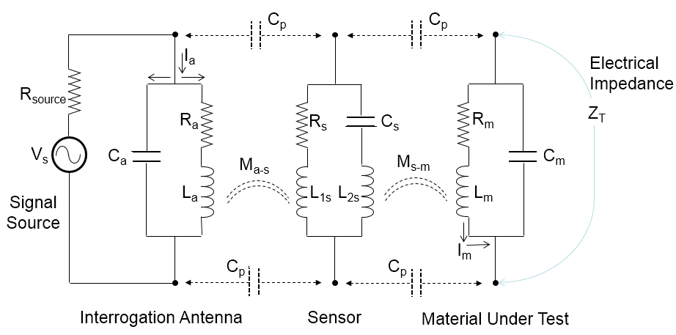
SansEC Sensor Theory
Equivalent Circuit Model
Lumped components in Antenna circuit will change resonance

Slide 7
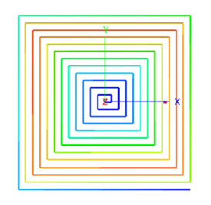
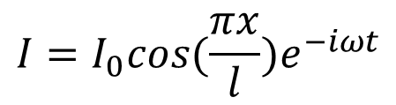
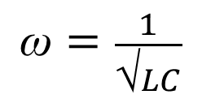
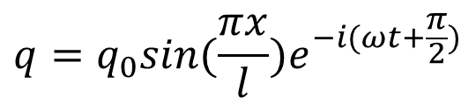
SansEC Sensor Theory
The SansEC sensor will have zero current at both ends of the resonant spiral. When excited by an oscillating electromagnetic field, the induced electromotive force (EMF) pushes the electrons carried by the conductor into the resonant state where the electrons move back and forth along the conductive trace.
Current Distribution
(zero current at ends)
Current Distribution
$$I=I_{0}cos(\frac{πx}{l})e^{−iωt}$$
$$\text{ω}=\frac{1}{\text{√}LC}$$
Charge Distribution
$$q=q_{0}sin(\frac{πx}{l})e^{−i(ωt+\frac{π}{2})}$$
(blue: lowest currents to red: highest currents)

Slide 8
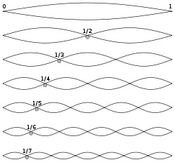
SansEC Sensor Theory
Resonant Modes
Current distribution along trace length
(blue: lowest currents to red: highest currents)

Slide 9
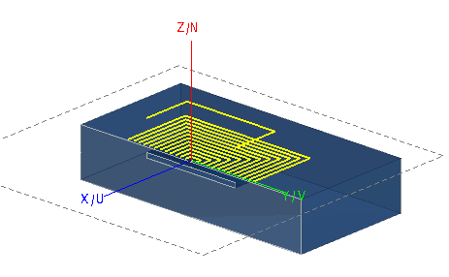
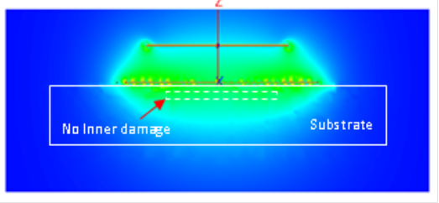
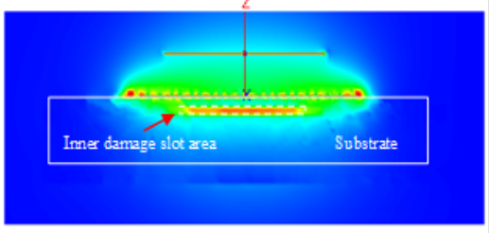
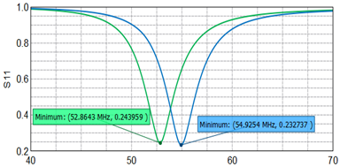
Computational Electromagnetic Modeling
Response Characteristics from Delamination in Composite
Fiberglass substrate model with inner damage
Electric field distribution
No Damage (ɛ_{r}=3)
Electric field distribution
With Damage (ɛ_{r}=1)
No inner damage
With inner damage
Computed SansEC resonant response

Slide 10
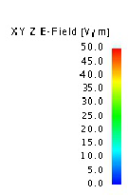
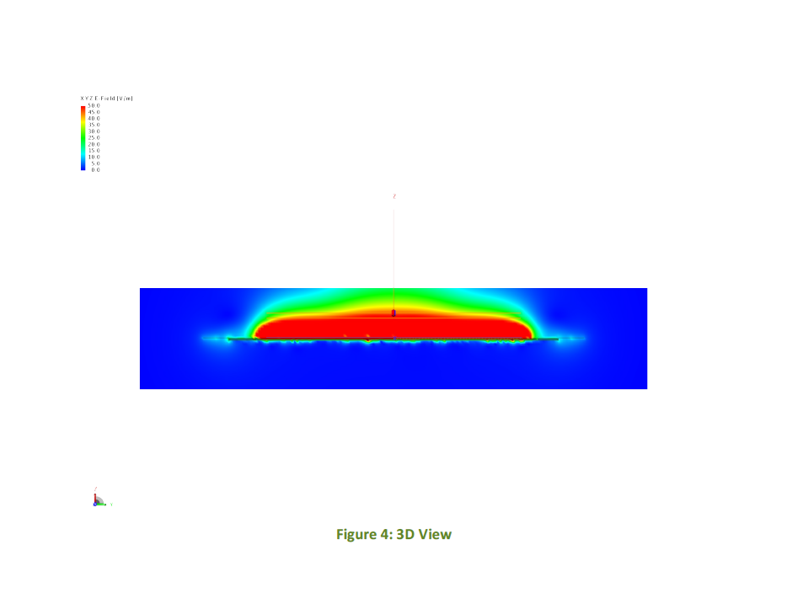
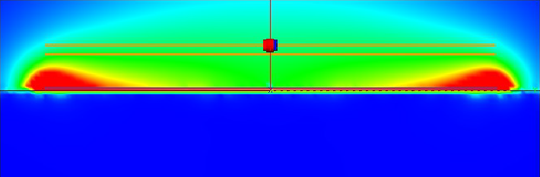
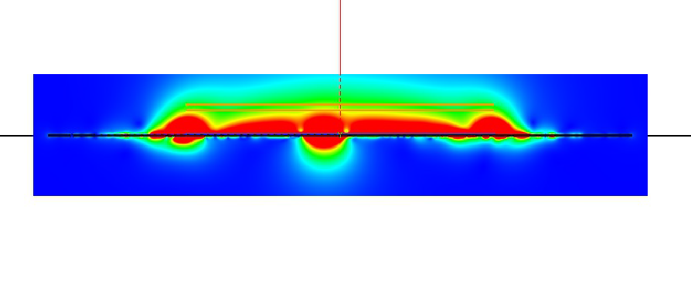
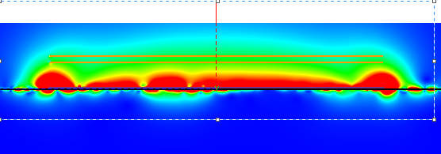
Computational Electromagnetic Modeling
Response Characteristics of CFRP Damage
Electric Field Visualizations
Delamination
No Damage
Puncture
Void

Slide 11
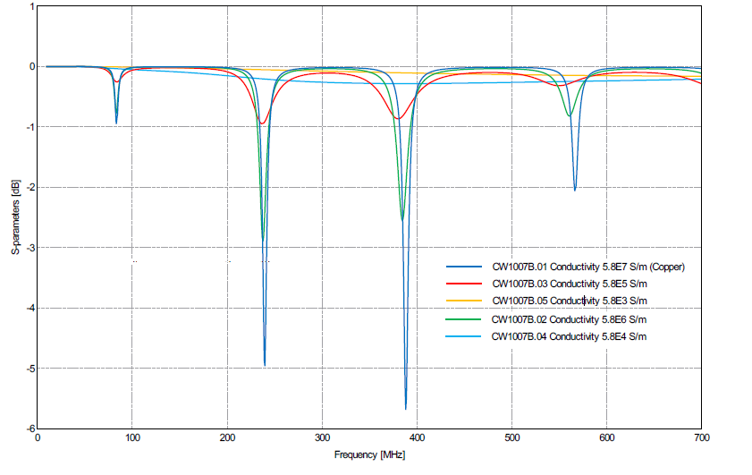
Computational Electromagnetic Modeling
Response Characteristics with changing Trace conductivities

Slide 12
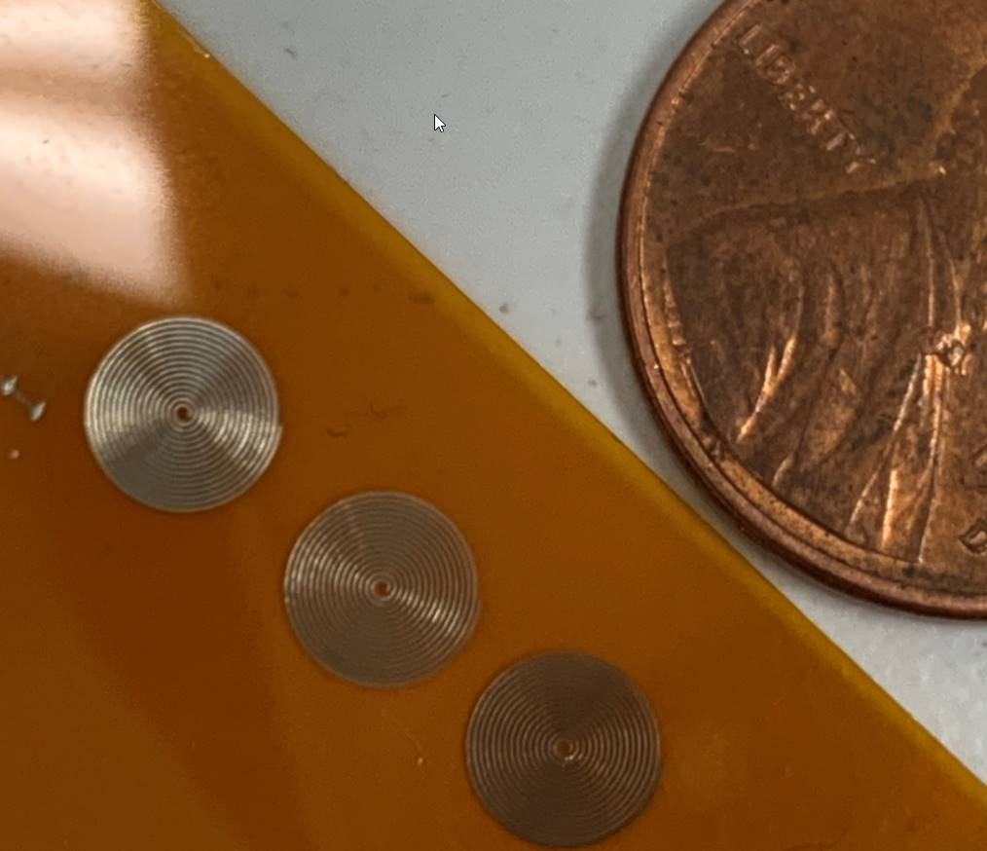
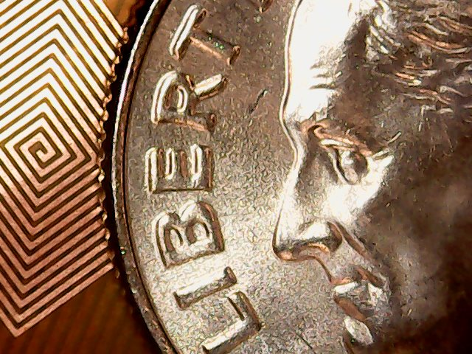
SansEC Sensor Fabrication
Sensors can be various shapes or sizes
The sensors free space resonate frequencies are determined by the overall length of the conductive trace along with the trace width and gap width.
.04 mm trace width from NanoJet printer
(second generation Aerosol 3D printing technology)
.15 mm trace width using conventional etching printed circuit board manufacturing techniques

Slide 13
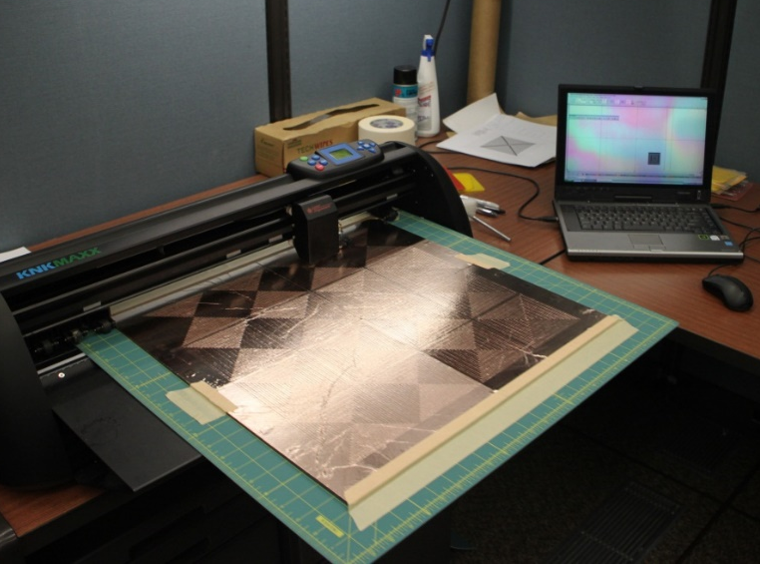
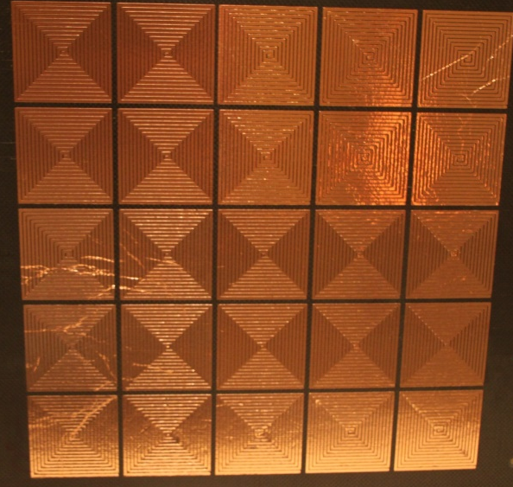
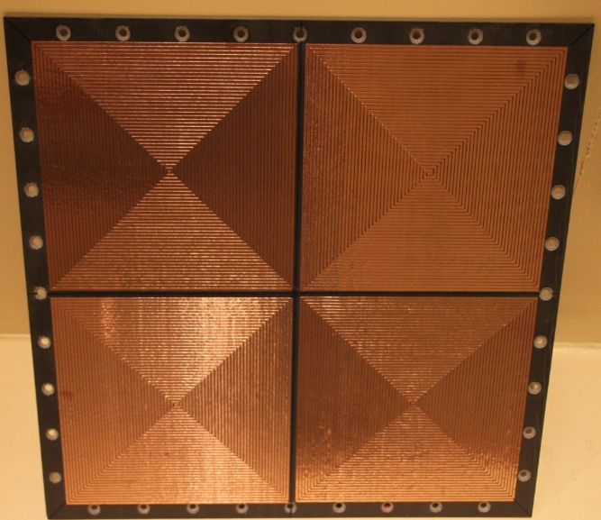


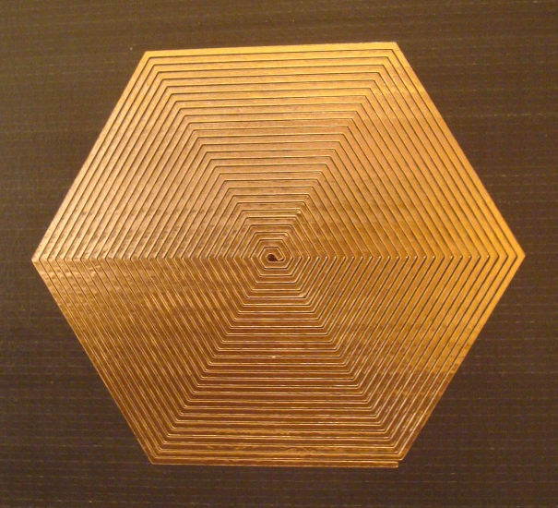
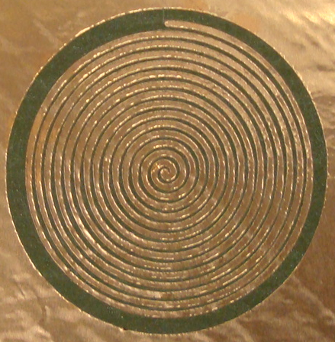
SansEC Sensor Fabrication
Klick-n-Kut Cutter
5x5 Square Array
2x2 Square Array
Triangular
Square
Hexagonal
Circular

Slide 14
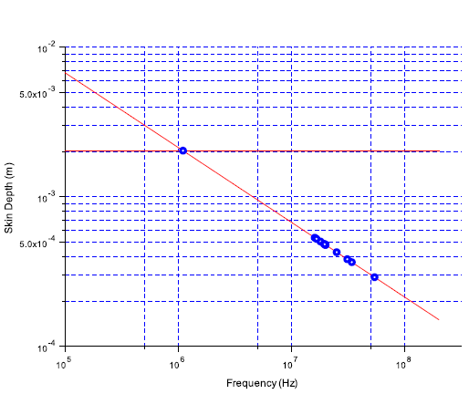
SansEC Sensor Fabrication
Skin Depth relative to Frequency
10 mm
1MHz
100MHz
The sensor trace thickness must be greater than the skin depth

Slide 15

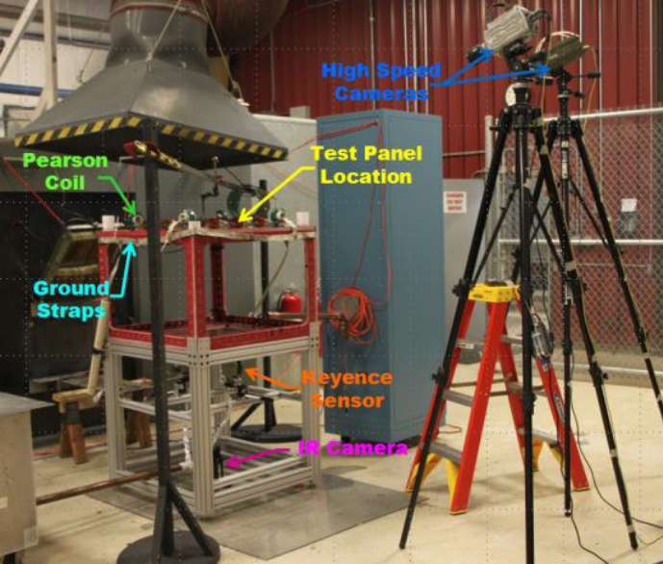

Applications – Composite Smart Skin
Program research focused on using SansEC Sensors on Carbon Composites
Composite aircraft require a thin layer of metal in the outer skin to protect avionics and airframe from lightning damage.
Post-flight ground inspection is conducted after a suspected lightning strike to identify continued air worthiness. (Visual inspections/Tap Test)
Demonstrated Lightning Strike Protection conductive layer can be replaced with resonant sensors to provide comparable lightning mitigation characteristics and damage detection.
Lightning Testbed
Lightning Strike Video

Slide 16
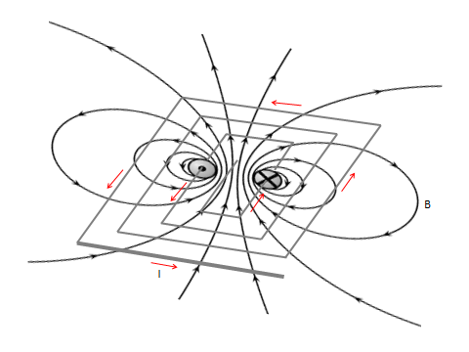

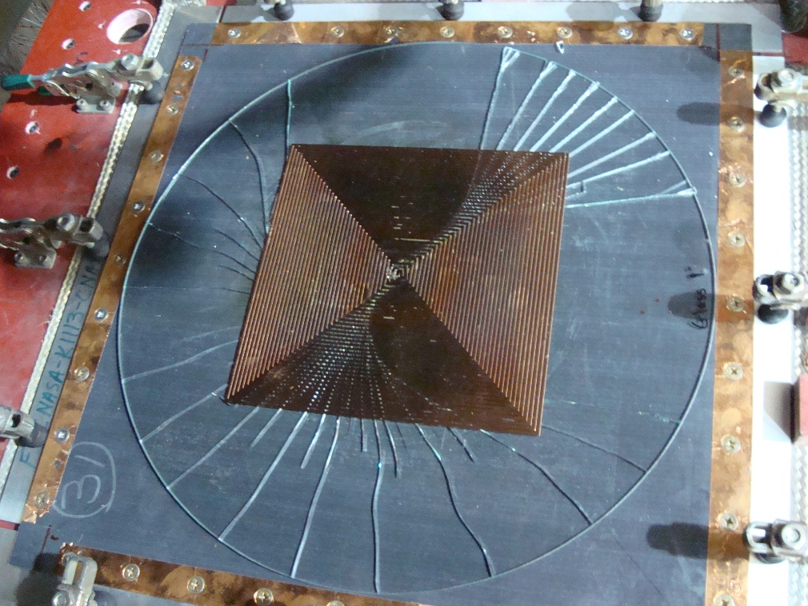
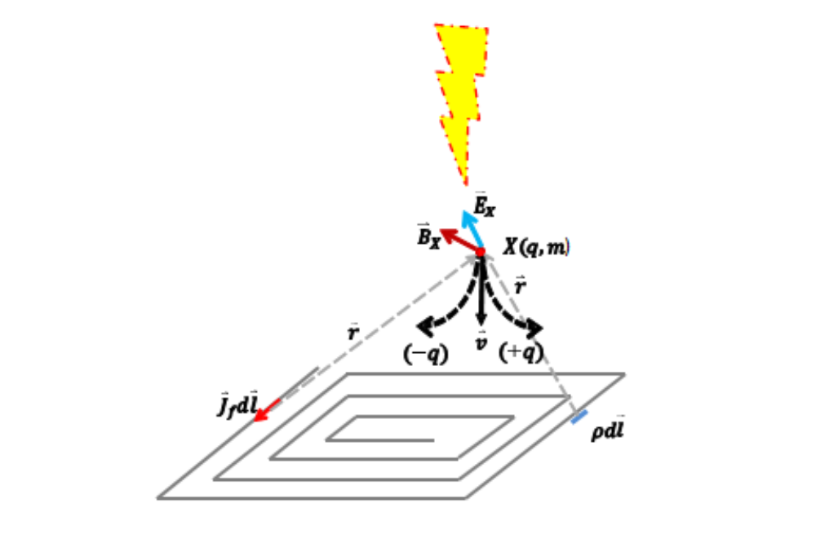
Applications – Composite Smart Skin
Lorentz Force
Sensor will generate a Lorentz Force on incoming charged particle

Slide 17
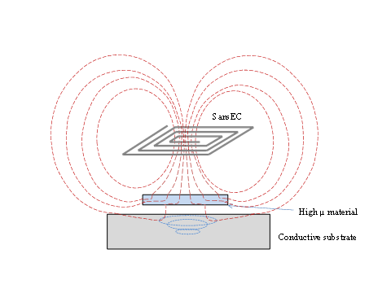
Applications – Composite Smart Skin
Operation on Carbon Fiber Composites requires a thin sheet of high permeability material to sustain the resonance.

Slide 18
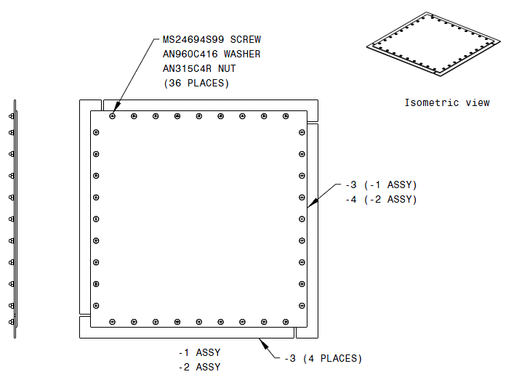
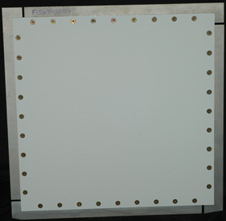
Universal Common Practice Guide for Lightning Damage Testing of Composites Panel Design
Applications – Composite Smart Skin
Previous Program Research
Layup: 16 ply tape with 2 ply fabric
[(SURF)(ECF)(0/90F)/45/90/-45/0/45/90/-45/0/0/-45/90/45/0/-45/90/45/(0/90F)]
Tape: Hexcel 8552/AS4 (HexPly 8552/AS4),
Fabric: Hexcel 8552/AS4 (HexPly 8552 / A193-PW, 3K-70-PW)
Lightning Protection: Dexmet 3CU7-100FA (3mil copper mesh)/ SansEC Smart Skin
Primer: 0.5-1.5 mils thickness
Top coat: 4 to 6 mils per Mil-F-18264 or equivalent.
Test Panel

Slide 19
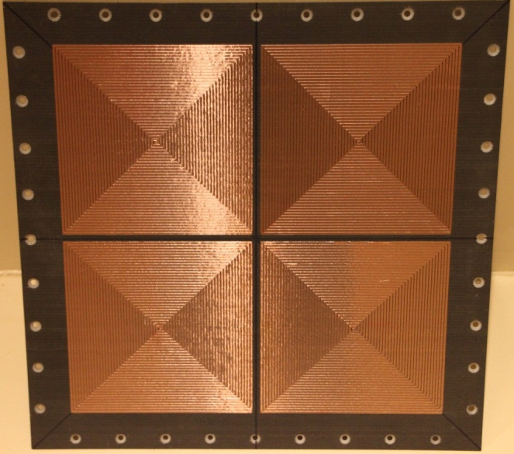
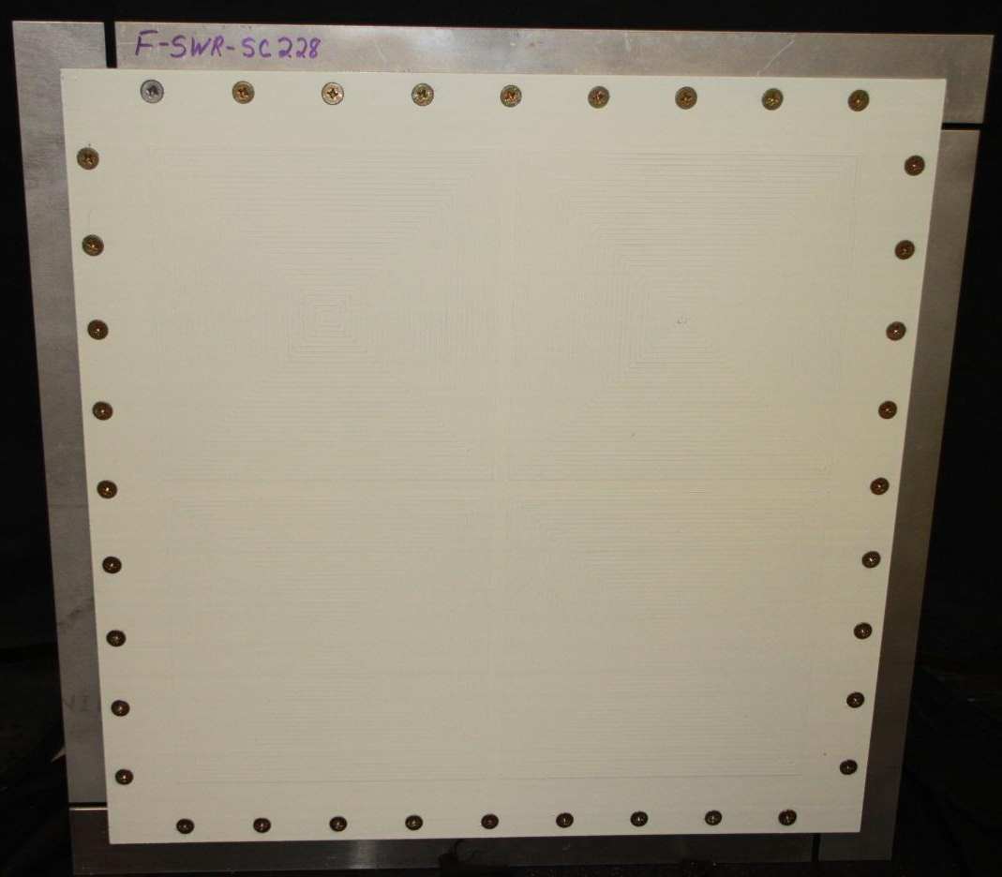
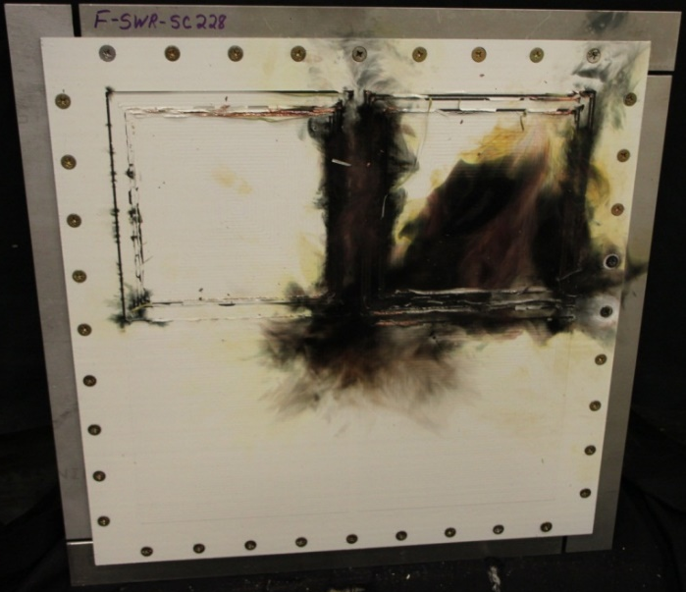
Applications – Composite Smart Skin
Previous Program Research
  SansEC Fiberglass Reinforced Plastic LSP Test Panels
Pre-Paint Test Panel
Pre-Strike Test Panel
Post-Strike Test Panel
8 inch SansEC Array

Slide 20
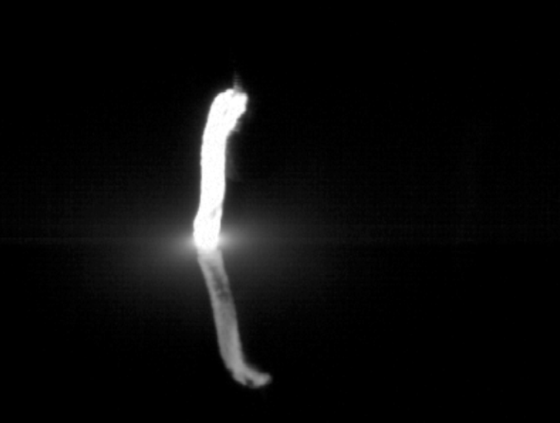
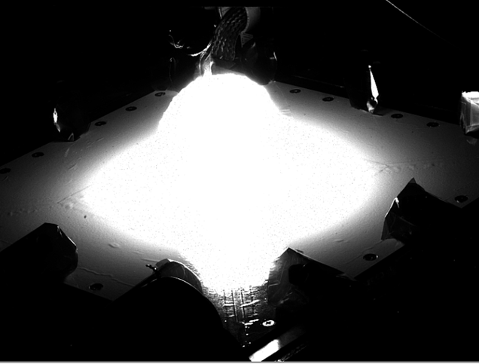
Applications – Composite Smart Skin
Previous Program Research
Carbon Fiber Panel Lightning Direct Effects Testing
Two 100 kA Strikes
High Speed Video First Frame showing Lightning Strike Initial Attachment on Mesh Protected Carbon Panel
High Speed Video First Frame showing Lightning Strike Initial Attachment on SansEC Protected Carbon Panel

Slide 21
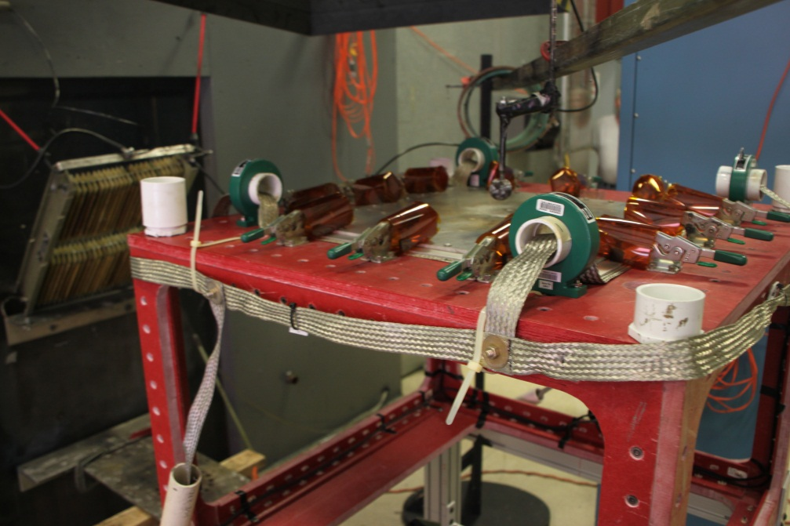
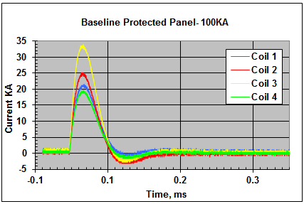
Applications – Composite Smart Skin
Previous Program Research
Electrical Current on the 4 Edges of the Test Panel were Independently Monitored during Lightning Test
Pearson Probes mounted on Test Bed
Current Data collected during 100KA Strike
4 independent current monitors enable measurements on the 4 edges
Inductive effects from ground strap installation should be minimized

Slide 22
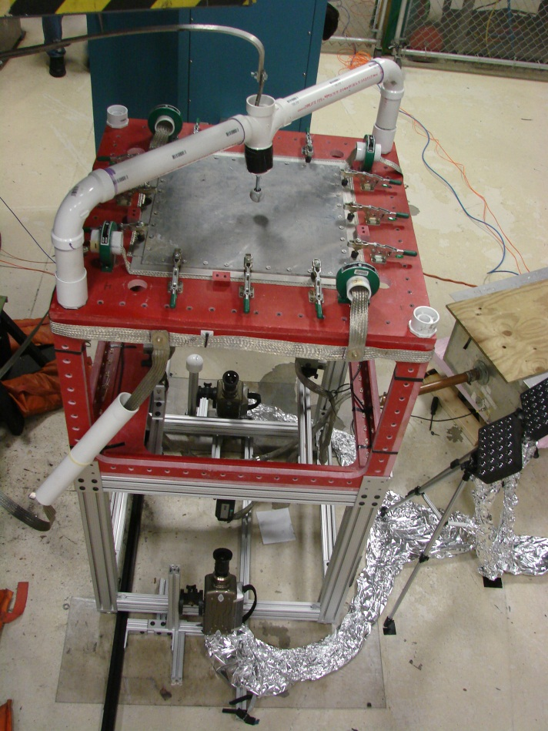
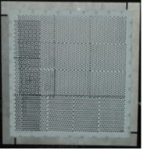
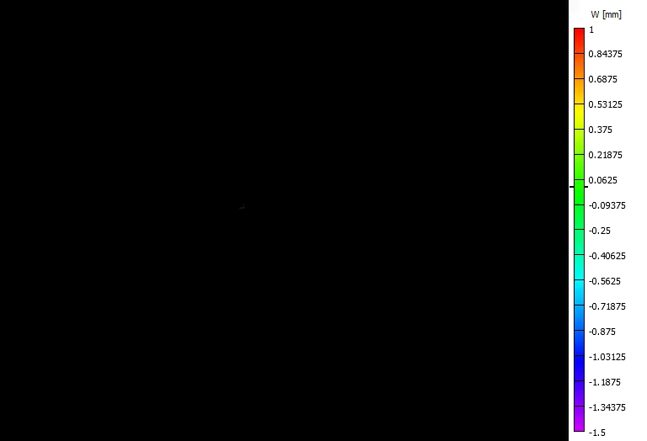
Mechanical deflection is measured using optical sensors or digital image correlation cameras
Applications – Composite Smart Skin
Previous Program Research
Digital Image Correlation Video
Digital image
Correlation
cameras

Slide 23
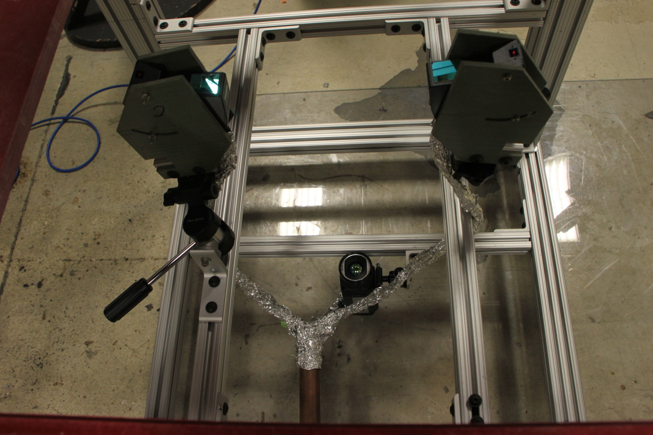
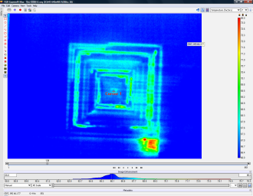
Applications – Composite Smart Skin
Previous Program Research
Backside Thermal Data was Acquired using FLIR Systems SC645 IR Camera
IR Camera
Infrared (IR) Camera Setup
Backside IR image of 8” SansEC LSP on Fiberglass Substrate

Slide 24



Applications – Composite Smart Skin
Previous Program Research
Hotter temperatures in the IR image represent the location of lightning attachment or current propagation.
Lightning Attachment was observed to occur at high electric field locations.
Computed E Field
Backside IR Temperature
Post Strike Damage

Slide 25



Universal Common Practice Guide for Lightning Damage Testing of Composites NDI Assessments
Applications – Composite Smart Skin
Previous Program Research
Lightning Experiments – Damage Assessment
Pre-Test NDI: Inspect the cured panel with a through transmission ultrasonic (TTU)'C' scan inspection at 5 MHz. A defect is defined as an area with ultrasonic attenuation that is at least 6db larger than the attenuation of the adjacent areas without flaws greater than 0.50 inch in diameter. Multiple defects are allowed, up to three (3) per panel as long as they are at least 1.00 inch apart.
Post-Test NDI: Pulse-Echo Ultrasonic Assessment, X-ray Assessment (Optional)
  Areas with ultrasonic attenuation >6dB larger than adjacent areas without flaws or defects.
Destructive Damage Assessments
  Taper sand to remove damaged material, use P-E Ultrasonics to verify. Then count plies remaining.
Photos from NASA Document Number: DOC-128697
TTU Data
Damage Assessment

Slide 26






Applications – High Efficiency Plasma Generator
Previous IRAD Research
Dielectric Barrier Discharge (DBD) SansEC Sensor
Double sided SanEC Design for DBD Test
Pitch Centerline
Front Trace
0.100 in.
Substrate
0.100 in.
Back Trace
0.03125 in.
0.050 in.
Section A-A
DBD Sensor Mounted inside Ventilation Hood
Experimental Setup
Response at 2KHz
Response at 10KHz

Slide 27


Applications - Wearables
Conductive Yarn Sensors Embedded in Textiles
Video showing instantaneous temperature change
Experimental Setup

Slide 28







Applications - Wearables
Hand Gesture Measurements

Slide 29
Detectable Phenomena
If the monitored phenomena undergoes a change in its electrical impedance, SansEC sensing can possibly detect it.
Structures & Materials
  Composite Damage
  Stress & Strains
  Flutter/Morphing
Habitat Environmental Conditions
  Temperature
  Humidity
  Pressure
Physiological Measurements
  Vital Signs
  Body Mechanics
  Intercranial Fluids
Rocket/Jet Engines
  Fuel Cavitation
  Performance Monitoring
  Turbine Blade Monitoring
Chemistry
  PH Level
  Contaminations
  Water/Ice Detection
  Mineral Exploration
Autonomous Assembly
  Proximity
  Angular Rotation
  Fastener Torque
  Integrity Monitoring

Slide 30
Conclusions
SansEC Sensors
Wireless
Passive
Non-Contact
Electromagnetic Resonators
Used to detect change in a physical phenomena by measuring/monitoring electrical impedance
Measurement components include the sensor, interrogator, loop antenna and signal processing
The physics-based data features work well in machine learning algorithms for quantification

Slide 31
Reference Publications
Szatkowski, G. N., et al, “Open Circuit Resonant (SansEC) Sensor Technology for Lightning Mitigation and Damage Detection and Diagnosis for Composite Aircraft Applications”, NASA TP 2014-218554 https://www.worldcat.org/title/open-circuit-resonant-sansec-sensor-technology-for-lightning-mitigation-and-damage-detection-and-diagnosis-for-composite-aircraft-applications/oclc/916508919
Woodard, S. E., et al, “SansEC sensing technology — A new tool for designing space systems and components”, IEEE 2011 Aerospace Conference https://ieeexplore.ieee.org/document/5747495
Wang, C., et al, “Open Circuit Resonant (SansEC) Sensor for Composite Damage Detection and Diagnosis in Aircraft Lightning Environments”, 4th AIAA Atmospheric and Space Environments Conference, June 25-28, 20012, New Orleans, LA https://ntrs.nasa.gov/archive/nasa/casi.ntrs.nasa.gov/20120011948.pdf
Delelegn, D. T. et al, “Data Driven Understanding of SansEC Sensor Using Random Forest”, NASA study https://tpsas.larc.nasa.gov/lf99_view.cfm?lf99_id=34315&lf99_action=view
Cluff , Kim, et al, “Passive Self Resonant Skin Patch Sensor to Monitor Intraventricular Volume using Electromagnetic Properties of Fluid Volume Changes” https://ieeexplore.ieee.org/document/8472269
Griffith, Jacob, et al, “Non-invasive Electromagnetic Skin Patch Sensor to Measure Intracranial Fluid-Volume Shifts” https://ieeexplore.ieee.org/document/7516261

