Slide 1
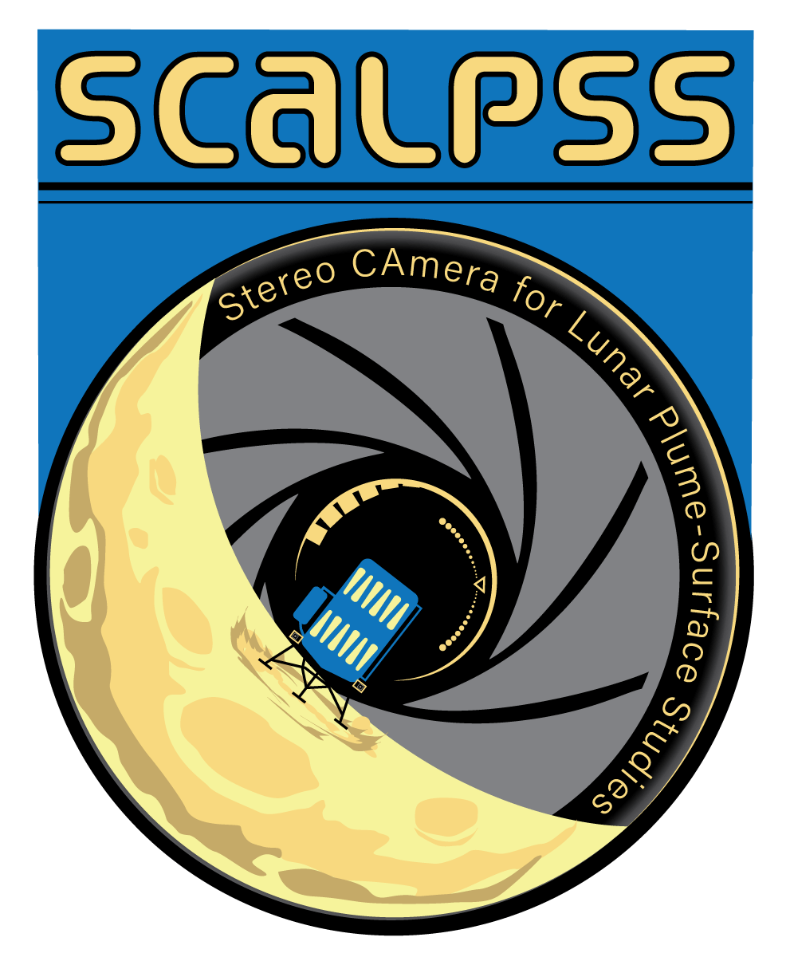

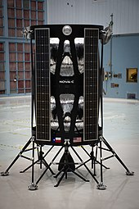
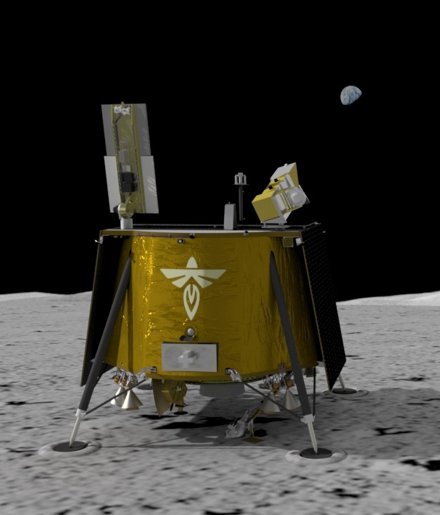
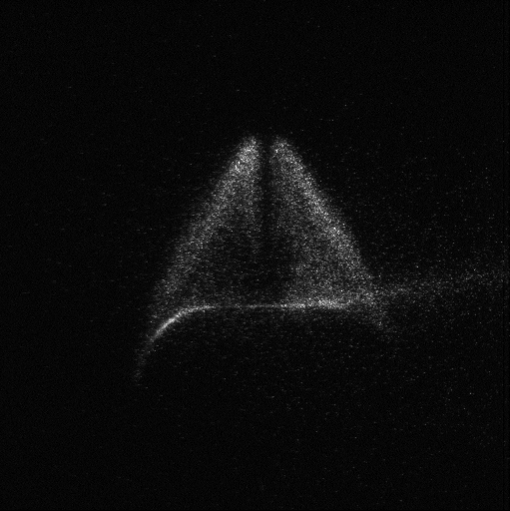
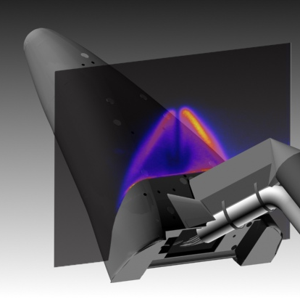

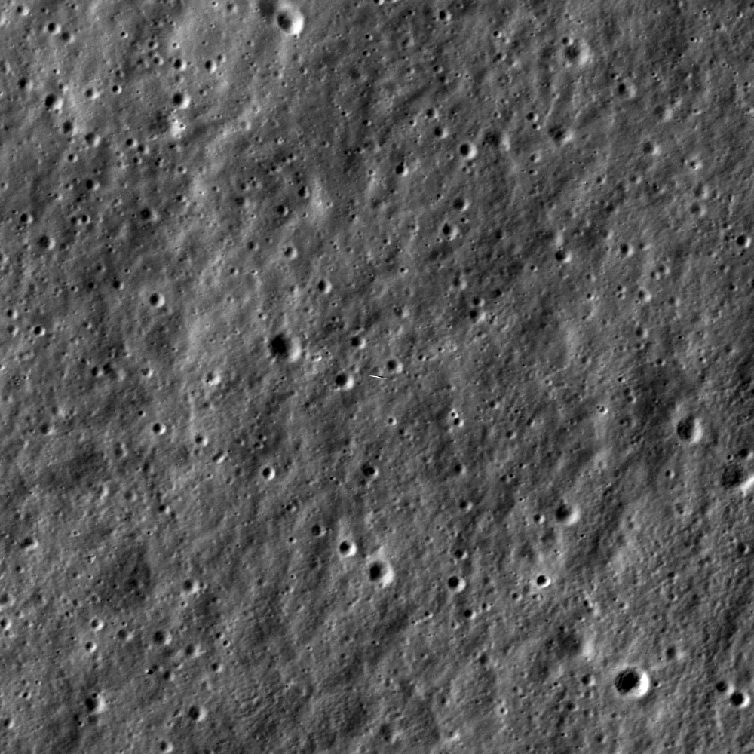

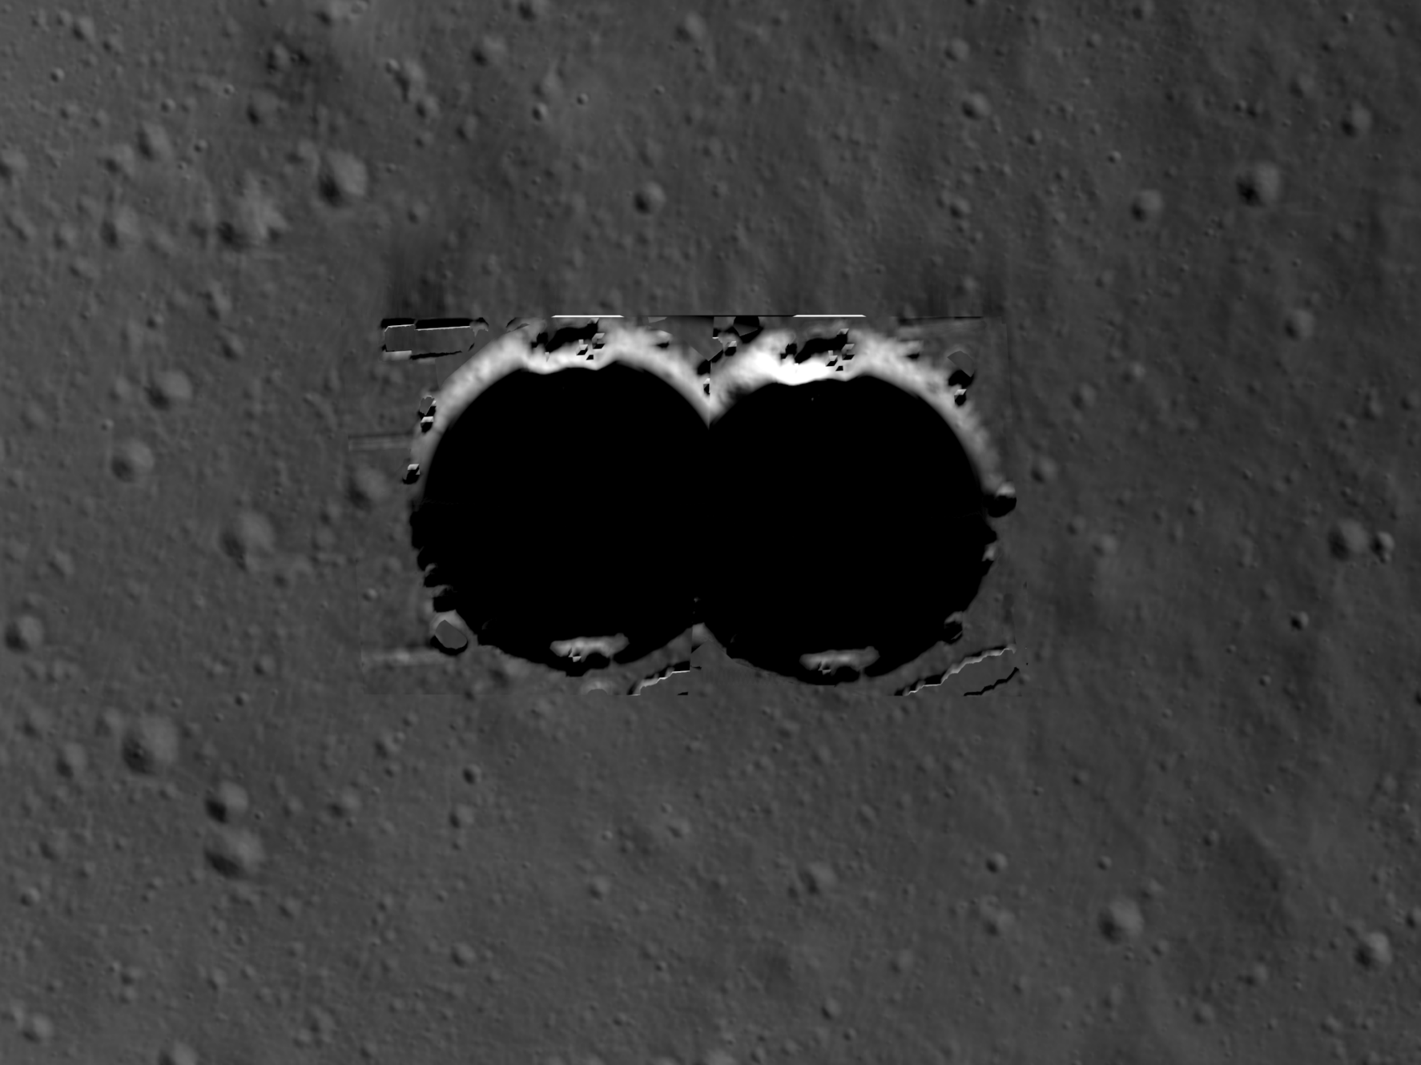
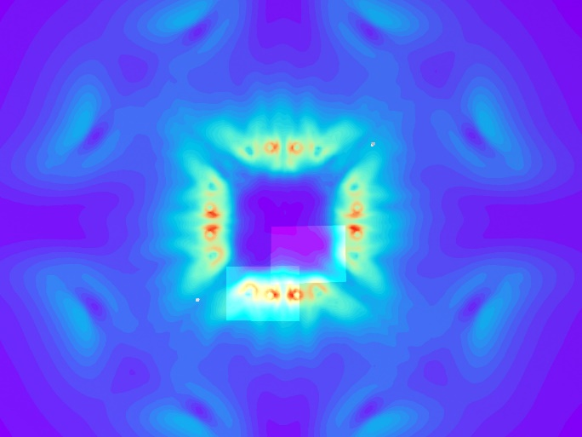
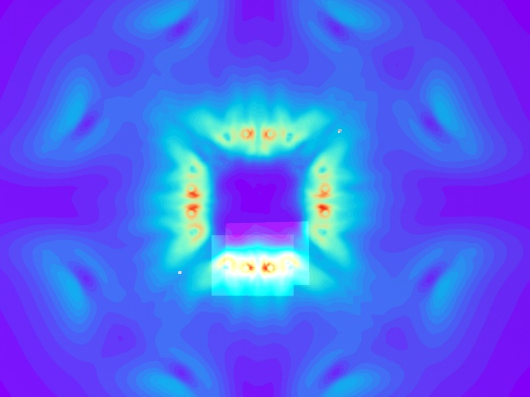
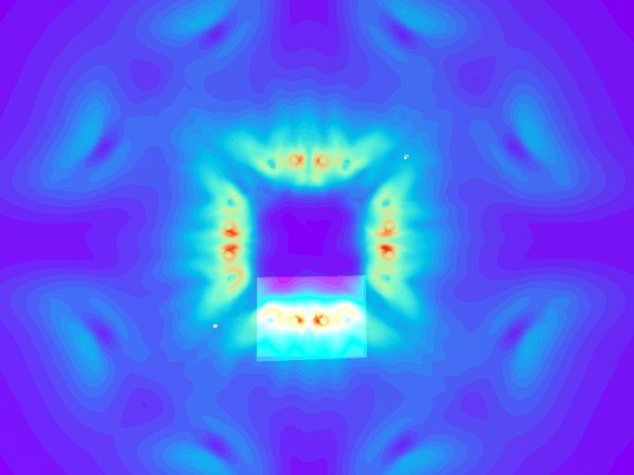
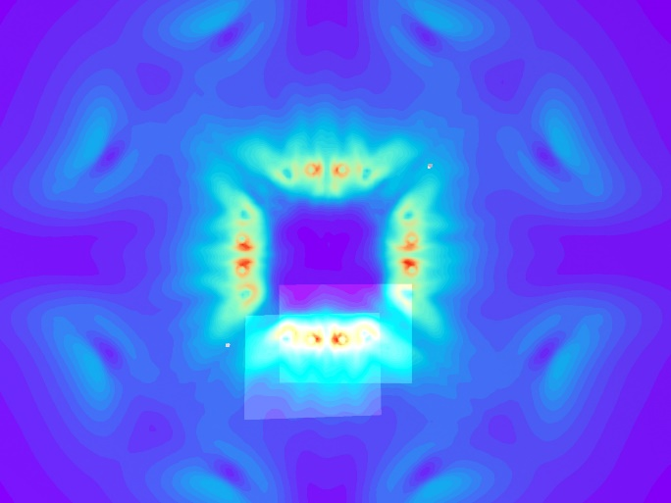
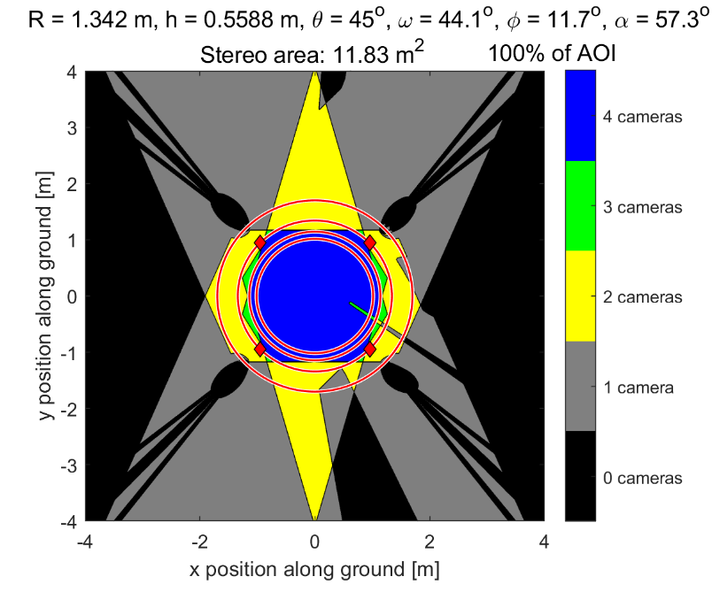
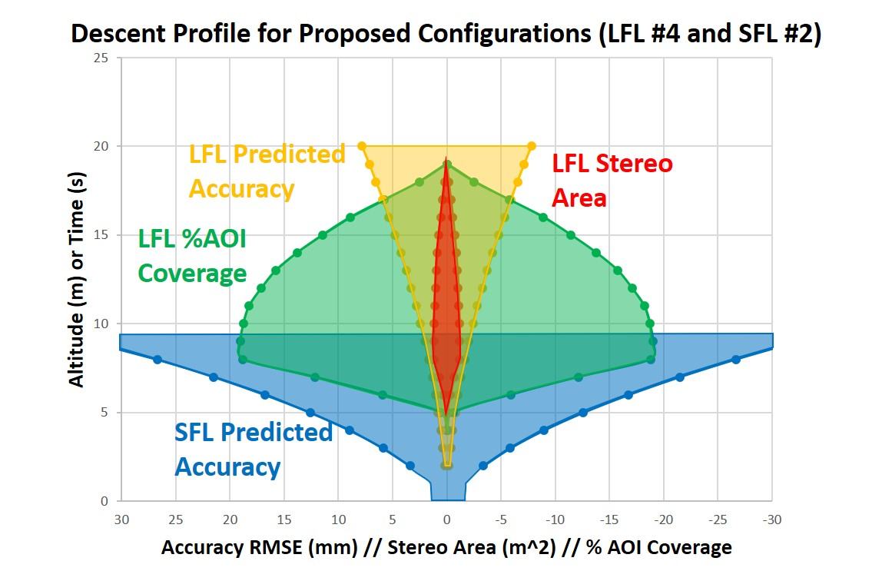



Simulation and Optimization of a Lunar Plume-Surface Interaction Measurement System
OLIVIA K. TYRRELL*, RYAN J. THOMPSON*, PAUL M. DANEHY*, WILLIAM C. KROLICK†, ANDREW B. WEAVER†, JEFF S. WEST§
*NASA LANGLEY RESEARCH CENTER, HAMPTON, VA, †JACOBS SPACE EXPLORATION GROUP, HUNTSVILLE, AL, §NASA MARSHALL SPACE FLIGHT CENTER, HUNTSVILLE, AL
Overview:
The Virtual Diagnostics Interface (ViDI) is applied for the analysis, simulation and design of a camera system that will perform photogrammetry during descent and post-landing on the surface of the Moon to assess plume-surface interaction.
What is ViDI?
What is SCALPSS?
Without ViDI:
“What am I looking at?”
With ViDI:
Stereo Cameras for Lunar Plume Surface Studies
What: a multiple camera photogrammetry system that will collect images of the lunar surface during descent and post landing.
Objective: study the topic of plume-surface interaction on the lunar surface.
  Surface Erosion
  Regolith Ejection
  Crater Formation
Why: these phenomena can cause damage and health risks to mission infrastructure and crew on future manned missions to the Moon and Mars and have limited testing and simulation capabilities on Earth.
Leeside Imaging on Lifting Body (X-33)
SCALPSS 1.0: Intuitive Machines’ Nova-C Lander
Landing on the Moon in 2022
Four camera system to image the crater formed by main engine thruster after landing.
SCALPSS 1.1: Firefly Aerospace’s Blue Ghost Lander
Landing on the Moon in 2023
Six camera system to image the undisturbed regolith during descent and the craters formed by four pairs of attitude control thrusters after landing.
Virtual environment that combines 3D modeling, camera simulation and data visualization to plan and optimize diagnostic experiments. Typically used for wind tunnel experiments at NASA Langley Research Center.
Simple schematic of SCALPSS system capturing crater formation
Simulation and Analysis:
Long Focal Length Lens Cameras (2) – capture images of partial AOI prior to erosion during descent
Challenge: SCALPSS 1.1 aims to capture stereo imagery both before and after erosion of the regolith has occurred.
  At what altitude will erosion start to occur?
  What is the necessary accuracy for the system to take measurements above the surface, and how can this be predicted?
  How large of an area can the cameras capture and how long will their views be overlapping? What is our area of interest (AOI)?
Development of empirical model for accuracy of a stereo pair of cameras:
Lander
$$Accuracy_{RMSE}\left(mm\right)=0.611∗(\frac{3.37}{f})(\frac{1.9}{d}){\left(h\right)}^{1.79}$$
$$h$$
$$d$$
Surface
50mm focal length lens
Single camera coverage in red Stereo camera coverage in orange
Short Focal Length Lens Cameras (4) – capture images of full AOI after landing
Altitude = 8m
Altitude = 5.84m
Altitude = 7.37m
Altitude = 8.13m
Altitude = 9.65m
Simulated long focal length camera image of a pair of craters forming underneath an ACS thruster pair.
Diagram of CFD-derived solutions for erosion of the lunar surface underneath the four pairs of thrusters with projected camera views at varying altitudes.
Results:
Cohesive prediction of camera coverage, accuracy, and imagery during descent and post-landing informing an optimized camera configuration.
Altitude = 8m
Simulated camera views of the four short focal length cameras with the erosion CFD performed at NASA Marshall Space Flight Center.
Stereo coverage and field of view plot for a selected four short focal length camera configuration.
Contact: Paul Danehy
NASA Langley Research Center • Hampton, VA
paul.m.danehy@nasa.gov
Acknowledgements: This work was supported by the NASA Space Technology Mission Directorate (STMD) and an internship grant from the Iowa Space Grant Consortium.

