Slide 1
Aerogravity Assist
(Presentation for ARC/LaRC Summer Interns 8/5/2021)
Jim Arnold, AMA-Inc.,
Retired Chief, Space Technology Division NASA Ames
What is Aerogravity Assist (AGA)?
Example Missions where AGA has been considered
  Solar Probe: Precluded by “Sharp Body” Technology issues.
  Enceladus Exploration: Enabled/Enhanced by Titan AGA Blunt Body technology.
  Caveat: Contamination control of Titan organics during AGA maneuver required.
Suggested forward work

Slide 2
Gravity Assist (GA), Aerogravity Assist (AGA) [1] and Application to Solar Probe Mission
Gravity Assist: Exo-atmosphere. Used extensively for outer planet missions
Aerogravity Assist -> GA + atmospheric flight. Not yet adopted for a mission.
Drag Minimization -> High L/D , “Sharp” body (Wave Rider) [2] -> Severe leading-edge heating -> Thermal Protection System (TPS) and packaging issues.
Aerogravity assist can be used to decrease or increase a spacecraft's heliocentric velocity V_{s/c} depending on whether it is desired to travel toward or away from
the Sun. See heliocentric vector diagrams.
AGA Application to Solar Probe mission - 1992 analysis [1]
Venus AGA only to study sun at 4 solar radii -> 30 km/s at Venus periapsis.
Venus AGA followed by Mars AGA -> 20 km/s in Mars atmosphere. 13 - month flight.
Technology issues were problematic for use of AGA on this Solar Probe mission.
GA only Application to Parker Solar Probe mission [3]
Parker Solar Probe (SPS mission) using 7 Venus GA’s, over 7 years is achieving mission objective to study sun from 8.9 Solar radii.
1

Slide 3
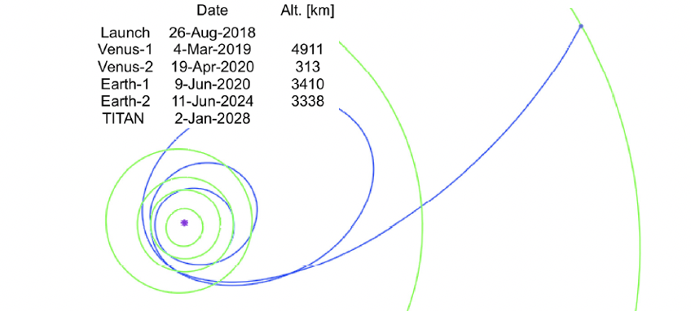
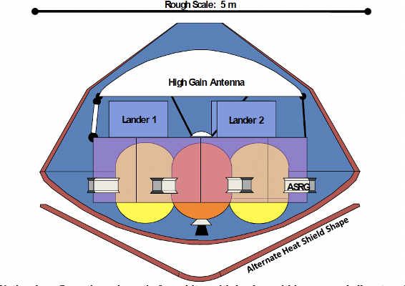

Concept of Operation for the Exploration of Enceladus by Spilker, et al. [4]
(1) Earth -> Saturn 4 GAs
(2) Titan AGA with a 5 m
conceptual blunt body (BB)
(4) Exploration of Enceladus’s geysers
and ocean from orbit and/or landers
• Habitability of Enceladus’ ocean established
by Cassini measurements.
• 2009 analysis by Spilker, et al., [4]: Concepts for
9 Enceladus explorations including orbiters and
landers enabled by BB Titan AGA.
• 2018 NASA Roadmap to Ocean Worlds strongly
recommended search-for-life mission to
Enceladus be a high priority for next decade [5].
• Many prior studies of Titan AGA e.g. [1, 6 and 7]
Enceladus
(3) 2.25 yr. GA Pumpdown
to Enceladus (Moon Tour)
Image courtesy of NASA JPL
2

Slide 4
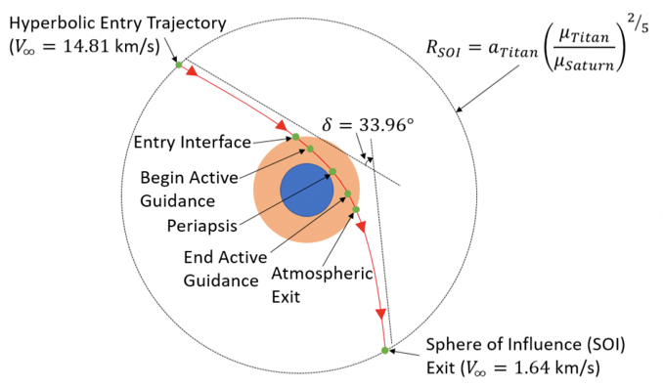
Support for the Spilker, et al. Mission ”E” Concept using Blunt Body Titan AGA [8,9]
Heat Shield [8]
GN & C [9]
• Titan AGA TPS: 60^{O} sphere-cone, 5 m base dia., 3800 kg mass.
• TRAJ code. 3-D DoF Titan AGA trajectory.
• AGA flight occurs above methane rain and condensate haze.
• Peak Heating (PH) and heat shield mass fraction (HSMF)
depend upon intercept location of space craft with Titan’s orbit.
• HSMF mass estimated from stagnation point sizing.
• Low HSMF TRL 9 TPS Phenolic Impregnated Carbon Ablator [10]
(PICA) solutions at lower speeds. TRL 6 Heatshield for Extreme
Entry Environments [11] (HEEET) works for 14.81 km/s case.
• Titan AGA GN &C for the 2/23/2043 case from [8].
Heritage 70-deg sphere cone based on (MSL).
• POST2 code. 6 DOF based on repeated predictions
using a numerical predictor corrector. (NPC). Control
using the Direct Force Control (DFC) method.
• G&C methods would work with other heritage shapes
(e.g., Apollo capsule or Genesis 60^{O} sphere-cone).
• AGA maneuver reduces the necessary propellant load
to observe Enceladus by 99.5 % (W/O AGA aeroshell).
3

Slide 5
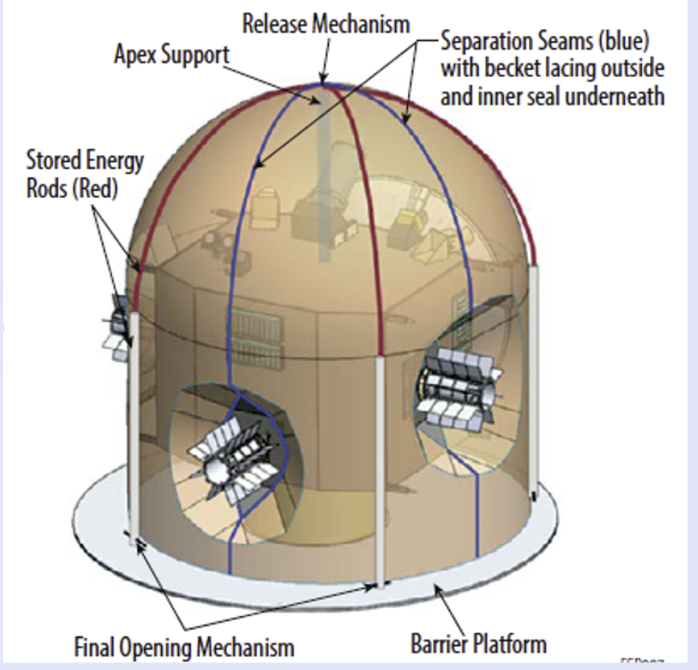
Observations Re 2009 [4] and 2020 [12] Enceladus Mission Concepts
2020 Study by Mackenzie, et al. [12]
7-yr time-of-flight (TOF) from October 2038 launch to Saturn orbit using Space Launch System
(SLS) with a CASTOR30B upper stage/C3= 106.6 km²/s² and a Jupiter GA flyby to shorten transit
time to Saturn.
Low-cost alternative: 9.3-yr TOF using Falcon Heavy expendable launch vehicle/C3= 41 km²/s²
with two Venus GA’s plus one Earth GA.
No Titan AGA. 4.5-yr Pumpdown (moon tour).
Contamination control by staying ”safe” distance from Titan.
2009 Study by Spilker, et al, [4]
Titan AGA and 2.25 year pumpdown (Moon Tour).
Contamination control during Titan AGA was not addressed.
Observation
if emerging bio-shield technology could be extended for use from launch – post Titan AGA, and
in-cruise bake-out matures [13], contamination control might be acceptable allowing the use of
Titan AGA for Enceladus exploration. If so, this could shorten the duration of the Mackenzie
et al., Enceladus mission concept by 2.25 years
Orbilander [12]
Full Orbilander
Bio Barrier [10,11]
Bio Shield [12,13]
4
4

Slide 6
Summary and Suggestions for Forward Work
Summary
• AGA can increase or decrease hyperbolic exit velocities with magnitudes larger than by GA.
• Technology needed to address leading-edge heating on “sharp” AGA vehicles for “Fast” outer planet missions.
• Whitepapers for the 2023 Decadal Survey support the 2009 hypothesis by Spilker, et al. that use of blunt
body AGA at Titan is enabling for missions looking for life signatures in Enceladus’ ocean: GN & C can be
accomplished with heritage bunt body vehicles fitted with low mass, high TRL heat shields.
• Titan AGA could significantly reduce mission duration and propellant load for the Orbilander Enceladus
2020 mission concept by MacKenzie, et al.
• Contamination control of organics resulting from flight in Titan’s atmosphere is an issue that must be
addressed for use of AGA for Enceladus missions.
Suggested forward work
• Conduct research to support or refute the hypothesis that contamination control is achievable is by
emerging technology [13] and that the AGA aeroshell could be safely discarded during the moon tour [14].
• Encourage study using modern entry technology tools to evaluate sharp leading-edge solutions being used
for hypersonic airbreathers [15] and Space Station crew escape vehicles [16] for potential use in AGA.
Success would have great pay-off for solar system exploration mission designers.
5

Slide 7
Acknowledgments
1. Adopted figures from the cited literature herein were created by authors conducting research
funded by NASA. In most cases, use of the figures was approved by the lead authors.
2. J. Arnold acknowledges the support of the authors of the companion Decadal Survey Whitepapers [8, 9]
displayed in chart 3, herein:
[8] James O. Arnold, T. R. Spilker, D. M. Cornelius, G. A. Allen Jr.., A. M. Brandis, D. A. Saunders, M. Qu,
R.W. Powell, M. L. Cable and R. A. S. Beck.
[9] Benjamin Tackett, Richard W. Powell, Soumyo Dutta, Rafael A. Lugo and Daniel Engel.
3. J. Arnold appreciates the invitation from Dr. Dutta to present the information herein describing AGA
to the Ames and Langley 2021 summer interns.
4. J. Arnold appreciates the funding for his research on Titan AGA provided by AMA-Inc.
6

Slide 8
References
[1] Randolph, J. E., and McRonald, A. D., “Solar System "Fast Mission" Trajectories Using Aerogravity Assist.”, JSR , Vol. 29, No. 2, March-April 1992. https://ww.sciencedirect.com/science/article/pii/S0094576520306512
[2] Anderson, J. D. Jr., Lewis, M. J., Kothariand “Hypersonic Waveriders for Planetary Atmospheres” VOL.,.,28 NO 4 JULY-AUGUST 1991 , JSR.
[3] Guo, Y., et al., “Execution of Parker Solar Probe’s Unprecedented Flight to the Sun and Early Results”., Acta Astronautica Volume 179, February 2021, Pages 425-438. https://www.sciencedirect.com/science/article/pii/S0094576520306512
[4] Spilker, T. R., Moeller R. C,. Borden, C. S., Smythe W. D., Lock, R. E., Elliott, J. O., Wertz, J. A., and Strange, N. J., “Analysis of Architectures for the Scientific Exploration of Enceladus,” IEEEAC paper #1644, Version 5, updated January 9, 2009.
[5] Hendrix, A. R., Hurford, T. A., Barge, L. M., Bland, M. T., Bowman, J. F., Brinckerhoff, W., Buratti, B. J., Cable, M. L. et al., The NASA Roadmap to Ocean Worlds. Astrobiology, 19 (1), 1-27, 2018.
[6] Ramsey, P. and Lyne, J. E., “Enceladus Mission Architecture Using Titan Aerogravity Assist for Orbital Capture About Saturn,” JSR, 45(3):635-638 May 2008.
[7] Lu Y., Ph.D. Thesis, Purdue: “Mission Design and Analysis using Aeroassist Maneuvers,” August 2019. See Chapter 2, page 23, where it is stated that “Titan heating estimates do not account for radiation
7
[4] Arnold, J. O. et al., “Mature Heat Shield Candidates for the Titan Aerogravity Assist Vehicle.” To be submitted to a peer reviewed journal.
[5] Enceladus and the Icy Moons of Saturn: Editors: Schenk, P. M. et al., The Arizona University Press, 2018. https://uapress.arizona.edu/book/enceladus-and-the-icy-moons-of-saturn
[7] MacKenzie, S. et al., “Flagship Concepts for Astrobiology at Enceladus:
https://docs.google.com/spreadsheets/d/1MlcRloG9zRDm-DIWG099BcgmoZBLI7pXWaJSdLqCSn0/edit#gid=0
[8] Allen, G. A. et al., “The Trajectory Program (TRAJ): Reference Manual and User's Guide,” NASA TM-2005-212847, 2005.

Slide 9
[8] Arnold, et al., “Heatshields for Aerogravity Assist Vehicles Whose Deceleration at Titan Saves Mass for Future Flagship Class Exploration of Enceladus” Decadal Survey White paper # 431. https://data.surveygizmo.com/reportsview/?key=623127
[9] Tackett, B, et al., “Guidance and Control Approaches that Enable Titan Aerogravity Assist for an Enceladus Mission”, White paper # 544. https://data.surveygizmo.com/reportsview/?key=623127-
[10] Beck R. A. S. et al., “Development of the Mars Science Laboratory Heatshield Thermal Protection System, 26 Aug, 2014.” https://arc.aiaa.org/doi/full/10.2514/1.A32635.
[11] Venkatapathy, E. et al., “Entry System Technology Readiness for Ice-Giant Probe Missions,” Space Sci. Rev. (2020). https://doi.org/10./1007/s11214-020-0638-
[12] MacKenzie, S., et al. “Enceladus Orbilander Planetary Mission Concept Study for the 2023-2032 Decadal Survey A Flagship Mission Concept for Astrobiology, http://lib.jhuapl.edu/papers/the-enceladus-orbilander/http://lib.jhuapl.edu/media/filer_public/5a/bb/5abbf99c-cbf7-49df-a420-e64add0e6e0c/enceladusorbilander_2020pmcs.pdf[10864403-ef4f536559932303491907beb4db0cb1&realtime=true. Missions” ,
[13] Eigenbrode, J. L., and Gold, R. E., “Strategies for Stringent Contamination Control for Life Detection
(https://lpsc2021.ipostersessions.com/Default.aspx?s=5E-CD-08-41-7E-6D-18-1F-5E-BA-90-62-B7-D5-0A-B6). See also: Jennifer Eigenbrode, Rob Gold, John Canham, Erich Schulze, Antonios Seas, Alfonso Davila, Therese Errigo, Faith Kujawa, Dave Kusnierkiewicz, Chris Lorentson, Chris McKay (in prep), Contamination Control for Ultra-Sensitive Life-Detection Missions, Frontiers in Space Technology.
[14] Spilker, T. R., Private communication 2020.
[15] Glass, D. E., “Ceramic Matrix Composite (CMC) ThermalProtection Systems (TPS) and Hot Structures for
Hypersonic Vehicles”, [14] 15th AIAA Space Planes and Hypersonic Systems and Technologies Conference
28 April – 1 May 2008, Dayton, Ohio AIAA-2008-2682
[16] Reuther, J. Kinney, D. Smith. S. Kontinos, D, and Saunders, D., “A Reusable Space Vehicle Design Study Exploring Sharp Leading Edges”, Published Online:22 Aug 2012https://doi.org/10.2514/6.2001-2884,
35th AIAA Thermophysics Conference
8

