Slide 1
Space Launch System Payloads Thermal Environments
ICES-2021-61
Jose Roman – SPIE Interface and Integration Lead
Maurice Prendergast – SPIE Thermal Lead
Kayla Daniel/Stephen Wess – SPIE Thermal Analysts
July 12, 2021

Slide 2
Overview of Space Launch System (SLS) Block 1 Vehicle Configuration
SLS’s Block 1 configuration, capable of delivering at least 26 Mt to Trans Lunar Injection (TLI), consists of the Core Stage (CS), four RS-25 engines, two solid rocket Boosters, one Upper Stage (Interim Cryogenic Propulsion Stage), and two adapters (Launch Vehicle Stage Adapter (LVSA) and Orion Stage Adapter (OSA))

Slide 3
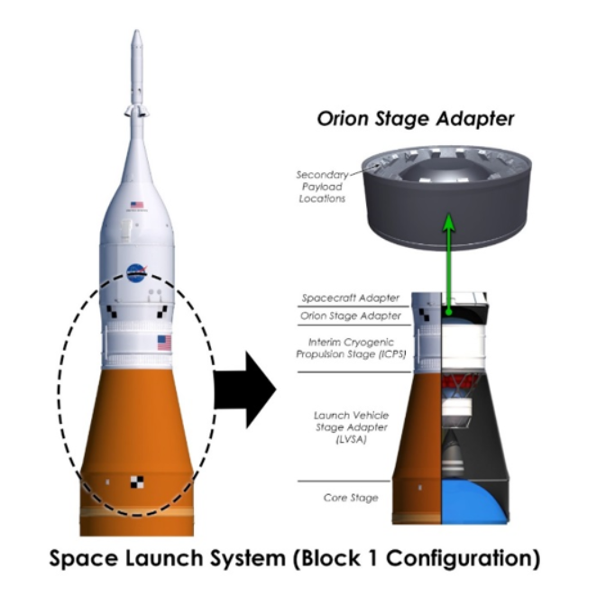
Overview of Integrated Spacecraft and Payload Element (ISPE)
The ISPE has multiple configurations based on the mission being flown.
The ISPE is managed by the Space Launch System Spacecraft Payload Integration & Evolution Office (SPIE)
  For Block 1 ISPE consists of
    LVSA
    Separation System
    ICPS
    OSA
    Secondary Payload System
All mated between the forward portion of the CS and aft portion of the Orion Multi-Purpose Crew Vehicle (MPCV)
Separation System
Space Launch System (Block 1, Artemis I Configuration)

Slide 4
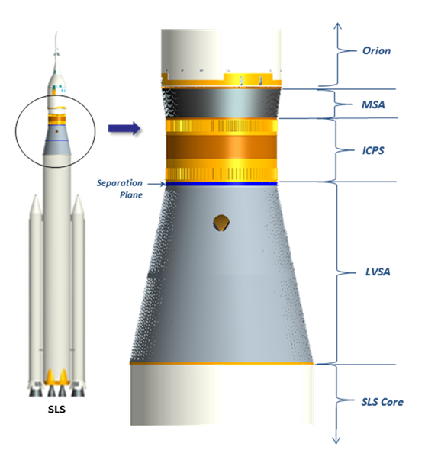
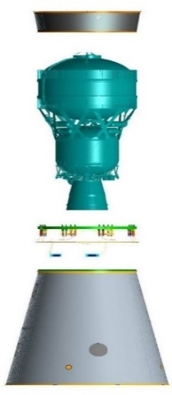
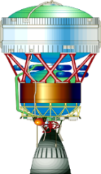
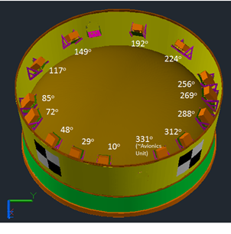
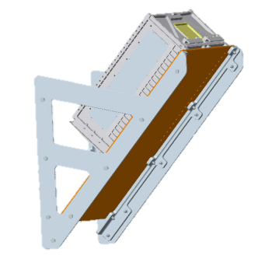
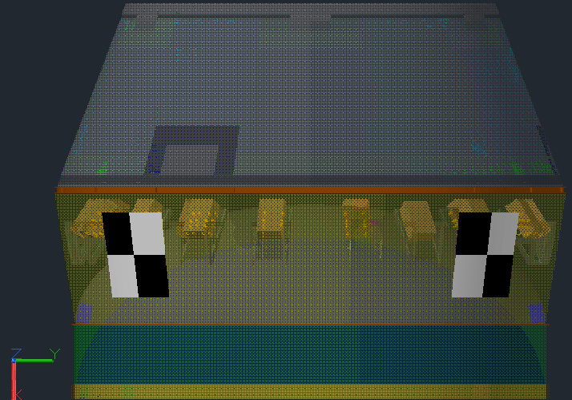
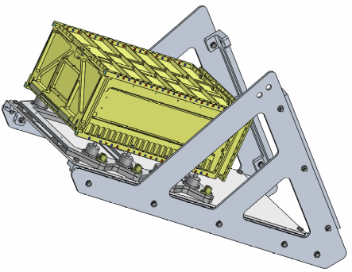
Overview of the Secondary Payload System (SPS)
The Secondary Payload System (SPS) consists of the Secondary Payload Deployment System (SPDS) and the Secondary Payloads (SPLs).
Purpose of the SPDS is to deploy payloads.
SPDS is comprised of an avionics unit (sequencer and battery), dispensers, flight integration cabling, brackets, vibration isolation systems, and the mechanical and electrical Ground Support Equipment (GSE) to support the SPDS.
Diaphragm
AU
Dispenser
SPIE thermal provides environments and does not design a thermal control system for the SPDS.
Modeling terminates at dispenser.

Slide 5
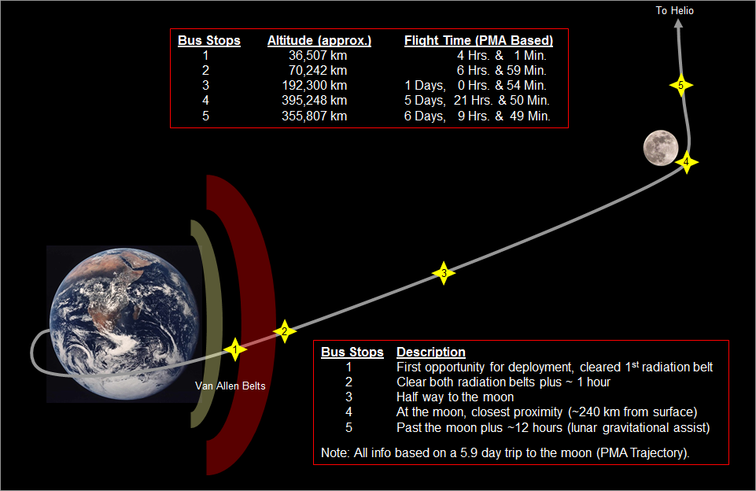
Secondary Payload Bus Stops
The SPLs housed within each dispenser were not modeled, due to lack of configuration details.
  The additional mass would damp the thermal response due to the higher capacitance.
The SPLs remain within the OSA after Orion separation, and through, potentially, some portion of ICPS disposal phase. Planned deployment options are referred to as “bus stops”.

Slide 6
Thermal Analysis
Simulated timeline from L-72 to L+12.79 hours.
  Rollout from Vertical Assembly building (VAB)
  On-Pad (unfueled and fueled)
  Ascent
  On-Orbit to TLI
  Disposal Phase (commences at ICPS hydrazine depletion)
SLS Artemis 1 mission trajectory
Thermal environments are based a combination of natural and induced environments applied to the model using a variety of methods.
Ascent aerodynamic heating environments are input from time zero through CS Main Engine Cut-Off (MECO). Aerodynamic heating is considered negligible during in-space operations.
Disposal Phase disturbances for 9 hours post ICPS hydrazine depletion also assessed
  Bounding attitudes during the disposal phase determined from a 2000 case Monte Carlo analysis performed by MSFC’s Guidance, Navigation, and Mission Analysis Branch
    Solar Exposure was used as the thermal indicator, with high solar exposure indicating more illumination (hot case), and low
    solar exposure indicating a cold case.
    The 3-sigma hot and cold cases capture 99.7% of all possible solar exposure cases resulting from attitude dynamics and
    disturbances.
    ICPS shuts down in a favorable sun angle and a 1 rpm roll.
Conservative assumptions (leveraging Ares I and Ares IX experience) were used for input parameters that are inherently uncertain, such as hold time at cryogenic conditions prior to launch or time of year, time of day for launch.
Orion Spacecraft Adapter and ICPS LH2 tank dome represent the outmost boundary conditions (supplied)
Integrated analysis performed for the prelaunch, ascent, on-orbit and disposal phases of the mission for both hot and cold cases.

Slide 7
Secondary Payload Bus Stops
Integrated SPLs will be exposed to the thermal environments defined below.
SPL Dispenser Temperatures (Prelaunch)
Case | Secondary Payload Dispenser Temperature (°F)
Rollout, NO purge, MAX | 130
Rollout, NO purge, MIN | 26
On-Pad, Purge ON, MAX | 101
On-Pad, Purge ON, MIN | 29
On-Pad, Tanked, Purge ON, MAX | 95
On-Pad, Tanked, Purge ON, MIN | 17
On-Pad, Tanked, Purge ON, MAX Time = 0.0 seconds | 88
On-Pad, Tanked, Purge ON, MIN Time = 0.0 seconds | 24
SPL Dispenser Temperatures (Ascent, On-Orbit to ICPS Hydrazine Depletion)
Case | Dispenser Temperature Ascent (°F) | Dispenser Temperature On-Orbit (°F) to ICPS Hydrazine Depletion
Phase, MAX | 88 | 90
Phase, MIN | 24 | 4
SPL Dispenser Temperatures (Disposal)
Case | Dispenser Temperature (°F) Bus Stop 1 | Dispenser Temperature (°F) Bus Stop 2 | Dispenser Temperature (°F) at 12.79 hours MET
Phase, MAX | 68 | 94 | 110
Phase, MIN | 5 | -23 | -49

Slide 8
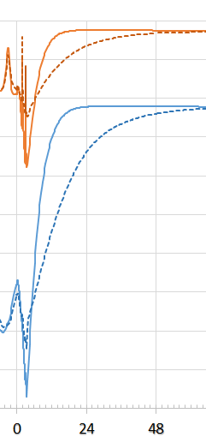

Factors Affecting Analytical Solution
Major Factors Affect Results Post Ascent Mission Phase | Description
Trajectory/Vehicle Orientation | Results based on EM-1 Trajectory For Analysis (TFA) vectors for Dec 10, 2017, 9:21 AM launch Results highly dependent on on-orbit trajectory and vehicle orientation Unknown … perturbations to vehicle orientation
Canisterized Satellite Dispenser (CSD) Optical Properties (tape/coatings) | Current tapes/coatings reduce the hot case results but contribute to colder cold case CSD temperatures.
CSD Isolator Conductance | A higher conductance will decrease CSD temperatures
Secondary Payloads (SPLs) | Payload mass has minimal affect during prelaunch (convection dominant environment) and from 48 hours to end of disposal (spin/sun angle) SPL mass will increase absolute minimum CSD temperature but slow heating affect after that resulting in colder temperatures up to 48 hours
Dotted line shows affect of maximum payload mass
Other factors that need to be considered are payload configuration, optical properties and location of sensitive components, conductance to dispenser wall.

Slide 9
Conclusion
Paper provided the SLS Secondary Payload thermal environments for Artemis I mission , documented on ESD 30000 SLS Mission planner guide
Payload integrated to the launch vehicle from the VAB until payload separation.
The environments that the payload sees after separation are not included as SLS is not responsible to determine those payload thermal environments
Payloads' responsibility to perform the detailed thermal analysis based on these bounding profiles. Adherence to these requirements is evaluated within the Payload Safety Review Panel (PSRP) function.
The Artemis I PSRP process is to provide the SLS Program with an independent review and recommendation of the safety of the payload in regards to the SLS vehicle and possible effects to Orion.
The PSRP does not review the material in terms of individual payload successful operation or whether the payload will function to obtain the scientific data it was designed to collect. The intent of the PSRP is to ensure that the payload, in and of itself, does no harm to the SLS vehicle.
The SPIE Thermal Analysis Report (SLS-SPIE-RPT-019) documents the thermal analysis predictions for the OSA, diaphragm and Secondary Payloads environments. It includes structural, shared compartment temperatures, and interface thermal conditions based on the current SPIE design definition for all relevant mission phases.

