Slide 1

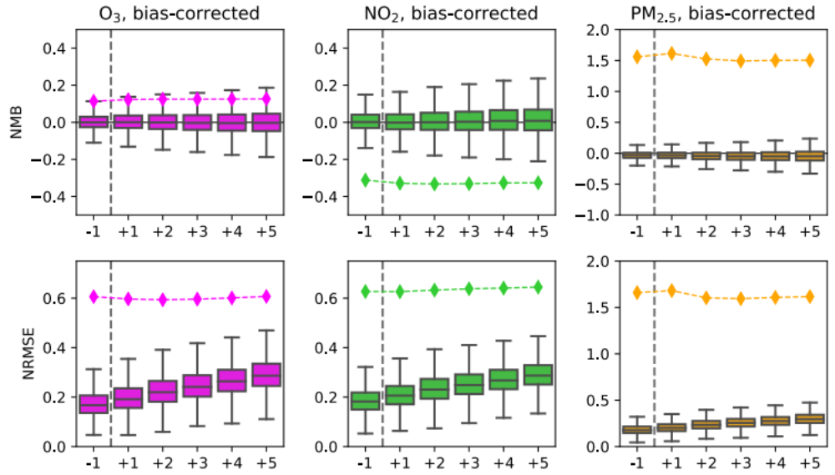
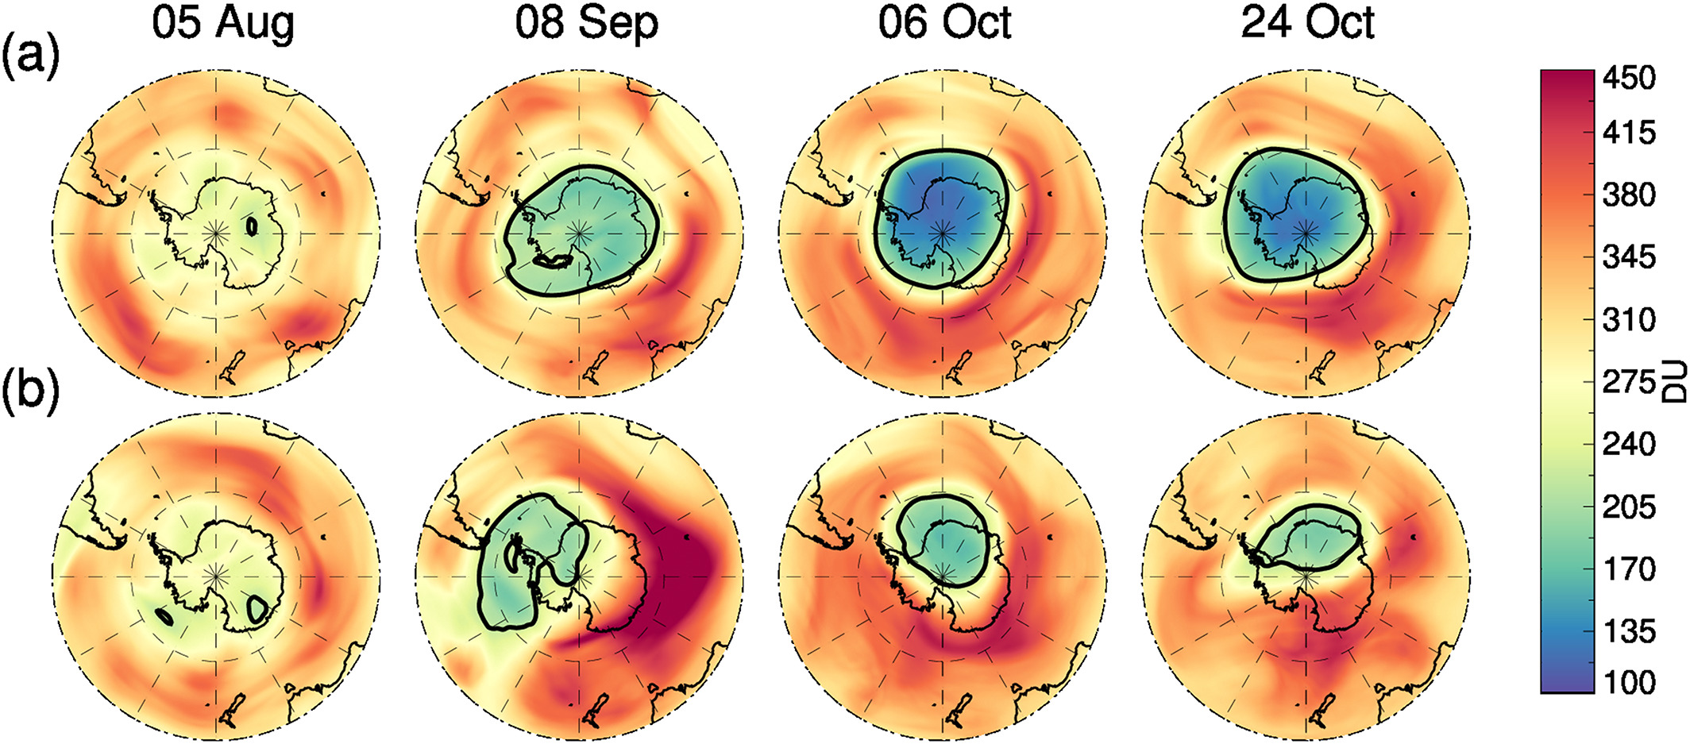

Atmospheric Composition Modeling Using the Goddard Earth Observing System
Christoph Keller^{1,2}, Patricia Castellanos¹, Arlindo da Silva¹, Krzysztof Wargan^{1,3}, Brad Weir^{1,2}, Steven Pawson¹
¹NASA GMAO ²Universities Space Research Association ³Science Systems and Applications, Inc.
The NASA GEOS Earth System Model is used for a variety of atmospheric composition applications
The Goddard Earth Observing System (GEOS) Earth System Model (ESM) is a General Circulation Model and Data Assimilation System developed and maintained by the NASA Global Modeling and Assimilation Office (GMAO). It consists of a suite of model components that can be connected in a modular manner for a variety of applications. Current capabilities as well as developments of GEOS pertinent to atmospheric composition modeling are highlighted below, including real-time forecasting of atmospheric constituents, reanalysis of chemical composition, and the use of machine learning emulators for data assimilation applications.
Stratospheric Composition Reanalysis (GEOS-SCREAM)
GEOS-SCREAM is a stratospheric reanalysis product assimilating ozone, water vapor, hydrogen chloride, nitric acid, and nitrous oxide profiles from the Microwave Limb Sounder (MLS) into the GEOS ESM with stratospheric chemistry. Comparisons show that GEOS-SCREAM provides realistic concentration maps and the assimilated constituents agree well with independent observations. The system accurately captures the anomalously small 2019 Antarctic ozone hole, caused by a disturbance of the polar vortex.
Improved Forward Radiative Transfer Calculations for Aerosol Assimilation using a Neural Network
Radiative transfer models (RTMs) are essential for radiance assimilation and generating simulated observations, such as for an observing system simulation experiment. Accurate vector solutions of top of atmosphere (TOA) radiance is computationally expensive, and often a less accurate scalar approximation is used instead. Neural networks - trained on input and output data of the vector model - can bridge this error gap by providing a correction to the scalar solution, significantly reducing the error associated with the fast scalar TOA radiance calculation.
Global forecasts of reactive trace gases (GEOS-CF)
The NASA GEOS composition forecast system (GEOS-CF) produces daily global forecasts of reactive tracer gases at ~25 km² horizontal resolution. GEOS-CF realistically predicts background concentrations of key constituents such as O₃ and NO₂. Applying a bias-correction to the surface model output using the XGBoost machine learning algorithm significantly improves local model forecasts.
Neural network reduces error in scalar top of atmosphere radiance
Mean scalar error before (left) and after (right) correcting model simulated top of atmosphere scalar radiance at 354 nm (as compared against vector radiance). From Castellanos and Da Silva (2019).
Improved local forecasts using machine learning bias correction
The anomalous 2019 Antarctic ozone hole in GEOS-SCREAM
GEOS-CF model skill scores for the hindcast (−1) and the 5-days forecasts (+1 to +5) relative to surface observations (GAW and OpenAQ). Boxplots show the variation in the normalized mean bias (NMB) and root mean square error (NRMSE) across all sites for bias-corrected daily mean O₃, NO₂, and PM_{2.5}. Diamonds indicate median statistics of the original model values. From Keller et al. (2021).
Daily mean total ozone from GEOS-SCREAM on 5 August, 8 September, 6 October, and 24 October 2018 (a) and 2019 (b). Black contours indicate 220 Dobson units. Adapted from Wargan et al. (2020).
References: Castellanos and Da Silva (2019), JTECH, https://doi.org/10.1175/JTECH-D-18-0003.1; Wargan et al. (2020), JGR, https://doi.org/10.1029/2020JD033335; Keller et al. (2021), JAMES, https://doi.org/10.1029/2020MS002413
E-mail: christoph.a.keller@nasa.gov | Web: gmao.gsfc.nasa.gov

