Slide 1

Spacesuit Padding Design for Mobility and Comfort
National Aeronautics and Space Administration
Yaritza Hernandez KBR, Houston, TX
Alex C. Gordon KBR, Houston, TX
Garima Gupta MEI Technologies, Houston, TX
Han Kim, PhD Leidos Inc., Houston, TX
Sudhakar Rajulu, PhD NASA Johnson Space Center, Houston, TX

Slide 2
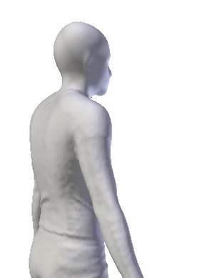
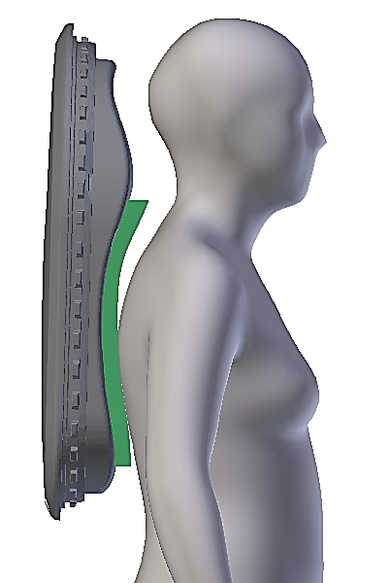
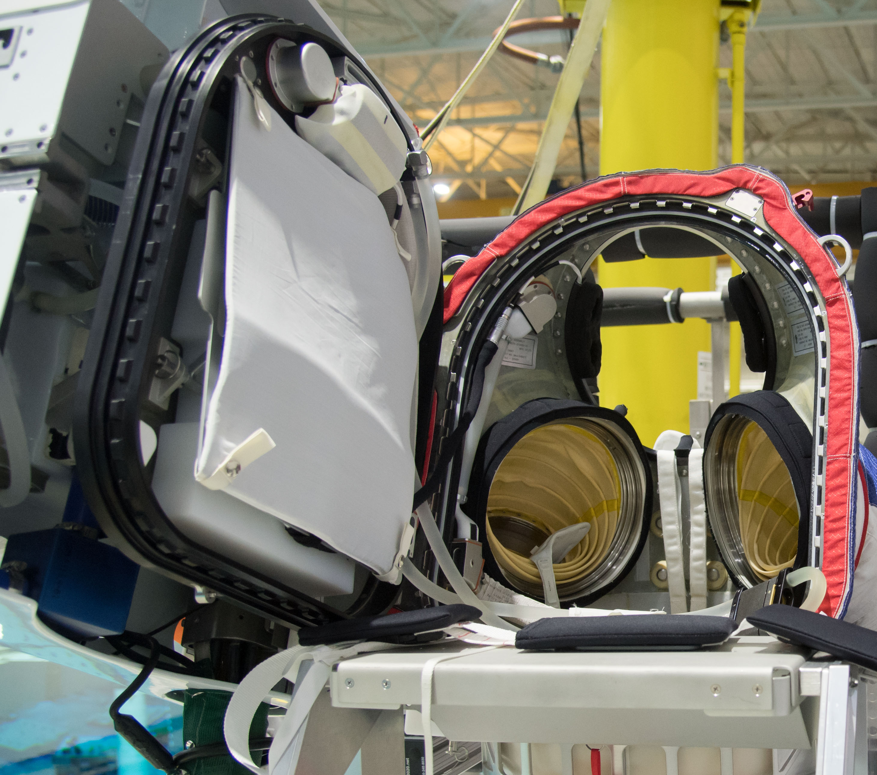
Background
The next generation xEMU spacesuit is available only in a discrete number of sizes
Poor spacesuit fit can lead to encumbered performance and discomfort
Padding inside the suit helps maintain proper body-suit indexing and relieves contact stresses from the suit
Traditionally, layers of uniform sheets of foam have been used for padding
  Does not account for the curvature of the body
  Does not account for dynamic moving body parts
Back curvature deformations during functional tasks
Current Z2/xEMU padding

Slide 3
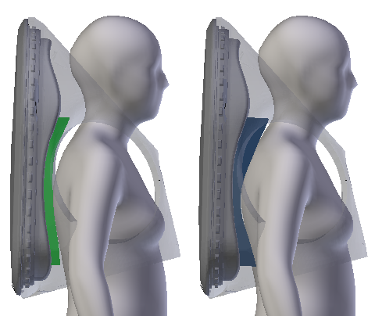
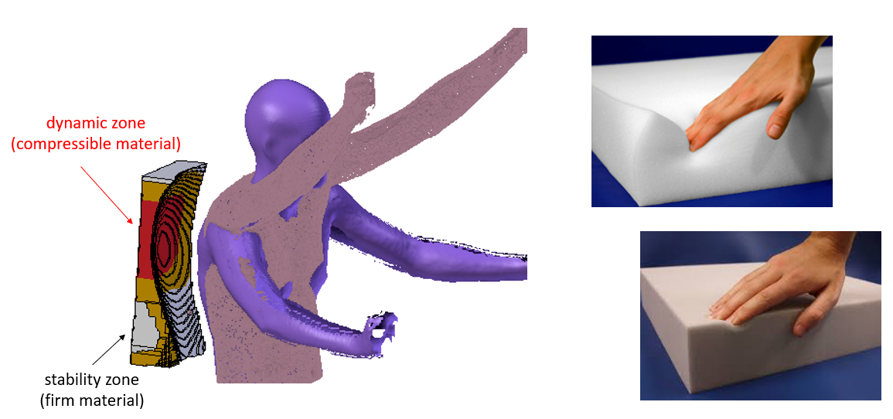
Framework Design
  We have developed a design framework for the xEMU Hard Upper Torso (HUT) padding optimized for anthropometric body curvatures and motion dependent body deformations using test subjects performing a prescribed series of functional postures.
  The framework developed a design for shape and structure using a multilayer padding approach
  firm materials can provide good support and indexing for static body parts
    (e.g., mid-thoracic region)
    compliant materials can provide comfort for dynamically moving body parts
    (e.g., shoulder blades)
    The design framework focuses on improving comfort and stability and
    optimizing subject indexing
Stability Zone (Firm Material)
Dynamic Zone
(Compliant Material)
Current xEMU padding
New Proposed xEMU padding

Slide 4
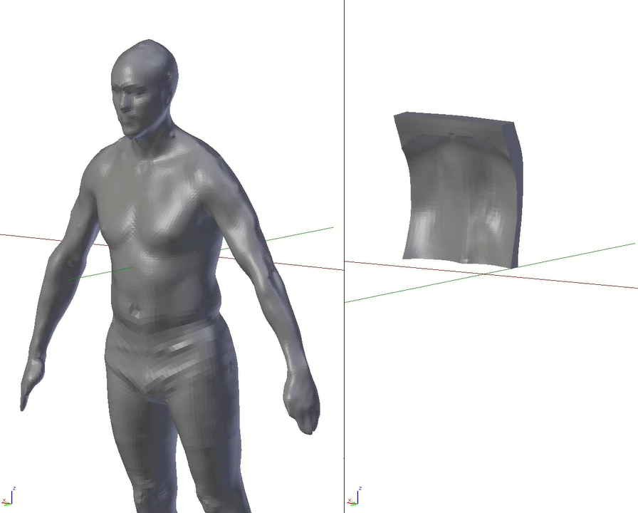
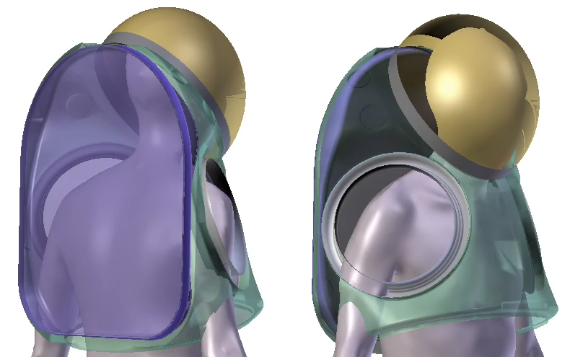
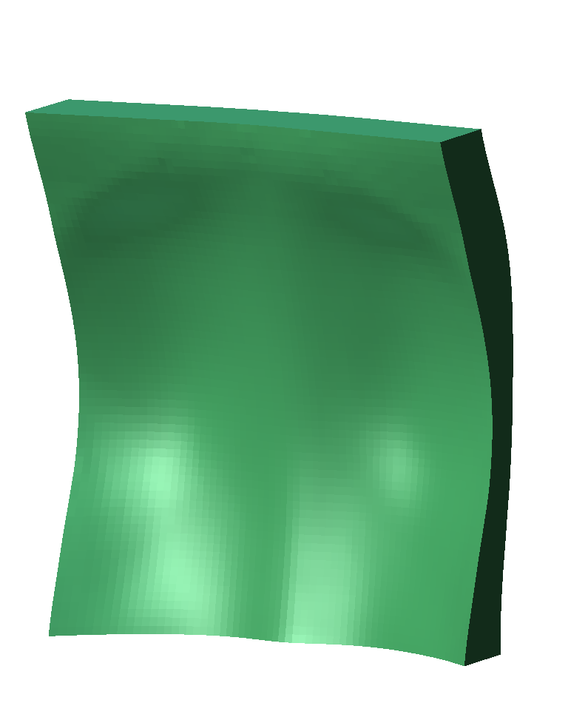
Reference Padding Geometry
An optimized padding geometry was created using 3-D body shapes virtually indexed in the xEMU HUT.
Retrospective 3-D body scans (n=146) virtually indexed in the HUT were used to create the optimized padding geometry based on the subject’s back curvatures and suit-to-body indexing/spacing demands.
Virtual fit 3-D body scans in small xEMU HUT
Padding geometry based on 3-D body scans
(face anonymized)
Reference padding curvature

Slide 5
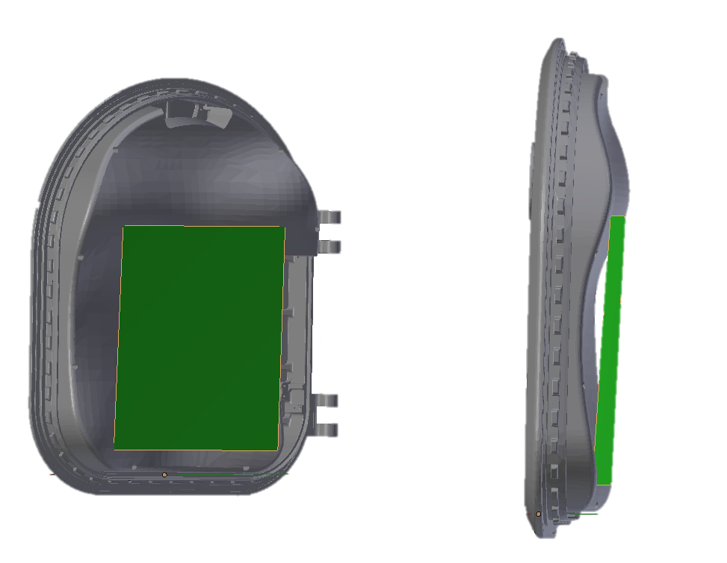
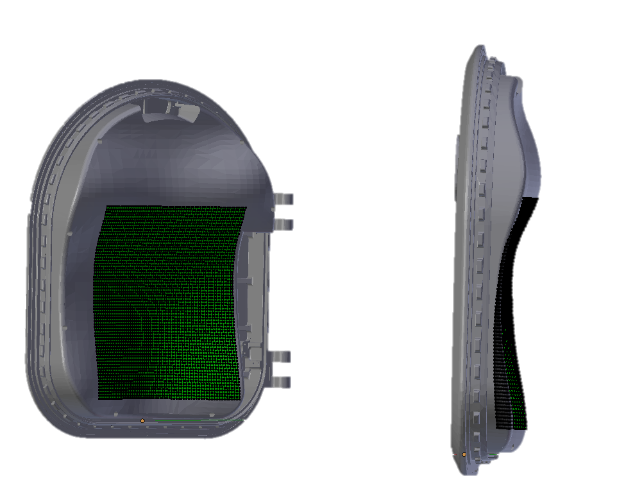
Padding Creation
  An initial padding plane was created based on the surface area on the hatch that contacts the body surface
  This subdivided plane is projected on to the hatch to match its curvature

Slide 6
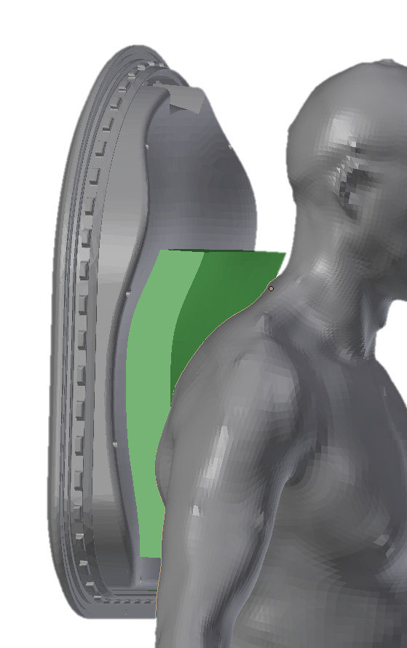
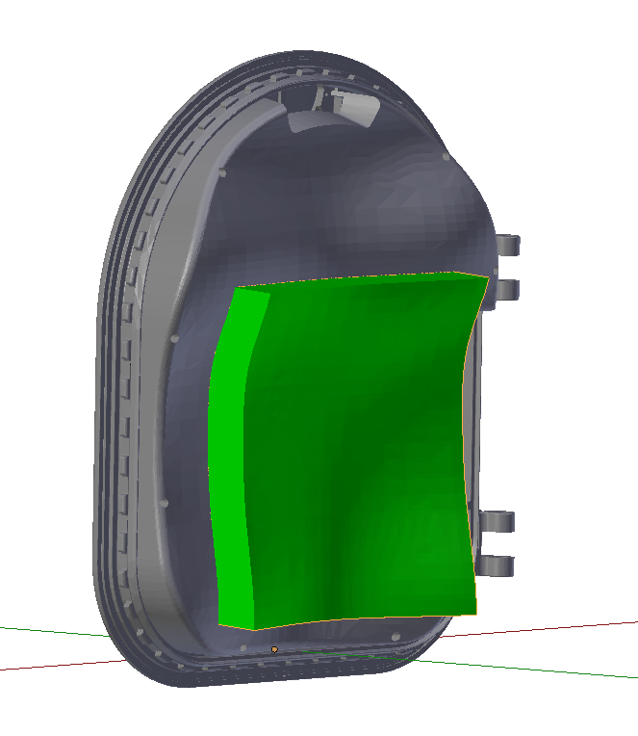
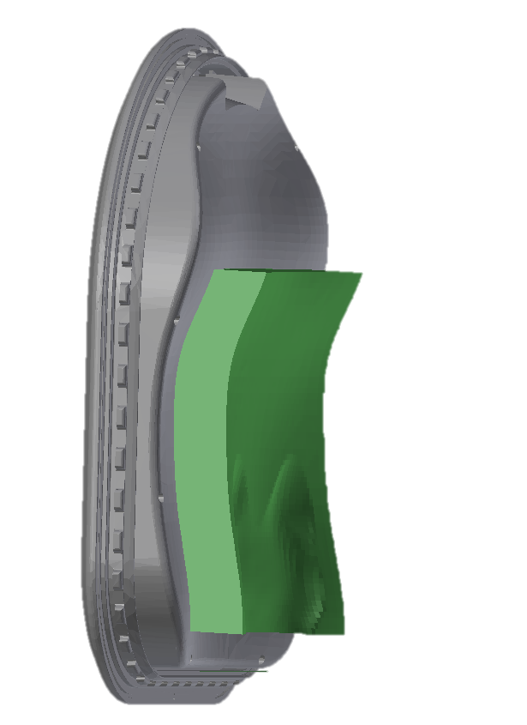
Padding Geometry
Each vertex of the initial padding plane was ray casted along the normal vector
  If the ray contacts the currently loaded and indexed homodel in the HUT, the distance is stored
  Else, the distance is set to the maximum threshold provided of 2“
A pad was created for 146 subjects
Every distance used to inflate the pad is averaged across all homodel pads and a new pad is created using the distances

Slide 7
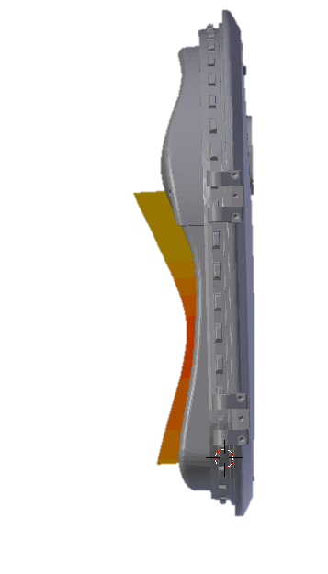
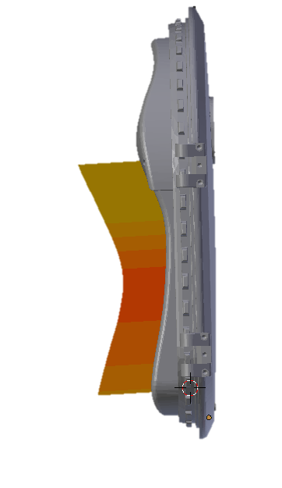
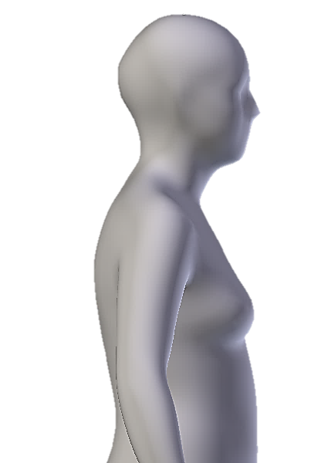
Reference Padding Geometry
Traditional uniform sheets of foam currently used in suit are in half-inch increments.
Padding geometry thickness and increment size will be determined based on the suit to body spacing available and subjective preference of the suited subject.
Reference padding curvature

Slide 8
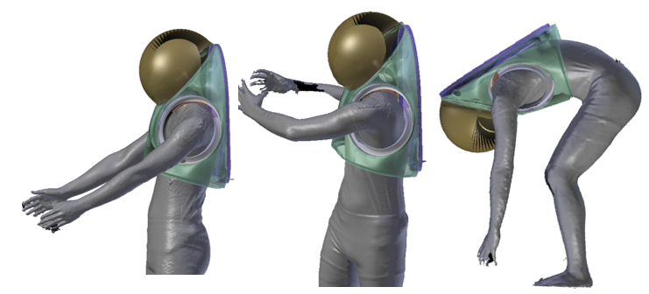

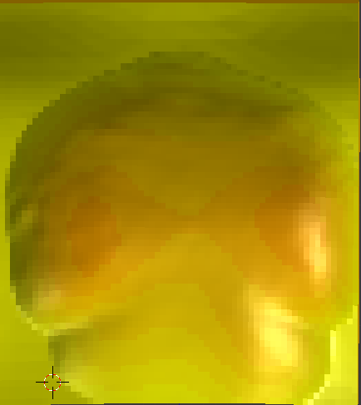
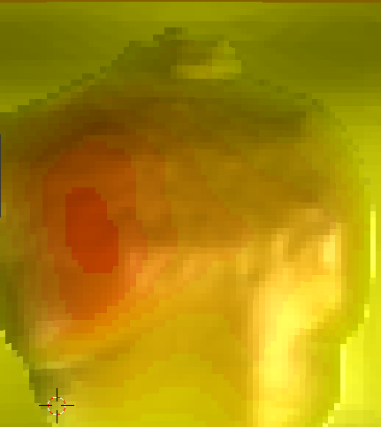
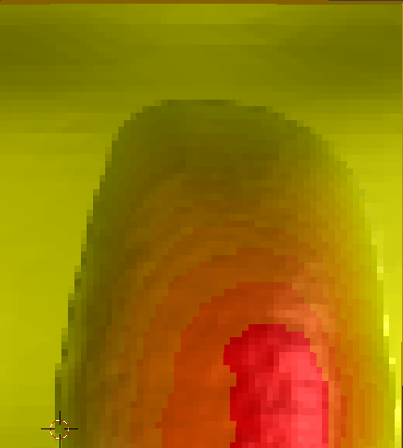
Body Deformation during Motion
Motion dependent body deformations were taken from 3-D body scans (n=12) of two participants performing a prescribed series of functional postures both in tight-fit scan wear clothing and wearing a mockup HUT without the back hatch.
The deformation and variations of body shapes were determined for each scan with a gradient from yellow to red.
Yellow indicates areas with no deformation
Red indicates areas with greatest deformation
3-D scans of subject performing functional EVA postures
max deformation observed
no deformation observed
Motion-dependent deformations from corresponding functional EVA postures
Notes:
Pose specific

Slide 9
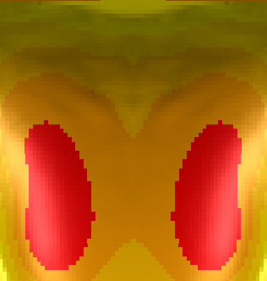
Design of Optimized Padding
Dynamic versus static zones of the padding were identified from the body deformations.
The motion-dependent body deformations were applied to the geometry to create a multi-layer padding assembly.
Each layer matches the mobility and support demands of the body through the different functional EVA postures.
max deformation observed
Stability Zone (Greater Thickness of Firm Material)
no deformation observed
Dynamic Zone
( Greater Thickness of Compressible Material)
Final padding deformation based on average of all EVA functional postures

Slide 10
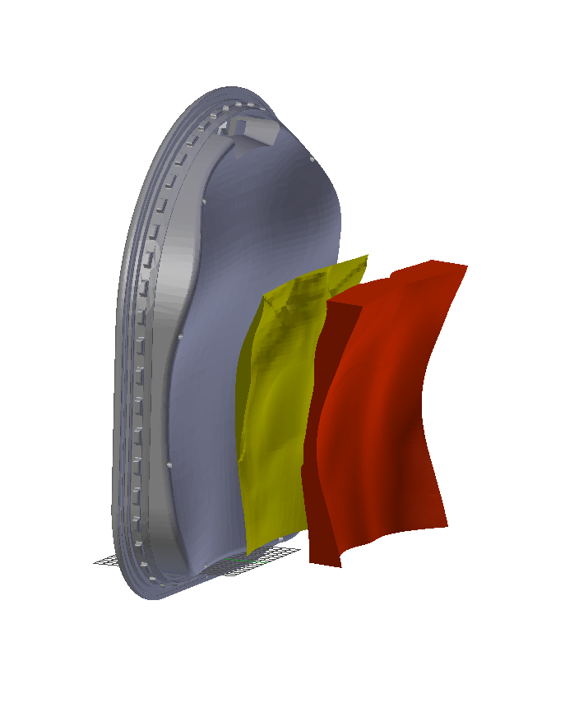
Multi-Layer Padding:
Fabrication & Usability Assessment
Padding can be CNC-fabricated in two layers, where the contour and firmness match the mobility and support demands for the contacting body surfaces.
Usability and comfort can be assessed using structured questionnaires from subjects performing simulated EVAs.
The outcome can then be compared against the traditional padding configurations.
Fabrication and assembly of multi-layer padding
Current xEMU padding
New Proposed xEMU padding

Slide 11
Discussion
The framework enabled a streamlined design process, including 3-D body scan modeling, structure identification, and fabrication process.
Additional subjects can be easily incorporated to increase fidelity
The optimized padding design can be utilized during pressurized suit testing and analog training to maintain proper body-suit indexing/spacing and relieve contact stresses from the suit.
Padding design framework can be applied and tested for different suit components, including the lower torso assembly and boots.
Effect of additional garments inside the suit such as cooling garment will be considered during usability assessment.

Slide 12
Contact Information
Yaritza Hernandez
y.hernandez@nasa.gov
Sudhakar Rajulu PhD
sudhakar.rajulu-1@nasa.gov

