Slide 1











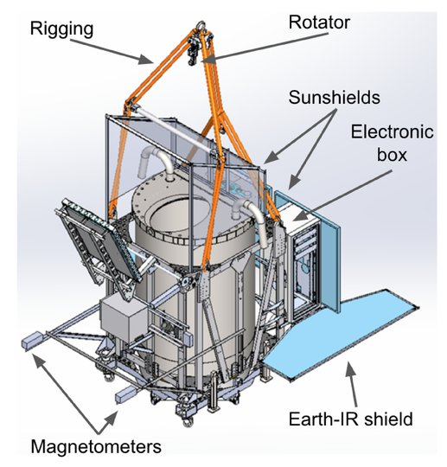
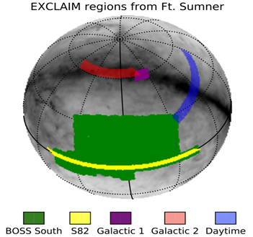
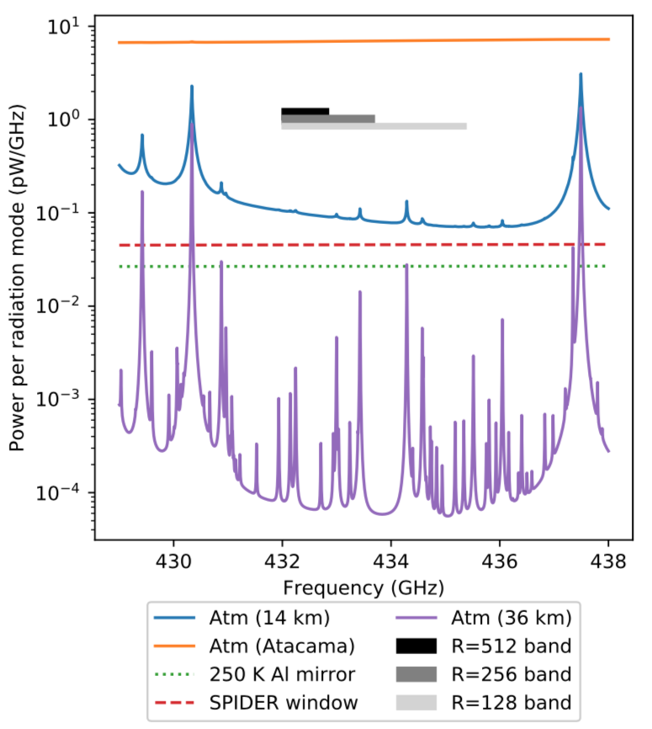
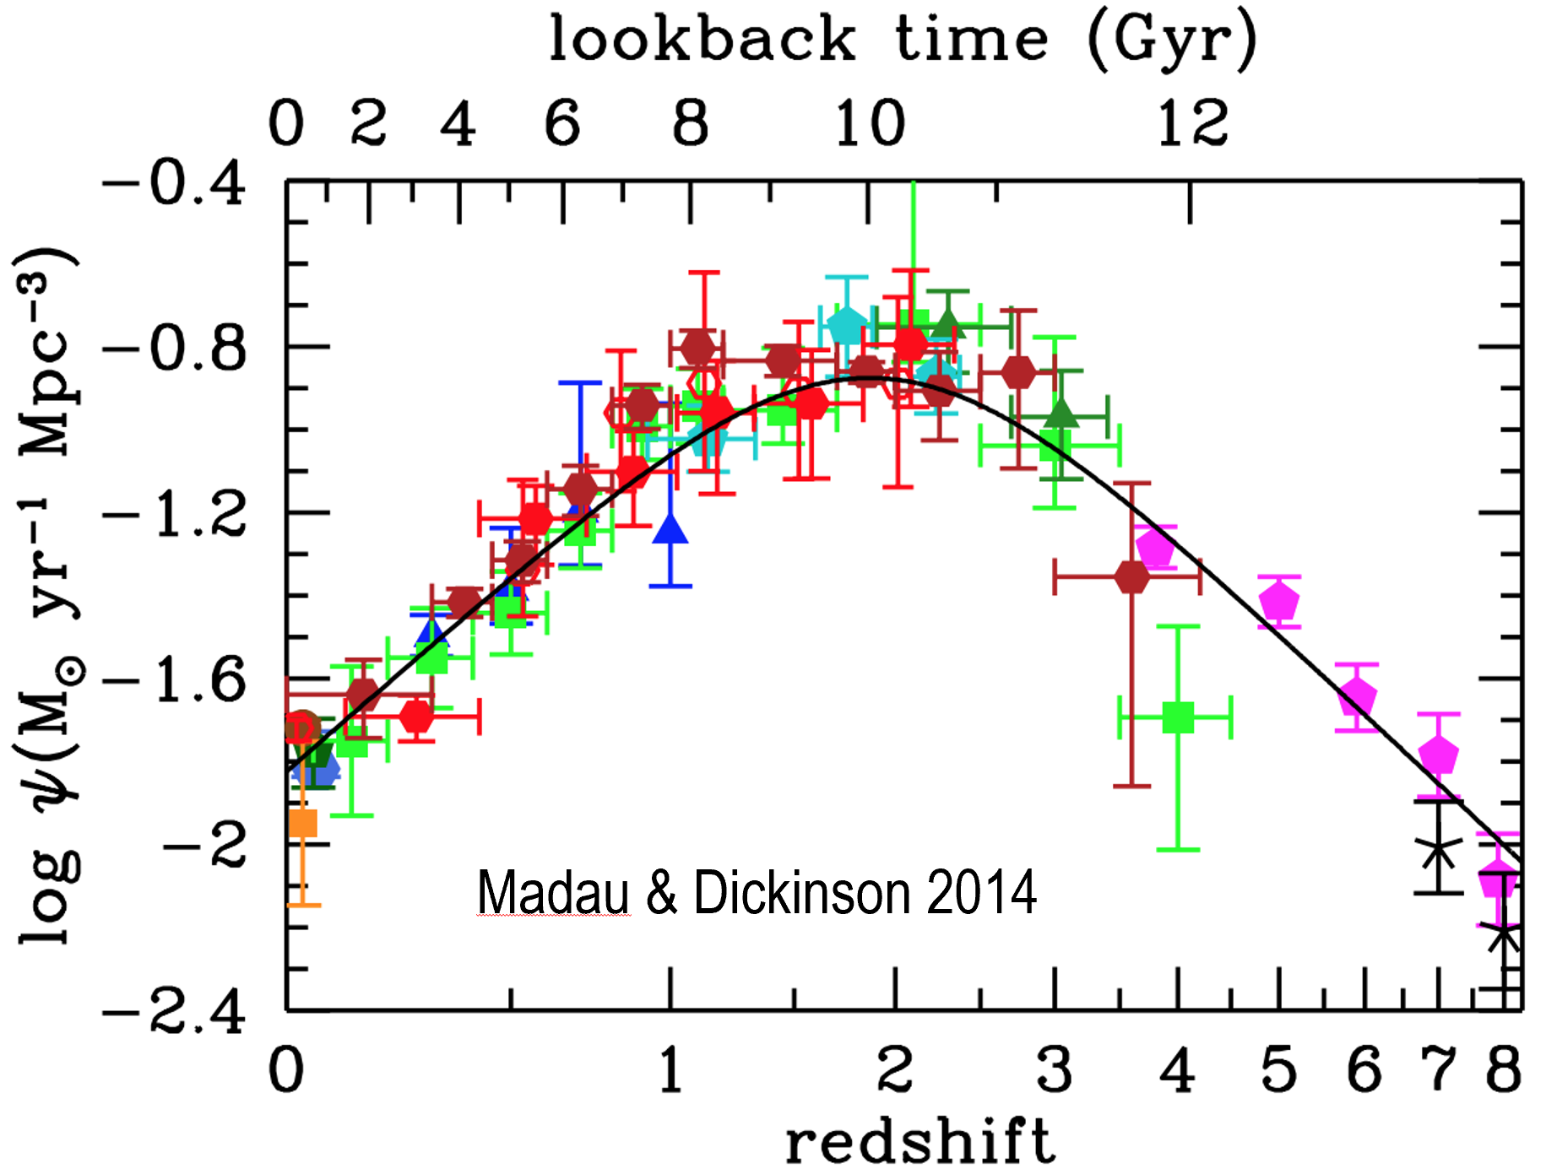
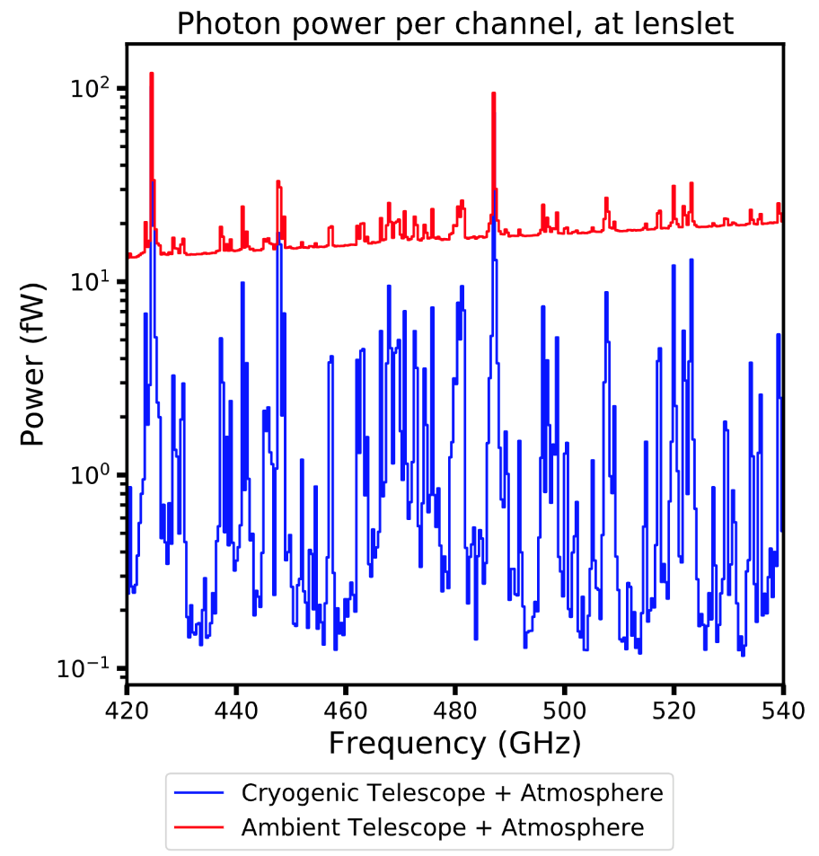
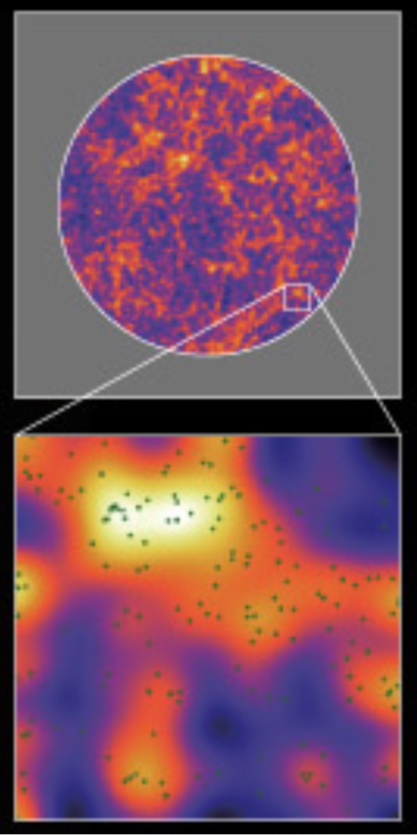
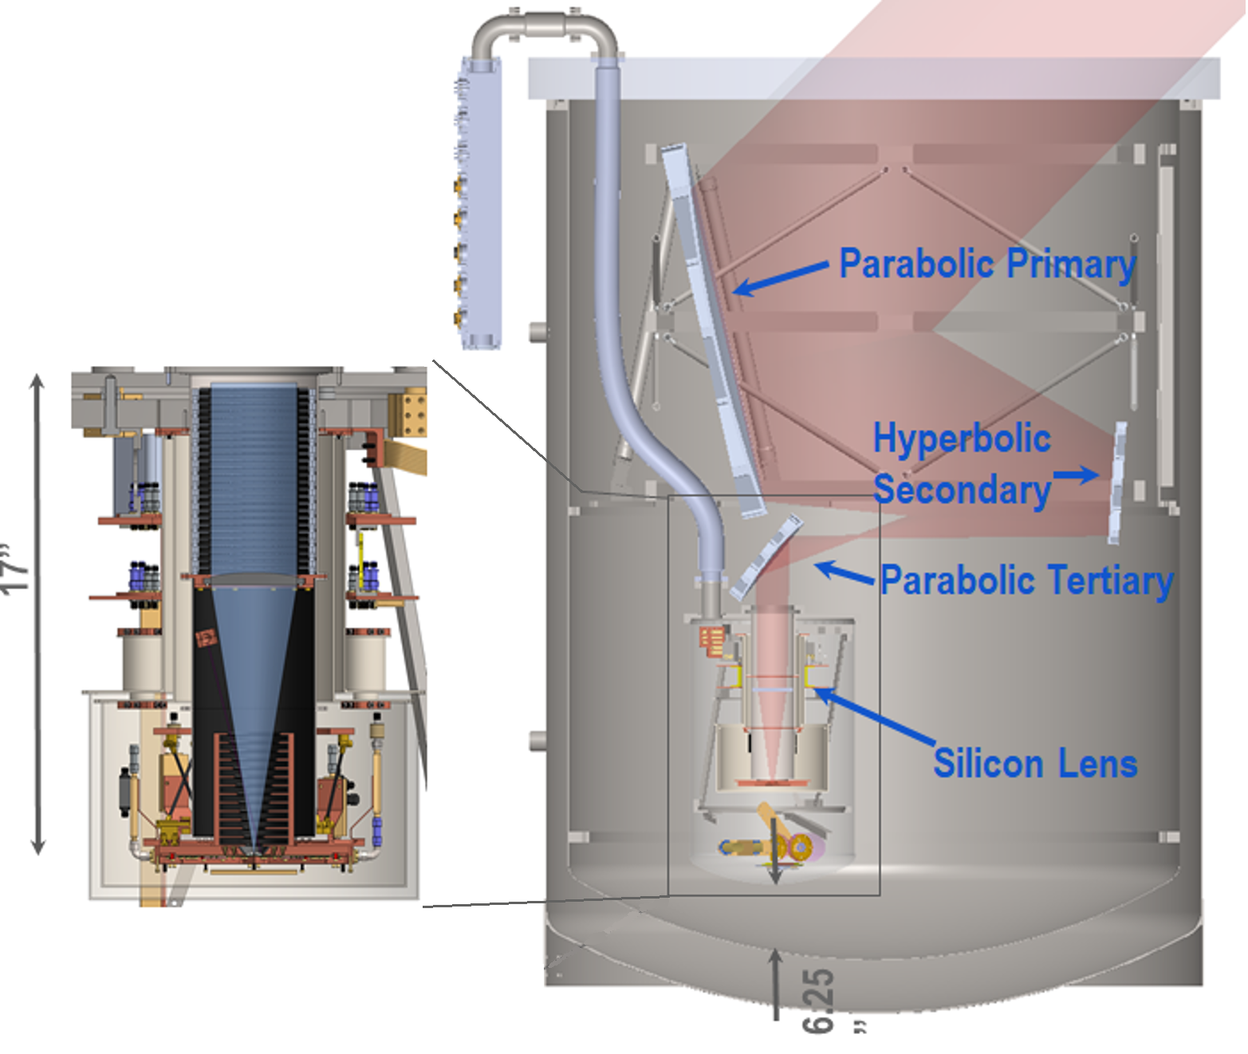
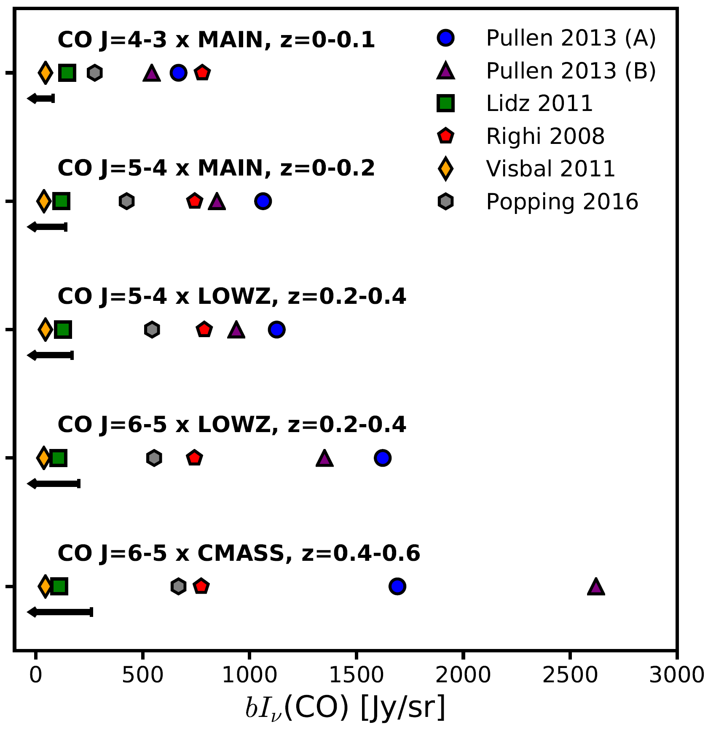
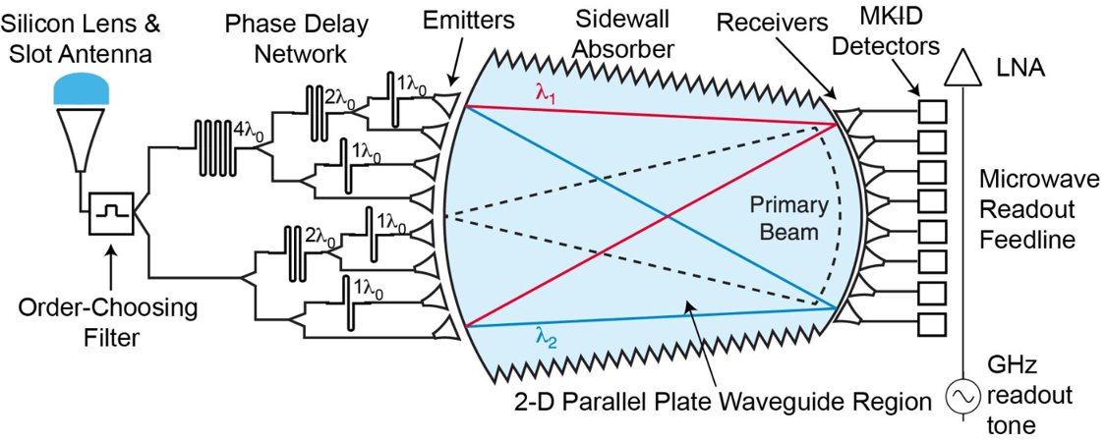
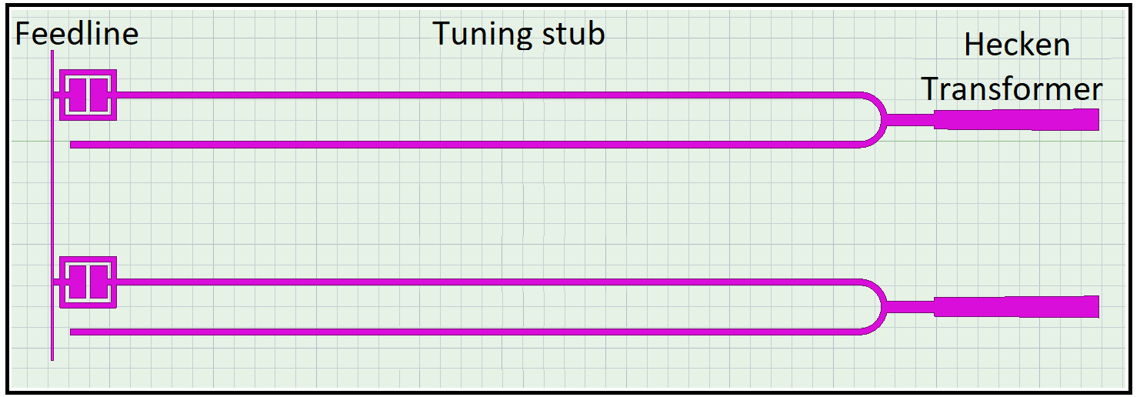
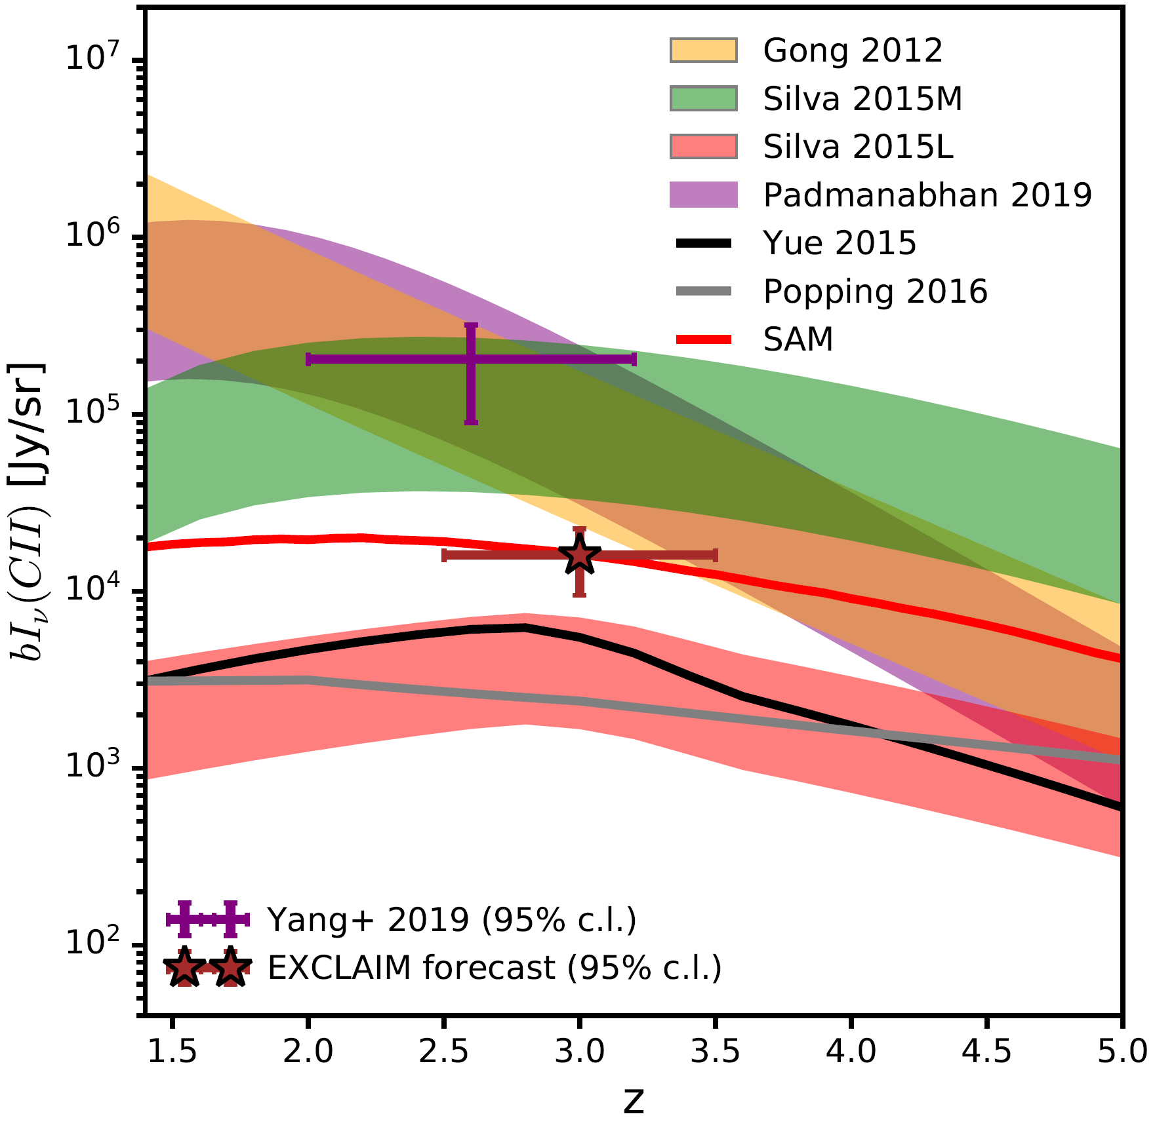

The Experiment for Cryogenic Large-aperture Intensity Mapping (EXCLAIM)
Maryam Rahmaniª , Peter A. R. Ade^{b}, Christopher J. Andersonª, Alyssa Barlisª, Emily M. Barrentine^{b}, Jeffrey Beeman^{c}, Alberto D. Bolatto^{d}, Patrick C. Breysse^{e}, Berhanu T. Bulchaª, Giuseppe Cataldoª, Jake Connors^{f}, Negar Ehsanª, Thomas Essinger-Hilemanª, Larry A. Hessª, Amir E. Jahromiª, Trevian Jenkins^{d} ,Mark K. Kimballª, Alan J. Kogutª, Luke N. Loweª, Phil Mauskopf^{h}, Jeff McMahon^{g}, Mona Mirzaeiª, S. Harvey Moseley^{i}, Jonas Mugge-Durum^{d}, Omid Noroozianª, Trevor M. Oxholm^{j}, Tatsat Parekhª, Ue-Li Pen^{l}, Anthony R. Pullen^{e}, Florian Roselli^{l}, Konrad Shire^{d}, Gage Siebert^{j}, Adrian K. Sinclair^{h}, Rachel S. Somerville^{m}, Ryan Stephenson^{h}, Thomas R. Stevensonª, Eric R. Switzerª , Peter Timbie^{j}, Jared Termini^{n}, Carole Tucker^{b}, Elijah Visbalº, Carolyn G. Volpert^{d}, Edward J. Wollackª, Shengqi Yang^{e}, L. Y. Aaron Yungª
ªNASA-Goddard Space Flight Center, Greenbelt, MD, USA; ^{b} Cardiff University, Cardiff, UK; ^{c}Lawrence Berkeley National Lab, Berkeley, CA, USA; ^{d}University of Maryland-College Park, MD, USA; ^{e}New York University, New York, NY, USA; ^{f}National Institute of Standards and Technology, Boulder, CO, USA; ^{g}University of Chicago, Chicago, IL, USA; ^{h}Arizona State University, Phoenix, AZ, USA; ^{i}Quantum Circuits, New Haven, CT, USA; ^{j}University of Wisconsin-Madison, Madison, WI, USA; ^{k}Canadian Institute for Theoretical Astrophysics, Toronto, Canada; ^{l}ISAE-SUPAERO, Tolouse, France; ^{m}Center for Computational Astrophysics, Flatiron Institute, New York, NY, USA; ^{n}University of Iowa, Iowa City, IA, USA; ºUniversity of Toledo, Toledo, OH, USA
ABSTRACT
INSTRUMENT OVERVIEW
OBSERVING STRATEGY
Submillimeter and far-IR spectroscopy provides insight into galaxy evolution through measurement of atomic and molecular line emission. The EXperiment for Cryogenic Large-Aperture Intensity Mapping (EXCLAIM) is a cryogenic balloon-borne instrument designed to carry out intensity mapping to measure the cumulative redshifted line emission from carbon monoxide and singly-ionized carbon to probe star formation in windows from the present to z=3.5. During this time, the rate of star formation dropped dramatically, while dark matter continued to cluster. Intensity mapping permits a blind and complete survey of emitting gas through statistics of cumulative brightness fluctuations. EXCLAIM achieves high sensitivity using a cryogenic telescope coupled to six integrated spectrometers with spectral resolving power R=512 and employing microwave kinetic inductance detectors. Here we summarize the status of the mission.
Cryogenic Balloon-Borne Instrument:
Launch with 2400 liters of liquid helium supports 12 hours of science operation at 1.7 K.
An adiabatic demagnetization refrigerator backed by 4He adsorption
cooler supports a 100 mK focal plane.
Launch with 11 or 34 million cubic foot (heavy) conventional balloon.
Superfluid He pumps distribute the liquid He to cool the optics.
The pointing elevation is fixed at 45 degree, controlling spill and
atmospheric modulation.
A sinusoidal scan with 14 sec period and 7 degree throw maps ±1.4
degree about the celestial equator.
Pointing: star camera, gyro, magnetometer, tilt. Online pointing to
1 degree
Heritage: Primordial Inflation Polarization ExploreR (PIPER) [17]. Uses gondola, housekeeping electronics, software, and ADR designs.
Cross-correlation with BOSS for primary science
Large area: Cross-correlation can/should go wide (more isotropic volume); in contrast, auto-power aims for SNR~1 per mode.
Access linear scales up to k~1 h Mpc⁻¹.
Cryogenic telescope for fast integration in dark atmospheric windows.
On-chip MKID spectrometer
GOAL
Conventional flight from TX or NM: well-matched to BOSS-North region, simple logistics, high recovery rate, regular flight opportunities.
Goal: Time resolving of the evolution of galaxies over the history of universe compared to the information obtained via FIR background.
Fact: The star formation has had a rapid increase till about redshift-2 followed by a fairly steep decline by a factor of 20.
Preliminary survey plan
Daytime field: anti-solar scan, 200 degree²,
crosses the galactic plan. 3-6 PM local.
Galactic field 1: 6-7 PM. 45 degree².
BOSS S82 field rises 7 PM local until 1 AM. 305 degree².
Galactic field 2: 2-7AM, 216 degree².
The spacing between bright atmospheric emission
lines is ~5GHz. Pressure broadens these lines,
following the relation ~10 MHz/Torr. This, to
observe between these lines requires <10 Torr,
or >100000 ft altitude. EXCLAIM will fly
at >120,000 ft (36 km).
To resolve these windows at
~500 GHz requires R > $\frac{500 GHz}{5 GHz}$= 100. The EXCLAIM
goal is R=512.
We truncate at 540 GHz to avoid the bright
ortho-H₂O line at 557 GHz.
A cryogenic telescope is required to realize the full sensitivity achievable in dark windows between atmospheric lines. These windows are approximately 50 darker per EXCLAIM channel than a bounce or transmission through ambient optics.
Question: Why did this evolution take place? Abundance of molecular gas over time? Efficiency of star formation?
Approach: Measurement of the abundance, phases, and excitation of those gases by looking at atomic lines to get redshift information.
INTENSITY MAPPING (IM)
EXCLAIM Spectrometer & MKID Parameters
Spectrometer Design | µ-Spec, antenna-coupled diffraction-grating analog, Rowland configuration
Number of spectrometers | 6
Spectral Range | 420-540 GHz
Spectrometer Grating Order | 2 (operates over a single order)
Resolving Power, R = λ/Δλ | 512
Spectrometer Efficiency | 24% (from Si lens input to the MKIDs), 7% (threshold)
Spectrometer materials | Nb planar transmission line, single-crystal Si dielectric
MKIDs per spectrometer | 355
MKID materials | 20 nm thick Al microstrip, single-crystal Si dielectric, ground plane Nb
MKID Readout Band | 3.25 – 3.75 GHz
NEP | < 3x the photon background limit at the spectrometer input (Photon NEP ~ 8 x 10⁻¹⁹ W/√Hz in the darkest atmospheric channels)
Operating temperature | 100 mK
LNA Noise Temperature | ≤ 5 K
EXCLAIM Instrument & Telescope Parameters
Mass | 2200 kg
Height(+sun shields) | 4.6 m
Telemetry rate | 57.6 kbps
Data rate | 18 MB/s
Gondola Power | 900 W
Readout Power | ≤ 120 W
Projected aperture | 74 cm
Angular resolution | 4’ – 5’
Edge Taper | 15 dB
Optical Spill | -40 dB
Telescope f/# | 1.5
Instantaneous FOV | 16.1’
Principle: The line emission from objects at different redshift occur at different frequencies and indicate the structure and density of structure in the universe.
Origin: Sunyaev & Zel’dovich 1972, 1975, Hogan & Rees 1979,and Bebbington 1989 (the 1st experimental intensity mapping realization using a frequency differencing technique).
Functionalities:
Complete blind census: Measurement of all objects rather than just brightest objects.
Narrowband: Too wide a spectral band washes out the density contrast.
Spectral signature: Foreground or continuum emission should be spectrally smooth whereas intensity should have a spectral signature.
Motivations:
Aperture: IM studies surface brightness rather than the flux of individual
sources.
Cumulative emission: IM is sensitive to all objects. It’s a complete blind
census plus all other forms of radiation as contamination.
Volume: The survey area covers a region three times the typical area of an over dense region so avoids the cosmic variants of smaller area sky surveys.
Environments: A wide variety of lines trace different ionization states and aspects of galaxies over time.
Hosts: Cosmological measurement is clustering biased and provides the mass of the host halos that galaxies & stars inhabit.
Systematics: No selection function (i.e. no dust extinction or issues such as fiber collisions from nearby galaxies).
Figure: (LAMBDA)-Intensity mapping does not resolve individual galaxies, but instead maps the cumulative line emission.
OPTICS AND RECEIVER
CURRENT STATUS
The telescope employs a 90 cm parabolic primary mirror, 30 cm flat fold mirror, and
10 cm parabolic secondary mirror in an off-axis Gregorian configuration (all aluminum)
The F/1.5 reflectors feed a single Si lens through a stop which couples
light onto the on-chip spectrometers.
The stop controls illumination of the primary and terminates stray
light onto blackened cold baffles.
Si lenses are anti-reflection coated with metamaterial.
The superfluid-tight vacuum window is silicon with metamaterial anti-reflective coating.
The EXCLAIM program began in April 2019 and has passed Preliminary Design Review, with subsystem designs in progress and spectrometer fabrication underway.
Engineering flight is expected in 2022 with one spectrometer, sky dips to verify atmospheric line model; galactic and preliminary extragalactic.
Science flight in 2023 with 6 spectrometers. This is a versatile platform for testing FIR spectrometer technology in space-like environment.
SCIENCE
µ-SPEC & READOUT
ACKNOWLEDGEMENT
EXCLAIM maps the sub-mm emission of redshifted carbon monoxide (CO) and singly-ionized carbon (CI), and C2 lines in windows comprising 0<z< 3.5.
Fig.: CO total abundance from cumulative luminosity. EXCLAIM sensitivity (black line) is compared to existing models [6-10]. J is the transition, b is the clustering bias of the emitters and I_{v} is the intensity.
MKID, a superconducting Microwave Kinetic Inductance Detector alleviates multiplexing and ultra-low sensitivity. This is implemented by using a thin film Al in a microstrip half-wave resonator design with a Nb ground plane.
Heritage: R=64 µ-Spec prototype demonstration [2]. Demonstration of Coplanar Waveguide (CPW) resonators of 10-25 nm thick Al with Q_{int}≥1x10⁶ [3]
and Nb with Q_{int}≥5x10⁵ [4].
Readout: EXCLAIM uses a Reconfigurable Open Architecture Computing Hardware (ROACH)-derived readout system developed by ASU [5],the most mature MKID readout system for balloon platforms.
We gratefully acknowledge funding provided by the NASA Astrophysics Research and Analysis (APRA) Program.
Ionized Intergalactic medium
CII HII NII
Self-Shielding Neutral Gas
Cold, Molecular Gas
EXCLAIM’s Primary Science Topics:
-Dramatic decline in star formation since z~2.
-Typical abundance, excitation and evolution
of the molecular gas which forms stars.
-The quality of CO trace H2 in galaxies.
-If intensity mapping is a viable approach to probe high redshifts.
REFERENCES
Star Formation
H2 CI CO
[1] Patel, A., et al., IEEE Trans. Appl. Supercond., 23.3 (2013): 2400404.
[2] Noroozian, O., et al., International Symposium on Space Terahertz Technology, (2015).
[3] Noroozian, O., et al., American Astron. Soc. Meeting Abstracts, (2018).
[4] Mirzaei, Mona, et al., Millimeter, Submillimeter, and Far-Infrared Detectors and Instrumentation for Astronomy X, (2020).
[5] Gordon, S., et al., J. Astron. Instrum., 5.04 (2016): 1641003.
[6] Lidz, A., et al., Astrophys. J., 741.2 (2011): 70.
[7] Popping, G., et al., Mon. Notices Royal Astron. Soc., 461.1 (2016):
93-110.
[8]Pullen, A. R., et al., Astrophys. J 768.1 (2013): 15.
[9]Righi, M. et al., Astron. Astrophys., 489.2 (2008): 489-504.
[10]Visbal, E., et al., J. Cosmol. Astropart. Phys., 2011.08 (2011): 010.
[11]Pullen, A. R., et al., Mon. Notices Royal Astron. Soc., 478.2 (2018):
1911-1924.
[12] Padmanabhan, H., arXiv preprint arXiv:1811.01968 (2018).
[13] Y. Gong, et al., Astrophys. J, 745:49 (2012).
[14] M. Silva, et al., Astrophys. J, 806:209 (2015).
[15] Yue, B., et al., Mon. Notices Royal Astron. Soc, 450.4 (2015): 3829-39.
[16] Li, Tony Y., et al., Astrophys. J, 817.2 (2016): 169.
[17] Gandilo, Natalie N., et al., Millimeter, Submillimeter, and Far-Infrared Detectors and Instrumentation for Astronomy VIII, ( 2016).
CII HII
HII
µ-Spec as a grating spectrometer integrates the dispersive element, filters, and detectors on a single chip.
Phase delay is introduced by a synthetic grating made of superconducting Nb microstrip lines patterned on both sides of a single-crystal Si substrate (450 nm thick) [1]. The high index of refraction of Si allows to do so in a compact space.
A 2-D parallel plate waveguide region in a Rowland circle architecture serves as a spatial beam combiner and focal plane (which Nyquist-samples the spectral response).
For EXCLAIM, an order-choosing filter selects the design order and will be placed before the delay network.
This figure is not to scale.
Lines & Levels:
CO: EXCLAIM cross-correlates with spectroscopic galaxy redshift catalogs (shown right) to constrain the total molecular CO gas abundance from 0 < z < 0.7.
CI: EXCLAIM maps neutral carbon emission in the Milky Way, providing data to determine the co-extensiveness of [CI] and CO gas in galactic photodissociation regions (PDRs), and probe existing assumptions about the [CI]/CO intensity ratios.
Fig.: CII total abundance from cumulative luminosity vs. redshift. EXCLAIM sensitivity (red star) is compared to existing models [7,13-15] and preliminary measurements [11]. Here b is the clustering bias of the emitters and I_{v} is the intensity.
CII: EXCLAIM cross-correlates with the BOSS QSO survey from 2.5 < z < 3.5 to provide a definitive test of CII abundance (shown right) and probe the CII and the star formation rate (SFR) relation [12] determining whether it follows local relations or suggests strong evolution of the average Interstellar Medium.

