Slide 1
Introduction to Radiative Heating
Brett A. Cruden
AMA Inc. at NASA Ames Research Center
Ames/Langley Summer Seminar Series
July 6, 2021

Slide 2
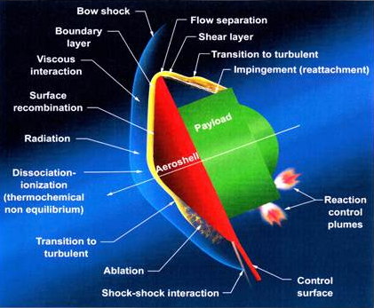
Radiation in Planetary Entry Aeroheating
Spacecraft kinetic energy is converted to thermal energy during atmospheric entry deceleration
Thermal energy must be absorbed/dissipated by thermal protection system (TPS)
Part of that thermal energy reaches spacecraft through convective and radiative heat transfer
  Radiative heating scales as ρr_{n}V⁸, in blackbody limit
  Becomes relevant for large vehicles and/or high entry velocities
Recent studies have found exceptions to the above
  Radiative heating often larger on the backshell than convection
  Regimes of molecular radiation occur at intermediate velocities, may cause non-monotonic radiation wrt V
Phenomenological models of shock radiation are used in CFD simulation tools to assess impact of radiative heating
  Models are developed and validated through ground testing (and flight test data, if available)
Notes:
Give motivation and objectives

Slide 3
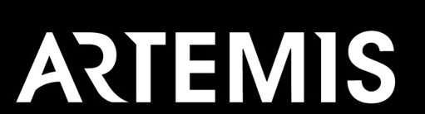

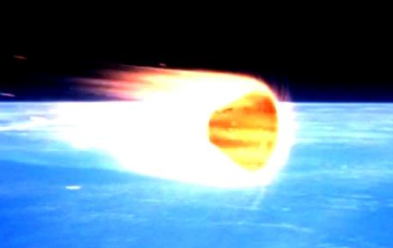

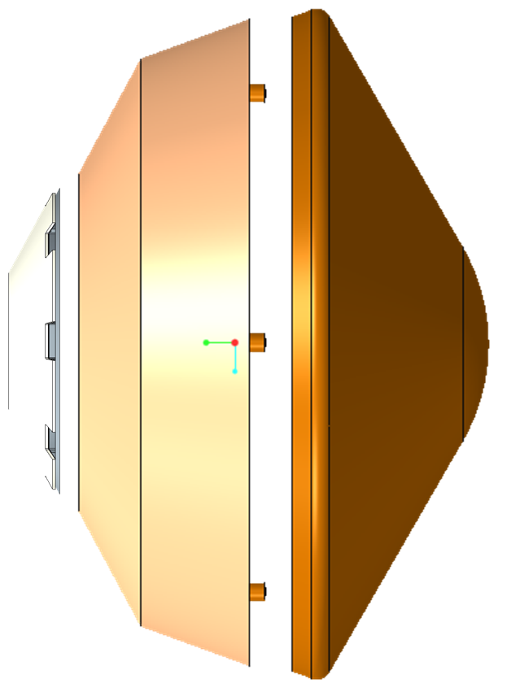
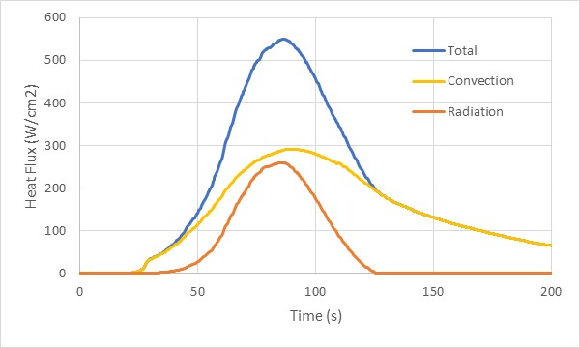
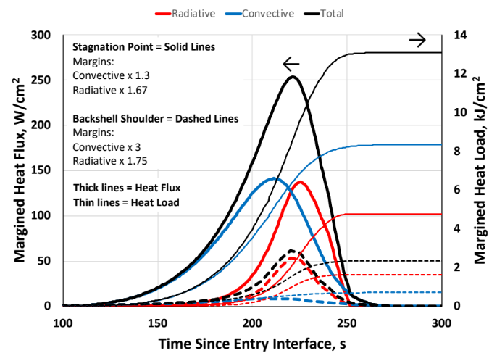

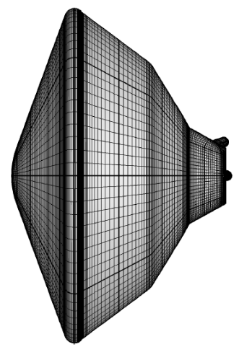
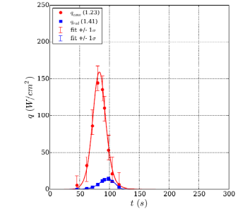
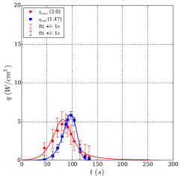
Radiation, in Mission Context
Radiation is significant form of heating for many missions
  Often dominant on backshell or at high velocity

Slide 4
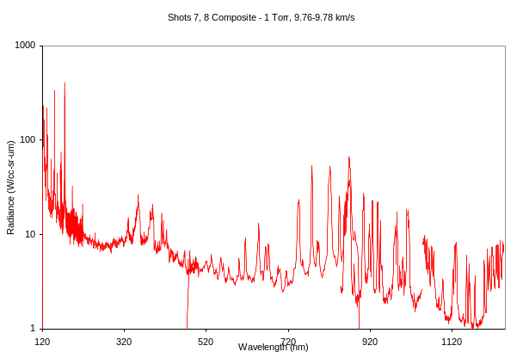
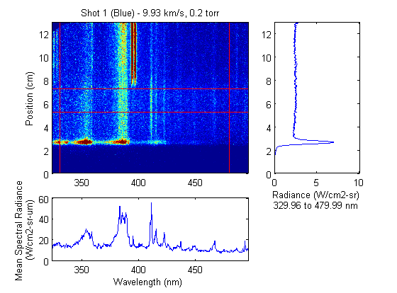
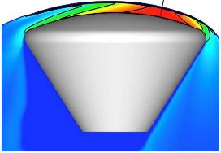
Basic Radiation Terminology
Radiative Heat Flux is equal to the:
  Irradiance, which is the integral of the:
    Radiance, which is the integral of the:
      Spectral Radiance, which is the integral of the:
        Volumetric Spectral Radiance
          kinda

Slide 5
Volumetric Spectral Radiance
Vehicle
Bow Shock
In the bow shock, a control volume radiates uniformly in all directions
The radiation has a spectral (wavelength dependent) signature
The surface “sees” the volume through its intersecting line of sight
The fundamental quantity then is the volumetric spectral radiance, e_{λ}
  Power per Wavelength per Volume per Solid Angle (W/cm³-sr-μm)
  (Also known as an emission coefficient)

Slide 6
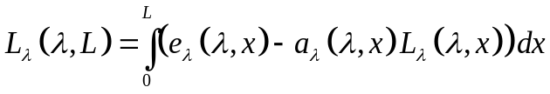
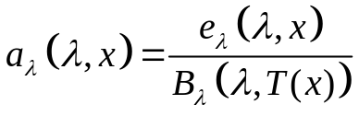
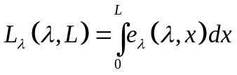
The Radiation is accumulated over a line of sight
A radiating Line of Sight passes through multiple control volumes, all of which absorb and radiate light. The surface sees the integral along this line of sight:
At equilibrium, the absorption coefficient is related to the emission coefficient by Planck’s function:
For optically thin cases (a small, L << B)

Slide 7
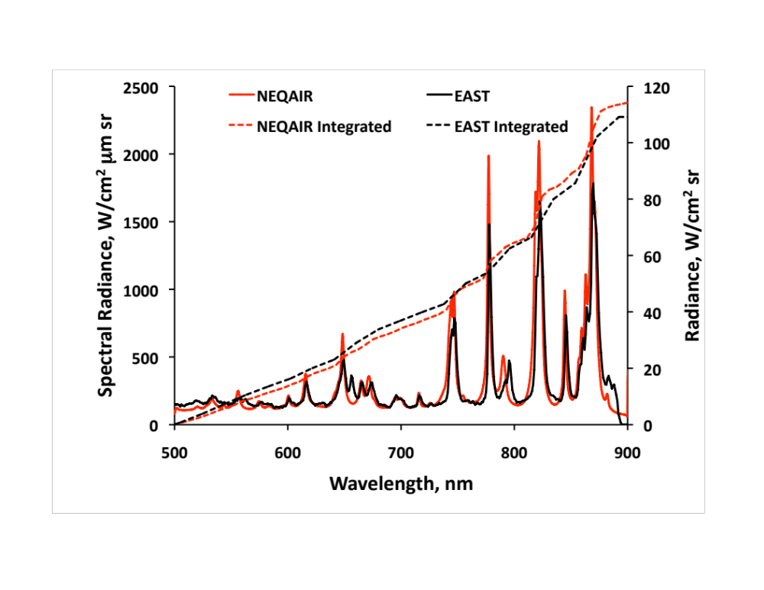
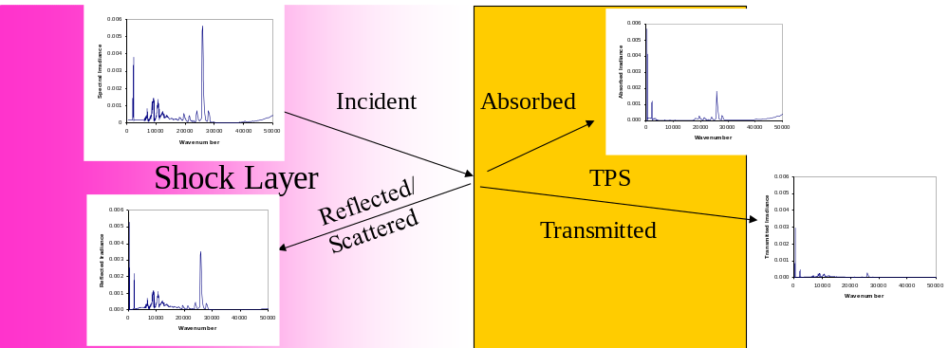
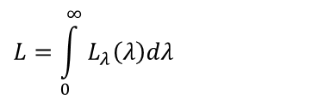
Spectral Radiance to Radiance
Simply, the Radiance is the integral of the Spectral Radiance:
However, heat absorbed depends on the interaction of the material with the radiation:
$$L=\int_{0}^{∞}{L_{λ}\left(λ\right)dλ}$$

Slide 8
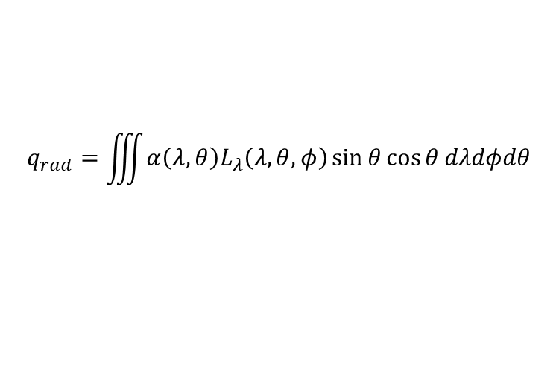
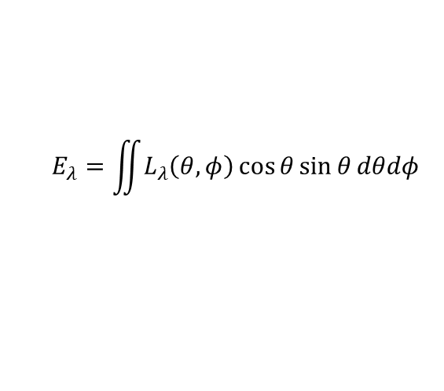
Radiation Comes From All Directions
The (spectral) irradiance to a surface is the integral of the normal component of (spectral) radiance:
Technically, the absorption/reflection coefficients are also functions of θ
The integrations over wavelength and angle can (generally) be performed in any order
L
L
L
ϕ
L
L
θ
$$E_{λ}=\iint{L_{λ}\left(θ,φ\right)\cos{θ}\sin{θ}dθdφ}$$
$$q_{rad}=\iiint{α\left(λ,θ\right)L_{λ}\left(λ,θ,φ\right)\sin{θ}\cos{θ}dλdφdθ}$$

Slide 9
Terminology
Quantity | Symbol | Units | Notes
Radiant energy | Q_{e} | J | energy
Radiant flux | Φ_{e} | W | radiant energy per unit time, also called radiant power.
Spectral power | Φ_{eλ} | W⋅m⁻¹ | radiant power per wavelength.
Radiant intensity | I_{e} | W⋅sr⁻¹ | power per unit solid angle.
Spectral intensity | I_{eλ} | W⋅sr⁻¹⋅m⁻¹ | radiant intensity per wavelength.
Radiance | L_{e} | W⋅sr⁻¹⋅m⁻² | power per unit solid angle per unit projected source area.
Spectral radiance | L_{eλ} | W⋅sr⁻¹⋅m⁻³ | Radiance per wavelength, commonly measured in W⋅sr⁻¹⋅m⁻²⋅nm⁻¹ May also be expressed in terms of wavenumber or frequency.
Irradiance | E_{e} | W⋅m⁻² | power incident on a surface, also called radiant flux density.
Spectral irradiance | E_{eλ} | W⋅m⁻³ | Irradiance per wavelength commonly measured in W⋅m⁻²⋅nm⁻¹ May also be expressed in terms of wavenumber or frequency
Radiant exitance /emittance | M_{e} | W⋅m⁻² | power emitted from a surface.
Radiosity | J_{e} or J_{eλ} | W⋅m⁻² | emitted plus reflected power leaving a surface.
Radiant exposure | H_{e} | J⋅m⁻²
Radiant energy density | ω_{e} | J⋅m⁻³
Volumetric Radiance | ε | W⋅sr⁻¹⋅m⁻³ | power per unit solid angle per unit volume.
Volumetric Spectral Radiance | Ε_{λ} | W⋅sr⁻¹⋅m⁻⁴ | Volumetric Radiance per unit wavelength/frequency/wavenumber
Luminance | L_{v} | Cd/m² | Radiance corrected for spectral response of the human eye
Luminous Power, Illuminance, Luminosity, etc. |  |  | Spectral Power, Irradiance, Radiosity, etc. corrected for response of the human eye
Adapted from http://en.wikipedia.org/wiki/Radiance

Slide 10
Intensity
The radiance (W⋅sr⁻¹⋅m⁻²) is sometimes called the Intensity
The irradiance (W⋅m⁻²) is sometimes also called the Intensity
There is also something called the radiant intensity (W⋅sr⁻¹) that is different from intensity, but may also be called the Intensity
The spectral radiant intensity (W⋅sr⁻¹⋅nm⁻¹) is often called the spectral intensity or intensity
The spectral radiance (W⋅sr⁻¹⋅m⁻²) is sometimes called the spectral intensity or intensity
The irradiance (W⋅m⁻²) is sometimes also called the spectral intensity or intensity
There are other quantities that might also be called intensity which are different from the above
Intensity is what people say when they don’t know or care what they are actually reporting

Slide 11


Wavelength, the 5th Dimension
In the flowfield, the volumetric spectral radiance is a function of position and time (4 dimension)
Radiation consists of electromagnetic waves (i.e. light)
An electromagnetic wave is characterized by a wavelength
Waves of different wavelength don’t (in general) interact with each other, so must be solved independently. This adds another dimension to radiation solutions
The energy of the radiation is determined by its wavelength, which is also related to the frequency or the wavenumber
Waves also have a polarization, but we’ll ignore that (assume randomly distributed, or circular)
Wavelength, λ
E = hc/λ
ν = c/λ
$\overline{υ}$ = 1/λ
Energy (eV)
Wavelength (nm)
Frequency (Hz)
Wavenumber (cm⁻¹)

Slide 12
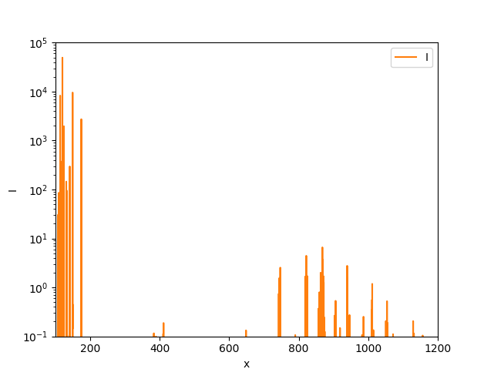


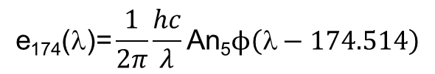
Computing Emission Coefficients
Emission coefficients depend on the species present in the gas
Through the magic of quantum mechanics, each species has particular allowed energy states
Transitions between allowed energy states cause radiation
Example: N atoms
n₇
n₆
hν @ 868 nm
hν @ 821 nm
n₅
n₄
hν @ 174 nm
hν @ 149 nm
Energy
n₃
Einstein coefficient(s⁻¹)
n₂
Lineshape function (nm⁻¹)
$$\text{e}\text{174}\text{(}\text{l}\text{)=}\frac{1}{2π}\frac{hc}{λ}\text{An}\text{5}ϕ\left(\text{l}−174.514\right)$$
n₁
Density of upper state (cm⁻³)
per unit solid angle, sr⁻¹
Energy of photon (J)

Slide 13
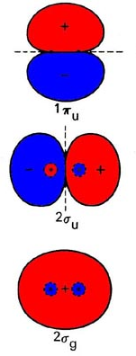
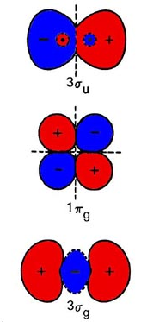
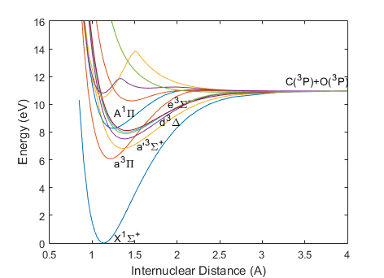

Molecular emission coefficients
Molecules have more states
  Electronic states

Slide 14
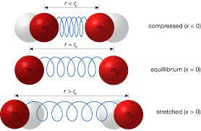
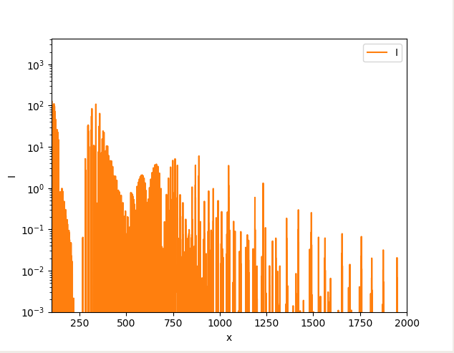
Molecular emission coefficients
Molecules have more states
  Electronic states
  Vibrational states

Slide 15
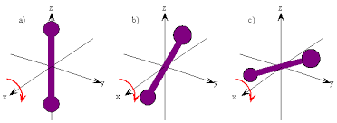
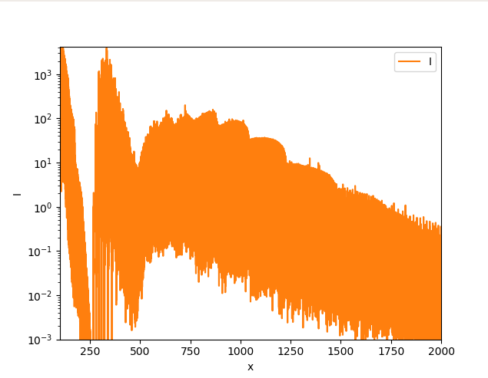
Molecular emission coefficients
Molecules have more states
  Electronic states
  Vibrational states
  Rotational states

Slide 16
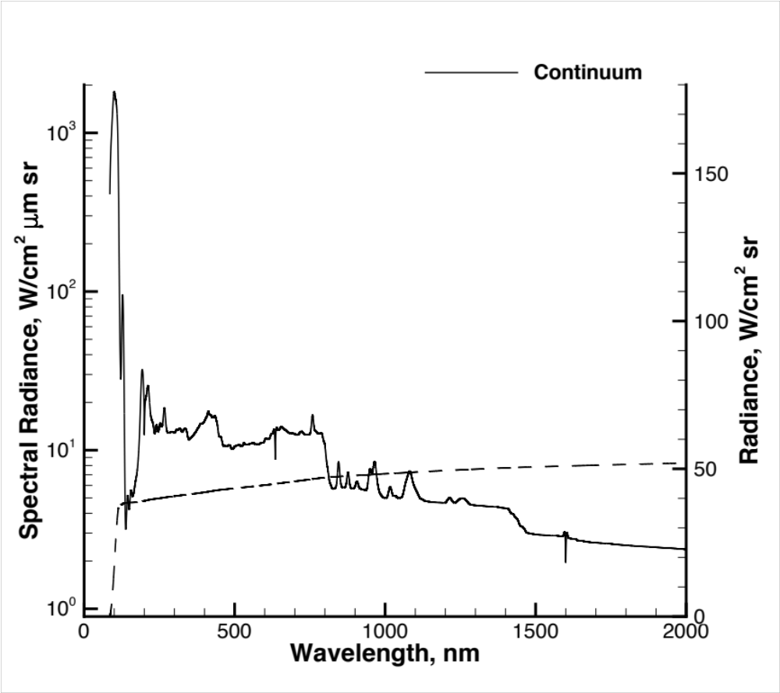
Building a spectrum
Example: FIRE II (Air entry, 10.7 km/s)
Continuum radiation, e.g.:
N⁺ + e⁻ → N + hν
hν = ΔE = E_{e} - ΔE_{rxn}
Electron (kinetic) energy is not quantized – emits as a continuum

Slide 17
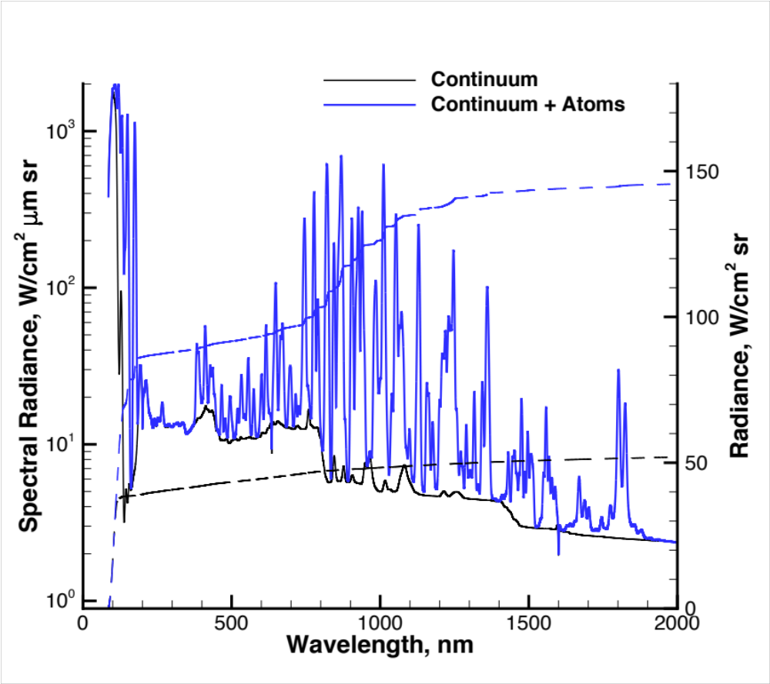
Building a Spectrum
FIRE II Test Case

Slide 18
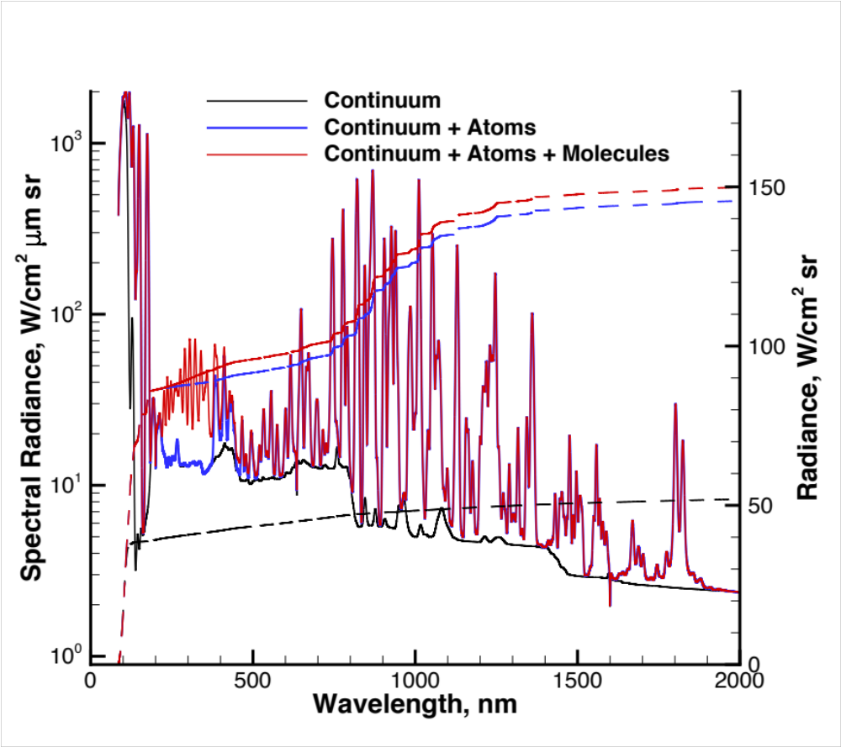
Building a Spectrum
FIRE II Test Case

Slide 19
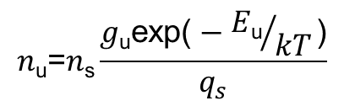
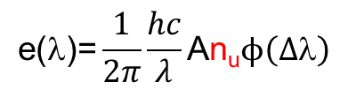
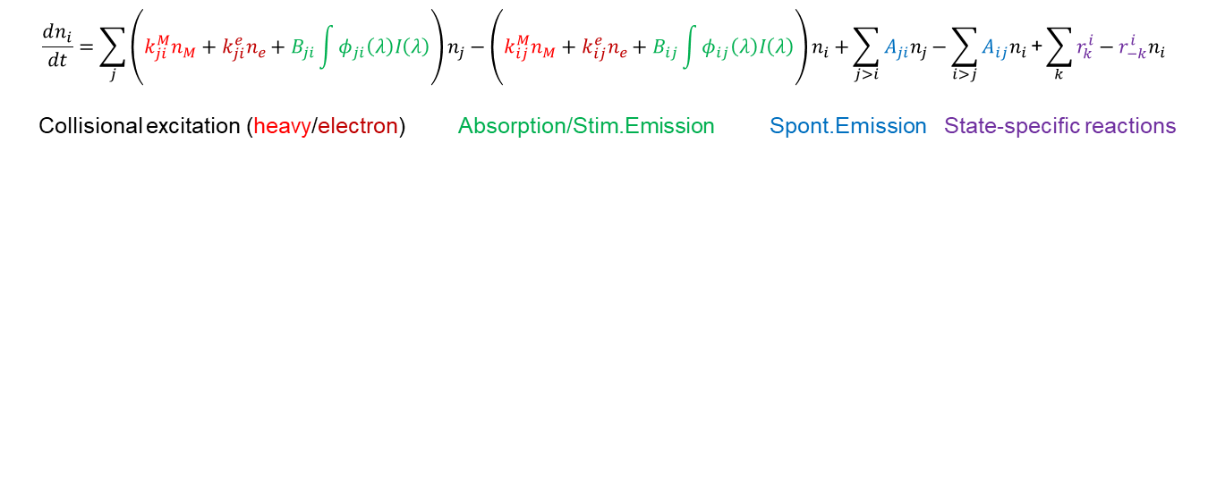
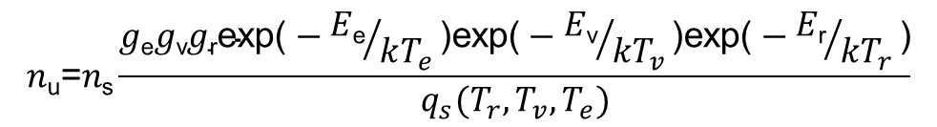
Solving state populations
The density of flowfield species (from CFD) need to be converted to the density of excited states
Boltzmann (thermal) distribution:
4-Temperature (T_{t},T_{r},T_{v},T_{e}) Boltzmann distribution
Non-Boltzmann (non-thermal) distribution
Typically, it is necessary to solve non-Boltzmann in electronic modes. Rotational, vibrational modes close to thermal
$$\text{e}\text{(}\text{l}\text{)=}\frac{1}{2π}\frac{hc}{λ}\text{A}\text{n}\text{u}ϕ\left(Δ\text{l}\right)$$
$$n\text{u}\text{=}n\text{s}\frac{g\text{u}\text{exp}\text{(}−{E\text{u}}/{kT}\text{)}}{q_{s}}$$
$$n\text{u}\text{=}n\text{s}\frac{g\text{e}g\text{v}g\text{r}\text{exp}\text{(}−{E\text{e}}/{kT_{e}}\text{)}\text{exp}\text{(}−{E\text{v}}/{kT_{v}}\text{)}\text{exp}\text{(}−{E\text{r}}/{kT_{r}}\text{)}}{q_{s}(T_{r},T_{v},T_{e})}$$
$$\frac{dn_{i}}{dt}=\sum_{j}{\left(k_{ji}^{M}n_{M}+k_{ji}^{e}n_{e}+B_{ji}\int{φ_{ji}\left(λ\right)I\left(λ\right)}\right)n_{j}−\left(k_{ij}^{M}n_{M}+k_{ij}^{e}n_{e}+B_{ij}\int{φ_{ij}\left(λ\right)I\left(λ\right)}\right)n_{i}+}\sum_{j>i}{A_{ji}n_{j}}−\sum_{i>j}{A_{ij}n_{i}}\text{+}\sum_{k}{r_{k}^{i}−r_{−k}^{i}n_{i}}$$
Collisional excitation (heavy/electron) Absorption/Stim.Emission Spont.Emission State-specific reactions

Slide 20
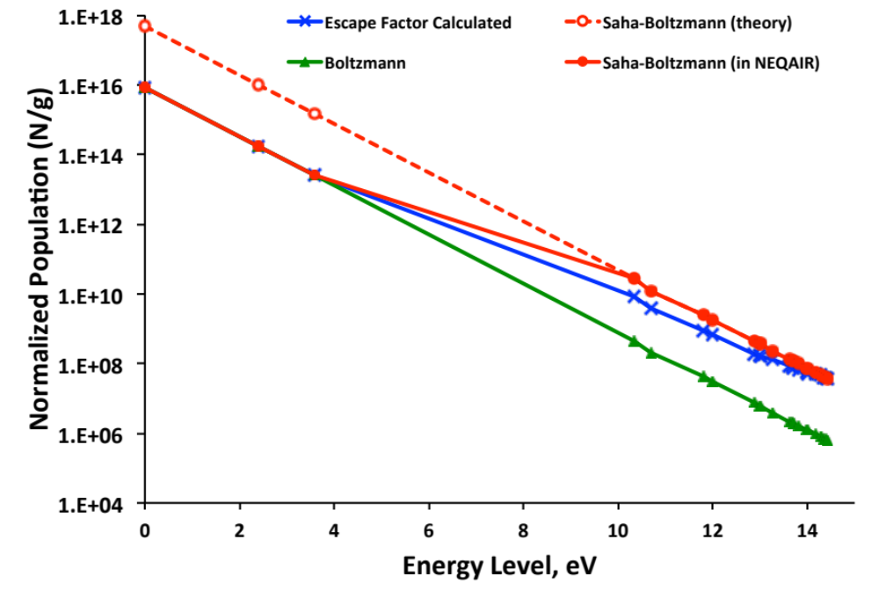
State populations: Boltzmann Plot
Boltzmann plot
  Population/Degeneracy is log-linear w.r.t energy at Boltzmann
  For molecules, need to normalize by q_{vr}(T_{v},T_{r})
  Slope equals 1/T_{e}
Some states tend to equilibrate with electrons instead of the ground state (Saha)
For molecules, may equilibrate with atoms or other species

Slide 21
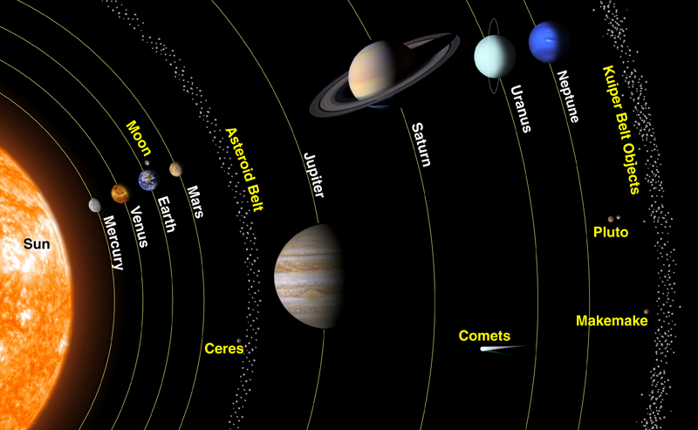
Radiation concerns for Different Destinations
CO₂/N₂/(Ar)
Velocities not very high (5-6 km/s)
Density is low
Radiation from CO₂ is concern
CN and CO radiation at higher velocity
Fast (32 km/s)
Radiation from
H, H₂, continuum
CO₂/N₂
Very high velocities (11 km/s)
Atomic species and ions (esp. C)
Later trajectory: CN, CO VUV, CO₂
Faster (27 km/s)
Radiation small
Velocities are fast (25 km/s)
But temperature is low
Radiation is negligible
H₂/He/(CH₄)
N₂/O₂/(Ar)
Lunar return and beyond
High (>10 km/s) velocities
Radiation from atoms, ions
Titan
N₂/CH₄
Velocities are low (~5 km/s)
But CN is strong radiator
Ludicrous (46 km/s)
Massive continuum radiation
Optically thick

Slide 22
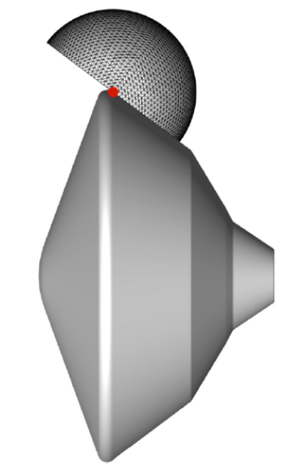
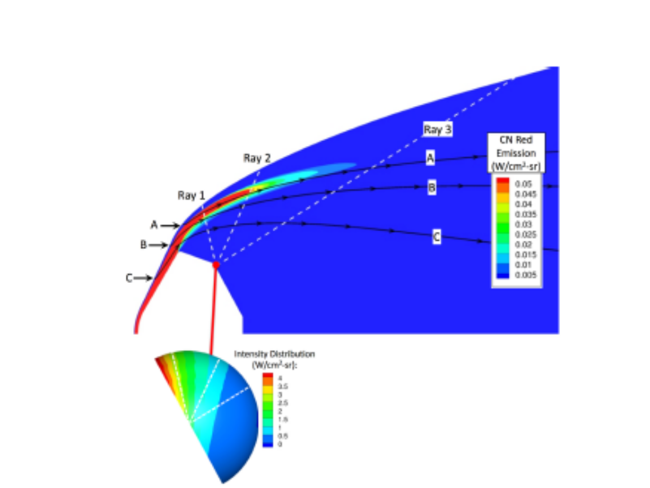
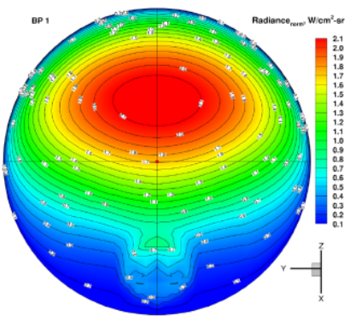
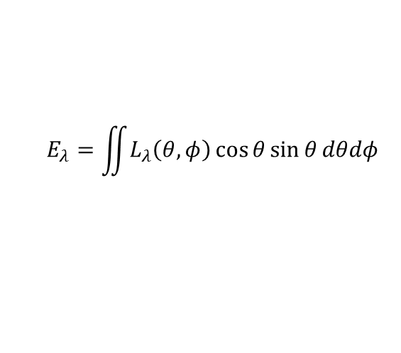
Evaluating the Angular Integral
The hard (accurate) way :
  Ray tracing
  Full angular integration
$$E_{λ}=\iint{L_{λ}\left(θ,φ\right)\cos{θ}\sin{θ}dθdφ}$$
Brute force approaches:
  Evaluation of 100s-1000s of lines of sight
  Can be slow
Other approaches: Monte Carlo, Finite Volume
  Not covered this talk

Slide 23
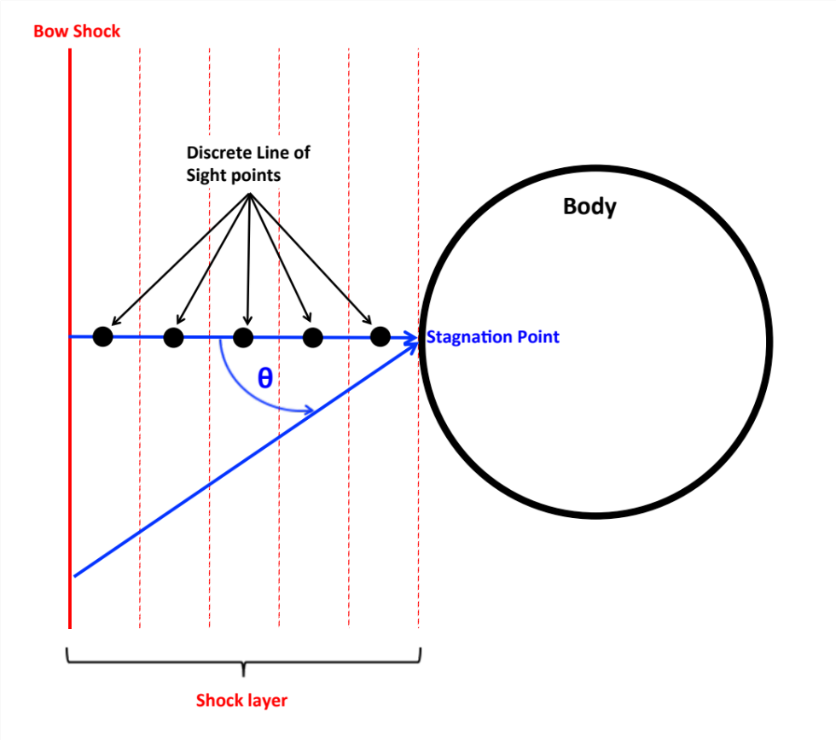
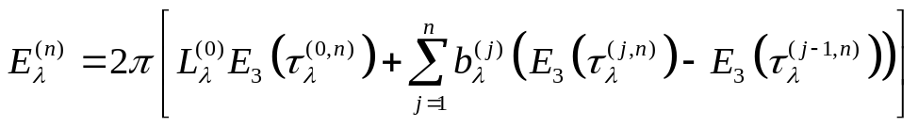
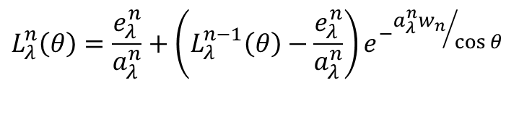

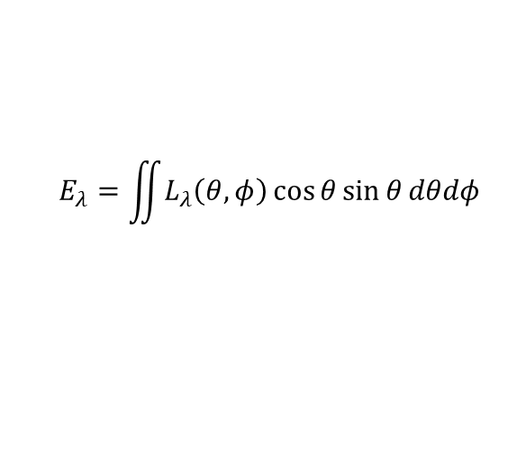
Tangent Slab Approximation
Assume 1-D Semi-infinite geometry:
Integral may now be expressed as a 1-D integral, or a summation of transcendental functions.
Only one Line of Sight required
Limits: E/L = π (optically thick) to 2π (optically thin)
Good on the forebody to ~10%. Worse on shoulder, bad on backshell
$$E_{λ}=\iint{L_{λ}\left(θ,φ\right)\cos{θ}\sin{θ}dθdφ}$$
$$E_{λ}=2π\int{L_{λ}\left(θ\right)\cos{θ}\sin{θ}dθ}$$
$$L_{λ}^{n}\left(θ\right)=\frac{e_{λ}^{n}}{a_{λ}^{n}}+\left(L_{λ}^{n−1}\left(θ\right)−\frac{e_{λ}^{n}}{a_{λ}^{n}}\right)e^{−{a_{λ}^{n}w_{n}}/{\cos{θ}}}$$
.
.
.

Slide 24





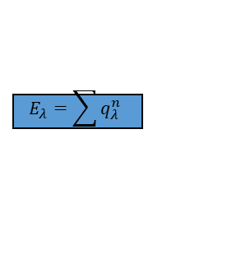


Putting it all together: radiative codes
CFD Code
n^{s},
T_{t},T_{r},T_{v},T_{e},T_{el}
Read Inputs
n=n_{LOS}
NASA has two codes
  NEQAIR (Ames Research Center)
  HARA (Langley Research Center)
JAXA, ESA, ROSCOSMOS have their own codes
Several academic codes exist with varying levels of fidelity/options
HARA is packaged with LAURA CFD code. US release only.
NEQAIR is available for US and foreign release. Has pretty wide use through the scientific and engineering community:
https://software.nasa.gov/software/ARC-15262-1B
n=1
Non-Boltzman
Solve (fast)
Calculate State
Populations
Calculate State
Populations
…
Emission/
Absorption
Coefficients
(slow)
Calculate e_{λ}, a_{λ}
Calculate e_{λ}, a_{λ}
…
Calculate
…
Calculate
$$τ_{λ}^{n}=a_{λ}^{n}w_{n}+τ_{λ}^{n+1}$$
$$τ_{λ}^{n}=a_{λ}^{n}w_{n}+τ_{λ}^{n+1}$$
Radiative
Transport
(relatively
fast)
Calculate
…
Calculate
$$E_{3}\left(τ_{λ}^{n}\right)$$
$$E_{3}\left(τ_{λ}^{n}\right)$$
$$q_{λ}^{n}=2πL_{λ}^{0}\left(E_{3}\left(τ_{λ}^{1}\right)\right)$$
…
$$q_{λ}^{n}=2πb_{λ}^{n}\left(E_{3}\left(τ_{λ}^{n}\right)−E_{3}\left(τ_{λ}^{n−1}\right)\right)$$
$$E_{λ}=\sum{q_{λ}^{n}}$$
Write Outputs

Slide 25
Conclusions
Regions of relevance for radiative heating
  Important at High velocity, high density
  More important on Large vehicles
  Often important on the backshell
  Sometimes radiation surprises us (e.g. Mars backshell heating by CO₂)
Radiative Heat flux is an integral over solid angle, wavelength, linear distance
  The fundamental measure of radiation is the emission coefficient, or volumetric spectral radiance
Radiation depends on wavelength – so does your TPS and sensors
Some radiation terminology and concepts to remember:
  Optical thickness
  Relationship of absorption to emission (blackbody fn)
  Radiance vs. Irradiance and Intensity
  Tangent slab vs. 3D radiation
  Molecular vs. Atomic vs. Continuum Radiation
  Boltzmann/non-Boltzmann
  Line of Sight
  Emission and absorption coefficients
Advanced topics not covered
  Escape factor and non-local effect
  Radiation/flowfield coupling
  Line broadening
  Excited state chemistry
  Spectral parameters
  The Planck Function
  Relationship of Boltzmann distribution to Planck’s function
  QSS Approximation
  Wavelength Classifications (vacuum ultraviolet, mid-infrared)
  Radiative Transport Equation

