Slide 1

3D Multifunctional Ablative Thermal Protection System Overview
NASA Ames Technology Transfer Materials and Coatings Webinar
Jay Feldman, Ph.D.
Materials Engineer
NASA Ames Research Center
7/28/2021

Slide 2


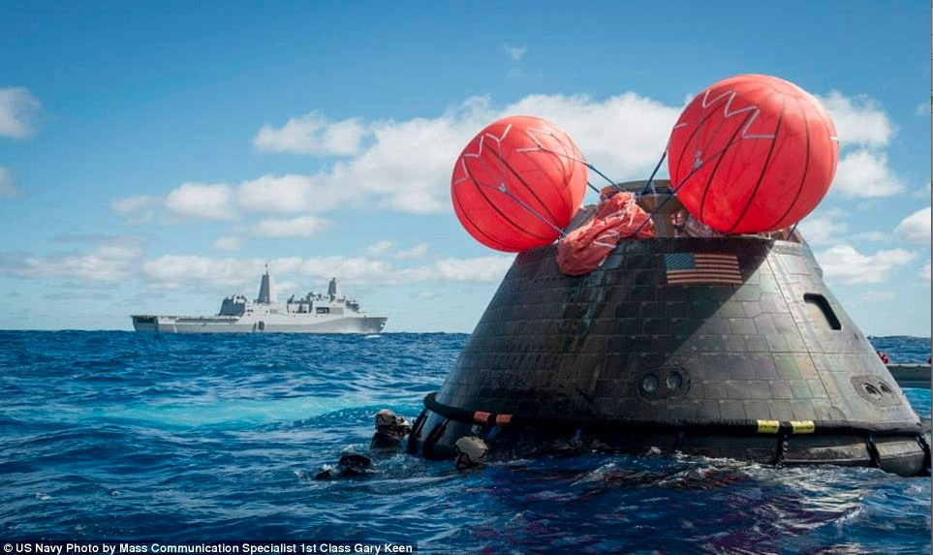
Orion Multipurpose Crew Vehicle
Orion Flight Test Launch Dec. 5, 2014
Orion Flight Test Recovery
Orion Flight Test Launch Dec. 5, 2014
Orion Multipurpose Crew Vehicle will transport astronauts to the Lunar Gateway
Artemis-1 mission targeted for November 2021 & astronaut missions targeted for 2022 and beyond
3D-MAT is one of the technologies specifically developed for the Orion vehicle
Peak Altitude: 3,600 miles
(Space Station: 220 miles)
Peak Altitude: 3,600 miles
(Space Station: 220 miles)
Notes:
NASA community is very excited about the Orion flight test a few months ago & that we are on the path to putting astronauts in space on an American vehicle.
Our country is on a path to regaining the ability to send astronauts to space with U.S. built spacecraft!
Com. Crew: Have been hitching rides on the Russion Soyuz since 2011 at a rising cost of $71M per seat.

Slide 3
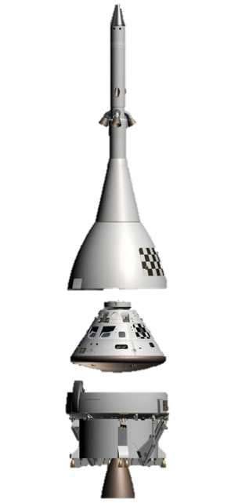
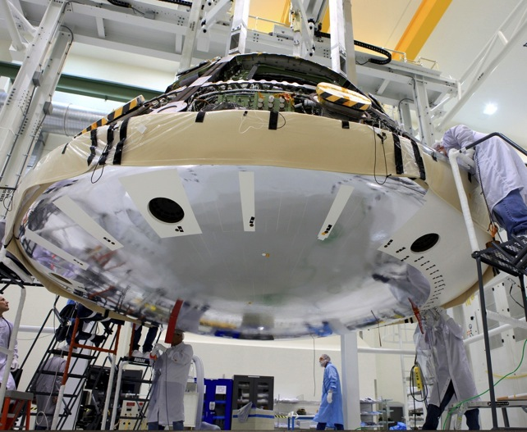
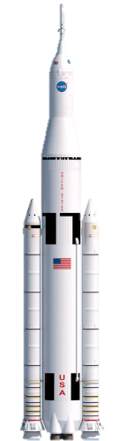
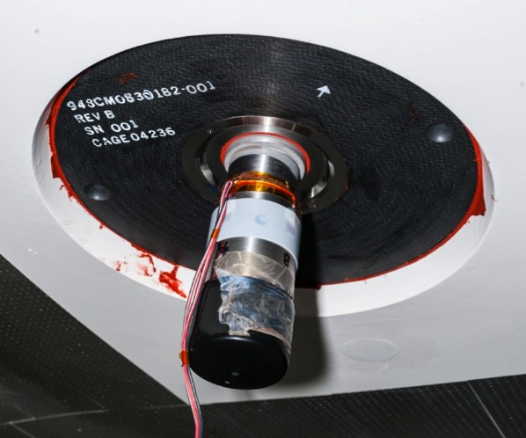
Background: Orion Compression Pad
Orion EFT-1 Vehicle
Launch
Abort System
Crew
Module
Compression Pad Locations (6)
Service
Module
Orion compression pads are the interface between Crew Module (CM) & Service Module (SM)
Required to withstand:
- Launch & ascent structural loads
- Pyro-shock (CM/SM separation event)
- Earth re-entry (high heating, ablation)
Compression Pad & Explosive Bolt
Notes:
SM: Power, propulsion, life support
ABLATION – heat shield is charred and partially consumed while keeping the inside of the vehicle cool

Slide 4
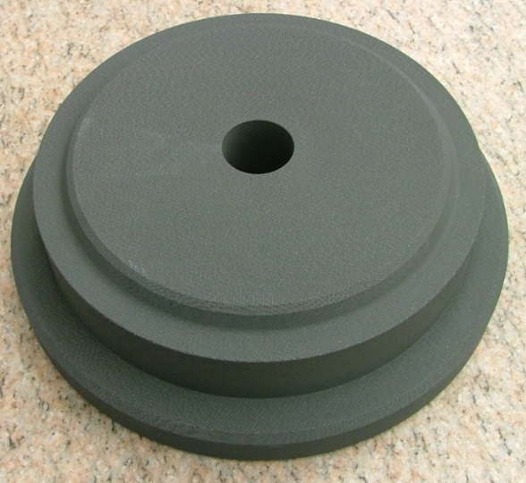
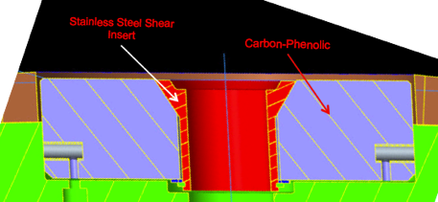
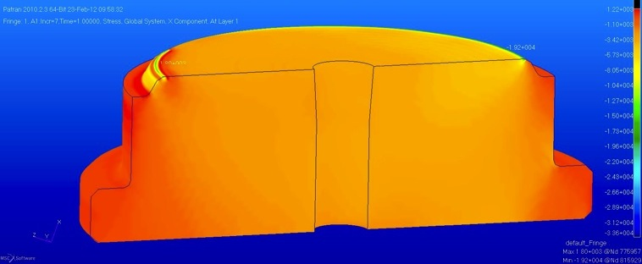
The Compression Pad Problem
Initial Pad Design: All Composite
EFT-1 (Earth Orbit) Only Design
Steel Insert
Carbon Phenolic
This design failed for 2D carbon phenolic laminate: poor inter-laminar strength
Metallic insert used for first flight where entry heating was relatively low
2D laminates have insufficient strength to take all structural loads
Metallic insert is problematic as it creates a thermal short, results in melt flow onto surrounding materials
Future Orion missions will go beyond Earth orbit & have significantly higher heating compared to EFT-1 flight
A robust 3D composite would eliminate the need for the metallic insert

Slide 5
3DMAT: Requirements & Challenges
Type | Orion Compression Pad Requirements
Thermal | Compression pad to Avcoat/carrier-structure interface shall maintain positive margin against the 500 °F maximum bondline temperature
Structural | Compression pad shall carry compression moment & shear loads
Structural | Tension tie shall maintain preload with losses due to creep & joint relaxation
Structural | Compression pad shall thermally function after exposure to the separation bolt pyro-shock event
Size | Pad material shall be manufacturable to at least 3” thickness by 11” diameter
Technology Challenges
Aggressive schedule to develop in time for Orion PDR (3 years)
New weaving & resin infusion processes developed to meet size requirement
  Scale up = challenging!
  Multiple process refinements needed during development
Notes:
Achieving the development within the aggressive schedule needed to support Orion EM-1 flight

Slide 6
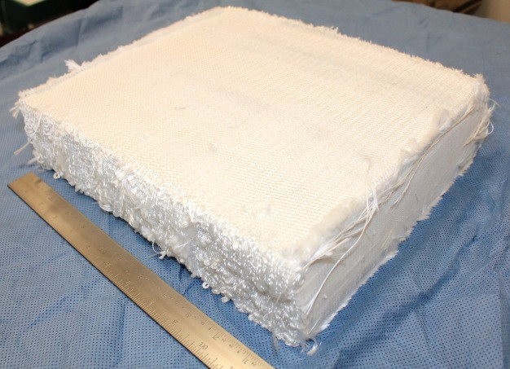
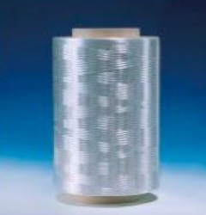
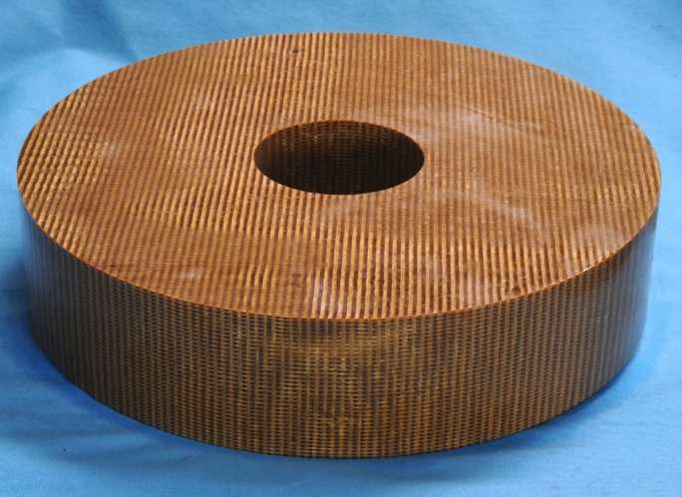
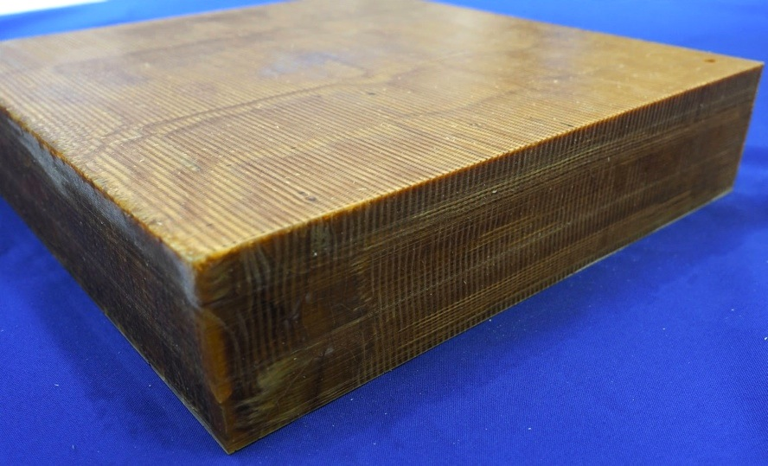
Manufacturing Process Overview
Quartz Yarn
3D Preform
3D Weaving
Resin
Infusion
3D Composite Billet
Final Machining

Slide 7
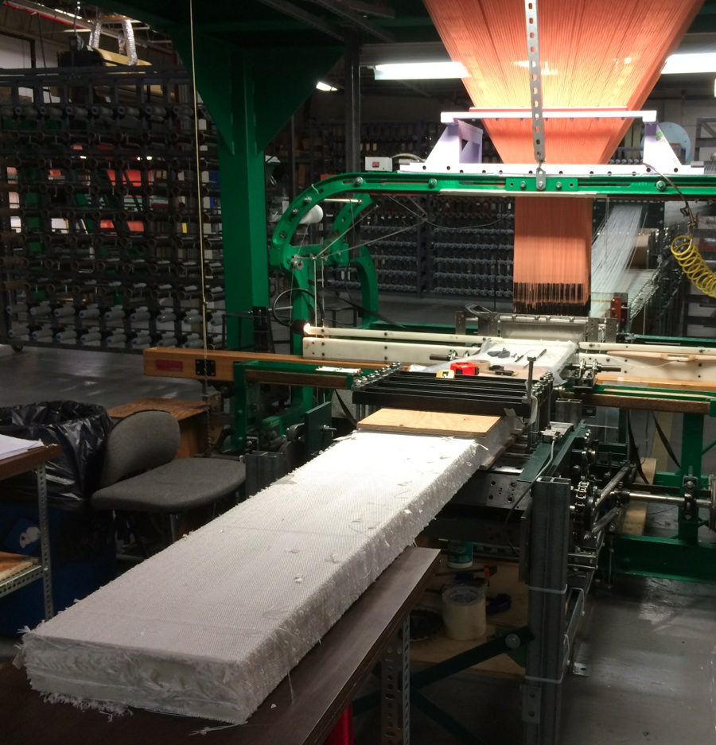
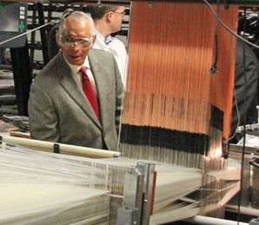
Weaving Scale Up
First ever achievement of continuous, automated weaving (Jacquard loom) at 12” x 3” scale
  57% fiber volume, 1/3 of fibers in X/Y/Z directions
  Cross-section scale up by a factor of 4 was challenging!
Bally Ribbon Mills
NASA-funded hardware
photo: Ken Kremer

Slide 8
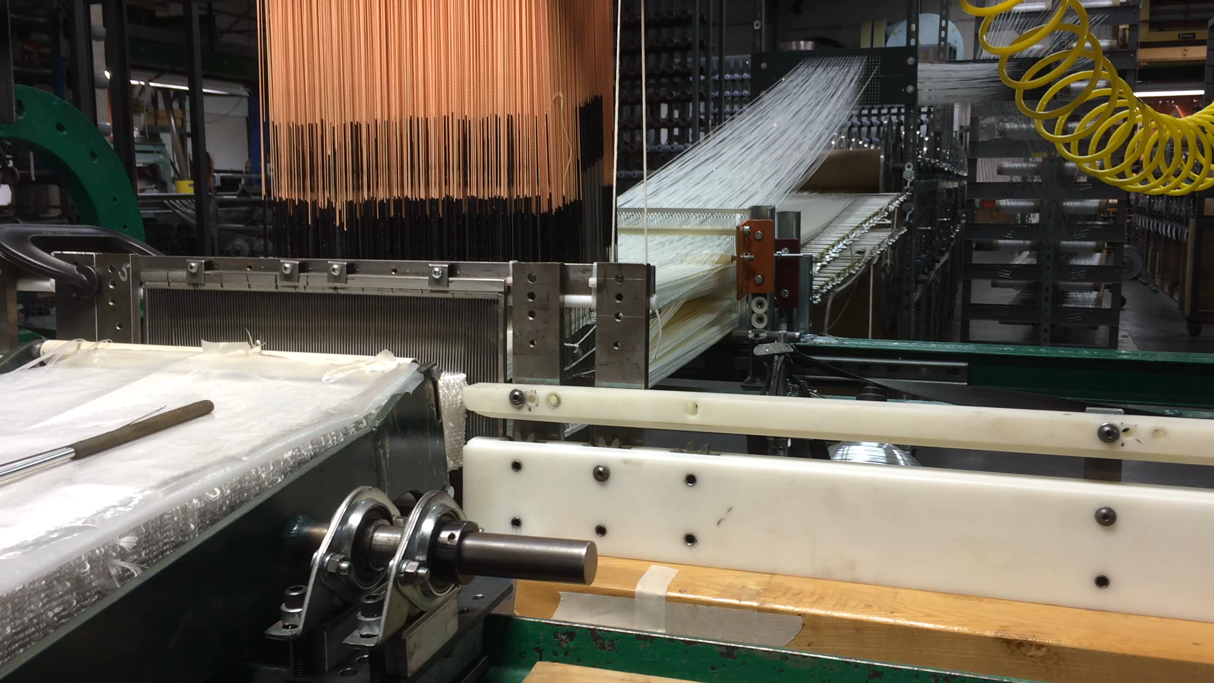
Weaving Video
Discuss:
5000? Individual warp yarns individually controlled
~50 layers built up from top to bottom prior to advancing one linear step
Large infrastructure of fibers on the creel etc.
8

Slide 9
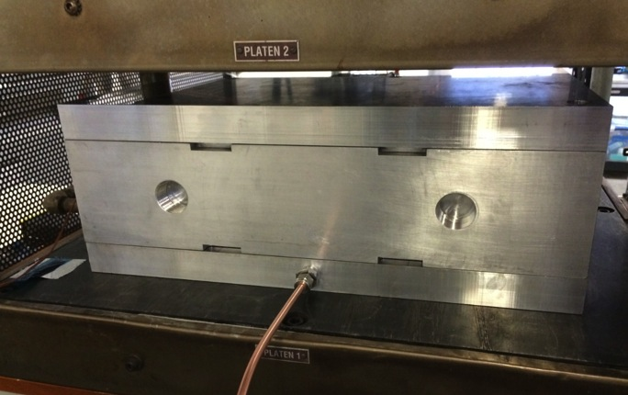
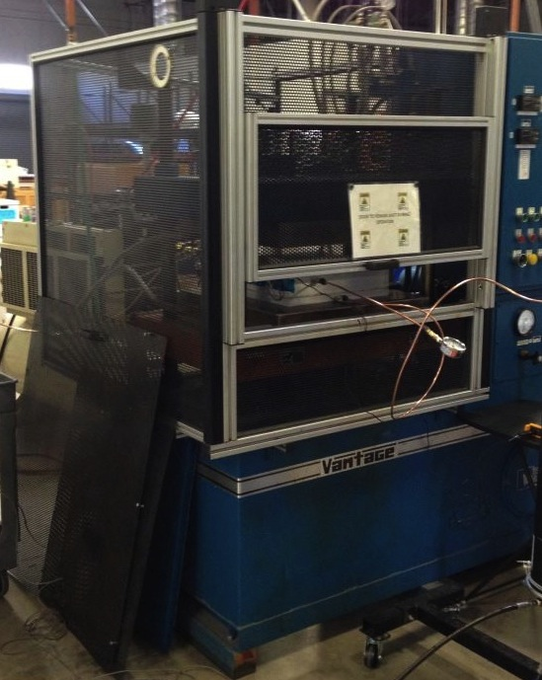
Resin Infusion Development
Cyanate Ester Resin Transfer Molding with San Diego Composites
Resin infusion & full densification (<2% porosity) of 3” thick preforms was established
Resin Transfer Molding (RTM) is widely used for full densification of thin (typically <0.25”) composites
5 separate approaches failed before we developed this RTM process with San Diego Composites
3D-MAT developed an RTM process for large scale preforms
yielding billets with low porosity
Notes:
Revamp photos: show open tool? Show tool in press.
Triazine ring

Slide 10
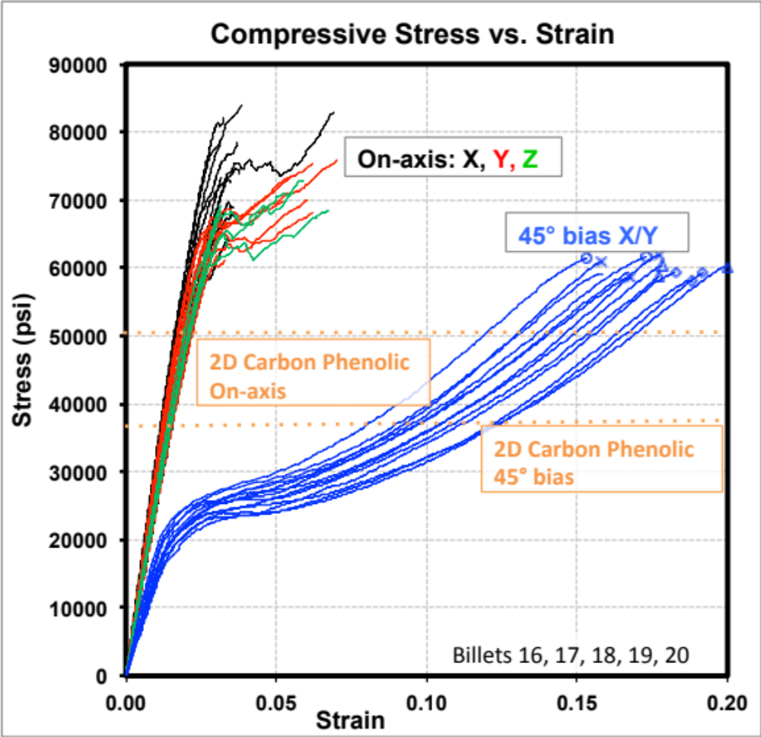
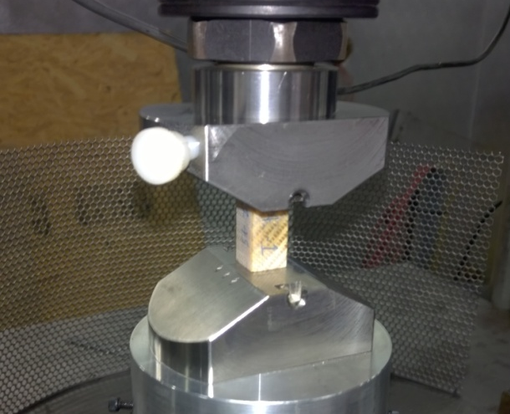
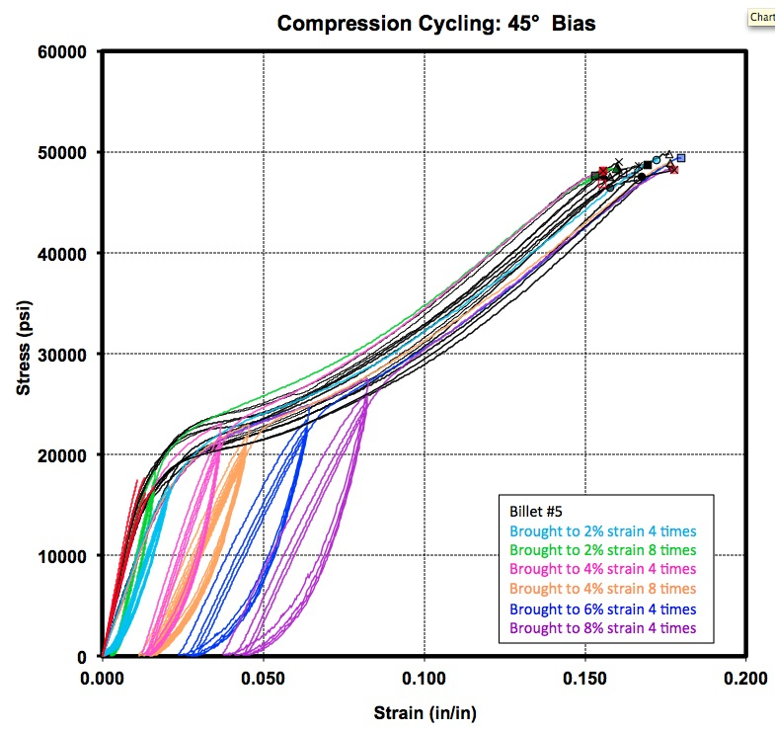
Compressive Testing
Compressive Cycling: 45° Bias
Very robust compressive performance!
Notes:
compression stress-vs strain including on-axis and 45. Show separate 45 cycling past knee. For both indicate where carbon phenolic lies.
Show Tensile properties: either stress strain or else just table comparison

Slide 11
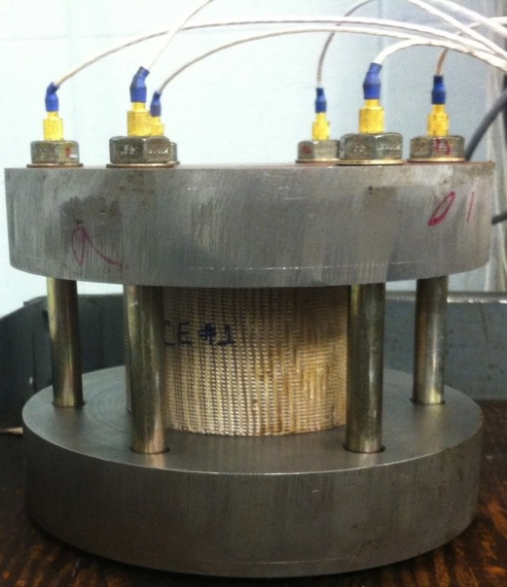
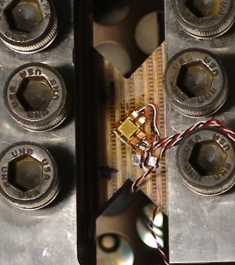
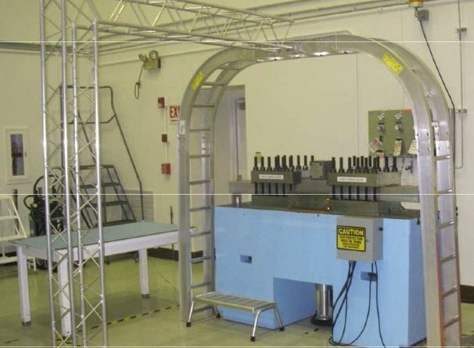
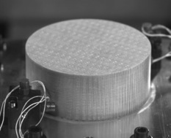
Testing to Achieve Mission Readiness
Material Property Testing:
Full suite for thermal & structural model development
Stress Relaxation (Creep) Testing
Property | 3DMAT vs 2D Carbon Phenolic
Compressive Strength On-axis (X,Y,Z) | 140%
Tensile Strength Interlayer (Z) In-Plane (X/Y) | 900% 245%
Thermal Conductivity Interlayer (Z) In-Plane (X/Y) | 75% 55%
Pyroshock Simulation
Significantly enhanced properties compared to EFT-1 compression pad material
Notes:
full suite of properties to support trm & tsa

Slide 12
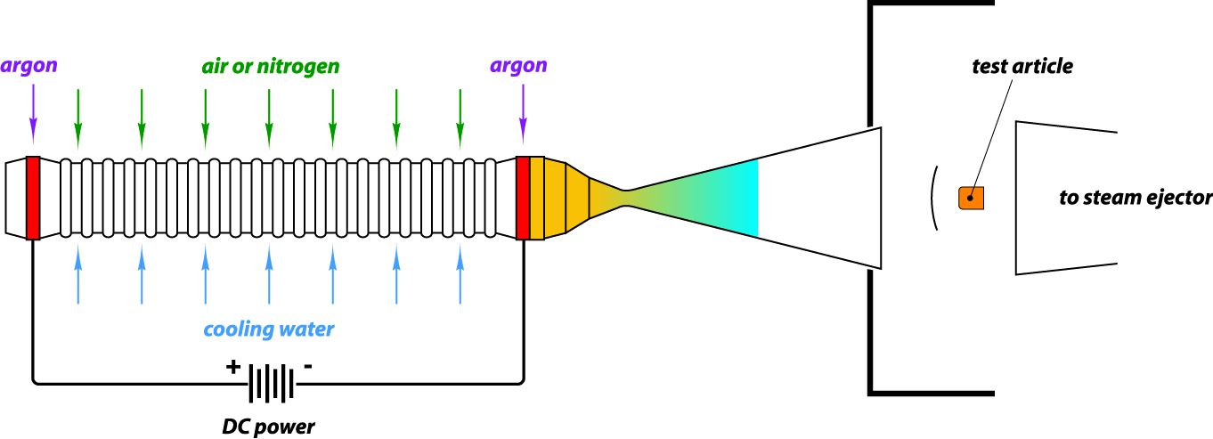
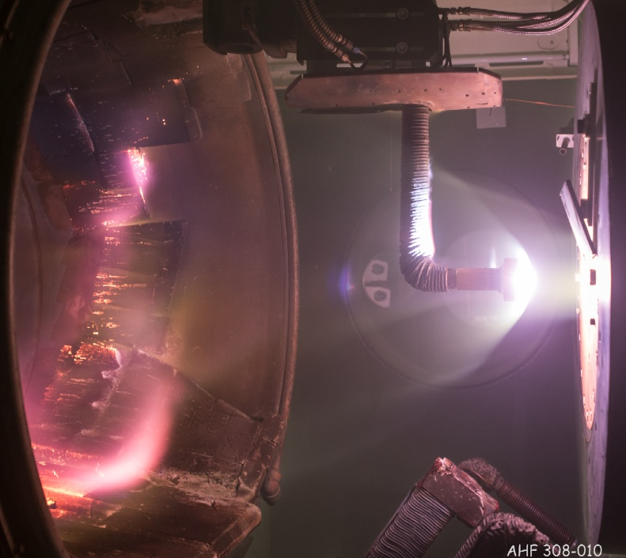
Arc Jet Introduction
Supersonic
flow
Objective
Create heating & pressure environments relevant to planetary entry
Test Facility
Gas flow is heated by electric discharge in a water-cooled, constricted arc column
The hot gas is expanded through a converging-diverging nozzle into a chamber where the test article is mounted on a water-cooled mechanical swing arm
The electrical power, gas flow rate, nozzle configuration, and distance of the test article from the nozzle exit plane are adjusted to achieve the desired stagnation pressure and temperature (or heat flux)
Notes:
Another critical test series in the development of 3DMAT was arc jet testing
electrode

Slide 13
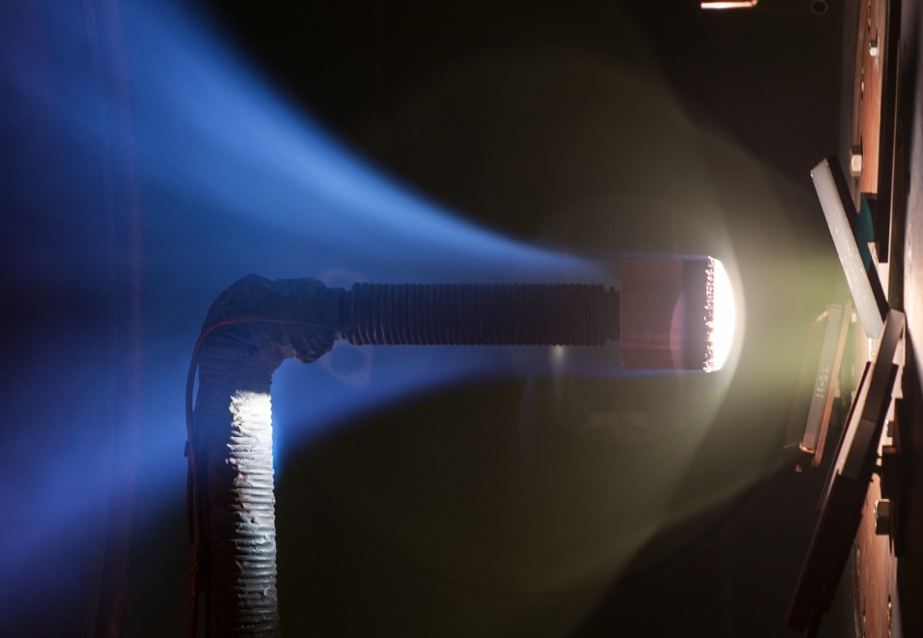
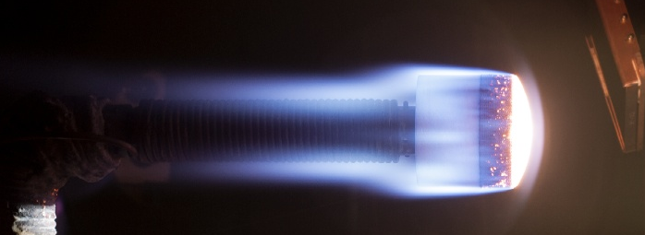
Arc Jet Conditions
Conditions Tested in 20 MW TP3 Facility
Heat Flux: 140 – 660 W/cm² (Shuttle: 6 – 60 W/cm²)
Pressure: 3 – 55 kPa
Duration: 60 – 200 s
Max Surface Temp: 1550 – 2400 °C
a
Cond 5 XY W/cm2
4”
Cond 4 W/cm2
13
Notes:
4” diameter – if we go bigger we reduce the amount of heating experienced by the model.

Slide 14
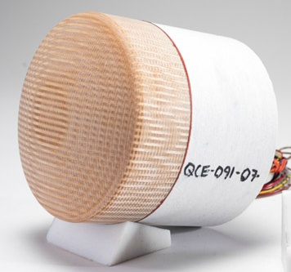
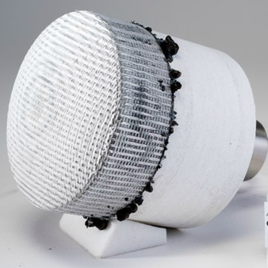
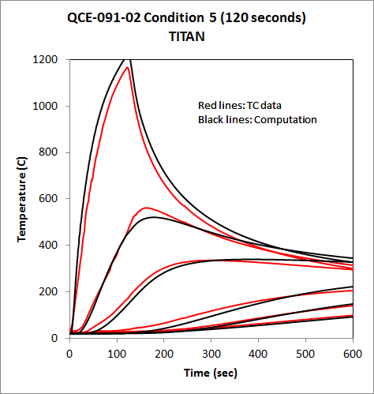
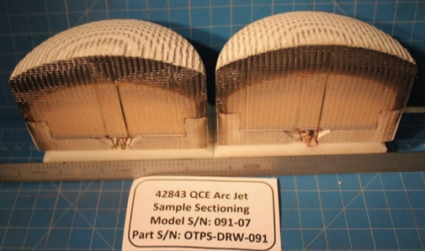
Arc Jet Results & Thermal Model
Pre-test
Post-test
Thermal Response Modeling
4.5 mm depth
TC Data
Computation
11 mm
17 mm
32 mm
43 mm
Post-Test Cross-Sectioned
Ablation chemistry & property-based thermal response model predicts the temperature as a function of depth & time (thermocouples at various depths)

Slide 15
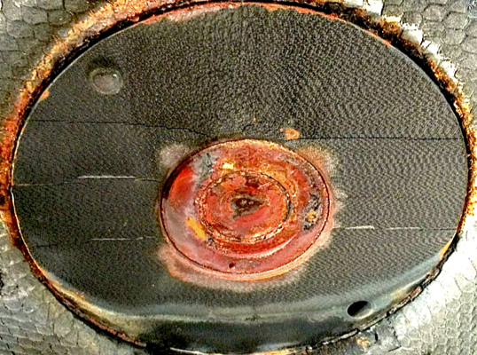
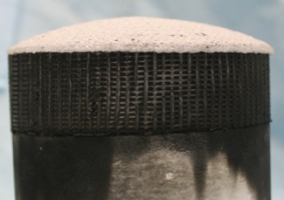
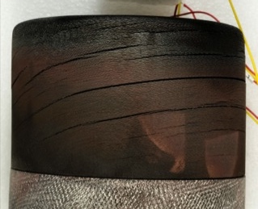
Aerothermal Performance
Arc jet testing of 3DMAT revealed no failure modes whereas carbon phenolic consistently cracks between lamina
Post-test 3DMAT
Side View
Post-test 2D CP
All EFT-1 carbon phenolic pads contained inter-laminar cracks post-flight
Side View

Slide 16
Summary
3D-MAT is a structural ablative qualified for the Orion Multipurpose Crew Vehicle
3D-MAT combines high strength, low thermal conductivity, and high temperature capability to create a unique, high-performance composite
Artemis-1 flight test (November 2021) will be the first flight of the material, in 18 different locations on Orion’s aeroshell (compression pad on the heatshield, various locations on the backshell)
Notes:
3DMAT project addressed a material capability need for Orion by developing a robust 3D composite.
Initial

Slide 17
