Slide 1


Augmenting Data Systems with Prediction based Embeddings
IGARSS, 2021
Rahul Ramachandran*¹, M. Ramasubramanian², Iksha Gurung², Carson Davis², Derek Koehl², Manil Maskey¹, Tsengdar Lee³
¹ NASA/MSFC
² University of Alabama in Huntsville
³ NASA/HQ

Slide 2
Motivation
1
Design and Implementation
2
Outline
3
Data System Applications
3
Data System Applications
4
Future Work

Slide 3
Motivation

Slide 4
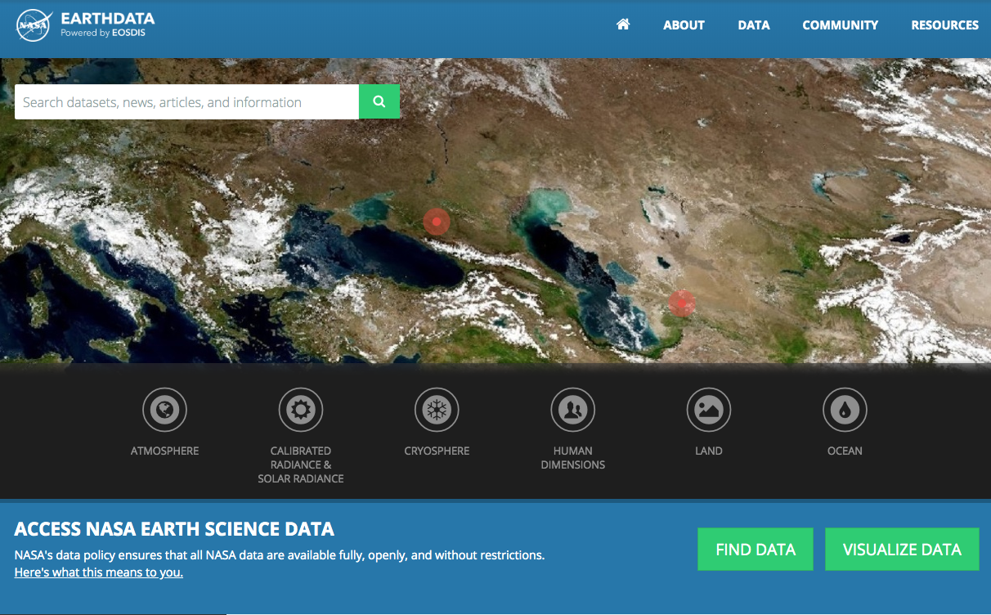
Earth Science Data System Program
The Earth Science Data System Program is an essential component of the Earth Science Division and is responsible for:
Actively managing NASA’s Earth science data (Satellite, Airborne, and Field).
Developing unique data system capabilities optimized to support rigorous science investigations and interdisciplinary research.
Processing (and reprocessing) instrument data to create high quality long-term Earth science data records.
Upholding NASA’s policy of full and open sharing of all data, tools, and ancillary information for all users.
Engaging members of the Earth science community in the evolution of data systems.
The Earth Science Data and Information System (ESDIS) project/GSFC maintains and operates a data and information system for Science Mission Directorate (SMD) and its Earth Science Division (ESD). IMPACT at MSFC supports ESDS Program and collaborates with ESDIS project.

Slide 5
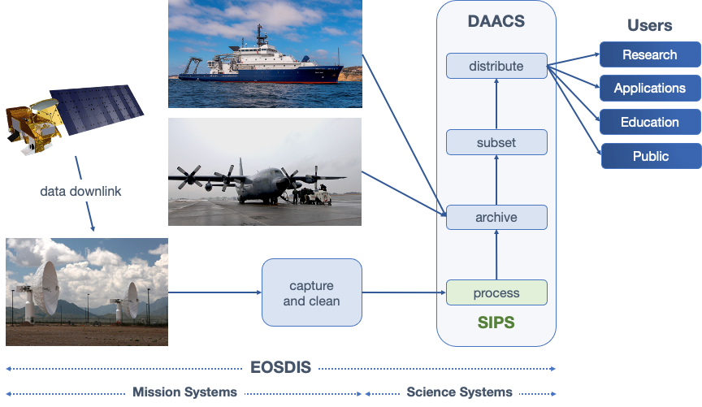
Earth Observing System Data and Information System (EOSDIS)

Slide 6
Data are Produced and Managed by
Science Discipline Experts
ASF DAAC
SAR Products, Sea Ice, Polar Processes
U. of Wisc.
SNPP Atmosphere
SEDAC
Human Interactions in Global Change
LPDAAC
Land Processes and Features
CDDIS
Crustal Dynamics Solid Earth
NCAR,
U. of Co.
MOPITT
GSFC
SNPP, MODIS, OMI, OBPG
JPL
MLS, TES, SNPP Sounder
OB.DAAC
Ocean Biology and Biogeochemistry
PO.DAAC
Ocean Circulation
Air-Sea Interactions
NSIDC DAAC
Cryosphere, Polar Processes
LAADS/MODAPS
Atmosphere
GHRC
Hydrological Cycle and Severe Weather
ASDC
Radiation Budget, Clouds, Aerosols, Tropo Composition
SIPS
DAAC
GHRC
AMSR-U, LIS

Slide 7
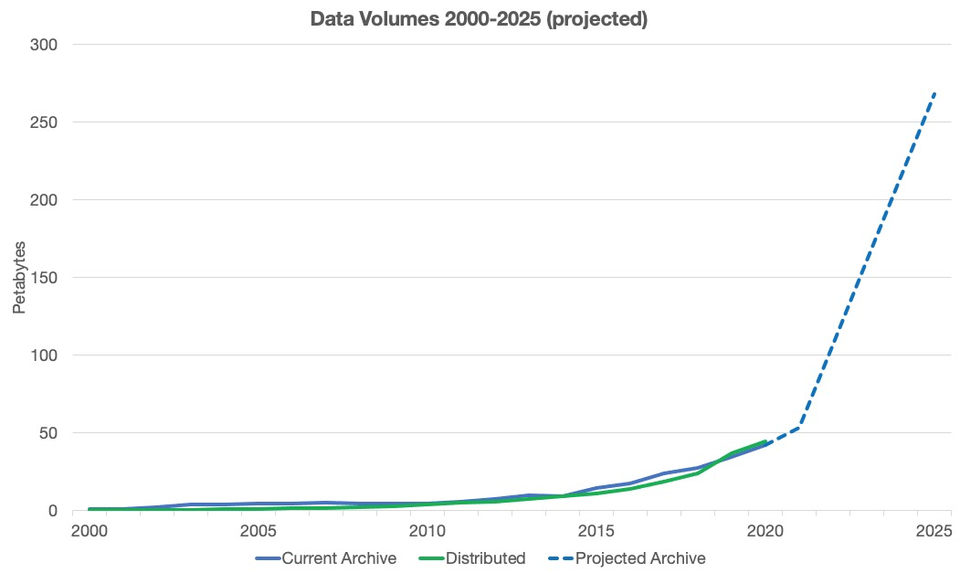





Extensive Data Collection
EOSDIS today has 12,800+ data types (collections)
  Cover & Usage
  Surface temperature
  Soil moisture
  Surface topography
  Surface temperature
  Surface wind fields & heat flux
  Surface topography
  Ocean color
  Winds & Precipitation
  Aerosols & Clouds
  Temperature & Humidity
  Solar radiation
Land
Ocean
Atmosphere
  Population & Land Use
  Human & Environmental Health
  Ecosystems
  Sea/Land Ice & Snow Cover
Human Dimensions
Cryosphere

Slide 8
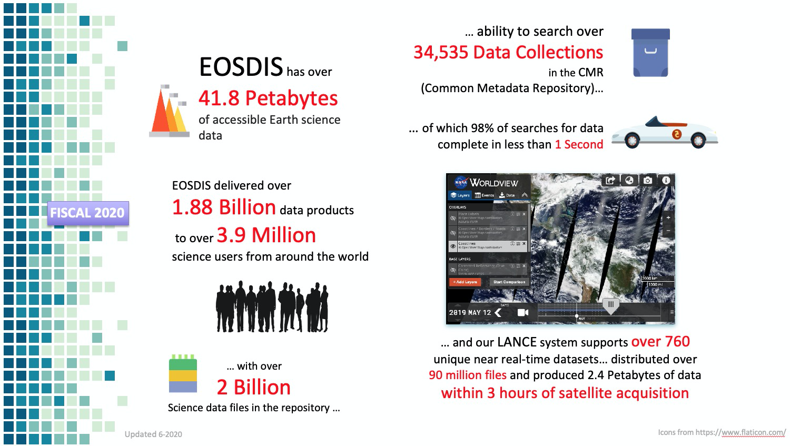
ESDS Program By The Numbers
Shift from open data to enabling and accelerating open source science

Slide 9
Challenges dealing with petabytes of heterogeneous data
How do we reduce the amount of time and effort required for data preparation before analysis?
Data preparation covers discovery, access, and preprocessing of useful science content from the increasingly large volumes of Earth science data and related information available.
Current data search systems enable researchers to find data primarily by metadata searches on instrument names or geophysical keywords.
  Assume that users have sufficient knowledge of the domain vocabulary to utilize the search catalogs effectively.
  Works well for those who know exactly which data sets they need but presents a steep learning curve for new or interdisciplinary researchers
Solution: design semantic layers within Earth science data systems to provide context to improve search and use of the Earth science data

Slide 10
2. Design and Implementation

Slide 11
Approaches
Ontology based top down manual approach
Ontology in computer science is defined as a shared conceptualization of domain knowledge.
Limitations:
  Developing a robust ontology for earth sciences is a complex task as it requires capturing and coalescing knowledge from many scientists.
  Some types of knowledge, such as taxonomic information, are suitable for representation by ontologies, whereas others are not.
  Ontologies cannot be static and must evolve as knowledge changes within a domain.
  Ontologies are not helpful for real-world applications once the ontologies get beyond a certain complexity level.
Bottom-up data-driven approaches based on NLP and Machine Learning, utilize existing corpus, typically unstructured text, to model the knowledge in a machine representable form.
Prediction-based Word Embeddings encode each word as a vector of other words and show great promise for practical applications. (Tshitoyan et al. [15] for materials science knowledge present in the published literature)

Slide 12
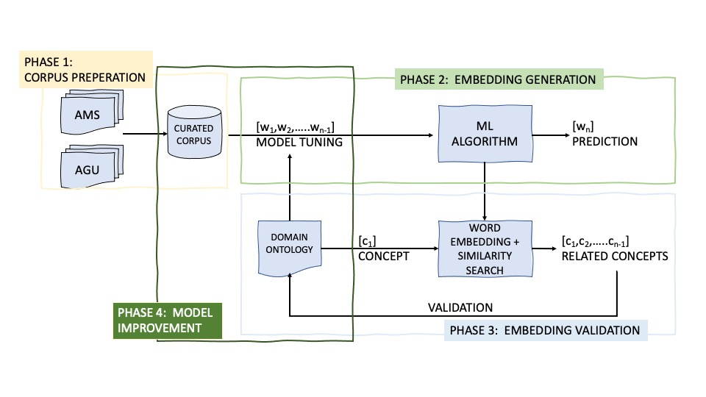
Hybrid Approach
Utilize a large corpus of journal publications from Earth science to build an embedding.
Utilize the existing Earth science ontologies to develop validation tests to evaluate the robustness and correctness of the embedding.

Slide 13
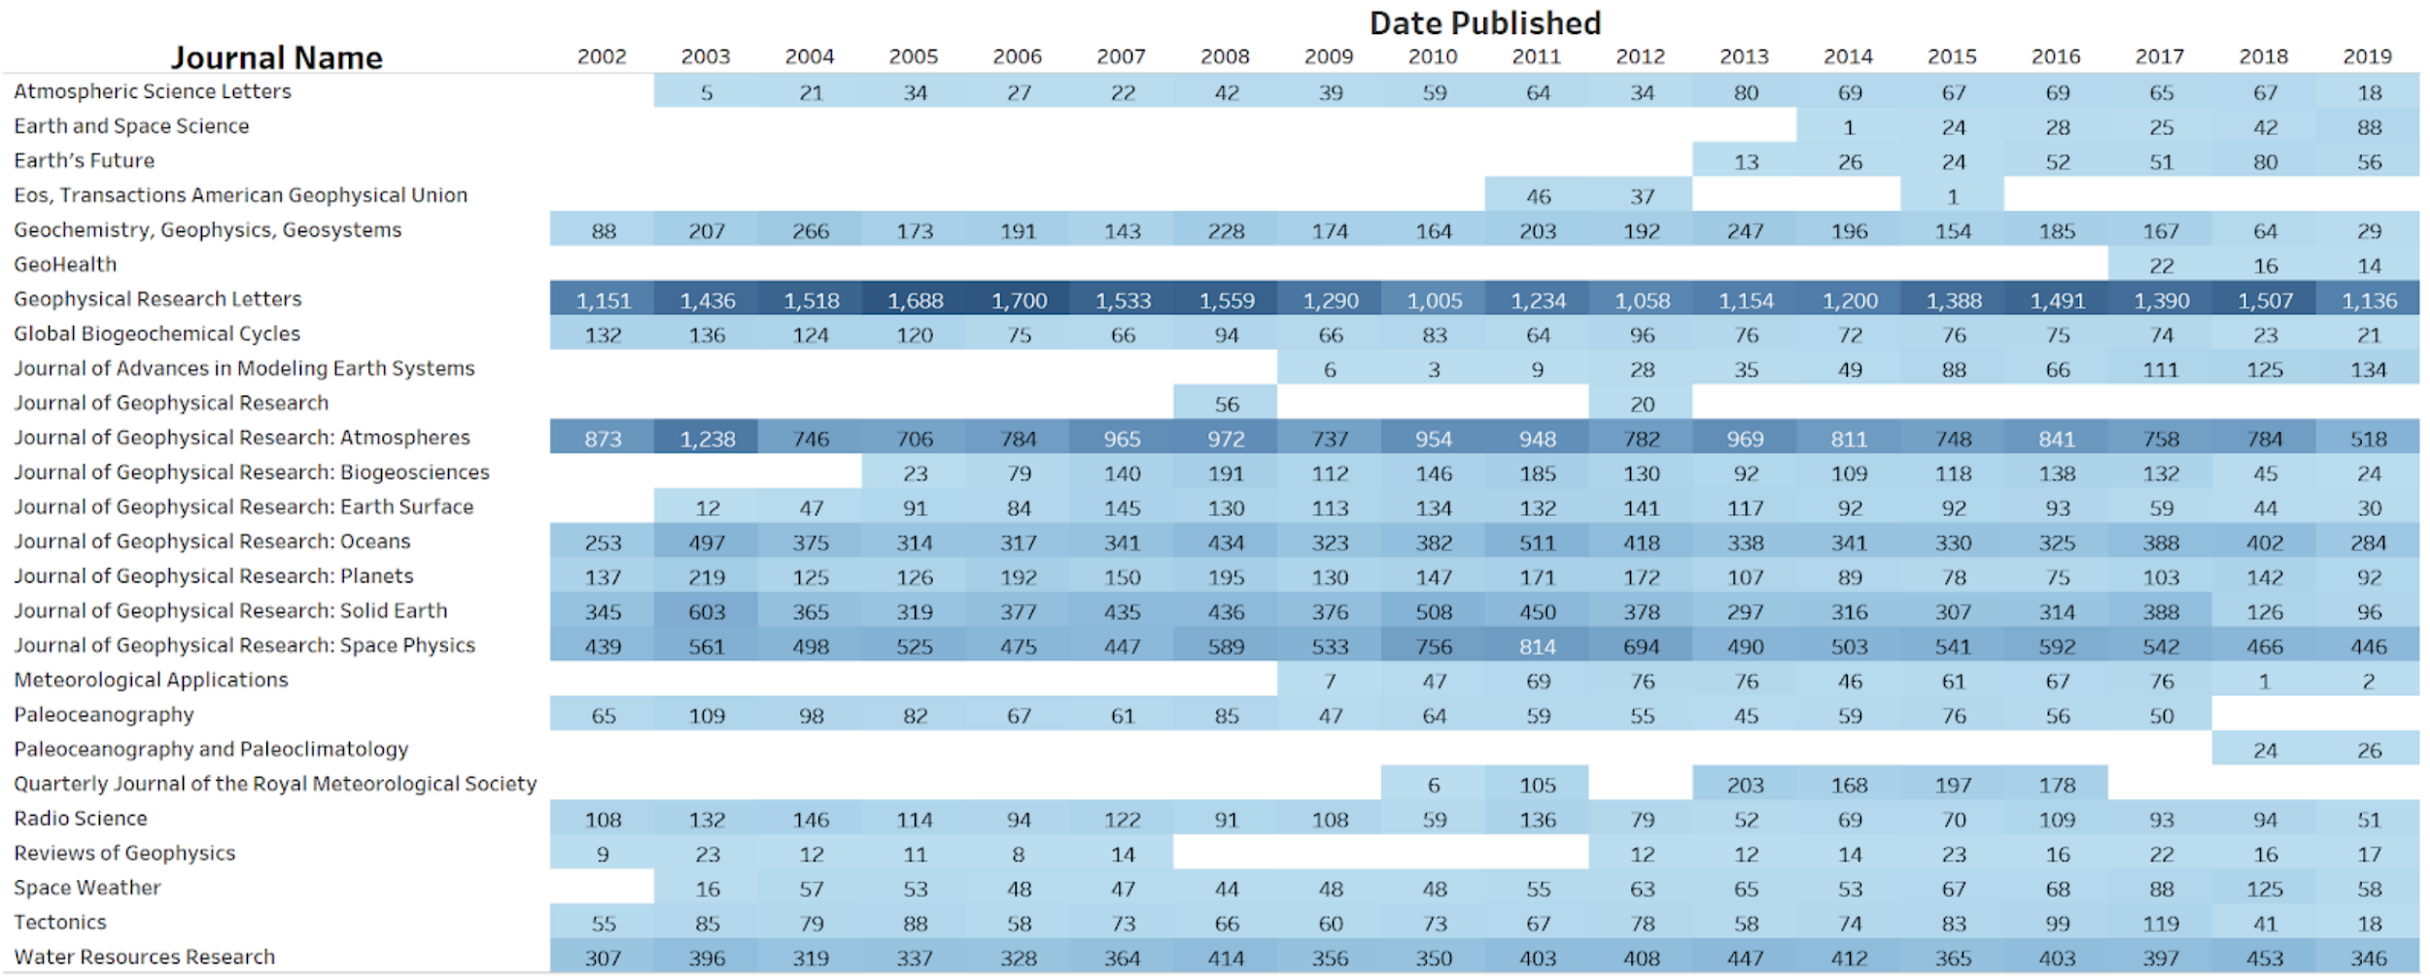
Corpus Preparation
Used a corpus of 88,410 AGU publications for our initial embedding, consisting of 530 million total words and 5.5 million unique words.

Slide 14
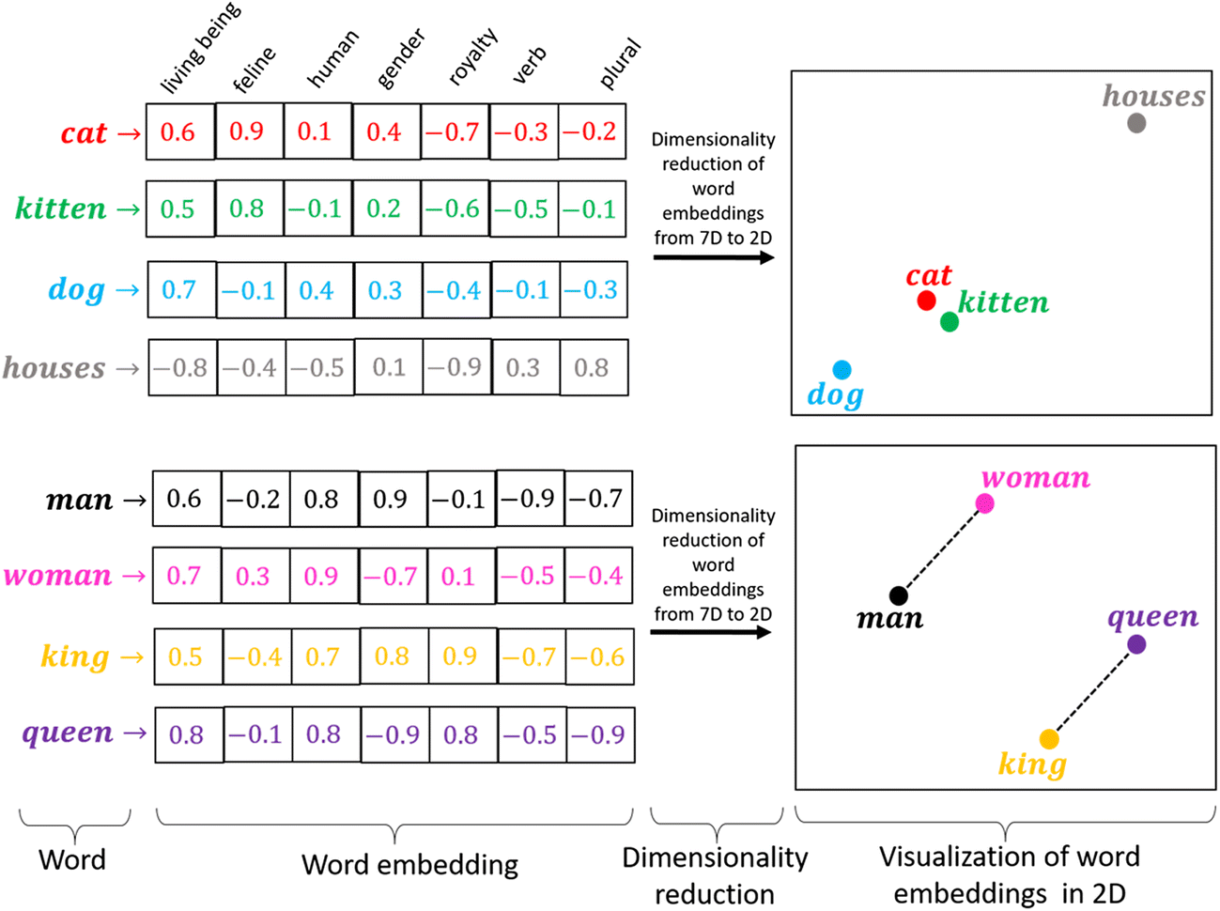
Word Embeddings
What are embeddings?
Numerical representation of text, compact and machine readable representation of text in a corpus
Maps text (words/phrases/characters) from the vocabulary to vectors of real numbers
How can it be used?
Topic extraction from text
Input into ML models for text classification tasks
Text similarity

Slide 15
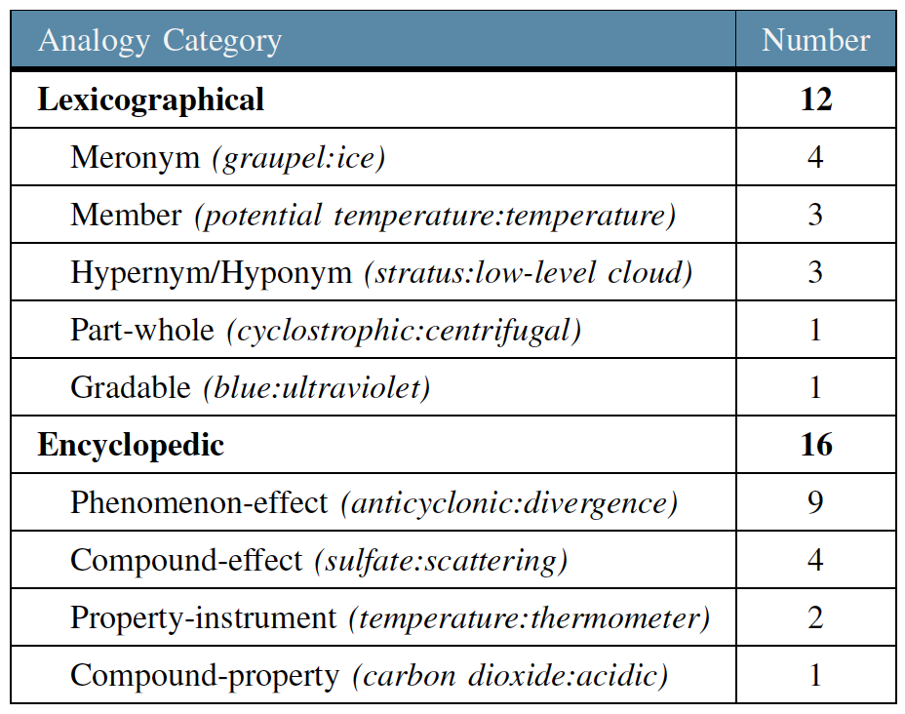
Ontology Driven Validation
Existing domain-specific ontologies can be used in the validation of domain-specific word embeddings
Create domain-specific word pairs that capture several analogical relationships
Use of analogies as a validation method for word embedding models has been established as a recognized approach in natural language processing (NLP) research
We developed a validation test using the Environment Ontology (ENVO) and the Global Change Master Directory (GCMD) taxonomy.

Slide 16
2. Data System Applications

Slide 17
Mapping Science Application Needs to Data Sets
Objective
Create an automated assessment workflow to increase the efficiency of NASA’s assessment process
Provide initial satellite needs evaluation to assessment teams
Example assessment workflow
Gather need specifications from survey response
Identify data sources that help meet need
Available datasets
Current missions
Future missions
Follow up with agency SME
Recommend any current missions they aren’t already using
Is new product development needed?
Are they aware of the upcoming missions?
Etc.

Slide 18
Sample Workflow
Automated assessment using CMR/CEOS MIM/OSCAR*
Example assessment workflow
Gather need specifications from survey response
Gather need specifications from survey response
Return candidate list of missions/datasets relevant to the need
Query integrated database and AI mapping service
Identify data sources that help meet need
Available datasets
Current missions
Future missions
Identify data sources that help meet need
Available datasets
Current missions
Future missions
Follow up with agency SME
Recommend any current missions they aren’t already using
Is new product development needed?
Are they aware of the upcoming missions?
Etc.
*NASA CMR - Common Metadata Repository
CEOS MIM - Mission/Instrument/Measurement Database
WMO OSCAR - Observing Systems Capability Analysis and Review Tool

Slide 19
Automated Candidate Lists
Context of need: What entity or phenomenon do they need to observe?
Which instruments strongly relate to the phenomenon?
AI-driven mapping based on word embedding in a corpus of journal articles
Survey response
Candidate list of missions/datasets that address agency need
Specifics of need: What spectral bands, resolution, etc. are needed?
Which missions/datasets match the agency needs?
Integrated database of satellite and instrument characteristics

Slide 20
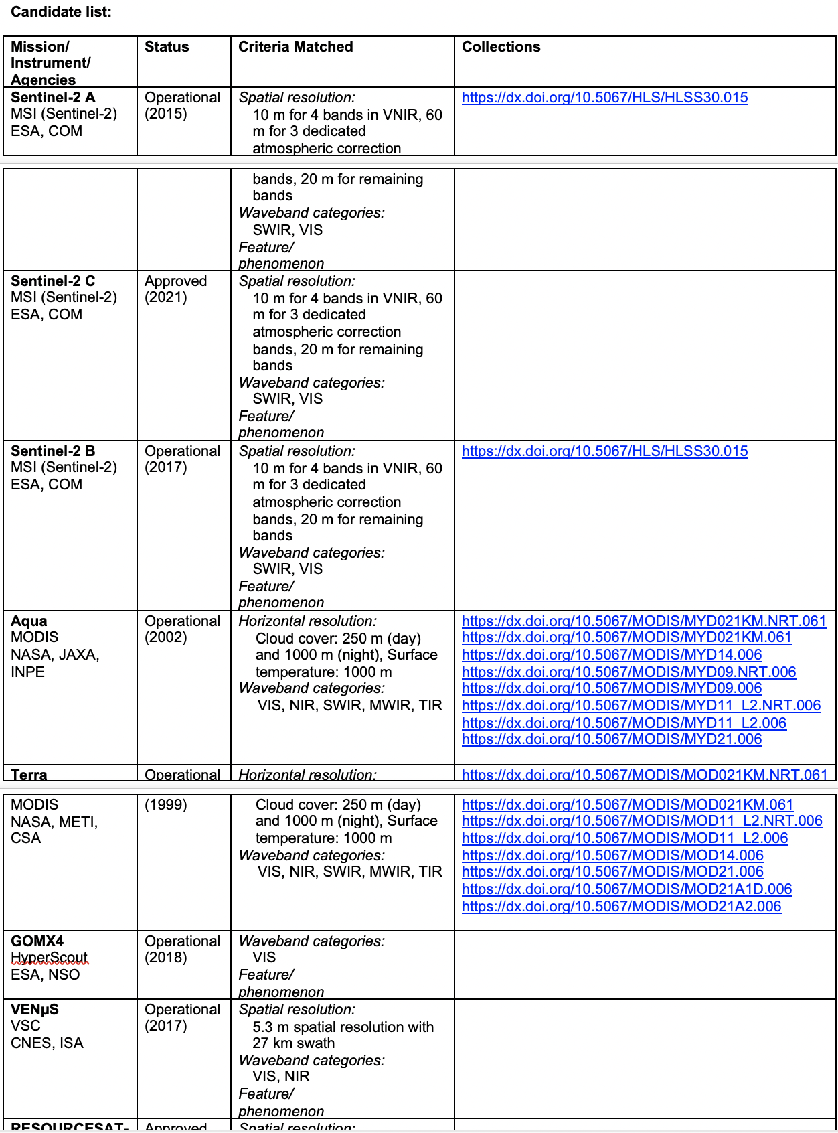
Example Candidate List
Need Profile
Variable | Land cover
Spatial extent | CONUS and Alaska/Hawaii
Spatial resolution | 5 m - 10 m
Frequency of observation | Multiple times per week
Spectral bands | VIS, NIR, SWIR, TIR
Processing Level | L1B, L2

Slide 21
(2) Keyword Recommender for Data: Problem
Assigning science keywords is currently a manual process, which is prone to human error and inconsistencies:
Metadata managed across a network of multiple data centers (i.e. keywords not assigned by a central entity)
Keywords may be assigned by non-subject matter experts (SMEs)
SMEs assigning keywords may not be familiar with GCMD keywords or how keywords are used in search engines
Science keywords are meant for data discovery across a broad range of users and may not encompass highly specific scientific variables
Can we train a machine learning model using the embeddings to accurately assign science keywords based on the dataset abstract?

Slide 22
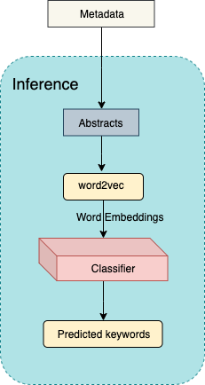
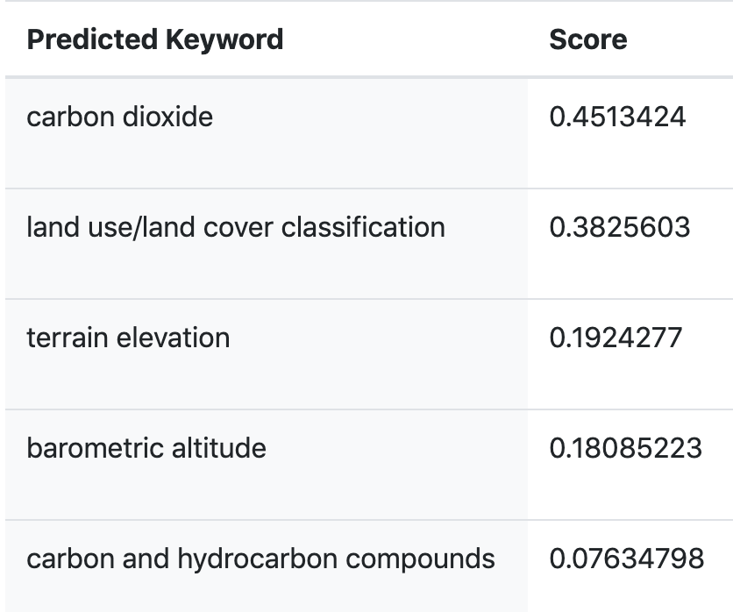
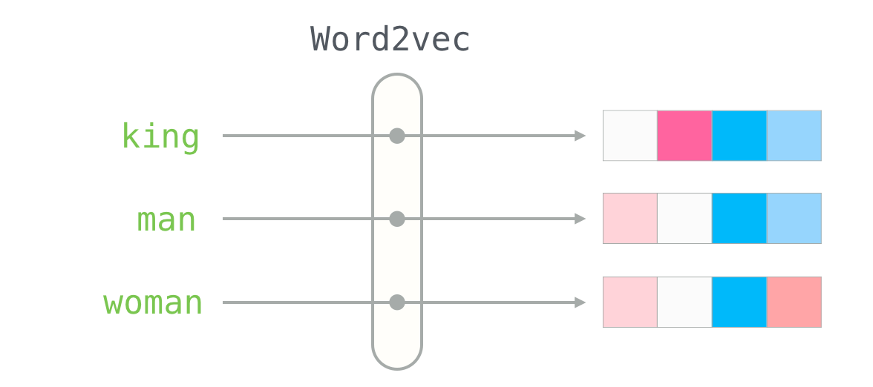
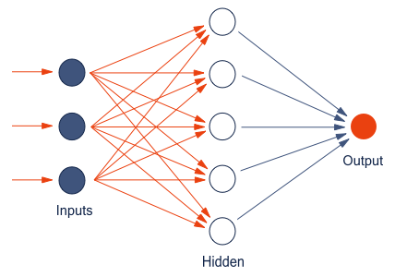
Methodology
Version 7.3 is the current version of the data set. Version 3.5 is no longer available and has been superseded by Version 7.3. This data set is currently provided by the OCO (Orbiting Carbon Observatory) Project. In expectation of the OCO-2 launch, the algorithm was developed by the Atmospheric CO2 Observations from Space (ACOS) Task as a preparatory project, using GOSAT TANSO-FTS spectra. After the OCO-2 launch, “ACOS” data are still produced and improved, using approaches applied to the OCO-2 spectra. The “ACOS” data set contains Carbon Dioxide (CO2) column averaged dry air mole fraction for all soundings for which retrieval was attempted. These are the highest-level products made available by the OCO Project, using TANSO-FTS spectral radiances, and algorithm build version 7.3. The GOSAT team at JAXA produces GOSAT TANSO-FTS Level 1B
Word2vec
Classifier

Slide 23
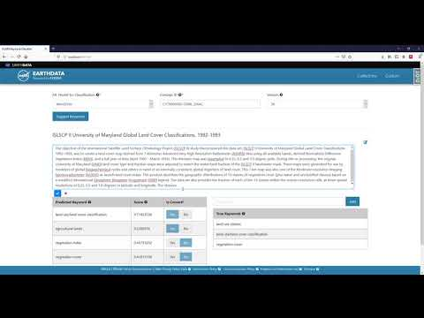
Keyword Recommender : Demo

Slide 24
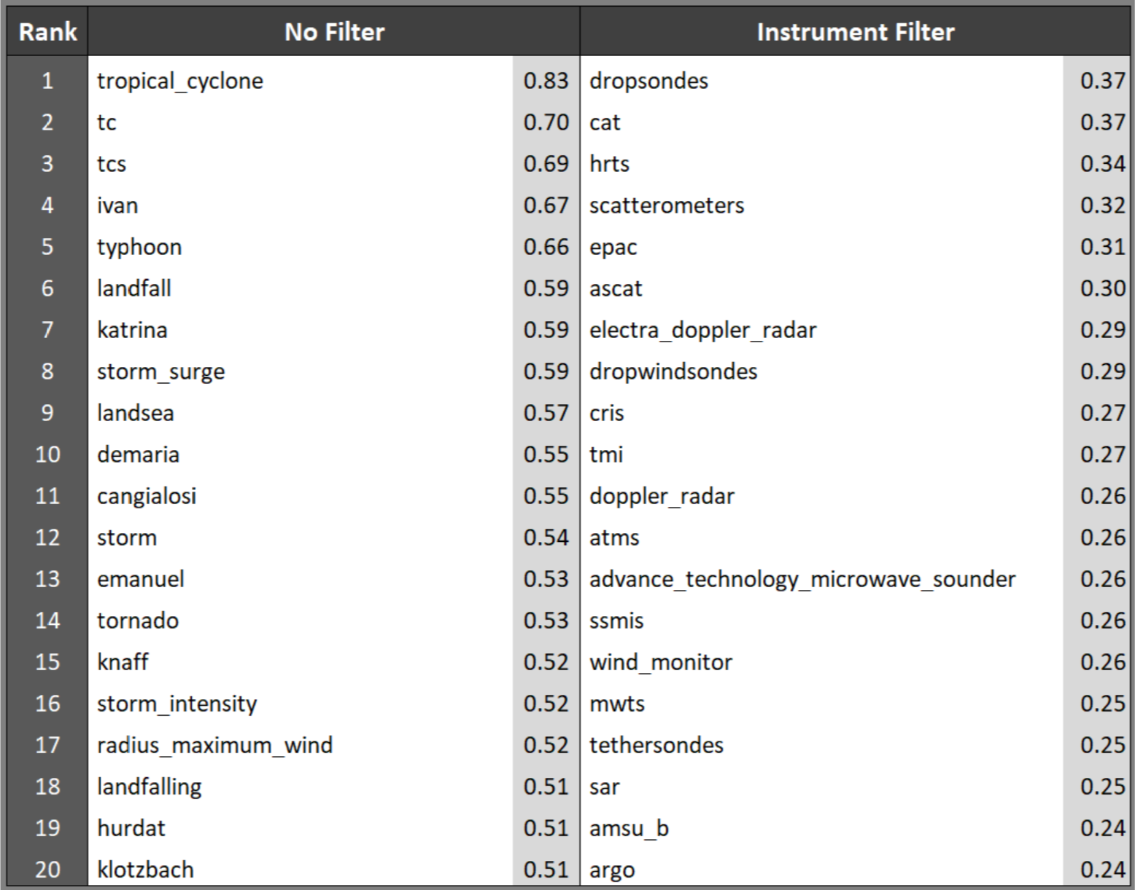
Summary and Future Work
Exploring the current word2vec embedding to discover latent information that is typically hard to unearth using standard search methods
Model Improvements tasks
Adding papers from AMS journals to the corpus database.
Using a newer algorithm to generate the embedding, specifically Bidirectional Encoder Representations from Transformers (BERT) [3]. Exploring approaches to feed information from the existing ontologies into the model to improve the embedding
Exploring the use of sentence structure information as an additional input into the model.

Slide 25

Contact Information
rahul.ramachandran@nasa.gov

