Slide 1
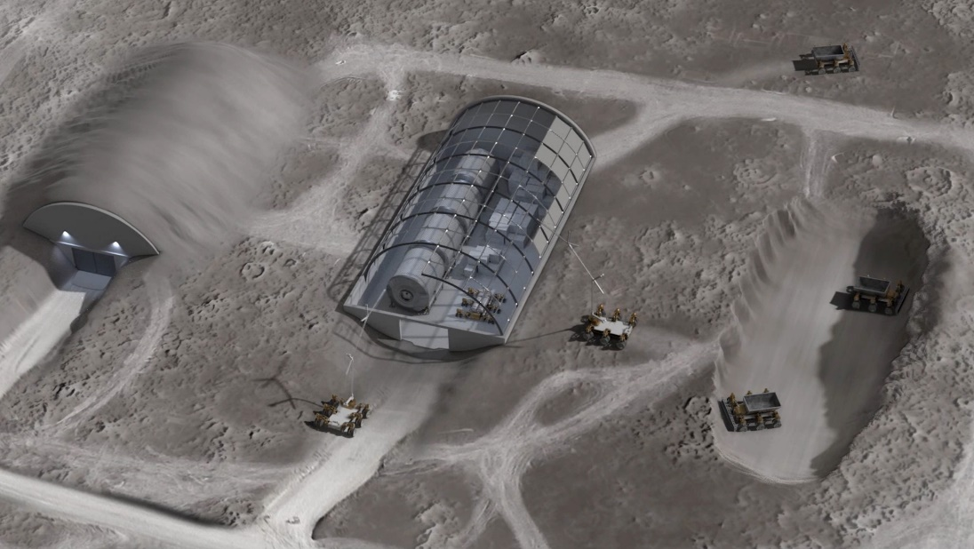
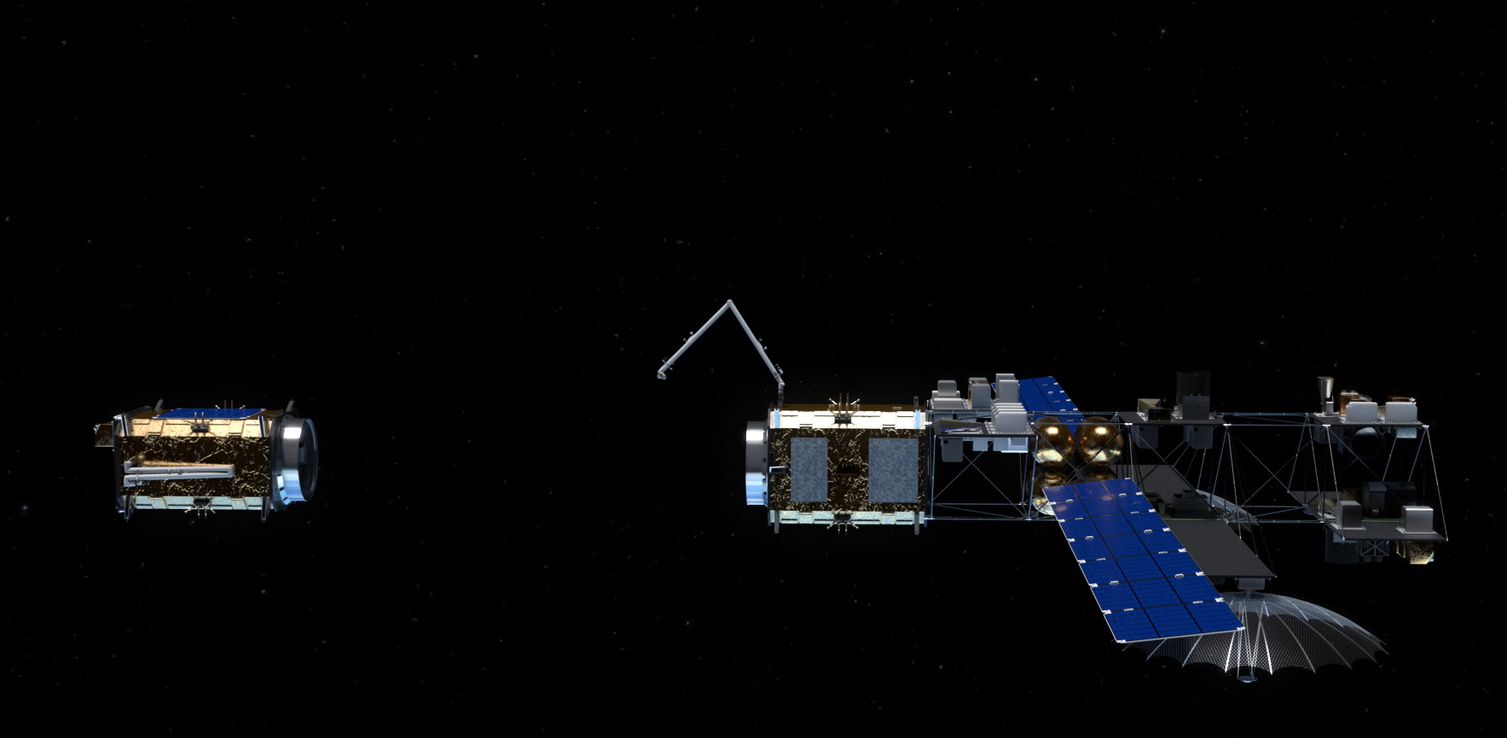
On-orbit Servicing, Assembly, and Manufacturing (OSAM) Overview
Dale Arney
Chief Architect
OSAM National Initiative
July 22, 2021
Image Credit: NASA
Image Credit: NASA

Slide 2
On-orbit Servicing, Assembly, and Manufacturing
OSAM is an emerging set of capabilities that enables inspection, repair, upgrade, modular assembly, and construction of space assets
Servicing is the alteration of a spacecraft after its initial launch using another spacecraft
Assembly involves aggregation of components to create a spacecraft that cannot be achieved with traditional deployment methods and available launch vehicles
Manufacturing involves transformation of raw materials into usable spacecraft components
+ Manufacturing
+ Assembly
+ Servicing
Current

Slide 3





















NASA’s Rich Legacy of OSAM Missions
Servicing
Solar Max
1984
HSM1
1993
HSM2
1997
HOST
1998
HSA3A
1999
HSM3B
2002
HRSDM
2005
Orb-Express
2007
HSM4
2009
RRM-1,2,3
2011-18
RROxiTT
2014
Raven
2017-19
OSAM-1
LRD 2025
Assembly
Apollo CSM-LM
1967-72
EASE/ACCESS
1985
ASEM
1992
International Space Station
1998 – present
OSAM-1 SPIDER
LRD 2025
Manufacturing
3D Printer Micro-G Exp
1998-2012
First 3D Printer
in Space
2014
ISS MIS Additive
Manufacturing Facility
2016
Refabricator
2018
“FabLab” Facility
2020
OSAM-1 MakerSat
LRD 2025
OSAM-2
LRD 2024
NASA has a deep heritage with OSAM, both internally and
in partnership with OGAs and the commercial sector
Image Credits: NASA
Notes:
Chart for internal use – remove this one for external use.

Slide 4
OSAM Stakeholders
NASA Science
NASA Exploration
Department of Commerce
Department of Interior
CIVIL
SECURITY
Department of
Defense
Intelligence
Community
Repair
Upgrade
Refuel
Relocate
Assemble
Construct
Reconfigure
Manufacture
Coat
Polish
Recycle
COMMERCIAL
Fleet Owners and Operators
Service Providers
Satellite Manufacturers
Insurance Companies
Notes:
These capabilities are not only necessary for civil space – national security and commercial space are relying on these capabilities to perform their ambitious missions as well

Slide 5
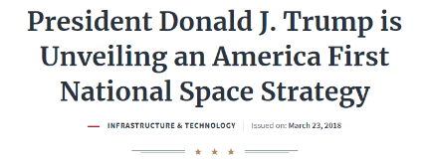



OSAM across the Government
2017-2019 Space Science and Technology (S&T) Partnership Forum on In-Space Assembly examined the cross-cutting value, potential for collaboration, and technology advancement for multiple government partners.
2018 National Space Strategy identifies NASA and DOD to lead OSAM technology development and demonstration, explore new OSAM capabilities, and enable OSAM activities in U.S. industry.

Slide 6


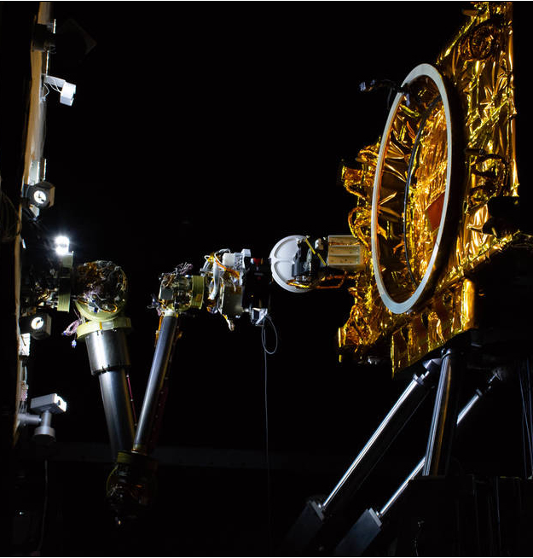
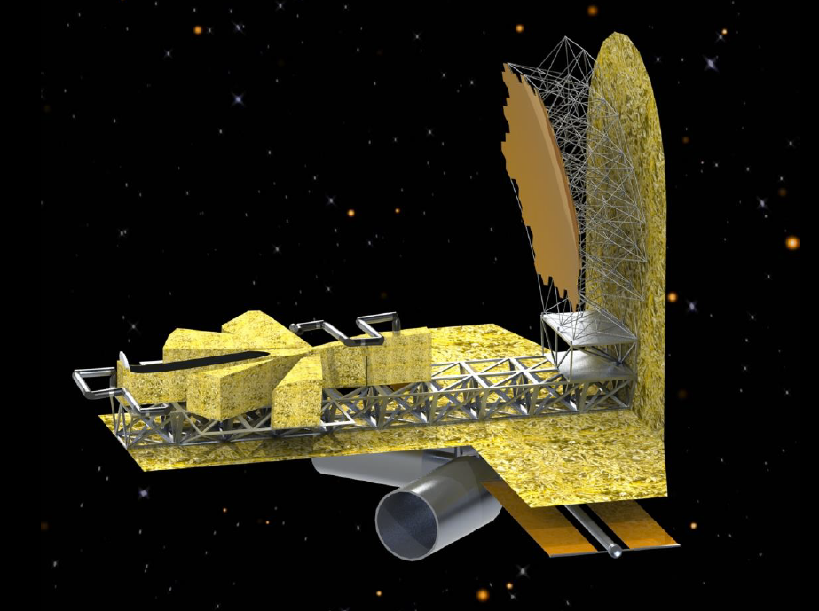
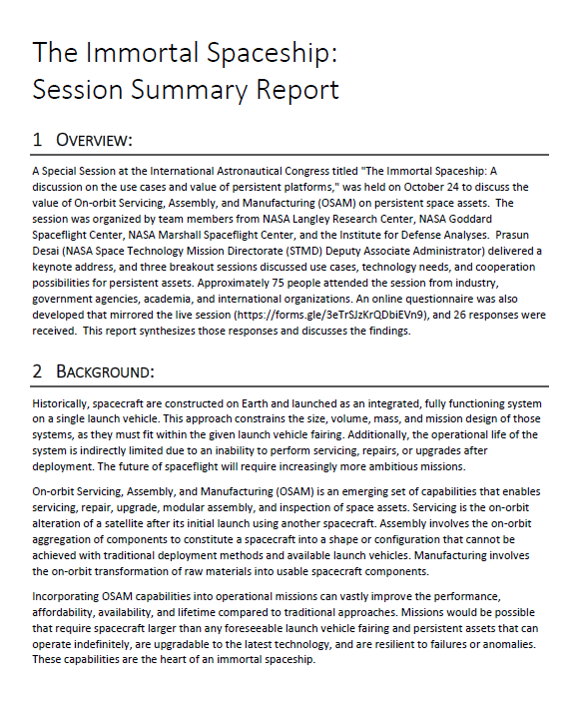
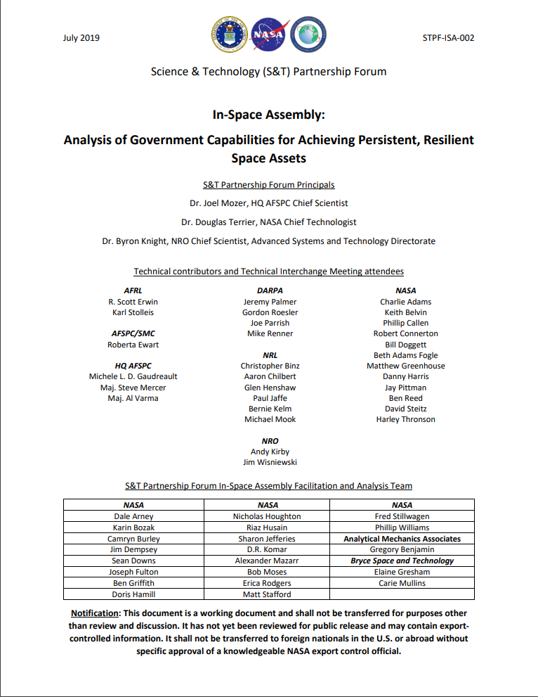

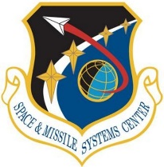





OSAM National Initiative
MISSION
Serve as the nation’s steward for OSAM capability development and as a central hub for engaging the broader OSAM stakeholder community
OBJECTIVES
Facilitate
Relationships
Develop and Share Technology
Advance New Concepts and Capabilities
Serve as a
Knowledge Center
… and more
Image Credit: NASA
Image Credit: NASA
POCs: Debi Tomek (deborah.m.tomek@nasa.gov) and Byron Knight (knightby@nro.mil)
Notes:
Facilitate Relationships:
Build and maintain relationships with commercial, US Government, and other stakeholders to ensure an informed, integrated approach
Develop and Share Technology:
Develop solutions to the most demanding technological challenges and seed the growth of US industry through tech development, sourcing, transfer, and collaboration
Image: OSAM-1 (formerly Restore-L) grapple testing at GSFC
Advance New Concepts and Capabilities:
Design and execute innovative mission concepts that enable breakthroughs in human exploration and science and support broader national objectives
Image: in-Space Assembled Telescope (iSAT) study
Serve as a Knowledge Center:
Develop and maintain a repository of data and relationships to ensure broad and consistent awareness of industry and government activity and capabilities
Image: First page of Immortal Spaceship Session Summary Report (available to public) and Space Science & Technology (S&T) Partnership (AIAA reports available to public)
NASA Coordination and activities:
LaRC, GSFC, MSFC
PT/SCLTs – Bo (RPO/Servicing), Mark (Structures/Assy), Vickers (Mfg)
OSAM Tech Transfer Day 2019 (GSFC), 2020 (LaRC), 2021 (MSFC)

Slide 7
OSAM Enables Persistence in Space
Image Credit: NASA
Notes:
Persistent assets that can grow, adapt, and evolve over time – immortal spaceships
Technology demonstration
Persistent observation
Robust, resilient systems
Source: NASA RAMSES https://youtu.be/FK8gD5PY-Ng

Slide 8

OSAM Enables New Discoveries
Image Credit: NASA
Notes:
Build systems larger and more capable than previously feasible within the launch constraint

Slide 9
OSAM is the Foundation for Sustainable Lunar Exploration
Image Credit: NASA
Notes:
Maintain and protect crew and systems on the surface
Source: VIDEO…

Slide 10
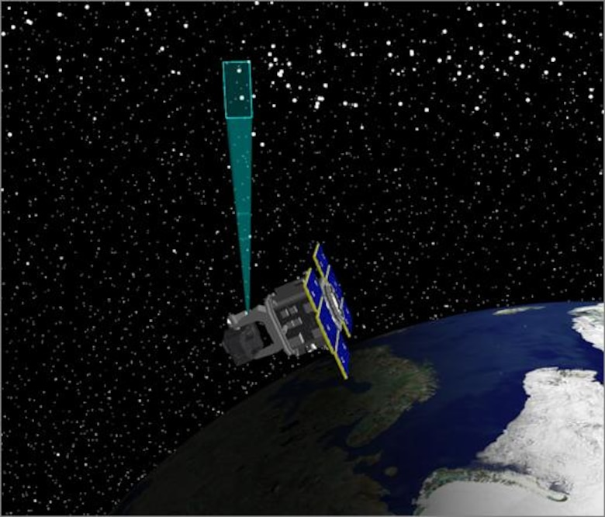
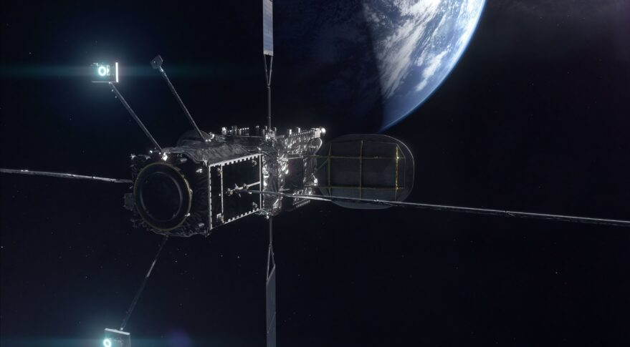
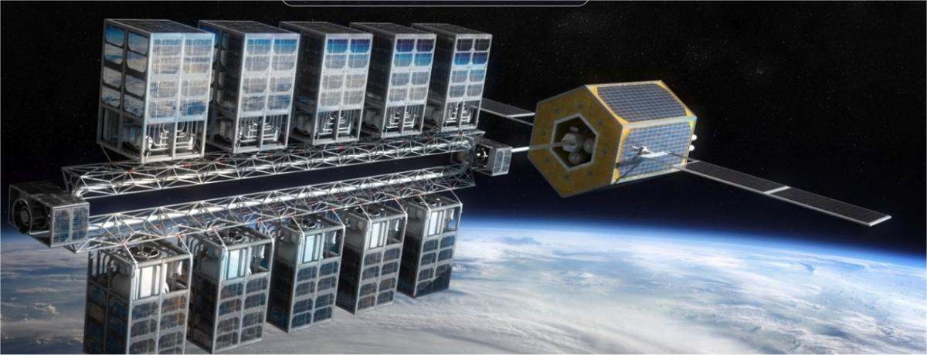
Crosscutting Uses of OSAM
Space Domain Awareness
Space Mobility & Logistics
Credit: Northrop Grumman
Credit: U.S. Air Force
Credit: Orbit Fab

Slide 11
OSAM National Initiative Capability Areas (2021)
Robotic Manipulation: Includes robotic activities such as cutting, placing modules, and assisted deployment
RPO, Capture, Docking, and Mating: Includes space situational awareness, crewed or autonomous docking/berthing, and formation flying
Relocation: Includes boosting, repositioning, deorbit, and life extension
Planned Repair, Upgrade, Maintenance, and Installation: Includes modular interface connections, instrument swap out, upgrade a system/payload that is intended to be changed
Unplanned or Legacy Repair and Maintenance: More complex servicing (e.g., non-cooperative systems, systems that weren’t intended to be replaced)
Refueling and Fluid Transfer: Includes cryogenic and non-cryogenic, surface and orbit fluid transfers
Structural Manufacturing and Assembly: Includes manufacturing (3-D printing, extruding, etc.) and assembly of structures with various interfaces, joining approaches, and precision
Recycling, Reuse, & Repurposing: Includes breaking down old parts for new feedstock and reusing old parts in new spacecraft
Parts and Goods Manufacturing: Includes internal (to a habitat), external, and manufacturing for Earth use (space factory) for spare parts, subsystems, and structures
Surface Construction: Includes building structures and infrastructure, using regolith to build, and standard interfaces for surface systems
Inspection and Metrology: Includes free-flyer inspection, non-destructive evaluation, and close (robotic) inspection
Notes:
Give a flavor of what’s going on in these capability areas

Slide 12
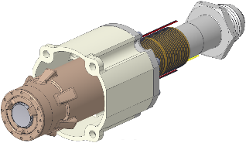
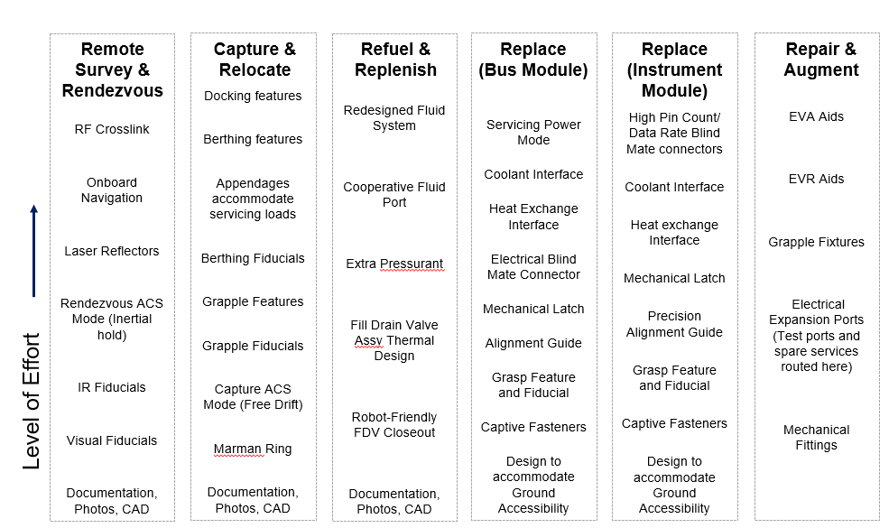
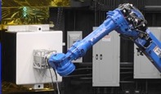
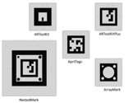
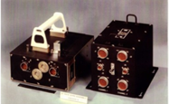
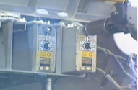
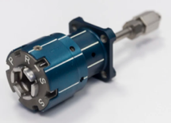
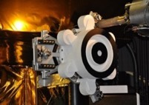
Cooperative On-orbit Servicing
Image Credits: NASA

Slide 13
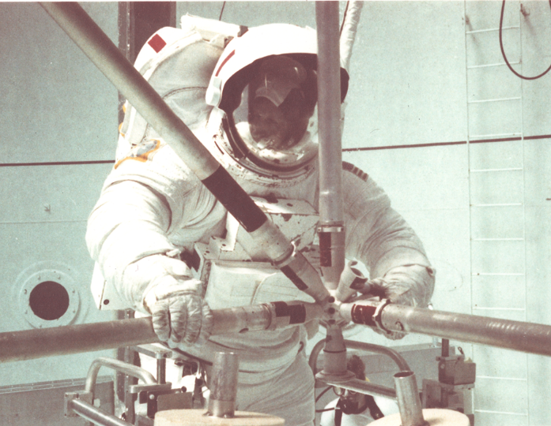
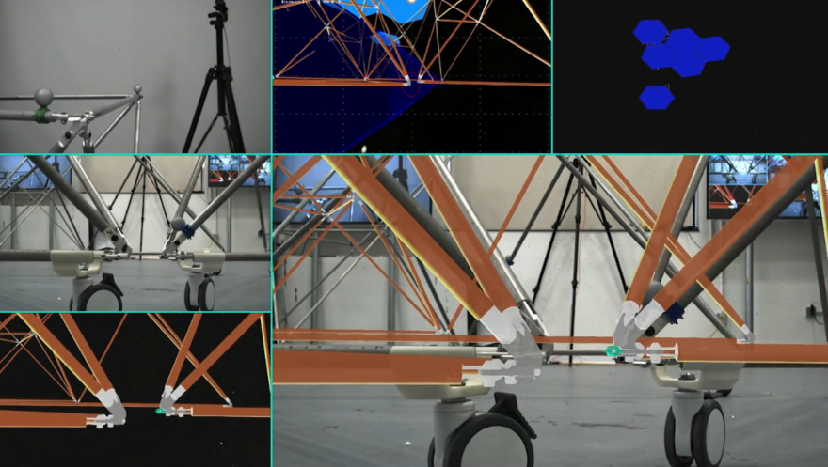
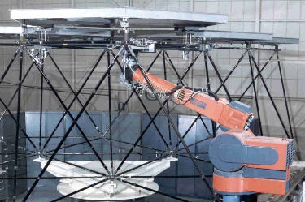
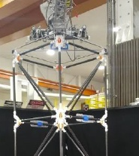
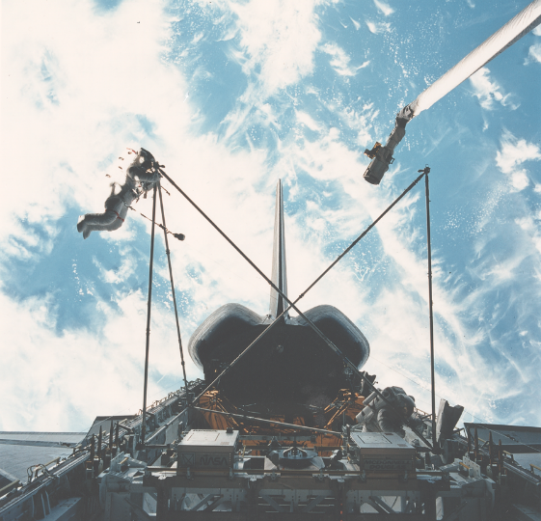
Structural Assembly
Past Assembly
Future is moving toward autonomous robotic assembly
Image Credits: NASA

Slide 14

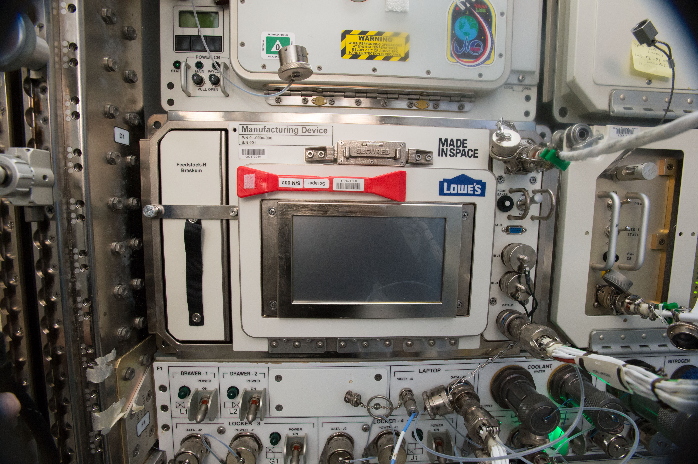
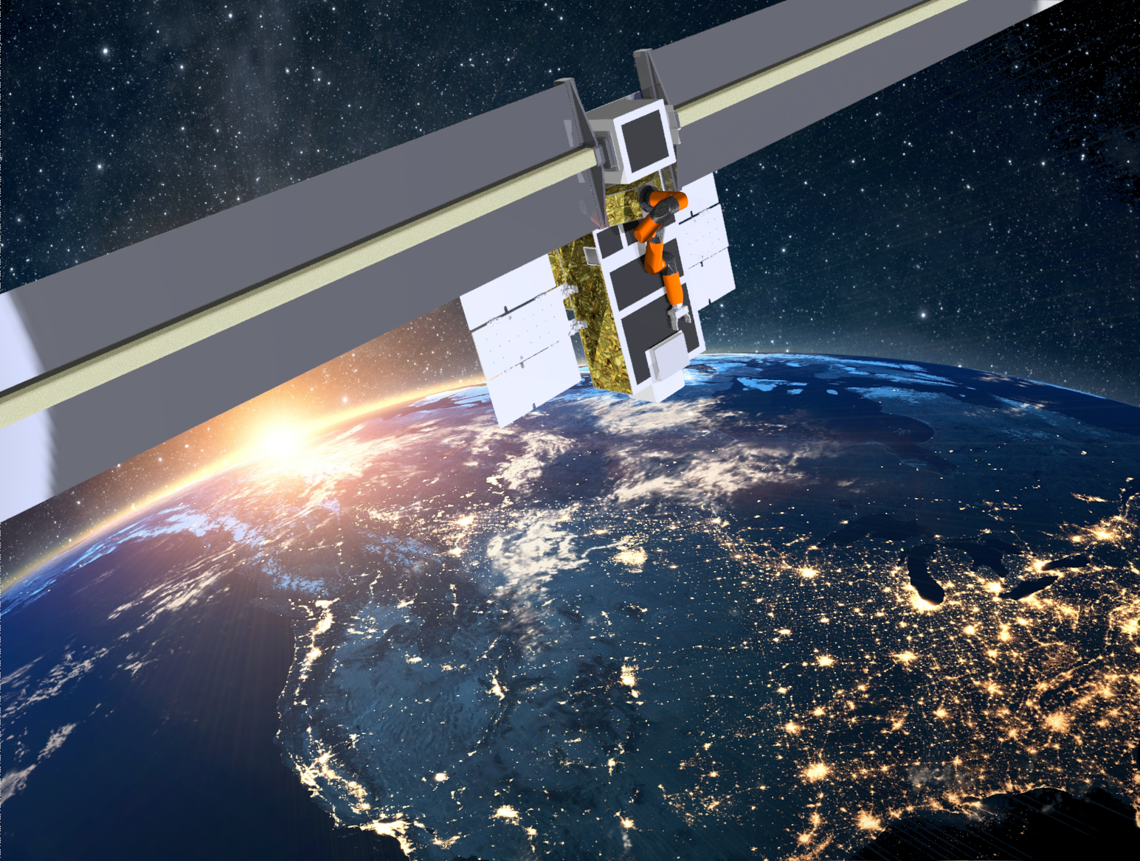
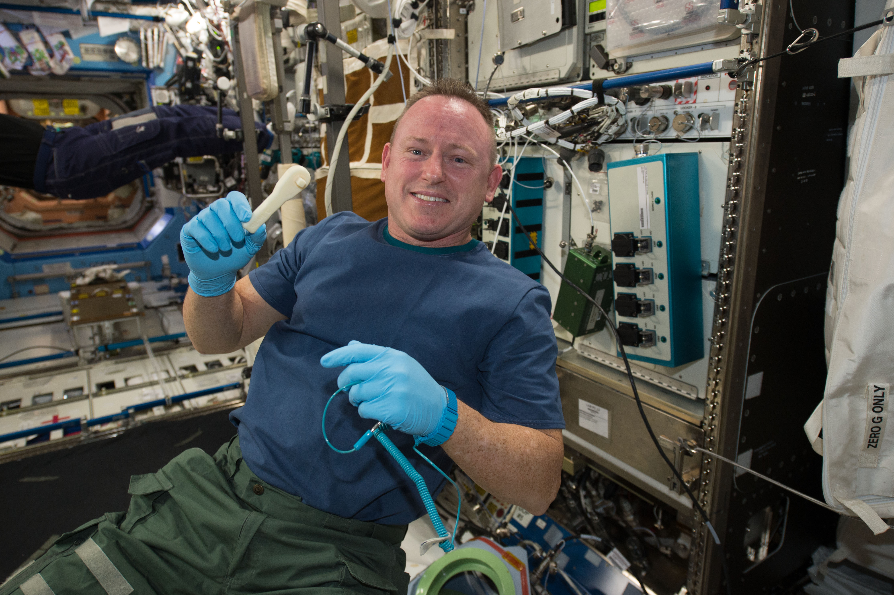
In-Space Manufacturing
Image Credits: NASA
Credit: Made in Space, Inc.
Manufacturing in a Habitat
Manufacturing in Vacuum
Notes:
OSAM-1 and OSAM-2 are demonstrating manufacturing in a vacuum.

Slide 15
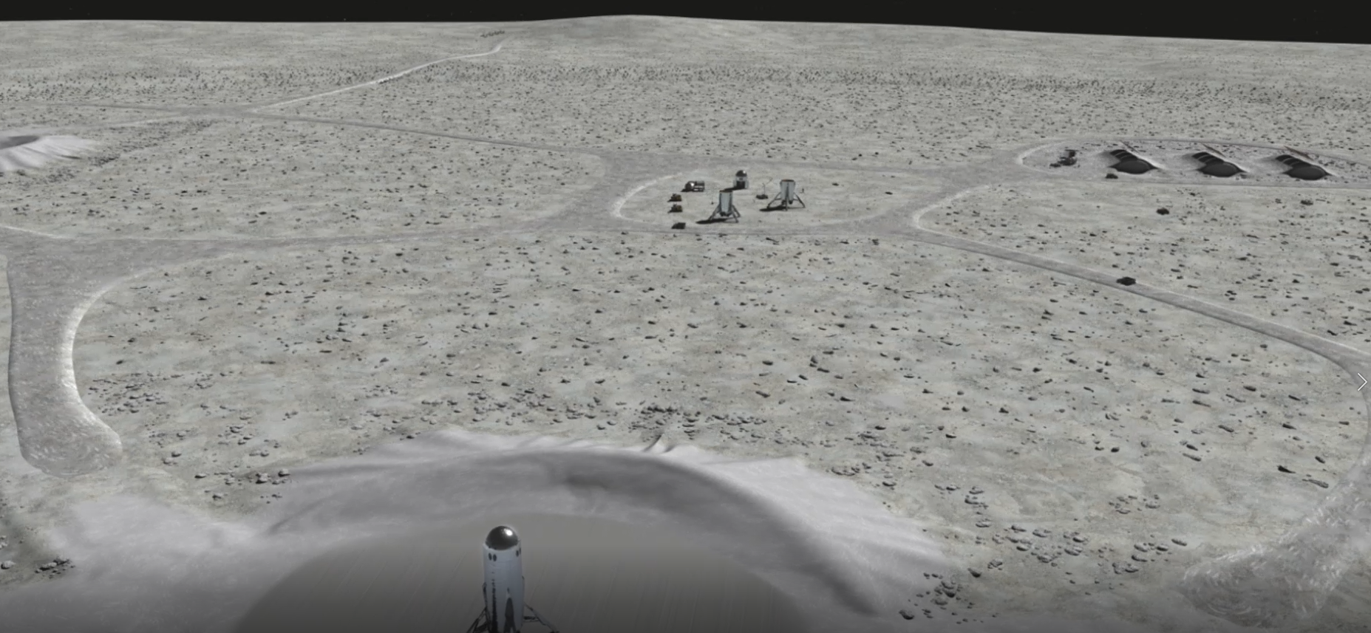
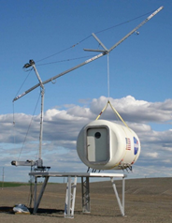
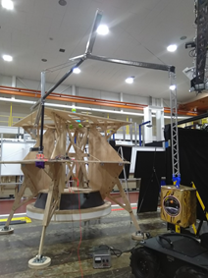
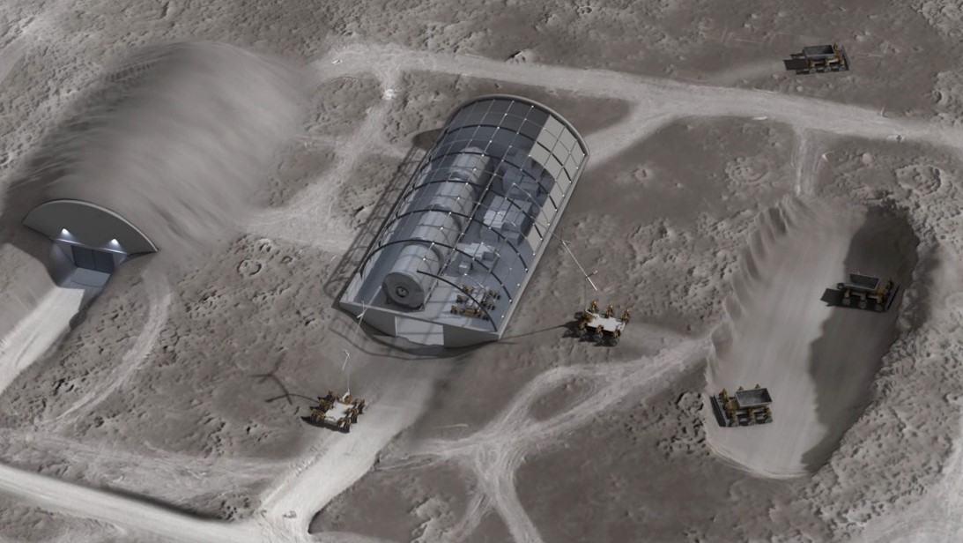
Surface Construction and Operations
Capabilities to offload and manipulate payloads on the surface
Horizontal and vertical construction
Image Credits: NASA
Notes:
OSAM is the foundation for sustainable lunar exploration. It enables reusable, multi-purpose, reconfigurable systems and enables Earth independent spares and logistics.
Lightweight Surface Manipulator System (LSMS) capable of offloading payload and supporting surface operations
Scalable from CLPS payloads to human-scale landers
Safe Haven; Power Generation; Launch, landing, and servicing infrastructure; Surface operations, mobility, navigation, etc.

Slide 16
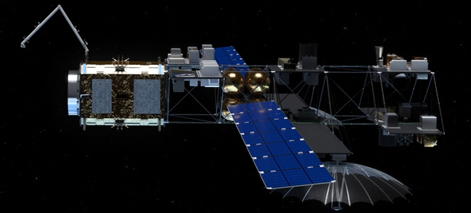
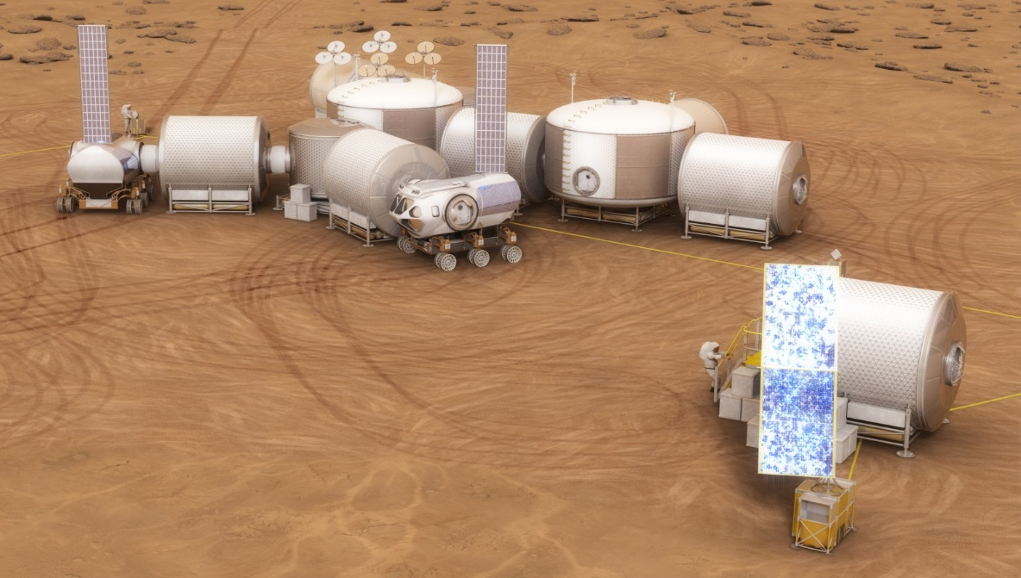
A Future Built Around OSAM
OSAM capabilities are the foundation for sustainable exploration and operations:
refueling, maintenance, repair, assembly, spares manufacturing, ISRU
Image Credits: NASA
Notes:
Create an ecosystem of future capabilities that make humanity a spacefaring civilization

