Slide 1
MIPs (Mandatory Inspection Points) Rubric Development
Prepared By:
Emma Wyckoff
Jaden Chambers
May 11th, 2021
Notes:
Today I will be presenting on the work we have done this term to develop a MIP rubric

Slide 2
Agenda
Origin of MIPs (Mandatory Inspection Points)
Project Goals
Research Phase
Results of Data Collection
Future Implementation
Categorization for Rubric
Next Steps
Questions
BLUF: This is a rubric tool that Lead Design Engineers are going to use to ensure that MIPs are considered in facility projects moving forward
Notes:
Jaden
This is the Agenda for the process that we took in creating the MIPS rubric

Slide 3
History and Project Goals
Origin of MIPs
  “An additional inspection on items whose condition is critical to the safety of personnel or the functionality of the end product.”
  Provide Quality assurance/Quality Control for systems during construction
  Confirm conformance with industry standards
  Implementation can reduce future error and rework
  New NE-TJ responsibility is to develop consideration for potential MIPs and inspection requirements
Project Goals
  Collect data on what past MIPs have been implemented
  Learn what issues have come up in the past that a MIP could have helped prevent
  Compile into database
  Develop a MIP rubric/website using collected data
Notes:
Jaden
MIPs are additional inspections for items whose condition is critical to the safety of personnel or functionality of the end product
These MIPs provide quality assurance and quality control measures throughout construction and confirm that the end product conforms with industry standards
The goal with implementing MIPs is to reduce the amount of rework and error on future and current projects
This initiative comes as a directive from upper management to develop a series of procedures and policies for MIPs
The following goals were decided on by Jaden and I as well as our matrix supervisor to contribute to this initiative

Slide 4
Research Phase
Interviewed members across the NE-TH, NE-TI, and NE-TJ branches
Questions considered:
  What differentiates a mandatory inspection from a normal (BOSS – Base Operations and Spaceport Services) inspection?
  What are some general MIPs that could apply to projects in your discipline?
  Describe a project you have worked on where having a MIPs list could have prevented complications.
  What are some specific MIPS that you believe could apply to one of your current projects?
  Do you know of any MIPS that could apply to other disciplines?
Answers recorded and compiled into MIP database
Notes:
Jaden –
The first part of the project consisted of the research phase.
We gathered feedback from multiple branches of NE-T, particularly NE-TH, NE-TI, NE-TJ
Feedback was acquired by developing questions used to acquire various perspectives on the subject matter
We developed the questions in a way that observed both facts and opinions
This provided us with their personal experiences with MIPs as well as gave us a good foundation to build the initiative on
All relevant feedback was then recorded into the MIPs database and reviewed

Slide 5
Data Collection Results
Understanding of MIPs varied greatly from person to person and across each branch
Workforce possessed no clear definition for a MIP
  Answers were used to interpret a MIP definition
Suggested MIPs were compiled into MIPs database
  Each MIP underwent judicious review
MIPs were transferred rubric
Grouped MIPs by Engineering Division
  Mechanical, Civil, Electrical, Fire Alarms
  Further categorized by UFGS (United Facilities Guide) specification number
  General MIPs included in 01 General Requirements
Mechanical | Civil | Electrical | Fire Alarms
22 Plumbing | 03 Concrete | 26 Electrical | 28 Fire Alarms
23 HVAC | 07 Thermal Moisture Protection
33 Utilities | 31 Earthwork
Notes:
Jaden – When asked to define a MIP, the individual responses were each very different, demonstrating the vagueness of the topic
Some people were very into the idea, and others were against it.
They believed doubling up on inspections would increase construction time and in turn increase its cost
The people that were for it said that it is vital for safety and mitigating future complications
However, there were common themes that could be taken from each
These themes were hugely significant in developing a way to define MIPs and distinguish them from normal inspections

Slide 6
Future Implementation
Lead Design Engineer uses rubric as a basis for discussion with stakeholders
Architect & Engineer/Design Manager will receive and review list
Lead Design Engineer can use rubric categories to justify decisions
Following discussion, project team will finalize MIP list
MIPs are identified in final design package
Architect & Engineer/Design Manager can challenge any they do not agree with
Notes:
Jaden
Following data collection, we discussed how we intend the rubric to be used by CoF in the future
Mention BLUF

Slide 7
Rubric Categorization
Common themes were pulled from MIPs collected during interviews
Used themes to develop rubric categories
Developed questions to consider for each category
Categories include:
  Criticality
  Singularities
  Dependencies
  Accessibility
  Cost
  Visibility
  Redundancies
  Pre-requisites
Notes:
Jaden
After reviewing the various answers to our interview questions, we were able to pull some common themes from our discussions
These themes were used to develop categories and guiding questions for the rubric
Categories include the system's criticality, the inspector conducting the MIP, system singularities, dependencies, and accessibility, what the cost of rework might be, PR visibility, redundancies with other inspections, and pre-requisites to the MIP

Slide 8
Categories
Criticality (Danger Level)
  Green - The system being inspected is independent from the other systems, but is still vital to the completion of the project
  Yellow - The system being inspected has other systems that are directly dependent on it. An error within inspection may result in an extended delay of the project
  Red - If performed or inspected incorrectly, the result could be fatal or result in significant financial loss
Singularities
  What unique, new, or complex parts of the system may be overlooked during a standard inspection?
Dependencies
  The systems that directly depend on the MIP
Notes:
Jaden-
Criticality – This can also be seen as the danger level
We determined that the best system to define this was to divide it into 3 categories, green demonstrating the least risk and red demonstrating the most
Singularities – This category consists of unique aspects of the system that may need to be brought to attention in order to prevent being overlooked
May include but is not limited to:
- Electrical Hardware
Structural Aspects
Mechanical Systems
Dependencies – Goes hand and hand with the Criticality system
Only is present when the Criticality is yellow or higher
Otherwise, is N/A

Slide 9
Categories
Accessibility
  The accessibility status of the MIP post-construction
  ‘Accessible’ or ‘Not Accessible’
Cost
  The cost of rework due to failure of the system
Redundancies
  Additional groups that have inspected the system
Visibility
  The social significance of system failure
  ‘High’ or ‘Low’
Pre-requisites
  Phases that need to occur prior to the MIP
  May include walkdowns, lab-tests, separate threshold inspections, etc.
Notes:
Jaden
Accessibility – A problem that we’ve seen reoccur is the lack of accessibility in some systems
By addressing and cracking down on the accessibility early on, we can ensure that it will be accessible in the future
Or at the very least be mindful of it
Would be categorized as ‘Accessible’ or ‘Not Accessible’
Cost – Displays ‘High’ or ‘Low’ regarding the cost of rework for a system failure
Also ties into criticality, as High costs will have Red Criticality
Redundancies – This section would demonstrate if any other groups have inspected the MIP in the past
Groups would be listed
Visibility – Demonstrates if a failure in the project would have a substantial impact on public relations
‘High’ or ‘low’ to demonstrate the level of impact
Pre-requisites – Any phases that need to occur prior to the MIP will be listed in this category
For example, if insulation needs to be installed on a CHW system it would make sense to do a pressure test beforehand

Slide 10
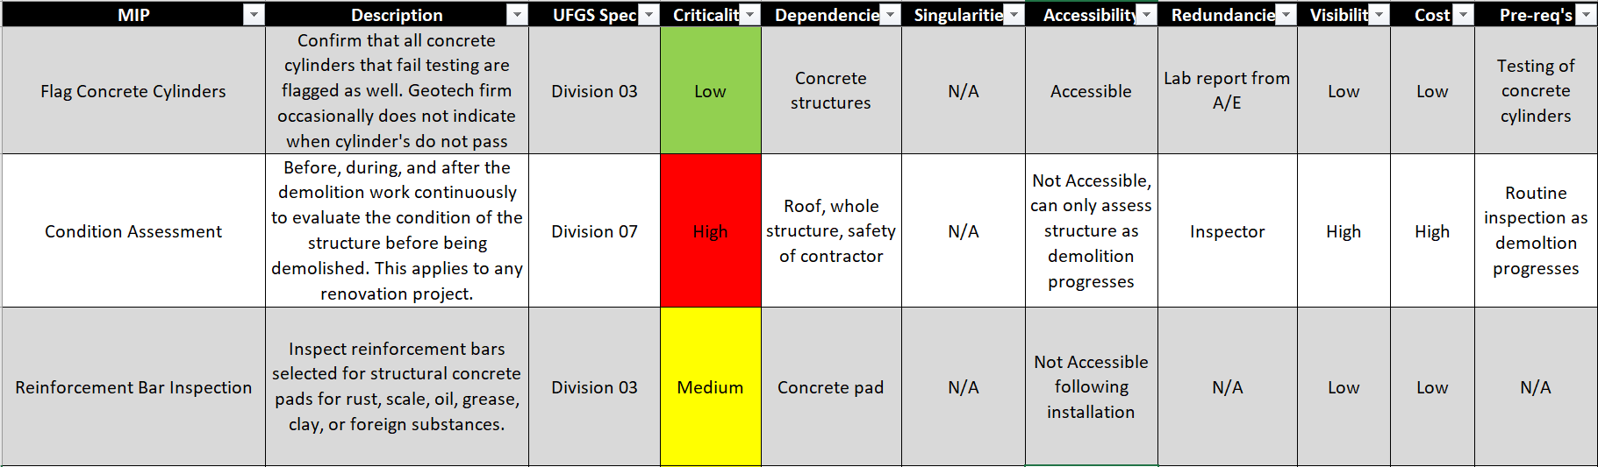
Categories
Notes:
Jaden
We added the categories to the MIPs already in our rubric to recreate how someone would fill out the rubric for a MIP in question
The LDE can use this rubric and the responses to each category as a basis for discussion with stakeholders
After reviewing the responses to each category, then a decision can be made whether or not to include the MIP

Slide 11
Conclusion
Next steps
  Continue to collect MIPs from current and past Construction of Facilities projects
  Determine most valuable format for rubric
  Rubric is a living document
  Transition Rubric into Website
Questions?
Notes:
Jaden
So that is the progress we have made on this initiative so far.
This rubric is a living document that will be added to and changed as more MIPs are implemented
Currently the rubric is formatted as an excel file, so in the future we will be determining what the most valuable final format for the rubric will be

Slide 12

Thank you for coming to
Session 2 of the KSC Pathways
Summer 2021 Student Showcase
Please take a few minutes to complete feedback evaluations for any of the presentations you attended. The survey link is in the chat.
Session 3 will be Tuesday, July 27
from 2:00 – 3:00 PM.
Please join us next week at this same link!

