Slide 1
Pathways Showcase
Presentation

Slide 2

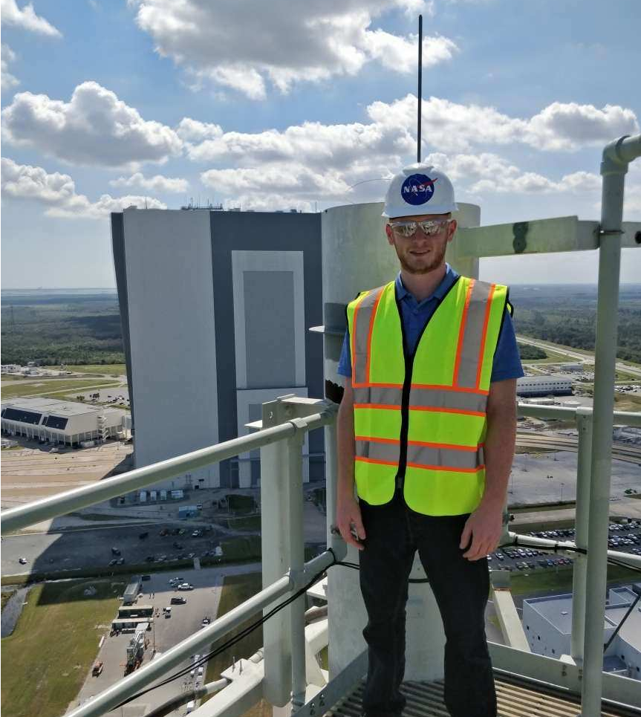
About Me
Mark Barbaro
24 years old
Working in the Engineering
Directorate (NE) since Jan. 2018
NASA Internships & Fellowships (NIFS)
for 1 year within the Computer Systems Branch
(NE-XC)
Supported the Launch Control System (LCS)
Pathways for 2 years within the Communications
and Tracking Branch (NE-XT)
Support the Radio Frequency Telemetry Station
(RFTS)
Transfer from the Florida Institute of Technology
Attend the University of Central Florida
Study Electrical Engineering BSEE
Graduate Aug. 2021

Slide 3

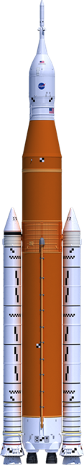
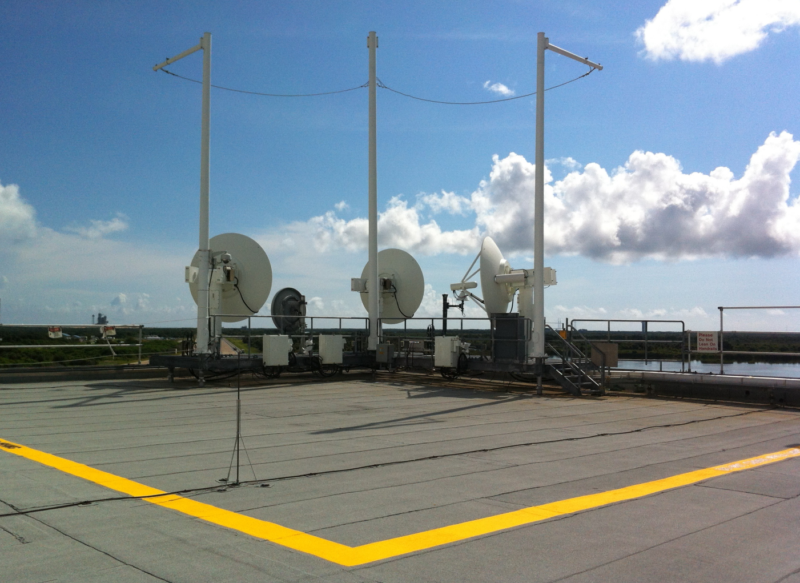
Radio Frequency Telemetry Station
RFTS
Located on the 2nd Floor of the Launch Control Center (LCC)
and houses most of the transmitting and receiving equipment
as well as data recording and Radio Frequency (RF) switching devices
RF equipment is also maintained in the Vehicle Assembly
Building (VAB) and on the Mobile Launcher (ML)
Station antennas are located on the LCC rooftop
Capable of relaying RF signals to other space and ground assets
from VAB relay antennas
Perform test and checkout of Spacecraft and
Launch Vehicle RF communication systems
Collect and analyze the operation of RF communication
systems prior to each Artemis mission
Supports RF testing and checkout in the VAB and at the Launch Pad
from the LCC

Slide 4


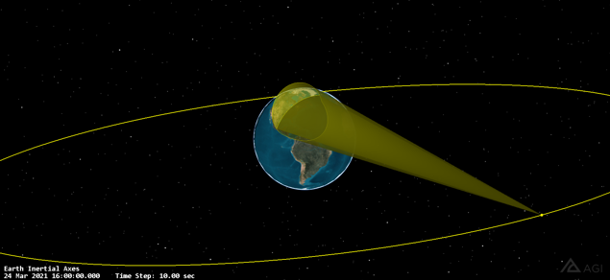
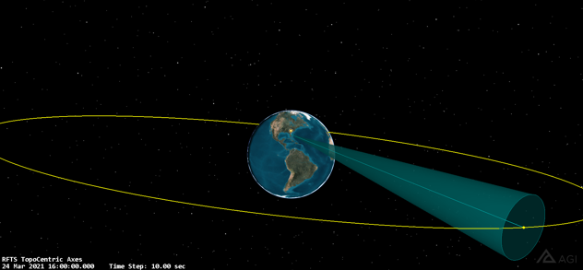
Capstone Project
Link Budget Analysis between Tracking
& Data Relay Satellite-12 (TDRS-12) and RFTS
Exercise knowledge in Satellite Communications
Made hand calculations using Excel Spreadsheets
Used Systems Tool Kit (STK) to verify calculations
from Excel
Rendered 3D graphics using the STK program

Slide 5
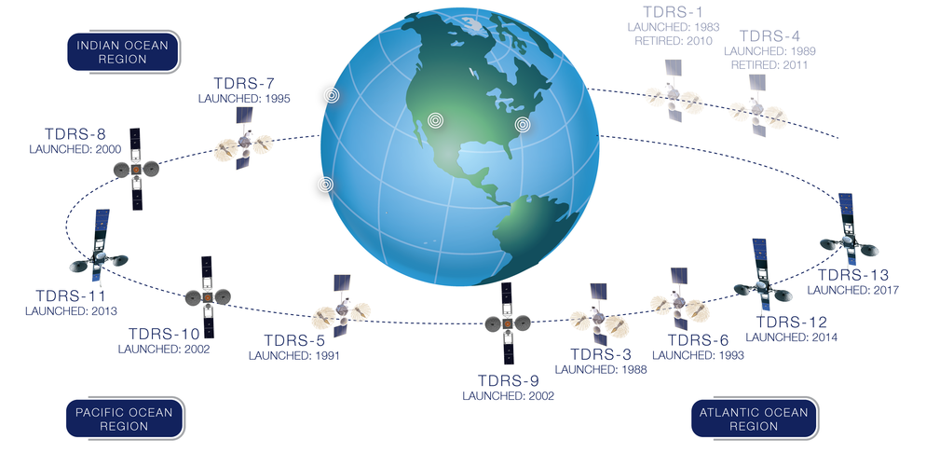
Tracking & Data Relay Satellite (TDRS) Fleet

Slide 6
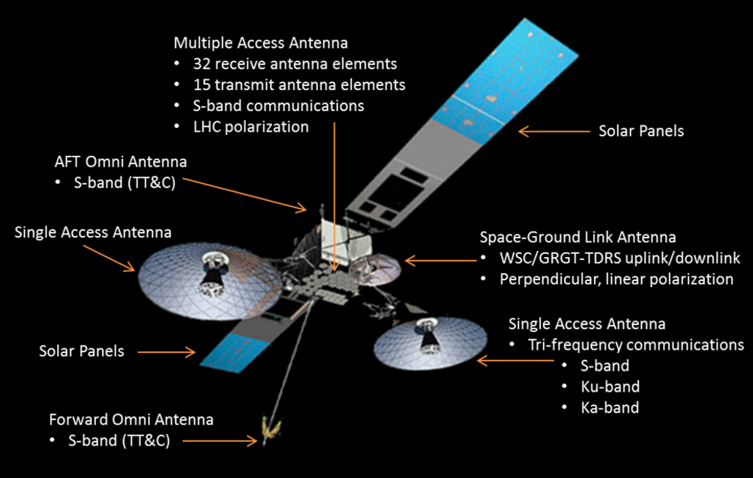
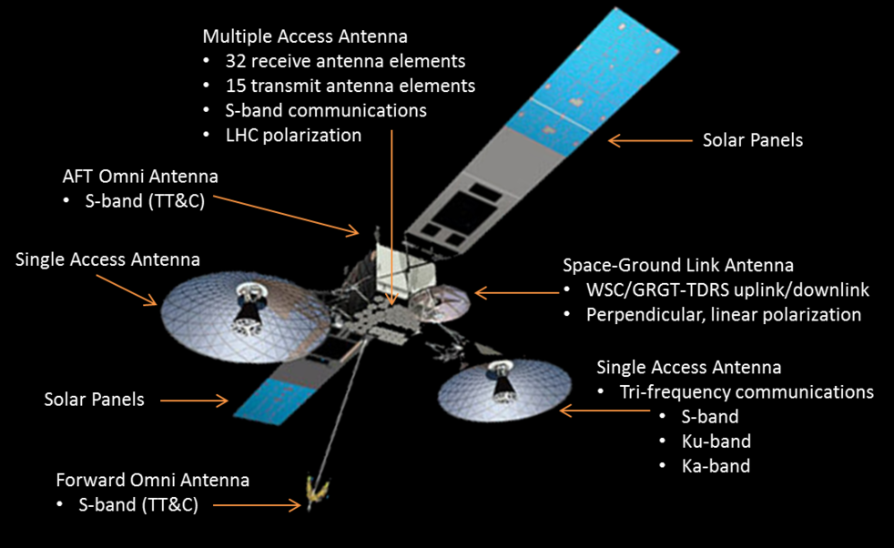
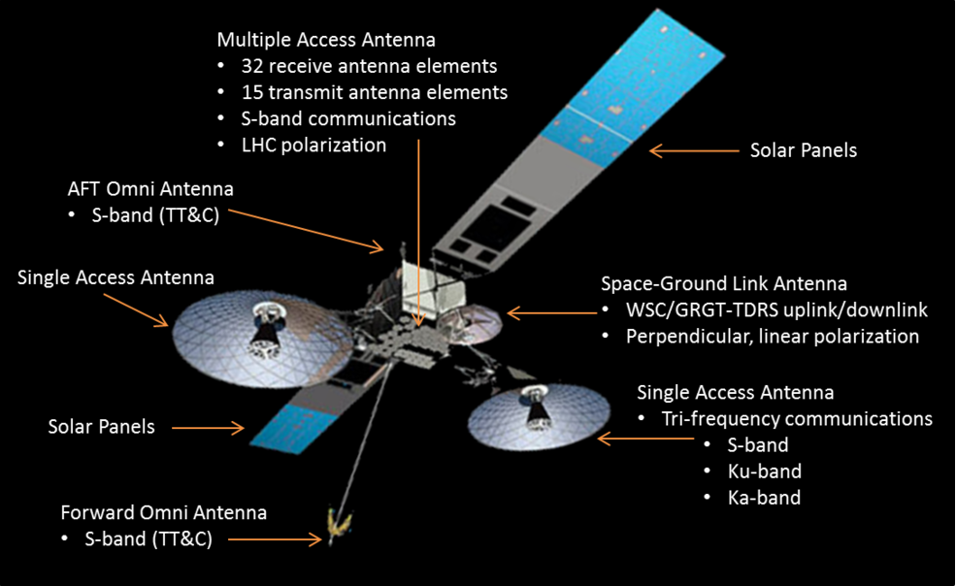
TDRS-12

Slide 7
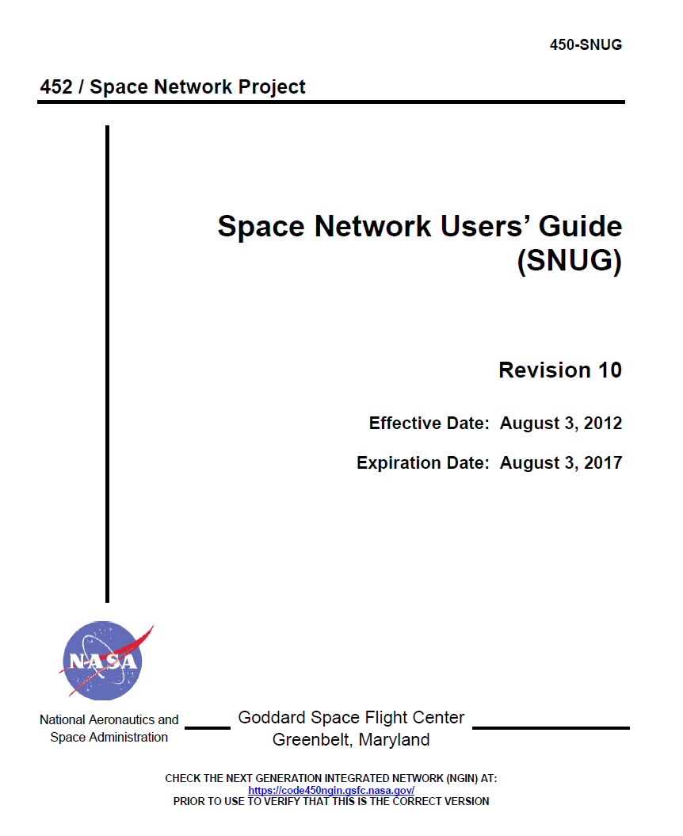
TDRS Resource

Slide 8
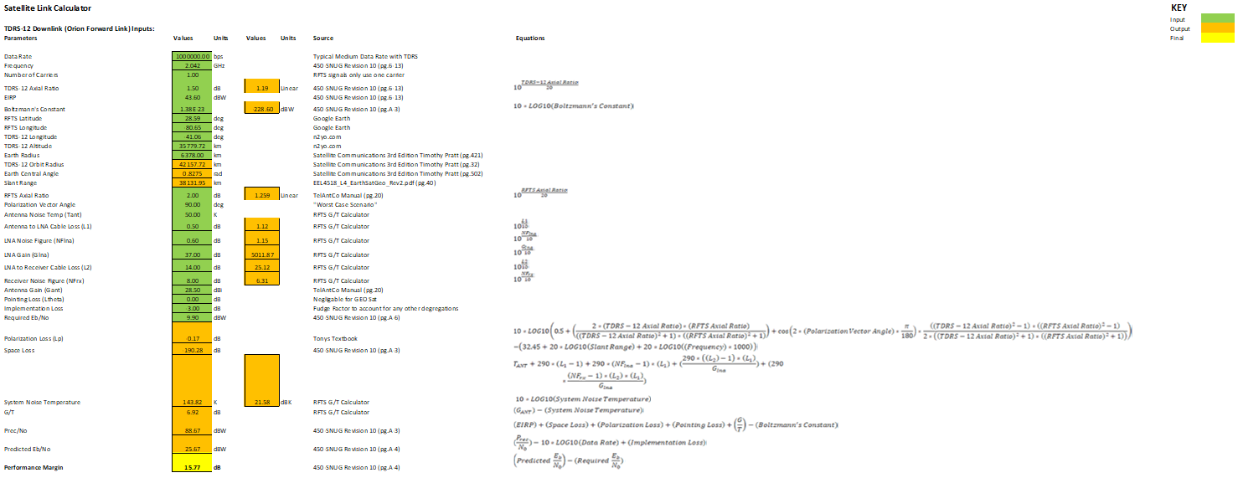
Excel Forward Link Results

Slide 9
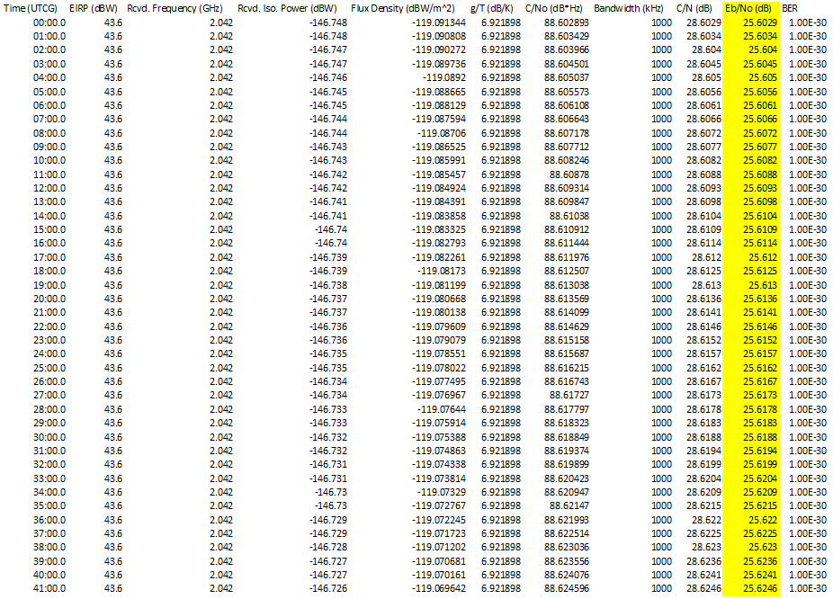
STK Forward Link Results

Slide 10
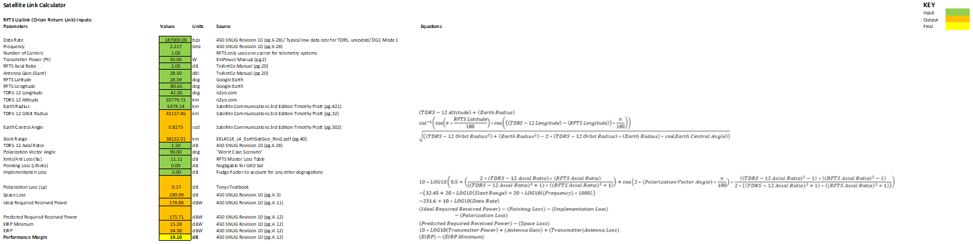
Excel Return Link Calculations

Slide 11
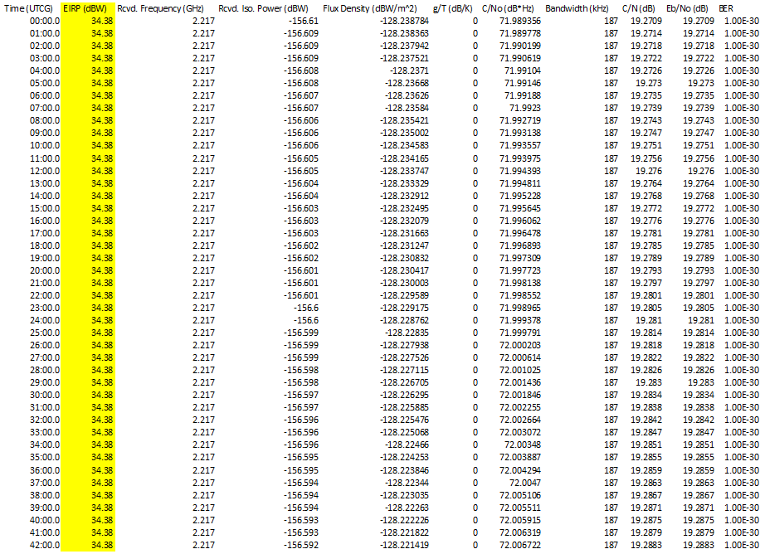
STK Return Link Results

Slide 12

Results Verified

Slide 13

Contact
Email: mark.a.barbaro@nasa.gov
13

Slide 14
Image References for STI Purposes
Presentation utilizes KSC Engineering Format
Slide 2 – Image of myself was taken with my camera
Slide 3 – RFTS Logo – Created by myself
Slide 3 – RFTS Antennas – Taken within my organization
Slide 3 – SLS Clip Art – Used in RFTS Presentations
Slide 4 – STK 3D Renditions – Screenshot made by myself
Slide 5 – TDRS Fleet - https://www.nasa.gov/directorates/heo/scan/services/networks/tdrs_fleet
Slide 6 – TDRS Capabilities - https://www.nasa.gov/directorates/heo/scan/services/networks/tdrs_third_gen
Slide 7 – SNUG Screenshot – Screenshot taken by myself of a NASA Document
Slide 8 – Excel Forward Link Screenshot – Screenshot taken by myself, and Orion data used is not exact in order to avoid SBU issues
Slide 9 – STK Forward Link Screenshot – Screenshot taken by myself
Slide 10 - Excel Return Link Screenshot – Screenshot taken by myself, and Orion data used is not exact in order to avoid SBU issues
Slide 11 – STK Forward Link Screenshot – Screenshot taken by myself
Slide 12 – Microsoft PowerPoint Clip Art

