Slide 1
3D Printing Services at KSC IT
IT-C1
Pathways Presentation
Ryan Ketzner

Slide 2
The 3D Printing Process

Slide 3
The 3D Printing Process
Model Development, Slicing, and Printing
Model Development: 3D models are created or refined with printability in mind.
Slicing: 3D models are converted into complete, layer-by-layer manufacturing geometry and instructions (g-code).
Printing: The printer’s firmware interprets higher level G-code commands into lower-level hardware commands to produce the final product.

Slide 4
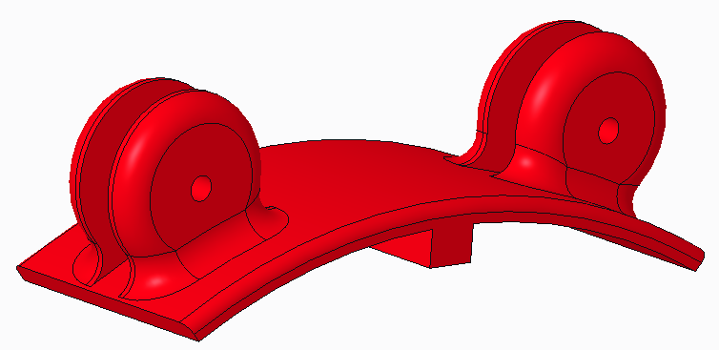
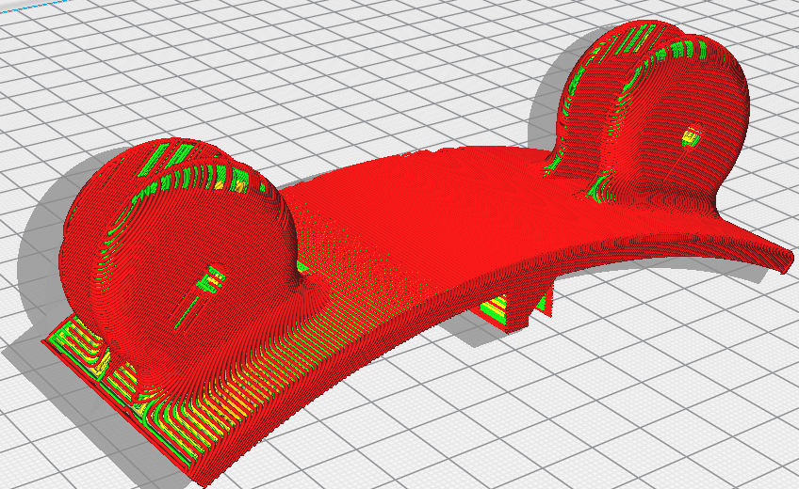
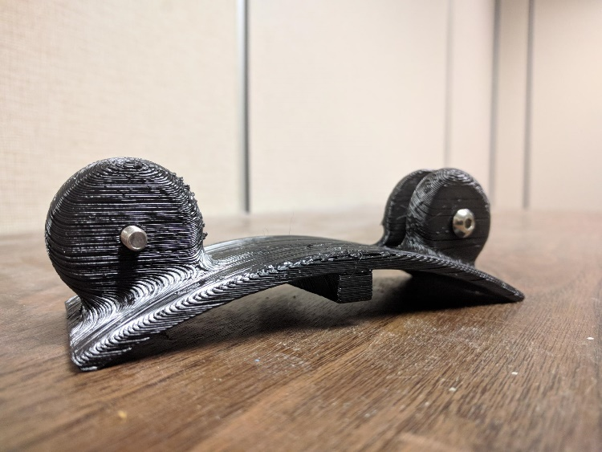
The 3D Printing Process
Model Development, Slicing, and Printing

Slide 5

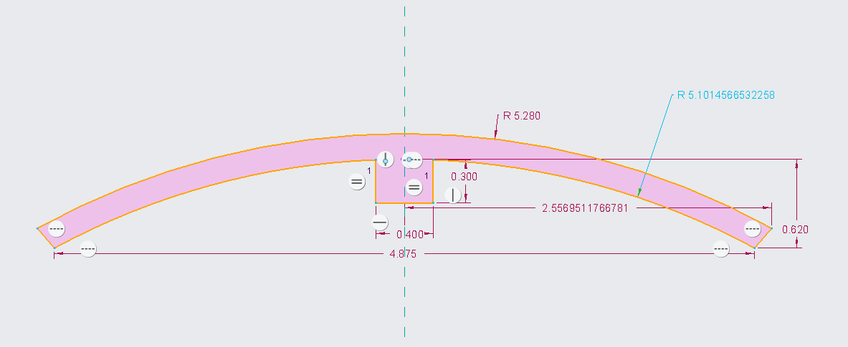
The 3D Printing Process
Model Development
Parametric CAD software like PTC Creo can be used to design parts with exact dimensions and constraints between features.
Used to make parts where dimensioning and geometric relationships are important.
Easy to edit.

Slide 6
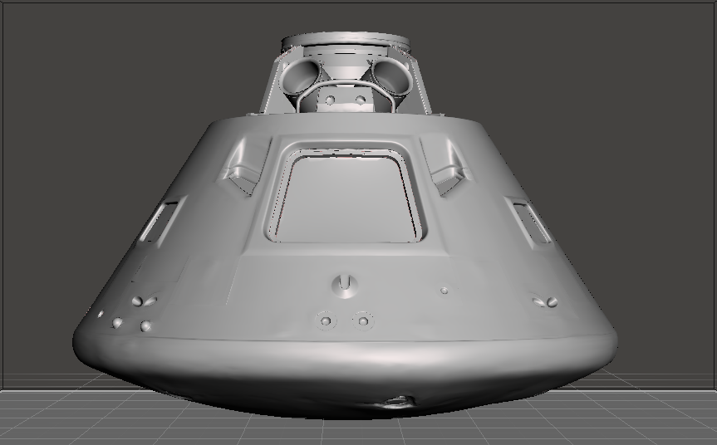
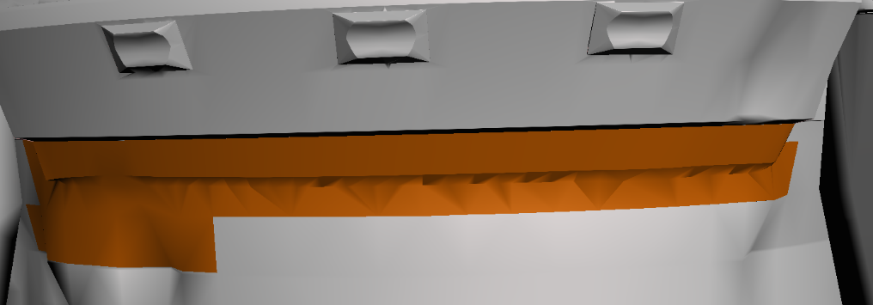
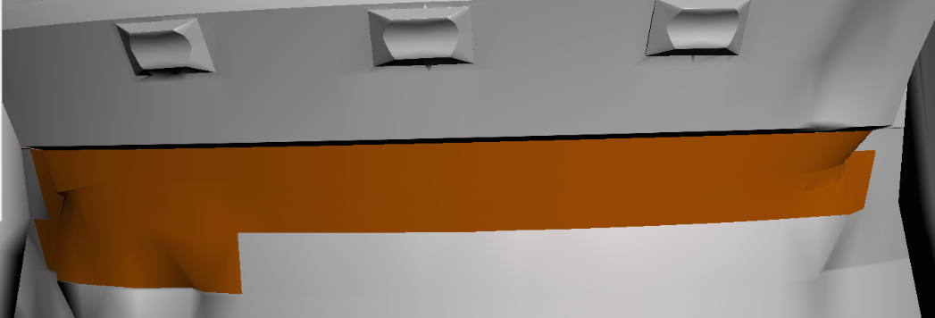
The 3D Printing Process
Model Development
Non-parametric CAD tools can be used to edit 3D meshes without strict reference to dimensions.
Used for smoothing or simplifying overly complex polygon mesh features.

Slide 7
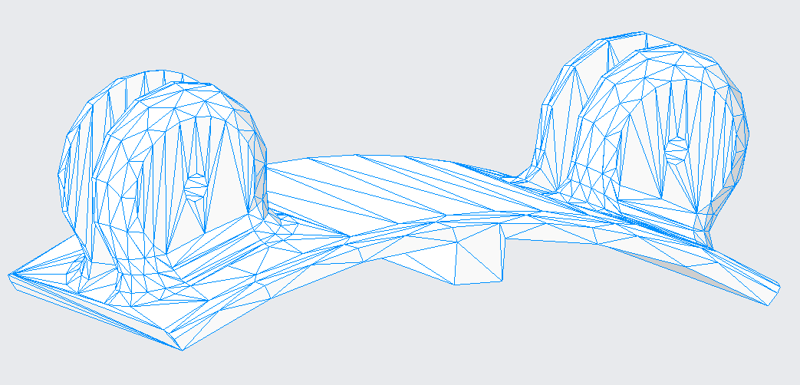
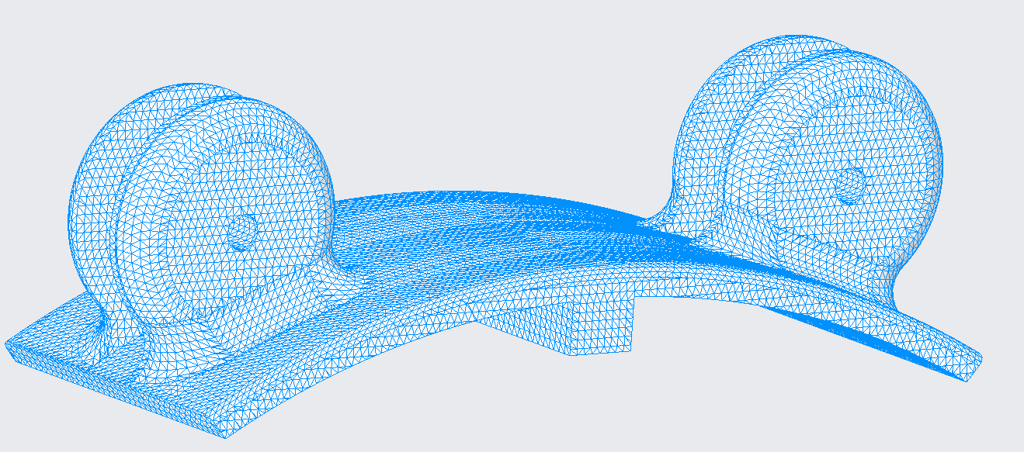
The 3D Printing Process
Model Development
The output of the model development process is a polygon mesh.
Usually specified with a .STL file, which defines a triangle mesh using vertex coordinates.
Alternative file formats
  .3MF – modern format which specifies polygon mesh as well as complete manufacturing information.
  .OBJ – allows more complex mesh and supports surface textures.

Slide 8
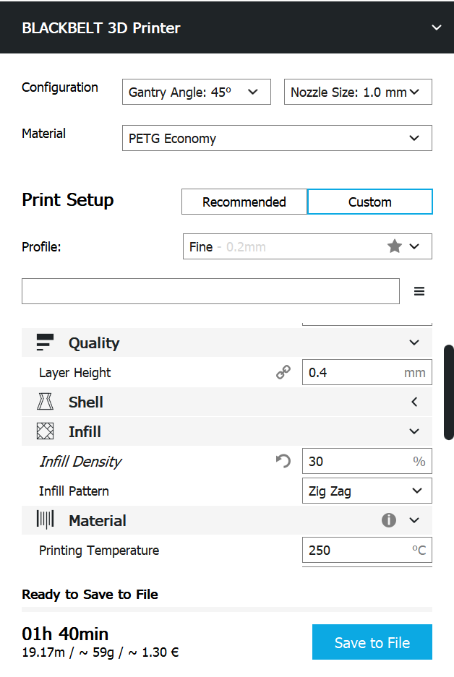
The 3D Printing Process
Slicing
Slicing is the process of converting a 3D polygon mesh into high-level machine instructions for printing.
Printer settings like nozzle temp, speed, retraction, etc. are adjusted depending on printer, material, and desired part characteristics.
Slicers are (mostly) printer-agnostic, use pluggable profiles to switch between printers.
Popular (free) slicers:
  Cura
  Slic3r

Slide 9
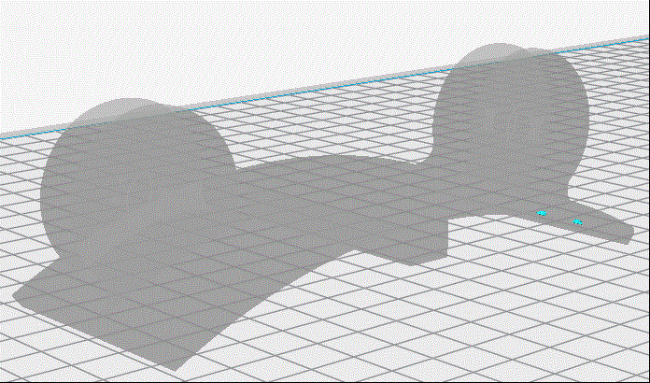
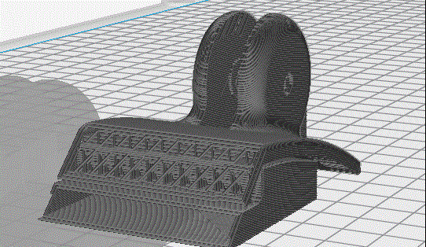
The 3D Printing Process
Slicing
The output of the slicing process is a g-code file, similar those used in CNC machining processes.
G-code is a set of predefined, human-readable commands.
Most consumer 3D printers use a flavor of the Marlin firmware, which defines around 100 different g-code commands
G-code defines the interface, while printer-specific firmware defines the execution

Slide 10
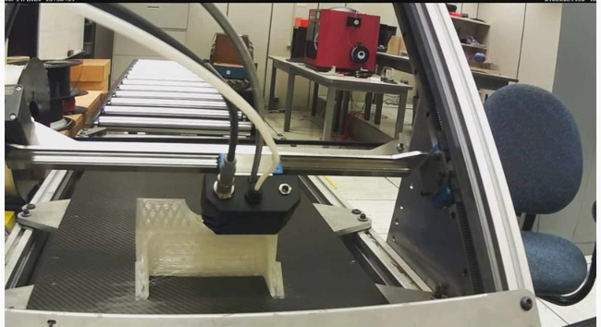
The 3D Printing Process
Printing
Several types of FDM printers in the IT-C1 3D Printing Center
  Cartesian
  Delta
  Belt
Prints started by loading SD card with g-code file, or by setting up a server to send g-code commands in real time over serial
Takes anywhere from several hours to several days!

Slide 11
Sample Projects

Slide 12
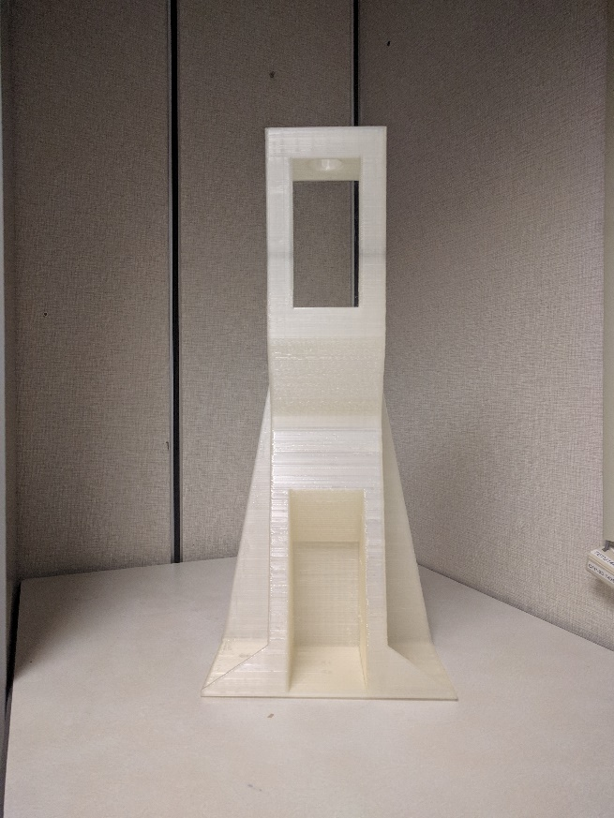
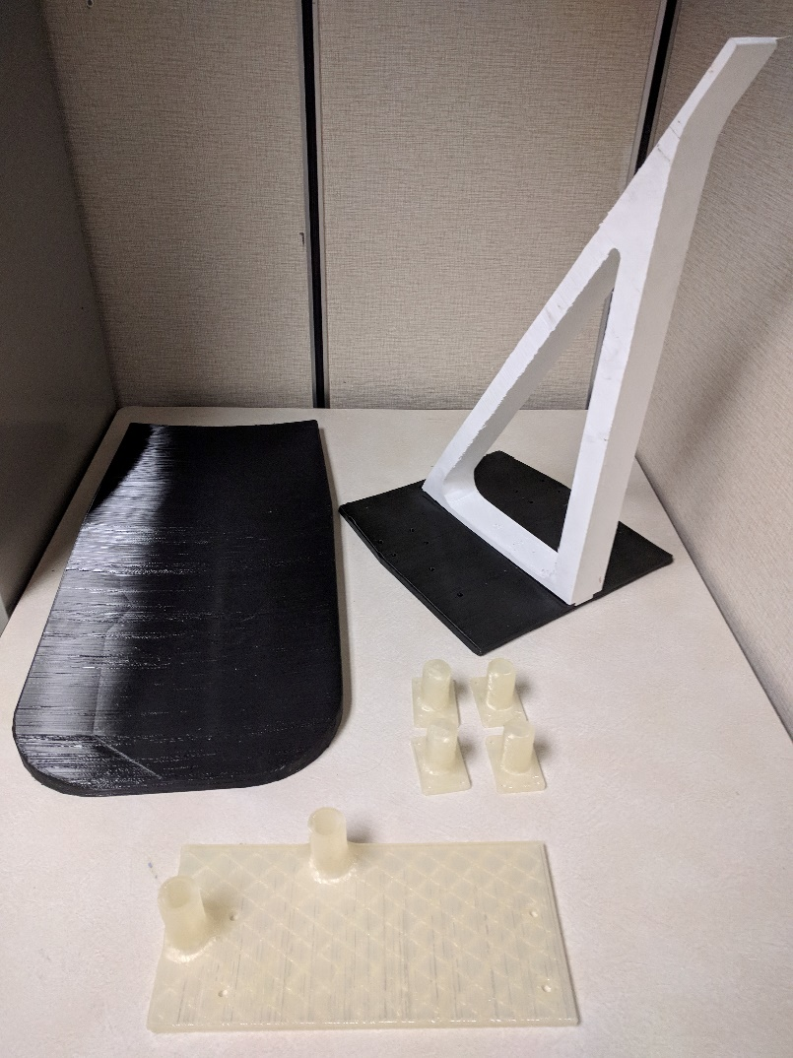
Projects
Orion Capsule Mirror Mount Prototype
Printed nearly 10-pound mirror mount fixture by splitting part into smaller components and assembling the final product with epoxy.
Over a week of printing time on our large-format belt printer.

Slide 13
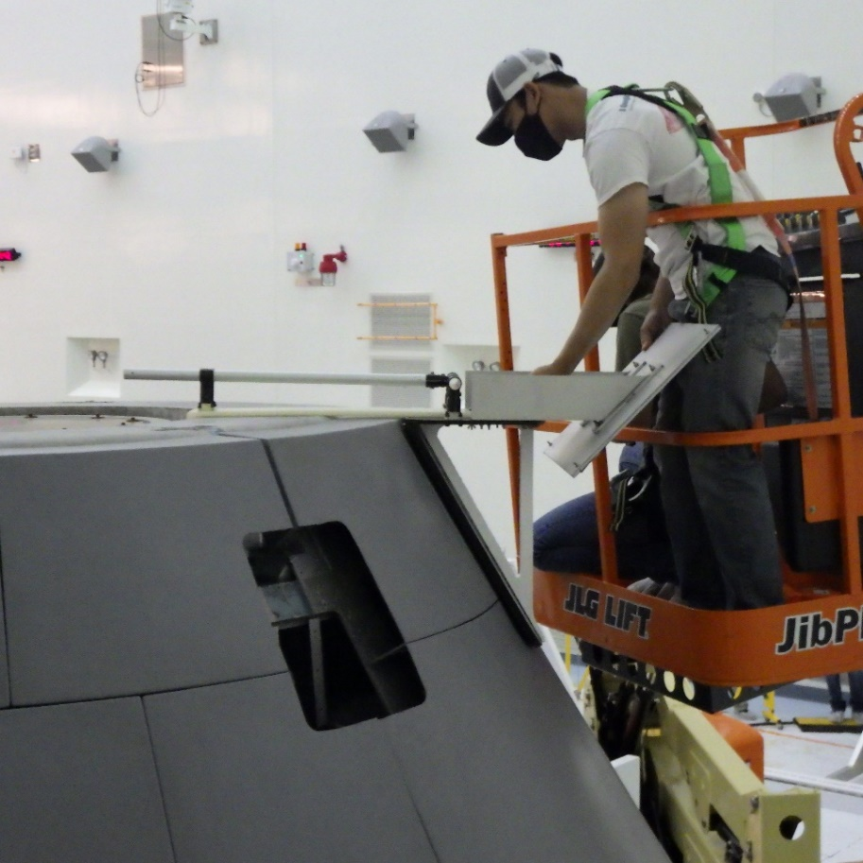
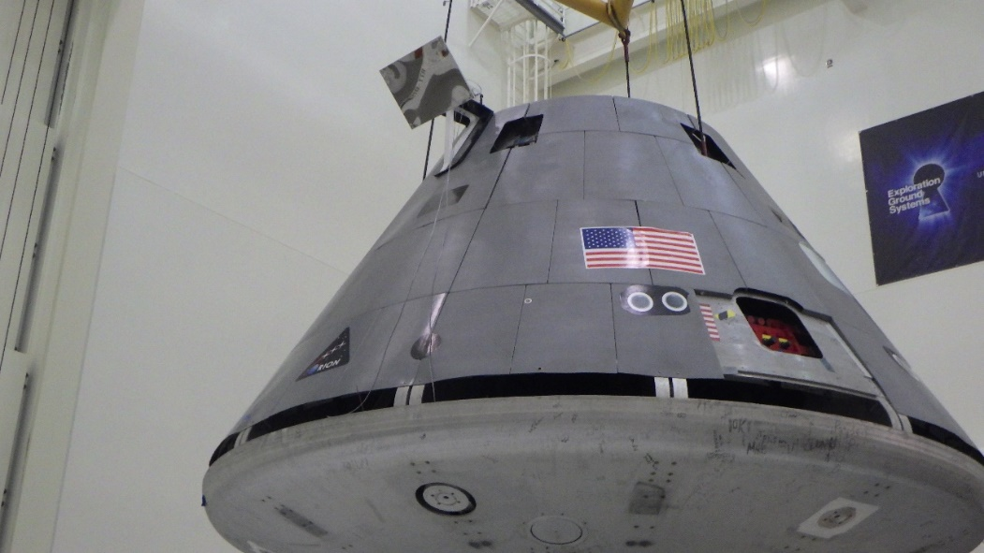
Projects
Orion Capsule Mirror Mount Prototype

Slide 14
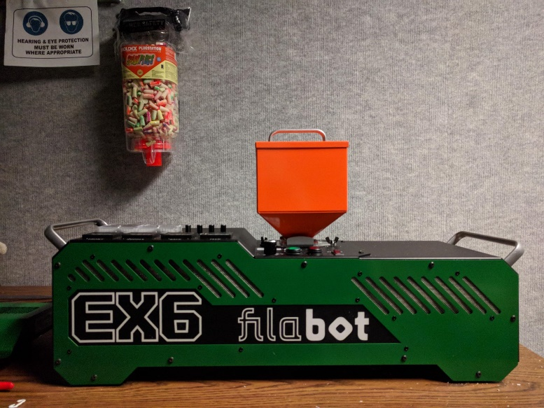
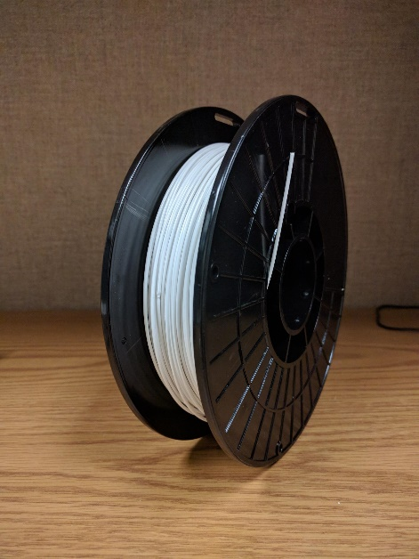
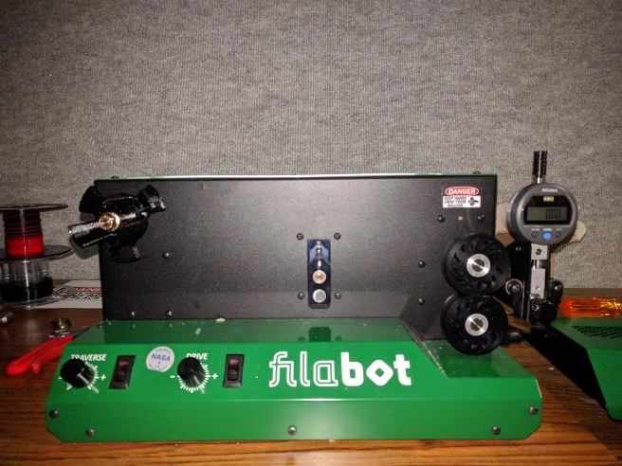
Projects
3D Filament Recycling
Determined appropriate processes and machine settings for extruding filament from recycled nGen regrind.
Working towards producing quality recycled filament for day-to-day operational use.

Slide 15
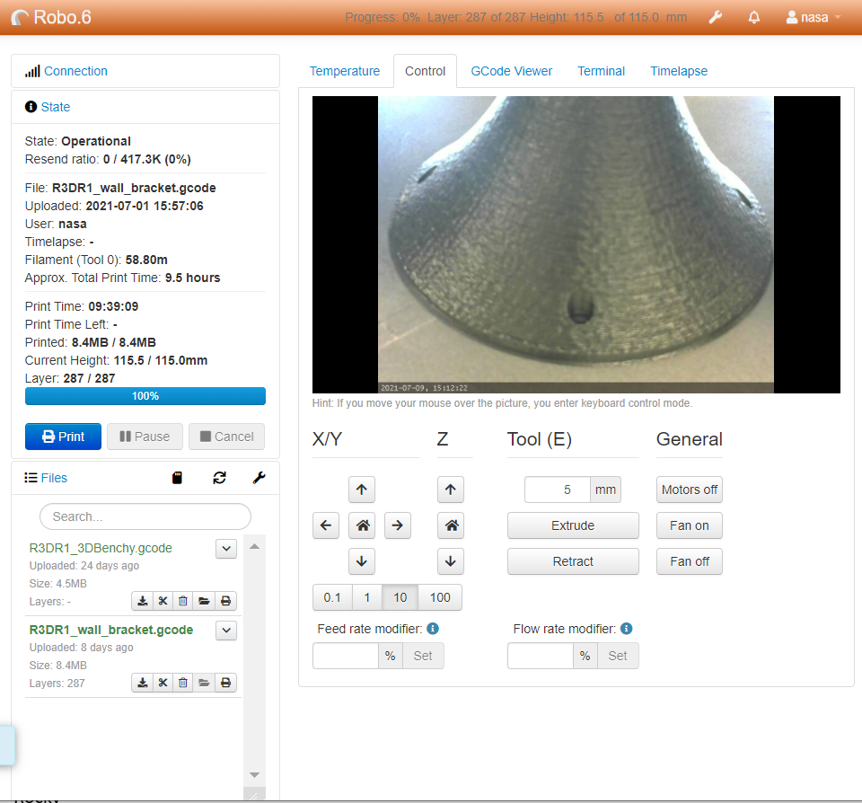
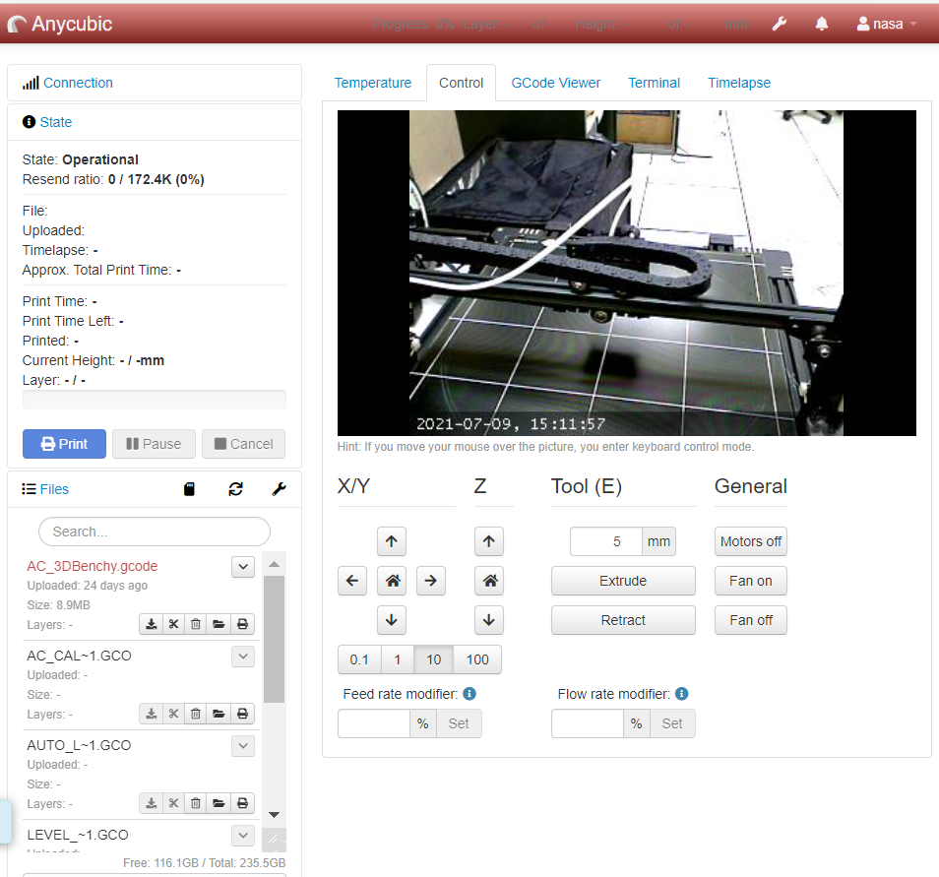
Projects
3D Printing Windows Server
Setup a Windows-hosted centralized 3D printing server for secure remote access and monitoring.
Useful for watching print quality and progress off-hours or remotely.

Slide 16
Thank you!

