Slide 1
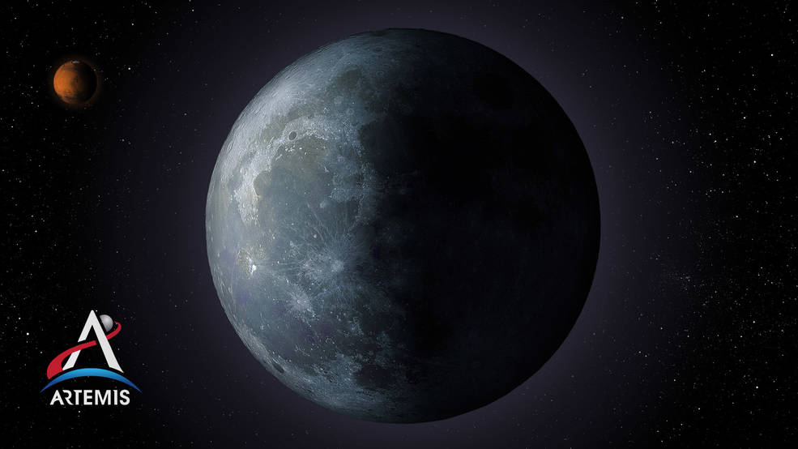
Welcome to the KSC Pathways
Summer 2021 Student Showcase
Session 4 Presenters
Adolfo Alvarado Rivera – VA-H2
  Mechanical Engineering – University of Central Florida
Mark Barbaro – NE-XT
  Electrical Engineering - University of Central Florida
Jonathan Mott – NE-L7
  Mechanical Engineering – University of South Florida
Nilab Azim – UB-E
  Chemistry, Materials – University of Central Florida
Francis Fajardo – GG-C-A
  Business Administration, Accounting – Penn State University
Cameron Mitchell – SA-E3
  Aerospace Engineering – University of Colorado - Boulder

Slide 2
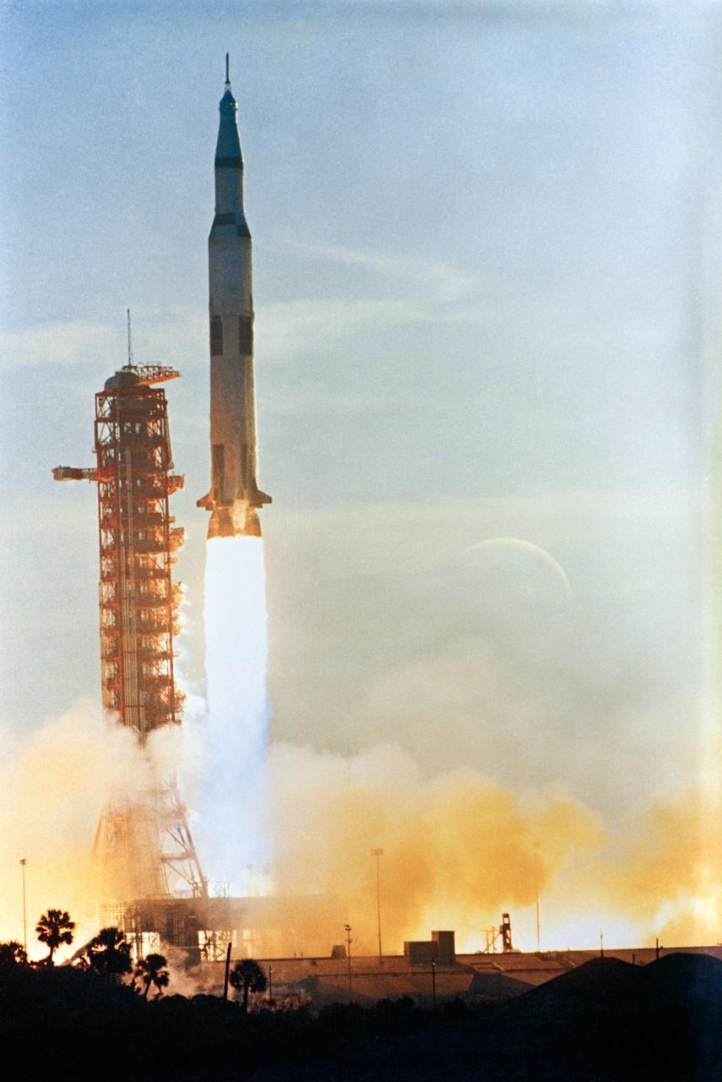
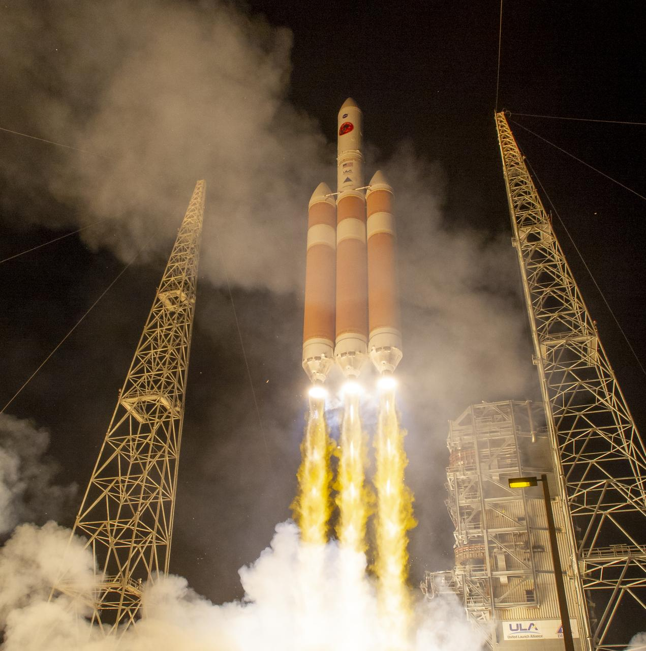
Rockets are loud!
LSP Dynamic Environments
By: Adolfo Alvarado

Slide 3
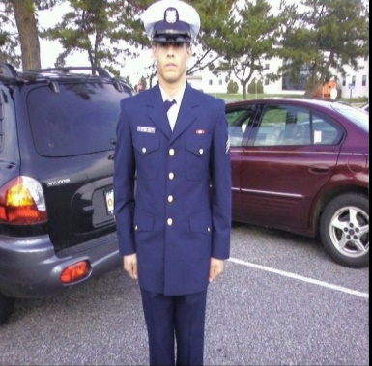
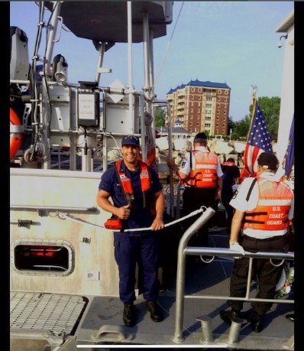
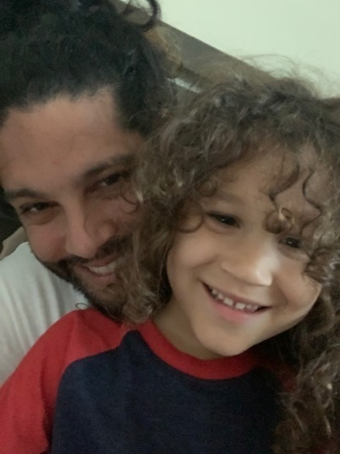
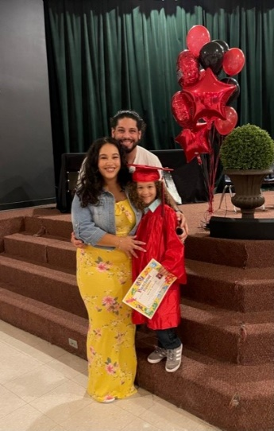
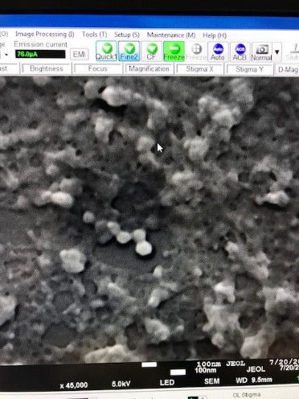
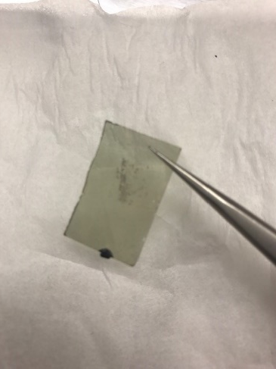
About ME!
Pathways intern at LSP since MAY 2019
Senior at UCF, Majoring in Mechanical Engineering, Minor in Physics.
LSAMP Scholar, conducted research on physics educational methods.
Conducted research on the Thermal annealing of ferro- electric thin films at IUPUI.
Family with a 5 year old son.
Served 7 years active duty in the US Coast Guard, 1st ship stationed on moored at NASA Michoud Assembly Facility.

Slide 4
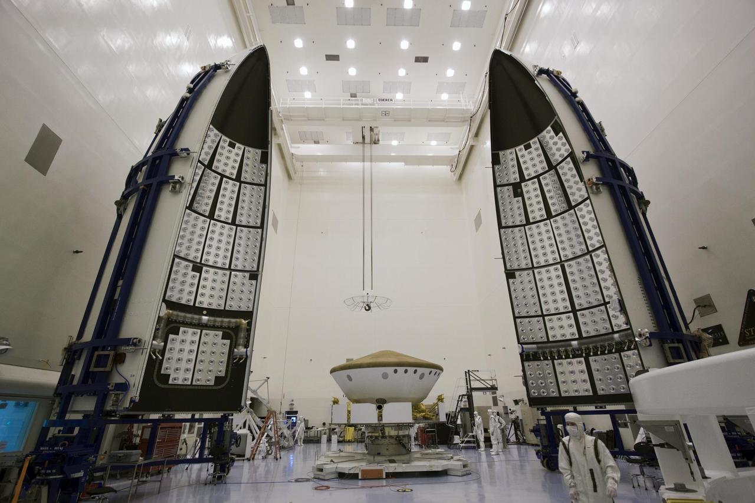
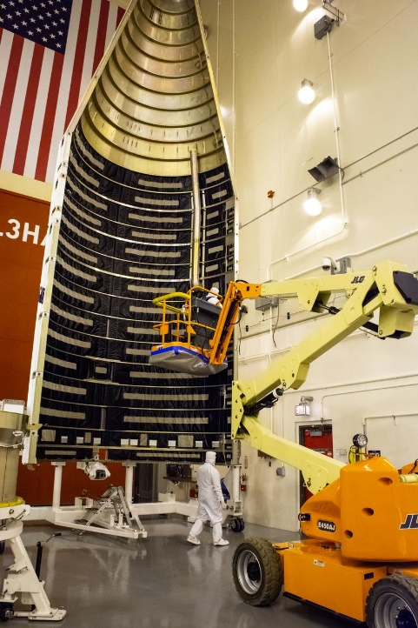
Project overview
The environment inside a payload fairing during the launch of a rocket can be strenuous on the instruments onboard. To help assist in minimizing the noise that may affect the instruments inside the payload fairing is lined with specific types of acoustic foam.
Using an acoustic impedance tube, tested multiple different types of foams and their effectiveness in attenuating sound.
Foam layer

Slide 5
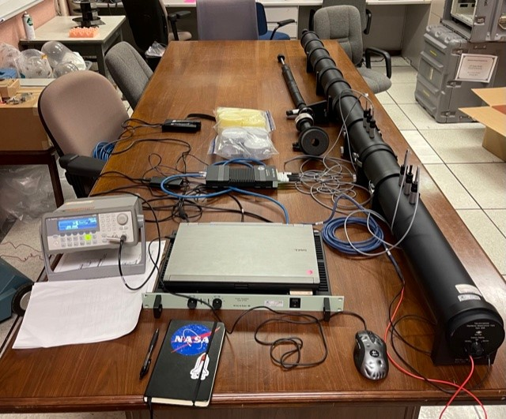
Acoustic Impedance tube
An impedance tube is used to measure the transmission loss and absorption coefficient.
The tube is 4 inches in diameter and in this project study was packed with foam towards the end to create an anechoic termination “sound doesn’t bounce back or escape”.
Uses a speaker on one end to send sound waves across the tube.
The specific tube used has 4 microphones to record.
  2 mics placed before the sample and 2 after.
The sample holder.
Wave generator is used to simulate random noise.
Tube operating frequency range is from 50 to 1600 Hz.

Slide 6
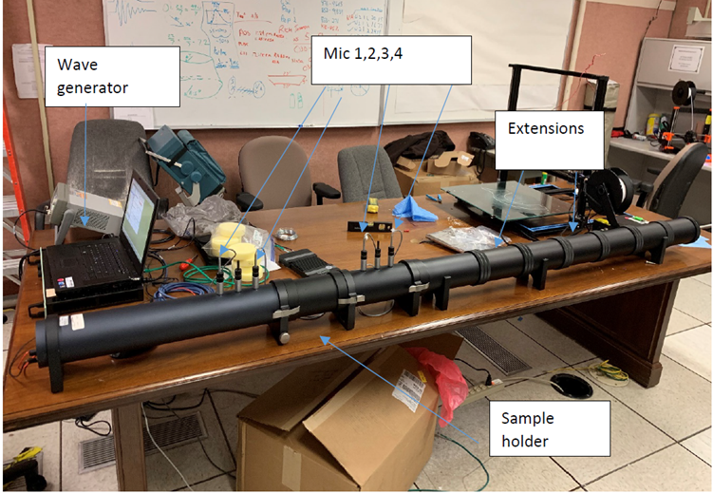
Sound wave
Generator
Mics 1,2,3,4
Area packed with foam for anechoic termination
Data acquisition system
Sound wave direction
Speaker
Sample holder

Slide 7
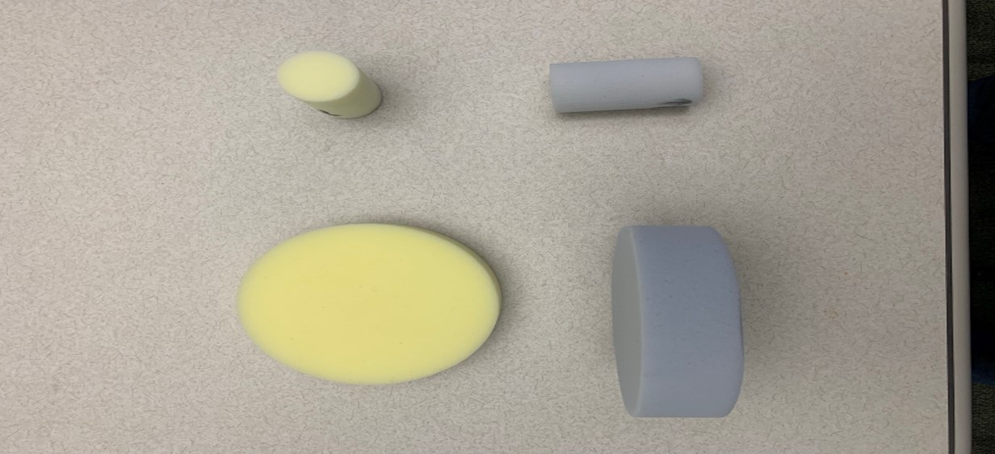
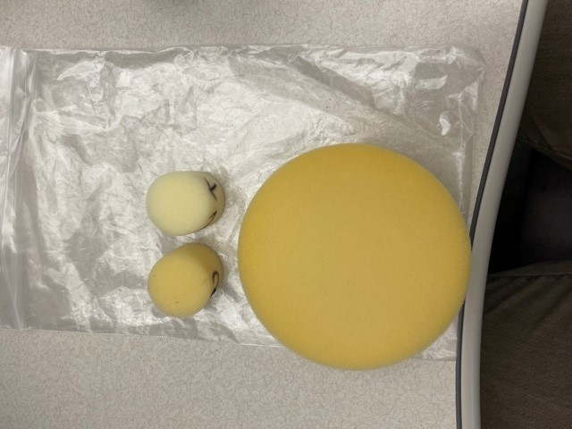
Various Foam properties that affect attenuation
Melamine foam
Ultra light
Density: 6 kg/m^3
Porosity
Density
Material coating
Surface cuts
Pattern design
Quality control
Protective layering
Melamine foam
G
Density: 9 kg/m^3

Slide 8
Test setup and data collection
Make sure all microphones are set properly in place. Always double check!
Turn on all equipment, DAQ, Signal Generator, Amplifier, Computer with applicable program to collect data.
Calibrate mics.
Place sample in sample holder, make sure seated correctly and snug. Data will show inconsistencies if this is done incorrectly .
Run applicable test with settings needed to fit testing conditions desired.
After all test are ran, post processing of data begins.
Results from post processing will show if test conditions met expectations or not.

Slide 9
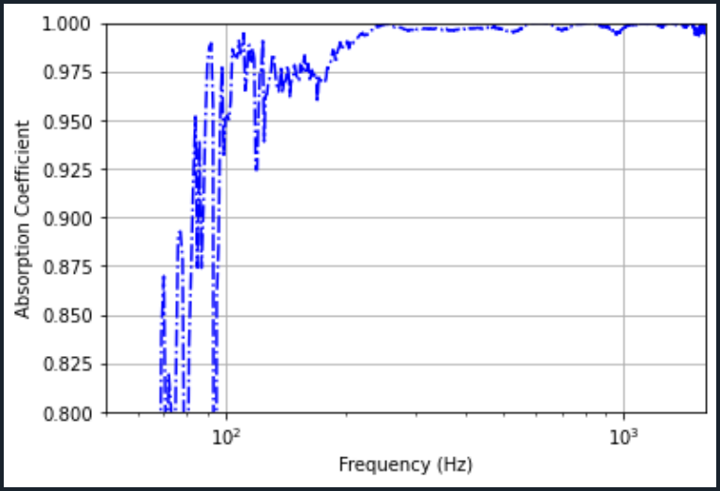
Anechoic Termination
Anechoic termination is needed to test the before and after of the sound waves, at above 0.98 we know that sound is not going to bounce back and affect results. Anything that may return will have little to no impact
Anechoic termination at above 0.98 after 200 Hz.
Majority of sound from 200 Hz to 1600 has been absorbed.
Anything below 200 anechoic termination cannot be confirmed.
0.98
200

Slide 10
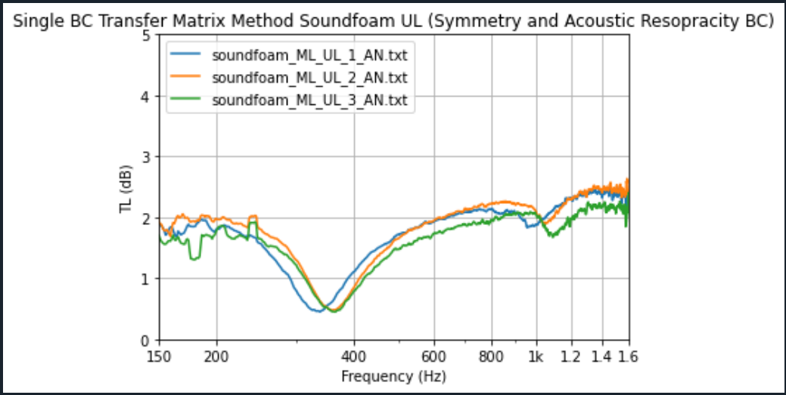
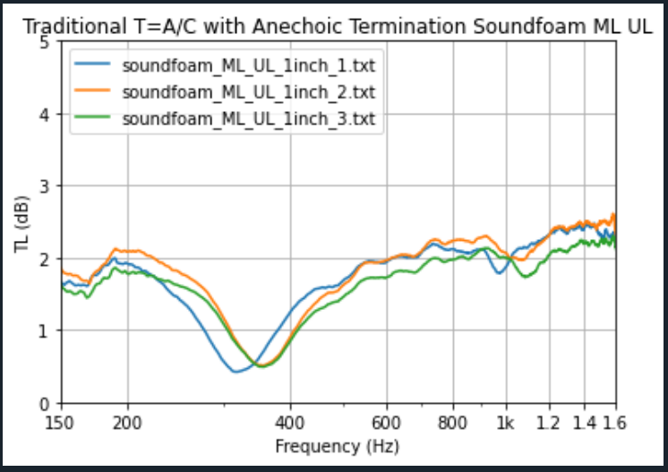
Results from post processing
Same samples processed using two different techniques in calculating their effectiveness in attenuating
sound for a frequency range of 150- 1600.

Slide 11
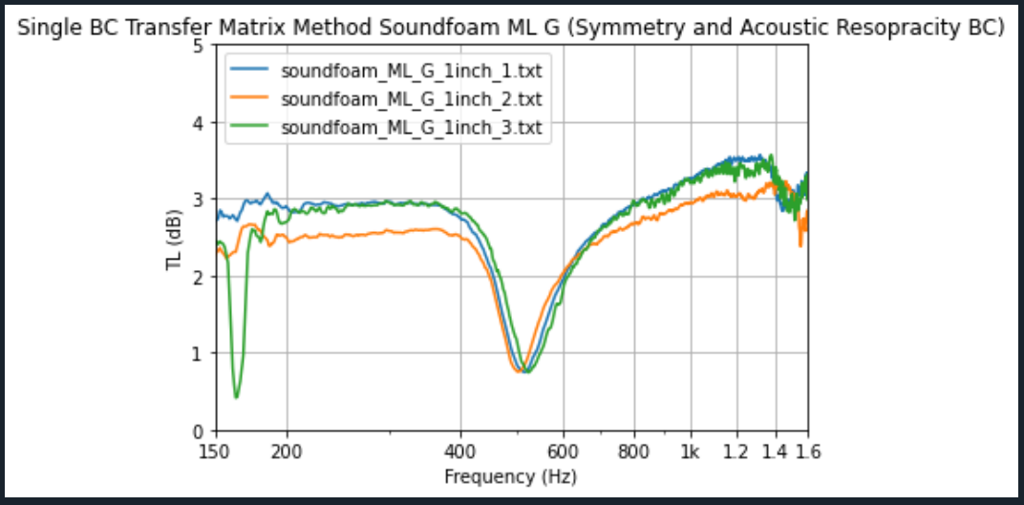
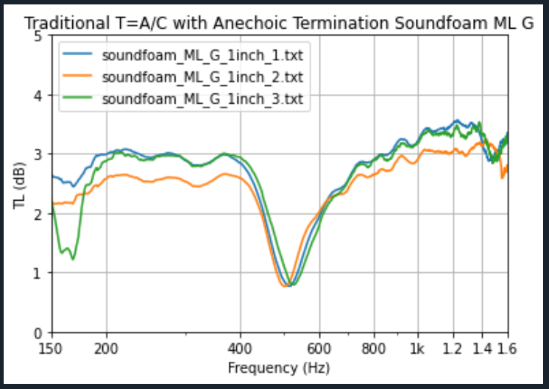
Foam G, samples 1-3
Higher density foam attenuates sound more at the cost of weight.

Slide 12
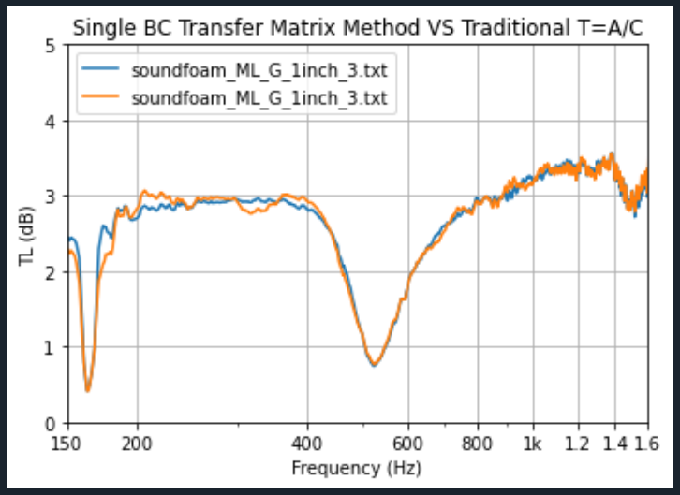
Comparing techniques
Less than a 0.25 dB difference between both techniques.

Slide 13
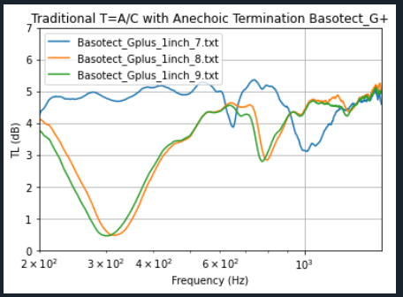
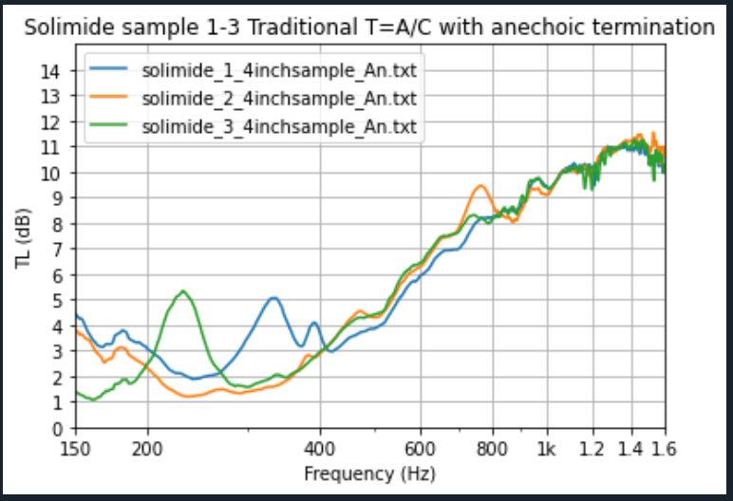
Foam data errors
Here we see that samples 8 and 9 ran similar yet sample 7 has some inconsistencies in the data
What actually affected the data needs further investigation.
Here we have data on what happens when the sample is not securely set in position and shifts during the testing. Mic spacing calculations off.

Slide 14
Conclusion:
Higher density foam gave an additional 1 dB of attenuation but at the cost of weight.
What foam properties are affecting attenuation needs further investigating.
The boundary conditions are very important for quality of testing.
Lessons Learned:
Sample placement.
Improved programing skills.
Testing has setbacks with equipment issues.
Future progress to project:
Testing of all remaining foam using the 3 Boundary conditions.
Develop a data base to store data and scripts for the benefit of other groups who may be interested in
reviewing this project.
References:
L. E. Kinsler, A. R. Frey, A. B. Coppens and J. V. Sanders, Fundamentals of Acoustics, 4th ed., John Wiley and Sons, Inc., 1999
Referenced Paper (ELVL-2017-0044807)
  Ray Rutkowski and Bryan Song
    “On the use of Four Microphone Acoustic Impedance Tube for Calculating Transmission Loss”

