Slide 1

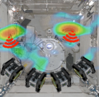
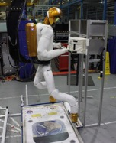
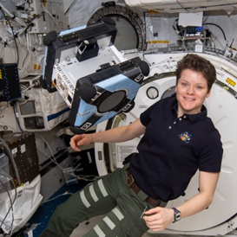
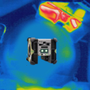
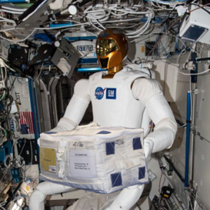

Integrated System for Autonomous and Adaptive Caretaking (ISAAC)
Astrobee Working Group Update
The ISAAC team, Trey Smith presenting
07.08.2021

Slide 2
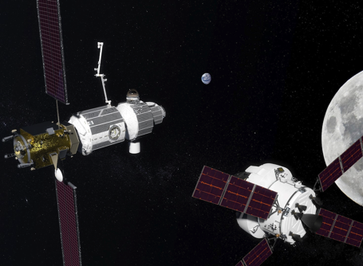
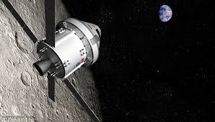
ISAAC Overview
Research project, 2020-2022, to develop technology for autonomous caretaking of spacecraft primarily during uncrewed mission phases
Led by NASA Ames Research Center with collaboration from Johnson Space Center
Integrate autonomous intra-vehicular robots (IVR) with spacecraft infrastructure (power, life support, etc.) and ground control
Focus on capabilities required for the Gateway that also apply to human missions to Mars and beyond
Test with existing IVR on the ISS (Astrobee, Robonaut) as an analog for future IVR on Gateway
Do not:
  Develop the IVR needed for Gateway
  Develop Gateway flight software
  (These tasks are vital but not part of ISAAC.)

Slide 3
Why ISAAC?
Gateway will be uncrewed for extended periods. During these periods NASA needs autonomous systems that can perform:
  Fault Detection, Isolation, and Recovery (FDIR)
  Routine maintenance
  Logistics operations
  All through high latency communication to ground controllers
Autonomous systems can free crew from routine maintenance and logistics tasks
  Gateway Ground Rules & Assumptions has crew spending 3.5 hours/day working non-utilization/non-exercise tasks
ISAAC provides the glue between Intra-Vehicular Robotics (IVR) and vehicle systems (power, life support, etc.) through
  Integrated data
  Coordinated execution
  Integrated control interface
Infusion into Gateway:
  Interaction with IVR Working Group
  ISAAC MOU with Gateway

Slide 4
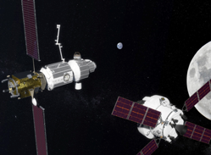
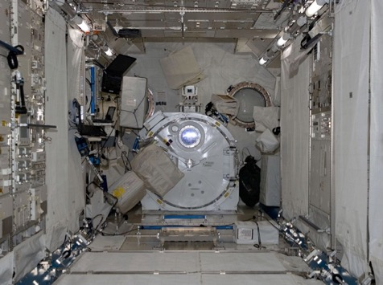
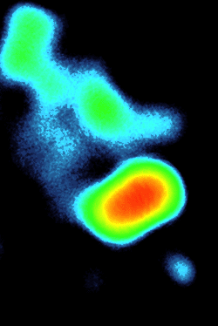


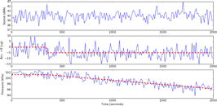
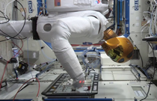
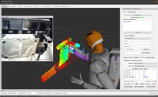

Technical Thrusts
Gateway
Spacecraft Subsystems
ECLSS
GN&C
Therm.
EPS
Comm
Struct.
Integrated System Manager
4
Mission Control
Notes:
Now we’ll go over ISAAC’s three technical thrusts

Slide 5
Technology: Integrated Data
Gateway
Spacecraft Subsystems
ECLSS
GN&C
Therm.
EPS
Comm
Struct.
Integrated Data
Integrated System Manager
5
Mission Control
Notes:
The Integrated Data thrust is about unifying telemetry from the different subsystems and robots, and making it available for integrated analysis, whether that is serving onboard autonomy or operator situation awareness.
Using the motivating example of a leak caused by a micrometeoroid impact, you would detect the leak using life support pressure sensing and isolate the location of the leak using robotic sensing. These are different telemetry sources, but for fault management, to understand the situation, you need to have access to both sources, and they need to be linked and registered with each other.

Slide 6
Technology: Coordinated Execution
Gateway
Spacecraft Subsystems
ECLSS
GN&C
Therm.
EPS
Comm
Struct.
Coordinated Execution
Integrated System Manager
6
Mission Control
Notes:
The Coordinated Execution thrust is about unifying the commanding framework between spacecraft subsystems and robots and bringing in higher-level management so you can have the components collaborate effectively.
In the leak scenario, you detect the leak with vehicle sensing, isolate the leak with a mobile inspector robot, and patch the leak with a mobile manipulator robot. But clearly you need a higher-level manager to coordinate this task, and the commanding of the different components needs to be linked and registered in common terms. For example, we need to have a common frame of reference, so the leak location can communicate the leak location in terms that the mobile manipulator understands.

Slide 7
Technology: Integrated Control Interface
Gateway
Spacecraft Subsystems
ECLSS
GN&C
Therm.
EPS
Comm
Struct.
Integrated Control Interface
Integrated System Manager
7
Mission Control
Notes:
And ISAAC’s final technical thrust is an Integrated Control Interface.
This thrust is about unifying things not just on the spacecraft side, but also on the ground side. For example, if your fault diagnosis engine gathers clues across subsystems, your operator interface should be able to show you all of that information together in one place. And operators need good situation awareness about all the threads of coordinated execution so they can intervene if needed.

Slide 8
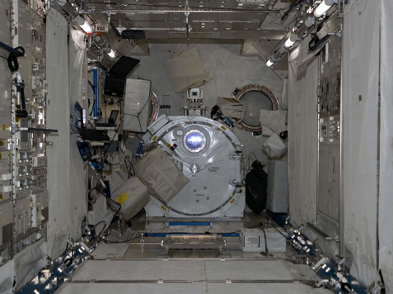
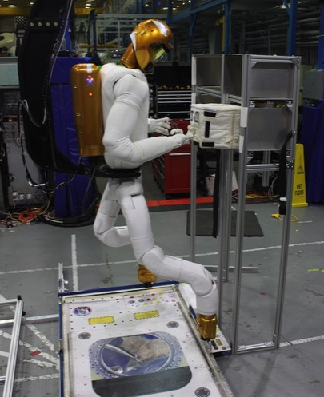
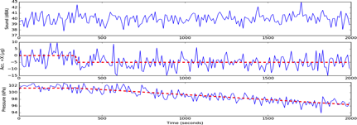
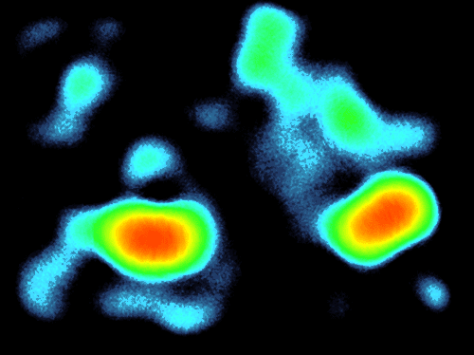






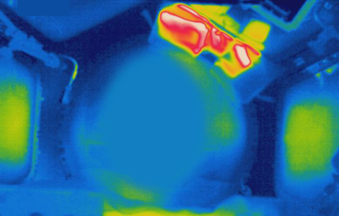
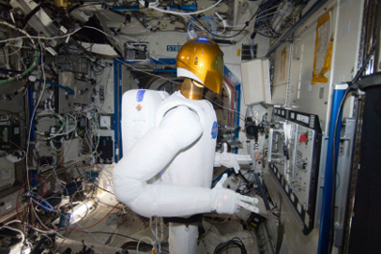
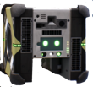
Capability Areas
Autonomous State Assessment
Autonomous Logistics Management
Integrated Fault Management
Structure
Detect Leak
GN&C
ECLSS
Locate Leak
Localizing signal sources by analyzing signal strength variation
Robotic cargo transfer
Patch Leak
Habitat thermal mapping
Notes:
The technical thrusts we just discussed are cross-cutting relative to a variety of applications. In parallel with the technical thrusts, ISAAC also has what we call capability areas, or ways we can apply those technical thrusts.
Autonomous state assessment is about staying aware of the vehicle state during uncrewed periods, using IVR and vehicle sensing together to identify any developing issues.
Autonomous logistics management is about both inventory tracking and cargo transfer, with the background that we may have uncrewed cargo vehicles visiting Gateway, and wouldn’t it be nice if the robots could handle unpacking them and save the crew time.
Integrated fault management looks at how vehicle subsystems and IVR can work together to manage faults, as in our motivating scenario with the leak.

Slide 9
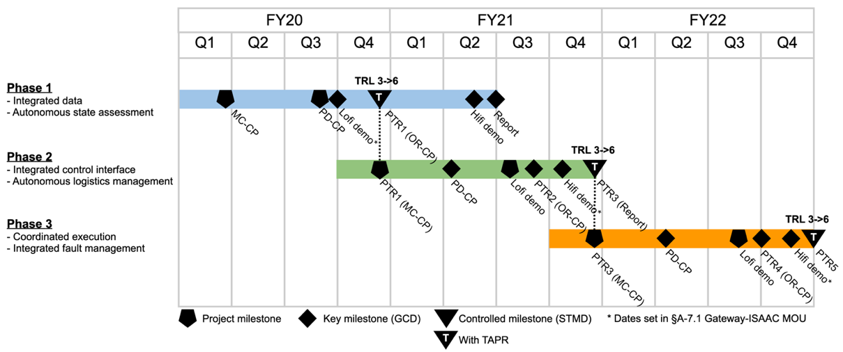
Schedule
FY19
FY20
FY21
FY22
ISAAC
ISAAC Formulation
We are here
Notes:
And this schedule shows how the phases are laid out. They are roughly aligned with fiscal years, but each phase extends longer than a year, and there is some overlap so for example we start ramping up on phase 2 before we finish off phase 1.

Slide 10
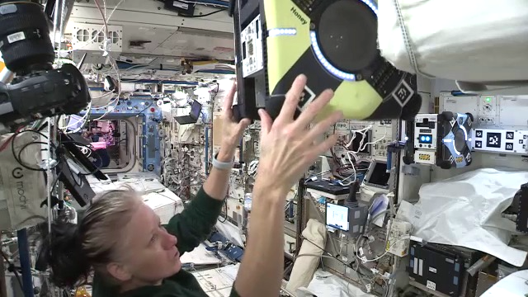
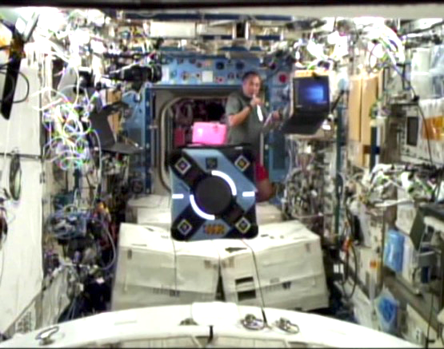
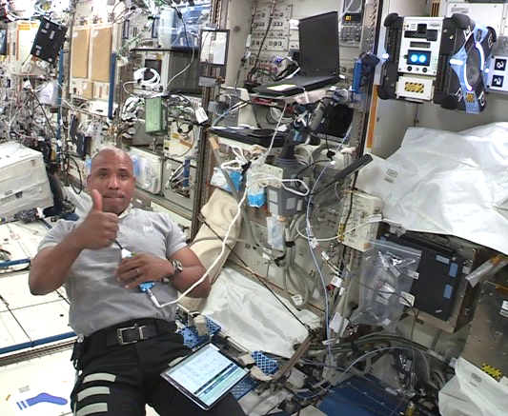
ISAAC Phase 1 ISS Activities
ISAAC-1
ISAAC-2
ISAAC-3
2021/02/23
2021/03/26
2021/04/19
NASA astronaut Shannon Walker manually moving Honey near target to collect calibration imagery
JAXA astronaut Soichi Noguchi pauses to watch Bumble conducting a multi-sensor map survey
NASA astronaut Victor J. Glover configuring the JEM module for Astrobee ops
Calibrate sensors
Validate mapping approach with a small survey
Cover full survey area
Build baseline 3D geometry and high-res surface texture
Respond to simulated CO₂ fault with Astrobee inspection
Automated detection of anomalous object blocking vent
Cover full survey area again
Stream live 3D surface texture updates to operator

Slide 11
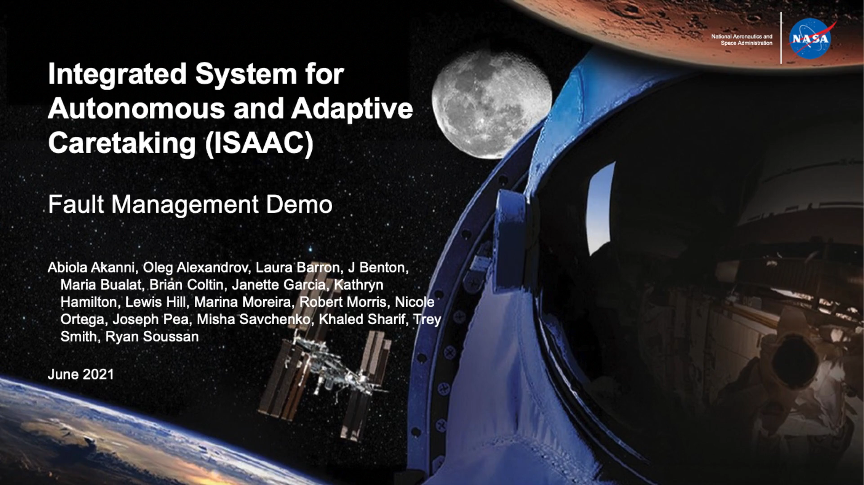
Fault Demo Video

Slide 12

Survey Demo Video

Slide 13
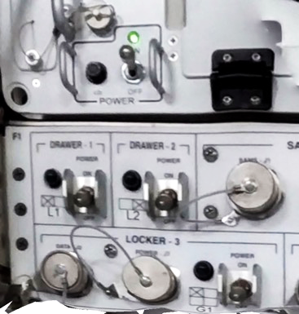
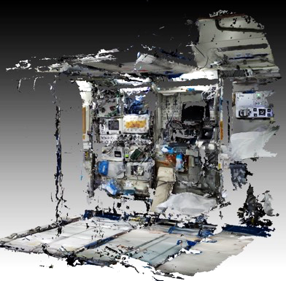
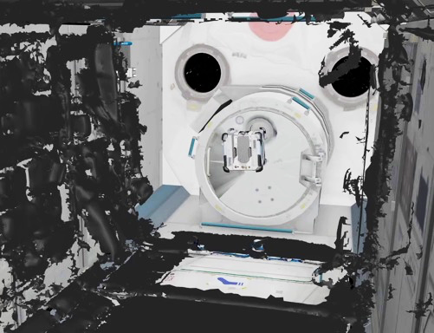
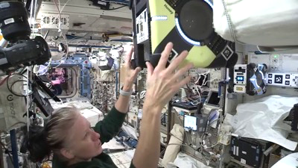

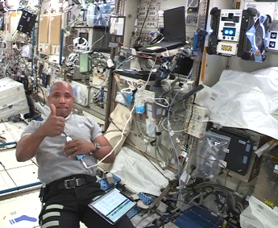
Phase 1 Summary
Multi-Sensor Mapping
Anomaly Detection
Integrated Demonstrations
Achieved KPP goal values
Demonstrated multi-sensor mapping and anomaly detection
Performed three integrated demonstrations on ISS

Slide 14
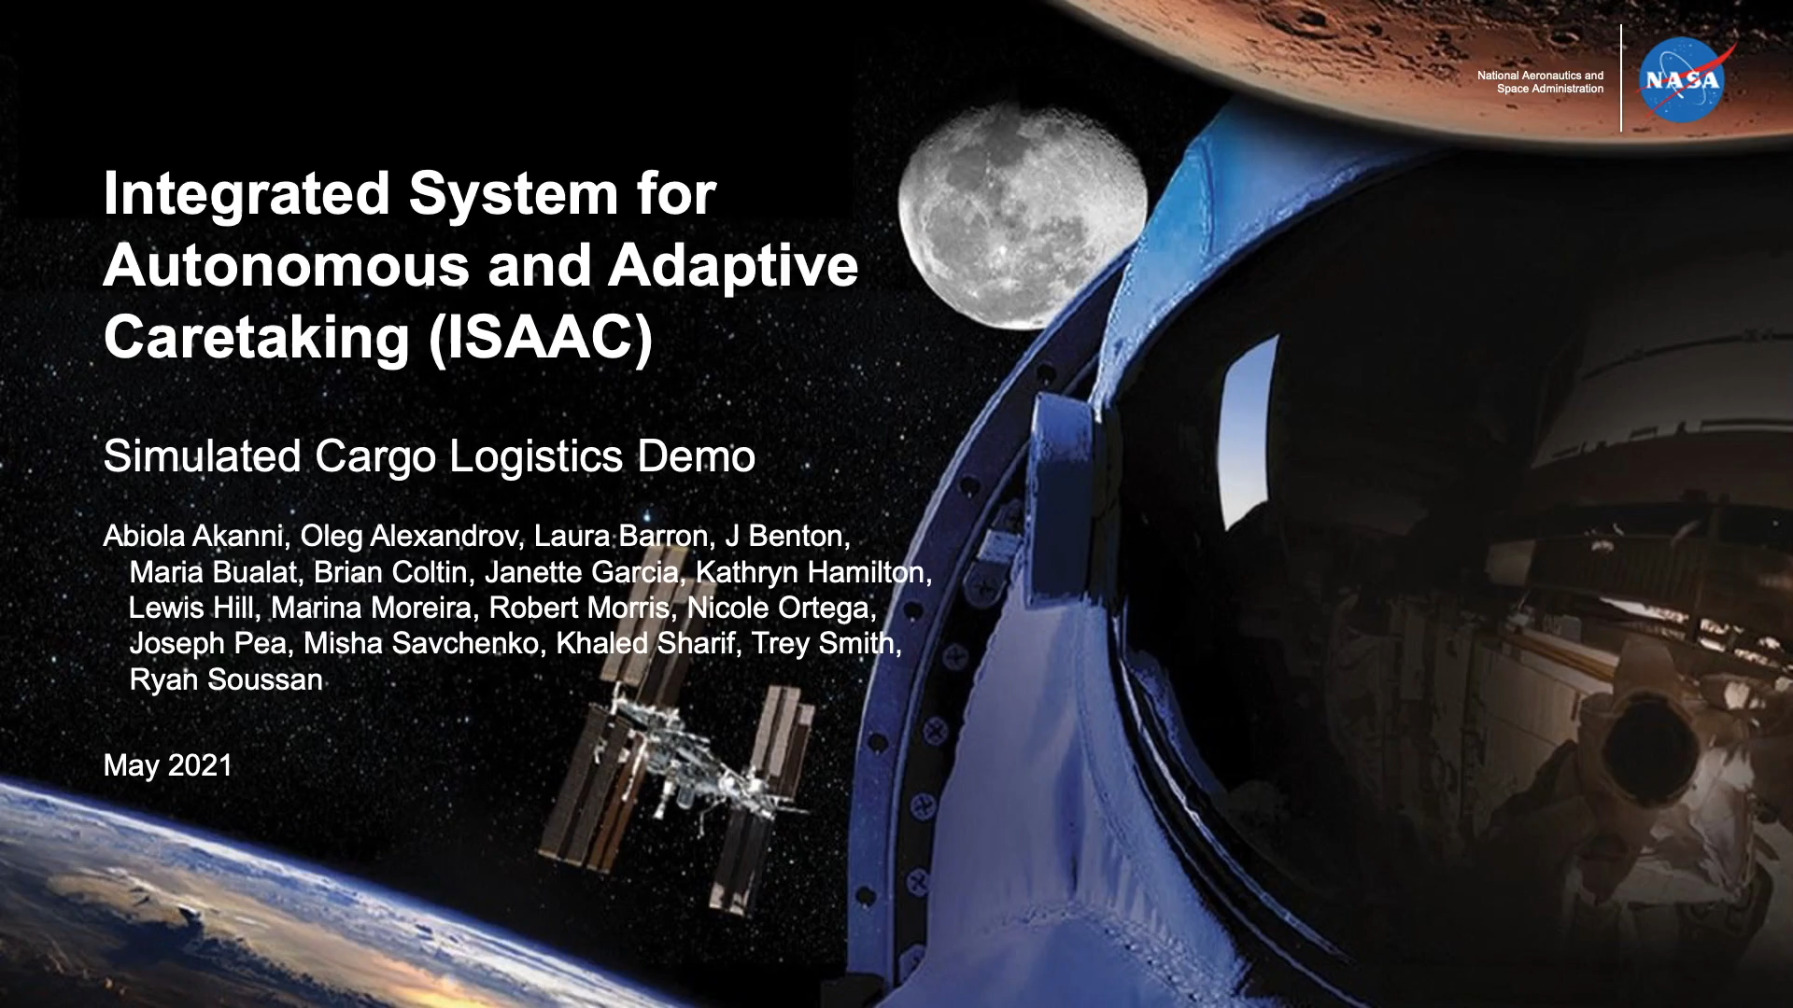
Phase 2 Low Fidelity Demo Video

Slide 15
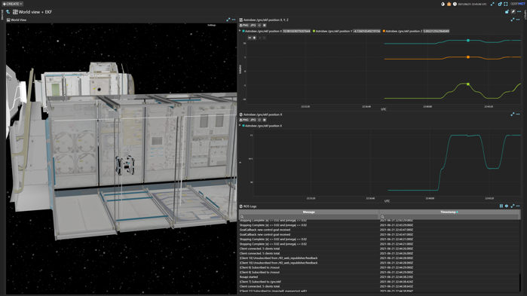
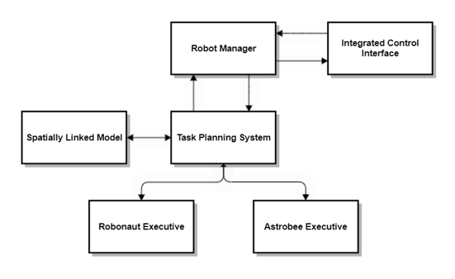
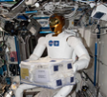

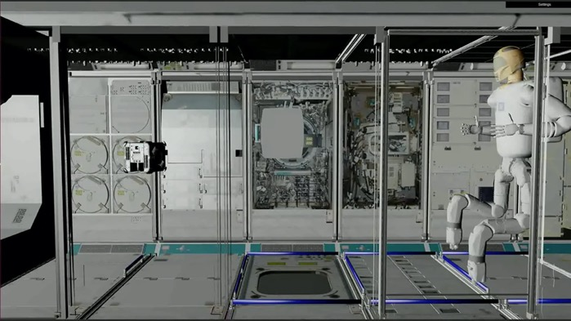
Phase 2 Summary
Integrated Control Interface
Multi-Robot Coordination
Autonomous Logistics Demo
Integrated control interface: improve operator situation awareness and productivity
Multi-robot coordination: automated task planning system generates multi-robot plan and ensures constraints are met
Cargo transfer scenario: heterogeneous multi-robot approach increases productivity

Slide 16
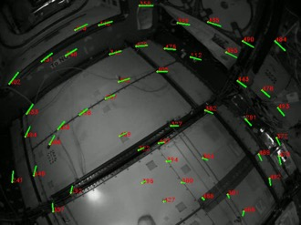
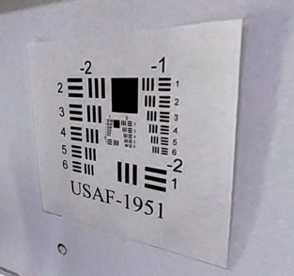
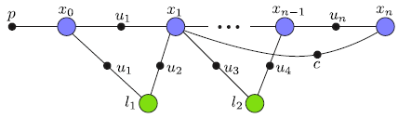
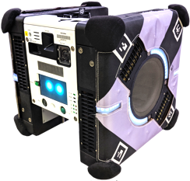
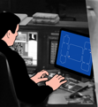

Astrobee Enhancements Summary
Robust Graph Localizer
Astrobee SciCam Computer Vision
SciCam
ROS on Ground Segment
ISAAC has made Astrobee more reliable and autonomous with the new graph localizer, and enabled computer vision with the SciCam
Many other ISAAC updates streamline Astrobee software development and lay the groundwork for future enhancements
These improvements were key enablers for reliably executing ISAAC’s multi-sensor mapping activities
ISAAC’s changes have been incorporated into Astrobee’s baseline flight software, making them available to all Astrobee Facility users
Astrobee flight software
Ground
segment
Node 1
Node 2
Node 3
Node 1
Node 2
Node 3
ROS
ROS
NEW
Astrobee control station
Bridge
Bridge
DDS
Space-to-ground link

Slide 17
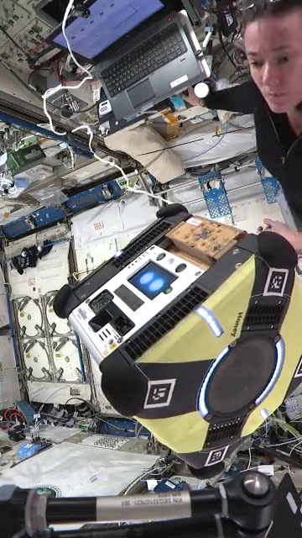
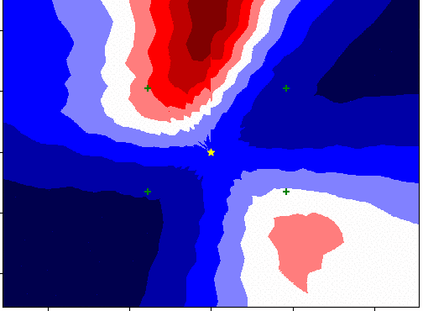
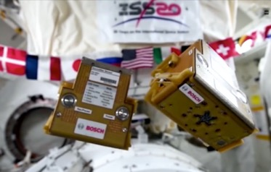
Recent Update – SoundSee-Data-1
SoundSee-Data-1 activity led by the SoundSee team from Bosch USA was successfully executed on July 7, 2021 (yesterday!)
ISAAC assisted the SoundSee team with conops and live operational support
Both SoundSee and ISAAC have talented interns who will be working this summer to analyze the data
We hope to demonstrate using Astrobee to locate sound sources and build 3D acoustic maps that fit into ISAAC’s multi-sensor mapping framework
Acoustic images generated from SoundSee data collected during an earlier checkout activity on ISS
SoundSee on ISS
NASA astronaut Megan McArthur prepares Honey for SoundSee-Data-1 operations

Slide 18

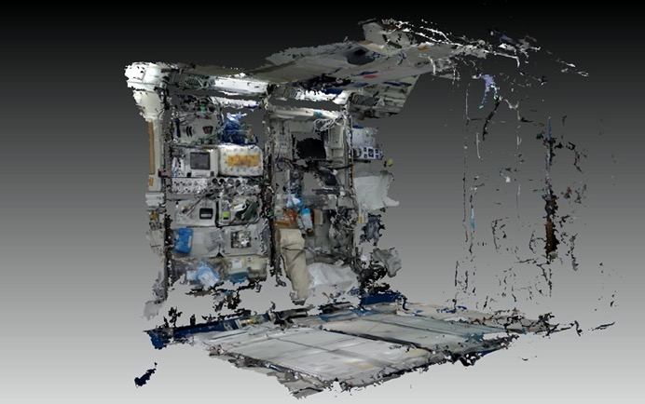
Near-Term Next Steps
Improve phase 2 cargo transport demo
  Multiple bags
  Automated replanning on action failure
  Improve operator interface
Extend effort on multi-sensor 3D mapping
  Improve 3D reconstruction quality
  Make survey more robust and expand coverage
  Incorporate SoundSee acoustic map layer
  Make prototype 3D maps of ISS interior available to potential users and pursue infusion into near-term ISS operational use
Continue assisting Astrobee Facility with flight software enhancements
ISAAC Control Interface organized to show 3D robot view, plots, and logs
ISAAC will make prototype 3D maps of ISS interior available for potential users

Slide 19
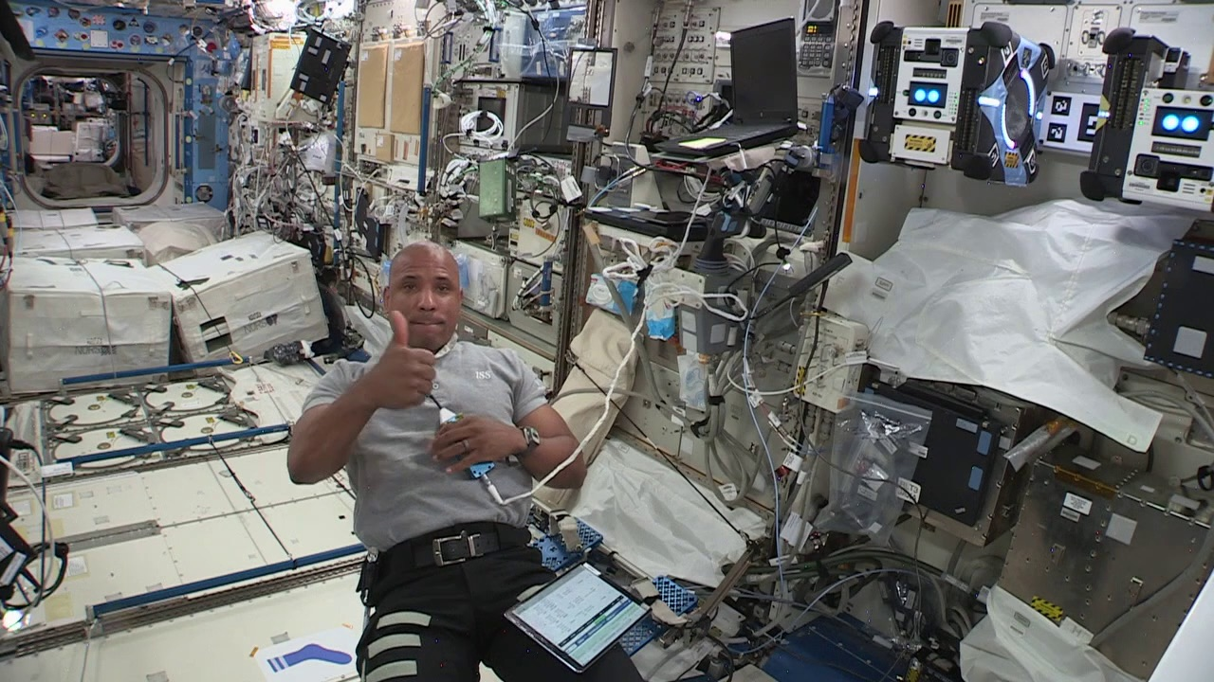
QUESTIONS?

