Slide 1
Formal Methods for Unmanned Aircraft Systems
Aaron Dutle*
Safety-Critical Avionics Systems
NASA Langley Research Center
Leipzig Symposium on Intelligent Systems
July 22, 2021
*Work done in collaboration with Cesar Munoz, Anthony Narkawicz, Paolo Masci, Swee Balachandran, Marco Feliu, Alwyn Goodloe, Ivan Perez, and others

Slide 2
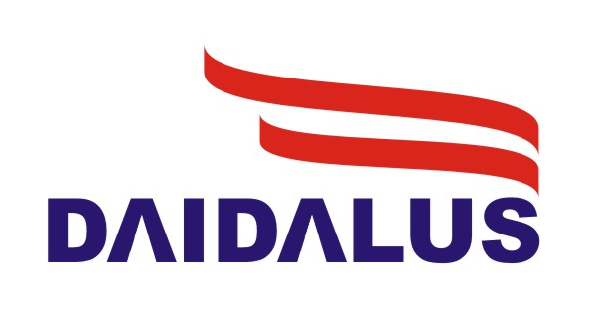

A tale of two systems
Detect and AvoID Alerting Logic for Unmanned Systems
Independent Configurable Architecture for Reliable Operations of Unmanned Systems
Developed as the reference implementation for Detect and Avoid for DO-365
Provides 1x1 alerting and 1xN guidance to avoid conflicts with other aircraft
Library available in Java, C++, and formal models in PVS
Extensible publish-subscribe based architecture
Incorporates DAA (Daidalus), geofencing, path planning, scheduling, decision making and other capabilities as modules
Allows autopilot and/or ground station to execute missions
The emphasis on Formal Verification is what sets them apart from competing systems

Slide 3
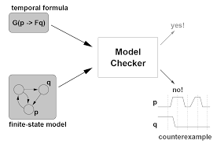
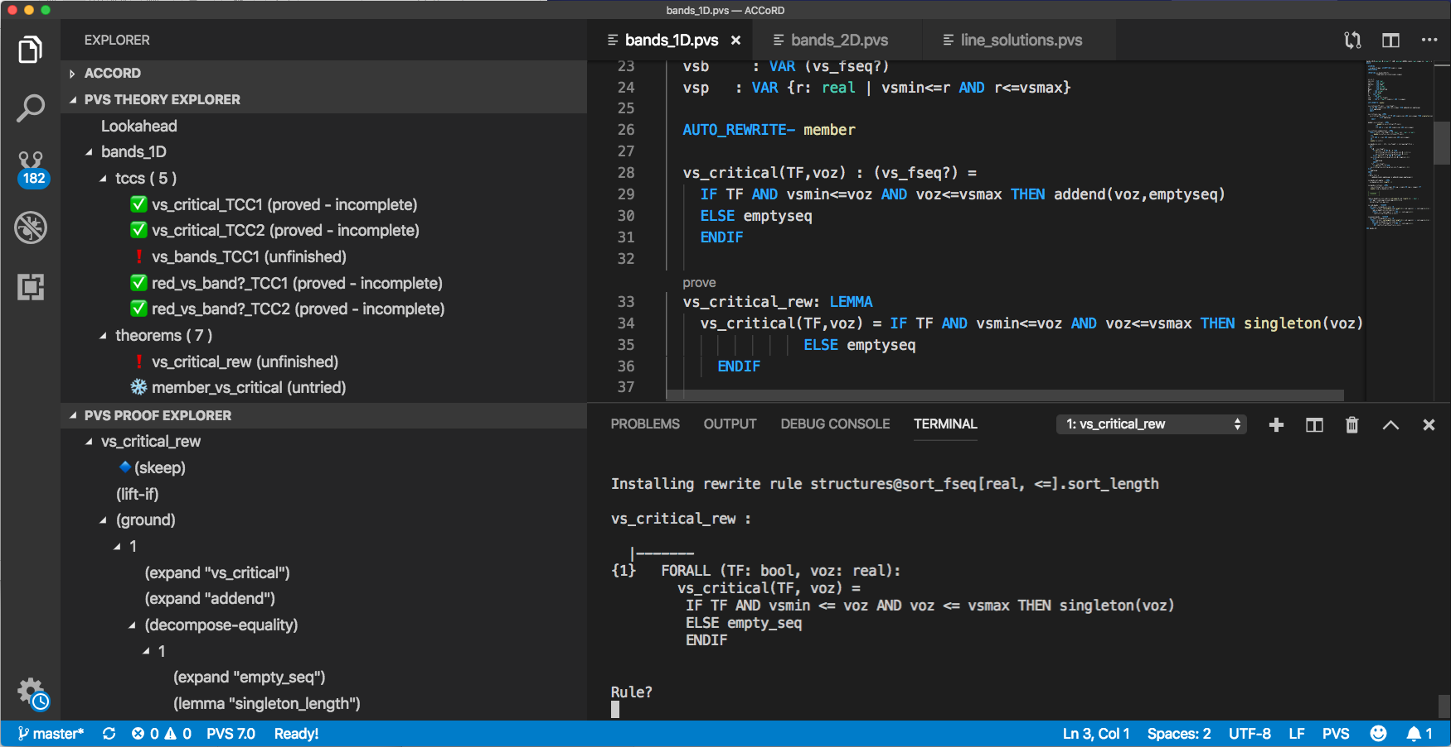
What is Formal Methods?
Formal Methods:
Mathematically rigorous techniques and tools for the specification, design, and verification of software and hardware systems
Many Formal Methods provide a means to symbolically examine the entire state space of a digital design (whether hardware or software)
This allows users to establish correctness or safety properties that are true for all possible inputs
Model checking
Some Techniques:
Interactive theorem proving
Static analysis
Model checking
Verified compilers
Runtime verification
Requirements analysis
Interactive theorem proving

Slide 4
Pre-Daidalus: FAA SARP definition of Well-Clear
Requirements determined for a viable definition:
Provide a geometric means to determine well-clear status
Enable self-separation capabilities
Avoid undue concern for traffic aircraft
Interoperate with existing collision avoidance systems (TCAS II)
Formal modeling and verification of the concept performed by the NASA Formal Methods group added 3 related desirable properties:
Inclusion: Contains the TCAS II volume, and as the well-clear parameters increase, the volume does
Symmetry: The ownship and intruder should determine the same well-clear status (assuming the same information held by both)
Local Convexity: In a non-maneuvering encounter, there should be (at most) one time interval where the aircraft are in conflict

Slide 5
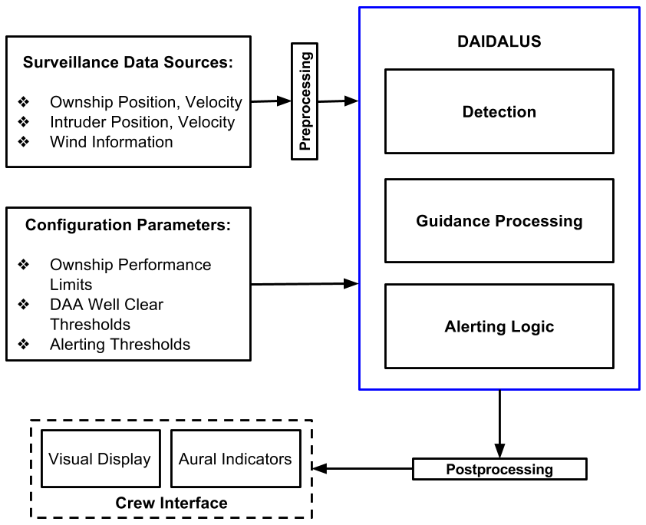
What’s in the box?
System based on formally verified core algorithms that:
  Determine the current pairwise well-clear status (Detection)
  Compute maneuver guidance to maintain or regain well-clear status (Maneuver Guidance)
  Determine alert type (Alerting)

Slide 6
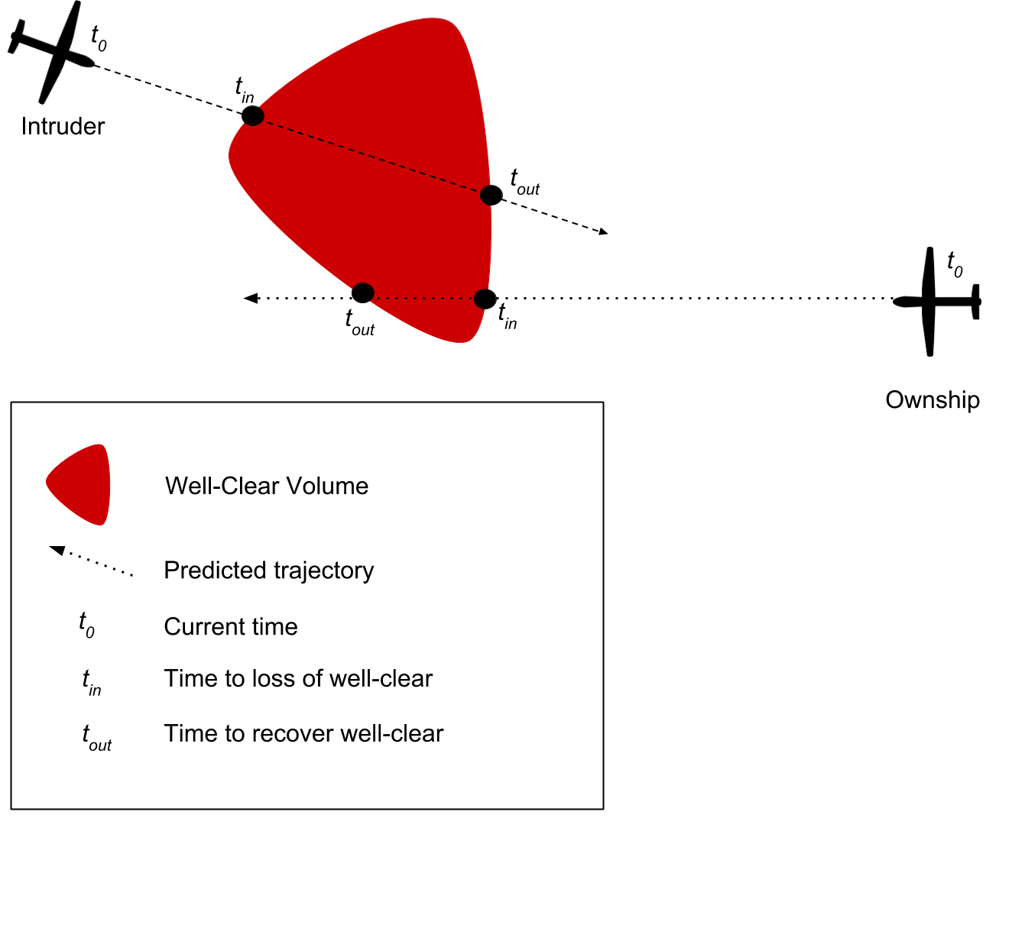
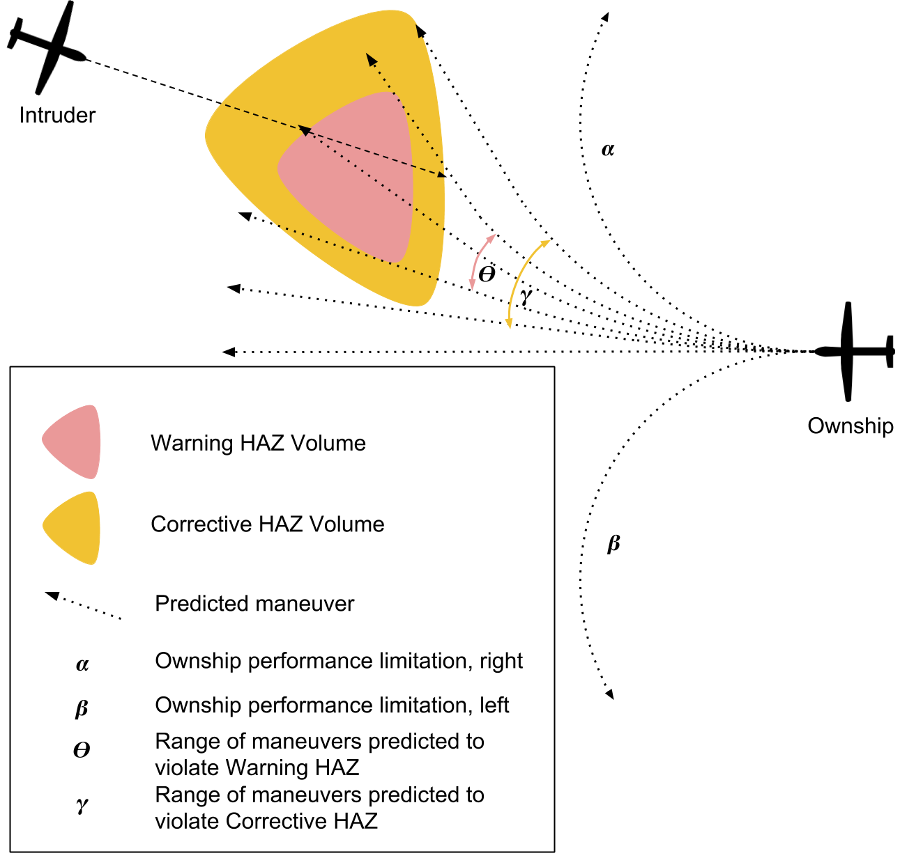
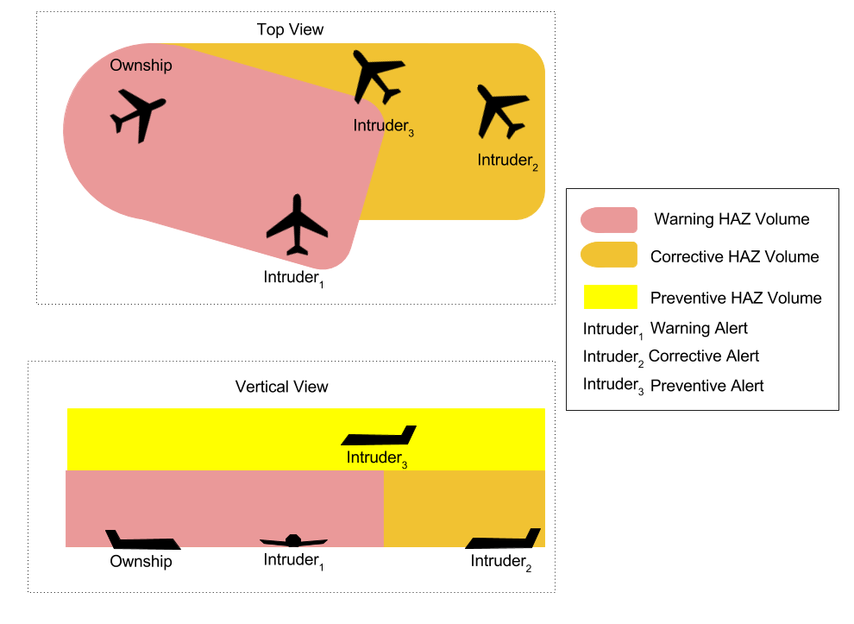
Core functionality
Detection determines the time interval where a loss of well-clear is predicted to occur
Maneuver Guidance finds ranges of maneuvers that lead to entering some hazard volume
Alerting computes a number indicating the severity of a potential loss of well-clear
Notes:
Provides maneuver guidance for turns, vertical speed, ground speed, and altitude. Provides different severity alerts for predicted violations of well-clear.

Slide 7
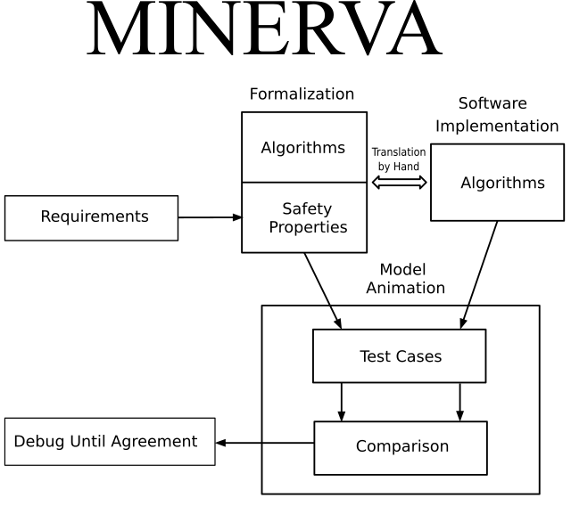
The verification process for DAIDALUS
Verification
Mirrored Implementation
Numerically Evaluated against
Rigorously Verified Algorithms

Slide 8
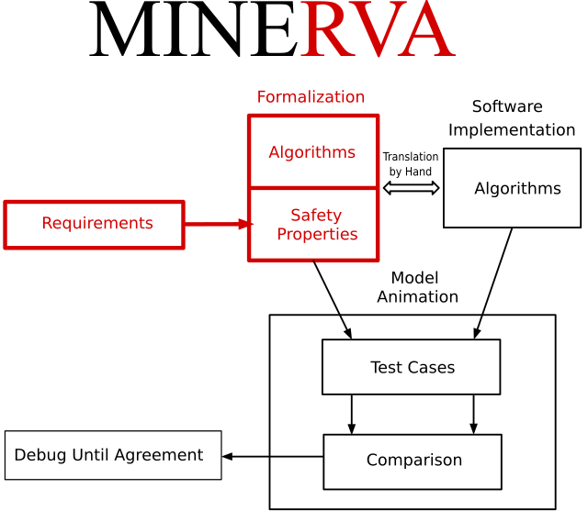
Rigorously Verified Algorithms
Verification
Using the Prototype Verification System (PVS)
Specify safety, correctness, or otherwise desirable properties
Write algorithms meant to satisfy them
Formally prove that the algorithms do as desired

Slide 9
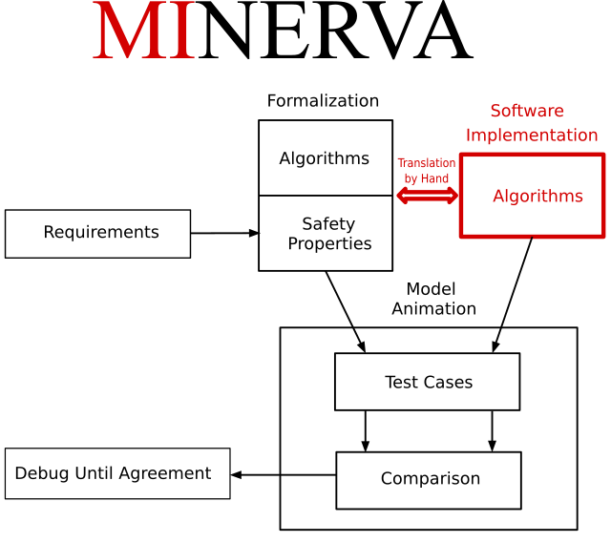
Mirrored Implementation
Verification
Use a more common programming language (Java and C++) to implement the algorithms
For low-level functions, literal mirroring of functions
For higher level, mirror the functionality of components

Slide 10
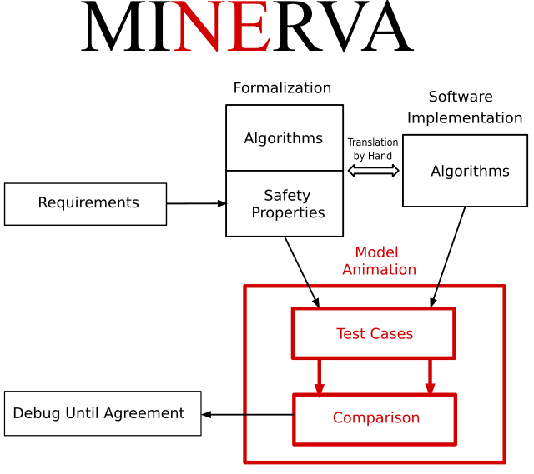
Numerically Evaluated
Verification
A method of testing for human error in translation and for numerical error in implementation
Build a collection of representative test cases
Evaluate cases using the formal model and the implementation
Compare the results

Slide 11
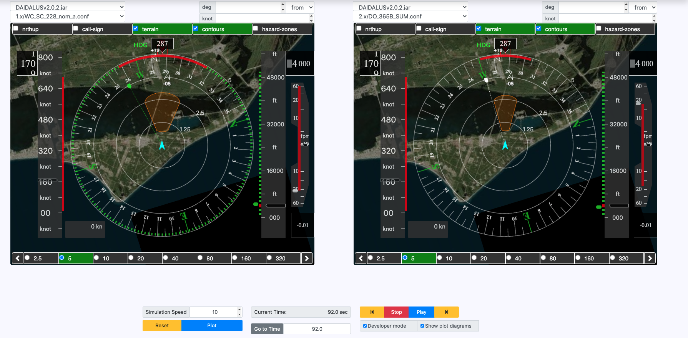
Real-time comparison
Developed a visual Co-simulation environment (DAA-Displays)
Real-time conformance checking of implementation vs. formal model
SME input and validation without specialized Formal Methods knowledge
Visualization allows simpler analysis of some data output

Slide 12
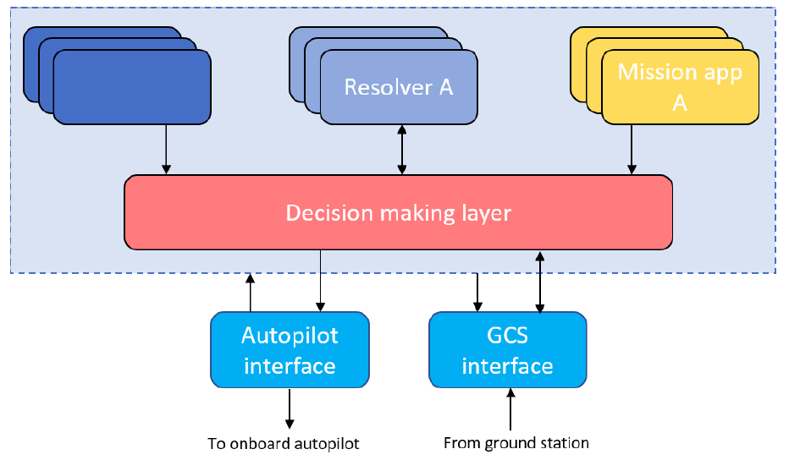
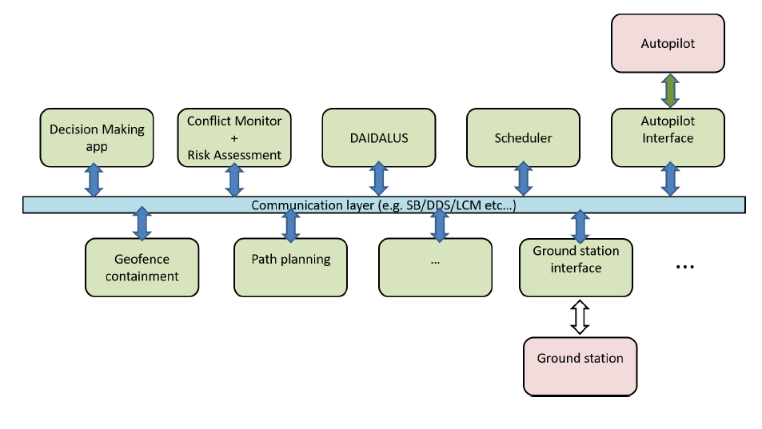
Architecturally:
Separate software modules, with extensibility
Some included modules have formal verification
Publish -- Subscribe communication
Built on NASA-pedigreed core Flight System platform
Detector A
Functionally:
Mission applications maintain and achieve goals
Detectors anticipate upcoming problems
Resolvers avoid problems discovered by detectors
Decision making layer negotiates and communicates

Slide 13
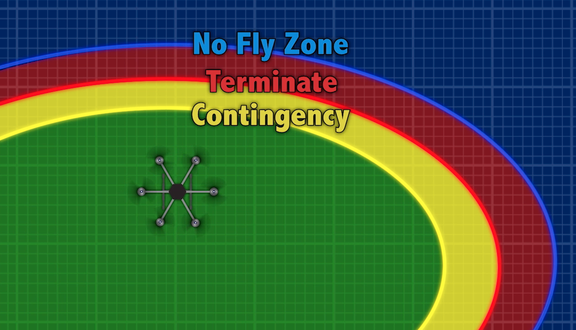
ICAROUS formal verification
Some ICAROUS modules have undergone formal verification in an interactive theorem prover (PVS)
Geofence visualization
DAIDALUS:
See previous slides…
Geofence Containment:
Default module is based on a formal development called PolyCARP
Same process as DAIDALUS for the implementation
Path Planning
Formal models specified
Some proven properties

Slide 14
ICAROUS formal verification
Immediate
Landing
Initiate
Hover
Loss of position
Some ICAROUS modules have undergone modeling as state machines and verification performed with model checkers (TLA+)
Geofence Breach
Monitor
DAA conflict OR Geofence conflict
Request
Reroute
Decision-making application:
Monitors current flight plan
Subscribes to DAA, Geofence and other modules to check for conflicts
Chooses action to take (e.g. send request to path planner for a new path)
Important that decision making doesn’t make things worse, and that a decision is made
Currently undergoing system modelling and verification using TLA+

Slide 15

ICAROUS formal verification
Overall system level interactions have been analyzed using model-checking (MAUDE) to perform reachability analysis
Interactions:
Specified states of several of the components of ICAROUS, and their interactions
Use the MAUDE model-checker to perform a reachability analysis
Discovered several reachable deadlocks (e.g., the FMS can enter a state awaiting a command that can’t be received)
Discovered other reachable undesirable states (e.g., autopilot AND remote pilot in control simultaneously)

Slide 16
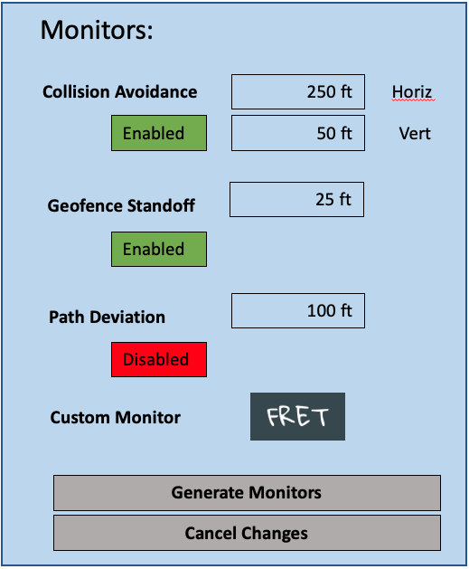
ICAROUS formal verification
Runtime Verification in ICAROUS:
Specify safety requirements at a system level, and monitors these properties externally, alerting the operator of violations
Runtime monitors in ICAROUS:
Developed a toolchain for simple specification (using FRET), translation into RV framework (Copilot), generation of C99 monitoring code
Automatic integration still in progress

Slide 17
Summary
and : A pair of NASA-developed systems for the safe operation of unmanned aircraft, with a research focus on the use of Formal Methods
Some of the Formal Methods employed:
Interactive Theorem-Provers: Used to specify algorithms and mathematically prove properties of them (PVS)
Conformance Verification: Makes sure the models and the implementation agree (MINERVA process, Co-Simulation)
Model Checking: (Usually) specify a state transition system, and verify properties of the system (MAUDE, TLA+)
Runtime Verification: Uses monitoring code to check that a system is performing as desired during runtime (Copilot)
The methods and tools above are only a taste of the variety of ways to do formal verification. All of them provide safety assurance beyond standard verification via testing. Try some yourself!

Slide 18
Links/references
DAIDALUS:
https://github.com/nasa/daidalus
César Muñoz et al, DAIDALUS: Detect and Avoid Alerting Logic for Unmanned Systems, Proceedings of the 34th Digital Avionics Systems Conference (DASC 2015), Prague, Czech Republic, 2015.
ICAROUS:
https://github.com/nasa/icarous
Swee Balachandran et al, Independent Configurable Architecture for Reliable Operation of Unmanned Systems with Distributed On-Board Services, Proceedings of the 37th Digital Avionics Systems Conference (DASC 2018), London, England, UK, 2018.
PVS: https://pvs.csl.sri.com/
DAA-Displays:
https://github.com/nasa/daa-displays
Model Checking
MAUDE : http://maude.cs.illinois.edu/tools/lmc/ TLA+ : https://lamport.azurewebsites.net/tla/tla.html
Marco Feliu et al, Verification-driven development of ICAROUS based on automatic reachability analysis: a preliminary case study, Proceedings of the 24th International SPIN Symposium on Model Checking of Software, July 2017
Runtime Verification
Copilot: https://copilot-language.github.io/
Aaron Dutle et al, From Requirements to Autonomous Flight: An Overview of the Monitoring ICAROUS Project, Proceedings of the Second Workshop on Formal Methods for Autonomous Systems (FMAS 2020)

