Slide 1


Summer 2021 Student Showcase
Libby Carso
Mentor: Rob Whited
LSP Strength & Fatigue/Fracture Mechanics Group

Slide 2
About Me
University of Wisconsin - Madison
  B.S. Aerospace Engineering
  B.S. Atmospheric & Oceanic Science
Strength & Fatigue/Fracture Mechanics Group of NASA’s Launch Services Program
  2nd Rotation as a Pathways intern

Slide 3
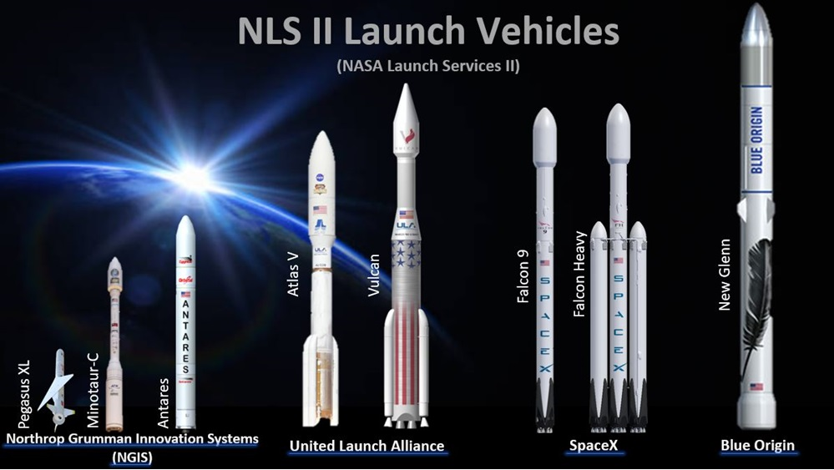
LSP Strength & Fracture Mechanics Group
NASA’s Launch Services Program (LSP) is responsible for launching uncrewed commercial rockets carrying NASA missions
LSP’s Flight Analysis Division independently verifies launch vehicle analysis to ensure successful missions
[1]
The Strength & Fatigue/Fracture Mechanics Group focuses specifically on structural, fatigue, & fracture analyses

Slide 4
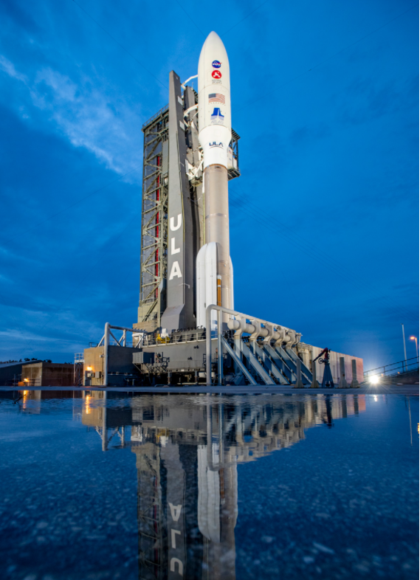
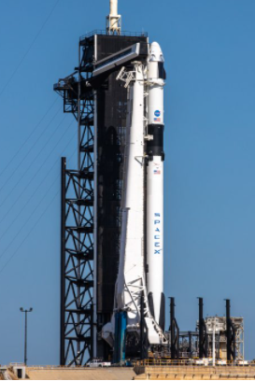
LSP Work Assignments
Divided my work in LSP into two categories:
  Pathways project
  Additional Work – 3 Engineering Review Summaries (ERS’s)
Worked with my mentor through the analysis process for secondary structures on ULA’s Atlas V and SpaceX’s Falcon 9
Created charts that were presented by my mentor to other disciplines and head engineers in LSP
ULA’s Atlas V
SpaceX’s Falcon 9
[2]
[3]

Slide 5
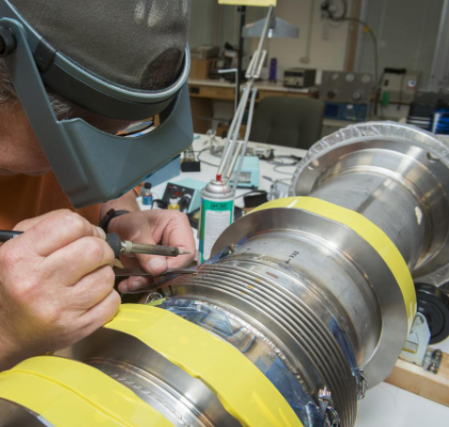
Project Background
Ultimate Project Goal: Design a finite element model that simulates bellows forming and calculates residual stress
Bellows: Typically used in piping systems to account for changes in temperature and pressure
Stages of Hydroforming Bellows
Hollow Cylinder
Internal Pressure
Bulging Forms Convolutions
[4]
Residual stress is created in the metal when bellows are formed
  Goal of project is to simulate this process & quantify these stresses

Slide 6
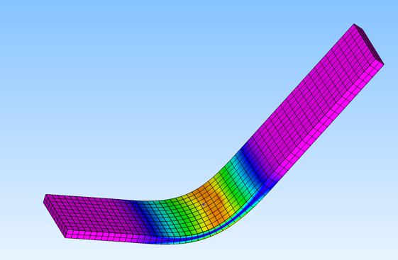
Pathways Project
Pathways project was to create and validate a finite element model that simulates sheet metal forming
Finite element models simulate how structures behave under certain conditions
Simplified shapes were chosen so that the model could be validated through hand calculations
[5]

Slide 7
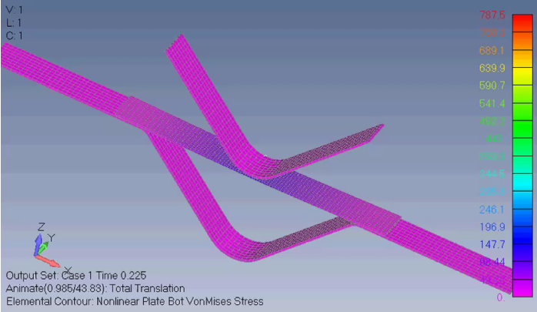
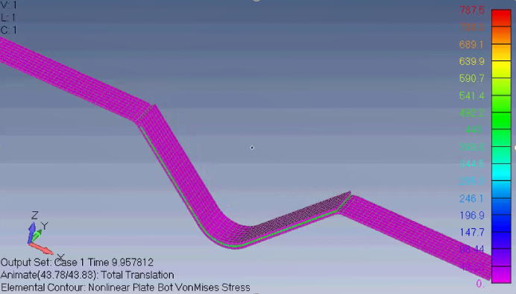
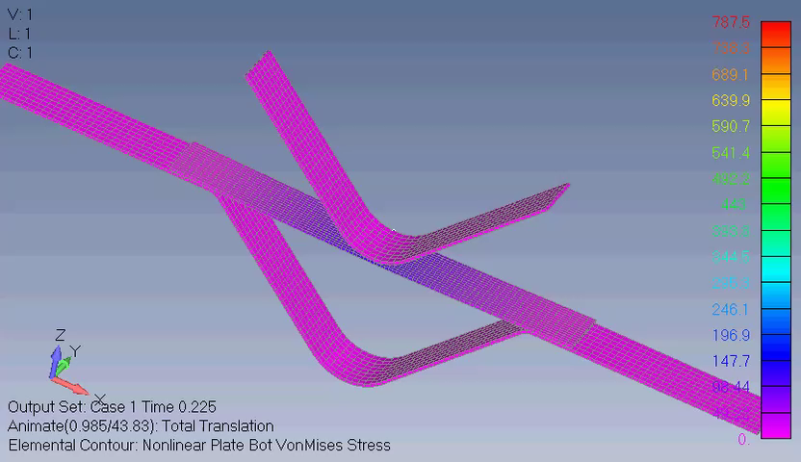
Project Results
Punch and Die Bending Model
Animation
[6]

Slide 8
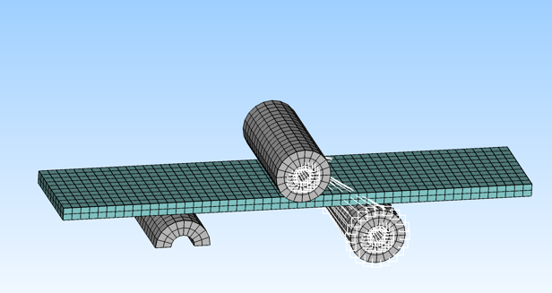
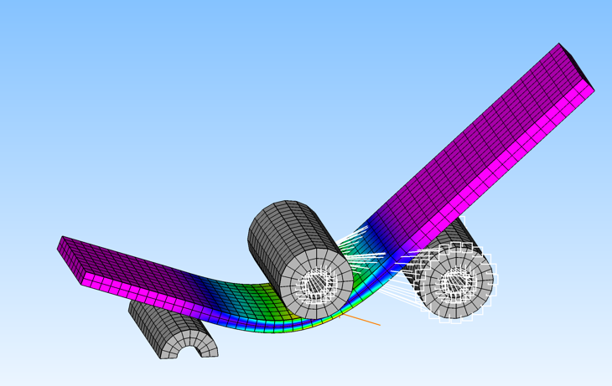
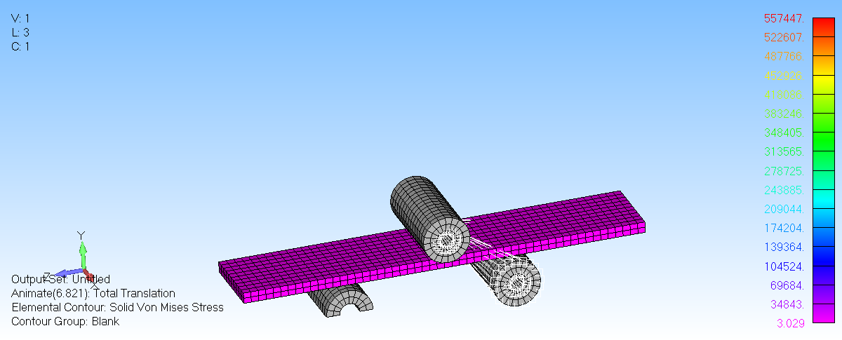
Project Results
Roll Bending Model
Animation
[7]

Slide 9
Future Work
Continue improving current models and working with mentor on additional work
Continuation of project into ATP:
  Possibly do a physical experiment to validate current sheet metal bending models
  Apply knowledge from Pathways project to create a bellows forming model that calculates residual stress
My Takeaways
  Combining my knowledge from my coursework and skills from previous rotation into project
  Thank you to my mentor, Rob Whited, Karl Thal, Vipul Patel and the LSP Strength Team for a great experience!

Slide 10
Image Citations
[1-4] https://images.nasa.gov/
[5-7] Images by Author

