Slide 1
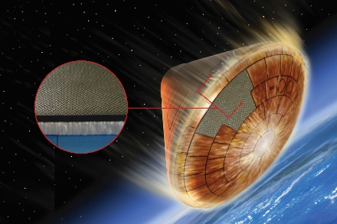
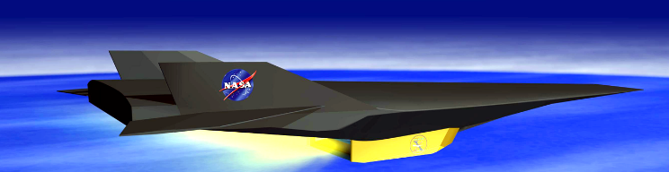
OCE Engineering Research & Analysis Program
Hot Structure Concepts and Materials for Space Exploration Project
Sandra P. Walker, Structural Mechanics and Concepts Branch
and
Kristopher E. Wise, Advanced Materials and Processing Branch
NASA Langley Research Center
July 29, 2021

Slide 2

Background
State-of-the-Art Thermal Protection System (TPS)
Ablative TPS material
Not reusable
Relatively thick TPS
TPS bonded to underlying carry structure
TPS is brittle - no load carrying capability
TPS has been manufactured in tiles due to its brittle nature
Carbon-Carbon (C/C) Hot Structure Capability
Can be reusable for some applications - heat flux conditions
More dimensionally stable and lower volume requirements
Structural material - can carry large loads at high temperatures
Potential to provide lighter weight, integrated TPS/structure solution with reduced manufacturing/fabrication time/cost
Shortcomings: large material variability and low interlaminar tension (ILT) and shear (ILS) strength
Mars Science Laboratory Heat Shield
Notes:
Engineering R&A Goals- Initiative seeks to restore NASA’s investments in basic engineering capabilities in targeted critical areas of discipline-based basic engineering research

Slide 3

Hot Structure Project Overview
Goal: Deliver advanced knowledge and capability towards developing lightweight, reusable, and dimensionally stable hot structures concepts to enable advanced space exploration missions.
Focus: Improving 2D C/C material system
Two-fold Approach: Improve the performance of hot structures by advancing the computational design of C/C materials and by improving the fundamental understanding of thermal stress response in hot structure concepts
Potential Applications:
Hot Structure Heatshield
Hypersonic Cruise Vehicle
Develop Computational Tools for Modeling the Fabrication Process - make better 2D C/C material – lower variability
Thermal-Structural Concept Development
- make better C/C structures – improve ILT and ILS response
Nozzle Extension
Project Duration: April 8 to Sept 30, 2020 (~ 6 months)
Notes:
Engineering R&A Goals- Initiative seeks to restore NASA’s investments in basic engineering capabilities in targeted critical areas of discipline-based basic engineering research

Slide 4
Team Membership
Name | Role | Organization
Core Team
Sandra Walker | Project Lead | NASA Langley Research Center
Kris Wise | Computational Tools Lead | NASA Langley Research Center
James Smith | Damage Modeling/Analysis | NASA Johnson Space Center
Carl Poteet | Thermal-Structural Analyst | NASA Langley Research Center
Lauren Raffanello | Thermal-Structural Analyst | NASA Langley Research Center
Andrew Lovejoy | Fabrication/Testing | NASA Langley Research Center
Ronald Kreuger | Damage Mechanics/Analyst | NIA Research Fellow
Jacob Gissinger | Material Modeling/Fluid Dynamics | NASA Postdoctoral Program Fellow
Consultants/Partners
Stan Bouslog | Thermal Structures Consultant | NASA Johnson Space Center
Steve Rickman | Project/Thermal Consultant | NASA Johnson Space Center
Wally Vaughn | C/C Material System Consultant | NASA Langley Research Center
James Ratcliffe | Damage Testing Consultant | NASA Langley Research Center
David Glass | C/C Materials Consultant | NASA Langley Research Center
Business Management
Pam Throckmorton | Budget | NASA Langley Research Center
Notes:
8 core team members – who contributed on the project
Then there were also five consulting team members

Slide 5
Computational Tools for Modeling the Fabrication Process *
Effort focused on developing and applying modeling approaches to help reduce manufacturing time and cost while improving part quality and performance
Examples of problems to be addressed:
Number of infusion/carbonization cycles required to reach full density
Matrix resin char yield, structure and connectivity of porosity
Post-production machining required to correct geometric defects
Residual stresses and their dependence on thermal history
Intra and interlayer, fiber/matrix interface, etc.
Coating compatibility and adhesion for certain applications
Nuclear Thermal Propulsion, rocket nozzle extensions, leading edges
* POC: Kris Wise, Computational Tools Lead

Slide 6
Computational Tools for Modeling the Fabrication Process
Approach: Leverage in-house modeling and experimental capabilities along with external collaborations to develop a multiscale understanding of the material system
In-house modeling capabilities
Quantum mechanical modeling (reactions, properties)
Small systems, short times, high accuracy
Classical molecular dynamics (MD) simulations
Much larger systems and times, accuracy dependent on parameterization
Reactive MD simulations
Similar to classical MD, but incorporates chemical reactivity
Micromechanics and Finite Element Model (FEM)-based fracture mechanics
Covered later in talk
In-house experimental capabilities: Resin synthesis, composite fabrication, carbonization, structural characterization and mechanical testing

Slide 7
Overview of Process Modeling Plans
Variables to consider:
Matrix precursor chemistry
Preform structure
Cure/pyrolysis conditions
Infusion parameters (P, T)
Etc…
Develop Computational Fluid Dynamic (CFD) model for matrix precursor flow into representative fiber preform structure
Improve CFD model by capturing the effect of stepwise progression of carbon matrix formation within the fiber preform
Starting matrix preform structure
Matrix precursor infusion
Polymer cure and pyrolysis
Predict structure and properties of final composite
Adapt REACTER tool to model pyrolysis process for selected precursor chemistry in classical MD simulations
Demonstrate ability to predict structure and morphology of pyrolysis product, both in isolation and in presence of fiber surface
Develop coarse grained representation of initiation and growth of carbon matrix on and between fibers
Green text: goals for first year

Slide 8
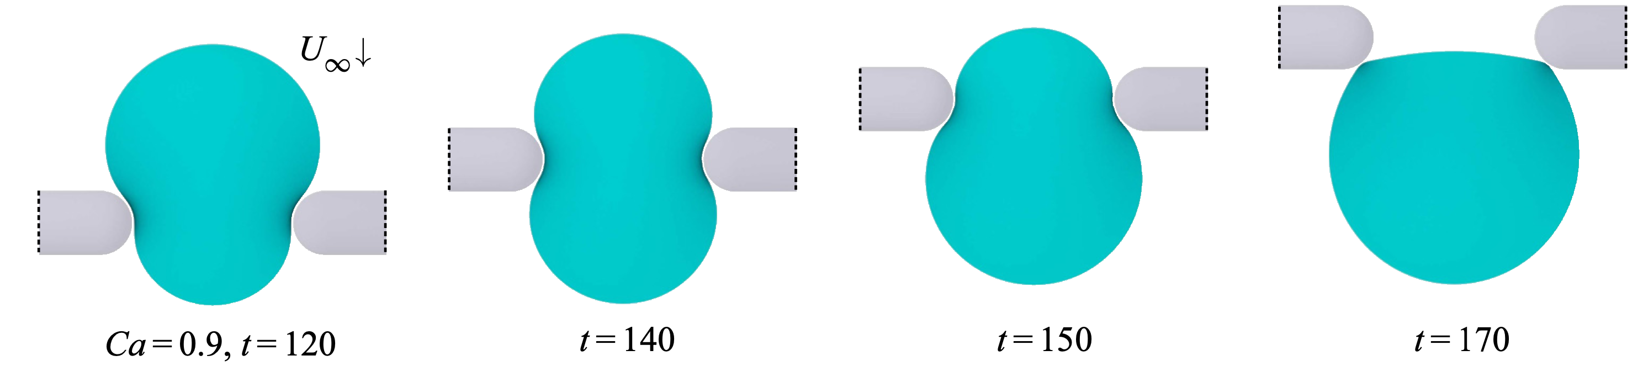
Matrix Precursor Infusion Modeling
Example of two-phase flow through fibrous material using BIM
U∞ : Far-field flow velocity, Ca : Capillary number, t : Simulation time (L/|U∞|)
The boundary integral method (BIM) is a highly accurate but computationally expensive method for modeling multiphase flow
The interface (and only the interface) between two fluids is discretized with a mesh
A graph neural network may lend itself to training on BIM data (a mesh is a graph)
A graph-convolutional network may be able to accurately simulate flow through fibrous media, such as woven carbon fiber, at a fraction of the computational cost
BIM model has been demonstrated, machine learning element is still in the very early stages

Slide 9
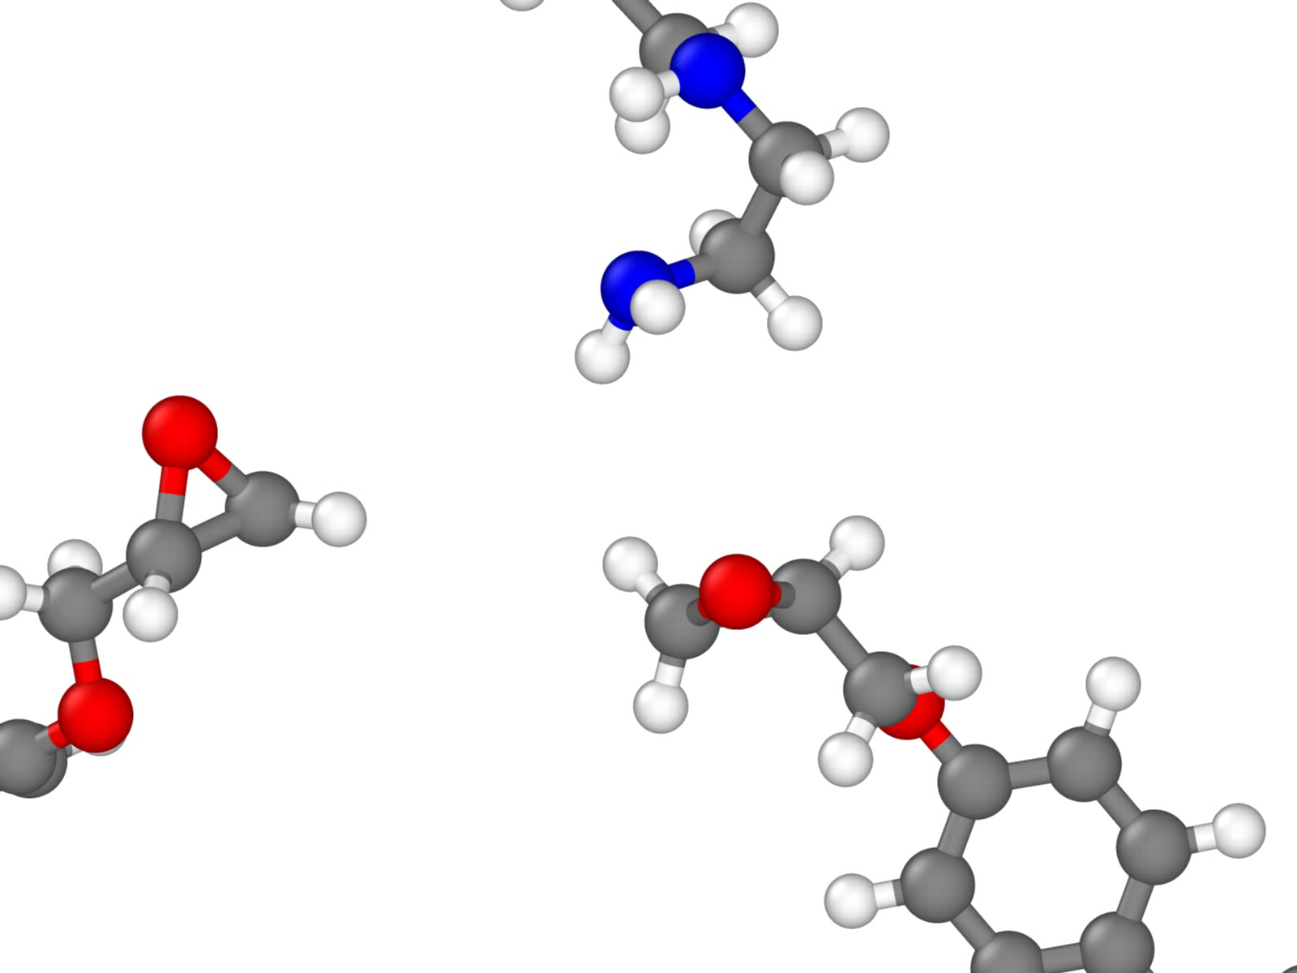
Polymer Cure and Pyrolysis
Method Development: REACTER
Collection of new tools for adjusting topology during classical Molecular Dynamics (MD)
Adding/removing specific bonds, angles, dihedrals, and impropers
Modifying all force field types as well as atomic charges
Stabilizing system energy after topology change
Support for any fixed-valence force field (PCFF, OPLS, etc.)
Parallel implementation in LAMMPS MD package as fix bond/react
Required user input
Templates of pre- and post-reaction topologies
A map file relating atoms before and after the reaction
Epoxy Crosslinking Reaction
Gissinger, Jensen & Wise. Macromolecules 53, 22, 9953–9961 (2020).
www.reactor.org

Slide 10
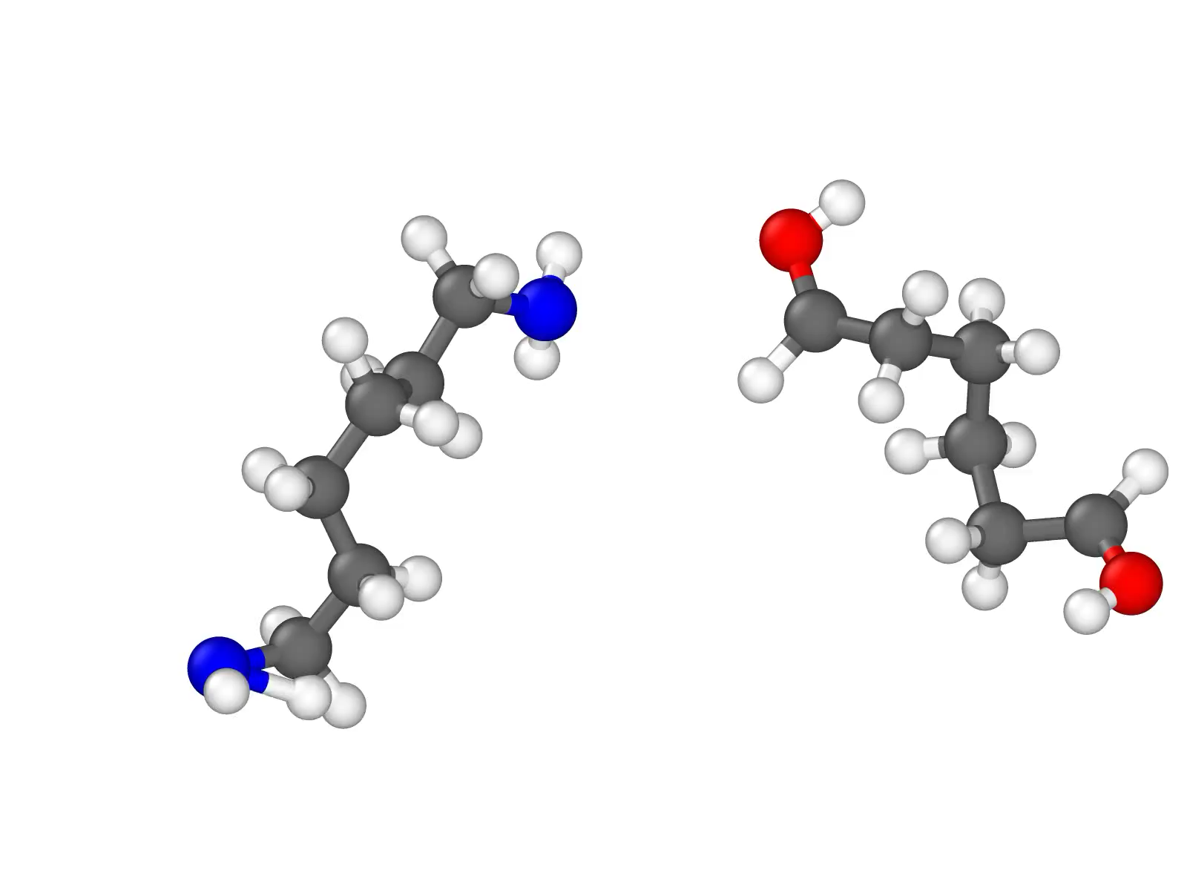
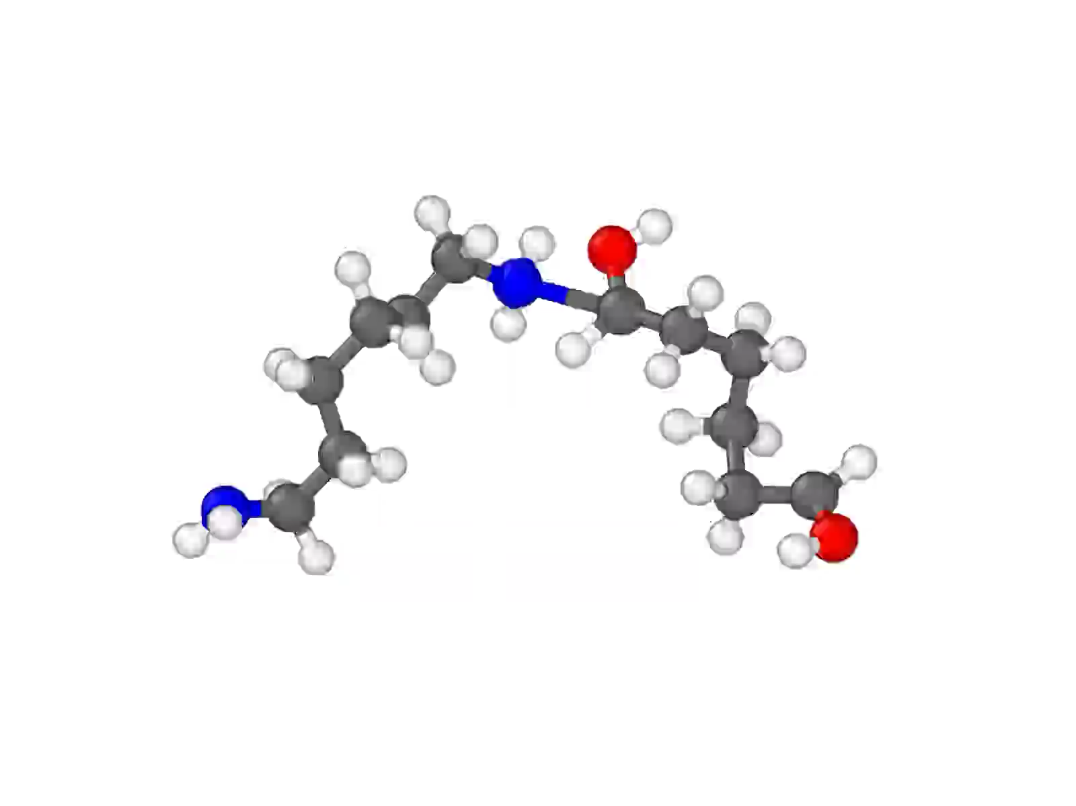
Polymer Cure and Pyrolysis
Method Development: REACTER
Other Useful Features:
Deleting reaction byproducts
Water molecules in condensation reactions
Gas phase byproducts in carbonization
Simulating bond scission reactions
Mechanical failure in polymers and composites
Computation performance is essentially the same as classical MD, no QM required!
Deletion of Reaction Byproducts
Modeling Bond Scission Reactions

Slide 11
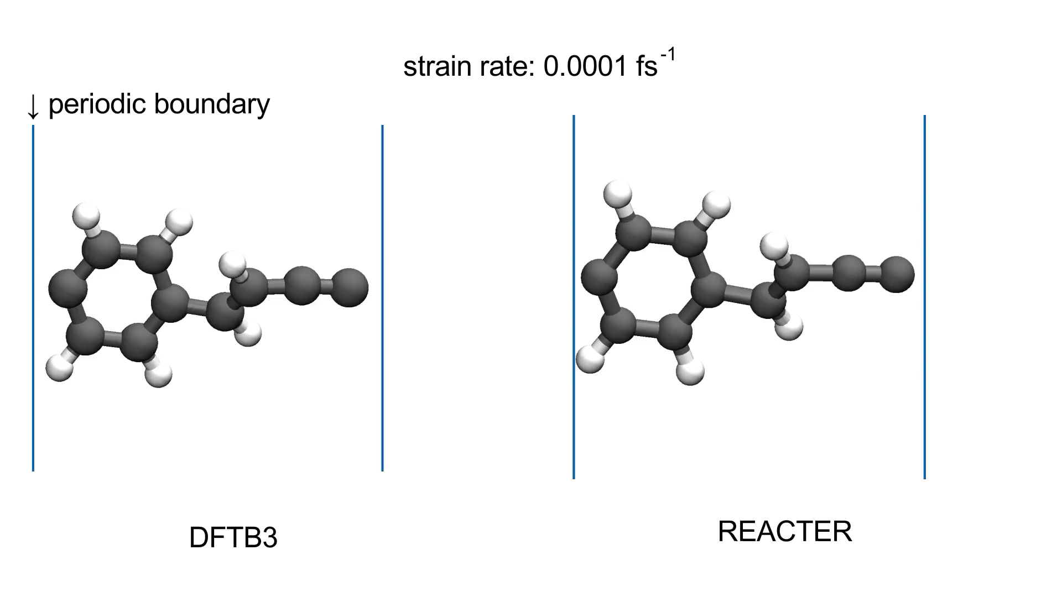
Polymer Cure and Pyrolysis
Method Development: REACTER
Quantum-informed Reaction Constraints
Potential energy constraint allows REACTER to replicate quantum-accurate bond breaking
Will be applied to ultimate strength calculations of thermosets and composites

Slide 12
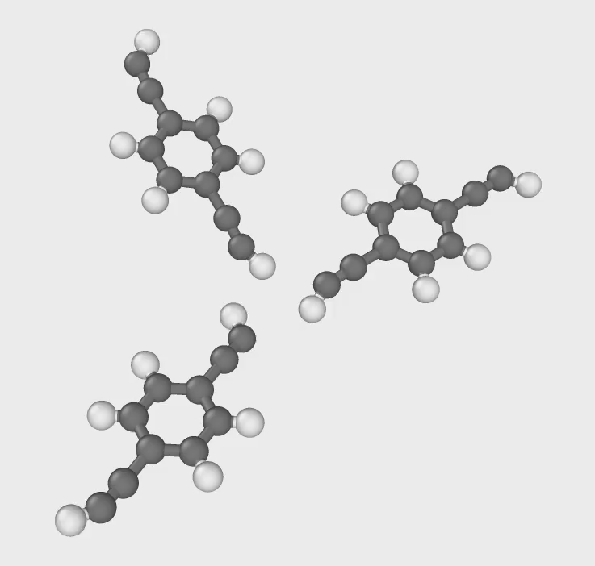
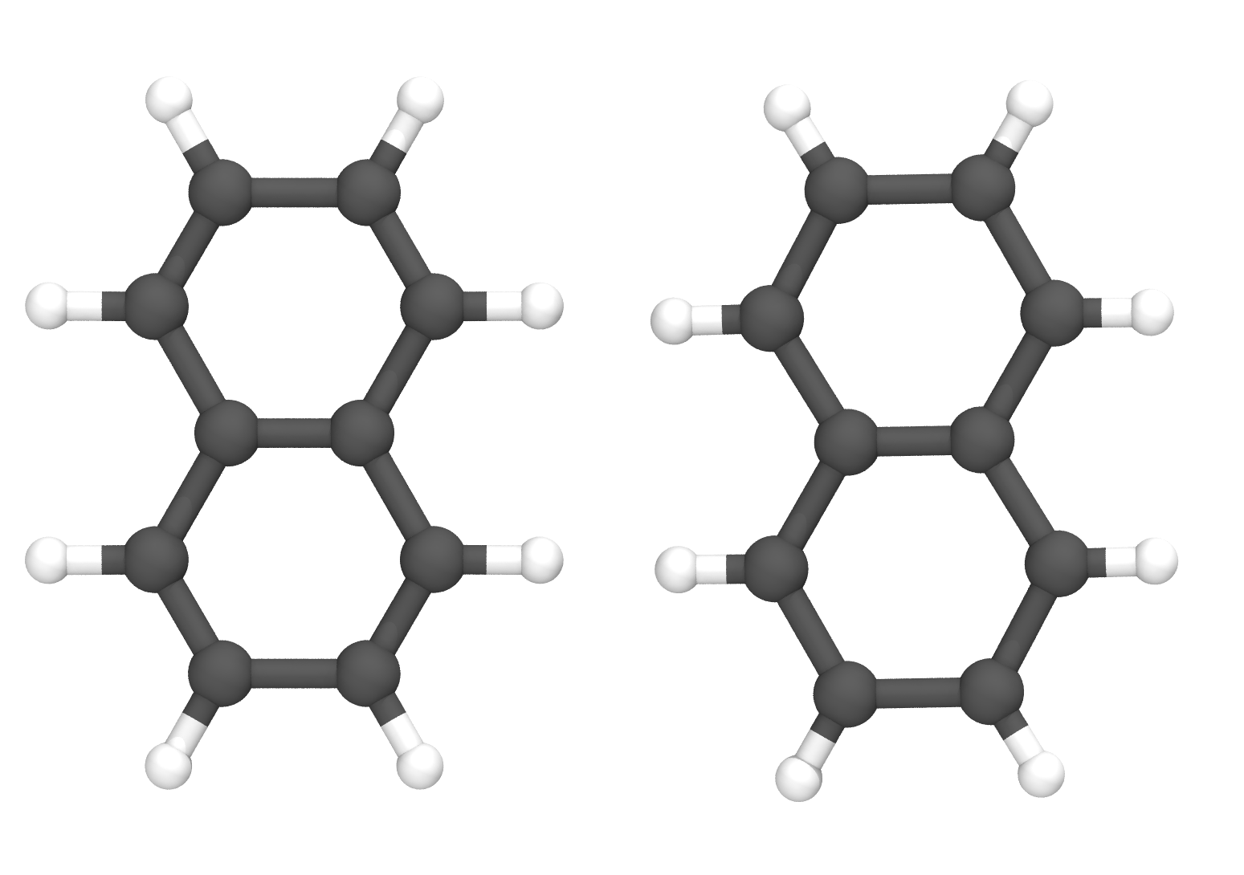
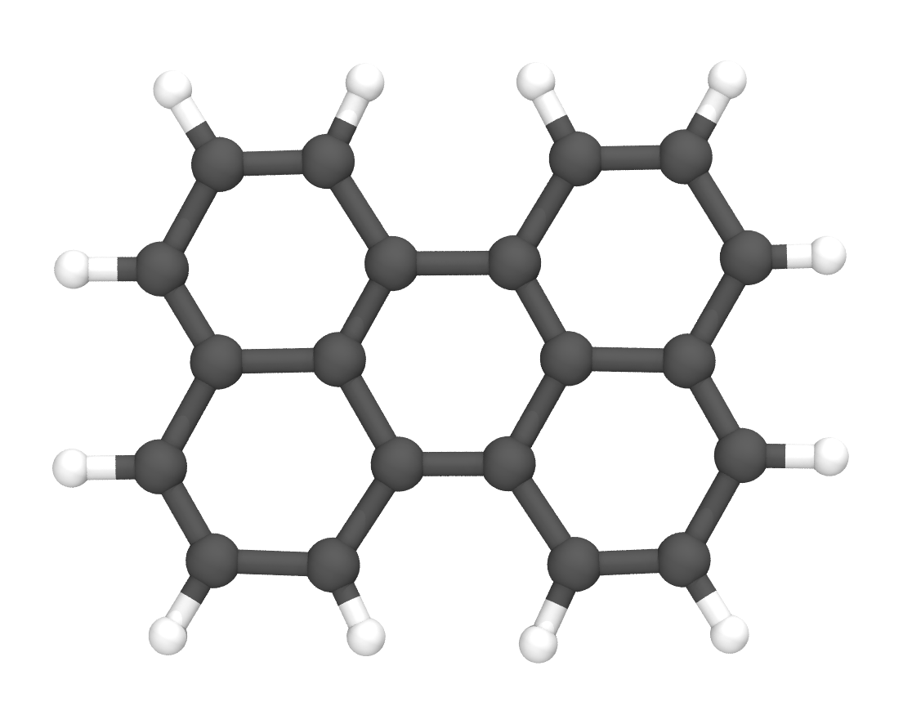
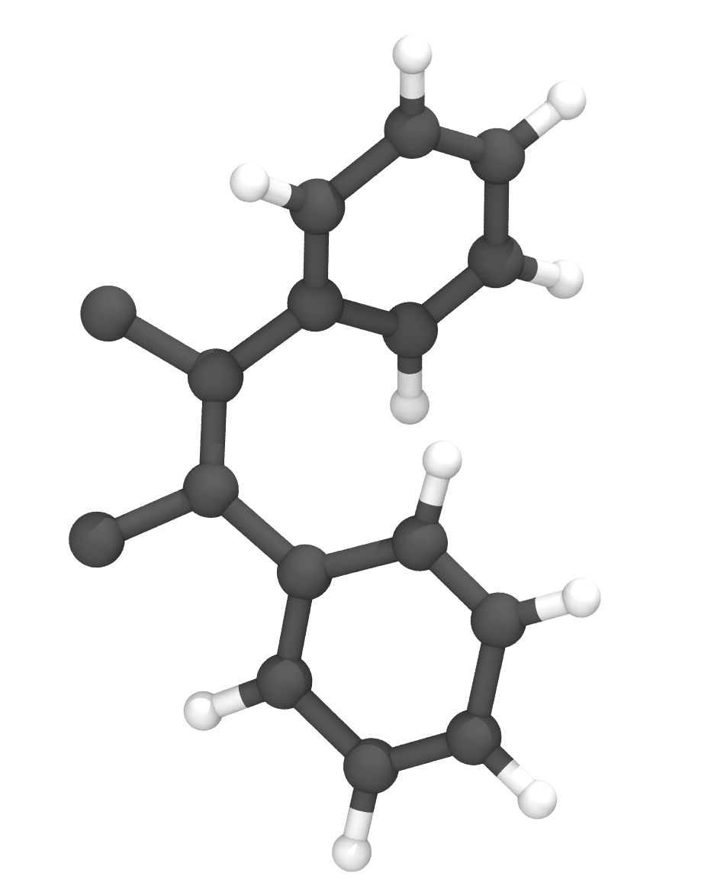
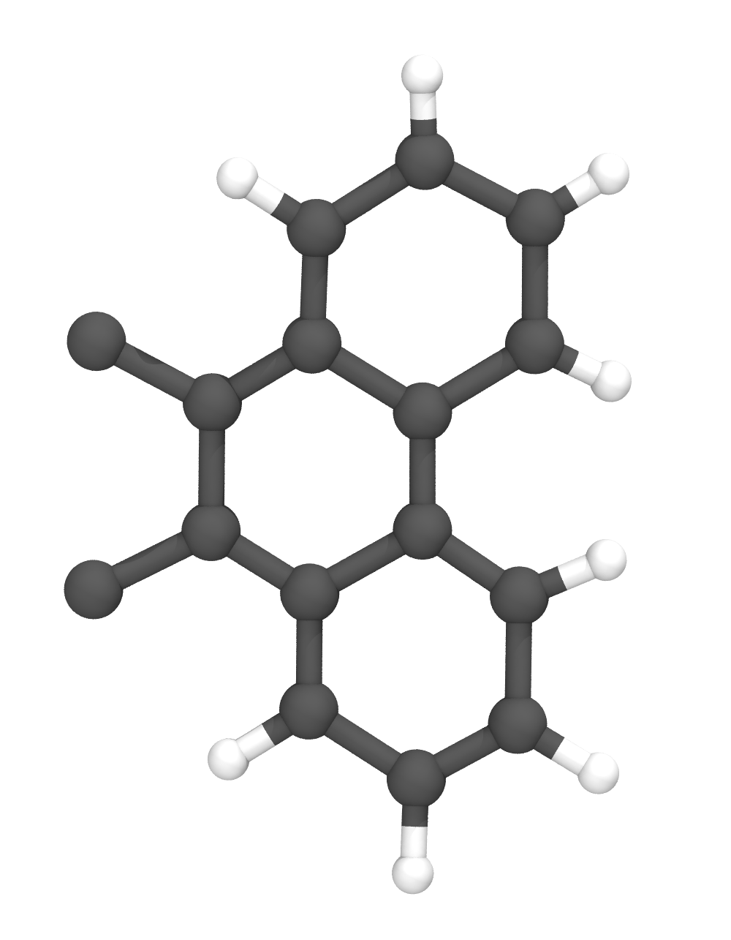
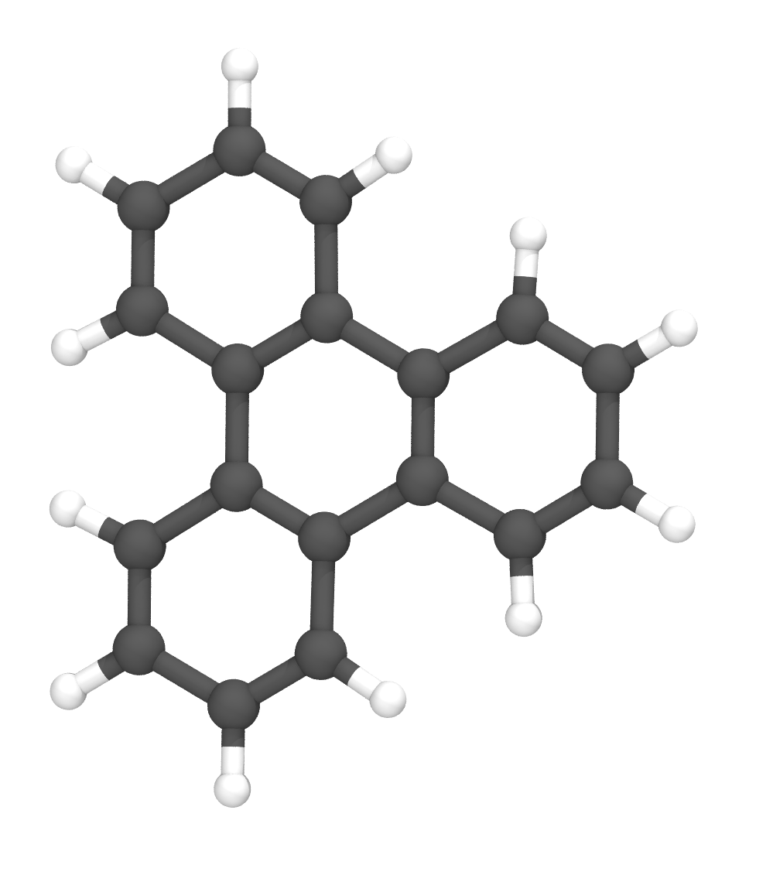
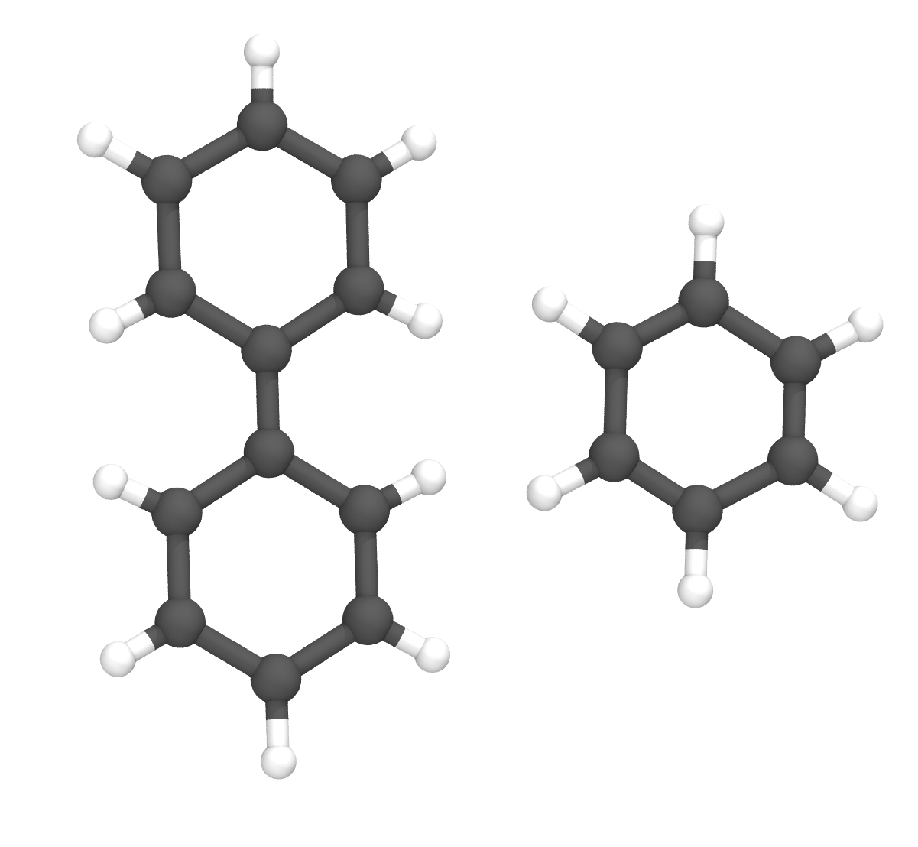
Polymer Cure and Pyrolysis
Polymerization/Carbonization of polyarylacetylene (PAA)
Diethynylbenzene polymerized via linear and cyclotrimerization reactions
PAA cyclotrimerization reaction
Carbonization moves

Slide 13
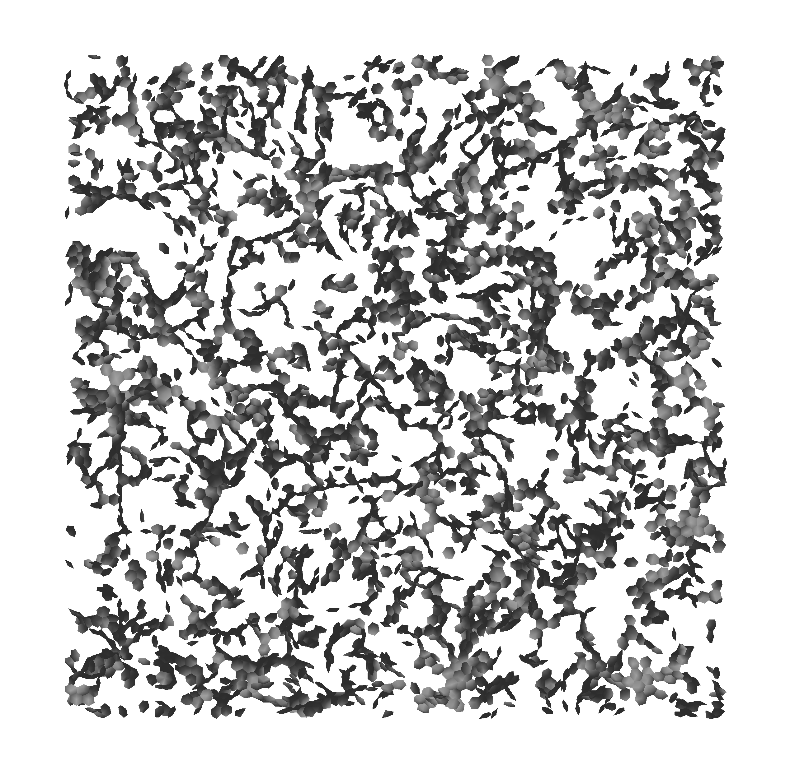
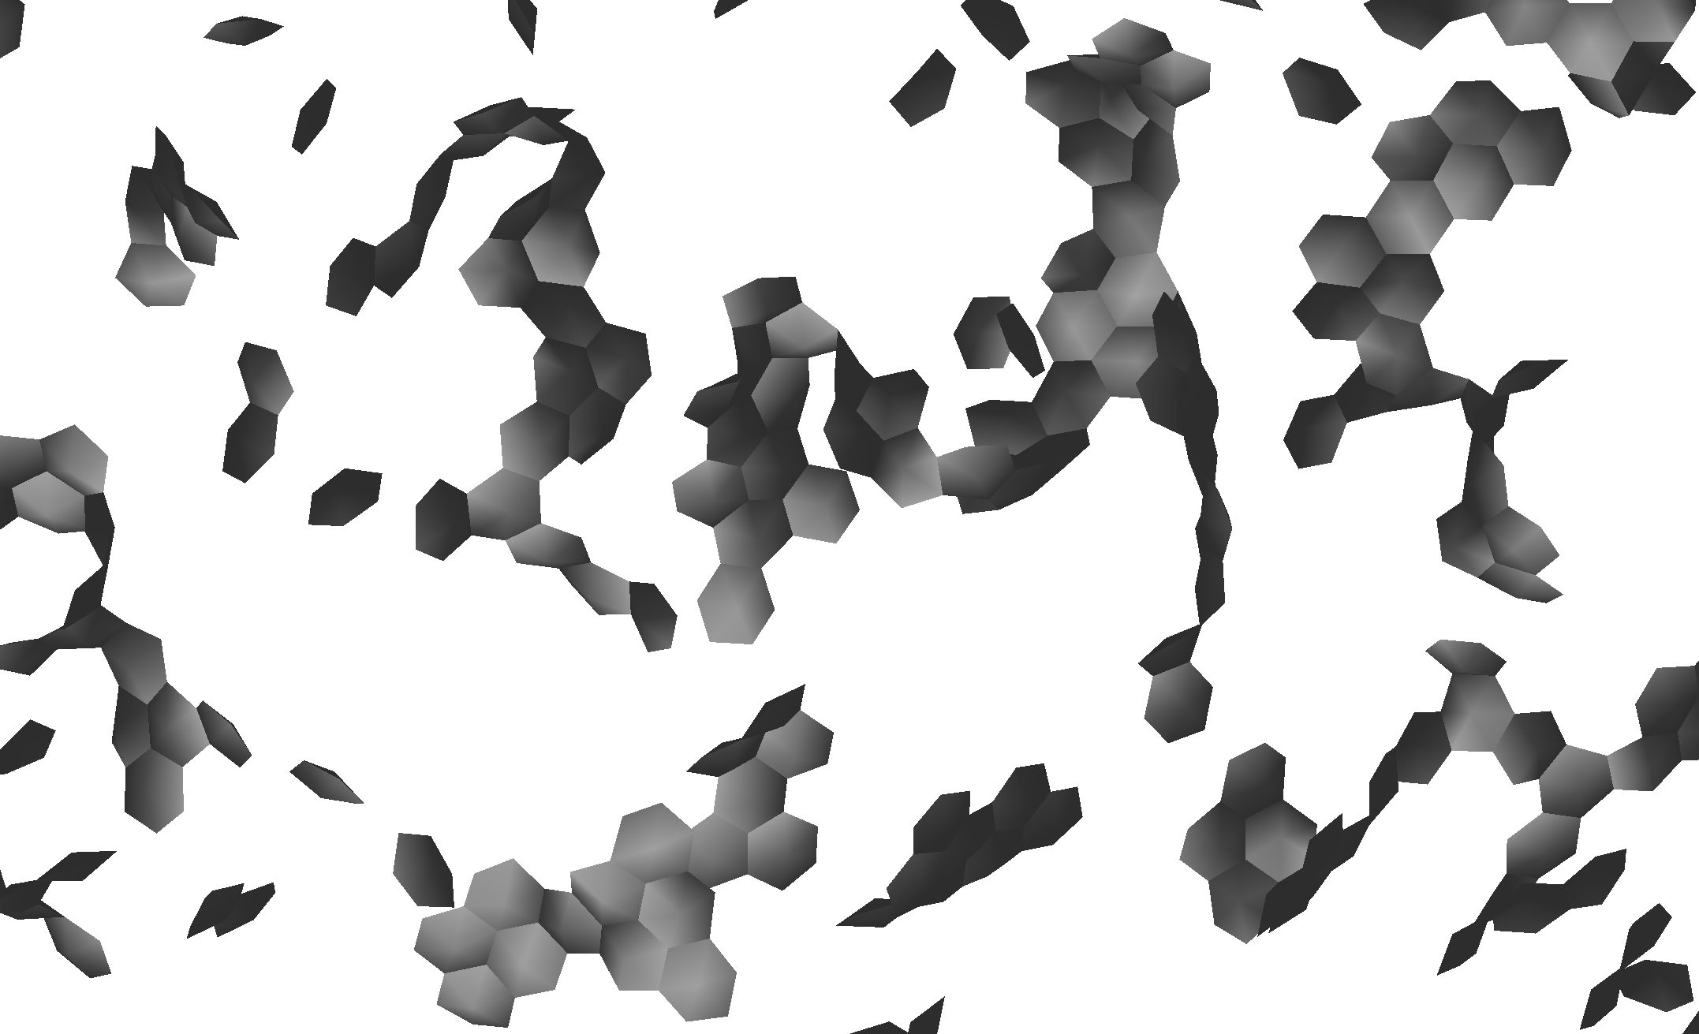
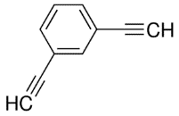

Polymer Cure and Pyrolysis
Nano-ribbon Formation in polyarylacetylene (PAA)
After ~99% polymerization and ~14.5K carbonization reactions
Partially graphitized structure can be starting point for later-stage graphitization simulations
Slice is 7 Å thick; only rings shown
Density: 1.0 g/cm³
Box Size: (13.8 nm)³
1:1 Ratio

Slide 14
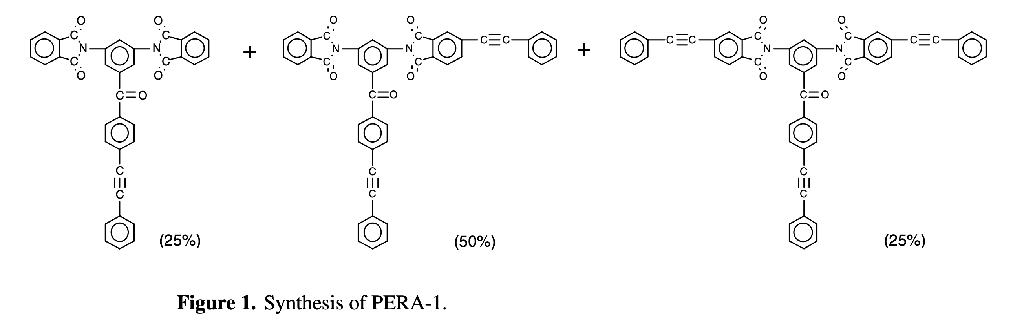
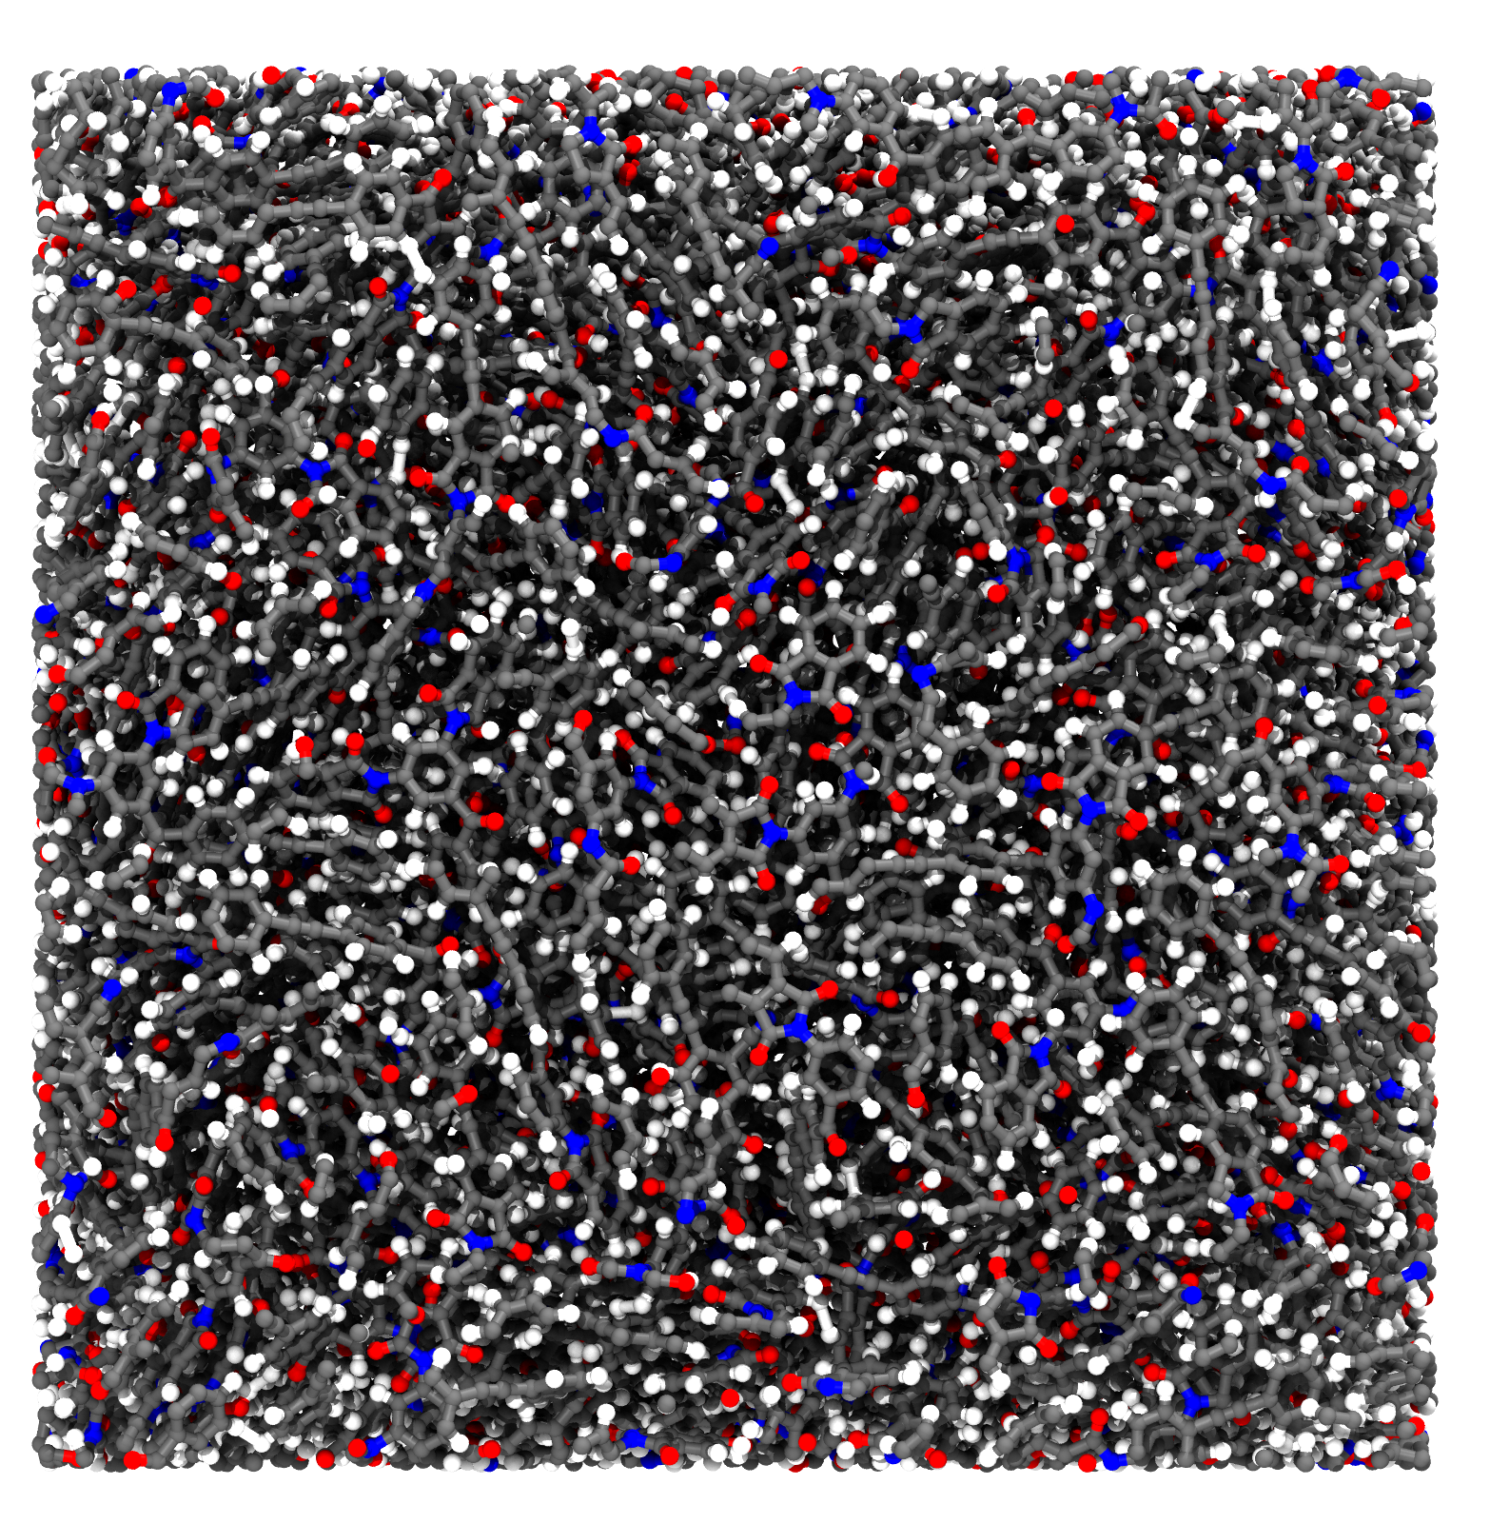
Polymer Cure and Pyrolysis
Polymerization/Carbonization of PERA-1
During carbonization simulation, small molecules are deleted
Shifts reaction in favor of carbonization
Average bond orders used to determine species (molecule type)
Feature added to LAMMPS’ ReaxFF implementation
Temperature Ramp Cycle:
300K → 3000K at 10 K/ps
Hold at 3000K for 270 ps
3000K → 300K at 10 K/ps
6.7 nm
32K atoms/416 molecules
Density: 1.5-1.8 g/cm³
Box Size: (6.7 nm)³
Connell, J. W., Smith Jr, J. G., Hergenrother, P. M., & Rommel, M. L. (2000). Neat resin, adhesive and composite properties of reactive additive/PETI-5 blends. High performance polymers, 12(2), 323-334.

Slide 15
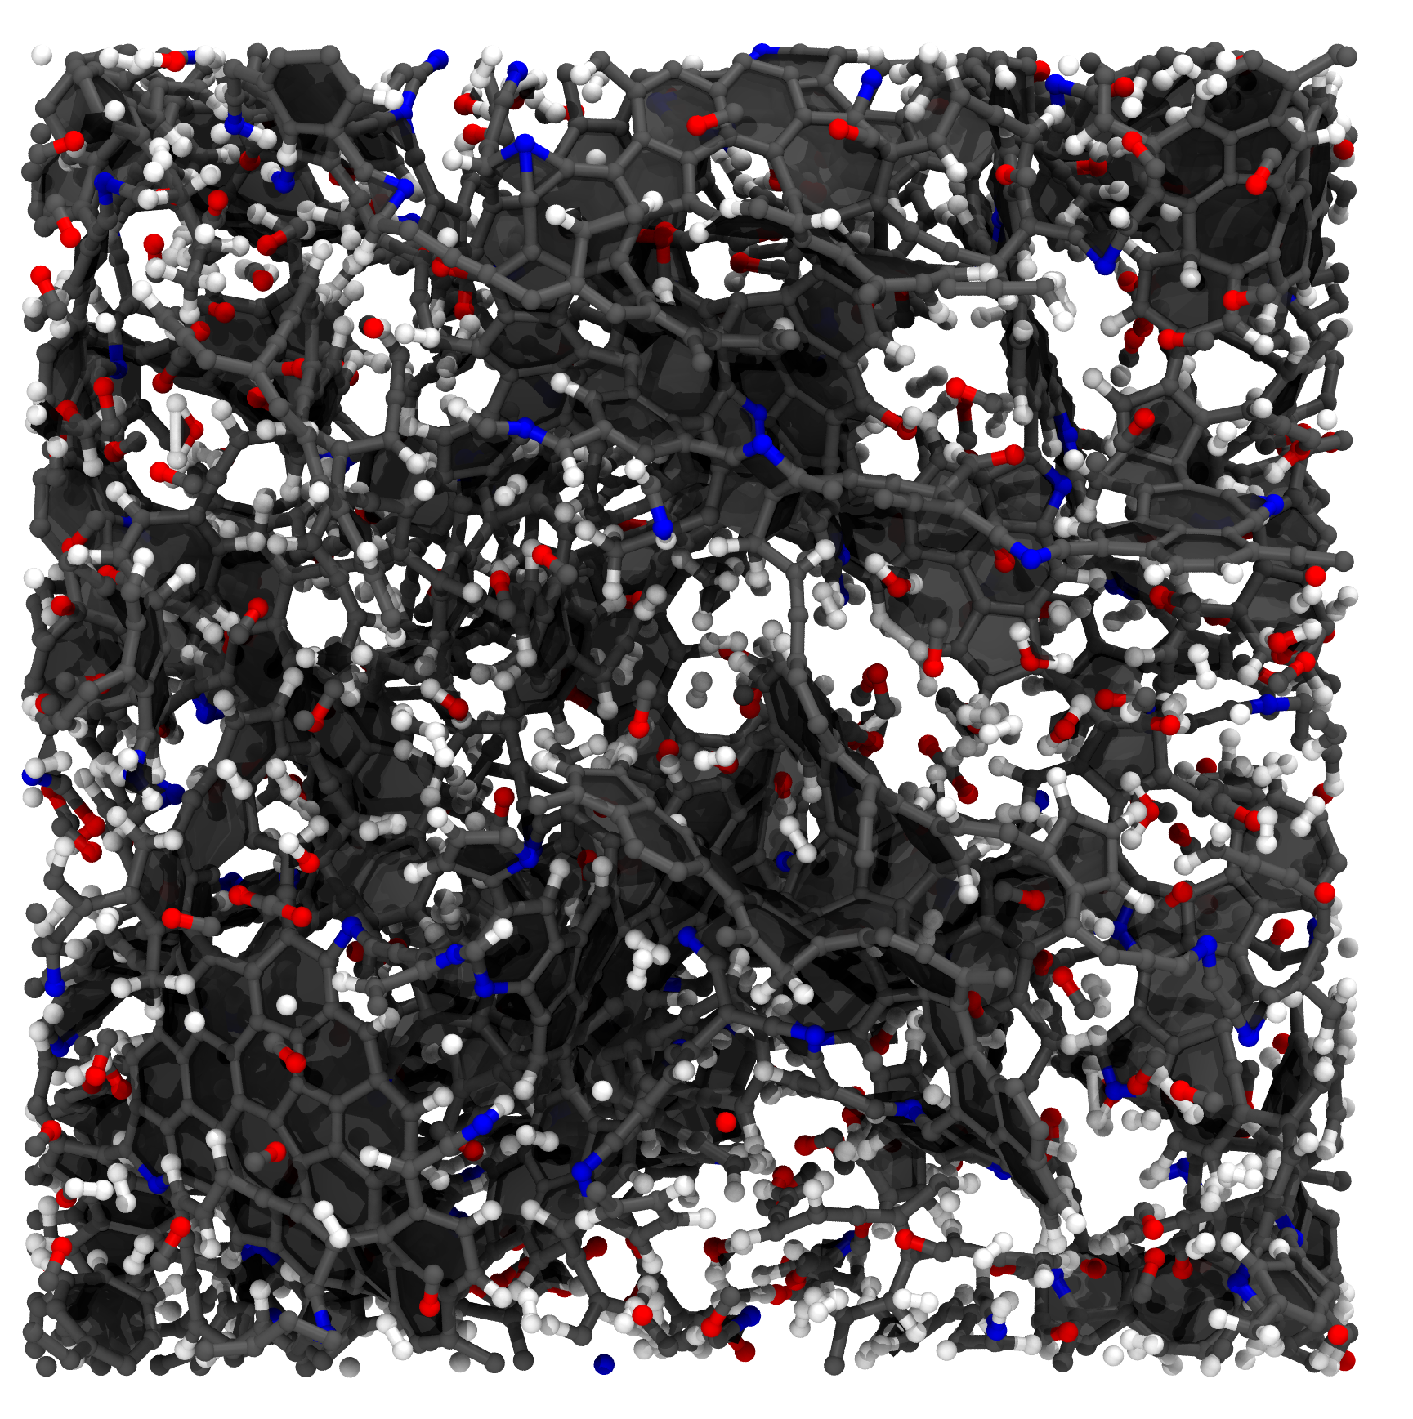
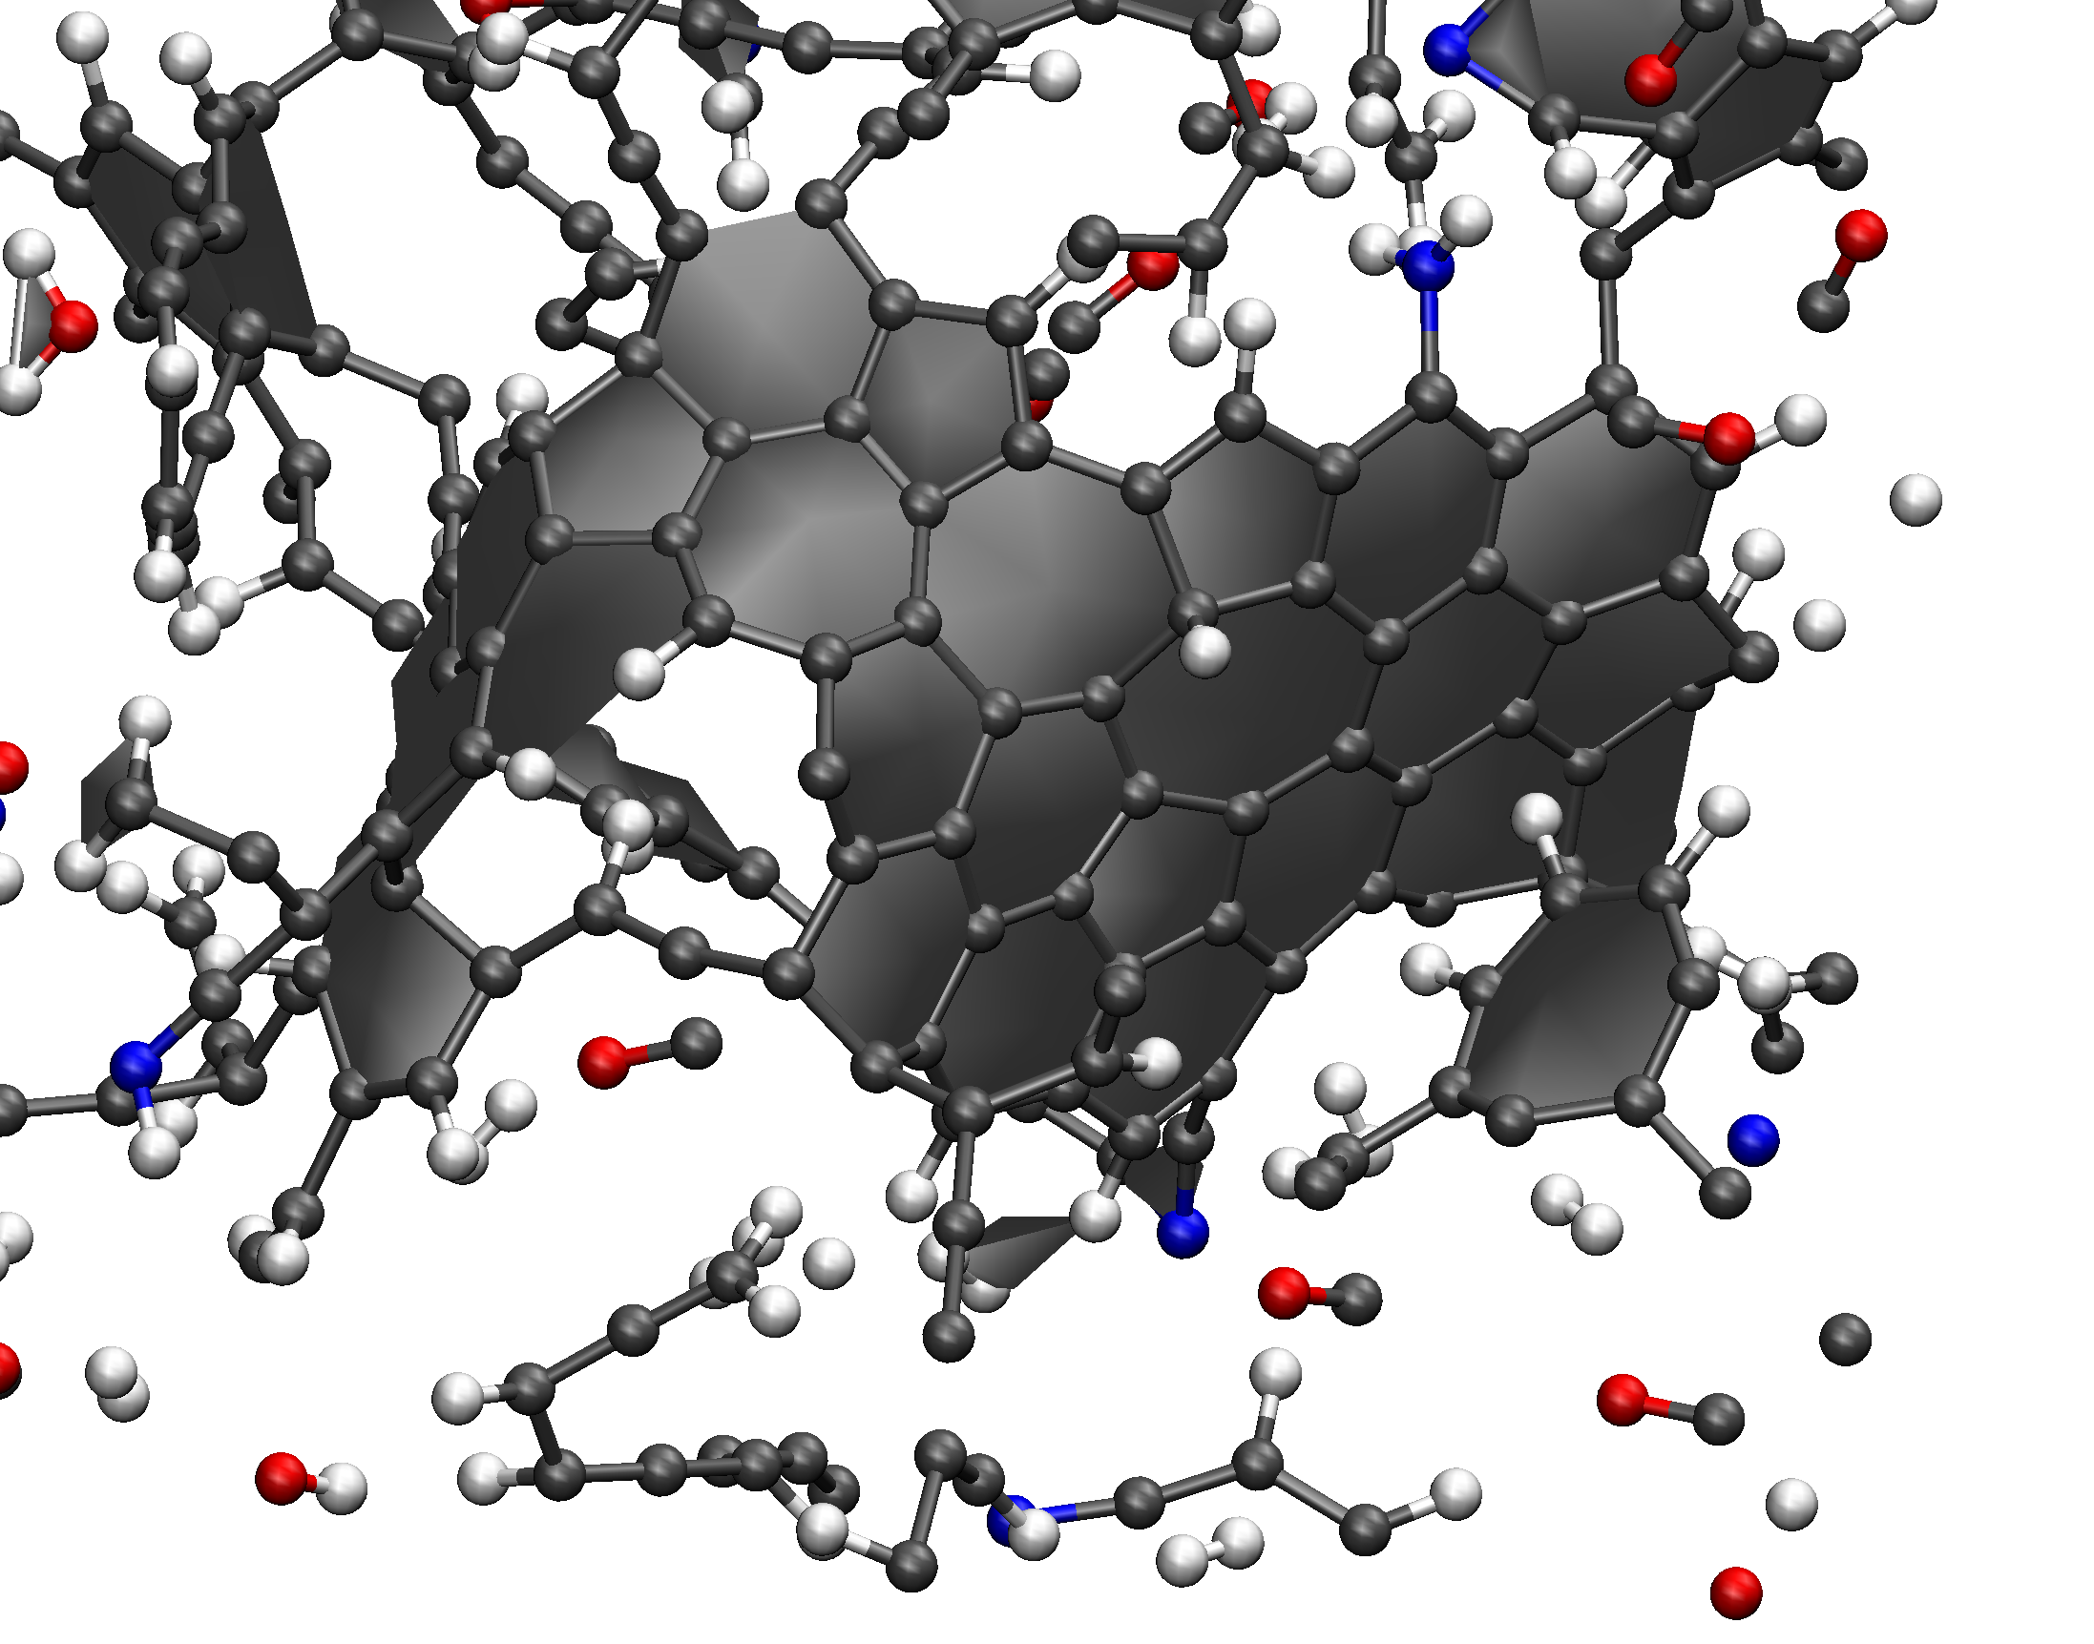
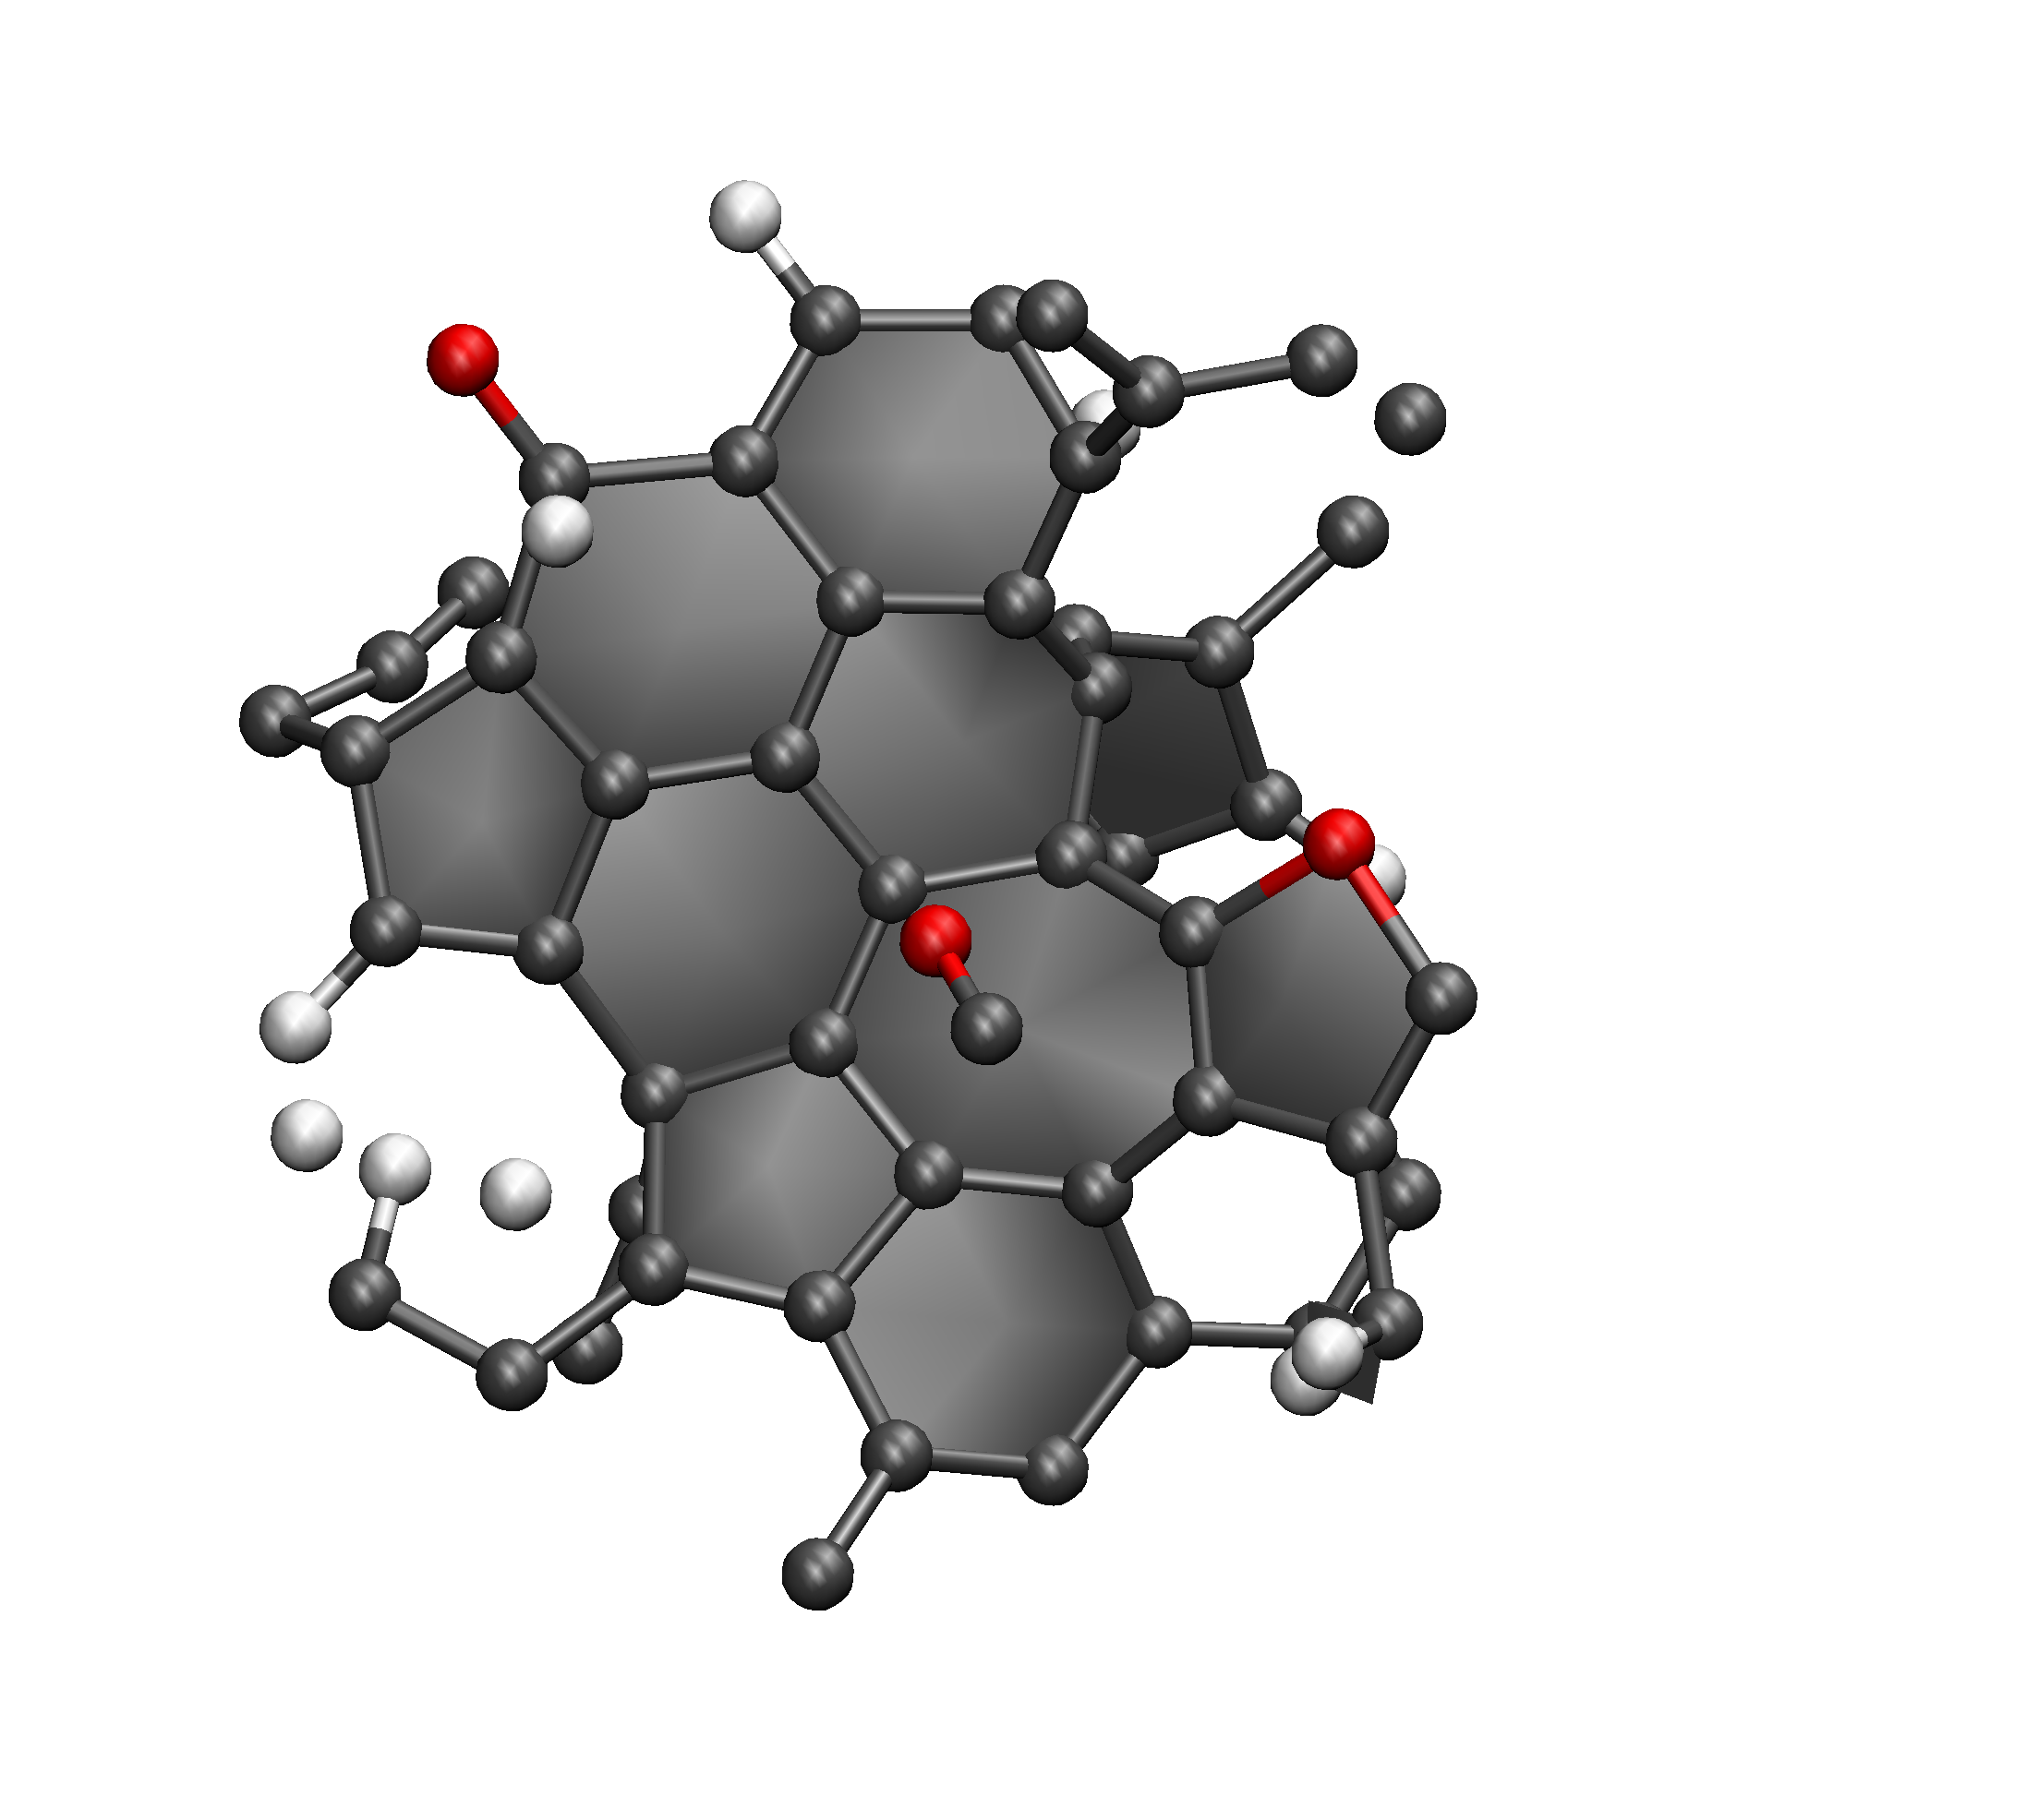
Polymer Cure and Pyrolysis
PERA-1 Carbonized Structures
Fused 5, 6, and 7-membered rings form at onset of graphitization
3952 atoms/52 molecules,
Density=1.07 g/cm³

Slide 16
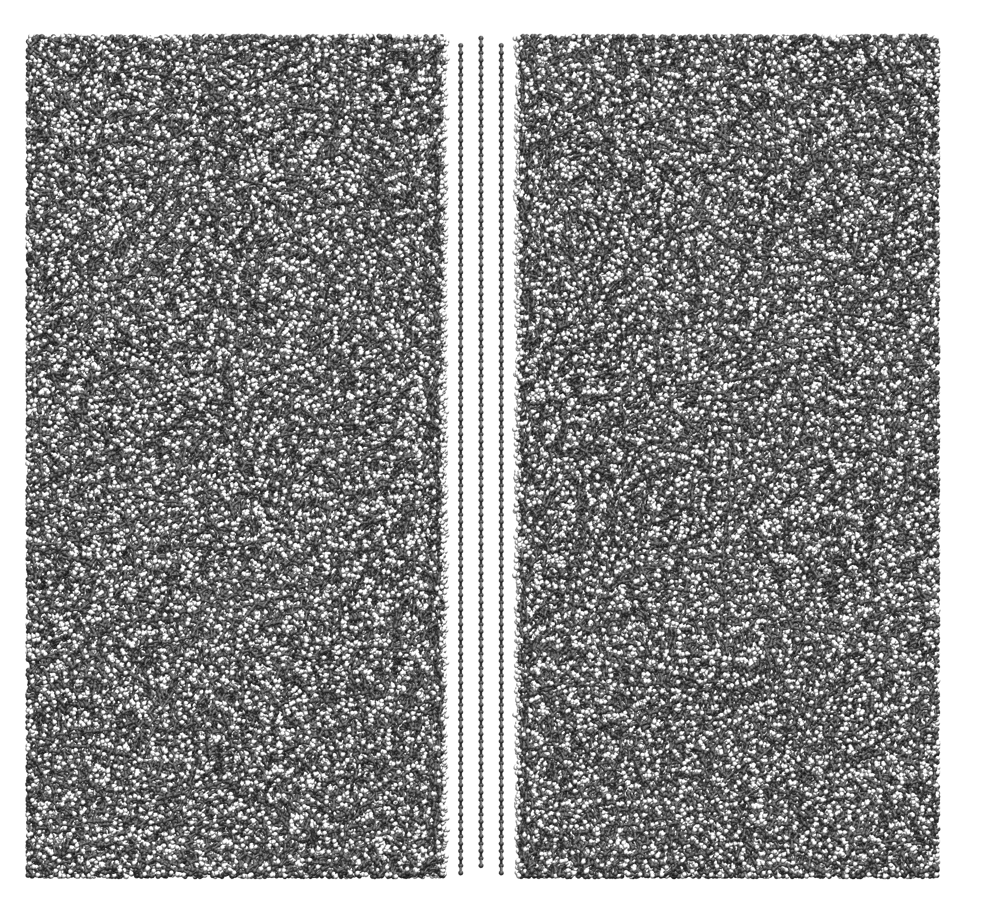
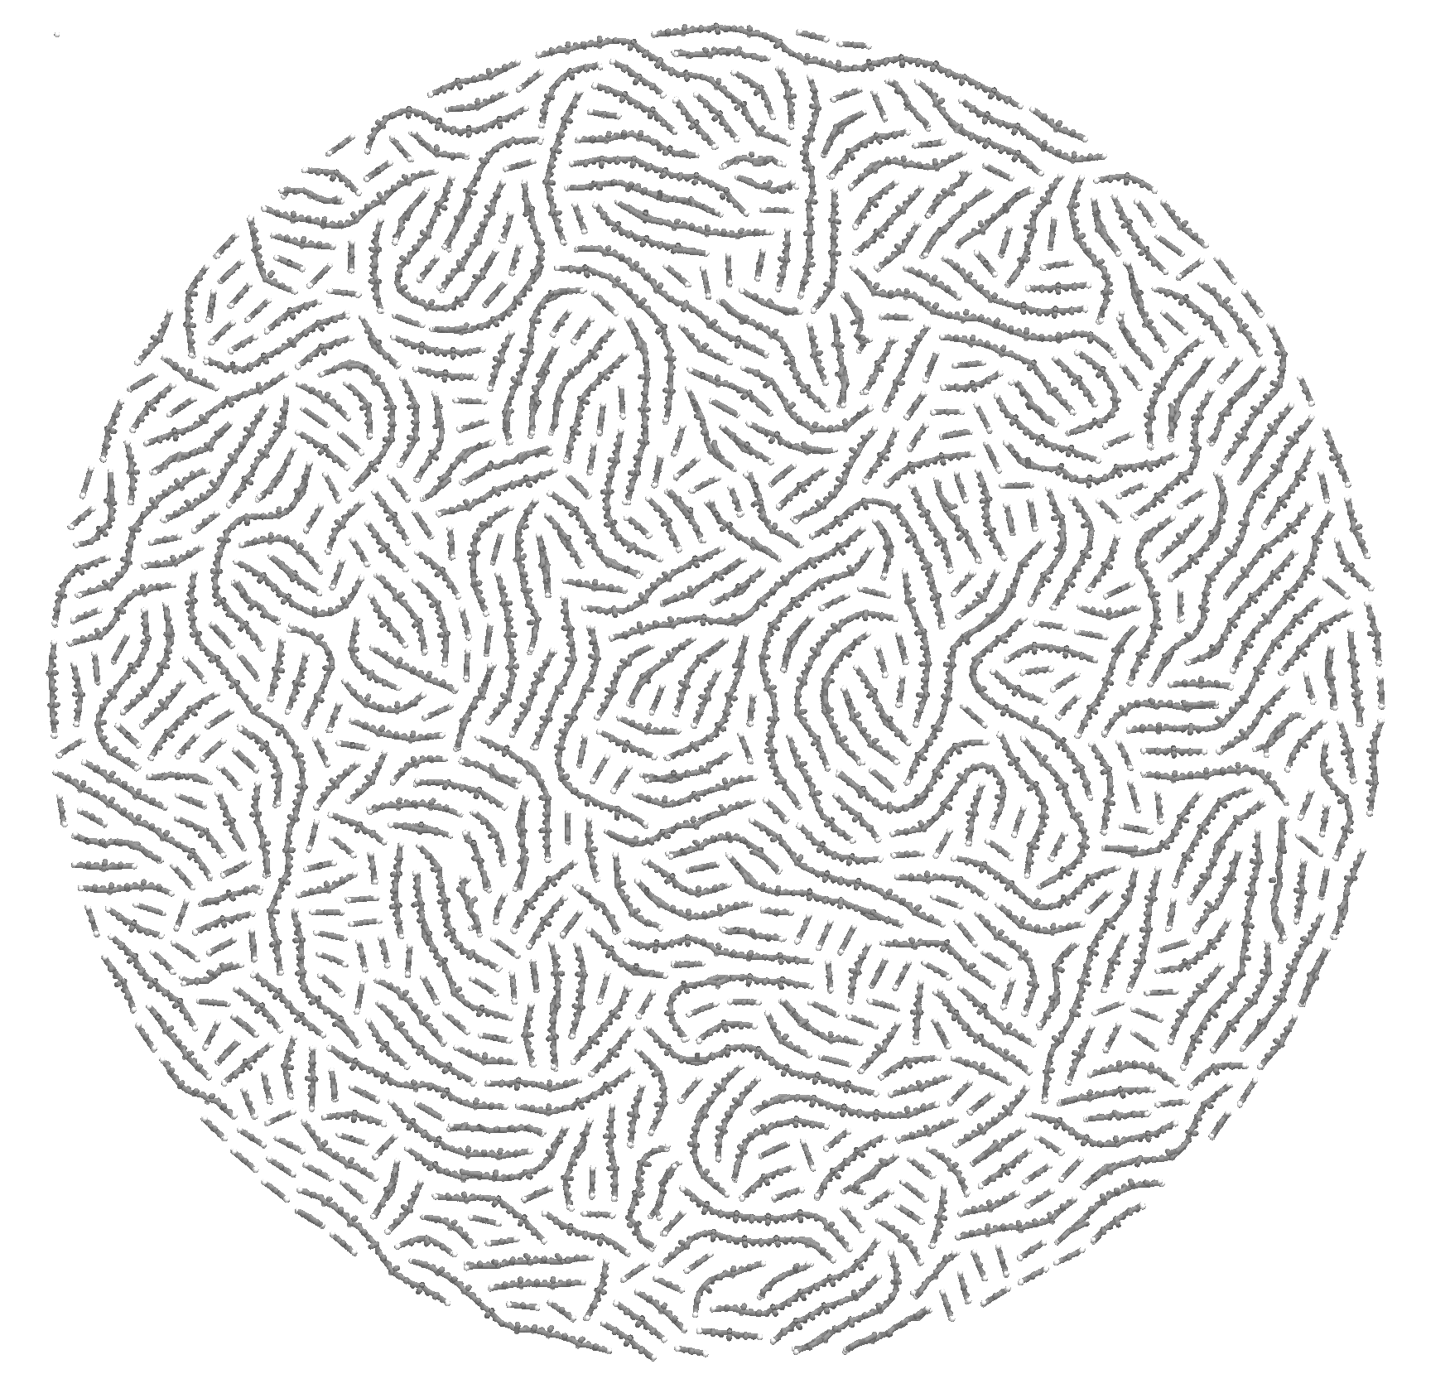
Polymer Cure and Pyrolysis
Higher Fidelity Representations in Composite Simulations
Graphene layers are often used to represent carbon fiber surfaces in atomistic simulations
REACTER is being used to create more realistic representations of carbon fibers
Technique able to reproduce morphologies observed in transmission electron microscopy images of carbon fibers
Graphene sheets
Polymer

Slide 17
On-going Process Modeling Work
Ongoing work supported by the Superlight-weight Aerospace Composites (SAC) project under the STMD Game Changing Development (GCD) program
Continued development of flow modeling for matrix precursor infusion
Creation of accurate fiber preform geometries
Computational and based on X-ray CT structures
Exploration of applying machine learning techniques to accelerate BIM method
Larger simulations of PAA and PERA-1 polymerization and carbonization
Refinement of carbon fiber surface model to improve fiber-matrix representation
Simulations of polymerization/carbonization in presence of carbon fiber surface
Exploration of alternative matrix chemistries with higher char yields in collaboration with synthetic chemists

Slide 18
Thermal-Structural Concept Development
Objective: Improve thermal stress response to increase operational load capability of hot structures
Analysis Approach:
Parametric study initiated to study critical thermal stress response in typical/simplified hot structure application
Investigate use of stitching to improve interlaminar behavior
Apply knowledge towards making better hot structure concepts

Slide 19
Thermal-Structural Concept Development 2D C/C Material Properties
Initiated effort with consideration of 2D C/C material system
Synthesized material property data reports
Needed C/C fabric lamina data to generate high fidelity Finite Element Models (FEM) to evaluate thermal stress response
Material property set needed for high-fidelity analysis
Lamina and quasi-isotropic laminate properties
Coefficient of Thermal Expansion, CTE(T)
Carbon fiber properties
Static fracture properties
References included 7 papers and presentations
Some properties calculated/estimated based on existing properties
Established a complete C/C and carbon fiber material property data spreadsheet needed for use in high-fidelity finite element thermal-structural analysis

Slide 20
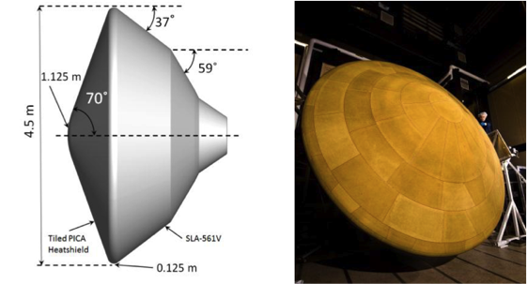
Thermal-Structural Concept Development Parametric Study- Thermal Stress Analyses
Need to identify critical conditions/locations when interlaminar stresses become severe
Mechanical loads
Thermal loads
Geometric attributes
Material system configuration
Boundary conditions
Initiated parametric study on cylindrical curved sections
Initial focus on the shoulder region of a planetary entry heat shield

Slide 21
Thermal-Structural Concept Development Parametric Study: Thermal Stress Analyses
Generated simplified finite element model
Geometric parametric variables
Shoulder radius: R_{SHOULDER}
Vehicle radius: R_{VEHICLE}
Shoulder thickness
Circumferential length
Boundary conditions
Loading Condition variables included thermal, pressure and combined load cases
Example load cases:
Radial Thermal Gradient
Circumferential Thermal Gradient
Applied Pressure
Notes:
The parametric range of geometric values evaluated in this study for the half circle and vehicle radii were chosen to somewhat encompass the range of possible radii for advanced hot structure concepts on future aerospace vehicles. Values where analyses were performed included: 1-inch, 5-inch and 10-inch for the shoulder radius and 18-inch, 45-inch, 180-inch, and 1000-inch for the vehicle radius. As a point of reference, existing aerospace vehicles where hot structure concepts could be considered include the Mars Science Lab (MSL), which has an approximately 5-inch shoulder radius and 90-inch vehicle radius. Also, for comparison Orion has approximately a 10-inch shoulder radius and 100-inch vehicle radius, Pioneer Venus had an approximately 45-inch vehicle radius, and Mars Sample Return had an approximately 18-inch vehicle radius. Furthermore, the large radius of 1000-inch used in this study was to evaluate a large radius that would approach a plain-strain solution; that would be somewhat representative of a leading edge on a hypersonic vehicle, or a winged entry vehicle with control surfaces.

Slide 22
Thermal-Structural Concept Development Parametric Study: Thermal Stress Results
Case | Shoulder Radius (inches) | Vehicle Radius (inches) | Thickness (inches) | Pressure (psi) | Temperature Distribution | Condition | Margin of Safety | Interface Layer
1 | 1 | 90 | 0.17 | 20 | Radial Linear Gradient | Max ILT Stress | -0.01 | 6
 |  |  |  |  |  | Min ILT Stress | -0.03 | 7
2 | 5 | 90 | 0.17 | 20 | Radial Linear Gradient | Max ILT Stress | 0.49 | 6
 |  |  |  |  |  | Max ILS Stress | 0.80 | 6
 |  |  |  |  |  | Min ILT Stress | 0.45 | 7
 |  |  |  |  |  | Min ILS Stress | 0.70 | 7
2b | 5 | 90 | 0.34 | 20 | Radial Linear Gradient | Max ILT Stress | 0.06 | 12
 |  |  |  |  |  | Min ILT Stress | 0.04 | 13
3 | 10 | 90 | 0.17 | 20 | Radial Linear Gradient | Max ILS Stress | -0.08 | 6
 |  |  |  |  |  | Min ILS Stress | -0.16 | 8
Preliminary analysis identified cases where excessive interlaminar stresses occur
More refined analysis needed to design tests/test matrix for experimental study

Slide 23
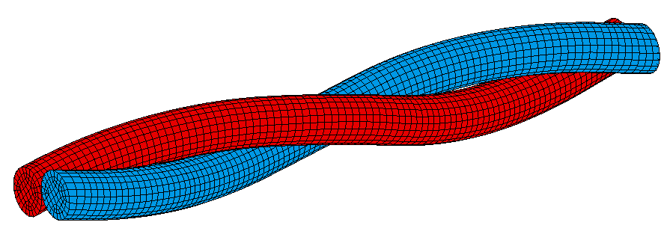
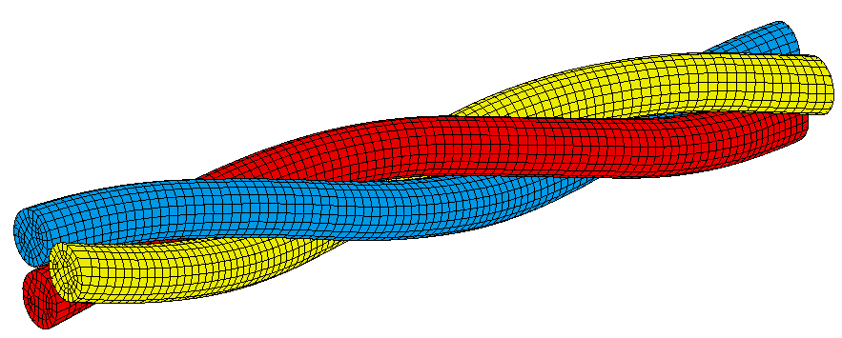
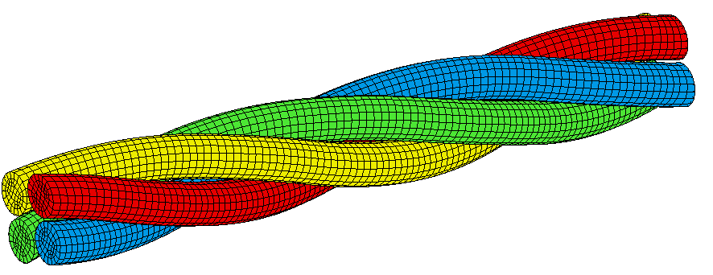
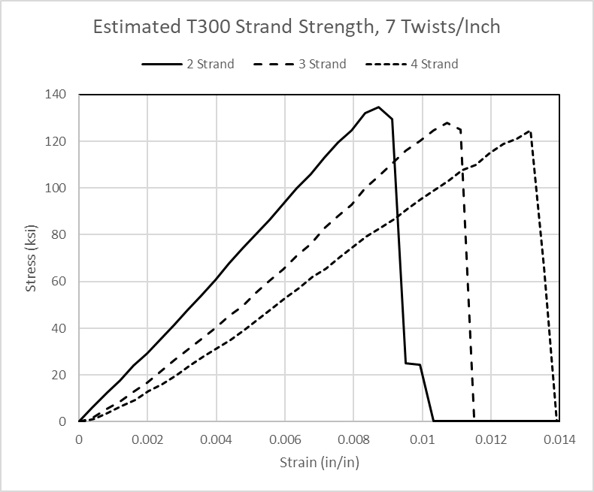
Thermal-Structural Concept Development Stitched C/C: Stitching Thread
Prior experimental study yielded preliminary results indicating some benefits of stitching on interlaminar strength
Preliminary micro-mechanics model developed to estimate material properties of carbon thread constructed from carbon fiber
2-strand thread
3-strand thread
4-strand thread
Estimated T300 Thread Strength, 7 twists/in
2-strand 3-strand 4-strand
T300 Carbon fiber properties
Tsai-Wu Damage Model
Results indicated greater strength with less strands
Results indicated greater strain to failure with more strands
T300 Carbon fiber has been procured
Need to have thread manufactured for experimental validation
Normalized Stress
Normalized Stress
Normalized Strain
Normalized Strain

Slide 24

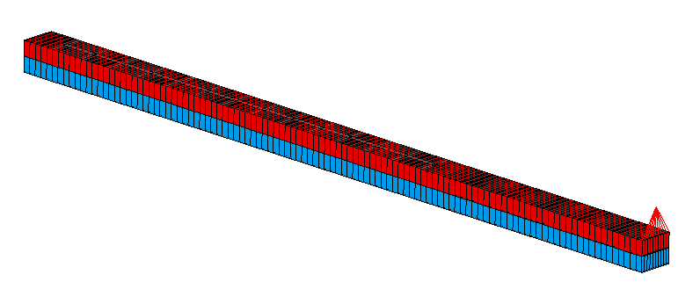
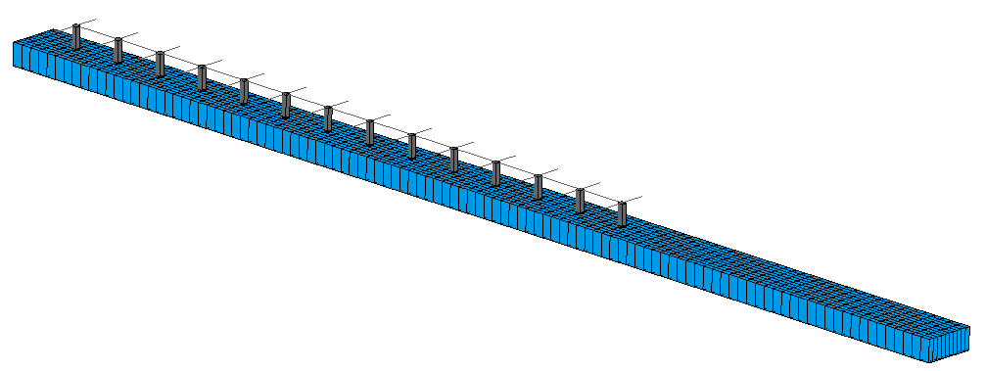

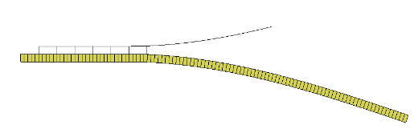
Thermal-Structural Concept Development Stitched C/C Laminate Analysis
Illustration of stitching C/C laminate:
Plane strain model developed to evaluate stitching
Progressive failure analysis performed
Preliminary results indicated a two order of magnitude increase in fracture toughness
Fracture toughness value can be used as effective value for stitched laminates in unstitched model
3D FEM initiated and can be further developed to evaluate optimal stitch parameters
stitching
Full Model
Top solid elements removed
Stitch element
L=109 mm
Width=5 mm
H=2.159 mm (per layer)
Starter crack 7 mm ahead of first stitch
First stitch failed
Several stitches failed

Slide 25
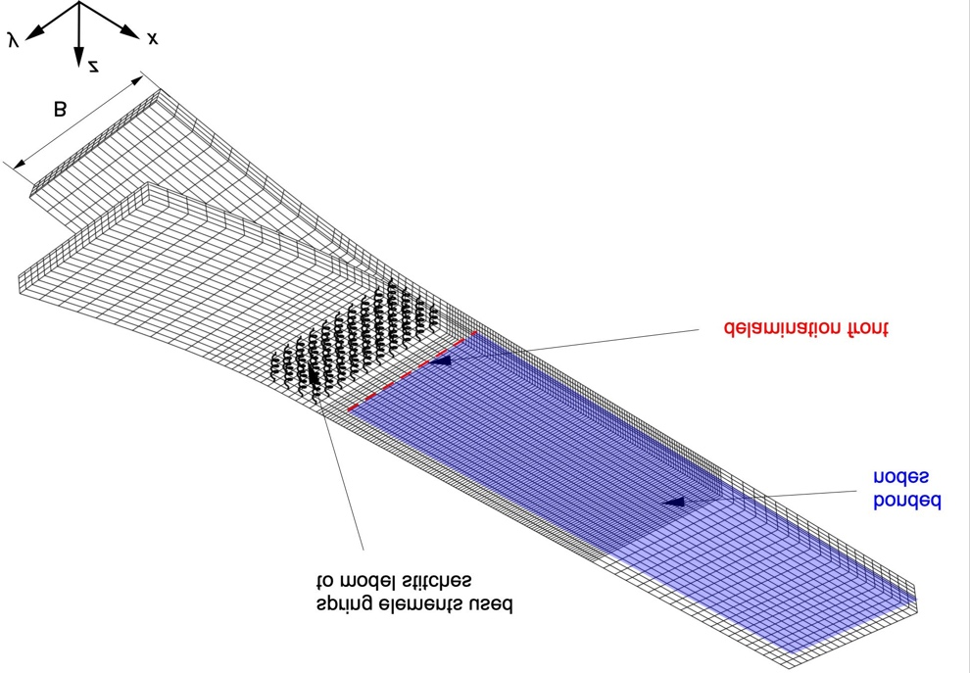
Thermal-Structural Concept Development Fracture Mechanics FEM
Higher fidelity 3D model of a Double Cantilever Beam (DCB) specimen
Stitches modeled using spring elements
Computed Mode I energy release rate, G_{I}
Results indicate stitches shielded the delamination front – crack did not propagate
Results published in NASA CR
Need to validate through experimental study
Spring elements
Bonded
nodes
Delamination
front
G_{I}
Specimen width, B

Slide 26
Concluding Remarks
Computational Tools for Modeling the Fabrication Process
Developed and demonstrated boundary element based CFD simulations of viscous polymer flow into a simplified representation of a woven carbon fiber preform
Adapted a molecular dynamics simulation method created for modeling polymerization to address pyrolysis and demonstrated its use for the conversion of phenolic resin to amorphous char
Work on-going under current GCD project
Thermal-Structural Concept Development
Parametric studies on curved hot structure concepts initiated
Micromechanical models of stitching thread developed
Initiated Fracture-mechanics model development to evaluate effect of stitching
Carbon fiber and 2D carbon fabric procured for fabrication of test specimens

Slide 27
References and Publications
References for Computational Tools for Modeling Fabrication Process
Gissinger, J. R.; Jensen, B. J.; Wise, K. E. “Modeling Chemical Reactions in Classical Molecular Dynamics Simulations” Polymer, 128, 211-217, 2017.
Gissinger, J. R.; Jensen, B. D.; Wise, K. E. “REACTER: A Heuristic Method for Reactive Molecular Dynamics” Macromolecules, 53, 9953, 2020.
References for C/C material property spreadsheet
Glass, D. E., Vaughn, W. L., Development of an Advanced Carbon-Carbon (ACC-6) Material Property Database, JANNAF Conference, 2020.
Vaughn, Wallace L, et. al., Interlaminar and In-plane Shear Strengths and Moduli of Carbon-Carbon Composites, The 42nd Annual Conference on Composites Materials, and Structures, January 22-25, 2017, Cape Canaveral, FL
Vaughn, Wallace L, et. al., Mechanical Properties of a Cut Ply Quasi-60 Carbon-Carbon Composite, The 43nd Annual Conference on Composites Mateials, and Structures, January 30th, 2018, Cape Canaveral, FL
https://toraycma.app.box.com/s/ru9sr1uzk0nw6vhilrt8hrmofytpjm1r
Sauder, Cedric, Jacques Lamon, and Rene Pailler. "Thermomechanical properties of carbon fibres at high temperatures (up to 2000 C)." Composites Science and Technology 62.4 (2002): 499-504.
Colmer, T., et al. “Dependence of Fracture Toughness on Delamination Direction in Carbon/Carbon Laminates,” Proceedings of the Joint Army, Navy, NASA, Air Force (JANNAF) Meeting, Dayton, USA, 2019.
Smith, A.J., et al. “Measurements of Mixed Mode-I/II Interlaminar Fracture Toughness of 2D-Woven Carbon/Carbon Laminates,” Proceedings of the 44rd Annual Conference on Composites, Materials, and Structures, Cocoa Beach, 2020.
New Publication
Kruger, R., Analysis of Delamination Growth in Stitched and Unstitched Double Cantilever Beam Specimens Made of Carbon-Carbon Composites, NASA CR-20210011852, March 2021.

