Slide 1
Investigation of medical countermeasure requirements for meeting permissible radiation exposure limits in space
HEALTH PHYSICS SOCIETY
66th annual meeting
2021
C.M. Werneth, T.C. Slaba, L.C. Simonsen
NASA Langley Research Center

Slide 2
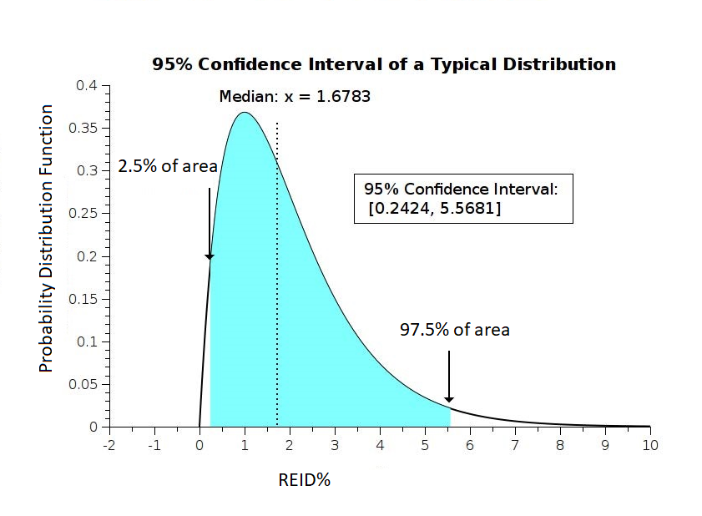
REID Probability Distribution Function
NASA STD-3001
“Career exposure to radiation is limited to not exceed 3 percent Risk of Exposure Induced death (REID) for fatal cancer. NASA assures that this risk limit is not exceeded at a 95 percent confidence level…”
NASA Permissible Exposure Limit (PEL)
3% REID at upper 95% confidence level

Slide 3
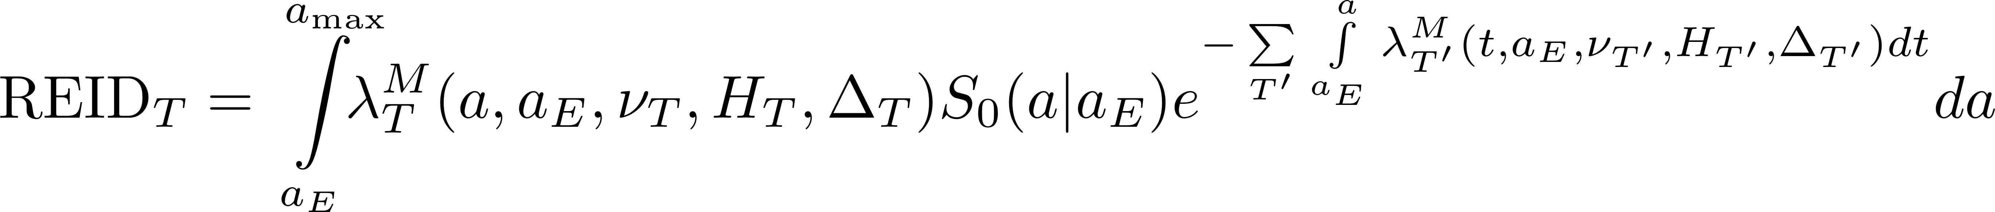
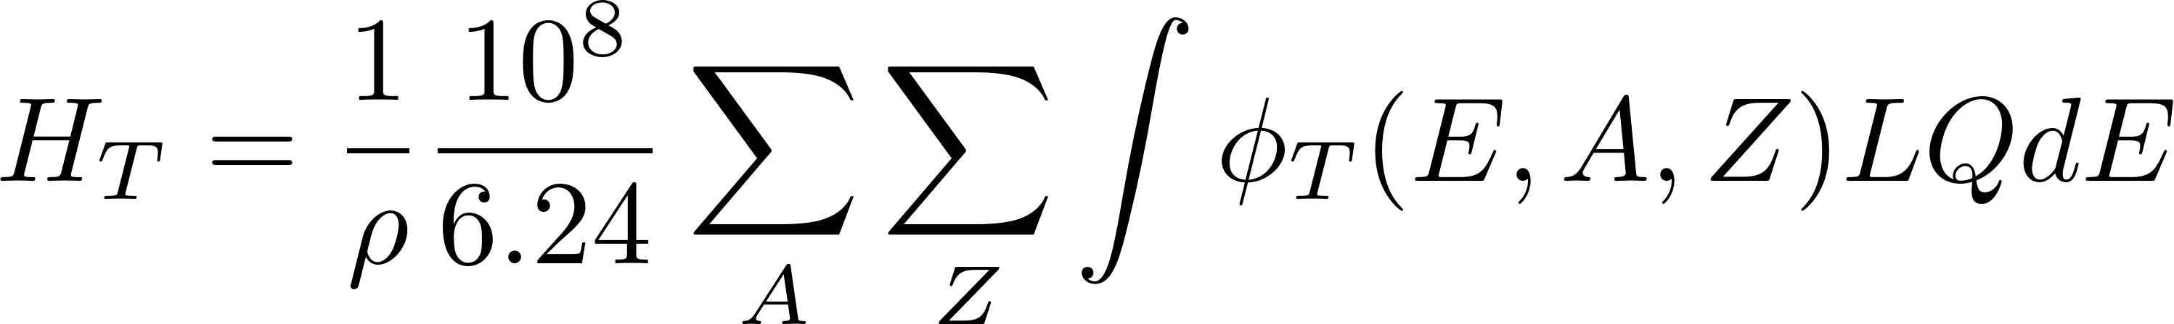
Risk of Exposure Induced Death (REID)
Conditional probability
of survival for background population (no excess radiation exposure)
Competing causes of death due to radiation exposure
Background Cancer Mortality Rate
Quality Factor
ERR = Excess Relative Risk
EAR = Excess Absolute Risk

Slide 4
Sensitivity Study
MCM modifications to the low linear energy transfer (LET) radiation risk models
  This assumes the MCM has the potential to reduce radiation risk associated with low-LET radiation
  Will be achieved by scaling the EAR and ERR risk coefficients
MCM modification of heavy ion component of radiation quality factor
  The assumption is that the MCM will affect heavy ions through some repair mechanism and reduce Q_{max}
  Will be achieved by scaling the maximum value the quality factor
MCM Modification of cancer background mortality rates:
  Modify background mortality rates with a method similar to that described in Werneth et al. Life Sciences in Space Research 25 (2020) 72.
  Will be achieved by scaling background cancer mortality rates

Slide 5
Exposure Conditions
45-year-old female
20 g/cm² spherical aluminum shield
Mars mission scenario
    Galactic Cosmic Ray (2001 Solar Max)
    Solar Particle Event (August 1972)
      Mars Landing Design Reference Mission
        12 months transit to Mars
        1 month stay on surface
        9 month return transit
What medical countermeasure reductions are needed to achieve 3% REID for fatal cancer at the 95th % confidence level?

Slide 6
Reduction of low-LET risk model coefficients

Slide 7
Scaling of low-LET risk models
Scaling factor

Slide 8
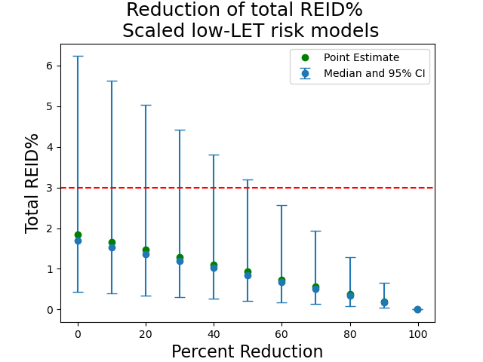
EAR and ERR Scaling
Percent Reduction | Point Estimate | Median | Lower 95% CL | Upper 95% CL
0 | 1.84 | 1.69 | 0.44 | 6.23
10 | 1.66 | 1.52 | 0.40 | 5.63
20 | 1.48 | 1.36 | 0.35 | 5.03
30 | 1.29 | 1.19 | 0.31 | 4.42
40 | 1.11 | 1.02 | 0.26 | 3.81
50 | 0.93 | 0.85 | 0.22 | 3.19
60 | 0.74 | 0.68 | 0.18 | 2.56
70 | 0.56 | 0.51 | 0.13 | 1.93
80 | 0.37 | 0.34 | 0.09 | 1.29
90 | 0.19 | 0.17 | 0.04 | 0.65
99.9 | 0.002 | 0.002 | 0.0004 | 0.007
55% Reduction is
needed to meet PEL
NASA STD-3001 PEL
Unmodified REID

Slide 9
Reduction of Q_{max} for all cancers

Slide 10

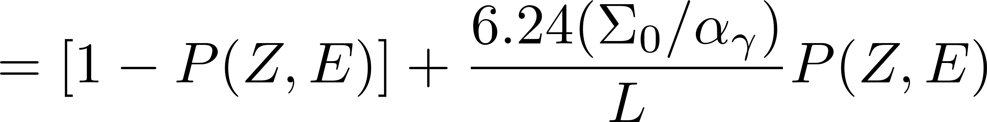
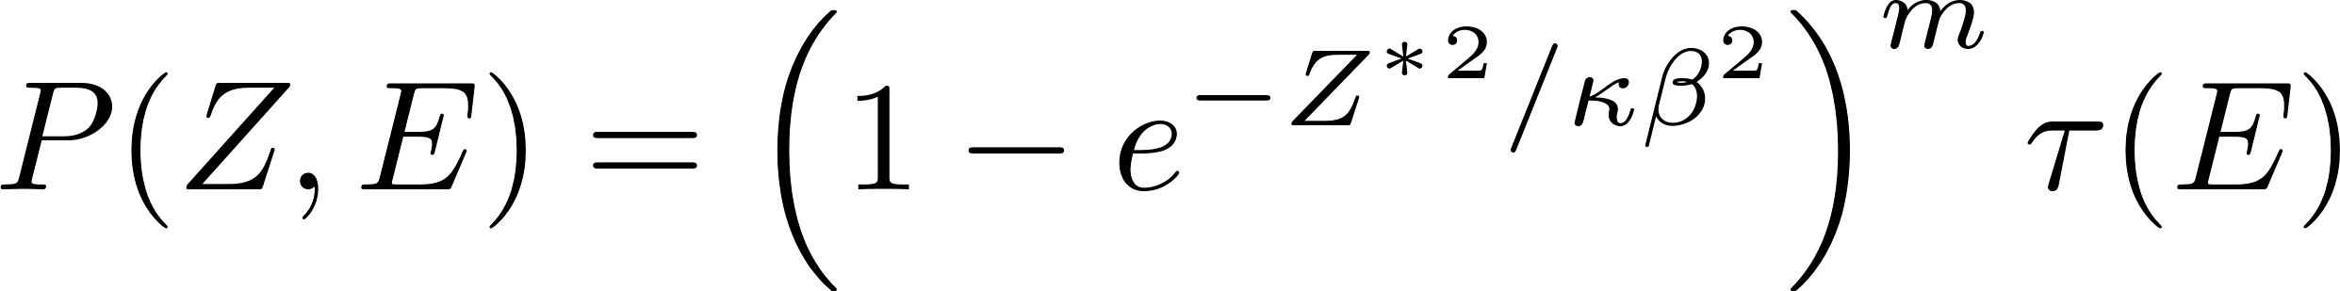
Quality Factor Modification (Q_{max})
Quality Factor
Q_{max}

Slide 11
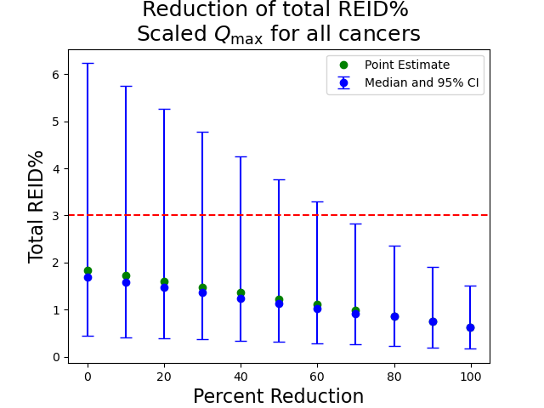
Quality Factor Scaling
Percent Reduction | Point Estimate | Median | Lower 95% CL | Upper 95% CL | <Q> (lung)
0 | 1.84 | 1.69 | 0.44 | 6.23 | 3.07
10 | 1.72 | 1.58 | 0.42 | 5.75 | 2.80
20 | 1.6 | 1.47 | 0.39 | 5.26 | 2.65
30 | 1.48 | 1.36 | 0.37 | 4.78 | 2.41
40 | 1.36 | 1.25 | 0.34 | 4.26 | 2.23
50 | 1.23 | 1.13 | 0.32 | 3.77 | 1.99
60 | 1.11 | 1.02 | 0.29 | 3.29 | 1.81
70 | 0.99 | 0.91 | 0.26 | 2.83 | 1.57
80 | 0.87 | 0.79 | 0.23 | 2.36 | 1.39
90 | 0.75 | 0.67 | 0.20 | 1.91 | 1.14
99.9 | 0.63 | 0.54 | 0.17 | 1.51 | 0.96
~67% Reduction needed
to meet PEL
NASA STD-3001 PEL
Unmodified REID

Slide 12
Reduction of background cancer mortality rates

Slide 13
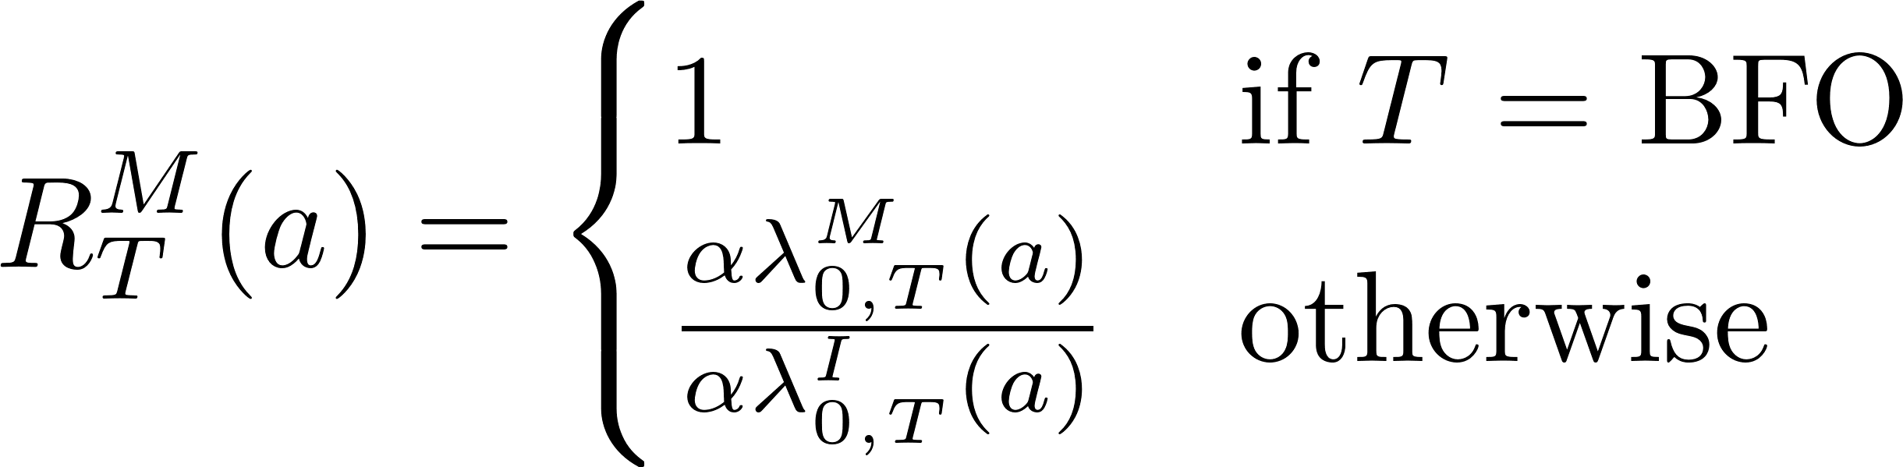
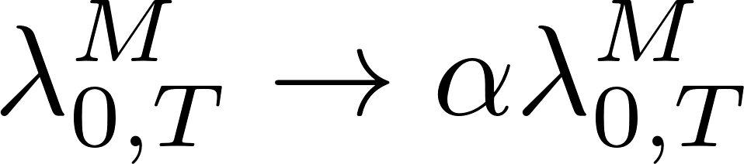
All Cancer Mortality Scaling: Case 1
Case 1: Reductions in cancer mortality are commensurate with reductions in cancer incidence
C_{F} is the female cancer mortality percentage for all cancers

Slide 14
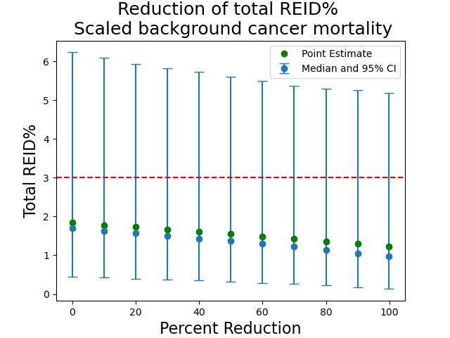
All Cancer Mortality Reduction: Case 1
Percent Reduction | Point Estimate | Median | Lower 95% CL | Upper 95% CL
0 | 1.84 | 1.69 | 0.44 | 6.23
10 | 1.78 | 1.63 | 0.42 | 6.09
20 | 1.73 | 1.57 | 0.39 | 5.92
30 | 1.67 | 1.50 | 0.37 | 5.82
40 | 1.61 | 1.43 | 0.35 | 5.72
50 | 1.55 | 1.37 | 0.32 | 5.61
60 | 1.48 | 1.30 | 0.29 | 5.49
70 | 1.42 | 1.22 | 0.26 | 5.36
80 | 1.36 | 1.13 | 0.22 | 5.30
90 | 1.30 | 1.05 | 0.18 | 5.25
99.9 | 1.23 | 0.97 | 0.13 | 5.19
PELs are not reduced significantly
Case 1
NASA STD-3001 PEL
Unmodified REID

Slide 15
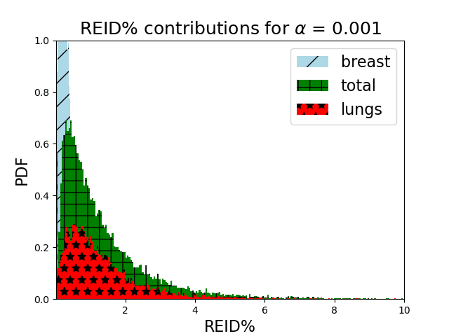
Largest Contributors to REID%: Case 1
Breast: 100% EAR model
Lungs: 50% EAR and 50% ERR
All other tissues: 70% ERR and 30% EAR

Slide 16
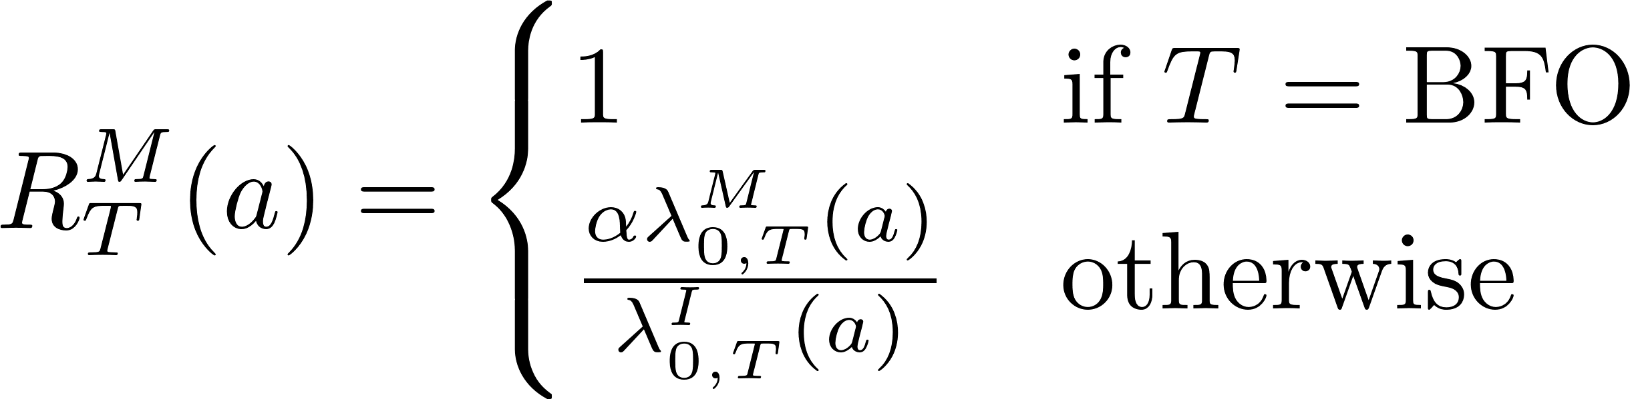
All Cancer Mortality Scaling: Case 2
Case 2: Cancer incidence rates remain unchanged, but cancer mortality rates are scaled
C_{F} is the female cancer mortality percentage for all cancers

Slide 17
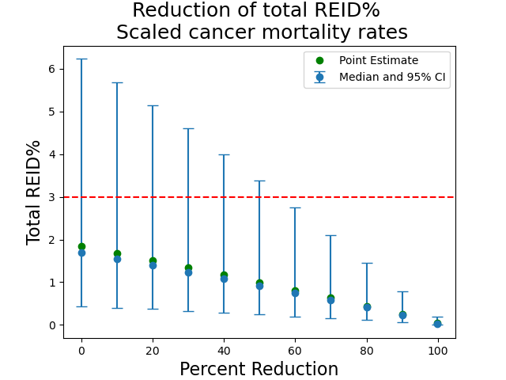
All Cancer Mortality Scaling: Case 2
Percent Reduction | Point Estimate | Median | Lower 95% CL | Upper 95% CL
0 | 1.84 | 1.69 | 0.44 | 6.23
10 | 1.68 | 1.54 | 0.40 | 5.69
20 | 1.51 | 1.32 | 0.37 | 5.14
30 | 1.34 | 1.23 | 0.32 | 4.60
40 | 1.17 | 1.08 | 0.28 | 3.99
50 | 0.99 | 0.91 | 0.24 | 3.38
60 | 0.81 | 0.75 | 0.20 | 2.75
70 | 0.63 | 0.58 | 0.16 | 2.11
80 | 0.44 | 0.41 | 0.11 | 1.45
90 | 0.24 | 0.23 | 0.059 | 0.78
99.9 | 0.042 | 0.018 | 0.0006 | 0.19
Case 2
57% reduction is
needed to meet PELS
NASA STD-3001 PEL
Unmodified REID

Slide 18
Summary
MCM modification of low-LET risk model coefficients
  55% reduction is required to meet the NASA PEL for fatal cancer
MCM modification of high-LET component of NASA quality factor model (Q_{max})
  67% reduction is required to meet NASA PEL for fatal cancer
MCM modification of the background cancer mortality rates
  Reduction of the cancer mortality rates alone is not sufficient to meet NASA PEL for fatal cancer
Greatest risk reduction is likely to be achieved by concurrent MCM modification of two or more components
Update: The National Academies has recently recommended that NASA use a mean value of 3% REID for the PEL.

