Slide 1


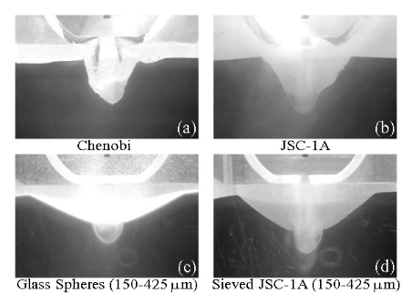
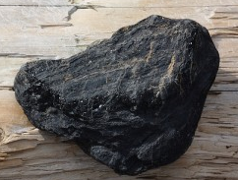
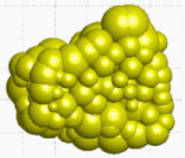
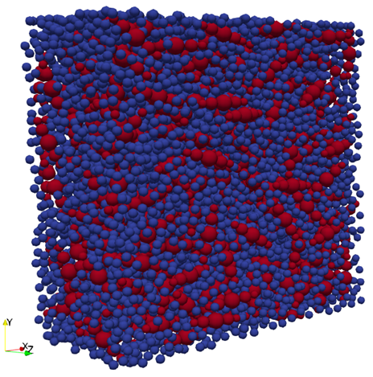
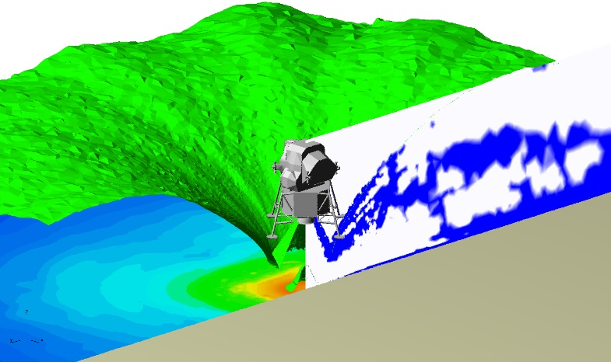
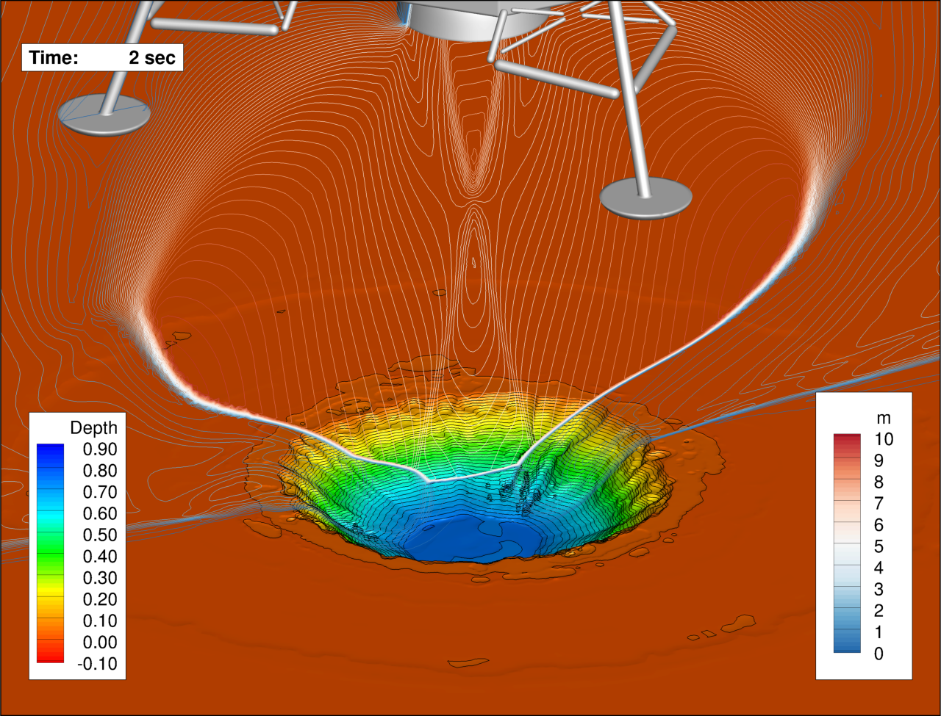
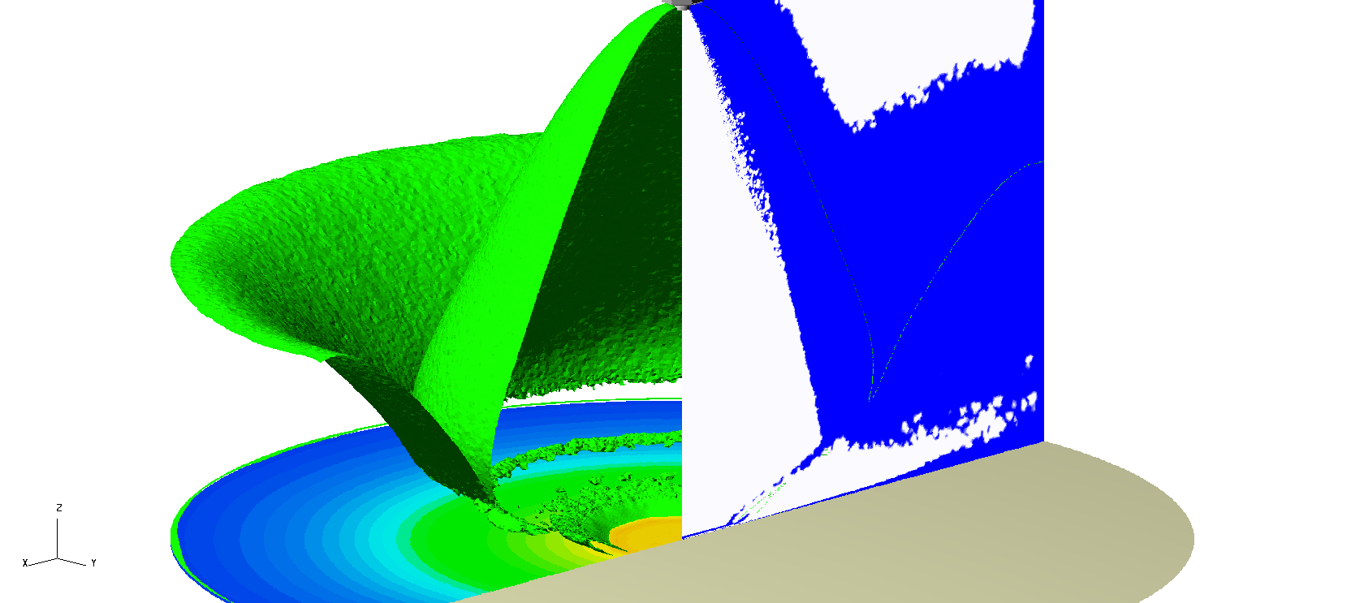
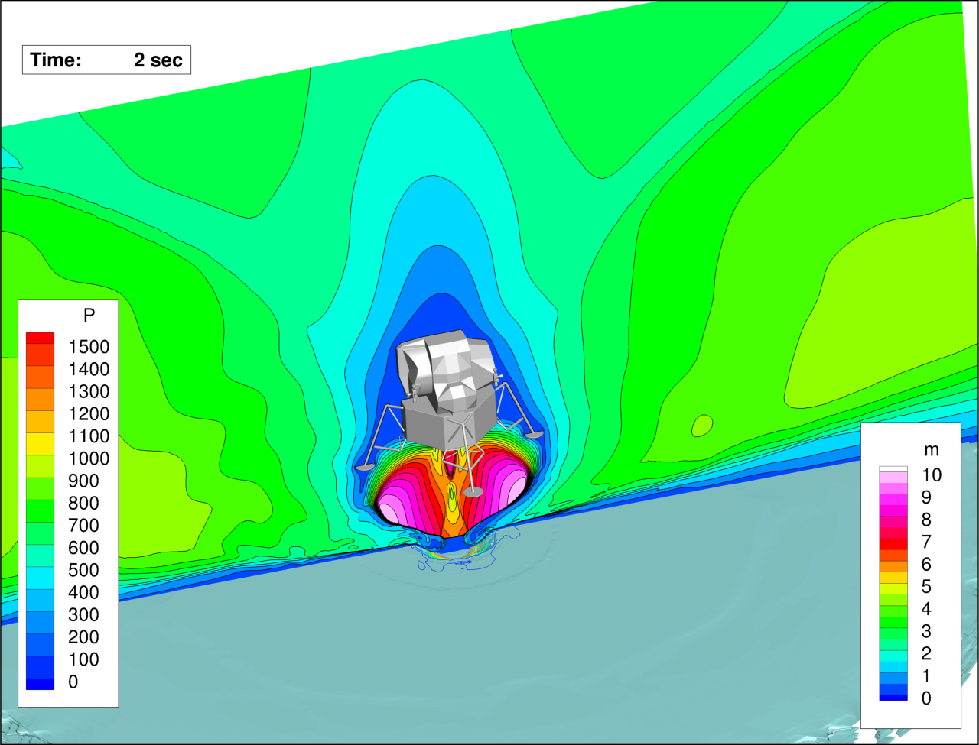
ADVANCES IN PLUME-SURFACE INTERACTION SIMULATION CAPABILITY UNDER LUNAR LANDING CONDITIONS
Peter A. Liever†, Jeffrey S. West§
†Jacobs Space Exploration Group, Huntsville, AL, §NASA Marshall Space Flight Center, Huntsville, AL
  Overview:
    Plume-Surface Interaction (PSI) between lander engine plumes and native regolith soil presents primary hazards in obscuration and contamination by particle clouds, high-energy ejecta streams, and landing area cratering damage.
    The MSFC Fluid Dynamics Branch has assembled a portfolio of simulation tools to develop a predictive PSI capability for NASA customers such as the Human Lander System (HLS) and Commercial Lunar Payload Services (CLPS)
    These tools are matured via funding by NASA’s STMD Game Changing Development Program and the NASA SBIR/STTR Program
Loci/GGFS Gas-Particle Interaction Modeling
GGFS features two-phase Eulerian-Eulerian modeling approach, treating both gas and particle mixture as continuum phases.
Eulerian granular material physics closure models (stress, cohesion, etc.) for non-spherical particle mixtures are extracted from small-scale particle DEM (Discrete Element Model) simulations.
Loci/Chem-Boltzmann Plume Impingement Modeling
Simulation tools tailored towards predicting PSI environments during extra-terrestrial propulsive landings include:
Loci/Chem-Boltzmann: Computational Fluid Dynamics program for plume impingement flow in mixed rarefied-continuum environments
Loci/GGFS Gas-Granular Flow Solver: Coupled gas-particle two-phase flow simulation to predict PSI induced crater formation and ejecta streams
These tools are designed to satisfy crucial modeling aspects for lunar PSI:
Plume impingement flow modeling in a lunar vacuum background environment requires accurate simulation of the mixed continuum-rarefied plume regions strongly affecting the plume extent and impingement characteristics that drive erosion (impact pressure, surface shear).
Modeling of liberation of the soil particles and the resulting crater shape and evolution is strongly affected by the extremely cohesive characteristics of the lunar regolith resulting from both the jagged irregular particle shapes and the wide particle size distribution.
The rarefied gas kinetic simulation module named Loci/Boltzmann has been integrated for simultaneous operation with Loci/CHEM in the Loci simulation framework. The hybrid Loci/Chem-Boltzmann allows for automatic cell-by-cell switching between the rarefied gas kinetic solver and the Navier-Stokes continuum CFD solver identified by continuum breakdown criteria within a simulation .
Irregular particle shape modeled by linked elemental spheres
Strong effect of poly-disperse, irregular shape particle physics on crater characteristics
Poly-disperse irregular particle mixture properties DEM simulation
Mach 1 Plume Iso-surface (Green)
Current Loci/GGFS application capability:
3D and axi-symmetric crater formation simulations
Soil models for mono-disperse spherical and elongated particles
Initial operational capability to perform bi-disperse modeling; extension to arbitrary poly-disperse mixture under development.
Automated cell-by-cell solver selection:
continuum (white) – rarefied (blue)
Log₁₀(P) on ground surface
Path forward in PSI tool maturation for the remaining 3 years of PSI GCD project
Continue to mature Loci/Chem-Boltzmann
  Including linking GGFS
  Extending to di-atomic and equivalent species
  Acceleration via GPU extensions
Continue maturation of Loci/GGFS
  Full poly-disperse capability
  Implementation of turbulence model suite
  Prescribed motion via overset to enable landing vehicle simulation
Develop ability to create complex soil models for use with Loci/GGFS
  Lunar and Martian regolith along with simulants for validation efforts
Develop models of soil particle cloud drag and particle turbulent kinetic energy
Conduct validation assessments of the following categories for both Lunar and Martian environments
  Plume Structure
  Soil erosion and crater formation
  Soil particulate ejecta and transport
Loci/CHEM-Boltzmann application example: Apollo Lunar Module at 5m elevation.
Mach 1 Plume Iso-surface (Green)
Log₁₀(P) on ground surface
Automated cell-by-cell solver selection:
continuum (white) – rarefied (blue)
Loci/CHEM-Boltzmann application example: Apollo Lunar Module at 56m elevation.
Rarefied regions exist around the expanding plume, at shocks just above the soil surface and at the soil surface at both small and large altitudes.
It is necessary to solve the Boltzmann equations in these regions.
Recent Loci/GGFS application demo example: Apollo Lunar Module crater formation at 5m elevation for mono-disperse 100 micron particles.

