Slide 1
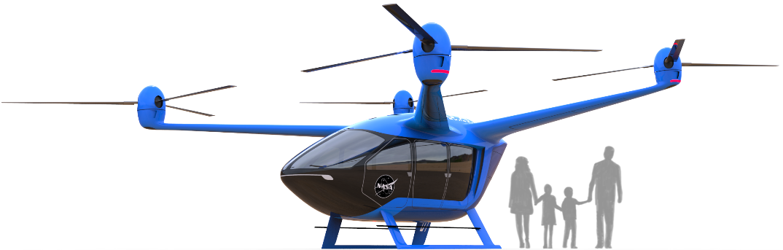
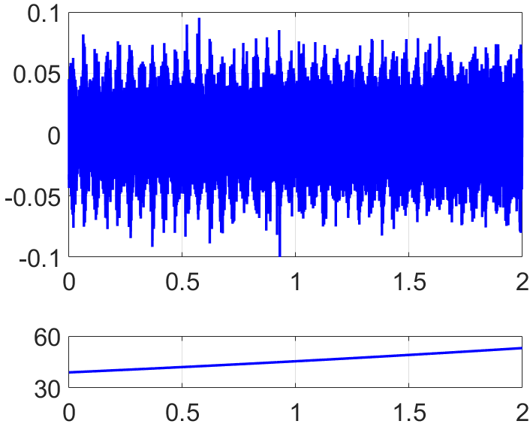

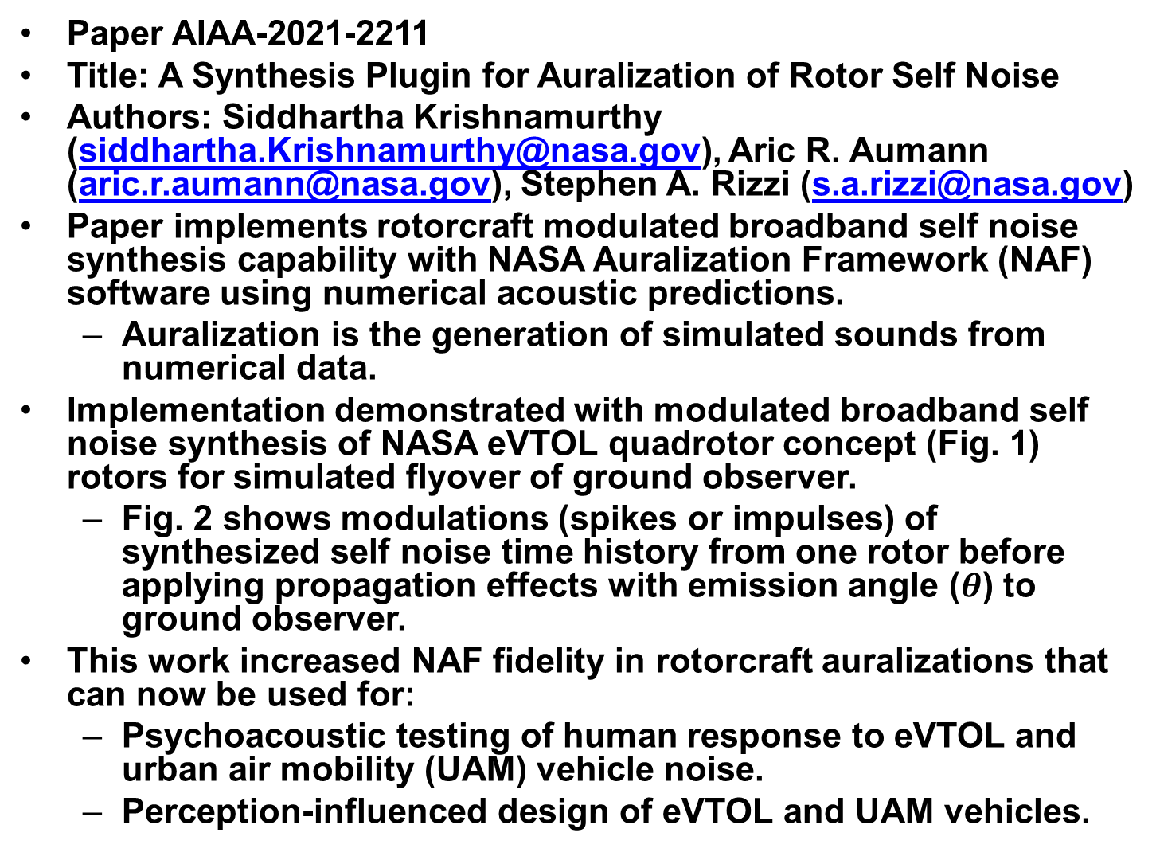
AA-29/TFS-19: Emerging Urban and Advanced Air Mobility Noise II
Paper AIAA-2021-2211
Title: A Synthesis Plugin for Auralization of Rotor Self Noise
Authors: Siddhartha Krishnamurthy (siddhartha.Krishnamurthy@nasa.gov), Aric R. Aumann (aric.r.aumann@nasa.gov), Stephen A. Rizzi (s.a.rizzi@nasa.gov)
Paper implements rotorcraft modulated broadband self noise synthesis capability with NASA Auralization Framework (NAF) software using numerical acoustic predictions.
  Auralization is the generation of simulated sounds from numerical data.
Implementation demonstrated with modulated broadband self noise synthesis of NASA eVTOL quadrotor concept (Fig. 1) rotors for simulated flyover of ground observer.
  Fig. 2 shows modulations (spikes or impulses) of synthesized self noise time history from one rotor before applying propagation effects with emission angle ($θ$) to ground observer.
This work increased NAF fidelity in rotorcraft auralizations that can now be used for:
  Psychoacoustic testing of human response to eVTOL and urban air mobility (UAM) vehicle noise.
  Perception-influenced design of eVTOL and UAM vehicles.
Fig. 1 NASA eVTOL quadrotor.
Pressure [Pa]
$θ$[deg]
Flyover Duration [s]
Fig. 2 Self noise synthesis.

