Slide 1
Designing validation experiments: combining modeler and experimentalist perspectives
Presenter: Jacob Hochhalter, University of Utah
Team Members:
Heather Hickmann, NASA Glenn
Rick Russell, NASA Kennedy
David Dawicke, Analytical Services & Materials
Patrick Leser and Paul Leser, NASA Langley
TMS Verification & Validation Short Course, August 3rd, 2021

Slide 2
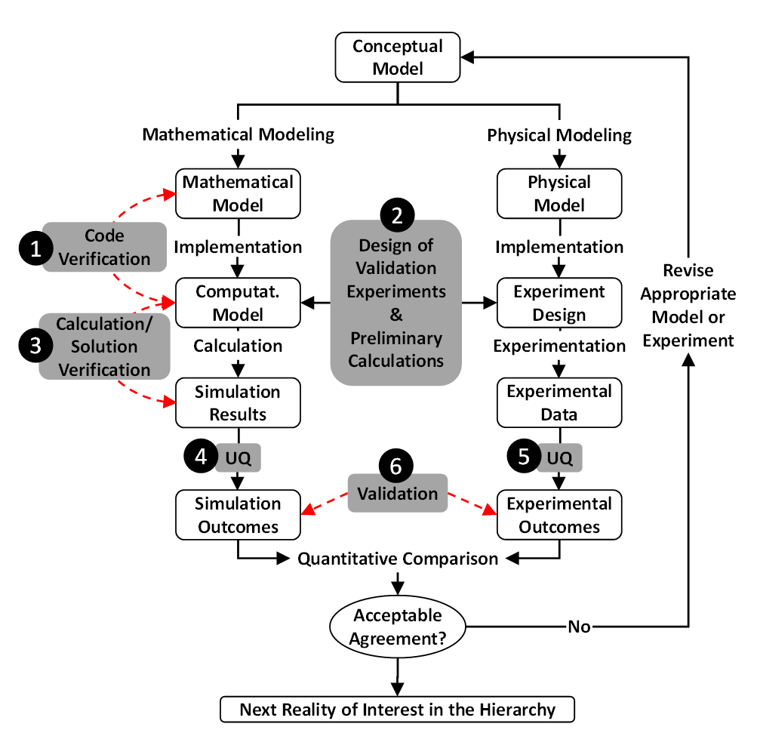
Topic Overview
“Step 2” in flowchart: experiment-design stage comes early in the V&V process and requires a close collaboration between modelers and experimentalists.
Objectives:
provide effective assessment of computational-model accuracy
design an experiment wherein measured quantities of interest (QoIs) serve as a validation basis
Modeler: specify QoIs together with all model-prediction assumptions and physical limitations to their validity
Experimentalist: design an experiment in which those QoIs can be reliably measured and compared directly with the model predictions
Following discussions of the main tasks are complemented with a few examples from practice to provide context.

Slide 3
Validation is the Goal
Definition
“In the broadest sense, validation of a computational model refers to the process of determining the degree to which the computational model is an accurate representation of physical reality from the perspective of the intended uses of the model”
There are no universally validated models: comparison of the model to empirical data is assessed for particular use cases.
Robust Recommended Practices
rigorous numerical testing to confirm whether the model represents the intended physics and physical space/domain,
quantification agreement of model with tests results, includes UQ,
use of data in validation as similar as possible to the real-world application of the computational model,
ensure data used for validation was not used in the development or calibration of the computational model,
ensure that the model and experiments should have similar error tolerance, standard deviation, and confidence levels

Slide 4
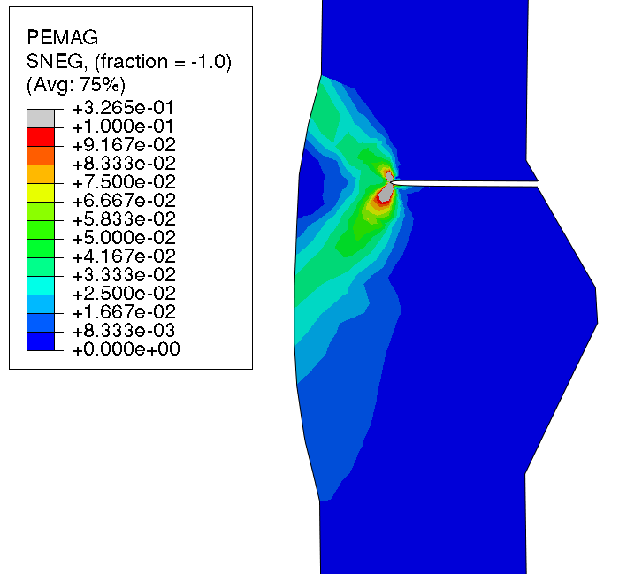
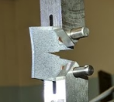
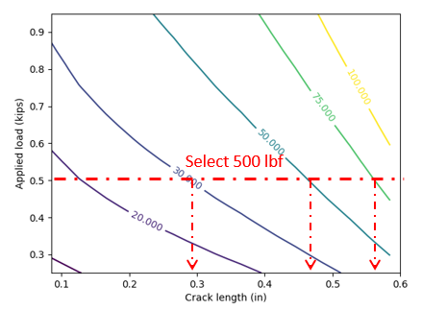
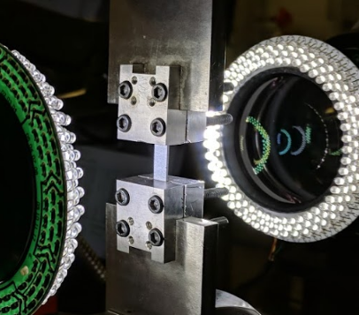
Design of Validation Experiments, and Preliminary Calculations
Task breakdown
Determine QoIs
Accomplish early in the V&V process
Define intent of experiments
Experimentalists, modeler/analysts, and customer/regulator
Preliminary model inputs and results
Experimentalists, modeler/analysts
User, modeler/analyst, and code developer.
Define the QoIs to be studied and/or predicted by the computational model
Describe the expected behaviors of these QoI
Assess test facility, funding, time, schedule
Define the physical phenomena of interest
List assumptions in the formulation of the model
Preliminary simulations for design of validation experiments
Initial model cal., BCs, and sensor details
Design validation experiments based on analyst description of requisite model inputs
Quantify material state
Ensure experiment does not violate model assumptions
List potential experiments, measurements of QoIs
Understand problem and most pertinent model outputs
Prioritize methods for QoI data acquisition
Experimentalists and analysts
List viable options for experiments and methods for measuring the QoIs
List pertinent capabilities of the test facility
In practice, the experimentalist and modeler must agree on beneficial values that can be measured, if QoIs can not
List tradeoffs
Confer on approaches for measuring QoIs
Data acquisition plan for model input data
Experimentalists, users, analysts
Experimentalist and analyst must agree on a method to calibrate input data using inverse solutions of the model
Estimate experiment uncertainties. Gage repeatability and reproducibility
Prioritize methods of measuring and calibrating material properties and boundary conditions
Output: Maintain/preserve a record of all associated datasets
Notes:
It is essential that all datasets associated with the validation experiments and preliminary calculations be captured, archived, and maintained over time, with proper version control and metadata. This requires some financial commitment to maintain the proper data registry in a sustainable fashion, and thus would involve funding organizations and/or other resource gatekeepers coordinating with the modelers and experimentalists in support of such data infrastructure. In cases where a sufficient data platform was not already in place or available to the user, this could also involve the initial development of such a platform.

Slide 5
Current and Recommended Practice
Current Shortcomings:
Insufficient communication between modeler/analyst and experimentalist
Measurement and input data uncertainties not rigorously investigated or reported
Detailed mathematical model idealizations of the experiment are commonly not reported
Lacking rigor (accuracy and UQ) in preliminary calculations
Recommended Practices:
Modeler/analyst inform experimentalist in advance the pertinent model assumptions, approximations, and requisite input data
  assessment of QoIs for expected numerical behavior
Experimentalist inform the modeler/analyst of the planned test procedures, data acquisition, diagnostics, range of possible conditions, and pertinent uncertainties
Modeler/analyst and experimentalist agree on the following:
  model-input parameters that will be directly measured and others that will require calibration
  identification and documentation of uncertainties in the experimental and preliminary calculations
  initial and boundary conditions in the experimental configuration, should be measured, understood, and incorporated

Slide 6
Nominal Task Sequence
Validation experiment design tasks:
Input: Funding and motivation
Determine QoIs
Define intent of experiments
Preliminary design of validation experiments and acquisition options
Calibrate (material) model parameters and identify/estimate uncertainties
Prioritize methods for QoI data acquisition
Output: Maintain and preserve a record of all associated datasets
In practice, these steps are not always chronological nor monotonic. Iterations that incorporate
lessons learned can be expected, especially in complex scenarios.

Slide 7
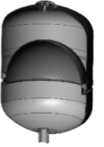
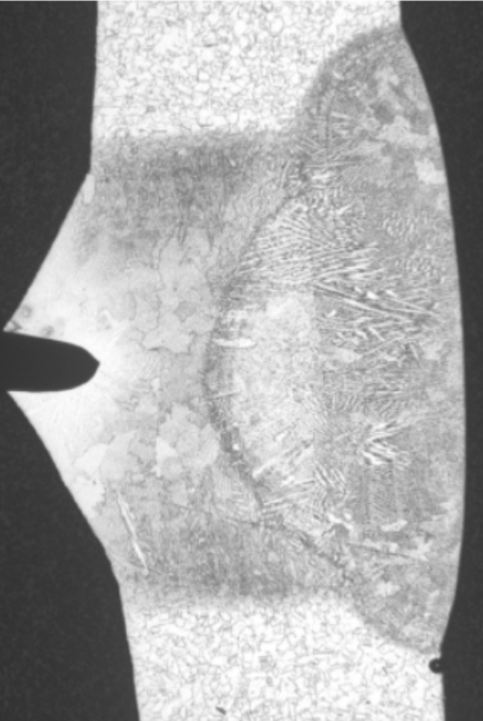
Pressure Vessel Use Case
Task 2, Determine QoIs: Strain magnitudes, concentrations, and onset of unstable cracking
Task 3, Define Intent: Prediction of strain localization at the weld
Tank
Gas
Diaphragm
Weld
Diaphragm
Pressurized fluid
Characteristic fracture site

Slide 8
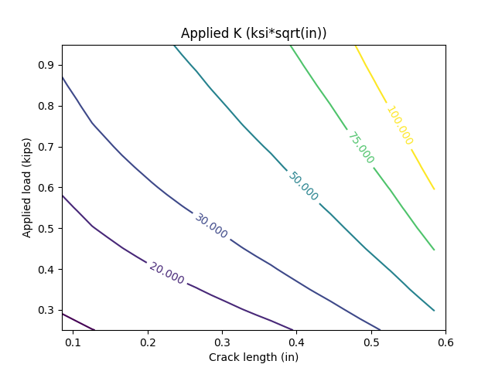
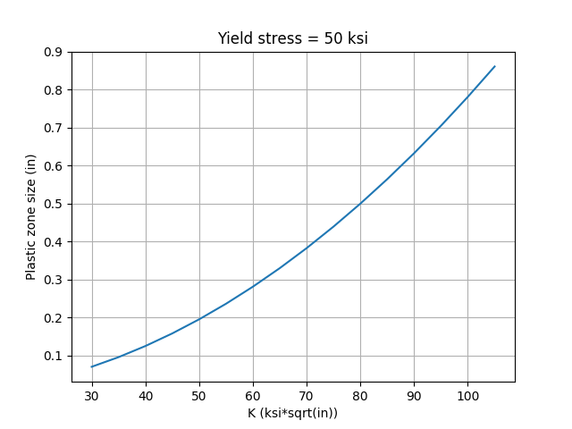
Pressure Vessel Use Case
Task 4, Preliminary design of validation experiments and acquisition options
Yield Stress = Lower bound estimate
Surface cracked, M(T), specimens:
About 5 kips would be required to produce desired K.
There would be net section yielding at a load much lower than that which would produce the desired K.
ESET (or CT) specimens:
Provides increased K at practical loads
Load being applied manually as hanging weight
Lacks surface crack similarity in tank
Select 500 lbf
Design steps:
select desired load (500 lbf used as an example)
select desired applied K (30, 50, and 75 ksi*sqrt(in) used as arbitrary examples here)
determine required crack length that satisfies above conditions
crack length + plastic zone size estimates width lower bound

Slide 9
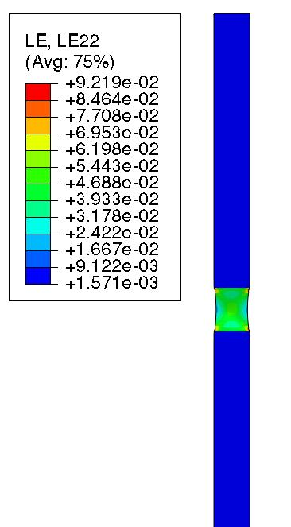
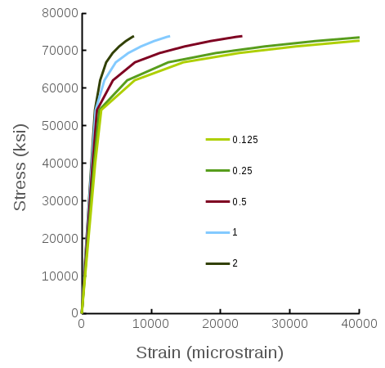
Pressure Vessel Use Case
Task 5, Calibrate (material) model parameters and identify/estimate uncertainties
Task 6, Prioritize methods for QoI data acquisition
1” gauge length commonly used to measure elongation – assumes homogeneous material
Weld modulus and yield calculated in this way represent a mixture of parent and weld materials
Stereo DIC
Increase in apparent yield and modulus by increasing gauge length in FE model
Gauge length
0.25” gauge
1” gauge

Slide 10
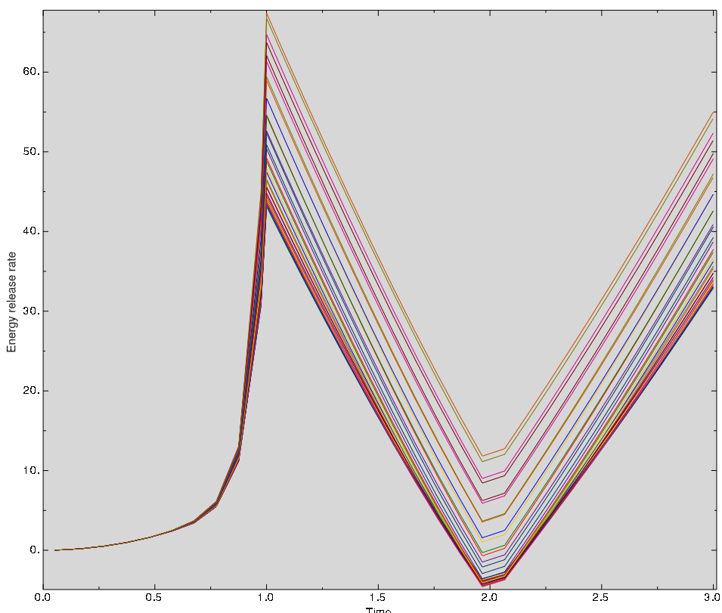
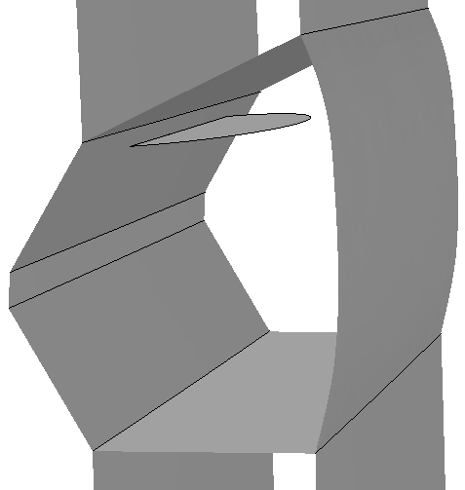
Pressure Vessel Use Case
Task 7, Finalize validation test design
Plastic Strain Mag.
J-Integral Results along crack front
Energy Release Rate
Side view of semi-circular surface crack near HAZ interface
Time
For c:a = 1, max(J) where crack front daylights (ID)
For c:a = 5, J nearly constant along crack front
Proof
MDP
3D view of crack

Slide 11
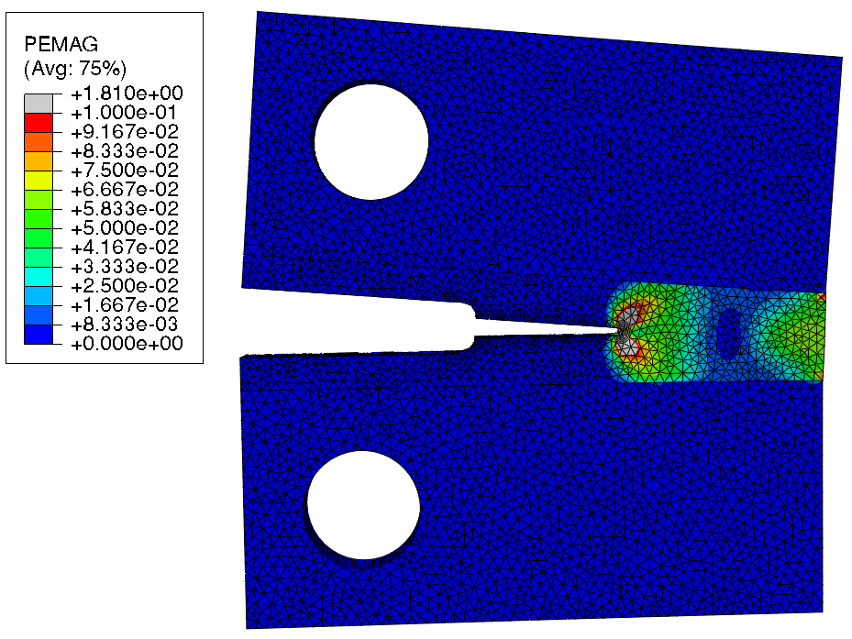
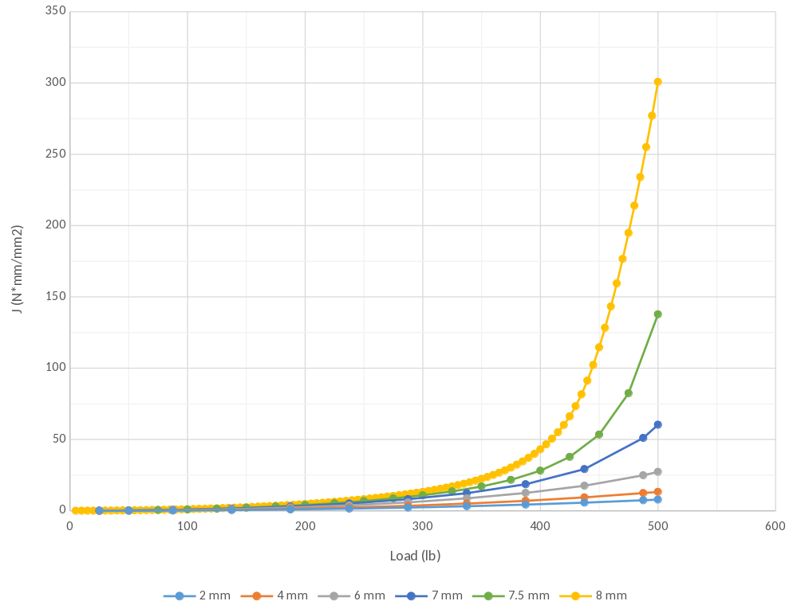
Pressure Vessel Use Case
Task 7, Finalize validation test design
Weld toughness
c:a = 1:5
c:a = 1:4
c:a = 1:1

Slide 12
Connecting Modelers and Experimentalists
Closing Remarks:
Strategy #1: Provide Incentive Mechanisms that Motivate V&V Contributions
  Multidisciplinary V&V funding streams and requirements
  Publication venues that reinforce joint experimental-computational V&V efforts
  Robust experimentation requirements for challenge problems
  Strategy #2: Build Awareness of the Value of V&V/UQ
  Value-driven collaborative V&V partnerships for decision making
  Professional society V&V committees/working groups
  Recognition and achievement awards for V&V efforts
  Advertisements for shared V&V resources
Strategy #3: Reduce the Entry Barrier for New V&V Practitioners
  Networking events for V&V team matchmaking
  Joint educational opportunities for experimentalist modeler teams

