Slide 1
EMC Habitat Layout & Assessment
Final Documentation
October 23, 2015 (Subject to update after further management review.)
David Smitherman
ACO Team
Notes:
At the completion of task 2 investigating co-manifested payloads, a comparison was made of the habitat mass and number of launches required. It was found that mass could be reduced and the number of launches could be reduced by moving to larger volume modules.
This study was set up to investigate several large module configurations that could be launched in a payload configuration on the SLS.

Slide 2
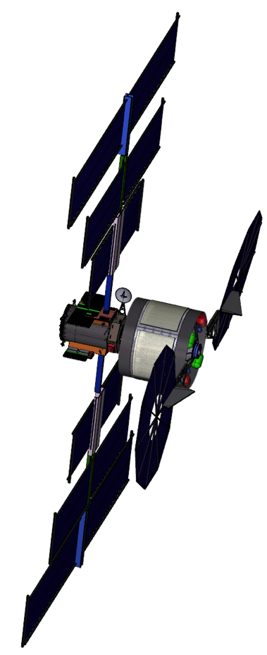
Outline
Study Overview
  Participants
  Study Schedule
  Customer / Products
  EMC Habitat for Assessment
Habitat Configurations
  Layouts
  Mass Summaries
  Primary Findings
Vehicle Configurations
Systems Summaries
Backup
  Acronyms

Slide 3
Participants
NASA / Marshall Space Flight Center / ED04 Advanced Concepts Office (ACO)
  Manager – Mark Rogers
  Team Leads
    Integrated Space Transportation Team (IST) – Barney Holt (acting)
    Space Systems Team (SST) – Jack Mulqueen
    Contractor Support from the Engineering Sciences Services and Skills Augmentation (ESSSA) – John Risdon
Role | MSFC ACO Team | Additional POC
Study Lead, GR&A, MEL | ED04 / David Smitherman | MSFC / Karen Knight JSC / Mark McDonald LaRC / Matt Simon LaRC / Kara Latorella
Crew Systems / Internal Layouts / Research / EVA | ED04 / Brand Griffin / ED04 / David Smitherman | JSC / Robert Howard LaRC / Matt Simon LaRC / Kandyce Goodliff MSFC / David Reynolds JSC / Pedro Lopez
Vehicle Configurations | ED04 / Mike Baysinger /
Structures / Mechanisms | ED04 / Jay Garcia / ESSSA | MSFC / Robert Hickman
Propulsion & Mission Analysis | ED04 / Jack Chapman ED04 / Tom Percy
ECLSS | ES62 / David Tabb | MSFC / Walt Schneider MSFC / David Howard LaRC / Kandyce Goodliff
Power / PEL | ED04 / Leo Fabisinski /
Avionics | ES35 / Gerald Watson ES45 / Hubert Gangl, ES35 / Richard Howard
Thermal | ED04 / Andrew Schnell
Notes:
The ACO team led and provided all final design and documentation for the study in consultation with the EAM team points of contact. Significant parallel work from the EAM team in the mission analysis, structures, thermal, and power areas was used for comparison purposes and may be available in separate documentation.

Slide 4
Study Schedule
Study Planning
October 14
  Team tag up
October 15
  1-4 Design Session
October 21
  Configurations tag up
October 22
  1-4 Design Session
October 23
  Final Product
Reporting
October 21
  Progress report to FCDT
October 23
  Final Product
Notes:
The study was completed on schedule.

Slide 5
Customer / Products
Customer:
Request from JSC / Mark McDonald, Future Capabilities Definition Team
Products to produce by October 23:
Provide a independent evaluation of the EMC proposed
  “Split Architecture, Transit Habitat, 1100 days” - attached
Provide detail Habitat Layout and assessment of the EMC proposed architecture
  FCDT Functions will be used on layout assessment to be compared to EMC
  Apply minimum Habitable volume:
    ISS crew quarters
    1 meter wide corridor(s)
    No large end dome volume
Package will contain:
  Layout
  Assessment
  Detail mass estimate
  Summary baseball card
Notes:
The study was sponsored by the NASA HQ Advanced Exploration Systems Program through the Exploration Augmentation Module Project led by Lora Bailey at JSC.
Lora in turn reported to and solicited guidance from Skip Hatfield in support of the Future Capabilities Definition Team efforts.

Slide 6
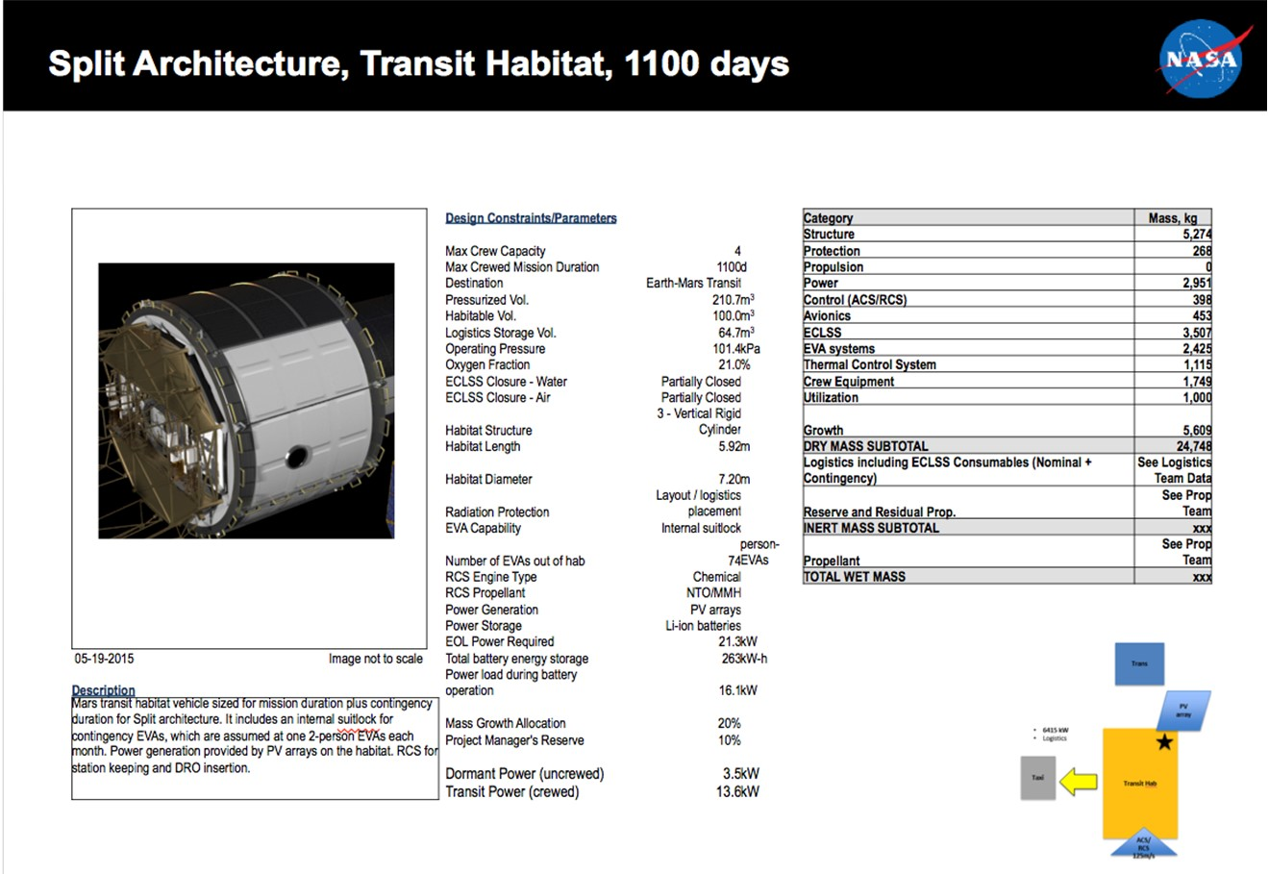
Reference EMC Habitat for Assessment

Slide 7
Additional EMC Habitat Guidelines
Per coordination with LaRC / Matt Simon
Docking guidelines
  3 NDS docking mechanisms with crew hatch
  1 EVA Hatch
  Chemical stage attachment done at outer skirt using standard launch adapter
  SEP stage attachment uses standard NDS listed above
  Landers & MAV attach to NDS listed above
EVA includes
  6 EVA, rear-entry, 8.2 psid
  4 LEA suits
Airlock
  Uses suit lock system
ECLSS
  Partially closed loop system based on ISS standards
  Assume 30 day open loop consumables backup
Laundry
Radiation Protection
  Assume logistics placement

Slide 8
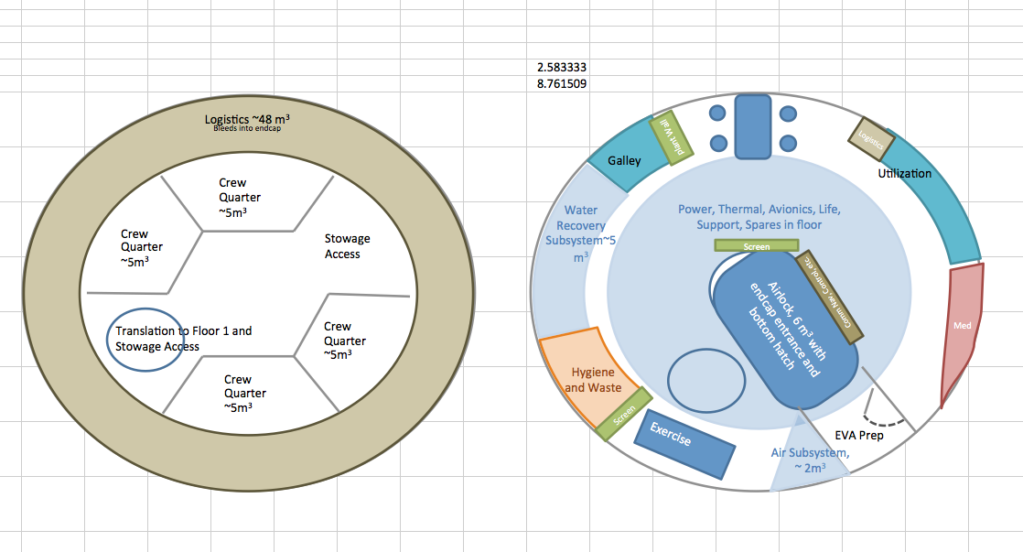
EMC Phobos Habitat Layout
Reference Material

Slide 9
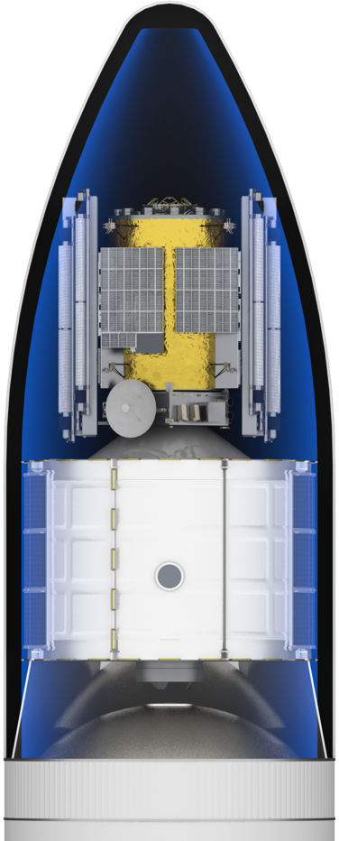
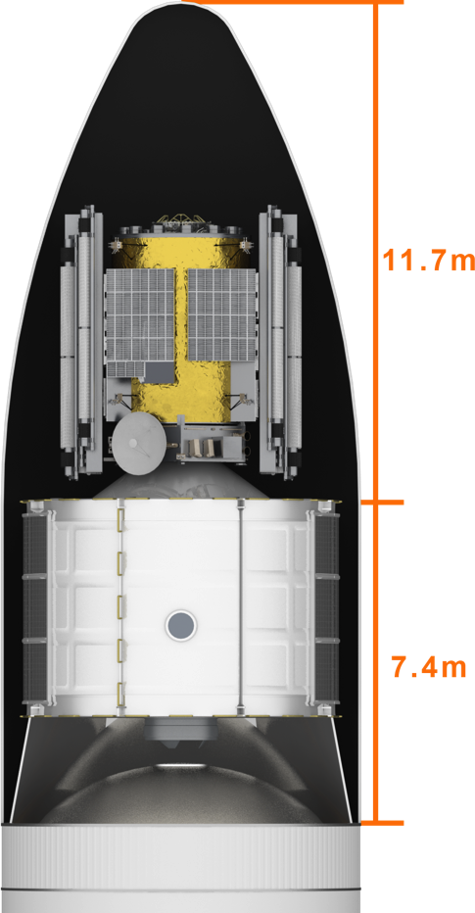
SLS Short Shroud
EMC Habitat / SEP Reference Payload Configuration

Slide 10
Habitat Configurations
David Smitherman
Brand Griffin
Mike Baysinger

Slide 11




Two Deck Vertical Configuration
Layout (7.2 m diam. x 5.92m Module / Ellipsoid End-dome)
Volume
Pressurized Volume: 210m³
Systems Vol.: ~34m³ (~16 ISPR equivalents)
Habitable Vol.: 65m³
Stowage Vol.: ~37m³
Work
Station
Avionics
Utility Chase
Dbl.
50kg
Dbl.
50kg
Dbl.
50kg
Dbl.
50kg
Dbl.
50kg
Dbl.
50kg
TCS
Dbl.
50kg
Dbl.
50kg
Dbl.
50kg
Dbl.
50kg
Dbl.
50kg
Dbl.
50kg
Dbl.
50kg
Dbl.
50kg
Dbl.
50kg
Dbl.
50kg
Dbl.
50kg
Dbl.
50kg
Dbl.
50kg
Dbl.
50kg
Dbl.
50kg
ECLSS
Dbl.
50kg
Dbl.
50kg
Stor
Equipment Not Included
5 more EVA Suits
~28 m³ more stowage volume
~35 m³ more habitable volume
Dbl.
50kg
Galley
Wardroom
EPS
Crew Sys
Waste
Hygiene
Dbl.
50kg
Dbl.
50kg
Dbl.
50kg
Dbl.
50kg
Dbl.
50kg
Dbl.
50kg
Dbl.
50kg
Dbl.
50kg
Dbl.
50kg
Dbl.
50kg
Dbl.
50kg
Dbl.
50kg
Dbl.
50kg
Dbl.
50kg
Dbl.
50kg
Dbl.
50kg
7.2 m
331 in
Dbl.
50kg
Dbl.
50kg
Dbl.
50kg
Work
Station
Dbl.
50kg
Dbl.
50kg
Dbl.
50kg
1.12m (44 in)
296 Dbl. CTBs
~37 m³ Stowage Volume
Average 20kg ea.: 5,920 kg
Max. 50kg ea.: 14,800 kg
Dbl.
50kg
Dbl.
50kg
Upper Level
Galley Equipment
Exercise
Work
Station
Dbl.
50kg
Dbl.
50kg
5.92m
233in
3.68m
145 in
Dbl.
50kg
Dbl.
50kg
Dbl.
50kg
Dbl.
50kg
Dbl.
50kg
Dbl.
50kg
Dbl.
50kg
Dbl.
50kg
Crew Quarters
Crew Quarters
Dbl.
50kg
Dbl.
50kg
Crew Quarters
Crew Quarters
Dbl.
50kg
Dbl.
50kg
Airlock / Suit lock
Dbl.
50kg
Dbl.
50kg
Dbl.
50kg
Dbl.
50kg
Dbl.
50kg
Dbl.
50kg
Dbl.
50kg
Crew Quarters
Crew Quarters
Dbl.
50kg
Dbl.
50kg
Dbl.
50kg
Dbl.
50kg
Dbl.
50kg
Dbl.
50kg
Dbl.
50kg
Dbl.
50kg
Dbl.
50kg
Dbl.
50kg
Dbl.
50kg
Exercise
Work
Station
Dbl.
50kg
Scale in meters
Dbl.
50kg
Lower Level
Notes:
The cross-sections show the floor to ceiling volumes available for this size module.

Slide 12
Two Deck Vertical Configuration
Layout (7.2 m diam. x 5.92m Module / Conical End-dome)
Volume
Pressurized Volume: 202m³
Systems Vol.: ~34m³ (~16 ISPR equivalents)
Habitable Vol.: 74m³
Stowage Vol.: ~36m³
Work
Stations
Avionics
Utility Chase
TCS
ECLSS
Stor
Equipment Not Included
Exercise Equipment
4 more EVA Suits
~29 m³ more stowage volume
~26 m³ more habitable volume
Radial NDS port and EVA hatch
Galley
Wardroom
Airlock Below
Waste
Hygiene
EPS
Crew Sys
7.2 m
331 in
Work
Stations
0.96m
38in
288 Dbl. CTBs
~36 m³ Stowage Volume
Average 20kg ea.: 5,760 kg
Max. 50kg ea.: 14,400 kg
Upper Level
Galley Equipment
Waste Mgt. & Hygiene
Dbl.
50kg
Dbl.
50kg
Dbl.
50kg
Dbl.
50kg
Dbl.
50kg
Dbl.
50kg
Crew Quarters
5.92m
233in
4m
157.5in
Dbl.
50kg
Dbl.
50kg
Dbl.
50kg
Dbl.
50kg
Dbl.
50kg
Dbl.
50kg
Dbl.
50kg
Dbl.
50kg
Dbl.
50kg
Dbl.
50kg
Dbl.
50kg
Dbl.
50kg
Dbl.
50kg
Dbl.
50kg
Dbl.
50kg
Dbl.
50kg
Crew Quarters
Crew Quarters
Dbl.
50kg
Dbl.
50kg
Dbl.
50kg
Dbl.
50kg
Dbl.
50kg
Dbl.
50kg
Dbl.
50kg
Dbl.
50kg
Dbl.
50kg
Dbl.
50kg
Dbl.
50kg
Dbl.
50kg
Dbl.
50kg
Dbl.
50kg
Dbl.
50kg
Airlock / Suit lock
Dbl.
50kg
Crew Quarters
Dbl.
50kg
Dbl.
50kg
Dbl.
50kg
Dbl.
50kg
Dbl.
50kg
Dbl.
50kg
Crew Quarters
Dbl.
50kg
Dbl.
50kg
Dbl.
50kg
Dbl.
50kg
Dbl.
50kg
Dbl.
50kg
Dbl.
50kg
Dbl.
50kg
Dbl.
50kg
Dbl.
50kg
Dbl.
50kg
Dbl.
50kg
Dbl.
50kg
Dbl.
50kg
Dbl.
50kg
Dbl.
50kg
Dbl.
50kg
Dbl.
50kg
Dbl.
50kg
Dbl.
50kg
Dbl.
50kg
Dbl.
50kg
Dbl.
50kg
Crew Quarters
Dbl.
50kg
Dbl.
50kg
Dbl.
50kg
Scale in meters
Dbl.
50kg
Dbl.
50kg
Dbl.
50kg
Dbl.
50kg
Dbl.
50kg
Dbl.
50kg
Dbl.
50kg
Lower Level
Dbl.
50kg
Dbl.
50kg
Dbl.
50kg
Notes:
The cross-sections show the floor to ceiling volumes available for this size module.

Slide 13
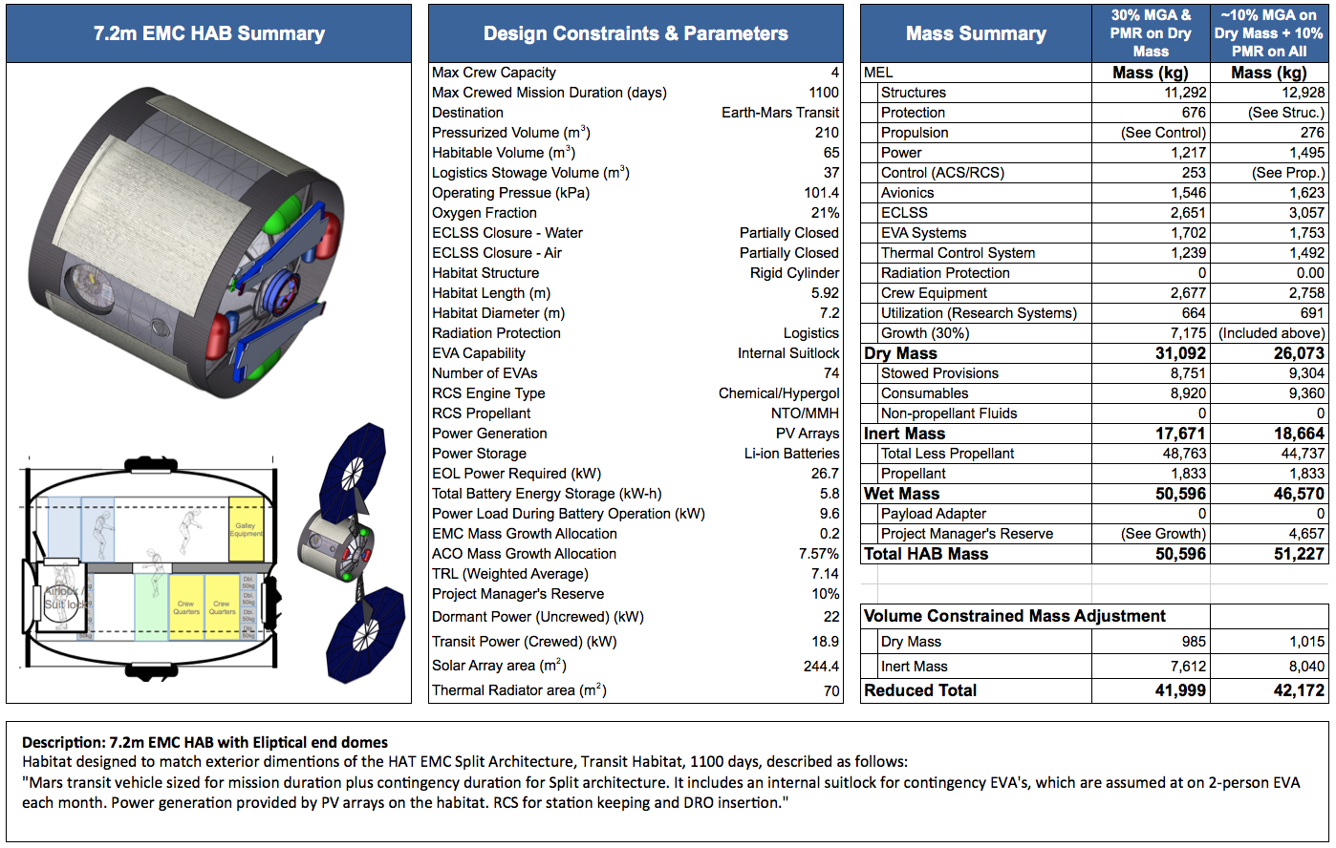
Two Deck Vertical Configuration
Design and Mass Summary (Using Elliptical End-domes)

Slide 14
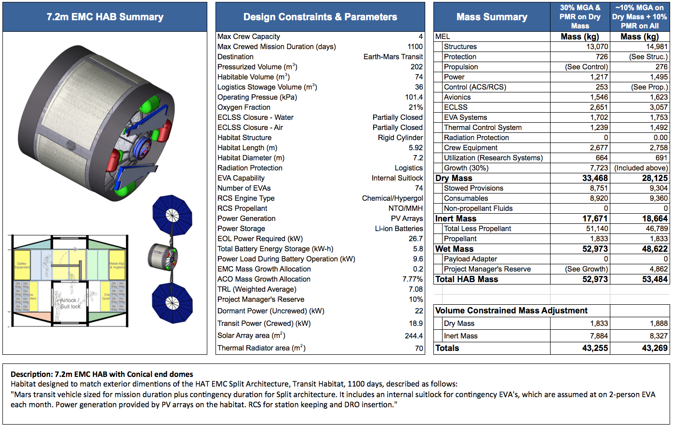
Two Deck Vertical Configuration
Design and Mass Summary (Using Conical End-domes)

Slide 15

Reference EMC Habitat for Assessment

Slide 16
Primary Findings
Volume:
  Usable habitable volume is about 65 m³. An additional 35 m³ is needed to reach the 100 m³ indicated for the EMC habitat habitable volume.
  Stowage volume available is about 37 m³. An additional 28 m³ is needed to reach the ~65 m³ indicated for the EMC habitat stowage volume.
Mass:
  The ACO structures mass is about twice that listed for the EMC habitat mass, which accounts for the primary systems mass differences between the EMC and ACO estimates.
Growth
  The EMC habitat applies the 20% MGA and a 10% PMR to the dry mass, whereas the ACO applies a lower ~10% MGA to the dry mass based on systems maturity and a 10% PMR to the entire vehicle. The end result is similar, but a common book keeping method for growth needs to be agreed too.

Slide 17
Vehicle Configurations
Payload Launch Configuration
Payload Flight Configuration

Slide 18
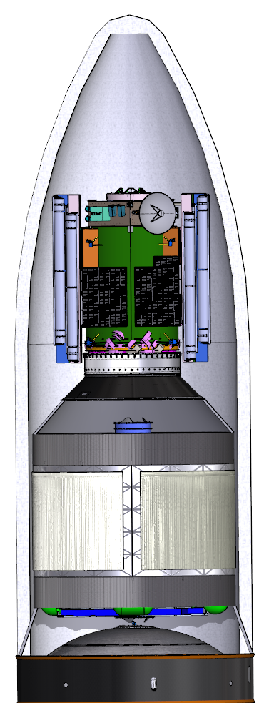
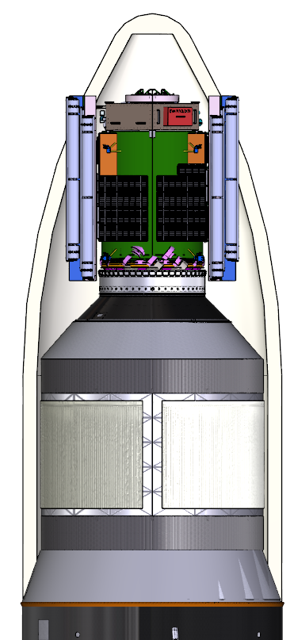
Payload Configurations
62’ Short Shroud
8.4m diameter
New 75’ Shroud under consideration
8.4m diameter

Slide 19
SEP / HAB configuration

Slide 20
Systems Summaries

Slide 21
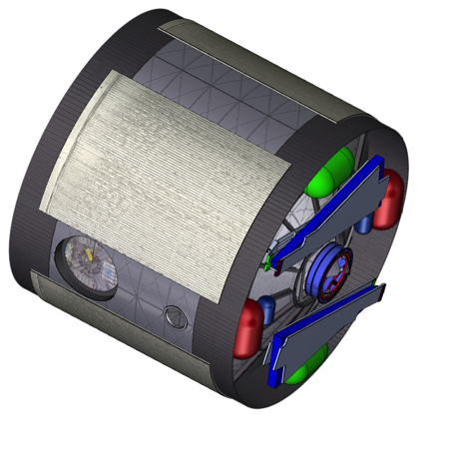
Systems Design Heritage
ACO Systems Design Heritage
  Orion MPCV:
    Avionics, ECLSS, Thermal
  ISS:
    Crew Systems, ECLSS, EVA Systems
  Gateway Study:
    Power: Advanced Modular Power (AMP)
  Shuttle:
    Propulsion / RCS
  SLS:
    Structures
ACO Sizing Approach
  Habitat Average Technology Readiness Level (TRL): 7.14
  Mass Growth Allowance (MGA): 9.57%
    MGA determined at subsystem level based on Depletion Schedule from AIAA Standard
    Low MGA based on high TRL for many systems
  Project Managers Reserve: 10%
Issues
  Structures mass in comparison to EMC mass
  Volume
    Habitable Volume too small for long duration missions
    Overall Volume insufficient for all systems
    Duplicate volume for safe haven needed
  ECLSS spares and expendables

Slide 22
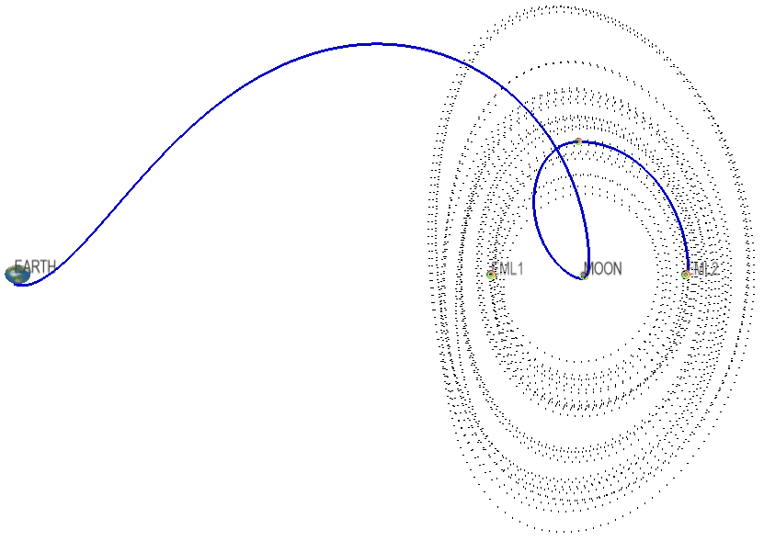
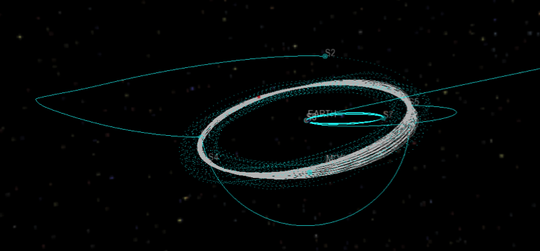
Mission Analysis
Delivery of payload to LDRO using SLS, EUS, and integrated propulsion
2 Options considered
  Fast Insertion: 9 days / 320 m/s
  Slow Insertion: 200 days / 130 m/s
Fast Insertion
Mission analysis approach
  Copernicus used to evaluate Fast Insertion option
  Slow Insertion option developed by LaRC
  Both options represent point designs on a continuum of flight time & ΔV
Slow Insertion

Slide 23
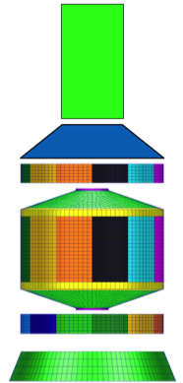
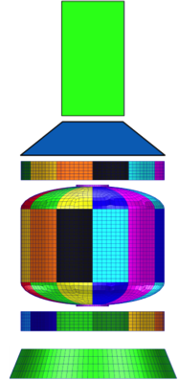
Primary Structure
Primary Structures Analyzed
  Habitat (Pressure Shell)
  Forward Skirt
  Aft Skirt
  End Port structure
Forward Skirt
Habitat
Aft Skirt
Notes:
Two configurations were evaluated for this study
Payload adapter not analyzed. Provides boundary stiffness for Aft Skirt
Conical End Dome
Elliptical End Dome
Structures Notes
  All primary structure 2219 Aluminum
  Pressure Shell designed to withstand 2 standard earth atmospheres (30psi)
  All sub-system mass included in the finite element model
  Loads applied using mass inertia and vehicle acceleration
Issues
  Conical Dome option not as structurally efficient as elliptical dome option
  Beta Cloth used for protection on Domes
  Thermal radiators on Habitat Barrel may act as environmental protection.
  MDPS assumed to cover Habitat Barrel (May not be required)

Slide 24
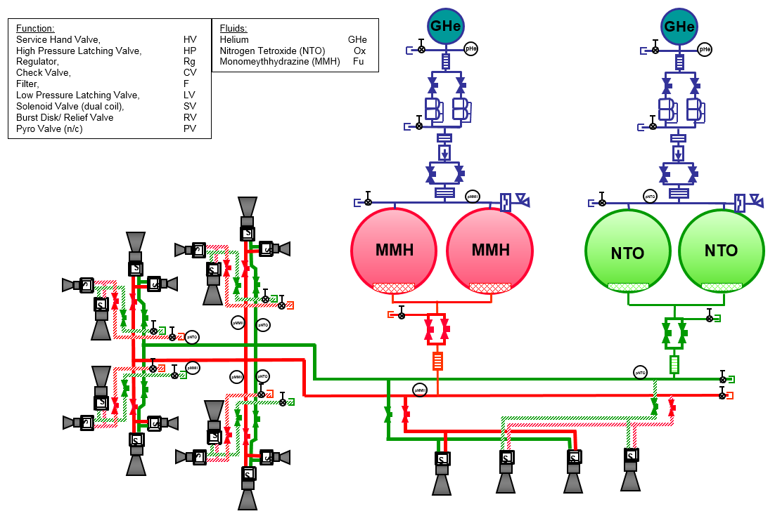
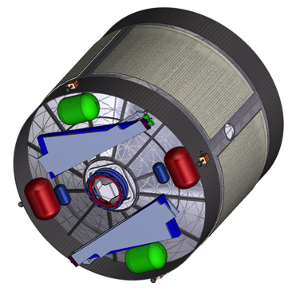
Reaction Control Propulsion System
Propulsion System Schematic
Hypergolic, pressure-regulated propulsion system. Nitrogen tetroxide: oxidizer, monomethyl hydrazine: fuel.
Assumes a total propellant mass of 1752kg; ΔV ~ 130 m/s total
Redundancy: Single fault tolerant at the component level. Duel fault tolerant at the functional level.
4 Degree-of-Freedom pitch, yaw, roll, +/- X translation.
Propellant tanks uses surface tension liquid acquisition device to deliver gas free propellant.
Heritage: The propulsion system is primarily comprised of TRL 9, previously flown component hardware designs, based on the Shuttle Orbiter reaction control system as well as various unmanned satellite, including MSL Sky Crane, DoD derived satellite hardware.
Minimum delta-qualifications required for all previously flown propulsion hardware.
The chemical reaction control propulsion system is launch attached to the aft end of the Hab.

Slide 25
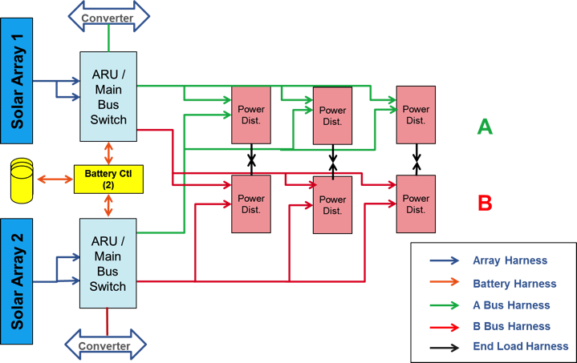
Power
Schematic
Provides 27 kW power (End of Life) using Mega Flex Solar Arrays.
Power management and distribution is fully redundant.
Power electronics are part of the Advanced Modular Power (AMP) architecture currently under development. Solar arrays are Mega Flex also under development
Issues/Risks – Most of the power systems components are TRL 6 and thus require some engineering development before they may be qualified.
Future Work
Need to develop better power and energy storage requirements – some concepts have very large (263 kWh) energy storage. If needed, consider fuel cells
Need to trade AMPS options to get least mass solution that meets requirements – centralized vs decentralized distribution.

Slide 26
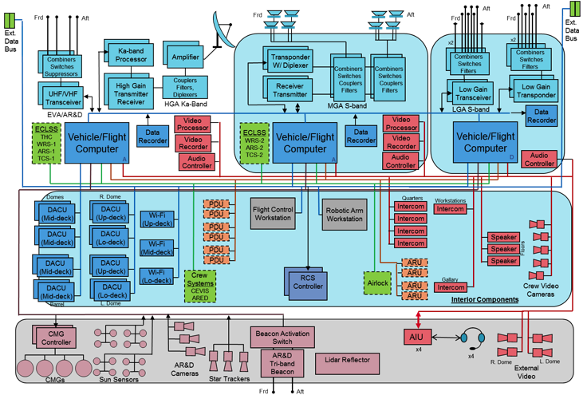
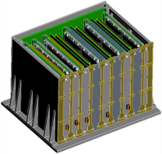

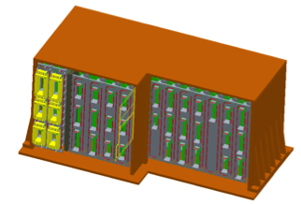
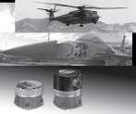
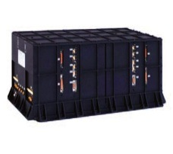

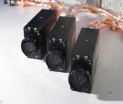

Avionics
  The Avionics System provides all command, instrumentation, data handling, and communications for the HAB.
  The avionics for the EMC HAB have been based on the MPCV crew vehicle.
  Using MPCV avionics establishes good commonality.
  The selected avionics has high TRL levels and meet radiation and thermal requirements of deep space.

Slide 27
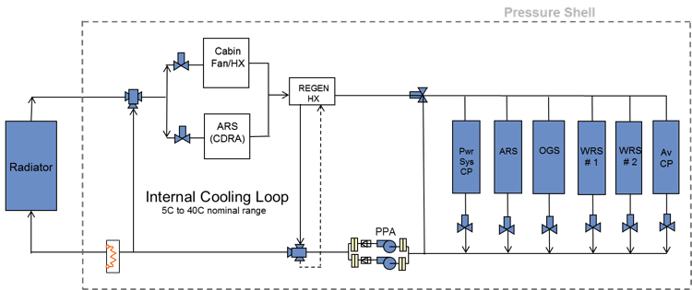
Thermal Control
Description
  Active cooling provided by ISS- derived pumped fluid loop and surface-mounted radiators.
  Radiators cover almost the entire cylindrical section of the spacecraft
  Passive system consists of multilayer insulation (MLI) and shell heaters
Notional pumped fluid loop
Design Heritage and TRL
  Active cooling system derived from ISS-heritage Hardware (TRL-9)
  MLI and shell heaters derived from ISS systems (TRL-9)
  Surface mounted radiators have flown on Apollo, but cooling requirements have increased. (TRL-Unknown)
Future Work / Issues
  Investigate integration of thermal control equipment into pressure shell interior
  Consider Orion-derived ATCS equipment
  More efficient radiators (surface mounted or deployable) will need to be developed to accommodate higher heat loads and tighter design constraints

Slide 28
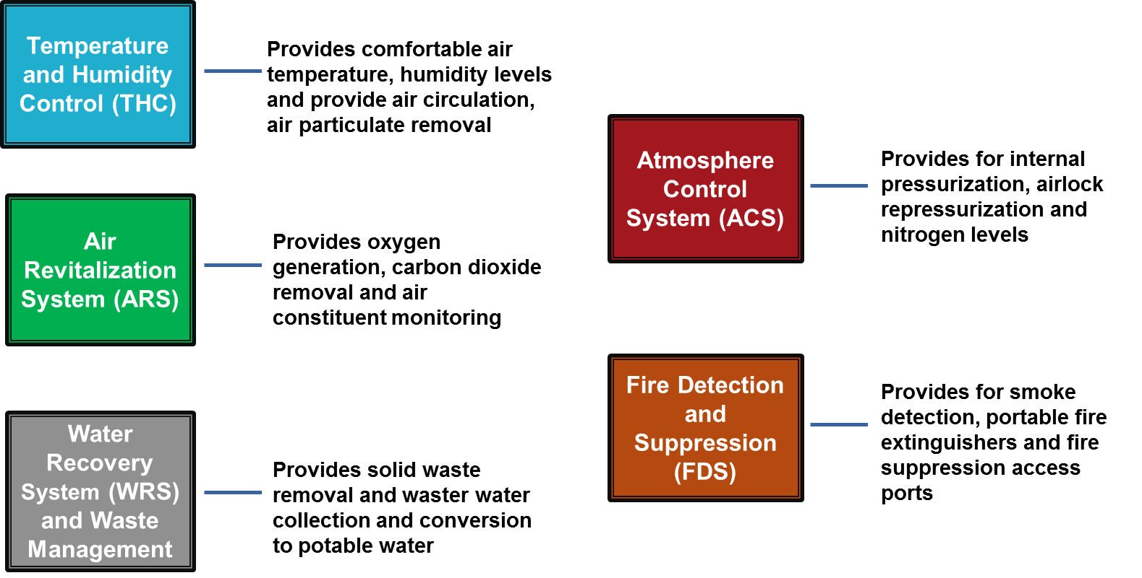
ECLSS
The total ECLSS function is comprised of five (5) subsystems:
  Atmosphere Revitalization Subsystem (ARS)
  Atmosphere Control and Supply Subsystem (ACS)
  Temperature and Humidity Control Subsystem (THC)
  Fire Detection and Suppression Subsystem (FDS)
  Water Recovery and Management (WRM)
ECLSS architecture utilizes existing and near-term upgrades of ISS equipment items and planned MPCV technologies where TRL are considered high
Issues/Risks – Most of the ECLSS systems are designed for ISPR integration; therefore modifications are required for use in a non-rack based habitat. ECLSS relies on significant plumbing between each subsystem and can require extensive routing and dictate equipment placement.
Issues
  Hardware sizing based on ISS systems and sized on a sizing tool for 4 crew / 1100 day missions.
  Spares and expendables sized from previous studies that investigated ISS spares and expendables requirements

Slide 29
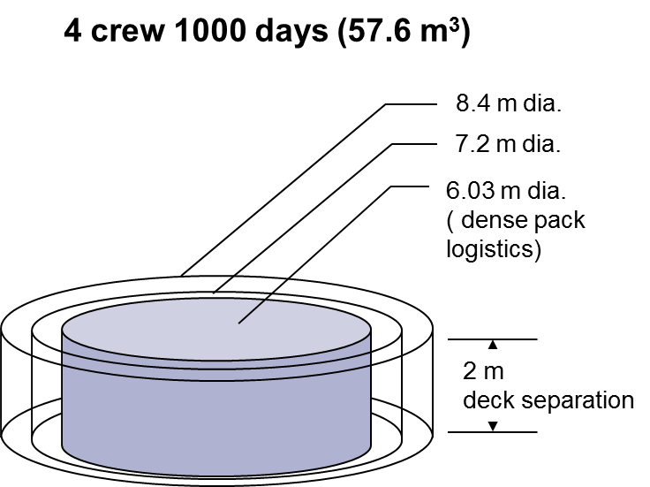
Crew Systems
Logistics Volume
Two Internal layouts developed
Two axial NDS hatches
7.2 m Dia. requires 2 recessed radial ports for NDS and EVA hatch
Stowage dominates volume
Same crew systems for each
1m x 1m Individual crew quarters (position and stowage for radiation protection)
1m corridor
Issues
  Not all crew system can be packaged into pressure vessel
  Access to stowage needs to be factored into volume
  Layouts need further development
  Laundry is provided, but disposable clothing mass is booked in MEL. Possible mass reduction item.

Slide 30
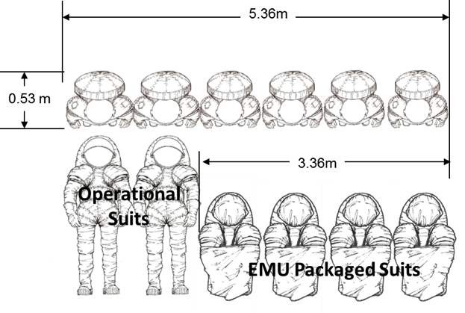
EVA
Volume (six suits)
Airlock included for weightless operations
Assume
  36 EVAs (two crew each)
  Six Rear-entry suits (4 packaged)
  Suits package into ISS EMU volume
Advanced Exploration Suits
Compatible with Suitport
STS Airlock sizing and mass used for transit hab
External EVA accommodations
Repress gas
Suit operational life
Suit maintenance volume
Four suits to surface?

Slide 31
Backup
Acronyms & Abbreviations

Slide 32
Acronyms & Abbreviations
ACO Advanced Concepts Office
AES Advanced Exploration Systems
AL Airlock
ARM Asteroid Retrieval Mission
ARV Asteroid Retrieval Vehicle
A/SM Augmentation / Service Module
CBM Common Berthing Mechanism
DM Docking Module
DRO lunar Distant Retrograde Orbit
EAM Exploration Augmentation Module
ECLSS Environmental Control & Life Support System
EELV Evolvable Expendable Launch Vehicle
ELV Expendable Launch Vehicle
EUS Exploration Upper Stage
EVA Extravehicular Vehicular Activity
GCR Galactic Cosmic Rays
HAB Habitat
HAL Habitable Airlock
iCPS Interim Cryogenic Propulsion Stage
ISS International Space Station
kg kilograms
LDRO Lunar Distant Retrograde Orbit
LEO Low Earth Orbit
LLO Low Lunar Orbit
LM Logistics Module
m meter
MEL Master Equipment List
MGA Mass Growth Allowance
mt metric tons (1000 kg)
MPCV Multipurpose Logistics Module (Orion)
NDS NASA Docking System
NRO lunar Near Rectilinear Orbit
PLSS Portable Life Support System
PMR Project Managers Reserve
SEP Solar Electric Propulsion
SKG Strategic Knowledge Gaps
SM Service Module
SPE Solar Proton Events
SLS Space Launch System
TCCS Trace Contaminate Control System
USA# Universal Stage Adapter No.

