Slide 1
Overview of the Dragonfly Entry Aerosciences Measurements (DrEAM) Suite
IPPW: July 20, 2021
Aaron Brandis – DrEAM Investigation Lead (aaron.m.brandis@nasa.gov), AMA/ARC
Helen Hwang (ARC), Ali Gulhan (DLR), Jose Santos (ARC), Eric Stern (ARC), Thomas Thiele (DLR), Frank Siebe (DLR)

Slide 2
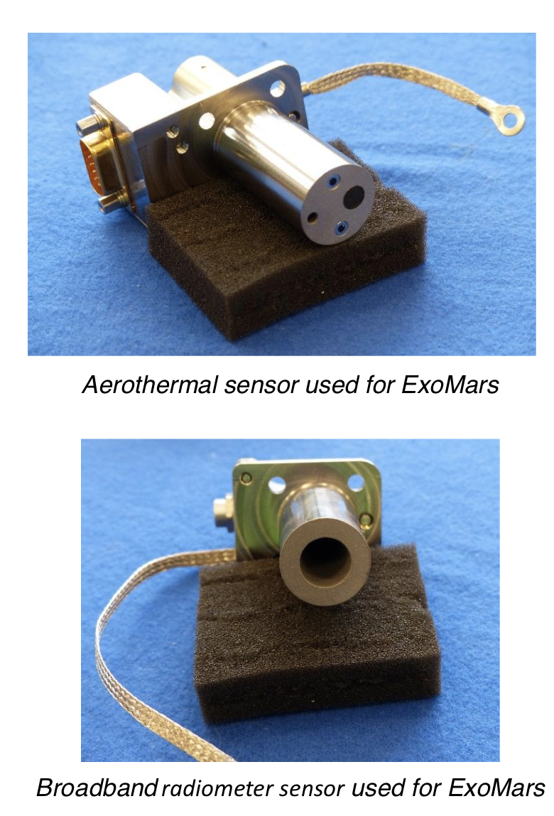
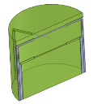
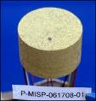
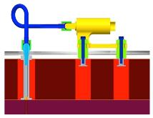
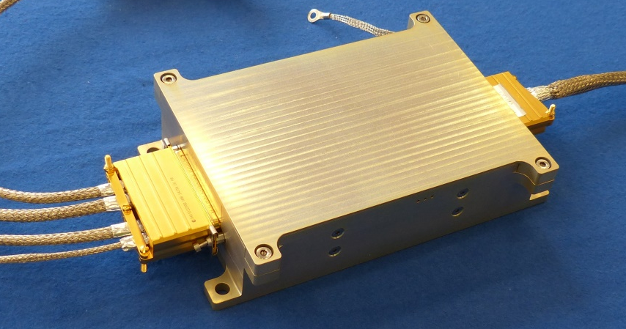
What Makes Up DrEAM?
Dragonfly Sensors for Thermal Reconstruction (DragSTR)
  In-depth thermocouples to back out the aerothermal environment and understand the material response of the thermal protection system (TPS)
Dragonfly Atmospheric Flight Transducers (DrAFT)
  Surface pressures on heatshield to understand flow and dynamics
COmbined Sensor System for Titan Atmosphere (COSSTA)
  Backshell sensors for radiative & total heat flux, pressure and temperature. Main focus to understand radiative heating from CN.
Data Acquisition System (DAS)
  DLR is also providing the data acquisition system for all the DrEAM instruments

Slide 3
ESI Measurement Categories: Dragonfly/DrEAM
  As identified in the proposal call, the minimum requirement for the ESI is to meet two high-priority goals and one medium-priority goal.
  DrEAM proposes to exceed these requirements by achieving two high-priority goals (aerothermal environments and TPS response), two medium-priority goals (atmospheric density measurements and vehicle aerodynamics), and one additional goal (radiation, indicated as “low priority” in the AO ESI package but widely considered to be more important for Titan than this might suggest)..

Slide 4
DrEAM Requirements & Goals
  High level goals for Dragonfly Entry Aerosciences Measurements (DrEAM):
    Measure near surface and in-depth temperatures in the heatshield
    Measure pressure at the heatshield surface
    Measure pressure on the aft TPS
    Measure aft radiative and total heat flux
  Constraints:
    New Frontiers budget
    Data acquisition bandwidth
    Minimize data for storage and Earth transmission
    No harm to the mission and primary science objectives
    Minimal interference to primary mission operations
  Solution:
    Using heritage and flight proven systems
      Utilize plugs similar to MEDLI MISP/MEADS and COMARS
      DLR provided data acquisition system and aftbody sensor suite
First ever dataset of this sort at Titan (and first in non-oxidizing environment)

Slide 5
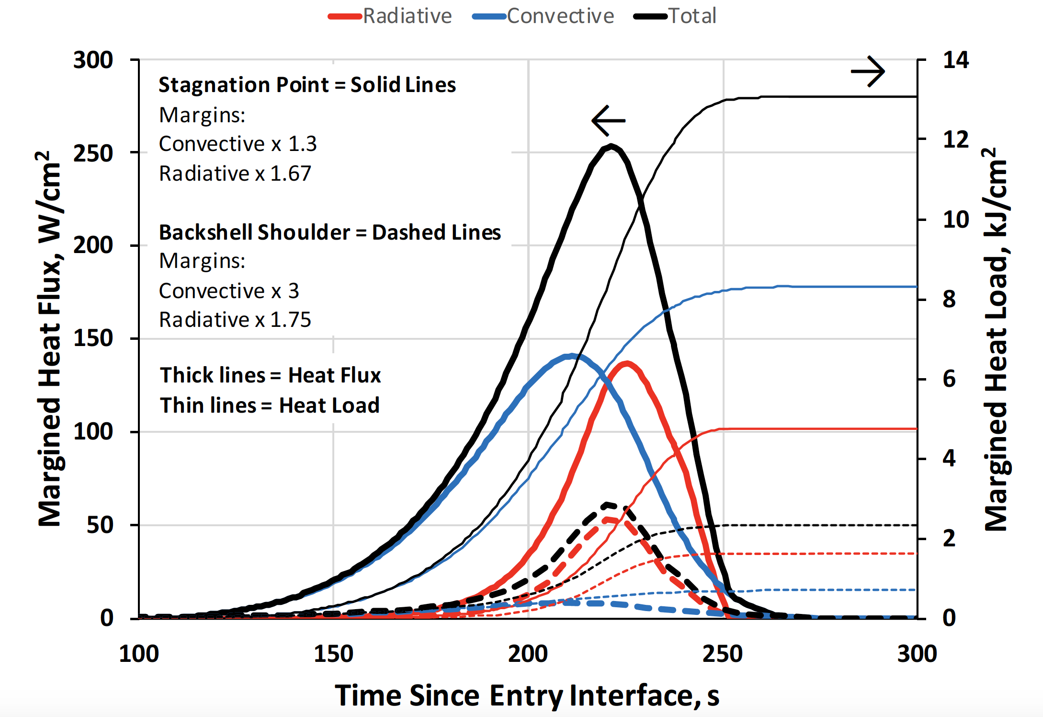
CSR Aerothermal Environments
Similar order of total heat flux compared to MSL / Mars 2020
  Dragonfly a little higher, particularly on fore-shoulder
Backshell heating dominated by radiation

Slide 6
Preliminary List of Science Objectives
Understand:
TPS response in non-oxidising environment
Forebody aerothermal environment
If excessive recession occurred
Aftbody radiative heating and impact on TPS design
Aftbody CN radiative heating (violet and red bands)
Composition of Titan upper atmosphere, and effect on radiative heating
When and how the heatshield flow transitions away from laminar
Convective cooling and its effect on providing relief for the bondline temperature, thus reducing required TPS thickness

Slide 7
Example of Preliminary Level 1 Requirements
D-L1-001: Aeroheating Environment
  DrEAM shall be able to determine the aeroheating environment during the atmospheric entry flight phase (Measurement: near & in-depth TC for heat pulse)
D-L1-002: Flow Transition
  DrEAM shall be able to determine across the heat shield when the boundary layer transitions away from laminar flow (multiple plugs with near surface TC for heat pulse)
D-L1-003: Thermal Soak
  DrEAM shall be able to determine the effect of thermal soak on the TPS response from Entry Interface until heat shield jettison (multiple in-depth TC until heat shield sep.)
D-L1-005: Atmospheric Composition
  DrEAM shall be able to determine the methane mole fraction in the Titan atmosphere during the atmospheric entry flight phase (narrow band radiometers)
D-L1-006: Heat Flux Measurement
  DrEAM shall be able to measure heat flux on the entry vehicle during the atmospheric entry flight phase (radiometers, total heat flux)
D-L1-009: Aerodynamic Force Coefficients
  DrEAM shall be able to determine the aerodynamic force coefficients during the atmospheric entry and descent flight phases (pressure transducers)

Slide 8
Partnering with DLR
  DLR developed and flew sensors (COMARS) on the backshell of the Schiaparelli mission. These sensors successfully measured heat flux, both total and radiative, confirming radiative heating due to CO₂ for the first time at Mars.
    NASA was interested in partnering with DLR to have them provide COMARS for New Frontiers missions.
  DLR will be developing the COSSTA instrumentation suite for DrEAM. As a co-investigator, they are equally invested as NASA to receive and analyze the data.
  DLR is providing the DAS (3 boxes) for DrEAM.
      Both the electronics box and sensors have been validated for flight through shock and vibe testing as well as appropriate bounds for Mars operating temperature environments.

Slide 9
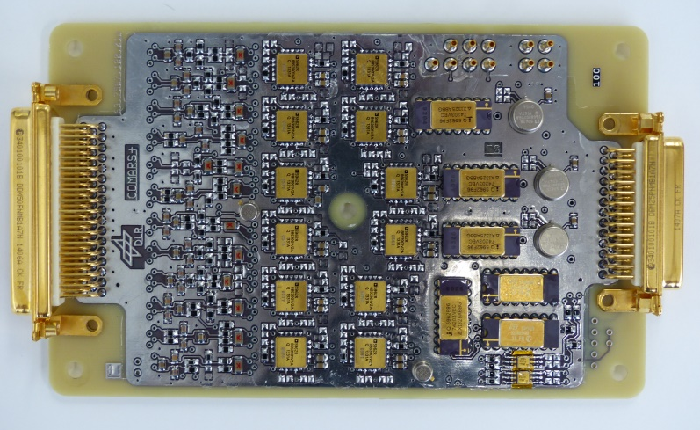
Dragonfly DLR Instrumentation
Overall 24 measurement channels available for each Multiplexing Card.
Depending on used pressure sensors (DraFTs, COSSTA) card design update is necessary to include sufficient power supply channels for pressure sensors.
Two analog electronic boxes are used for sensor signal conditioning and multiplexing. One box is placed at the front-shield and one at the aft-shield.
The analog electronic box contains one Multiplexing Card and one Power Card (containing DC/DC-converter and EMI-filter).
Multiplexing Card used for ExoMars Schiaparelli
Electronic box used for ExoMars Schiaparelli

Slide 10
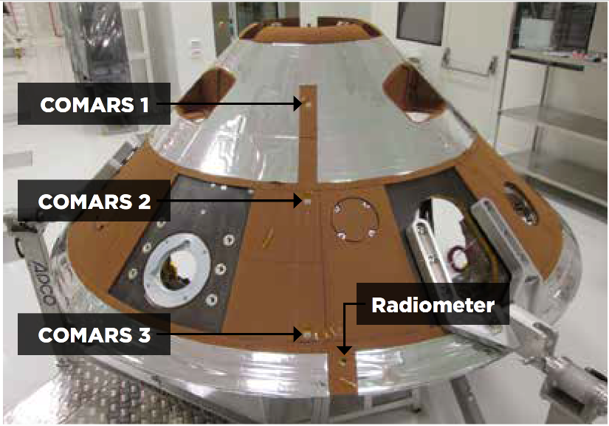
Comparison with DLR Flight Data: COMARS2
Total heat flux dominated by radiation
Excellent agreement with flight data, within 16% (generally much better).
Some higher relative error near noise floor of flight data, but absolute difference < 0.1 W/cm²
Measurements show that despite Schiaparelli crash, COMARS worked well, and our simulation tools show good agreement with the flight data.

Slide 11
Front-Shield Instrumentation - Sensor Overview
Sensor | Quantity | # Channels | Comments
DragSTR Thermocouples | 10 | 10 | 3-5 thermal plugs (depending on number of thermocouples per plug)
DrAFT | 4 | 12 | Pressure sensor with three measurement channels each (power supply, pressure signal, reference temperature)
Thermocouple Cold-Junction-Compensation (CJC) | 2 | 2 | Temperature sensor placed near main sensor connector on Multiplexing board (junction between thermocouple wires and PCB). (One housekeeping temperature sensor of the Multiplexing board is used as additional CJC temperature sensor)
 | Total | 24

Slide 12
Backshell Instrumentation – Sensor Overview
Sensor | Quantity | # Channels | Comments
DragSTR Thermocouples | 2 | 2 | One thermal plug with two thermocouples
Combined aerothermal sensor (COSSTA) | 2 | 14 | Each containing: 1 total heat flux sensor (2 channels: heat flux signal, sensor temperature) 1 pressure sensor (2 channels: supply voltage, sensor signal) 2 narrowband radiometers (2 channels: signal wavelength 1 & 2) 1 temperature sensor (reference temperature for pressure sensor and radiometer)
Combined aerothermal sensor (COSSTA) | 1 | 5 | Containing: 1 total heat flux sensor (2 channels: heat flux signal, sensor temperature) 2 narrowband radiometers (2 channels: signal wavelength 1 & 2) 1 temperature sensor (reference temperature for pressure sensor and radiometer)
Broadband radiometer (COSSTA) | 1 | 2 | Total radiative heat flux (2 channels: sensor signal, sensor temperature)
TC CJC | 1 | 1 | Temperature sensor for Cold-Junction-Compensation (CJC) of thermocouple measurements
 | Total | 24

Slide 13
Preliminary Sensor Layout
Dragonfly Sensors for Thermal Reconstruction (DragSTR):
  5 forebody TC plugs, 1 aftbody TC plug
Dragonfly Atmospheric Flight Transducers (DrAFT):
  4 forebody pressure transducers
COmbined Sensor System for Titan Atmosphere (COSSTA):
  3 combined total heat flux, pressure and temperature sensors
  1 radiometer

Slide 14
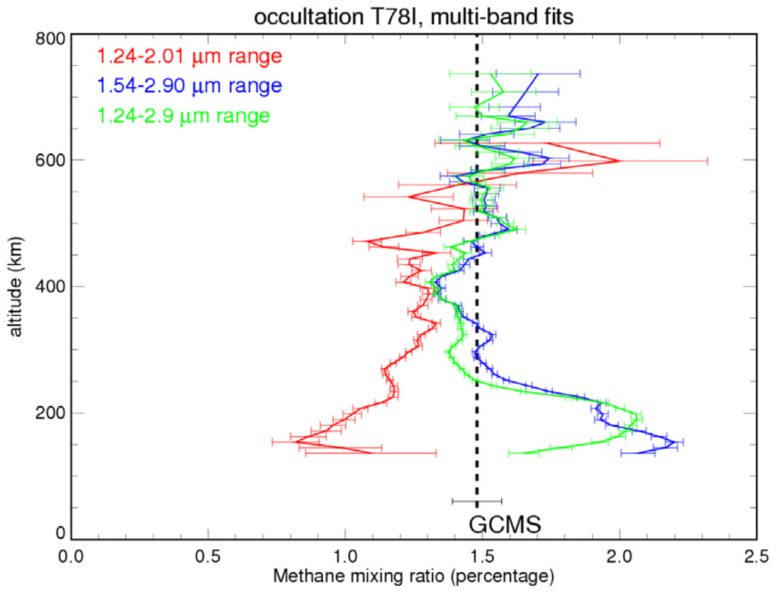
Reconstruction of DrEAM data
To reconstruct the DrEAM data, we will need to know the Titan atmospheric composition. Radiation is very sensitive to the amount of CH₄
The uncertainty in CH₄ for upper altitudes (~500 to 180 km) is about 0.9 to 2.2%.
How can we get a better estimate of CH₄ concentration to analyze DrEAM data?
Obviously can’t be measured directly…
Q: Could we infer CH₄ concentration from narrow band radiometers?
  Preferably a way to do this where you don’t have to assume the model is correct, allow for errors in sensor calibration
Peak heat flux, ~ 225 km
Maltagliati et al “Titan’s atmosphere as observed by Cassini/VIMS solar occultations: CH₄, CO and evidence for C₂H₆ absorption” Icarus 248 (2015) 1-24

