Slide 1
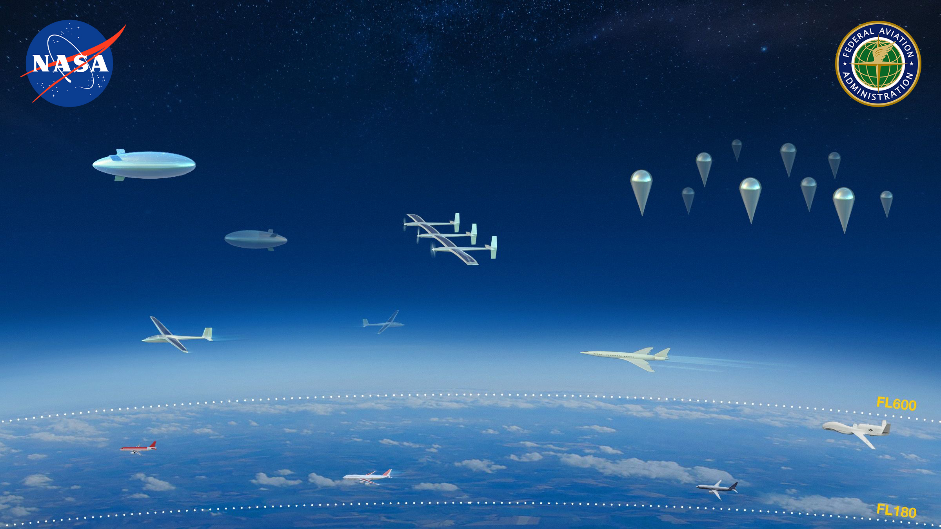
Intent Modeling and Intent Conflict Probability Calculation for Operations in Upper Class E Airspace*
Presented by: Min Xue
xTM subproject Technical Lead
NASA Ames Research Center, Moffett Field, CA
ETM Workshop July 21~22, 2021
* M. Xue, J. Jung, J. Homola, and H. Yoo, “Intent Modeling and Conflict Probability Calculation for Operations in Upper Class E Airspace”, AIAA Scitech Forum, January 3-7, 2022

Slide 2
What is flight intent?
In early ATM studies^{[1][2]}
  Flight intent was mostly defined in the form of a flight plan, such as Trajectory Change Points (TCPs).
  Trajectory prediction was separated from flight intent formulation.
  Flight intent and trajectory prediction were mainly developed for tactical situations.
In UTM^{[3]}, flight intent is submitted and shared in the form of an operation plan, which should “indicate the four-dimensional volume of airspace within which the operation is expected to occur”. Furthermore, “segmentation of the 4D volume is encouraged to promote the efficient use of airspace”.
[1] Zhao, Y., Haissig, C., and Hoffman, M. J., “Analysis of Pilot Intent Parameters in Air Traffic Management,” Proceedings of the American Control Conference, Philadelphia, PA, 1998.
[2] Ruigrok, R., and Valent Clari, M., “The Impact Of Aircraft Intent Information And Traffic Separation Assurance Responsibility on En-route Airspace Capacity,”2003 ATM R&D Seminar, Budapest, Hungary, 2003.
[3] UTM Concept of Operations v2.0, FAA, 2020.

Slide 3

Existing intent models in UTM and needs of advanced models
Static/dynamic 4D volume
Segmented dynamic volume
Problems with larger-than-necessary 4D volumes:
Inefficient use of airspace
Gaming and unfair use of airspace due to the arbitrariness
Unnecessary flight detours, interactions, and negotiations
Not making full use of known information (vehicle performance, wind, modeling technology, etc.)
Challenge with integrated and scalable airspace operations

Slide 4
A flight-plan-based probabilistic flight intent model
Goal:
  Minimize the 4D intent volume within which the operation is expected to occur
  Provide accurate intent conflict probability that Cooperative Operating Practices (COPs) can rely on
Inputs:
  4D Flight plan
  Wind information (nowcast, forecast, including uncertainty)
  Vehicle trajectory control performance
Output: probabilistic 4D flight intent volumes

Slide 5
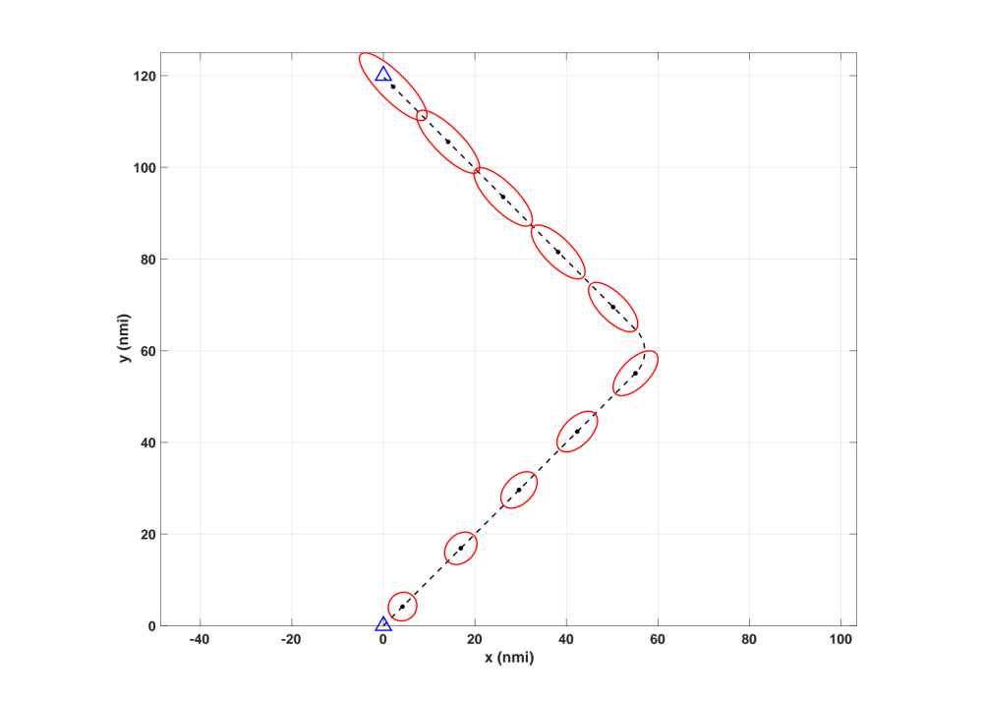
Probabilistic intent model : fixed wing aircraft
cross-track error
Assumption:
wind follows a Normal distribution
along-track error
Step 1: calculate the nominal 4D trajectory
Step 2: calculate the error ellipses along the nominal trajectory.
Wind vector
(mean)
Wind vector
(std.)
Along-track error
caused by airspeed and wind errors
Grows with time
Cross-track error
Constant, depending on the vehicle lateral control performance

Slide 6
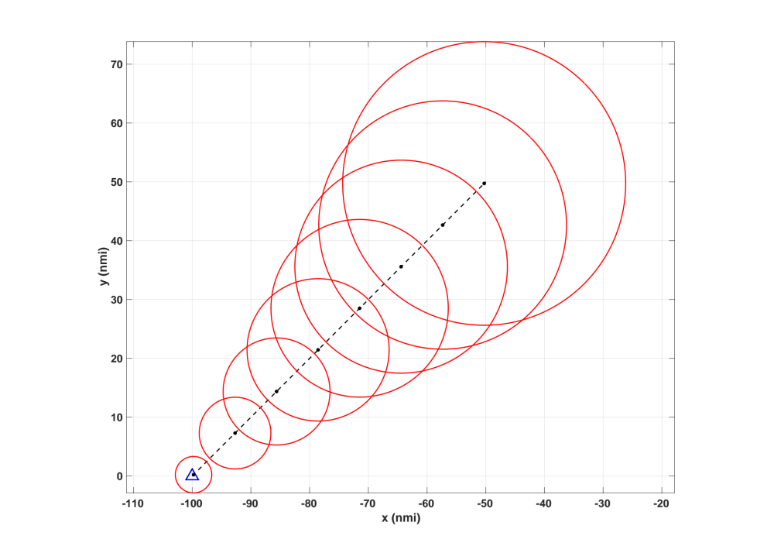
Probabilistic intent model : balloon
Assumption:
wind follows a Normal distribution
Wind vector
(mean)
Step 1: calculate the nominal 4D trajectory caused by wind mean vector
Step 2: calculate the error ellipses along the nominal trajectory.
Wind vector
(std.)
Along-track error
caused by airspeed and wind errors
Grows with time
Cross-track error

Slide 7
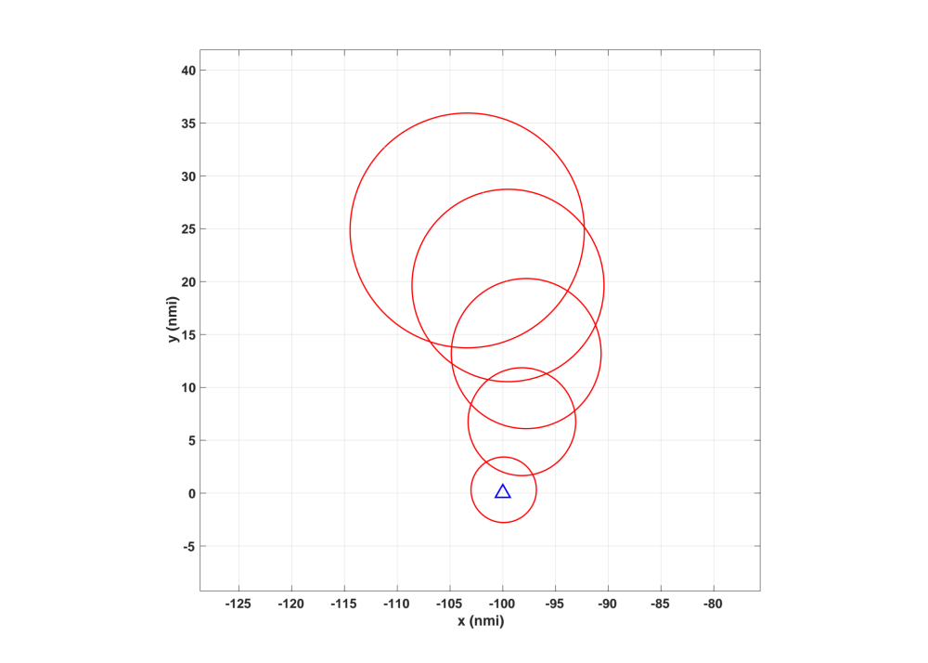
Probabilistic intent model : balloon with a ”flight plan”
A balloon climbs to a specified altitude - a flight plan with vertical segments
Operational intent for a balloon climbing in a wind field changing with altitude
Mean direction changes when altitude increases
Wind vector
(mean)
Wind vector
(std.)

Slide 8
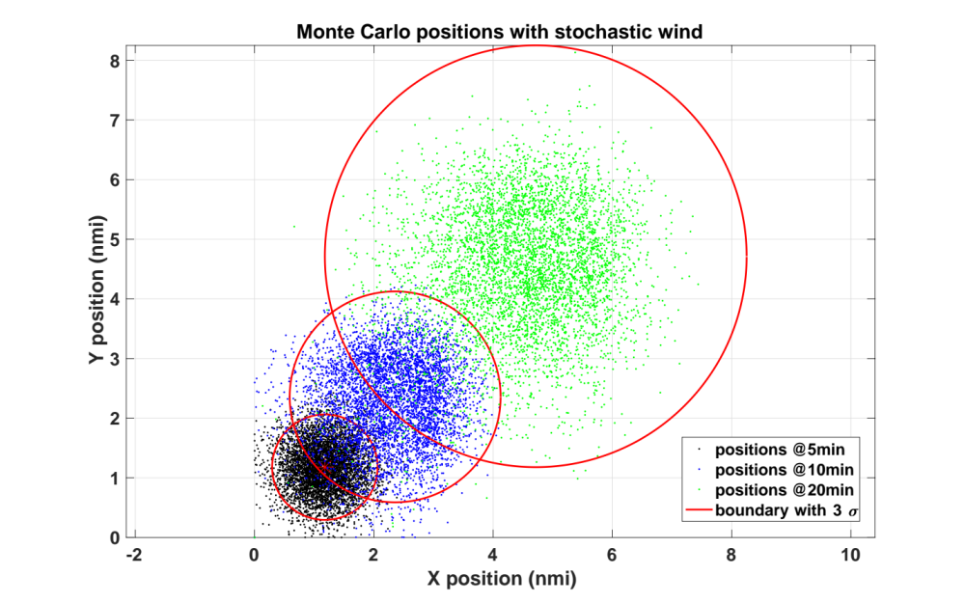
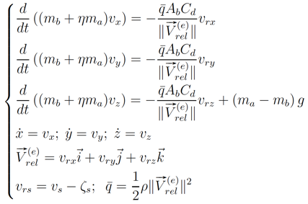
Verification with simulations
Balloon free-floating at the origin (0,0)
A total of 5,000 Monte Carlo simulations
A wind field following a Normal distribution
  Mean wind vector: 20 kts NE wind
  Wind std: 5 kts
Fe³ traffic simulator^{[2]} is used:
  Trajectory generated @ 2Hz
  A dynamic model for the balloon
Wind vector
(mean)
Wind vector
(std.)

Slide 9
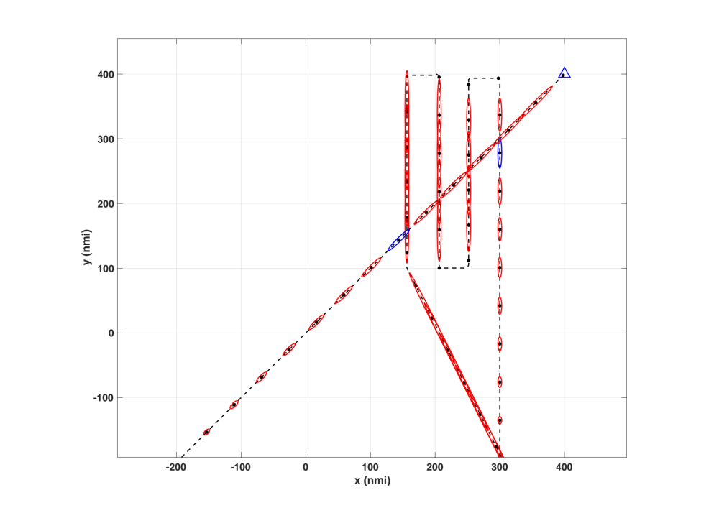
Incorporate uncertain flight plans and longer look-ahead times
25%
50%
Wind
Mean = 20kts
Flight plans uncertainty in spatial dimensions
Flight plans uncertainty in time
Can be simply used for longer look-ahead times
25%
Std. = 5 kts
starts 5 min earlier (20% likelihood)
starts on time (60% likelihood)
starts 5 min later (20% likelihood)
6-hour mission
Global Hawk
@ 340 kts
Global Hawk
@ 340 kts
Notes:
Hwang

Slide 10
Calculating Intent Conflict Probability

Slide 11
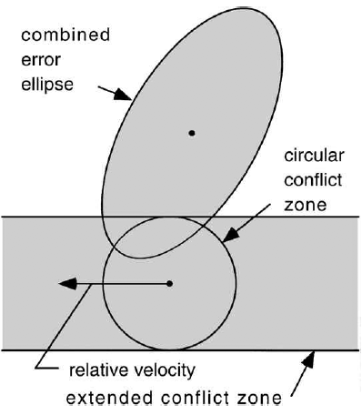
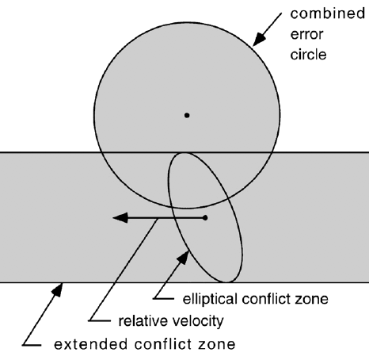
Calculation of intent conflict probability: Paielli’s method
Assumptions:
Relative velocity vector is constant
Combined error ellipse is constant
Total prob.
Instant prob.
Error ellipse modeling
Combined error ellipse*
Transformed combined error ellipse*
* R. Paielli, et. al. “Conflict Probability Estimation For Free Flight”, pp.588-596, Vol. 20, AIAA JGCD, 1997.

Slide 12
Calculation of intent conflict probability: Hwang’s method
* Hwang, I., and Seah, C. E., “Intent-Based Probabilistic Conflict Detection for the Next Generation Air Transportation System, ”Proceedings of the IEEE, Vol. 96, No. 12, 2008, pp. 2040–2059.
Notes:
Hwang

Slide 13
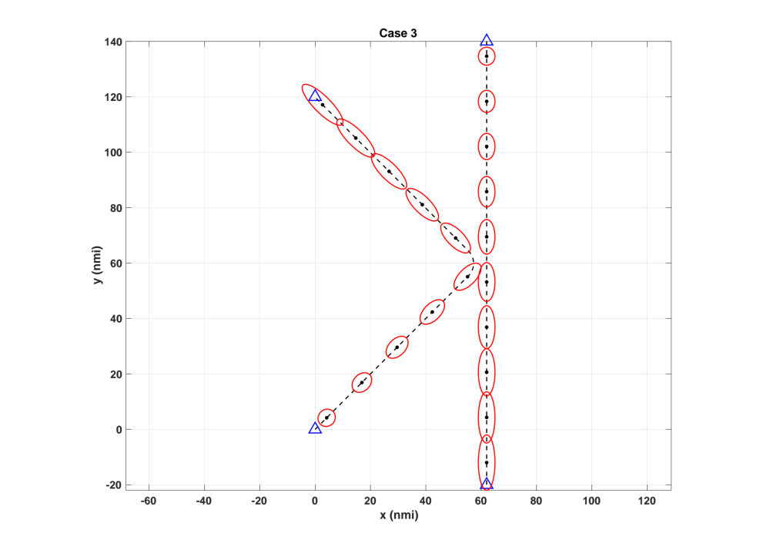
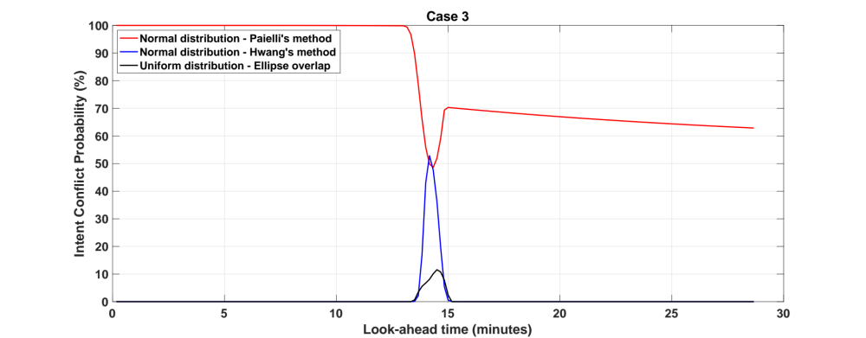
Comparison of methods
Mean = 20kts
Std. = 5 kts
Paielli’s method overestimates and doesn’t tell when the intent conflict will happen.
The “ellipse overlap” method is inaccurate and unreliable.
Notes:
Hwang

Slide 14
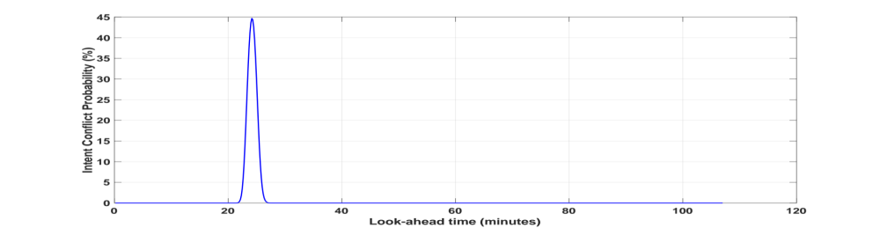
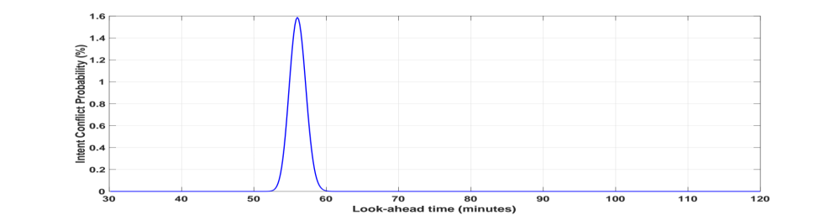
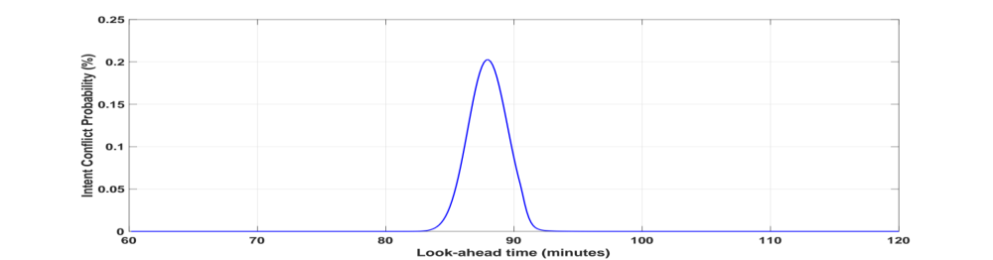
Sample scenario: a balloon and a Global Hawk
45%
Global Hawk starting now
1.6%
Global Hawk starting 30 minutes later
Wind
Mean = 20kts
Std. = 5 kts
Global Hawk starting 60 minutes later
0.2%
Notes:
4Hwang

Slide 15
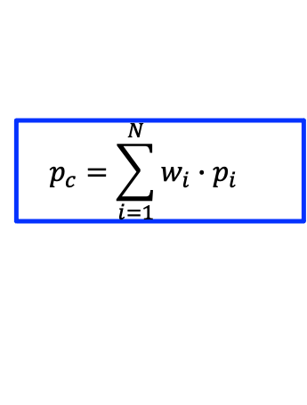
Probability with uncertain flight plans
25%
Mean = 20kts
50%
$$p_{c}=\sum_{i=1}^{N}{{w_{i}∙p}_{i}}$$
25%
Std. = 5 kts
starts 5 min earlier (20% likelihood)
starts on time (60% likelihood)
starts 5 min later (20% likelihood)
Notes:
Hwang

Slide 16
Summary
Proposed a flight-plan-based intent model that can:
  Minimize the 4D intent volume within which the operation is expected to occur
  Provide accurate intent conflict probability that COPs can rely on
  Provide time-efficient calculation of intent conflict probability
  Prevent gaming and promote equal and efficient use of airspace
  Support uncertain flight plans and strategic planning (longer look-ahead time)
  Accelerate integrated airspace operation
As a foundational component of UTM/xTM like system, operational intent will be discussed at tomorrow’s breakout session.

