Slide 1
Bayesian Genetic Programming Based Symbolic Regression
with Preferential Search
Karl Garbrecht¹, Nolan Strauss¹, Geoffrey Bomarito², Patrick Leser², Jacob Hochhalter¹
¹ University of Utah, ² NASA Langley Research Center
Notes:
1

Slide 2
Background
Genetic Programming Based Symbolic Regression (GPSR)
  interpretable symbolic models
  set of different models from which to select the most suitable form
Contemporary applications in material modeling and computational mechanics
  isotropic yield function with hardening: Bomarito et al., 2021¹
  multi-scale constitutive coefficients: Kotha et al., 2019 and 2020²
  temperature and strain rate dependent flow stress: Versino et al., 2017³
2

Slide 3

GPSR Overview
Genetic Programming Symbolic Regression (GPSR) - proposes, evaluates, and evolves solutions given fitness function and training data
Initial Solution Generation
Model Represented as a Directed Acyclic Graph
Chromosome | 6 | 5 | 4 | 3 | 2 | 1 | 0
Main | + | * | a | sin() | a | b | X
Topological | 5 | 4 | - | - | - | - | -
 | 1 | 3 | - | 0 | - | - | -
Evaluation
+
Propose New Models
Selection
*
b
$$a∗sin\left(x\right)+b$$
a
sin
Potential Solutions
x
3
Notes:
3

Slide 4
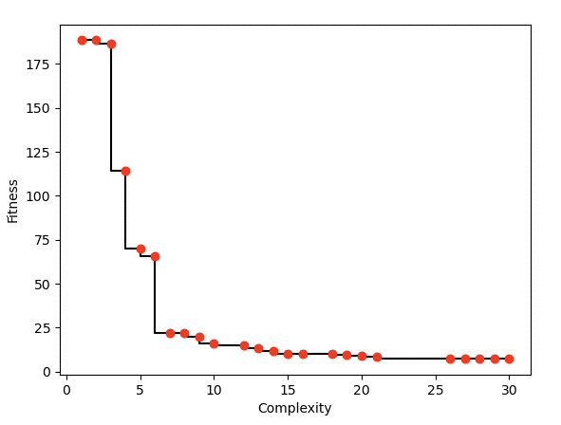
GPSR Results Discussion
Deterministic Algorithm
  prone to generate complex or overfitted models with many parameters and terms with sufficiently sparse/noisy data
GPSR Model Complexity vs Fitness
potential under-fitting
Bayesian Algorithm
  allows for unbiased model comparisons wrt observed data
  evaluation includes consideration of model complexity (number of fitted parameters)
optimal balance
potential
over-fitting
4
Notes:
4

Slide 5
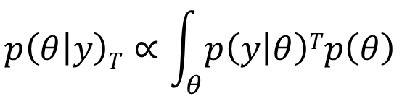
GPSR with Sequential Monte Carlo (SMC)
Initial Solution Generation
Bayesian Reformulation of Evaluation
Set Equation Priors Around Optimized Parameters
Sequentially Temper Posterior and Evaluate Equation
Selection via Bayesian Comparison
Bayesian Evaluation
Propose New Models
Selection
- Iteratively Increase T,
- Then use marginal likelihood for model selection
Potential Solutions
5
Notes:
5

Slide 6
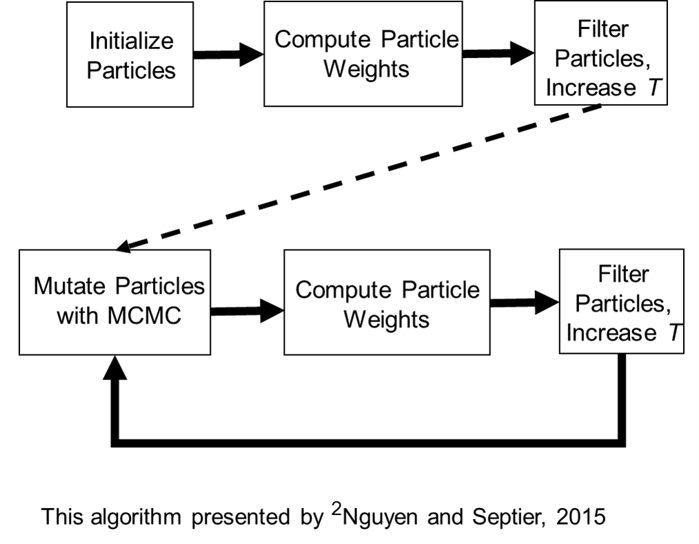
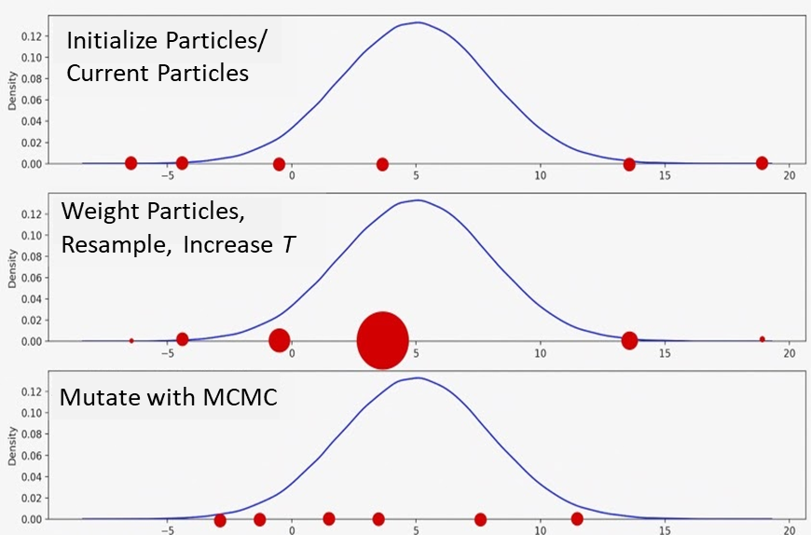
SMC Implementation
Probability Weighted Particle Filtering
Algorithm presented by Nguyen and Septier, 2015⁴
6
Notes:
6

Slide 7
Current Bayesian-GPSR Challenges
Bayesian-GPSR resource intensive, slow over-all run time
If a solution could be found with fewer Bayesian evaluations, the algorithm can be sped up
Full Bayesian
Evaluation
Strategy - propose many candidate models via multiple random cross-over and mutation events and select the most likely for Bayesian evaluation
Screen and selected preferred candidates
Selection
Propose Many New Models
7

Slide 8

Preferential Search with Spearman’s Rho
Spearman’s Rho: non-parametric measure between -1 and 1 of the ordinal association of two 1-D data sets
Key Feature
  Can be used to screen models without optimizing model parameters or conducting Bayesian fitness evaluations
Implementation uses scipy.stats.spearmansr(X, Y)
  X and Y are the observed data and the predicted data
  returns correlation coefficient (R) and associated p-value (P)
  Metric
Similar Existing Algorithm: ‘Statistical GPSR’ from MA Haeri, et al 2017
$$P^{(0.2)}∗R$$
8

Slide 9
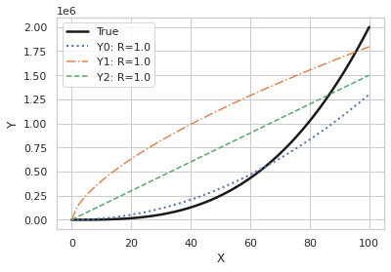
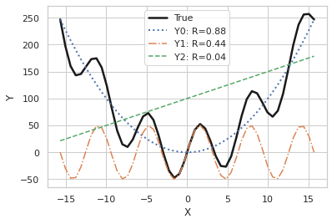
Spearman’s Rho Examples
True: x^2 + 50*sin(x)
True: 2*x^3
Y0: x^2
Y1: 50*sin(x)
Y2: 5x + 50
Y0: 130*x^2
Y1: 9e4*x^0.65
Y2: 1.5e4*x
9

Slide 10
Paris Law Trials
Paris Law w/ Noise
  C*(∆K)^{m} + Noise => 1.5e-14*(∆K)^{3.8} + norm(0, 1.5e-8)
60 repetitions of single core runs
GPSR Hyper-Parameters
GPSR | # Data | Population | Search Rate | Stack Size | Operators
Deterministic | 400 | 200 | 10 | 18 | +, -, *, /, ^, sin, exp
Bayesian | 75 | 100 | 10 | 18 | +, -, *, /, ^, sin, exp
10

Slide 11
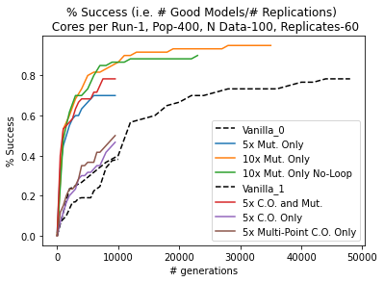
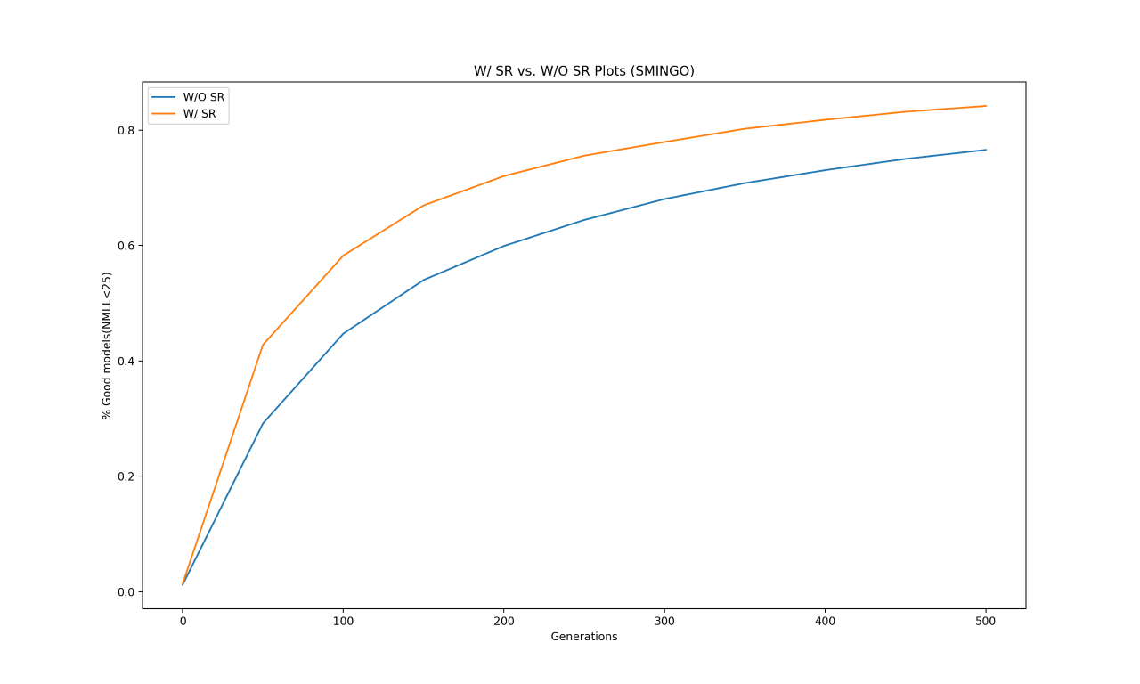
Paris Law Trial Results
Deterministic
Bayesian
100
100
50
50
Percent Success
Percent Success
0
0
0
10,000
20,000
0
250
500
# Generations
# Generations
11

Slide 12
Conclusions
Preferential search strategy with Spearman’s Rho reduces generations required for convergence
  minor increase (10-20 %) in overall percent success observed
  function of number of proposal individuals screened
  minimal over all speed up for deterministic GPSR
  approximately 40 % speed-up for Bayesian GPSR (dependent on Bayesian hyper-parameters)
Observed convergence improvement generally consistent with Statistical GPSR
12

Slide 13
Acknowledgments and Reference
Acknowledgments
The authors are grateful for experimental data made available by MID3AS Additive Manufacturing Challenge and project support from NASA Grant 80NSSC20M0128
References
Bomarito G, Townsend TS, Stewart KM, Esham KV, Emery JM, Hochhalter JD (2021) Development of interpretable, data-driven plasticity models with symbolic regression. Computers & Structures, Volume 252: 0045-7949.
Kotha S, Ozturk D, Ghosh S (2019) Parametrically homogenized constitutive models (PHCMs) from micromechanical crystal plasticity FE simulations, part I: Sensitivity analysis and parameter identification for Titanium alloys. International Journal of Plasticity 120: 296-319.
Kotha S, Ozturk D, Ghosh S (2019) Parametrically Homogenized Constitutive Models (PHCMs) from Micromechanical Simulations: Part II: Thermo-Elasto-Plastic Model with Experimental Validation for Titanium Alloys. International Journal of Plasticity 120: 320-339.
Versino D, Tonda A, Bronkhorst CA (2017) Data driven modeling of plastic deformation. Computer Methods in Applied Mechanics and Engineering. 318: 981-1004.
Nguyen TLT, Septier F, Peters GW, and Delignon Y (2015) Efficient Sequential Monte-Carlo Samplers for Bayesian Inference. IEEE Transactions on Signal Processing. 64:1305-1319.
Haeri MA, Ebadzadeh MM, Folino G (2017) Statistical genetic programming for symbolic regression. Applied Soft Computing. 60:447-469
13
Notes:
13

