Slide 1


High Speed Interferometry for James Webb Space Telescope Testing
B. Saif, L. Feinberg, R. Keski-Kuha
NASA/Goddard Space flight Center
Greenbelt, Maryland

Slide 2
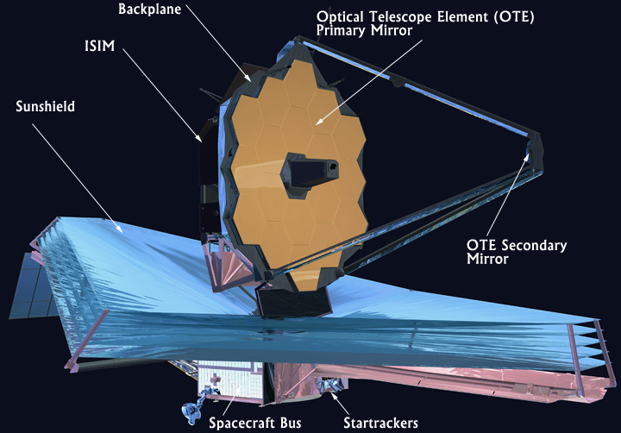
JWST Overview
James Webb Space Telescope (JWST) is a large infrared observing space telescope which will launch in 2021.
The observatory is comprised of 4 major subsystems
  Optical Telescope Element (OTE)
  Integrated Science Instrument Module (ISIM)
  Sunshield
  Spacecraft Bus
The OTE and ISIM were integrated together at Goddard Space Flight Center to form the OTIS assembly

Slide 3
Interferometer Development for JWST
High speed interferometry (HSI) is one of the key technologies that enabled successful development and testing of the James Webb Space Telescope (JWST) optical system that consists of a 6.5 meter diameter, segmented, lightweight primary mirror and lightweight carbon fiber composite structure.
Developed specialized interferometers to enable large space qualified structures and mirrors operating at cryogenic temperatures
  Multi-wave interferometer, speckle interferometer, high speed interferometer
Simultaneous phase shifting interferometers that are insensitive to vibration allow large optics and structures measurements at high vibration environment at long distances to few nm rms precision.
Provide accurate measurements for critical space hardware.
Key requirements are: high sensitivity, fast exposure time, insensitivity to vibration

Slide 4

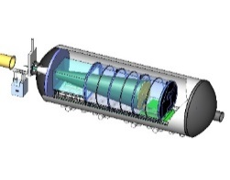
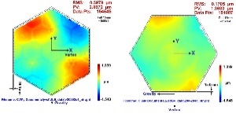
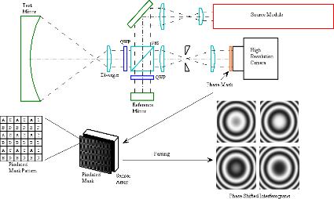
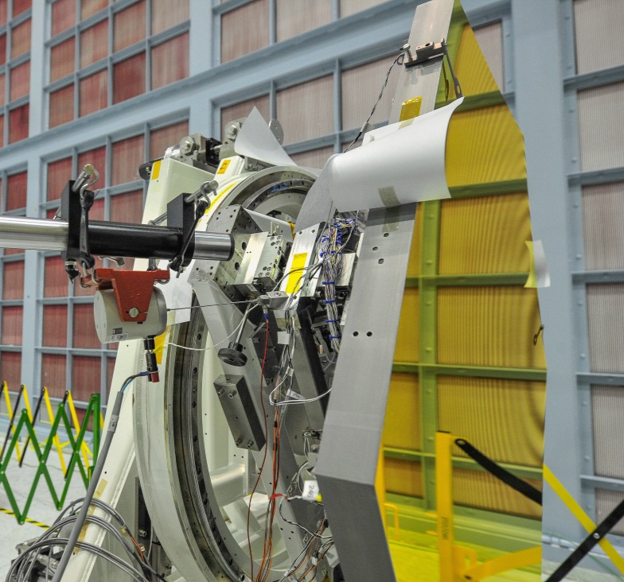
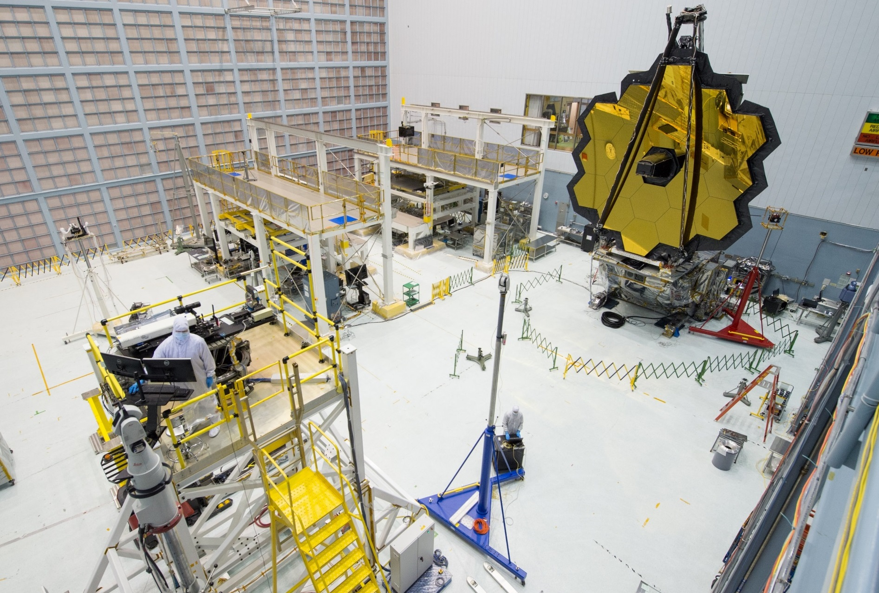
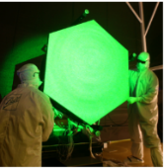
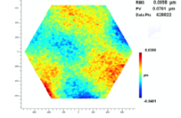
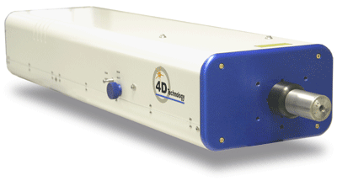
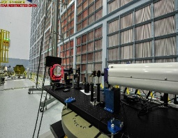
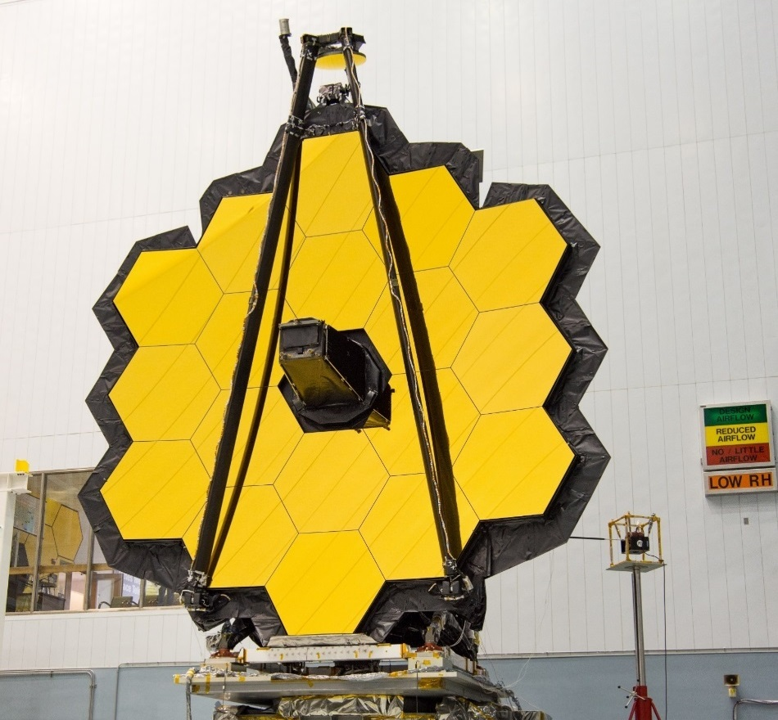
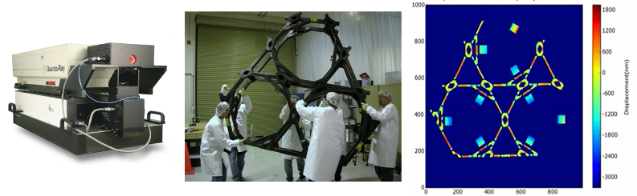
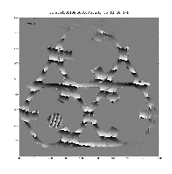
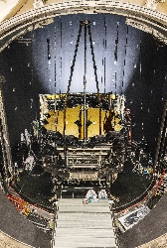
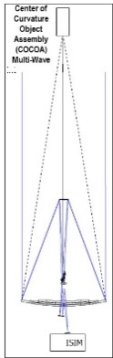
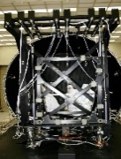
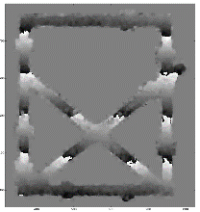
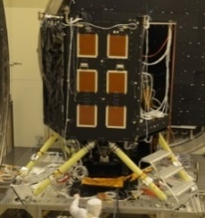
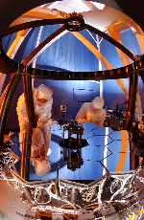
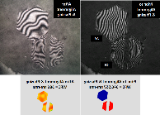
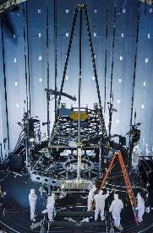
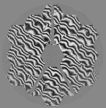
Webb Interferometry History
1996
1998
2000
2002
2004
2006
2008
2010
2012
2014
2016
2018
Phasecam:
Instantaneous Interferometry
Mirror TRL6
OOR
CoC Demonstration
and Algorithm
Development
OTE CoC Test
High Speed
Dynamic Interferometer
Mirror
Deformation Due
to Acoust/vibe
Backplane Stability Test Article (BSTA)\ TRL-6
CoC IF and CGH
Null on Hexapod
Electronic Speckle Interferometry
JSC OTIS Test
ISIM structure test article
Multiwave Pathfinder
Multi wave
Testbed Testing
Multiple Wavelength
Interferometer

Slide 5
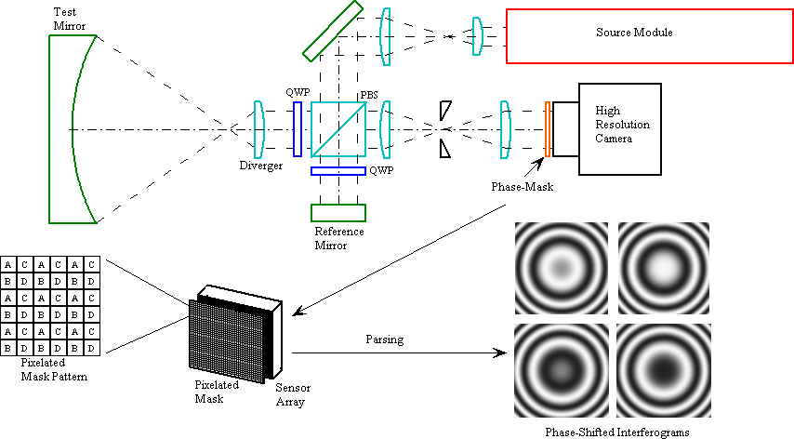
Phasecam Layout
Pixelated phase mask that allows simultaneous capture of four phase shifted interferograms is the key feature.
Developed by 4D Technology now subsidy of Onto Innovation
Key piece of metrology equipment throughout the primary mirror segments manufacturing and testing sequence including final verification at cryogenic temperature at XRCF at Marshall Space Flight Center.
Four Phase-shifted Interferograms Captured Simultaneously

Slide 6
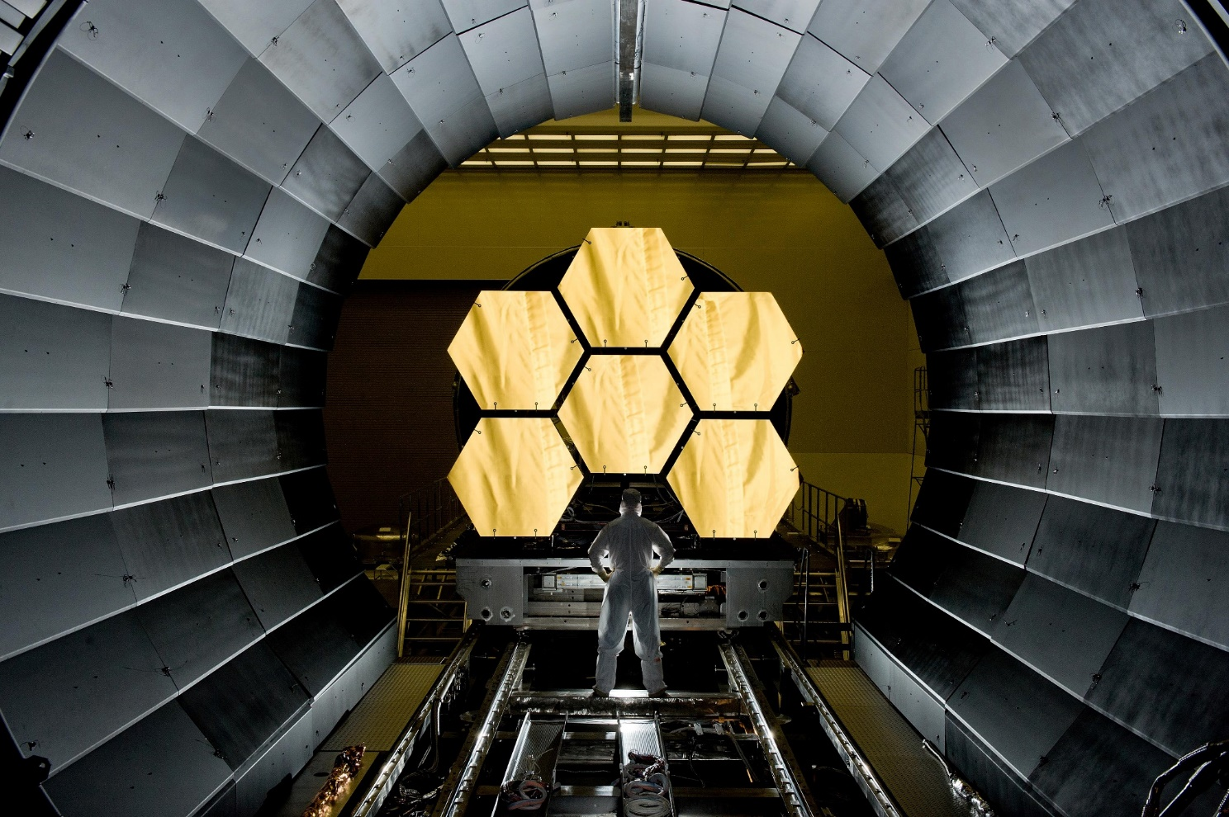
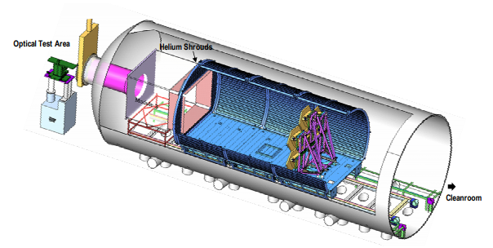
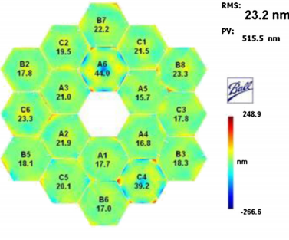
Primary Mirror Segment Assemblies Acceptance Testing
PMSA test configuration within the XRCF cryogenic chamber
Six of the 18 PMSAs in the XRCF chamber at MSFC used for the final cryogenic acceptance testing of the mirrors.
The surface figure error for the 18 flight mirrors as measured during acceptance testing

Slide 7
Structure Testing
Primary mirror segments are mounted on the Primary Mirror Backplane Assembly (PMBA)
  Has to be stable to maintain segment alignment on orbit
The thermal stability requirements are very stringent. JWST is the first mission to utilize a segmented Primary Mirror mounted on a Backplane.
The stability requirements can be only verified by a combination of analysis and ground test.
Verification required development of interferometry to verify structural deformations in large, deployable, lightweight, cryogenic, precision structures to nanometer level accuracy.
Simultaneous phase shifting electronic speckle pattern interferometry (ESPI) was developed to provide a direct measurement of structural deformations in large, lightweight structures to high accuracy by configuring 4D Technology Corporation’s simultaneous phase shifting interferometer PhaseCam for speckle interferometry.
ESPI works on non-specular surfaces like composites and can measure mirrors or structure in the ground state.
ESPI was designed and configured to measure the out-of-plane deformation and displacements of large test articles.
  The object under test is illuminated with a high-power pulsed Nd:YAG laser operating at the second harmonic (532 nm).
  The maximum energy output per pulse is about 0:9 J.
  The pulse duration is 9 ns,and the pulse repetition rate is 10 Hz.

Slide 8
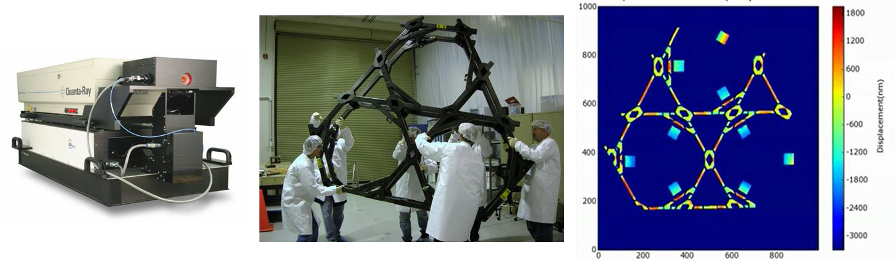
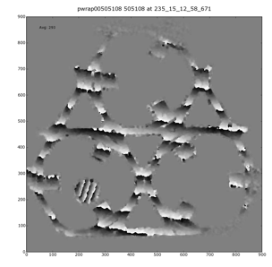
BSTA Test
BSTA test verified thermal stability of a structure similar to the JWST OTE backplane structure and validated the design processes and finite element models for the flight primary mirror backplane.
Babak Saif, et al. "Measurement of large cryogenic structures using a spatially phase-shifted digital speckle pattern interferometer," Appl. Opt. Vol. 47 (2008)

Slide 9
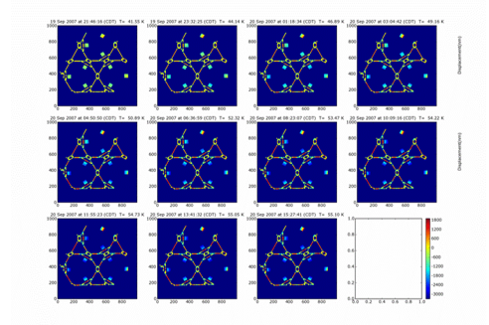
BSTA Distortion
A single crystal silicon plate (15 cm x 15 cm) was attached to each PMSA
fitting to monitor their motions during the test.
Discontinuous, diffuse surface, rate of data collection, and
distance between the interferometer were difficult challenges
Collected 11 Tb of data during the six week test period
Red ~1800 nm
Blue ~ -3000 nm
Babak Saif, et al. "Measurement of large cryogenic structures using a spatially phase-shifted digital speckle pattern interferometer," Appl. Opt. Vol. 47 (2008)

Slide 10
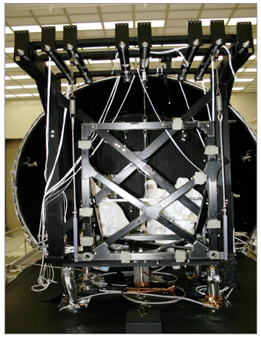
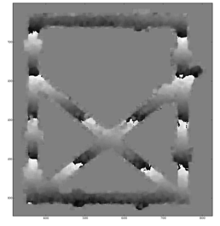
ISIM Structure Test Article (Breadbox)
ISIM (Integrated Science Instrument Module) Breadbox was developed to demonstrate the ability to verify thermal distortion analysis to the required level.
Breadbox is a three-dimensional frame structure which is representative of a portion of the ISIM structure.
Provide data for correlating the finite element model distortion predictions
Breadbox fringes
Breadbox at XRCF

Slide 11
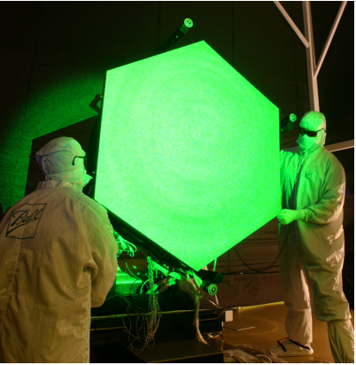
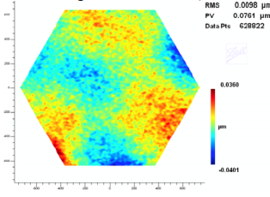
PMSA ESPI Test
To meet TRL-06 performance requirements for the James Webb Space Telescope (JWST) Primary Mirror Segment Assembly (PMSA) required Ball Aerospace Technologies Corp. (BATC) to use a flight PMSA machined substrate before an optical quality surface was polished onto it.
Measured surface figure change due to integration of flight mount and hexapod hardware as well as vibration & acoustic testing using ESPI.
Successfully showed compliance to the TRL-06 requirements.
Deformation Due to Vibration Testing, X, Y, & Z Axes (4.2nm-RMS Astigmatism Removed)

Slide 12
CoC Test
The OTIS assembly was integrated at GSFC and then went through a series of vibration and acoustic tests to verify its launch worthiness.
To verify that no detrimental changes occurred to the OTIS assembly from this environmental testing an optical Center of Curvature (CoC) test was conducted.
CoC (Center of Curvature) test is a standard type of optical test used to measure the surface figure of mirrors using an interferometer.
  For the SSDIF CoC test we expanded on this basic center of curvature test methodology by using a high speed interferometer manufactured by 4D Technologies capable of taking more than 5,900 surface figure measurements every second.
  HSI allows thousands of surface figure measurements to be taken every second and then pieced together temporally to determine mode frequencies and shapes of each mirror.
We measured one mirror at a time (i.e. no phasing of mirrors)
We performed two types of tests
  Static Test: measured the surface figure of the PM segments (one at a time) and looked for changes in the figure of the mirror. (resolution = 1520x1520) before and after the OTIS Vibro-Acoustic tests to determine if any detrimental changes have occurred to the primary mirror segments.
  Dynamic Test: measured the vibrational characteristics of the OTIS before and after the vibro-acoustic tests to assess changes to the composite backplane by taking up to 59,000 surface figure measurements over a 10 second period while applying a vibrational input force (stinger) to the OTIS backplane and then calculated changes to the phase and gain transfer functions. This is like having 40,000 one-axis accelerometers on each mirror segment. (resolution = 240x240)

Slide 13
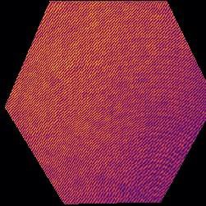
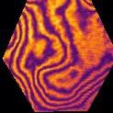
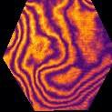
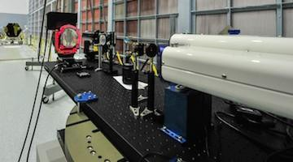
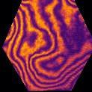
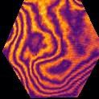
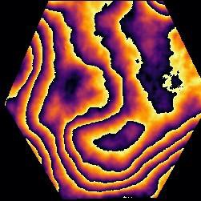
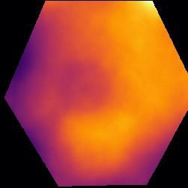
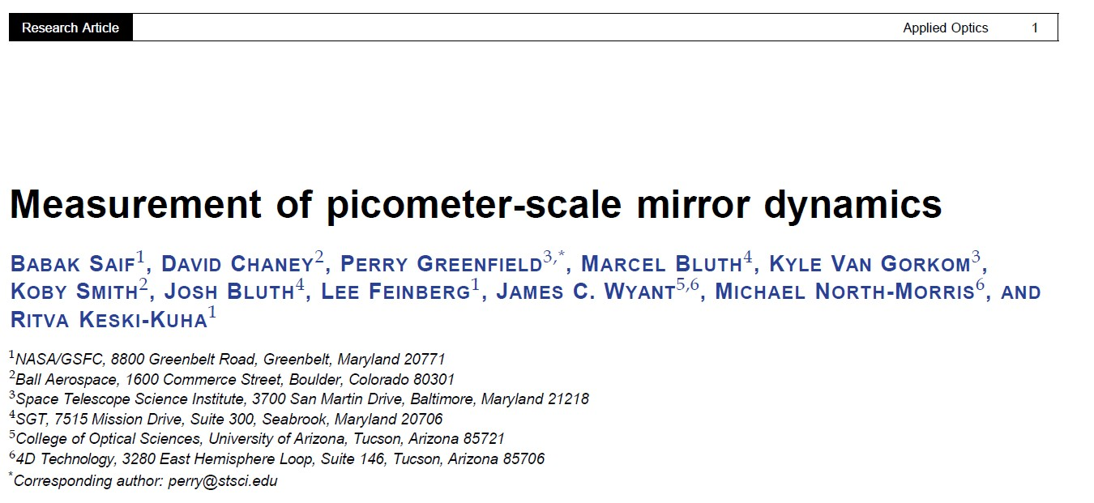
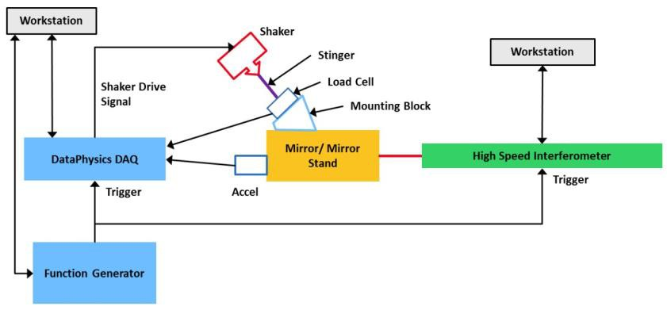
Picometer measurement of mirror dynamics
Single HSI frame comprises 4 interlaced phased- shifted interferograms which are converted (with an ellipse- to- circle correction to account for phase error) into a wrapped phase image that can be unwrapped to a surface profile.
This photograph shows all the optical elements in the test setup including the HSI, CGH (framed in red), and test mirror (hexagonal mirror on the far left).
This schematic diagram shows the relationship of the components of the test setup.

Slide 14
Picture of the CoC Test Layout
For dynamics test a vibration shaker is used to apply a low level force into the composite backplane structure.

Slide 15
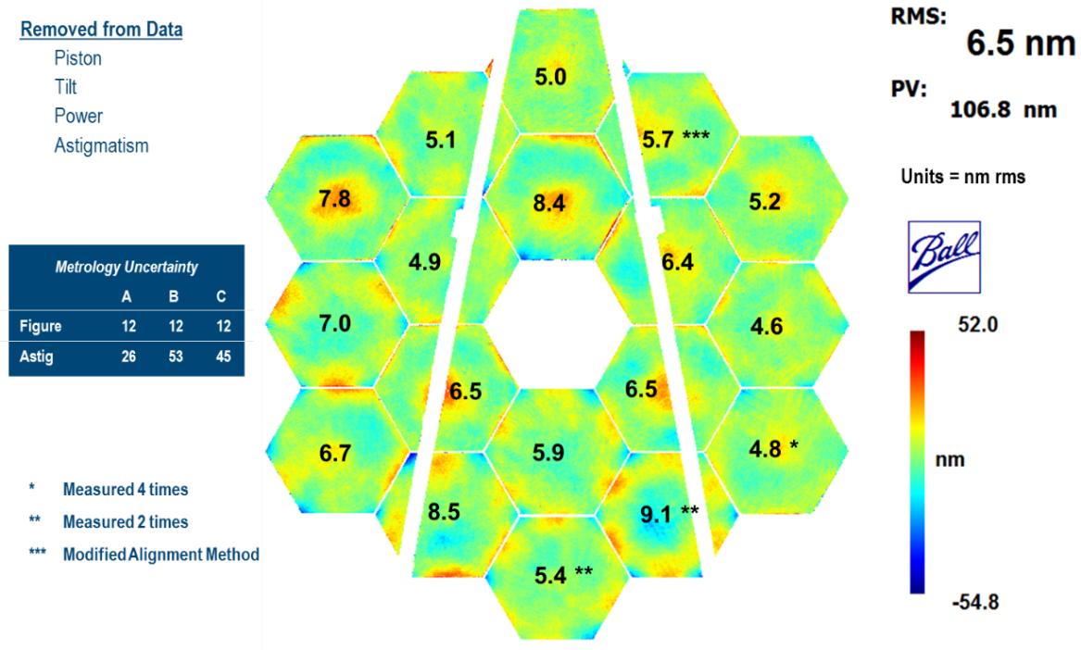
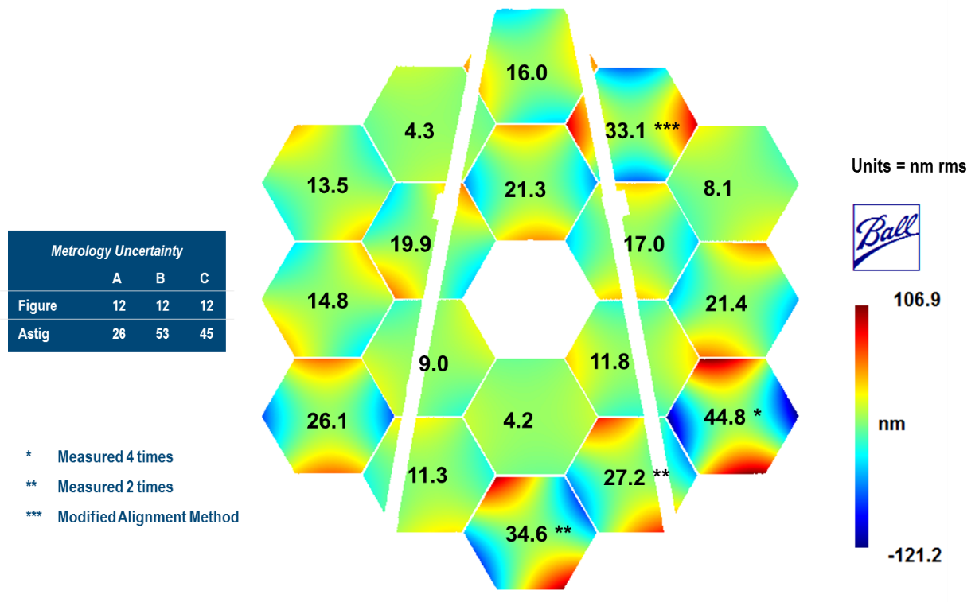
Composite Image of Surface Figure and Astigmatism Changes
Both figure and astigmatism all measured delta values are within uncertainty budget.

Slide 16
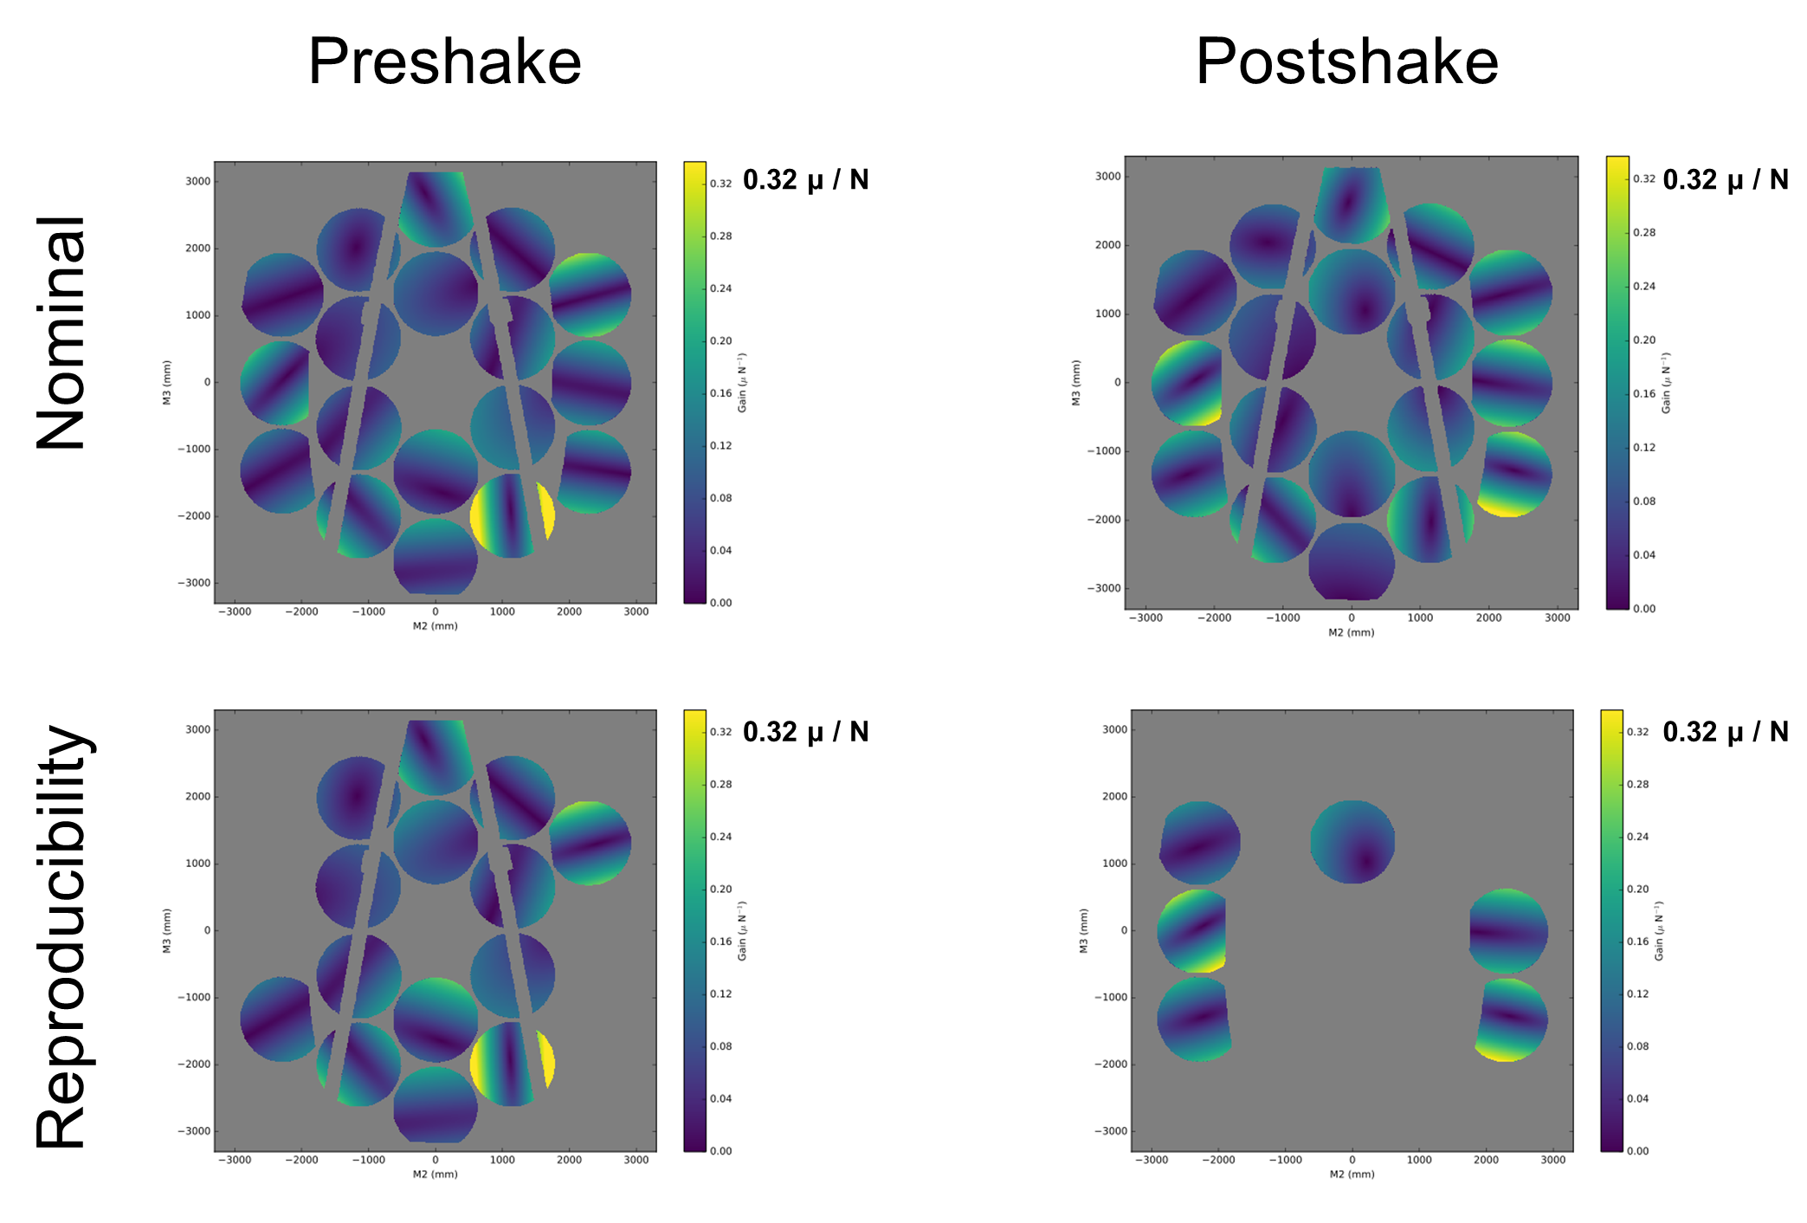
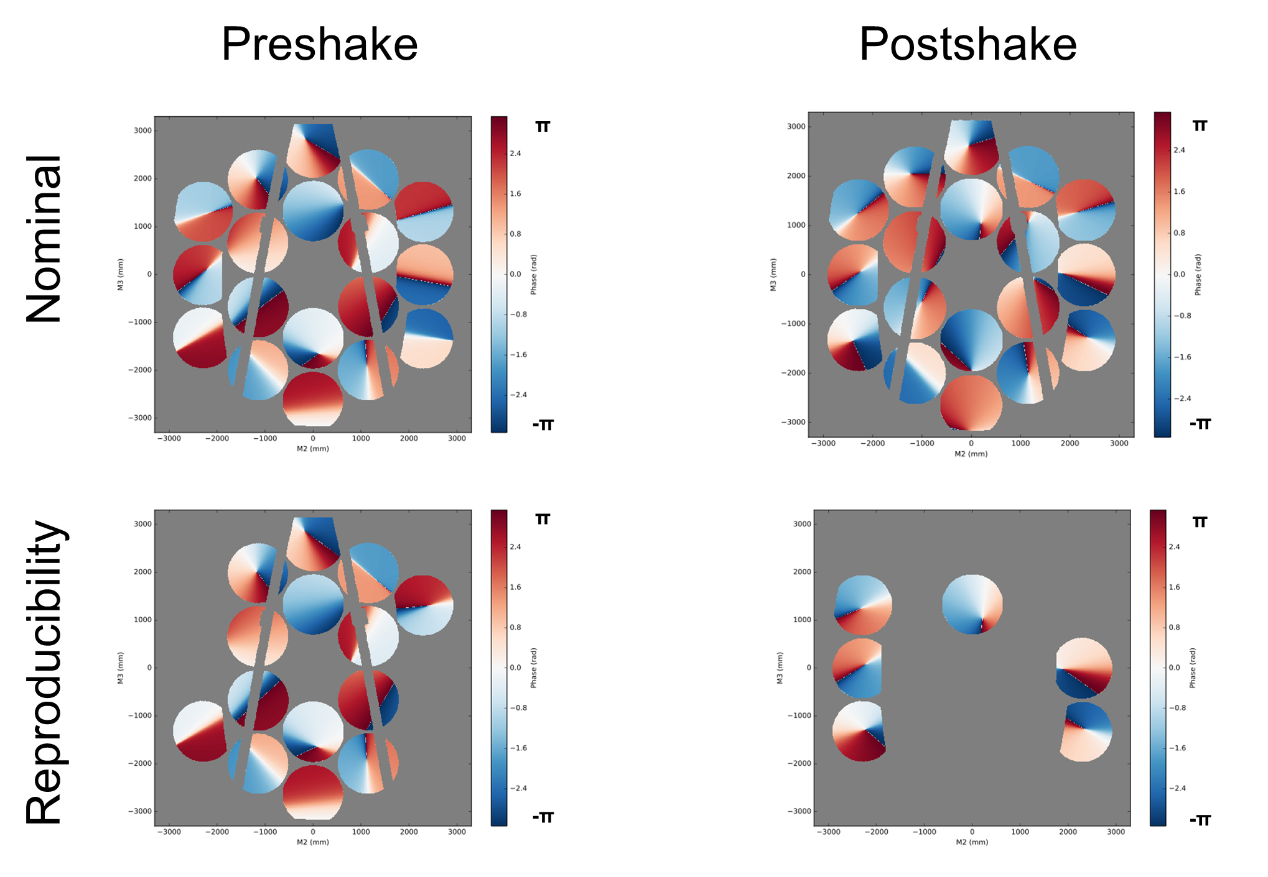
Example of Primary Mirror Dynamics Response
Rigid Body (Z1-Z3) at 43.0Hz
Transfer Function Gain
Rigid Body (Z1-Z3) at 43.0Hz
Transfer Function Phase

Slide 17
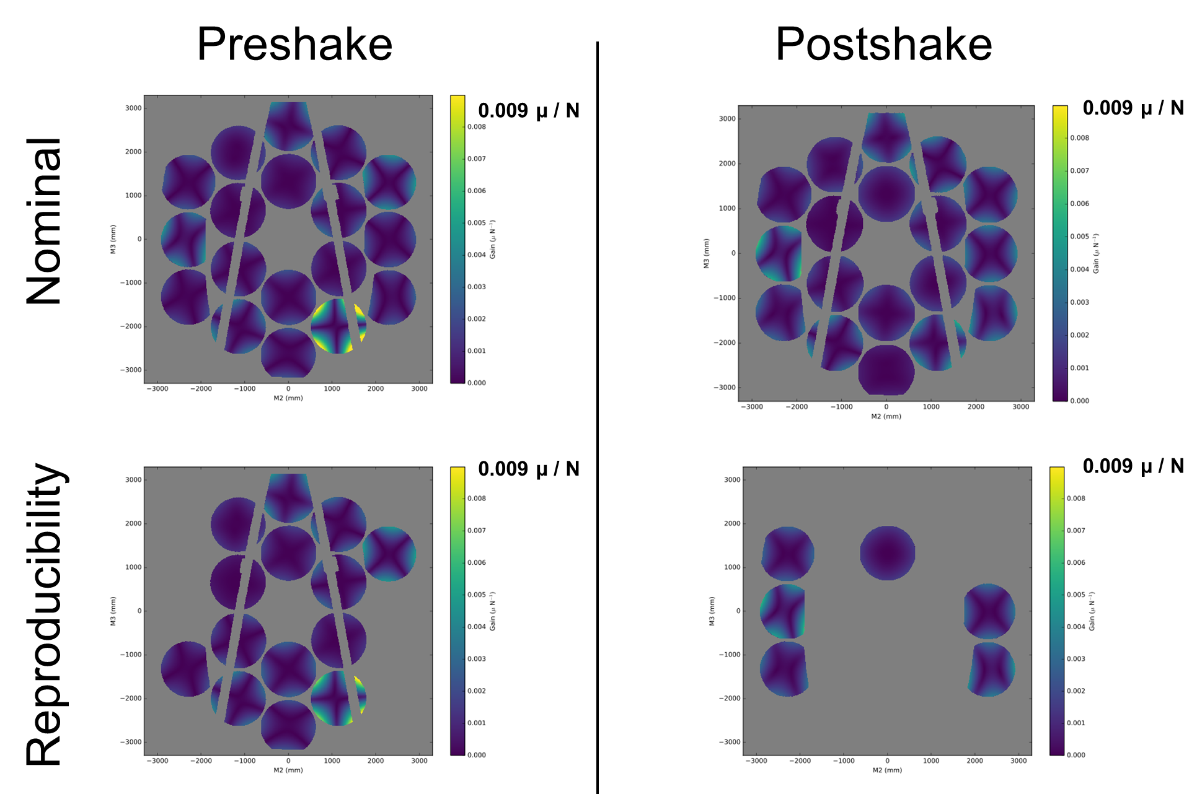
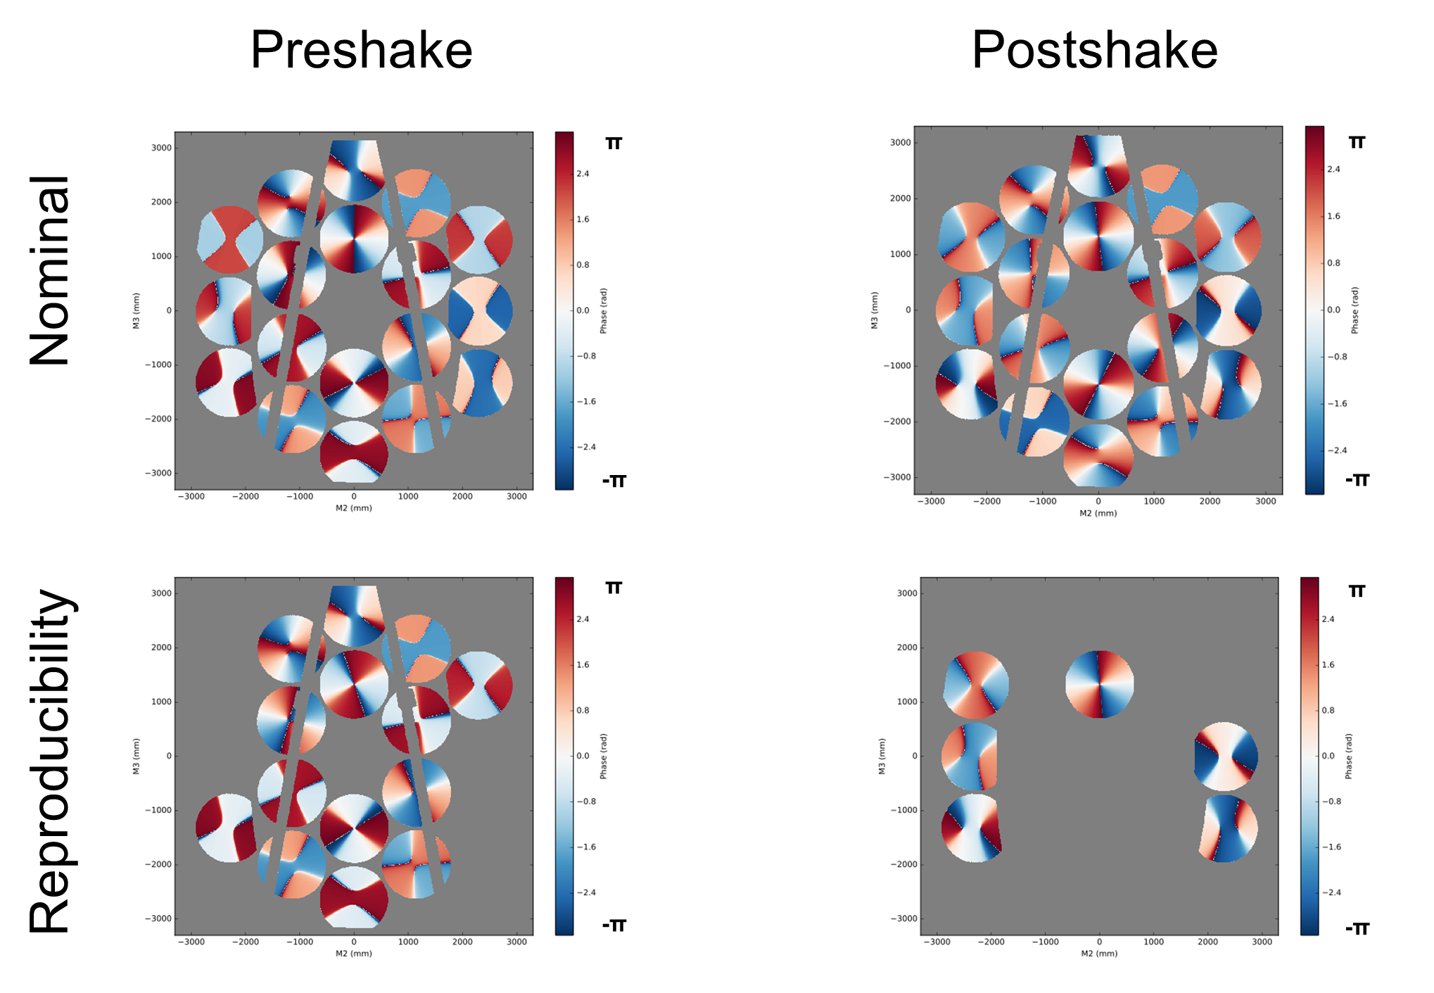
Example of Primary Mirror Response
Astigmatism (Z5-Z6) at 43.0Hz
Transfer Function Gain
Astigmatism (Z5-Z6) at 43.0Hz
Transfer Function Phase

Slide 18
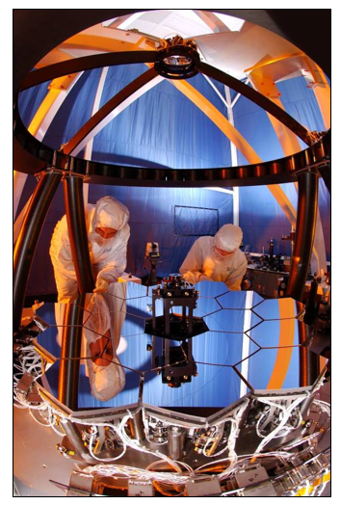
Multi-Wave Interferometer Background
Primary Mirror (PM) Center of Curvature test was a key OTIS test at JSC
  Only pre-launch demonstration of PM Phasing capability at cryo
  Only full aperture PM figure measurement
  Verified PM assembly process
  Confirmed sufficient actuator range for flight operations
  Demonstrated PMSA functionality at cryo with flight processes and connections
Multi-Wavelength Interferometer (MWIF) is key GSE for the PM cryo test at JSC
  Uniquely developed for JWST by 4D Technology
  By combining measurements at two laser wavelengths, synthetic wavelengths up to 15 mm could be achieved, allowing mirror segments with millimeter-level piston errors to be phased to the nanometer level.
MWIF Ball Test Bed Telescope (TBT) test was the only time it saw 18 segments pre-JSC

Slide 19




Multi-Wave Interferometer Pathfinder Test
Before the OTIS test, COCOA performance was assessed at JSC using the JWST Pathfinder telescope.
The Pathfinder OTE, consisted of a non-flight primary mirror backplane center section & secondary mirror support structure, two spare PMSA’s, the spare secondary mirror assembly, and or the flight AOS (Aft Optics Assembly)
Successfully demonstrated PM phasing
J. Hadaway, C. Wells, G. Olczak, M. Waldman, T. Whitman, J. Cosentino, M. Connolly, D. Chaney, R. Telfer, "Performance of the primary mirror center-of-curvature optical metrology system during cryogenic testing of the JWST Pathfinder telescope," Proc. SPIE 9904, Space Telescopes and Instrumentation 2016: Optical, Infrared, and Millimeter Wave, 99044E (29 July 2016)

Slide 20

Primary Mirror Phasing at JSC
Aligned the 18 PMSAs into a phased PM, with the proper ROC & conic constant

Slide 21
Conclusions
4D Technology Phasecam was a key piece of metrology equipment throughout the primary mirror segments manufacturing and testing sequence.
4D Technology developed three specialized interferometers for testing the JWST Optical Telescope Element based the Phasecam technology.
  Multi-Wave Interferometer (MWIF), Electronic Speckle Patterns Interferometer (ESPI), and High Speed Interferometer (HSI).
ESPI test demonstrated design, analysis and manufacturing technology readiness of large composite precision cryo structures technology as well as PMSA compliance with TRL-6 requirements.
CoC Test using the HIS informed about the health of the OTIS before shipping it to Johnson Space Center (JSC) for optical testing at cryogenic temperature.
  The test verified that no unacceptable changes occurred to the JWST telescope assembly as a result of vibro-acoustic testing.
  The dynamics portion of the CoC test successfully measured the opto-mechnical modes of the telescope in low amplitude stimulation to nanometer precision.
The MWIF enabled the alignment and phasing of the PM segments at cryo at JSC with the proper ROC & conic constant.

