Slide 1



Fine optimization of TES design for the X-IFU instrument on ATHENA
Nick Wakeham
J.S. Adams, S.R. Bandler , S. Beaumont, J.A. Chervenak, F.M Finkbeiner , J.Y. Ha, R. Hummatov, R.L. Kelley, C.A. Kilbourne, A.M. Miniussi, F.S. Porter, K. Sakai, S.J. Smith, E.J. Wassell, S. Yoon
NASA Goddard Space Flight Center (GSFC),
University of Maryland Baltimore County
Science Systems and Applications, Inc. (SSAI)
Sigma Space Corp. / Hexagon US Federal,
SB Microsystems
IRAP

Slide 2
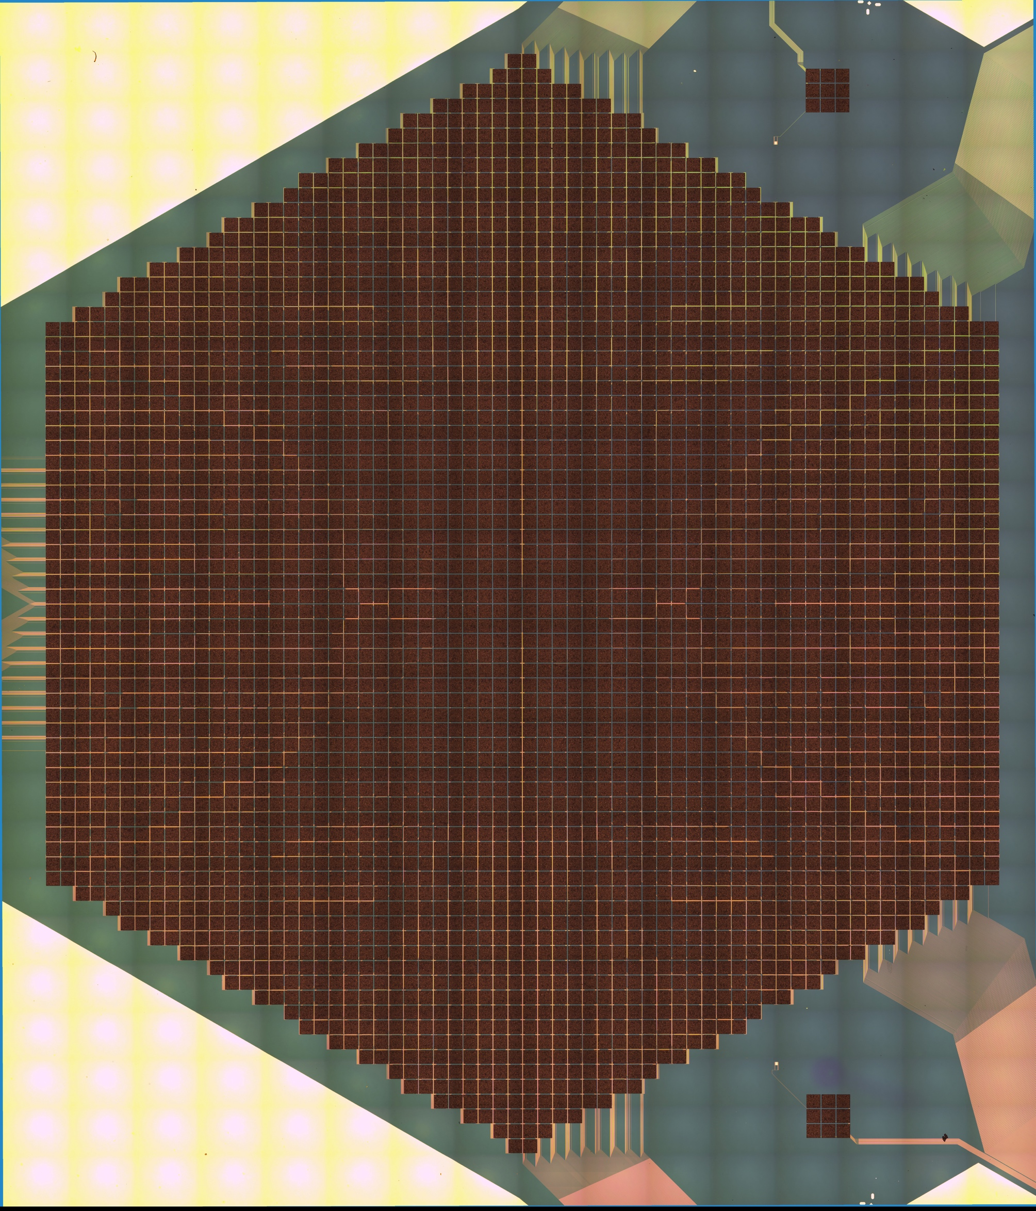
ATHENA – X-IFU
ATHENA is a European led x-ray observatory satellite due for launch in the early 2030s
The X-ray Integral Field Unit (X-IFU) instrument on ATHENA will have an hexagonal array of 3168 TES microcalorimeters
2.5 eV resolution at 7 keV
5 arc second angular resolution and a 5 arc minute field of view
Notes:
To give just one example of what xthe X-ifu will be capable of I show on the right an image of the bulk velocity in the Perseus galaxy cluster. The image on the left shows what was maeasured by the Hitomi satellite, the image on the right shows a simulation of what X-ifu will be able to measure. You can see the marked improvement in detail both spectrally and spatially. And so, this will give us unpresidented information about the composition, dynamics and evolution of these astrophysical objects.

Slide 3
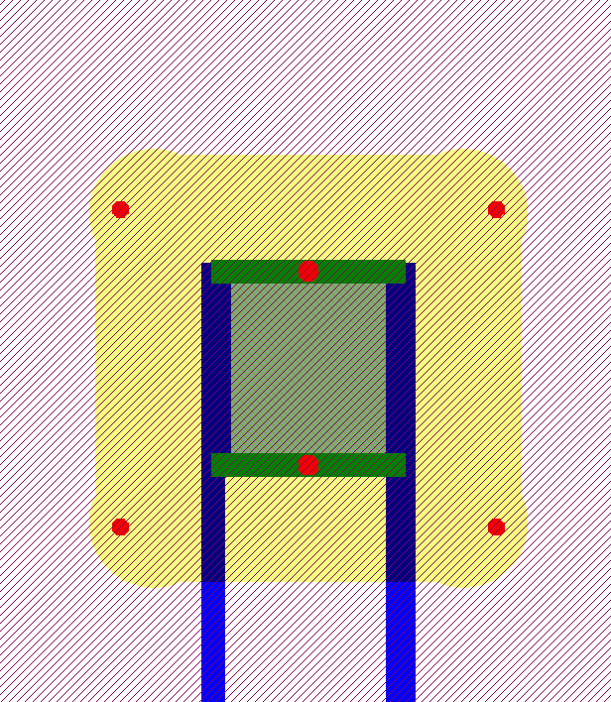
Baseline pixel design for X-IFU
Au/Bi/Au absorber
Au banks
Mo/Au bilayer
Silicon nitride
membrane
I
Mo/Au TES
Au Absorber stem attachment
Nb Leads

Slide 4
Baseline pixel design for X-IFU
Au/Bi/Au absorber
50 um
I
50 um
Mo/Au TES

Slide 5
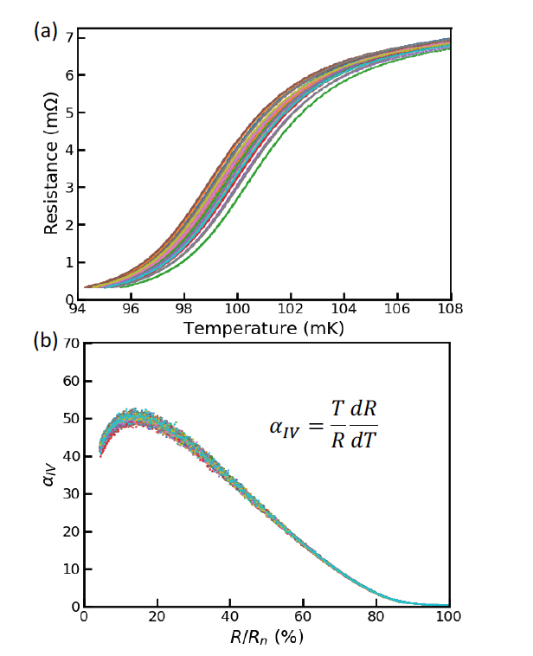
Performance of baseline pixel design
50 um
1000 pixel arrays have been shown to have highly uniform transitions
50 um
S. J. Smith et al., IEEE Transactions on Applied Superconductivity, 31, 5, 2021,

Slide 6
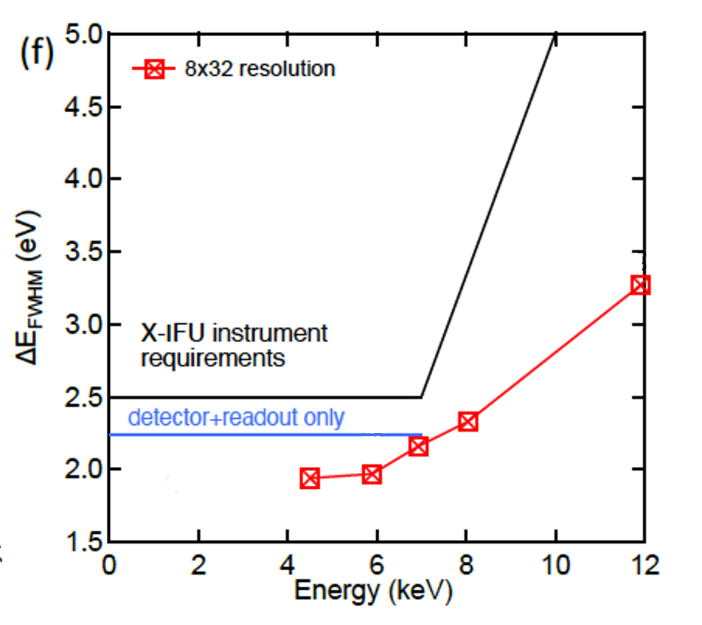
Performance of baseline pixel design
50 um
50 um
S. J. Smith et al., IEEE Transactions on Applied Superconductivity, 31, 5, 2021,
With this pixel design we have demonstrated performance required for X-IFU with TDM readout in > 200 pixels
To achieve this, single pixel spectral resolution should be < 2.07eV at 7 keV

Slide 7
Meet X-IFU requirements, but can we improve the TES design?
Increase Fall Time - There is some margin to increase the fall time of pixel response and still meet performance requirements for bright sources with high count rates.
Decrease Thermal Conductance- One way to make the most of this margin is to decrease the thermal conductance from TES -> thermal bath (G_{bath})
Decrease Slew Rate - if everything else is kept constant, this would reduce the maximum dI/dt or slew rate in the x-ray pulse, and therefore allow the use of a higher mutual inductance between TES circuit and readout.
Better Energy Resolution - This could give better noise performance when multiplexed, and therefore give more margin on the instrument energy resolution.
Therefore, we have studied several devices with different TES designs on a single chip to see if improvements are possible.

Slide 8
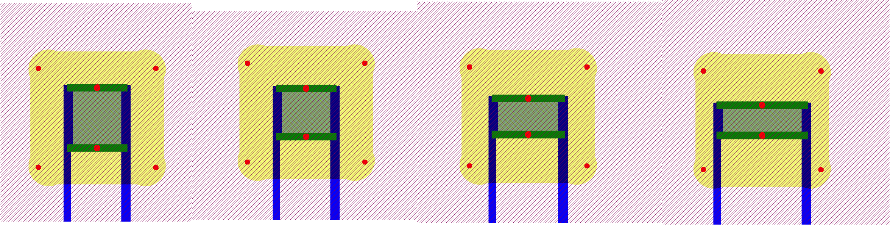
Reduction of G_{bath}
Trying to reduce the thermal conductance G_{bath} by ~ 10-15%
G_{bath} is proportional to the perimeter of the TES on the silicon nitride membrane.
So looked at variation on the TES perimeter. Smallest design perturbation in our new designs is to go to 50x40 μm TES
50 um
50 um
50 um
40 um

Slide 9
Reduction of G_{bath}
Trying to reduce the thermal conductance G_{bath} by ~ 10-15%
G_{bath} is proportional to the perimeter of the TES on the silicon nitride membrane.
So looked at variation on the TES perimeter. Smallest design perturbation in our new designs is to go to 50x40 μm TES
50 um
50 um
60 um
75 um
50 um
40 um
30 um
25 um
Have also seen in previous testing that slightly longer TES’s may give better overall performance
So we have designs with 60x30 μm and 75x25 μm TES’s.
With this aspect ratio in the longer devices we may be able to achieve the better performance while not increasing G_{bath}

Slide 10
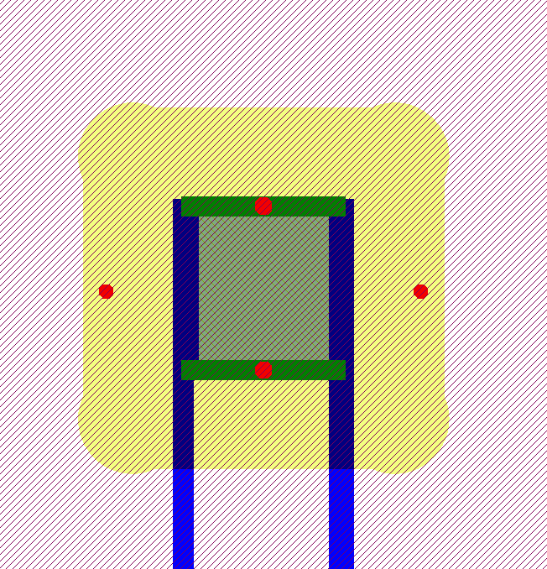
Reduction of G_{bath}
It has been shown that the absorber support stems on the membrane also contribute to the G_{bath} in proportion to their perimeter.
So we have designs with a total of 4 support stems instead of 6.
This is predicted to give a ~ 7% reduction in G_{bath}.

Slide 11
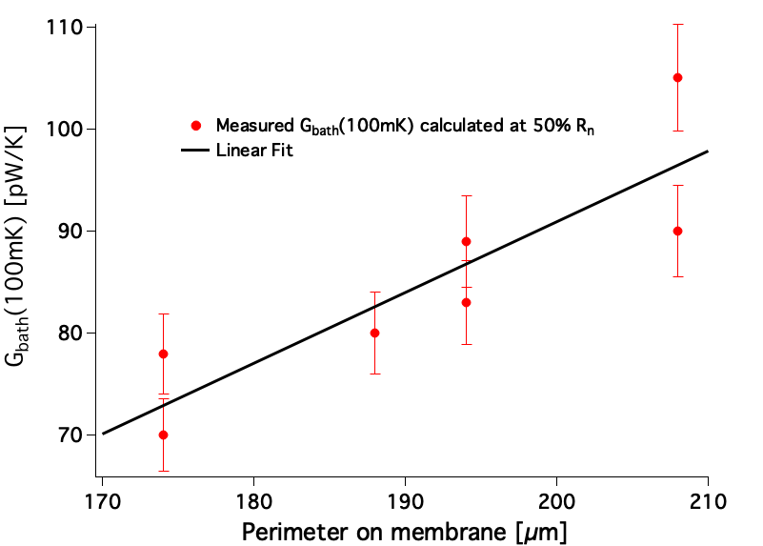
Measured thermal conductance G_{bath}
Our measurements confirm the dependence of G_{bath} on perimeter of TES and absorber support stems

Slide 12
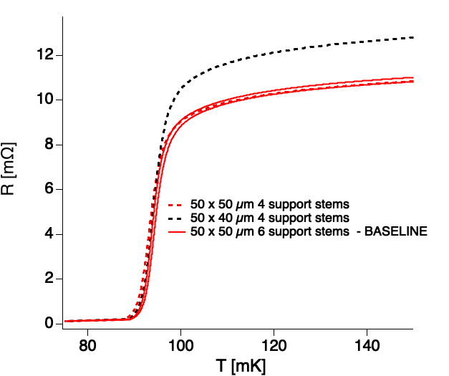
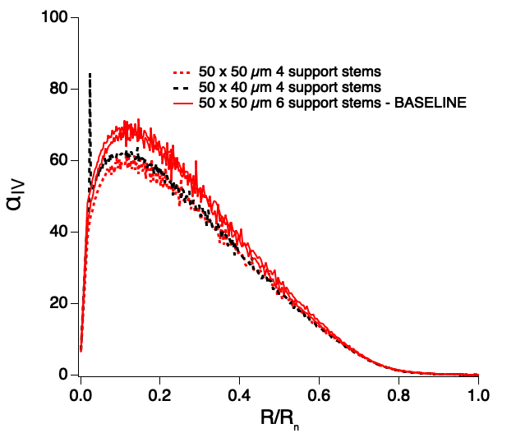
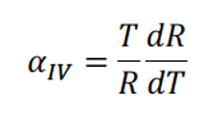
Other impacts of TES design changes – 4 support stems and 50x40 um TES
Characterization of the 50x50 μm (Baseline) design and the 50x40 μm design show that while G_{bath} and R_{n} change, transition parameters are not changed significantly.
Similarly, changing from 6 support stems to 4 -> only G_{bath} is affected.
Initial tests indicate slew rate may be slightly reduced but more measurements are needed.
So these seem promising options for optimization
Still need to test uniformity of transition on large arrays, and confirm modest slew rate reduction in flight like configuration

Slide 13
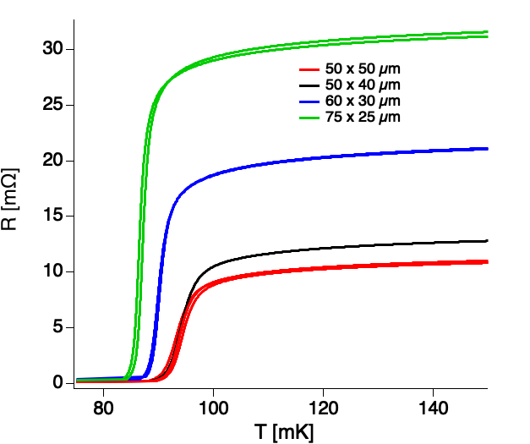
60x30 μm and 75x25 μm TES
For fixed bilayer-T_{c} , T_{c} of TES is reduced because the impact of proximity effect of the leads is diminished by increased TES length
Rn is also increased as aspect ratio increases
Note that these two effects could be compensated by adjustment of the bilayer thicknesses in future fabrication iterations

Slide 14
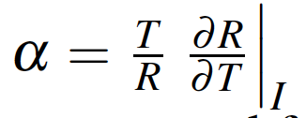
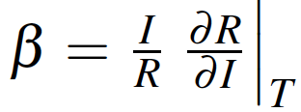
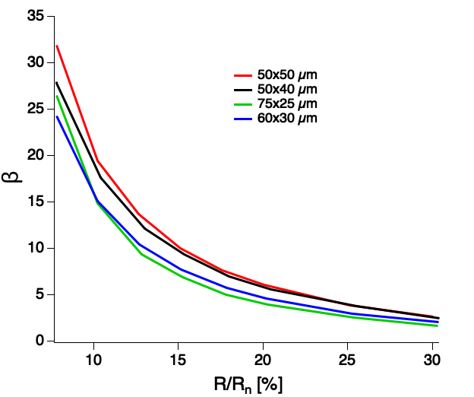
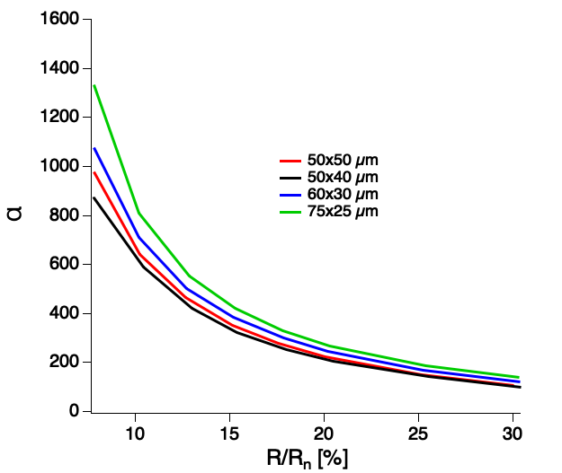
60x30 μm and 75x25 μm TES
These designs also have a different transition shape from the baseline pixel design
increases and decreases as the TES
becomes longer.

Slide 15
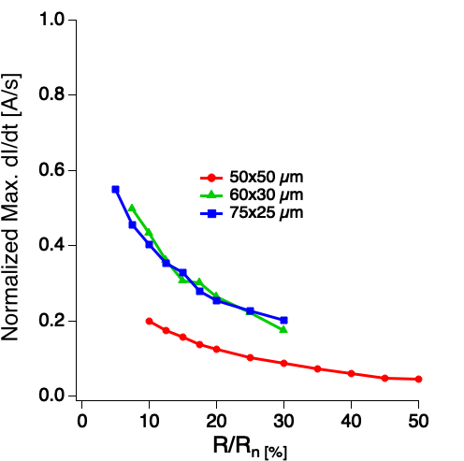
60x30 μm and 75x25 μm TES – Slew Rate at 6 keV
These changes in resistive transition parameters mean slew rate increases significantly, despite the lower G_{bath}.
Maximum slew rate normalized for constant, T_{c} , R_{n} and L/L_{crit}

Slide 16
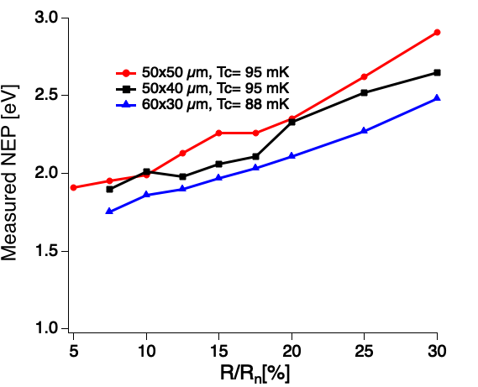
Measured and Predicted NEP
In low inductance limit measure lower NEP in longer TES’s
Note that in these non-linear devices inductance can have large impact on NEP and spectral resolution.
At 6 keV
Notes:
So the slew rate is actually increasing in these longer devices but are we realizing that improved performance that we anticipated?
If we look at the measured NEP in the low inductance limit we measure a lower NEP in the longer TES's as expect. As seen here.

Slide 17
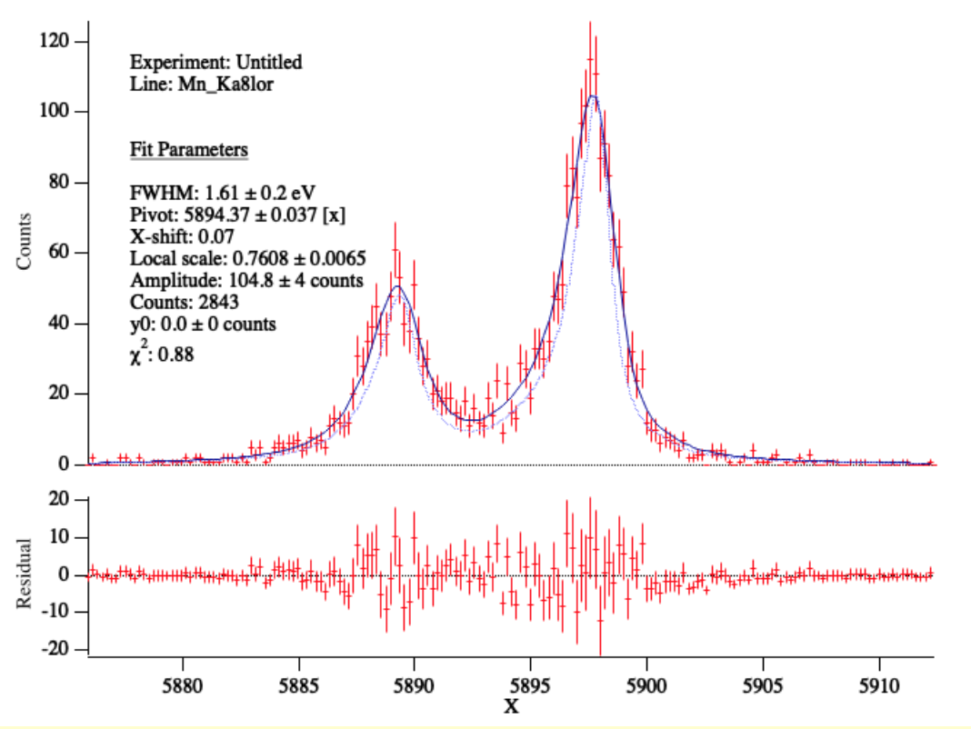
Measured and Predicted NEP
In low inductance limit measure lower NEP in longer TES’s
Note that in these non-linear devices inductance can have large impact on NEP and spectral resolution.
And we do measure excellent energy resolution compared with 1.9 eV at 6 keV in the baseline design
60x30 μm, 1.61 ± 0.2 eV
MnK⍺
At 6 keV

Slide 18
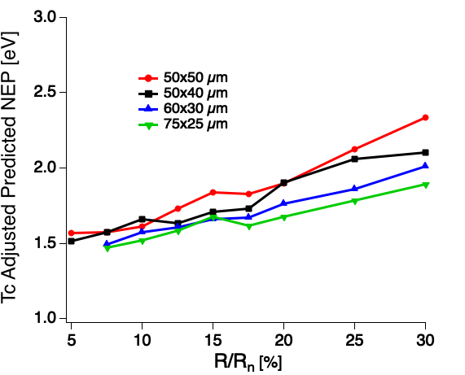
Measured and Predicted NEP
Fitting the measured noise and complex impedance we can calculate the predicted NEP in a linear small-signal model when normalized for Tc differences. (Model NEP is independent of inductance)
Also shows lower NEP in longer TES’s.
But taking into account Tc difference means improvement is only small
So NEP and spectral performance improvement likely not large enough to compensate for increased slew rate.
However, these linear models do not capture true performance of these non-linear devices, so more testing is needed.

Slide 19
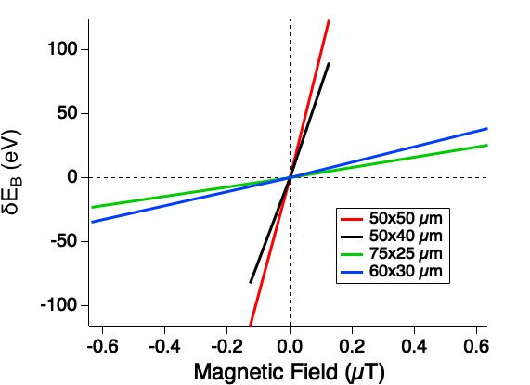
Magnetic Field Sensitivity
Variations in magnetic field on timescales too fast to correct will contribute noise in X-IFU
Magnitude of noise term dependent on the sensitivity of the pulse height (gain scale) to magnetic field, d(δE_{B})/dB
Reducing area of TES increases periodicity of Fraunhofer-like pattern of TES current as a function of magnetic field.
Therefore, expect smaller d(δE_{B})/dB in 50x40 μm than 50x50 μm
This is what we observe.
75x25 μm TES is the least field sensitive despite 60x30 μm TES having smaller area.
Likely because of a different spatial distribution of current as TES becomes narrow.

Slide 20
Conclusion:
Reduction of number of support stems or small decrease in width of TES from baseline design may be a good route to further optimize TES design for X-IFU.
While longer TES’s may offer slightly better single pixel performance, and reduced magnetic field sensitivity, the increased slew rate could be a problem. Only more testing will allow us to fully assess this.
Future work:
Need to carefully study performance in large arrays in flight-like readout configuration to ensure that new designs offer globally better optimization of performance and good uniformity.

