Slide 1
Space Nuclear Propulsion
Dr. David Burns
Science and Technology Office, Manager
Space and Missile Defense Symposium
August 11, 2021

Slide 2


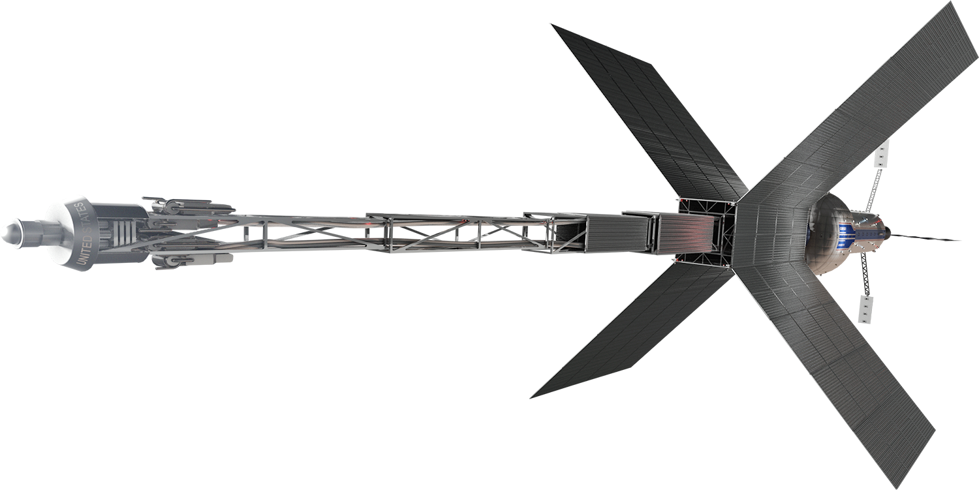
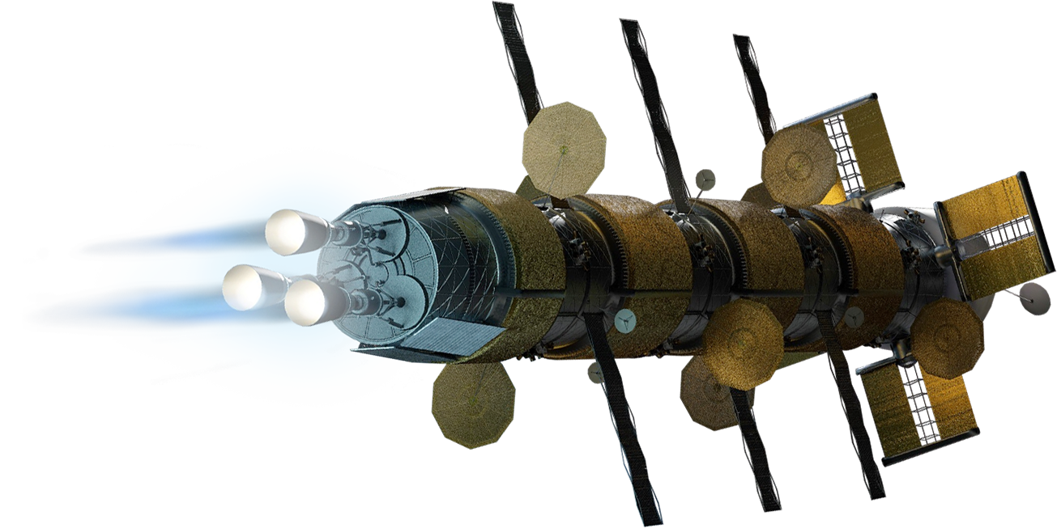
Robust Mars Transportation Requires Efficient Propulsion
Two Solutions Being Studied for both Human and Cargo Transportation
Nuclear Thermal Propulsion
High Thrust
High Performance
Short Propulsion Operational Times
Short Trip Times
Robust Abort Capability
Nuclear Electric Propulsion
Very High Performance
Continuous Access to Electrical Power
Potential to be combined with Chemical Stage for increased thrust capability
G–558966

Slide 3

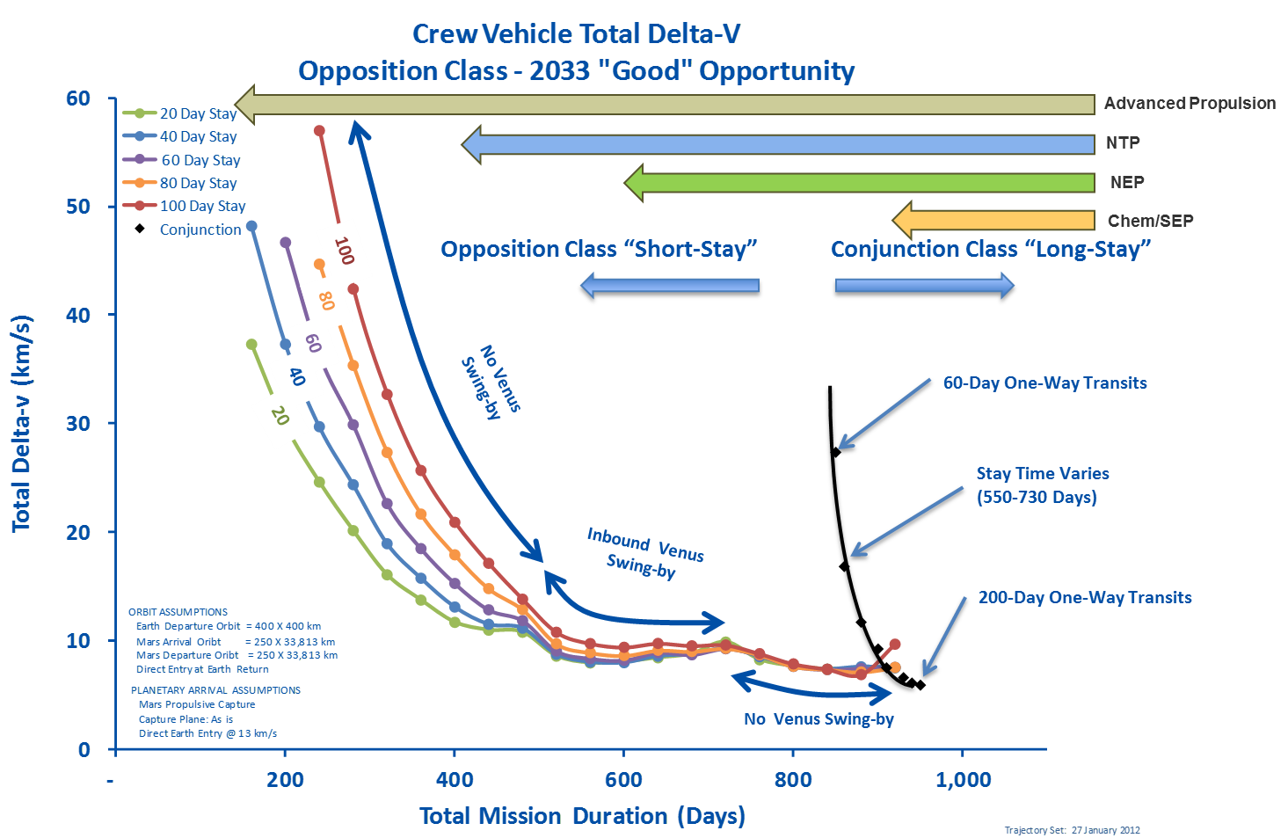
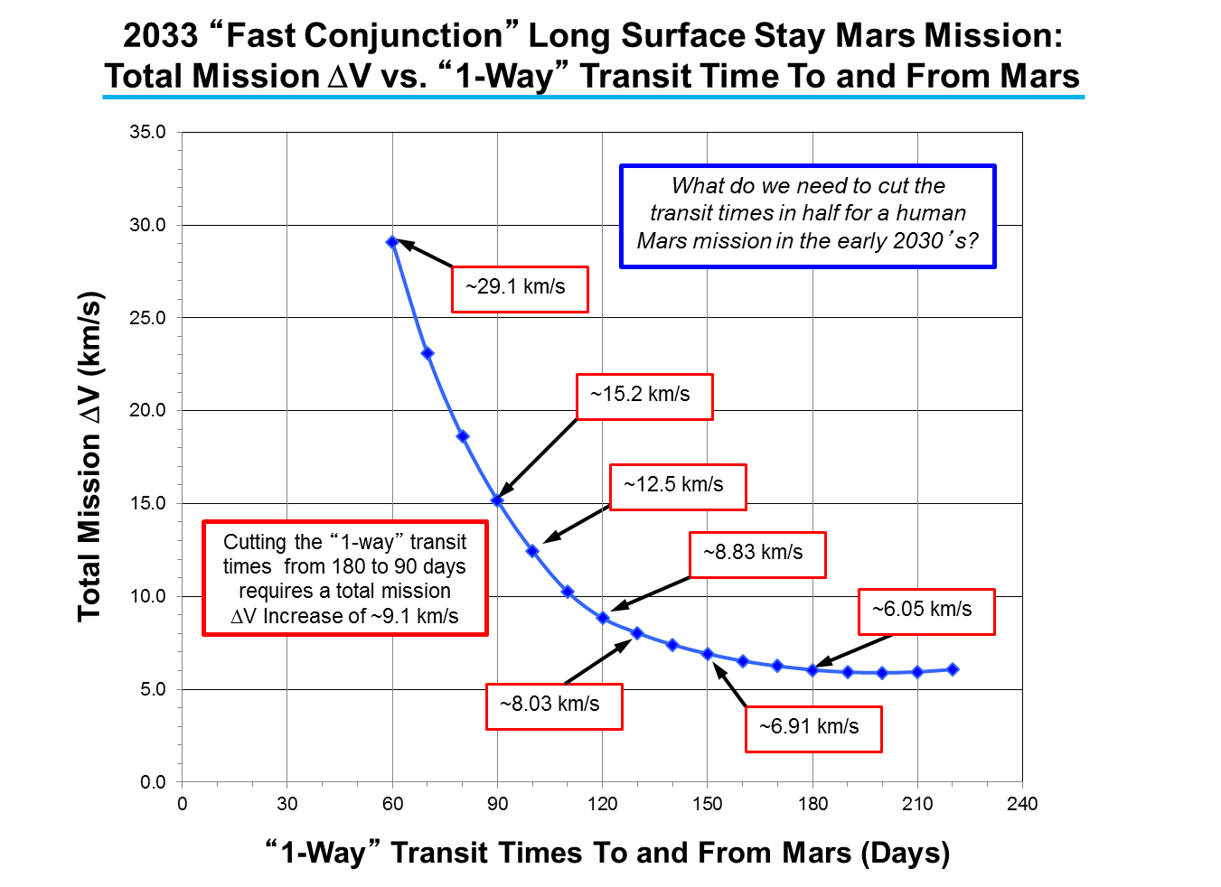
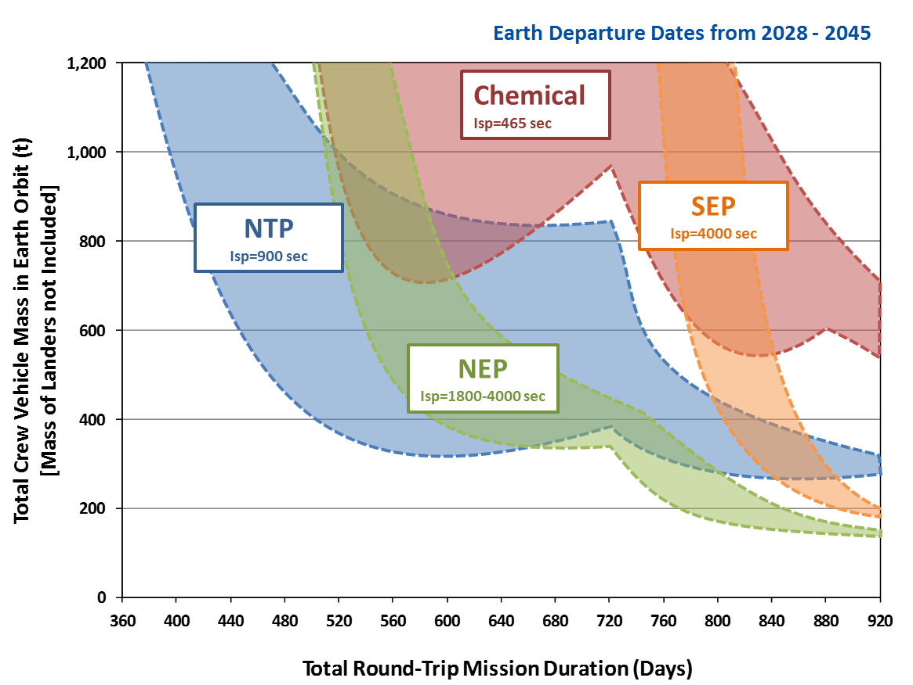
SPACE NUCLEAR PROPULSION
Why is Nuclear Propulsion Attractive for Human Missions to Mars?
Short Stay Opposition Mission with Earth Departure Dates 2028-2045
Nuclear Thermal Propulsion (NTP) and Nuclear Electric Propulsion (NEP) allows for shorter total mission time and shorter trip time (Less exposure to galactic cosmic radiation and zero-g)
Nuclear allows mission robustness and potential abort scenarios
Fewer rocket launches can save operation time, money, and reduce risk
Current efforts in NTP are initial steps towards advanced space nuclear power and propulsion, which could eventually help enable exploration and development of the solar system

Slide 4
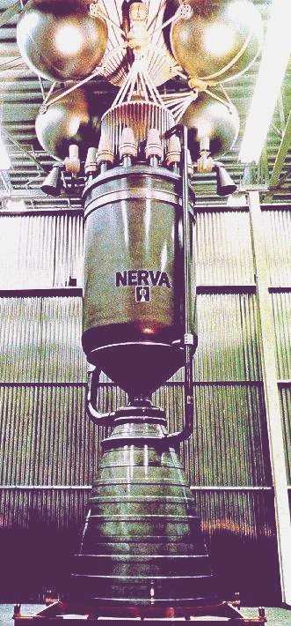
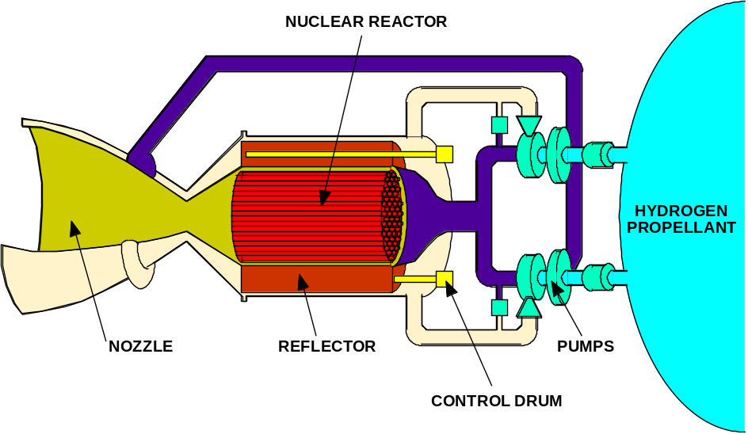
SPACE NUCLEAR PROPULSION
How Does Nuclear Thermal Propulsion (NTP) Work?
Propellant heated directly by a nuclear reactor and thermally expanded/accelerated through a nozzle (Low molecular weight propellant – typically Hydrogen)
Thrust directly related to thermal power of reactor: 100,000 N ≈ 450 MW_{th} at 900 sec
Specific Impulse directly related to exhaust temperature: 830 - 1000 sec (2300 - 3100K)
Specific Impulse improvement over chemical rockets due to lower molecular weight of propellant (exhaust stream of O₂/H₂ engine runs much hotter than NTP)
NERVA Nuclear Thermal Rocket Prototype
Major Elements of a Nuclear Thermal Rocket

Slide 5

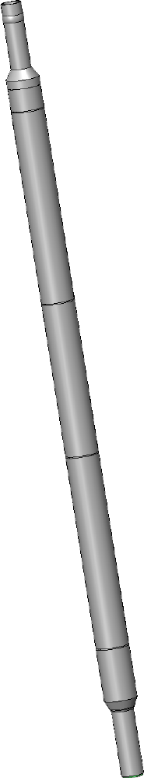
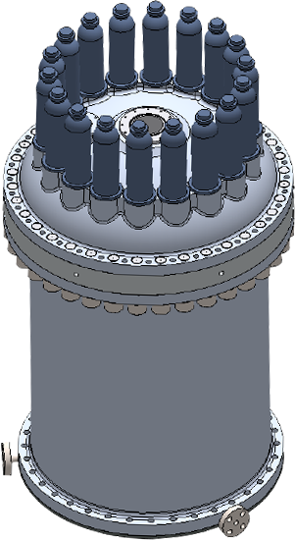
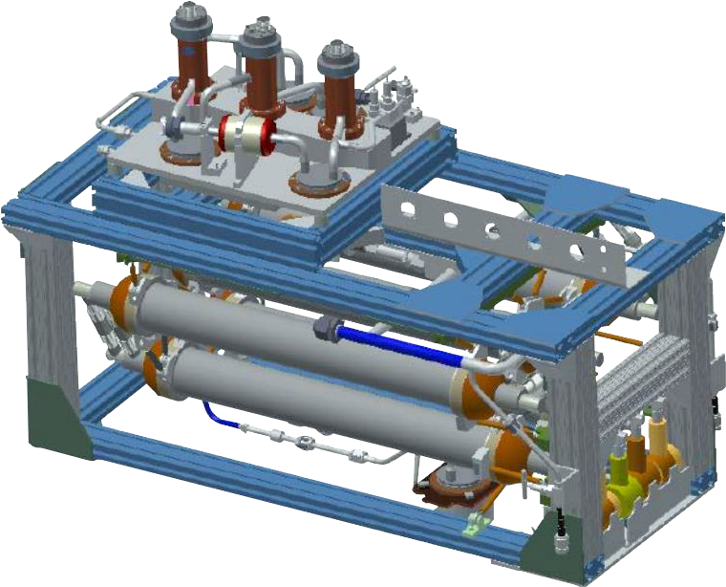
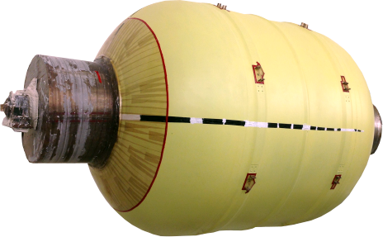
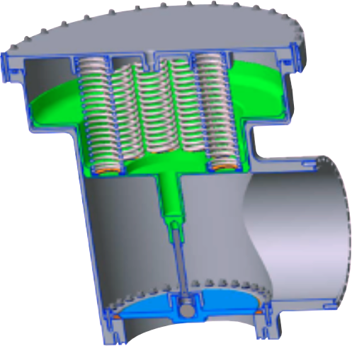
Nuclear Thermal Propulsion:
Technical Maturation Needed
High Temperature Nuclear Fuels
Cryogenic Fluid Management for Liquid Hydrogen
Low-Enriched Uranium Reactor
G–558966

Slide 6
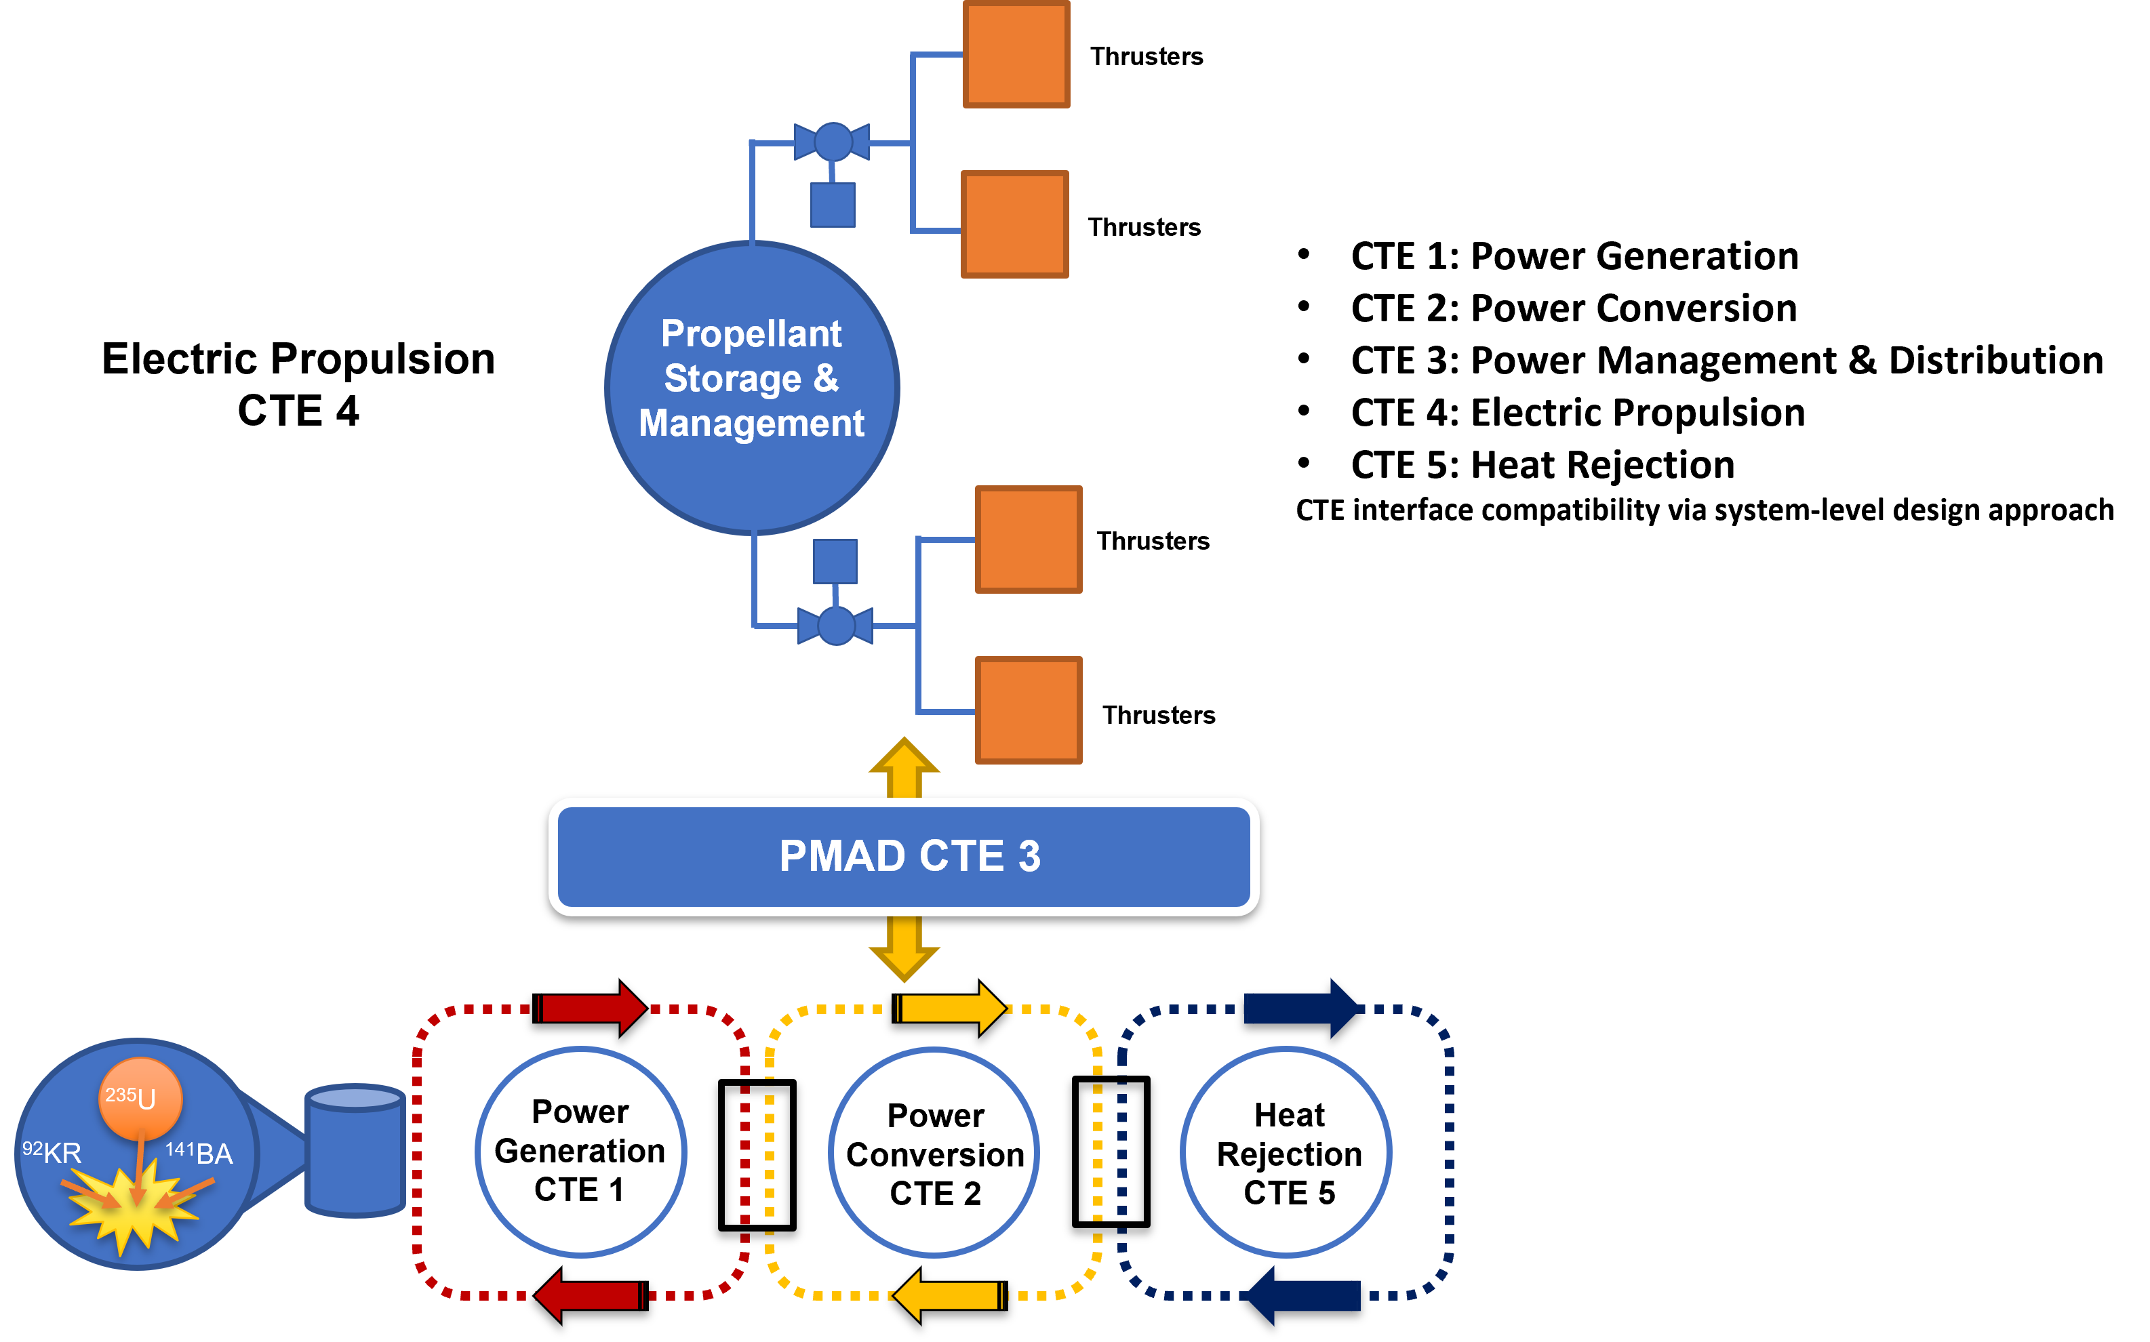
How Does Nuclear Electric Propulsion (NEP) System Work?
NEP uses the system (shown diagrammatically) to convert nuclear power to electricity that can power an electric propulsion system.
NEP system broken into 5 Critical Technology Elements (CTE).
Each CTE is further divided into assemblies and components
NEP technology choices should be based on numerous metrics: performance (on the system level), manufacturability, operability, testability, robustness, cost, industry alignment

Slide 7
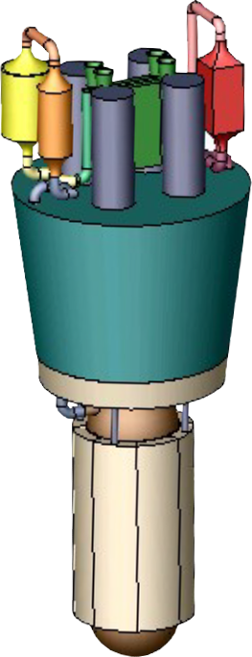
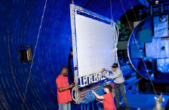
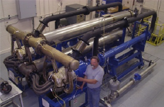
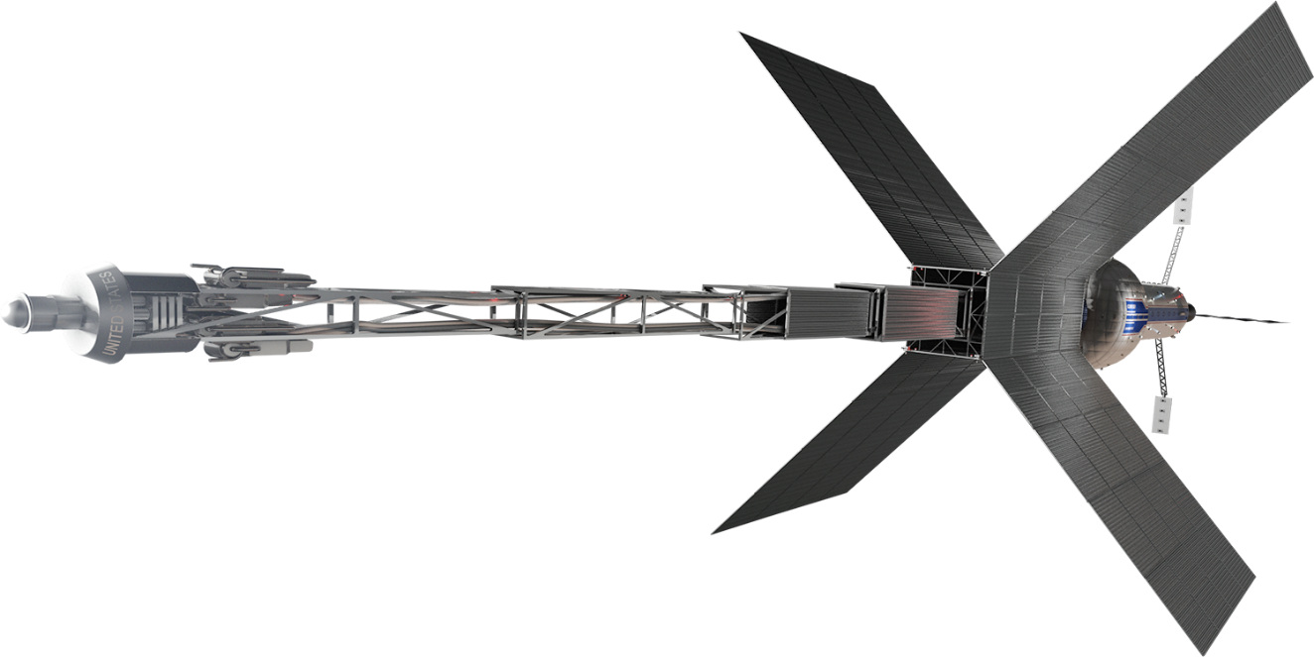
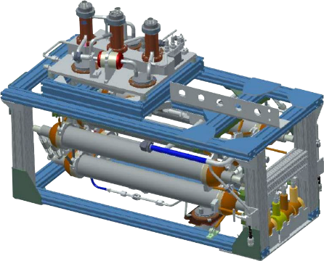
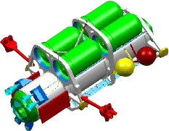
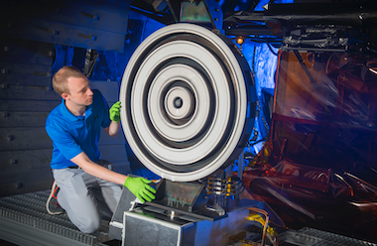
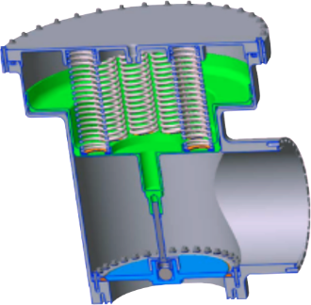
Nuclear Electric/Chemical Hybrid Propulsion:
Technical Maturation Needed
Liquid-Metal cooled Reactor System
Composite Radiator Heat Rejection
Megawatt-Class Power Conversion
High-Power Electric Thrusters
Cryogenic Fluid Management for Methane, Oxygen, Xenon
In-space Propellant Transfer
G–558966

Slide 8
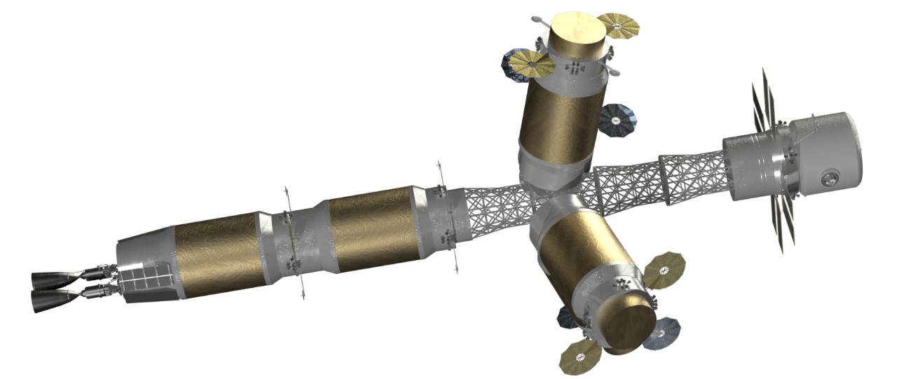
Why Nuclear, Why Now?
Space fission propulsion systems are game changing technologies for space exploration and cis-lunar mobility.
First generation NTP systems provide significant benefits to sustained human Mars exploration and other missions.
  Imagine Earth-Mars transit times of 120 days; imagine 540 day total Mars mission times; imagine reduced crew health effects from cosmic radiation and exposure to microgravity; imagine robust architectures including abort capability.
Advanced space fission power and propulsion systems will enable ambitious space exploration and development.

