Slide 1
Assembly of IXPE Mirror Modules
Author/Presenter: Steve Bongiorno (MSFC-ST12), stephen.d.bongiorno@nasa.gov
Co-authors: Kolodziejczak, Jeffery J.; Kilaru, Kiranmayee; Eng, Ron; Stahl, Mark T.; Ranganathan, Jaganathan; Ramsey, Brian D.; Tucker, John
Notes:
MSFC built 4 mirror module assemblies for the IXPE mission. This talk will be an overview of the assembly process how it went and the lessons that we learned along the way.

Slide 2
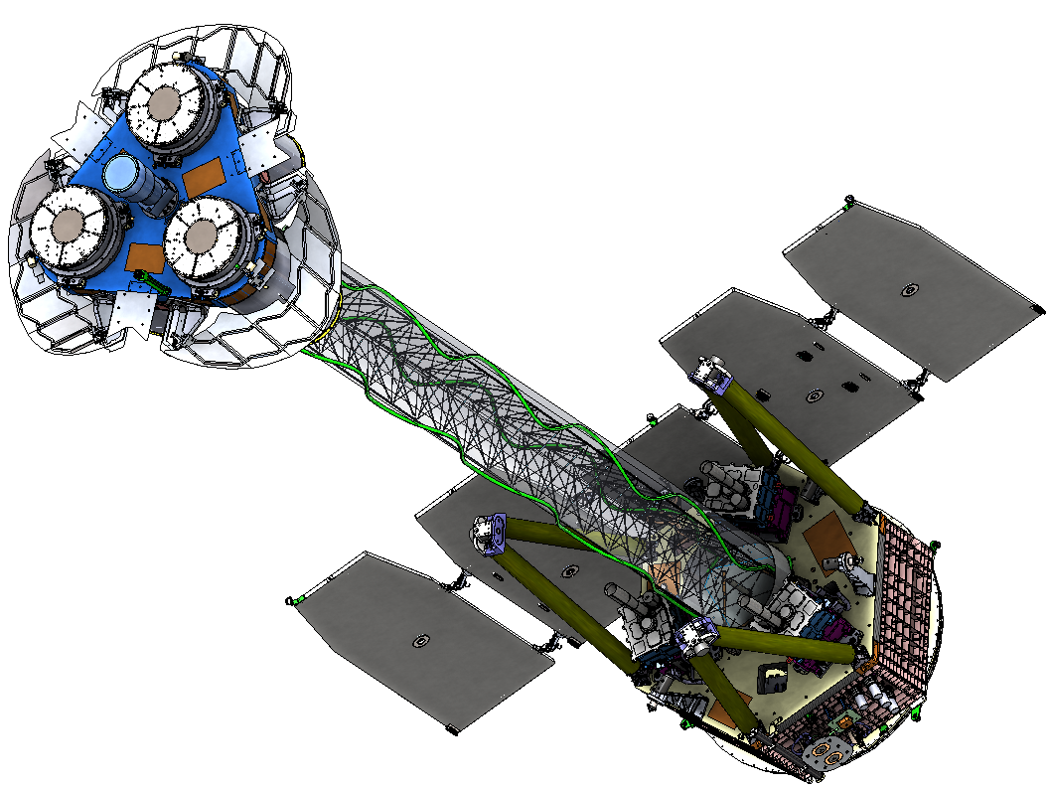
Imaging X-ray Polarimetry Explorer (IXPE) Overview
+Z Star Tracker
Motivation
IXPE will improve sensitivity over OSO-8, the only previous astrophysical X-ray polarimeter, by two orders of magnitude. ^{[1]}
IXPE will probe a wide range of cosmic X-ray sources, e.g. active galactic nuclei (AGN), microquasars, pulsars, pulsar wind nebulae, magnetars, accreting X-ray binaries, supernova remnants, and the Galactic center.
Science questions addressed through study of polarized X-ray emission:
What are the geometries of the flows, emission regions, and magnetic fields?
What physical processes lead to particle acceleration and X-ray emission?
What are the physical effects of gravitational, electric, and magnetic fields at their extreme limits?
The Observatory
IXPE consists of 3 telescopes
Each telescope consists of a Mirror Module Assembly (MMA) and a Polarization-Sensitive Detector Unit (DU)
MMAs were constructed at NASA/MSFC
DUs were supplied by Italian-lead ASI/INAF/IAPS/INFN collaboration.
Ball Aerospace Systems Corp. is the Prime Contractor
Mirror Module
Assembly (MMA x 3)
Boom Canister
MMA Thermal Shield
Deployed X-Ray Shields
Mirror Module
Support Structure
(MMSS) Deck
Detector Unit x 3
Boom Harness
Deployable Boom
with Thermal Sock
5.2 m overall
Launch Locks
Spacecraft Top Deck
Bipod Struts
[1] Weisskopf, M. C., Cohen, G.G., Kestenbaum, H.L., Novick, R., Wolff, R.S. & Landecker, P.B. 1976, X-ray Binaries, 81, "The X-ray polarization experiment on the OSO-8”
Notes:
The Imaging X-ray polarimetry explorer or IXPE is a space X-ray telescope.

Slide 3
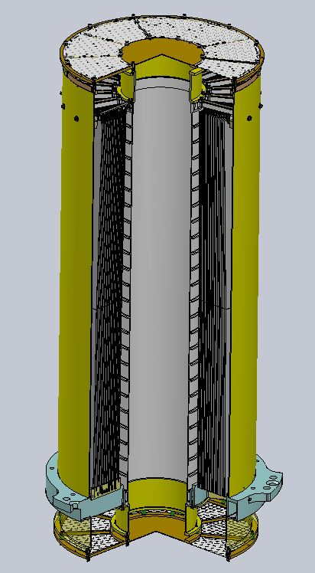
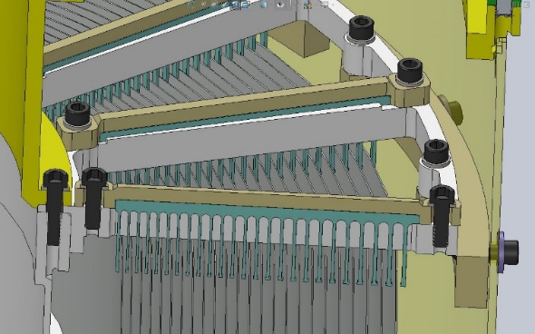
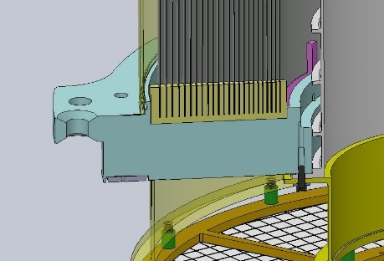
Optics Module
Each MMA consists of 24 nested X-ray Mirror Shells bonded at the large end into slots in front combs of a Spider-Central Support Tube Assembly:
Design: Wolter Type I
Shell Large End Diameter Range: 165 – 277 mm
Shell Length: 600 mm for Integral Parabola-Hyperbola
Focal Length: 4.00 m
Performance Requirement: 25 arcsec Half Power Diameter
Centering Alignment Knowledge Requirement: 25 μm
Post-Shell Assembly, the following components were added:
Outer Housings
Rear Spider and Rear Combs
Thermal Shields
Mirror Modules are labeled by spider serial number: MMA 1, MMA 2, MMA 3, MMA 4
3 for flight + 1 spare
Outer housing
24 nested mirror shells
Central support tube
Front spider

Slide 4
Assembly Stations
The shell assembly station aligns, offloads, and stabilizes shells so that they can be bonded to the front spider assembly. Shell assembly progresses from smallest to largest shell.
The rotation axis of the spin table provides the center and tilt reference for the shells and spider-tube assembly throughout.
Three proximity sensors (made by Keyence) are mounted to the spin table and rotate around the shell to measure its center, tilt and circularity with submicron precision.
One proximity sensor measures a top surface of the spider to monitor long term drifts.
Once mounted to the assembly station, shells are supported by 3 direct support wires and 6 off-loader wires on a rig suspended from a three-axis stage.

Slide 5
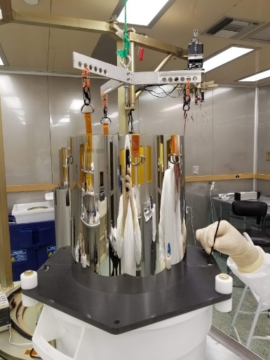
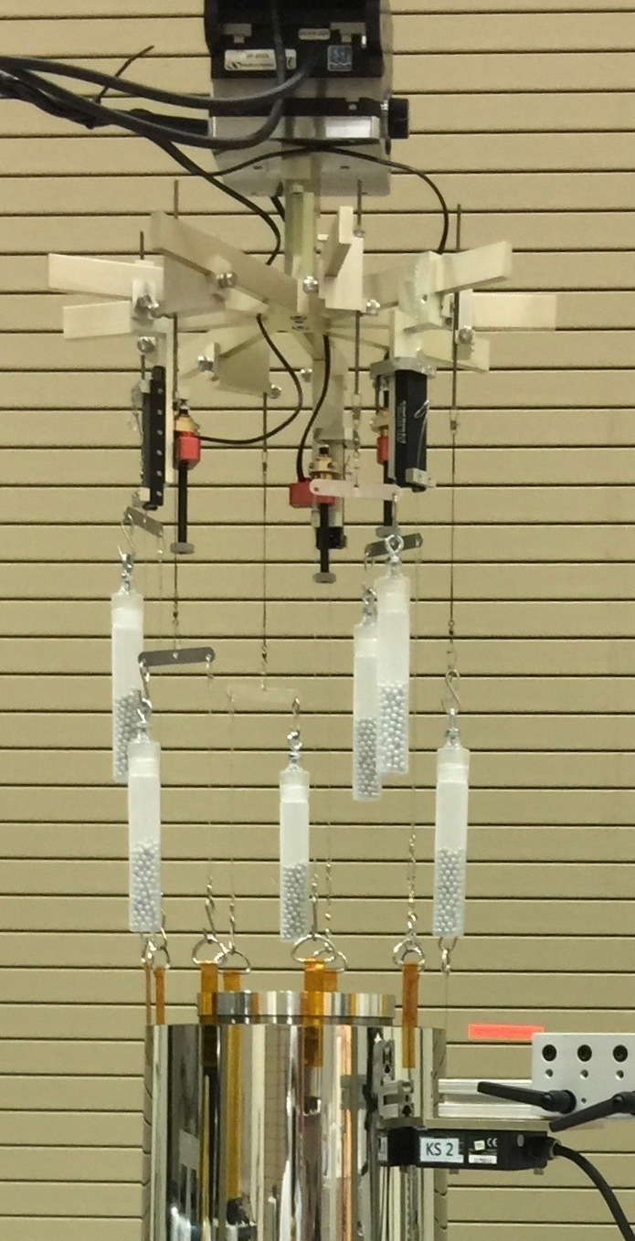
Shell Assembly Process Overview
First, the front spider central support tube (CST) assembly is installed onto flight-like mounting points on the assembly station.
The CST is aligned to the station’s rotation axis.
Shells are transferred from storage containers to the assembly stations, inspected and primed.
Shell is aligned - tilt is adjusted with 3 direct supports and node position is adjusted with 3-axis stage.
Based on circularity data, wire shims of custom thickness ranging from 0.0040” to 0.0075” are inserted between shell and front spider assembly to minimize shell shape distortion.
If shell tilt < 25 arcsec., centering < 30 µm ΔΔR< 20 arcsec., and values stable, epoxy bonding is performed.
Photographic inspection of each of the 9 bonds is the final step in the process.
3-axis stage
Direct support actuators
Shell transferred from storage container to alignment station
Shell mounted to alignment station

Slide 6
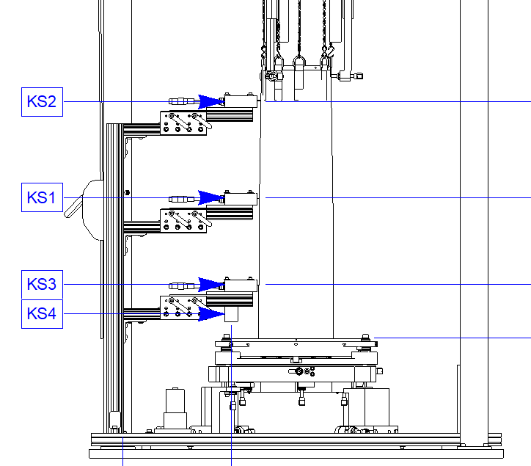
Shell Assembly Process: Alignment
Circularity measurements are made with three sensors (right) to calculate shell tip and tilt angles, x and y centering, and ΔΔR.
The shell is first aligned above the slots in a free state where a small pendulum motion is observed from room air currents acting on the shell.
Stabilizers are carefully installed to stop the pendulum motion while minimizing any translation of the shell from the bottom of the gravity well, and the shell is realigned.
Shell is lowered to 0.007” above the bottom of the slot and realigned.
Shims are inserted and shell is realigned.
Further alignment checks are performed after shimming, bonding, curing and suspension release for verification.
A MATLAB application (above right) partially automates the iterative alignment process:
Reads and analyzes sensor data and determines shell center, tilt, and ΔΔR performance estimate.
Automatically adjusts 5 axes (3 axis Newport Stage and 2 of 3 picomotors supporting fixed wires) to align shell.
Allows manual adjustment of stages
Typically 2-5 ~3 min iterations are required, depending on initial state to reach <5 arcsec and <5 μm alignment.

Slide 7
Shell Assembly Process: Bonding
Bond Design
Shell bond is a double lap joint (shell hangs in comb slots). Double lap geometry partially balances epoxy shrinkage.
Joint is filled by placing a drops of epoxy at the top of the outer comb-shell gap at each of 9 spider spoke locations. Epoxy wicks down and around shell edge.
Found that front side gaps <0.005” did not consistently wick down the front and up the back side.
Shims
To ensure minimum bond gap, flat wire shims inserted into outer lap of every bond joint.
Shims were made between 0.0040” and 0.0075” thick to optimize shell circularity and optical figure. Overall improvement was small, approx. 1.5 arcseconds on 25 arcsecond module HPD. Figure optimization via shim choice was limited by the need to maintain bond gap dimensions for reliable epoxy wicking.
NiCo Shell
Variable thickness flat wire shim
Comb
Cured epoxy
Epoxy flow path

Slide 8
Shell Assembly Process: Bonding
Environment
The priming and bonding processes require relative humidity in 30-55% range.
Bonding temperature required to be ±2°C of 20°C on-orbit set-point.
Fully wicked epoxy joints were:
achieved by limiting the shim sizes to those listed above
well predicted by <5 min. elapsed between resin-hardener mix and initial epoxy application to all 9 spokes
indicated by full external fillet formation within ~30 minutes bonding start time.
Wait minimum 8 hours for epoxy to cure before beginning next shell installation.
The four IXPE MMAs contain 864 shell bonds

Slide 9
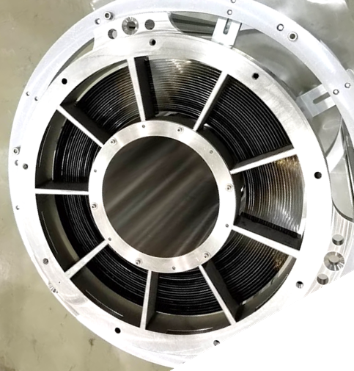
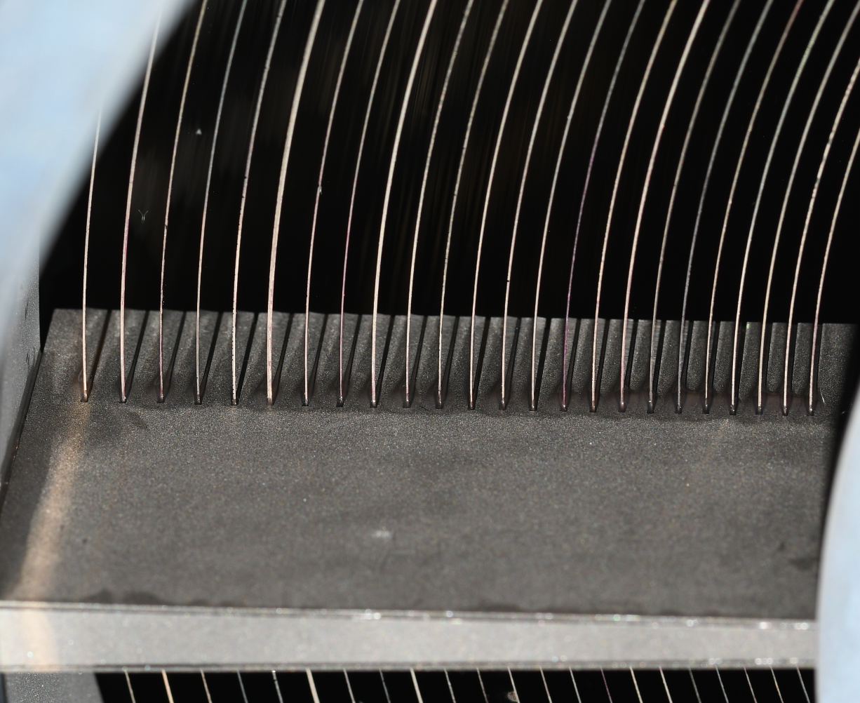
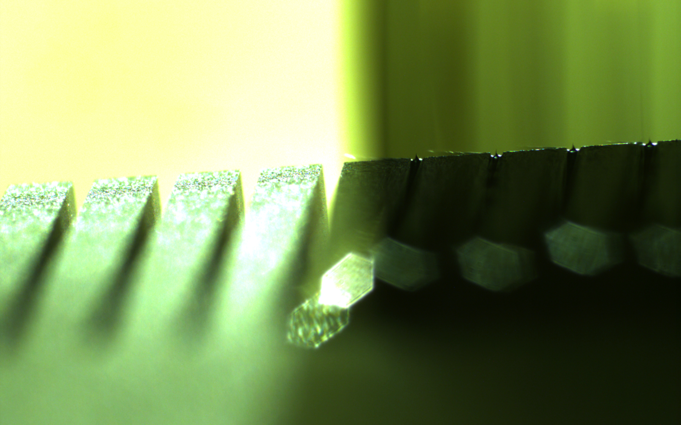
Shell Assembly Process: Mirror Bond Inner Inspection
After each shell installation, the inner (below) and outer (next slide) portion of each bond was inspected and photographed.
Complete epoxy filling of the inner bond gap was indicated by the curved glint of the small fillet near the top inner edge of the slot.
MMA Front (minus front thermal shields supports)
Front Comb
Mirror bond inner bond gap photos
Filled bonds

Slide 10
Shell Assembly Process: Mirror Bond Outer Inspection
The outer (right) portion of each bond is inspected for acceptable epoxy wicking.
Acceptable outer bond indicated by:
Trimmed wire shim in nominal location
Complete fillet
Epoxy did not wick away from bond joint.
Shim is trimmed and remained aligned
Complete fillet
Next slot is unobstructed

Slide 11
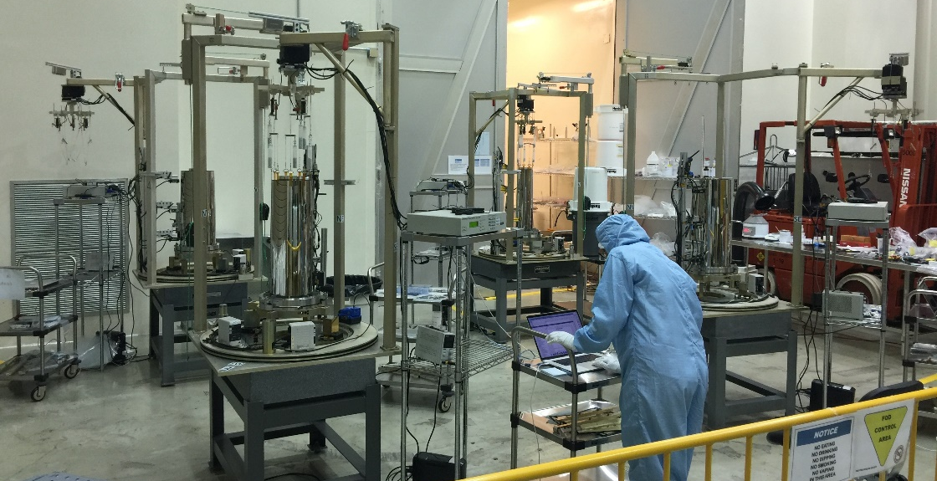
Assembly Operations
Shell assembly took place on 4 assembly stations following configuration-controlled procedures with quality assurance (QA) signoff.
Assembly took place in class 10000 clean room at MSFC’s X-ray and Cryogenic Facility (XRCF).
Temperature Controlled.
Marginal level of humidity control.
Shut down on several occasions when humidity was out of range. <5% of time.
Typical Daily Routine ~11 hrs. (2 shifts with overlap)
2 team members prepare shell(s) for primer application in AM.
Apply primer with QA witness around noontime and allow to dry for 1 hr.
Install align and shim shell in afternoon.
QA verifies alignment values in late afternoon.
Bond shell around 6PM-7PM and allow to cure overnight.
Delays were minimal
2 rejected shells without available spares
CoViD-19 Shutdown
Prioritized MMA1 and 2 assembly because, following assembly, environmental test was a serial process
Holidays
+ rejected
shell
CoViD-19 Shutdown
Rejected
Shell
2020
Notes:
We prioritized MMA 1 and 2 assembly and let delays fall on MMA3. This was because environmental testing was a serial process so it made sense to get one MMA into that queue as quickly as possible.

Slide 12
Shell Assembly Performance Metrics
We measured several parameters after assembly of each shell
Enabled cumulative MMA performance monitoring
Shell Centering Error
PSF of shell is displaced by shell miss-centering
Effect is small since equivalent angle is scaled by 4m focal length
1 arcsec = 20 μm center error
Shell Tilt Error
PSF of shell is degraded by shell tilt
Effect is small for <30 arcsec tilt error
Tilt causes miss-center since shell position is fixed at bonded end
Shell Distortion
PSF of shell is degraded by shell distortion
Insensitive to distortions that cause same angle change in both P and H segments
Very sensitive to bending distortions that cause opposite angle change in both P and H segments
1 arcsec of opposite shell distortion error in P and H = 4 arcsec error in a traced ray at focal plane.
This bending curvature effect on the traced rays is called delta-delta-radius error (ΔΔR)
Note: MMA 4 not shown, but similar
Notes:
These are the things that go into the performance predictions for each MMA. The 9-fold pattern comes from the shims. Determined that this distortion was worth while because it enabled us to reduce lower order DDR errors.

Slide 13
As-Built Performance Predictions
Plots at right show cumulative distribution functions of ΔΔR ray errors measured during assembly.
Half power diameters are the 50% points of these curves x2.
These values do not include HPD contributions from higher frequency axial figure errors intrinsic to the shells or scattering due to surface roughness.
The results are similar for all 4 MMA, though MMA 1 and MMA 3 have smaller values than MMA 2 and MMA 4 by 14-19%.
Values are in-family with the 6-shell engineering model value of 13 arcsec HPD.
The engineering model X-ray test gave ~18 arcsec HPD.
HPD=12.3 arcsec
HPD=14.4 arcsec
HPD=11.6 arcsec
HPD=14.2 arcsec
Notes:
Plots at right show what happens when you azimuthially integrate the point spread function and sum to create a cumulative distribution. Reading off where the curve hits 50% is the half power radius, so twice that is the half power diameter.

Slide 14
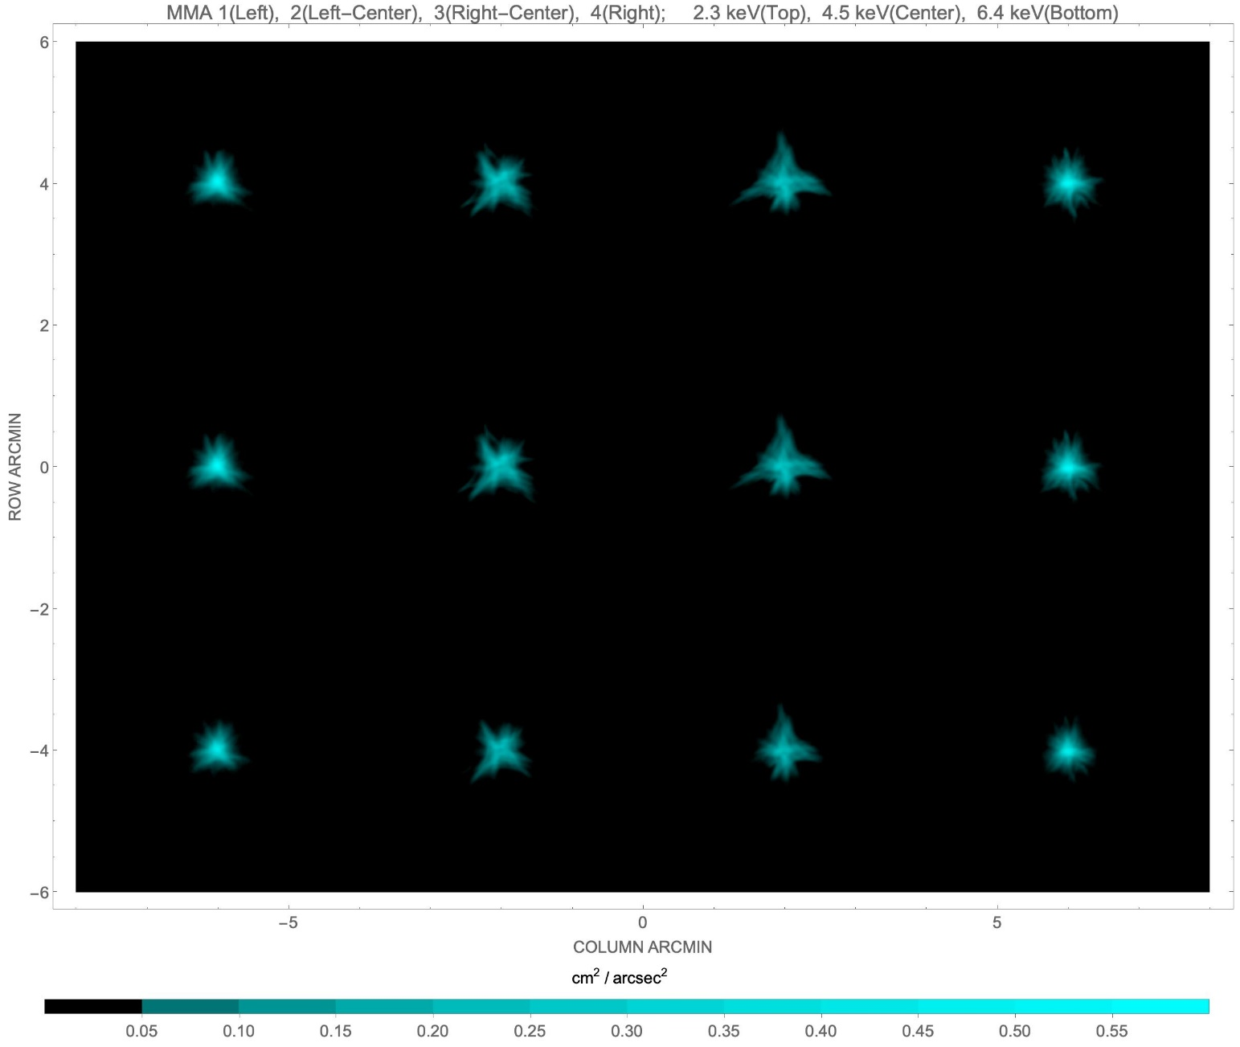
X-Ray Test Results: Point-Spread Functions and Performance
PSFs convey similar message to out-of-focus images.
MMA 1 and MMA 4 are much closer to ΔΔR estimates than MMA 2 and MMA 3.
HPD requirement was for 2.3 keV and 4.5 keV performance.
MMA 2 exceeded requirement by 4% at 4.5 keV.
MMA 3 exceeded requirement by 10% at 2.3 keV and 12% at 4.5 keV.
Because of availability, as of now MMA 1, MMA 2, and MMA 3 are being used for flight.
Requirements were waived, since:
Observatory performance requirement was still met
Schedule margin did not allow for swapping out for MMA 4.
Half Power Diameter in arcsec, ±0.3 arcsec
Energy (keV) | MMA 1 | MMA 2 | MMA 3 | MMA 4
2.3 | 19.0 | 25.0 | 27.6 | 20.0
4.5 | 19.9 | 26.0 | 28.0 | 20.8
6.4 | 20.2 | 25.0 | 25.8 | 20.1

Slide 15
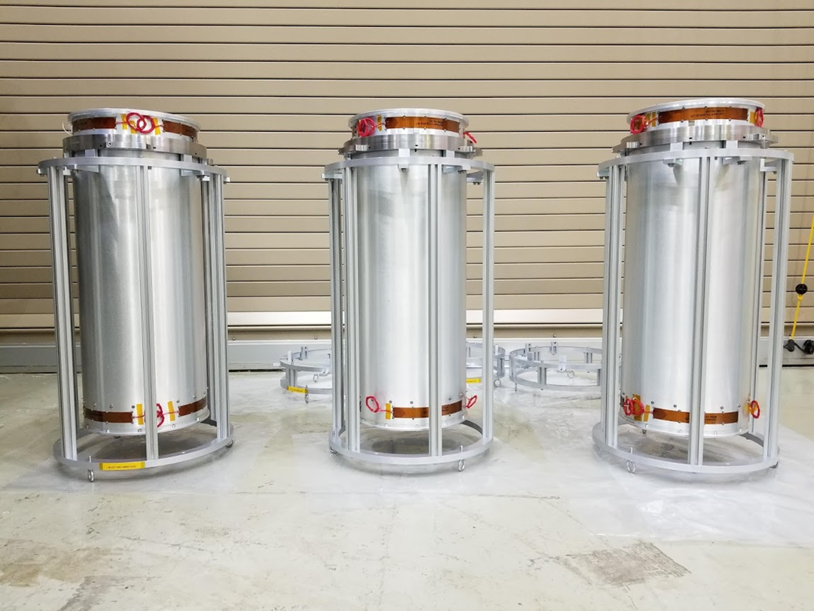
Summary
IXPE Mirror module assembly took place with a crew of 4 people at MSFC over a period from Oct. 2019 – July 2020, with a break for CoVID-19 shutdown over March-May 2020.
X-ray performance of 2 of the mirror modules (MMA 1 and MMA 4) was near predictions from build data.
X-ray performance of the other 2 mirror modules (MMA 2 and MMA 3) was worse than predictions from build data, and these models did not fully meet the Mirror Module Assembly IXPE requirement of 25 arcsec.
Out-of-focus x-ray images suggest that post- shell-assembly bending of the spider could have introduced the observed common-mode mirror shell astigmatism into these modules.
Because of IXPE project schedule constraints and relative module delivery times, MMA 1, MMA 2, and MMA 3 were integrated into the spacecraft, even though MMA 4 has better optical performance.
The three combined mirror modules and detectors meet the observatory-level performance requirement of 30 arcsec.
IXPE is scheduled to launch no earlier than December 15, 2021.

Slide 16
Backup

Slide 17
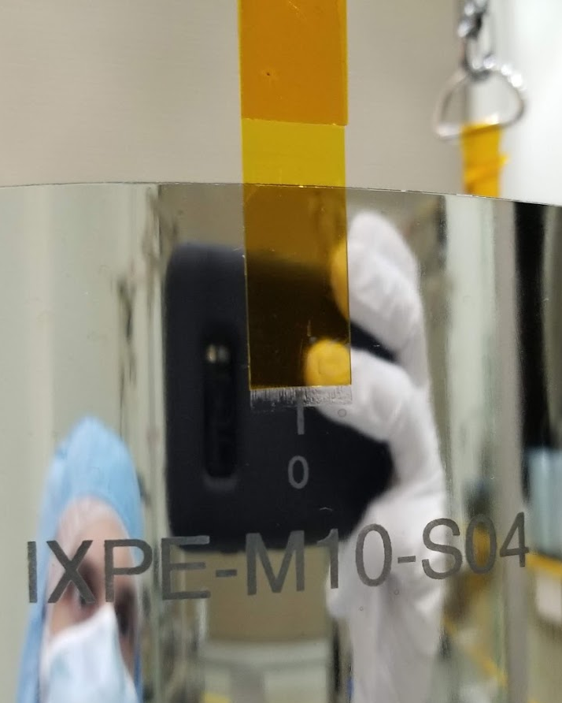
Unexpected Challenges
Inherent shell shape variations – Shell non-circularity necessitated shimming to achieve reliable epoxy wicking
Drift in suspended shell position while bond cures – Suspected to be Kapton tape adhesive age or UV degradation induced creep.
Sensitivity of epoxy bond strength to humidity
Sensitivity of epoxy wicking to bond gaps and mixing time
Late-in-design-cycle selection of launch vehicle led to over-test of engineering models
Shell rejection because of shell edge properties and contamination led to delays
COVID-19 pandemic
~3 mm tape creep observed over 4 month COVID-19 shutdown
Notes:
Circularity, edge variation
Drift tape
During EU development it was found that epoxy bond strength is related to the humidty
wick

Slide 18
Lessons Learned
Overall, the shell assembly went relatively smoothly despite various delays.
Having multiple assembly stations significantly improved scheduling flexibility due to various shell-related hold-ups. Often two shells were installed on different MMA in one day.
Bonding processes are more efficiently performed in environmentally controlled facilities.
Adequate schedule margin for design modifications following engineering model testing is essential.
Following shell assembly, all assembly steps should be subjected to analysis to identify potential to introduce permanent distortions into the spider.
Following shell assembly, all assembly steps should be performed with the spider in a flight-like mount configuration with any low-precision handling fixtures removed.
Waiting for launch vehicle selection until post-CDR imposes significant challenges and risks to design of vibration-sensitive optical systems.

Slide 19
Sensitivity to Post-Shell-Assembly Spider Bending
It is clear that MMA 2 and MMA 3 performance was degraded by shell distortions significantly larger than the engineering model
Facts that make it unlikely that these distortions occurred during shell installation:
All the shells in each of the worst MMAs have similar distortion
Both MMA 4 and MMA 2 were constructed on the same assembly stand, but one is clearly distorted and the other is not.
If a characteristic of the assembly station was the cause, then MMA 2 and MMA 4 would be similar.
Facts that make it unlikely that these distortions occurred when spider was unbolted from assembly station.
Sensor measurements were made before and after unbolting.
These indicated small levels of distortion below those observed in the x-ray tests.
These sensor measurements provide an estimate of sensitivity of MMA performance to spider bending
Facts that make it possible that these distortions occurred in later stages of assembly after the MMAs were removed from the assembly stations.
A handling fixture bolts to spider at 6 points and could bend spider while it is being attached.
Distortions smaller than handling fixture design tolerances could cause the observed distortions.
Subsequent assembly steps were performed with handling fixture attached, if temporary distortions occurred from handling fixture, they could be made permanent by assembly steps that involve the bonding of additional parts, like the outer housing,
Other post-shell-assembly support fixturing was fastened to components while they were being bonded to the spider. Removal of these fixtures could leave residual distortions.
Module-to-module distortions could be explained by varying dimensions within tolerances of the components involved.
Spider Bending from Unbolting and Astigmatism (arcsec)
N=2 Fourier pk-pk | MMA 1 | MMA 2 | MMA 3 | MMA 4
spider bend, μm | 4.0 | 5.6 | 1.6 | 3.0
Outer shell astigmatism at unbolting | 5.0 | 10.0 | 1.6 | 2.0
X-ray astigmatism | 6. | 18. | 15. | 7.
Notes:
Plot is row 1 vs row 2. shows there’s an inconsistency. Row 1 row 2 relatively small, row 3 is large.
We’re not sure what happened here have not done fault tree because it met requirements, but intend to run it to ground for the benefit of future programs. Here are things we can do: simulate the fixture/spider/shell assembly. Bolt misaligned front fixture to spider and look at shell/spider distortion.

Slide 20
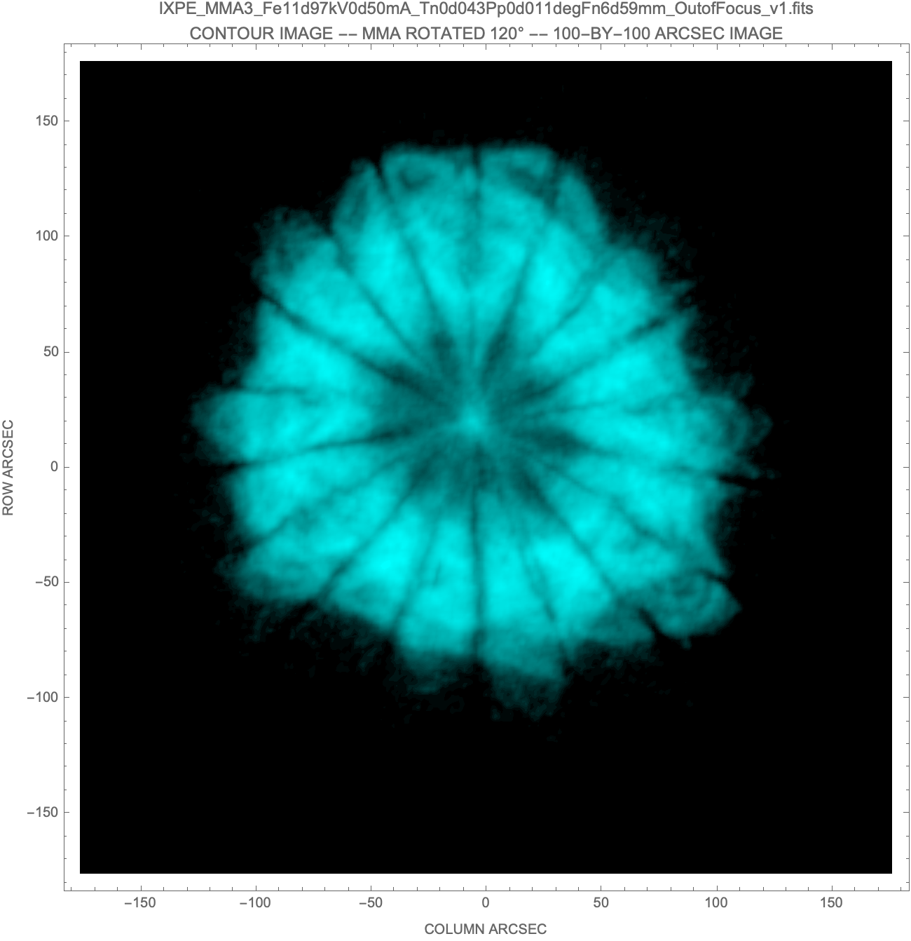
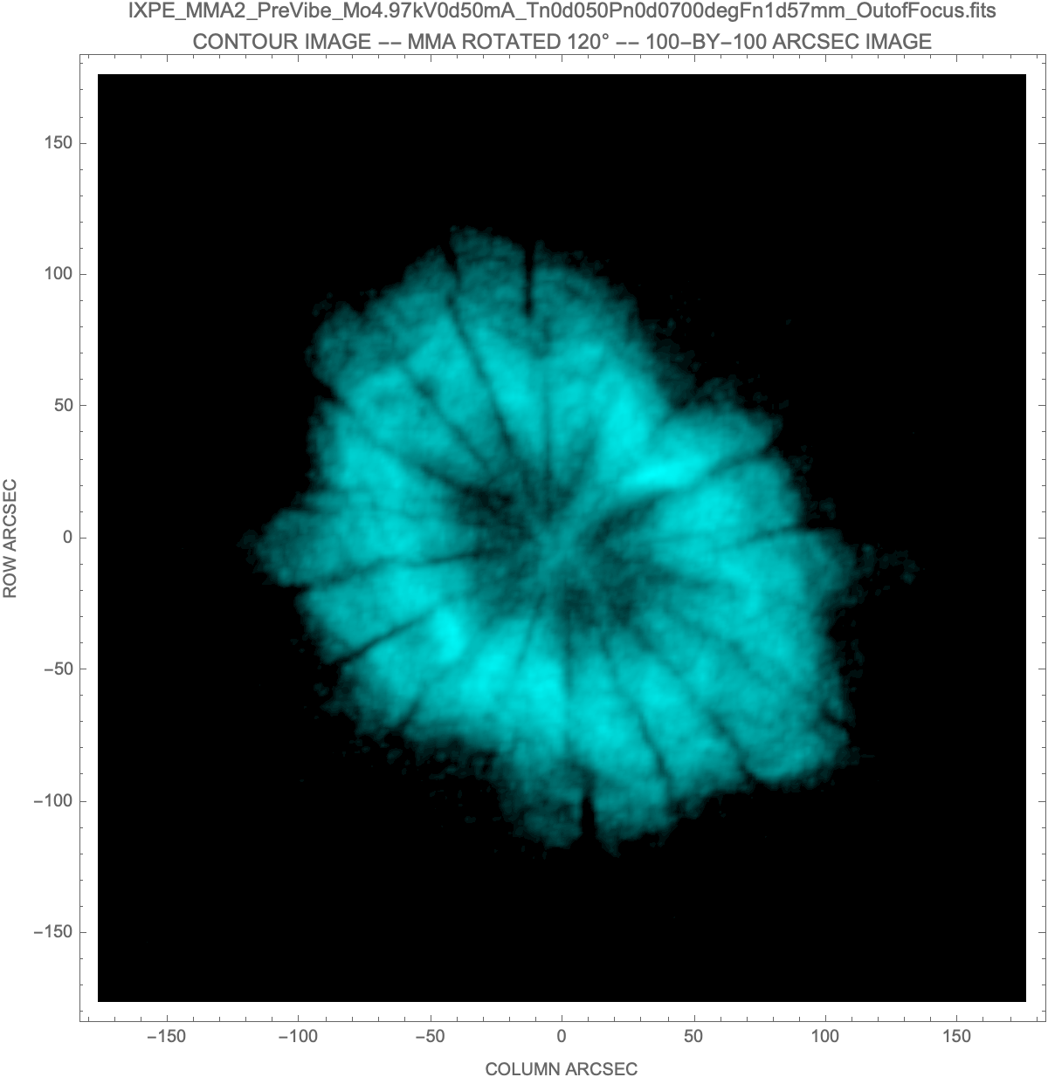
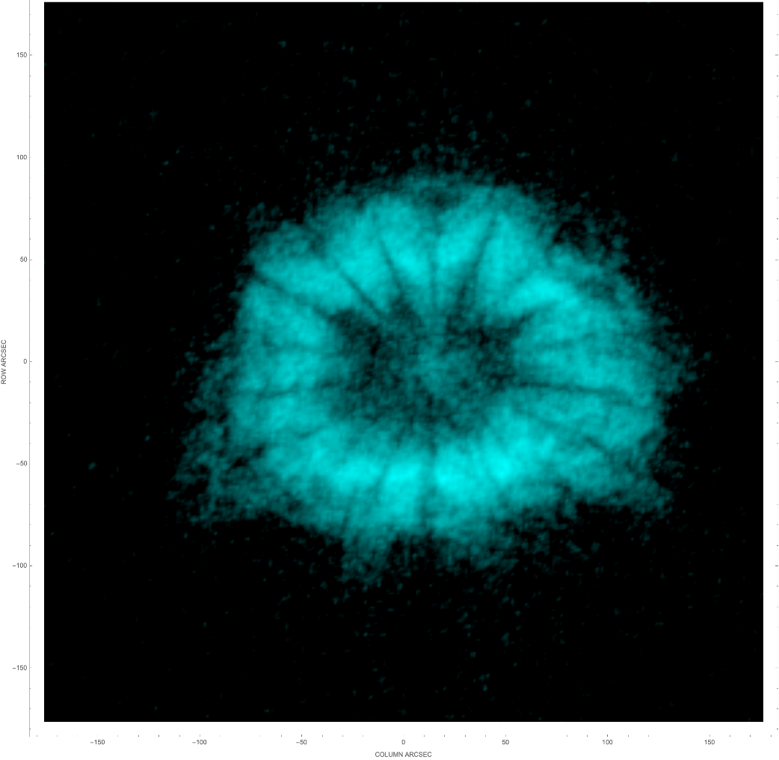
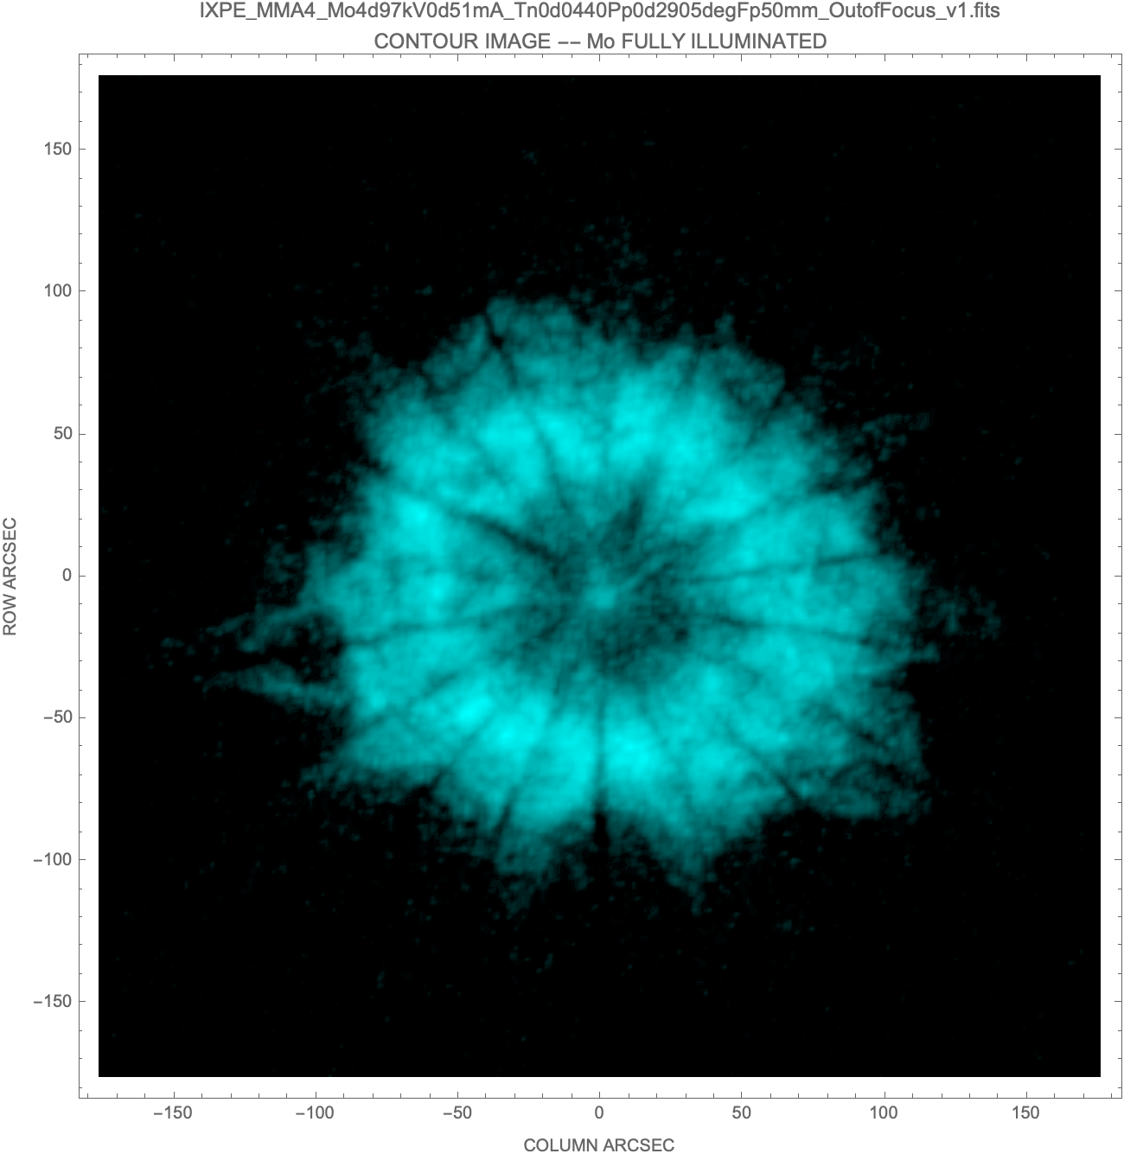
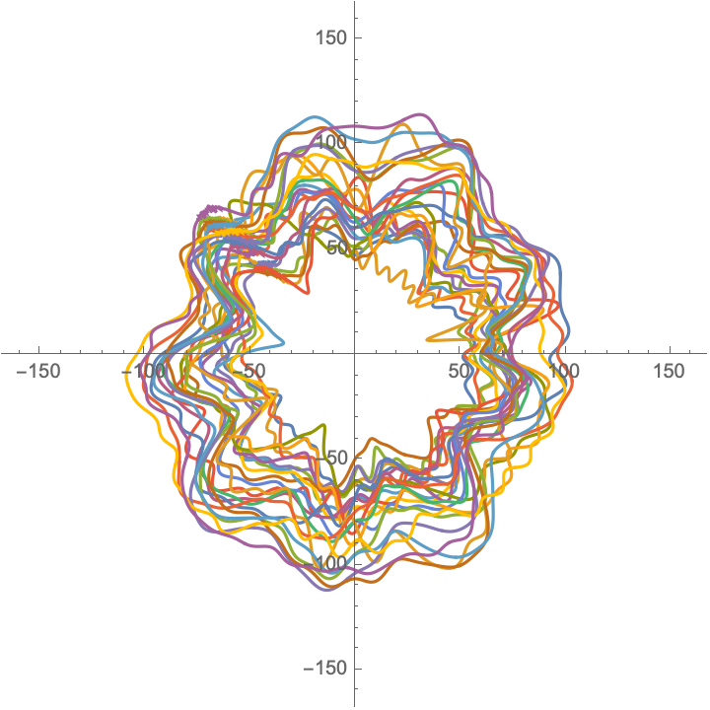
X-Ray Test Results: Out-of-Focus Images
X-ray images taken 50 mm pre-focus are shown at the right.
The ring image shows how rays from different azimuths of the shells converge toward focus.
Dark lines are shadows of the front and rear spider spokes.
Traces of ΔΔR error from sensor data acquired during assembly for MMA 3 are shown below.
All MMA show a similar symmetric pattern, with uniform ring width.
MMA 1
MMA 2
MMA 1 and MMA 4 are azimuthally symmetric as expected.
MMA 2 and MMA 3 have significant 2nd harmonic cyclic asymmetry.
This leads to the rays from the smaller radius azimuths of the ring focusing at a different depth than loss at the larger radius azimuths, i.e. astigmatism.
MMA 3 ΔΔR Traces
MMA 3
MMA 4

