Slide 1

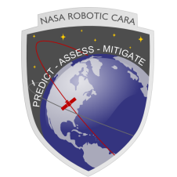
Conjunction Assessment Risk Analysis
Collision Avoidance “Short Course”
Part III: CA in Changing Space Flight Environment
Lauri Newman
NASA CARA

Slide 2
Changing Space Environment
Space environment has been changing, and will continue to evolve rapidly over the next few years due to the following drivers:
  Space Fence
  Large constellations
  New space actors
  SmallSat proliferation
New technologies and methodologies are evolving, adding complexity to the CA enterprise
  Maneuver Plan Streamlining
  Increasing on-board autonomy
CA practices will need to evolve to meet growing needs
  New methodologies
  AI/ML
  Best practices
  Data sharing
  Orbital registry

Slide 3
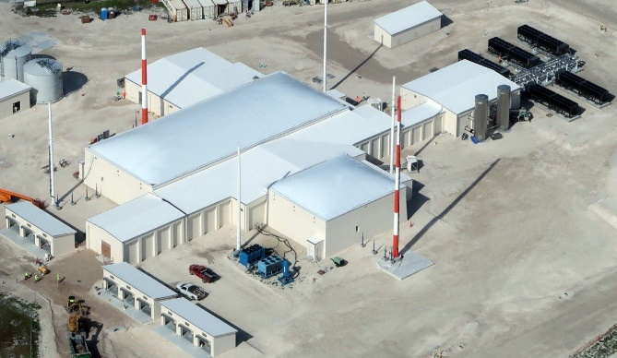
Space Fence (SF) Sensor
New Space Surveillance Network (SSN) sensor
  Equatorial phased-array S-Band sensor
  Can track to better than 5 cm (SSN capability 10 cm)
  Initial Operations Capability achieved
  Objects discovered by SF being introduced into CA enterprise
Expected impact on CA
  Increased quantity of new objects
    Overall CA workload increase estimate: low at present; potentially as much as 100% after a few years’ operation
  Quality of maintenance ODs
    Newly-discovered objects that can be tracked regularly should have reasonably good ODs
    Objects on edge of detection may have quality issues and create data actionability problems
  Workload increases will be felt both by CA practitioners and individual missions

Slide 4
Large Constellations
Many planned large constellations will add thousands of objects to catalog
  Just one constellation could cause a fresh conjunction every ~3 days vs ~1-2/month
  A Chinese company recently applied to the ITU for spectrum allocation for 13k vehicles in LEO
Operators with many spacecraft will need to rely on automation of maneuvers
  Maneuvers planned/executed only a few hours in advance allow no time for CA screenings
  Maneuvers performed without screening threaten flight safety
    Constellation cannot know maneuver intentions of other nearby spacecraft
    Ex. If two satellites simultaneously planning mitigations to avoid collisions with each other may maneuver into each other
Need to identify a CA process that enables automation without sacrificing ability to coordinate maneuver planning
  Near Real-Time screening of ephems
  Robust automated risk assessment tools
Transparency issue
  Not all operators sharing maneuver ephemerides for screening
Some Planned LEO Constellations
Name | Number | Altitude (km) | Inclination (deg)
ISS | 1 | 400 | 51.6
Starlink | 1584 | 550 | 53
OneWeb | 600 | 1200 | 88
Hongyan | 320 | 1094 | 50
Iridium | 75 | 780 | 86.4
GlobalStar Block 2 | 30 | 1410 | 52
Amazon Kuiper | 3236 | 630, 610, 590 | 51.9, 42, 33
Telesat Polar | 72 | 1000 | 99.5
O3B | 20 | 8063 | 0
Telesat Inclined | 45 | 1248 | 38
Envisat | 1 | 773 | 98.4
Hongyun | 156 | 1000 | 97.4
Synspective | 30 | 600 | 97.8
Orbcomm Block 2 | 18 | 750 | 47
Flock | 217 | ~489 | 97
Lemur | 76 | ~496 | 97
Table excerpted from Shepperd, Ryan, “How Big is Big? Better Metrics for Defining Constellation Size regarding Space Sustainability,” International CA Workshop, Paris, France, June 2019. Current constellation information available at https://www.newspace.im/

Slide 5
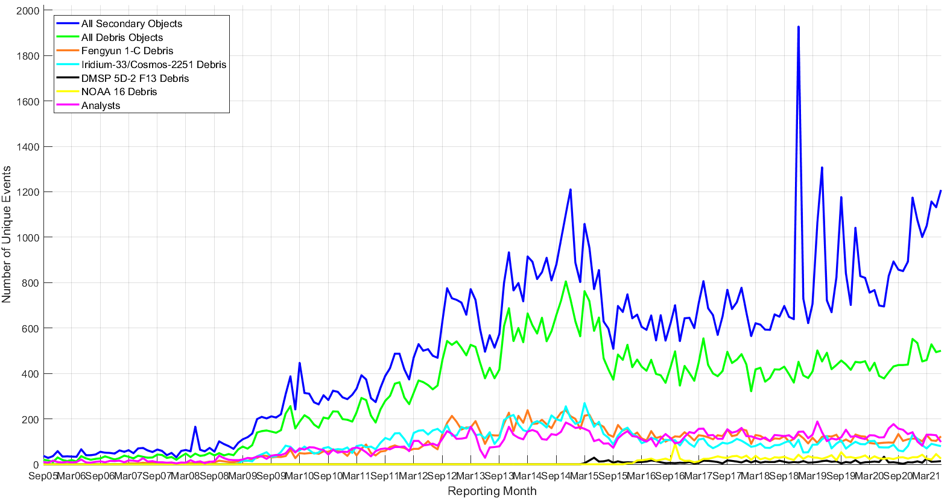
Increasing Workload-Space Fence and Large Constellations
Predicted Tracked Object Density
by Altitude in 2030*
Unique Events within 0.5x5x5-km Volume by Object Type, LEO
Starlink and OneWeb conjunctions
begin
*Prepared by The Aerospace Corporation
Current CA workload is large and expected to grow
  Across the LEO fleet, NASA CARA sees about 1200 unique conjunctions each month
    Up from 700 2 years ago primarily due to Starlink and OneWeb conjunctions (40%)
  About one conjunction per month per LEO spacecraft requires further analysis and mitigation planning
    Requires ~1 staff week of work for the CARA team for risk assessment as well as support from the mission flight operations team for maneuver planning
    Only about 20% of analyzed events result in a maneuver

Slide 6
New Space Actors
The space environment today is very different from a decade ago and continues to evolve very rapidly
  Historically, space operations were domain of large governmental entities.
  Commercial space operators are becoming commonplace and have different business models than government actors
  CubeSats are cost effective and accessible for everyone, even down to elementary schools
Challenge in educating new space actors on best practices and availability of data and tools
May require space “regionalization” rules
  E.g., altitude < 350km a “Wild West” region for cubesats with little flight dynamics experience or orbital control
  Allows inexperienced actors to access space without threatening high-value assets

Slide 7
SmallSat Proliferation:
Small Doesn’t Mean “Safe”
Small satellites can destroy large satellites and create large debris clouds as effectively as pieces of debris
Small satellites must be tracked in order to prevent collisions
  Small satellites harder to track, and some below regular tracking threshold
  Many small satellite operators do not compute their own ephemeris and rely on TLEs, making SSN tracking essential to their position determination
Maneuverable small satellites must have their maneuvers screened
  CA not effective if screenings cannot be performed against intended trajectories
In short, it is a fallacy that small, cheap satellites do not require CA
  In fact, in many respects more dangerous than traditional satellites

Slide 8
Trending Concern:
Maneuver Ephemerides Not Screened
Desire among satellite O/Os to streamline CA process given growing workload
  Understandable, given additional expected CA loading
Use collected CDMs to screen maneuver plans in-house, instead of using pre-maneuver screenings by 18 SPCS to save time
  If screening volume large enough, all possible conjunctions, even with primary ephemeris altered due to a maneuver, should be represented by CDMs
  Can use state and covariance information in current CDM set to perform equivalent of maneuver screening
Issue: ignores potential maneuvers of other primary objects
  “Regular” screenings consider only the submitted primary ephemeris or DoD primary solution against remainder of catalogue
  “Ephemeris on ephemeris” screenings are conducted in order to consider potential maneuvers of secondary objects, but only if ephemeris submitted
  Not screening maneuver ephemerides thus leaves category of potential secondary objects (i.e., other primaries) unaddressed

Slide 9
Trending Concern:
Importance of Data Sharing
Many spacecraft now using electric propulsion and/or automated onboard maneuver planning and execution
  Currently-maintained RSO catalog will lack up-to-date data on these satellites’ locations
Missions will need to share powered flight ephemerides to all for CA
  Without shared data, other operators have no way to tell where these assets are
  Users would have to change their practice to screen these ephemerides against their own instead of relying solely on 18 SPCS
  Sharing should be through a trusted/protected mechanism, like Space-Track.org or SDA
  Missions will have to have mechanism for screening these ephemerides
Issues
  How does an operator know that another operator exists, or know where to find ephemeris data for other assets?
  Many missions consider their ephemerides proprietary. This should never be the case, as this data is needed for flight safety and does not protect anything by being withheld.

Slide 10
Trending Concern:
Autonomous, On-Board CA
Some satellite operators have implemented autonomous,
on-board CA
  Use 18 SPCS CDMs uploaded at regular intervals
  On-board algorithms identify and plan needed maneuvers autonomously
  No notifications to anyone about intended maneuvers in advance
Issue 1: Cannot know maneuver intentions of other spacecraft
  Maneuver plans often changed with little lead time
  Presently O/Os work together to address such situations; impossible here
Issue 2: “Kantian Universality” failure
  One must act only in a manner that can become a universal law
  Cannot have more than one constellation with insular, autonomous CA
    If two satellites autonomously reacting to avoid collision with each other, and neither knows how the other is planning to react, no way to know whether a collision is being avoided
    Result might be for both satellites to maneuver into each other
NASA/industry collaboration working to develop resolution

Slide 11
Current Work:
Autonomous, On-Board CA
In order to enable large constellations that prefer to use autonomy to safely share data but still have near-real-time maneuvering, need to develop a method near real time sharing of maneuver intentions and resolution of conflicts among autonomous constellations
Collaboration formed among SpaceX, the NASA Starling mission, and CARA
  Starling will implement/test autonomous CA capabilities
  SpaceX Starlink will be second constellation in experiment
Starling/Starlink live automated interface experiment planned to begin early CY 2023
NASA plans to share prototype ground node solution to DOC for incorporation into their future OADR process

Slide 12
New Methodologies (1/2)
Potential new CA paradigms to handle workload
  CA remediation against “grouped” events using an aggregate Pc
  Station-keeping burn strategy to minimize conjunction risk, without actually remediating individual events unless an extremely high Pc
  Consideration of consequence in addition to risk to determine which events to remediate—already moving towards implementation at NASA
CARA tools are available free to the public as Software Development Kits (SDKs) on the CARA repository
  https://github.com/nasa/CARA_Analysis_Tools
  Contain benchmark test cases in addition to Matlab source code.

Slide 13
New Methodologies (2/2)
Automation/artificial intelligence
  Investigate methods to automate more of the process while retain key safety elements
  Determine usefulness of machine learning, neural nets, etc. in decision-making and/or risk analysis
  Enterprise difficult because CA lacks “truth” data—very few collisions actually take place
  NASA initial CA AI / machine learning studies show little improvement beyond current capabilities
Challenges
  No truth data makes training the system hard
  Parameter sets for prediction studies have large variations on Machine Learning models based on spacecraft constraints and orbital regime

Slide 14
Cis-lunar CA
Catalog of non-cooperatively tracked objects used in CA only available near Earth
Activity at Moon, Mars, and Libration points increasing risk of collision without screening
DOD developing cis-lunar catalog and screening capability
  Requirements not yet defined
  Implementation is many years away
NASA Multimission Automated Deepspace Conjunction Assessment Process (MADCAP) provides ephem-on-ephem screening for missions that utilize DSN
  Not Pc based; most operators do not provide covariance
  Relies on sharing of data; sharing of non-NASA data encouraged

Slide 15
CA Best Practices
CA industry is evolving rapidly
Guidelines/standards are needed to enable healthy growth
  Safety of Flight best practices should be adapted universally
Sources of existing best practices:
  Best practices for 18 SPCS support are available on the website
    www.space-track.org
  NASA published CA best practices Handbook in December 2020; contains analysis describing the technical/scientific foundations of best practices
    https://nodis3.gsfc.nasa.gov/OCE_docs/OCE_50.pdf
  Secure World Foundation publishes “Handbook for New Actors in Space”
  Best practices for satellite operations
    www.spacesafety.org
  CONFERS publishes best practices for Proximity ops
AIAA has a Space Traffic Management working-group to investigate various topics. One is best practices.
  For information contact Dan Oltrogge / AGI or Moriba Jah / UT Austin

Slide 16
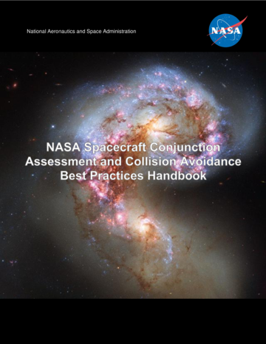
NASA Spacecraft Conjunction Assessment and
Collision Avoidance Best Practices Handbook
Covers the current USG CA process end-to-end, including high-level details of 18 SPCS screening process.
Provides list of best practices with rationale and appendices on methodologies
Comments or suggestions are welcome
    Send to ca-handbook-feedback@nasa.onmicrosoft.com
Downloadable from: https://nodis3.gsfc.nasa.gov/OCE_docs/OCE_51.pdf

Slide 17
Orbital Registry
Propose an “Orbital Registry” service as part of STM that would:
  Deconflict orbital placement: provide evaluation of mission orbit selection during design phase to determine impact from close approach perspective and offer trade space of alternative orbits
    Similar to filing flight plans; during license evaluation is too late to change orbit selection – should be during design
      Tweaking orbits by a few km can make a big difference in reducing the number of close approaches with neighbors
    Allows for advance notice of potential co-locations so that they can be avoided or managed smartly.
  Maintain database of operator contact information
  Enable protected data sharing: Sharing ephemerides is critical for powered flight/low-thrust modelling. Operators need to be ensured that their sensitive data is protected.
    Centralized screening service would allow trusted agent to do this screening while keeping data secure
  Provide access to best practices/guidelines
    Links to multiple sources in one place for easy access

Slide 18
Summary
Exciting growth offers opportunities that will change society, but needs to be done safely to ensure that we have continued use of the space environment for future generations
References:
  The Aerospace Corporation, “Space Traffic Management In The Age of New Space”
    https://aerospace.org/sites/default/files/2018-05/SpaceTrafficMgmt_0.pdf

