Slide 1
HIRAD
(Hurricane Imaging Radiometer)
Development, Demonstration, and Future Thoughts
Dr. Daniel J. Cecil
NASA Marshall Space Flight CenterEarth Science Office
Daniel.J.Cecil@nasa.gov

Slide 2
HIRAD Background
Observing objective
Demonstrate the capability to accurately map ocean surface wind speed:
over a wide swath (10’s of km; ~50 km when flown near FL600)
under heavy precipitation conditions
for high wind speeds (including Category 5 hurricanes)
to improve hurricane forecasts and decision support
Intended as wide-swath SFMR capability
Technology approach
- Synthetic Thinned Array Radiometer maps a wide swath via interferometric image reconstruction, ~60° swath (but noisy at edges) ; pushbroom imager
- 4.0, 5.0, 6.0, 6.6 GHz channels sensitive to surface wind and column rain

Slide 3
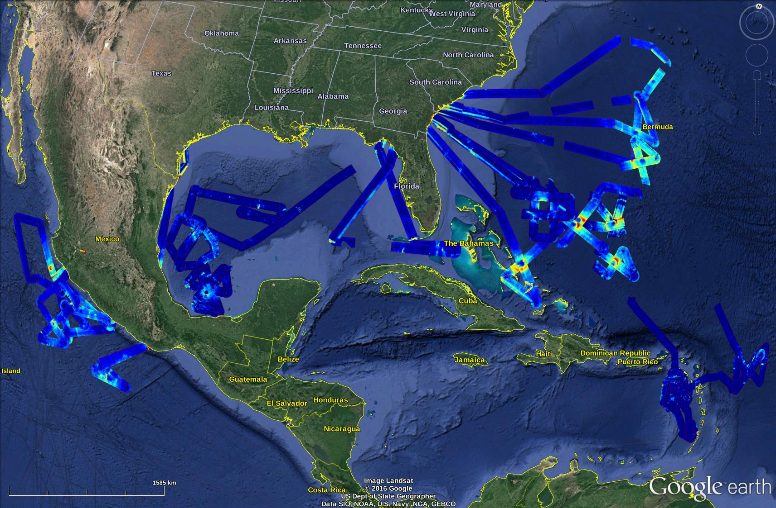


HIRAD History
History
Developed 2007-2010 by:
- NASA MSFC
U. Central Florida
U. Michigan
- NOAA
via NOAA and NASA MSFC internal support
Leverages previous technology developed at NASA LaRC and UMich
Flew on WB-57 and Global Hawk (~FL600) in GRIP 2010, HS3 2012-2014, TCI 2015
HIRAD wind speed retrievals,
2010-2015
2015 TCI flights with dropsonde comparisons in red
Joaquin 2015
Ingrid 2013
Earl 2010
Gonzalo 2014
Marty2015
Karl 2010
Erika 2015
Patricia2015
Gabrielle 2013
WS
(m/s)

Slide 4
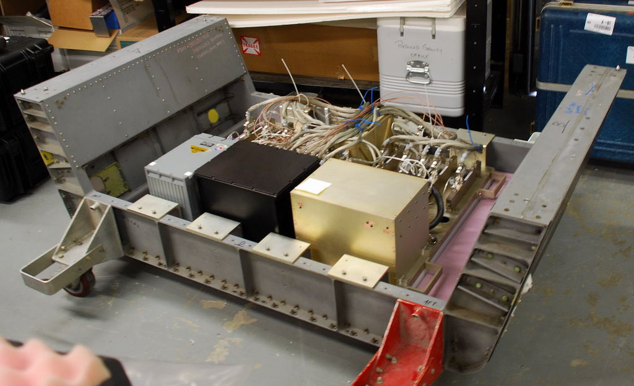
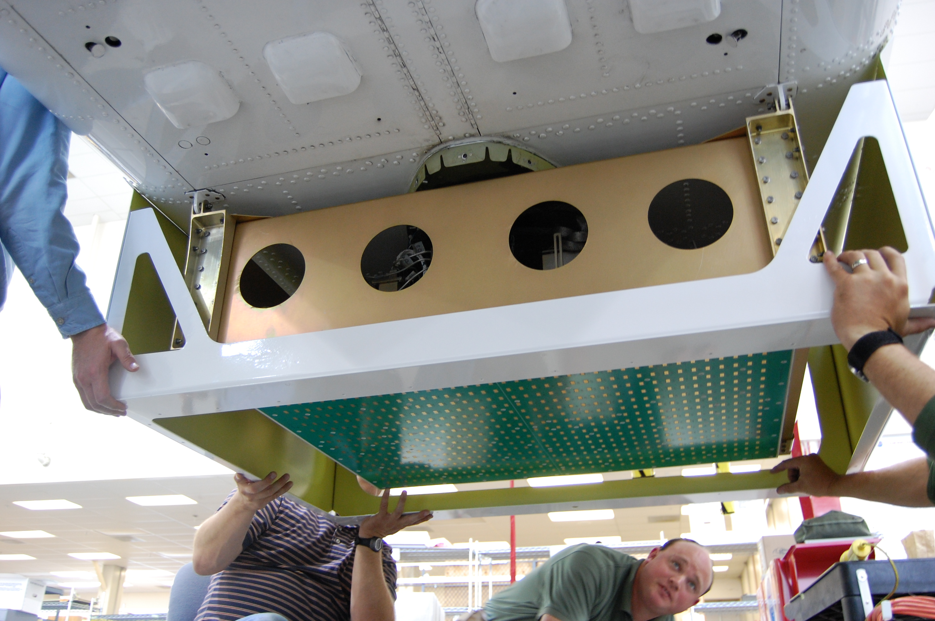
Instrument Details
HIRAD weighs about 250 lbs
Dimensions:
30” (forward-aft),
38” (starboard-port),
11.5” (height)
(not including any fixtures or covers)
33.7” x 50.1” by 0.6” radome mounts about 1.25” below the instrument. In the WB-57, the radome has served as the floor of a standard 3-foot pallet.
HIRAD also requires a somewhat stable temperature for whatever air is circulating in the pallet
Power requirements are 115VAC 400Hz at 2-3 Amps, and two 28VDC 15 amp circuits, 4-7 amp for C&DH and 4-13 amps for heaters that cycle during flight.
Besides WB-57 and Global Hawk, could fly on P-3
HIRAD mounted in WB57 standard 3-foot pallet (for placement in bomb bay)
HIRAD mounted on Global Hawk, before radome or fairing enclosure installed

Slide 5
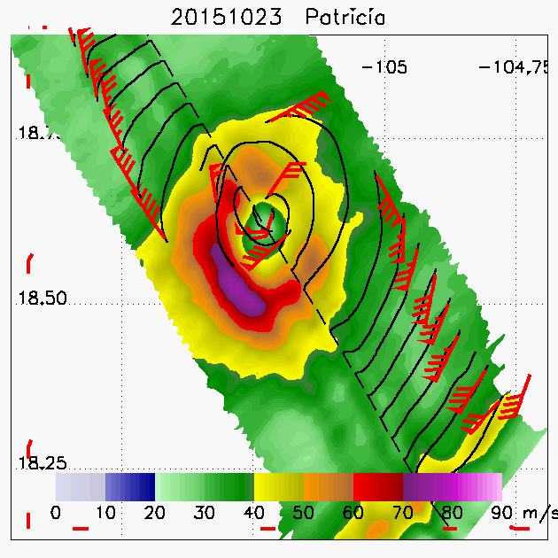
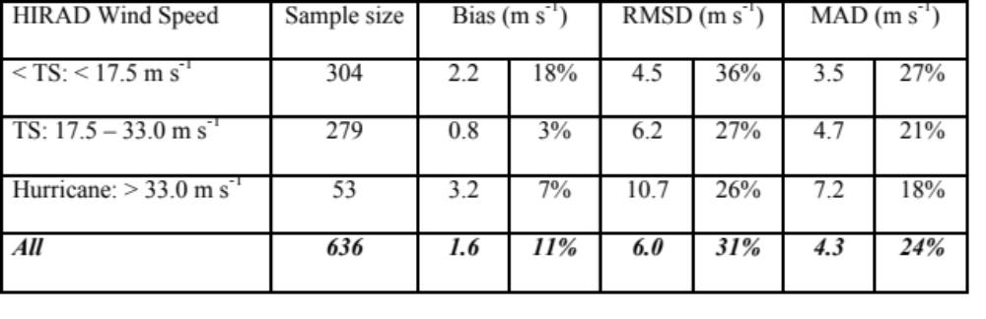
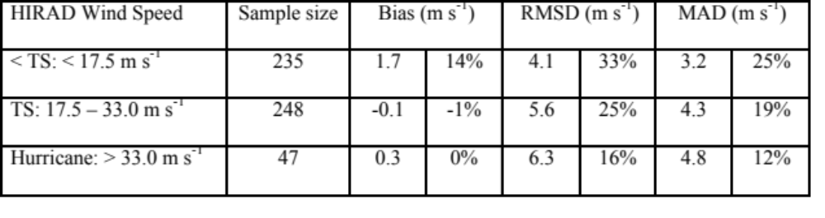
Wind Retrieval Validation
Using 636 HDSS sondes from 10 flights in TCI 2015
Omitting known problems (remnant of TS Erika, TS Patricia 21 Oct, and 3 dubious points from eye-eyewall gradient)
We estimate RMSE ~ 5 m s⁻¹ after accounting for uncertainties in the validation approach.
Hurricane Patricia (2015) (Cat 5)
ONR Tropical Cyclone Intensity (TCI) program
HIRAD + HDSS dropsonde winds

Slide 6
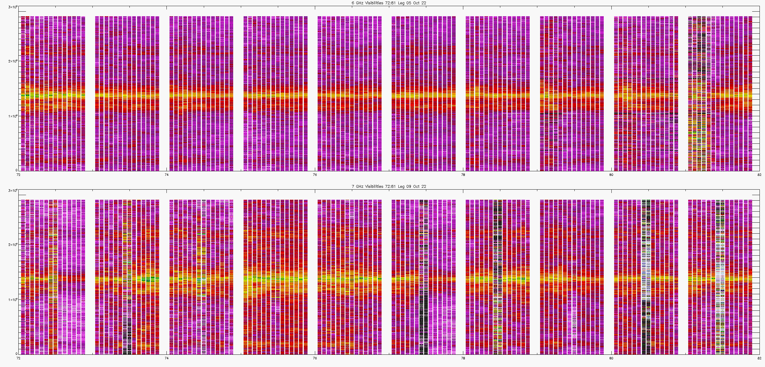
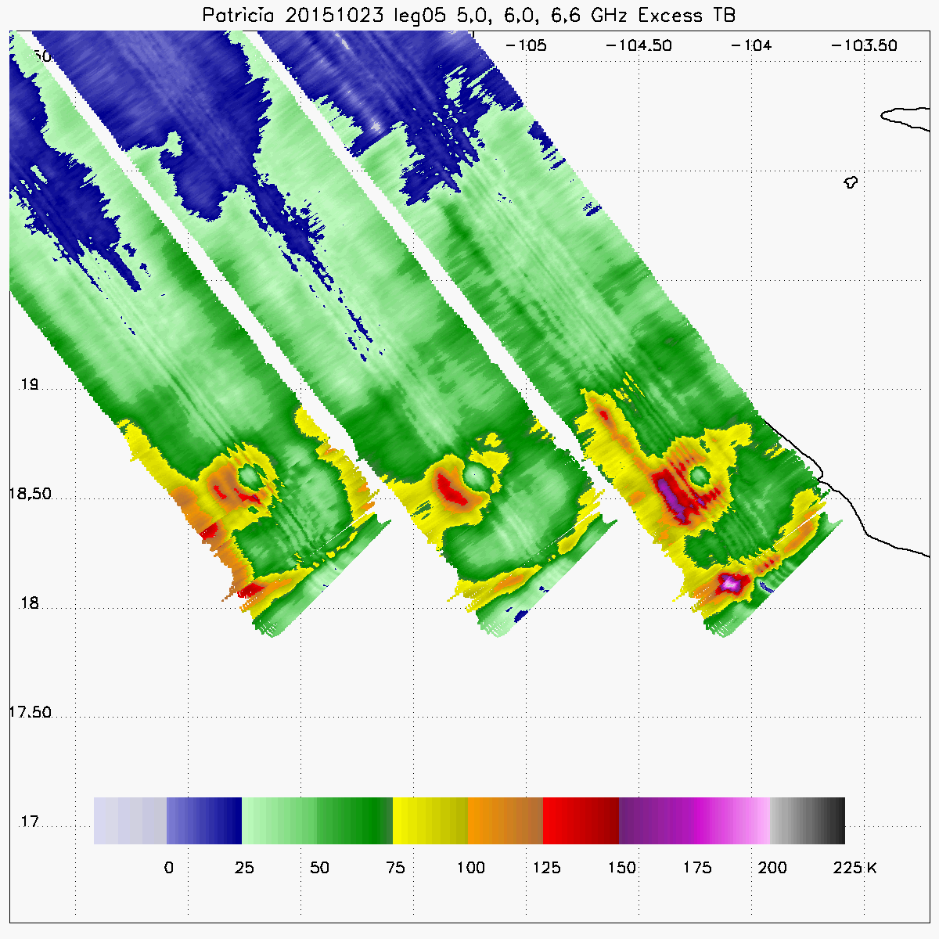
Some gory details, under the hood
Interferometric image reconstruction requires combinations of visibilities from pairs of antenna array elements.
The visibility pairs are calibrated and combined to produce brightness temperatures.
The brightness temperatures are calibrated using an ocean-atmosphere radiative transfer model and measurements over rain-free, low-wind ocean scenes during the flight.
Excess brightness temperatures are computed by subtracting the measured brightness temperature from that expected for a rain-free, low-wind scene. Excess brightness temperatures from each channel are supplied to the wind speed retrieval.
Brightness temperatures usually had along-track streaks or wave-like ripples that were not consistent enough to fully removal. Improvements in our instrument operation and data processing over the years improved this.

Slide 7
What should come next?
Dual-Polarization Antenna, Receivers, Beamformer in order to retrieve wind direction
Reduce size and mass, in order to increase options for where to install on aircraft (or smallsat?)
Thermal controls to keep antenna conditions uniform, stable
Updates to antenna, receiver, beamformer technology since HIRAD was built over a decade ago
    We started with a proof-of-concept instrument build, and tried to do piecemeal upgrades from there
    Difficult when the next “piece” in an upgrade is not an ideal fit to the technology of the previous piece, or when the next piece is an expensive / risky enabling step that does not immediately result in improved instrument
For now, our best datasets are Joaquin (2015) and Patricia (2015), available from NCAR EOL and NASA GHRC. These data have not been heavily used yet. Data assimilation experiments using HIRAD have shown positive impacts.

