Slide 1
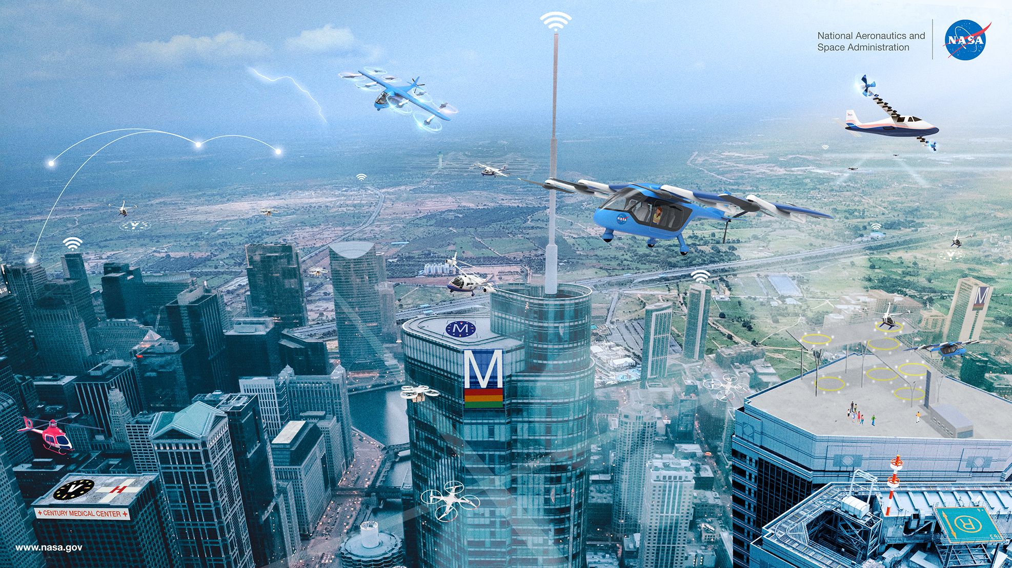
AIAA Transformational Flight Certification Symposium:
Making Flying as Simple as Driving
Ken Goodrich, Deputy Project Manager for Tech
NASA Advanced Air Mobility Project
4 August, 2021

Slide 2
Simplified Vehicle Operations
Conceptual model of vehicle operation, including human and automation elements
Lessons from driving
Certification and regulatory challenges
  Spoiler, airworthiness regulations (e.g. §Part 23) aren’t the principle challenge

Slide 3

Model of intelligent control process
Can represent,
Human
Automated system
Human-Automation system
Modeling
Perception
Decision
making
Desired
Outcome
Actions
Evaluation
Execution
Internal
External
Environment
Sensing
Effectors
Physical System

Slide 4
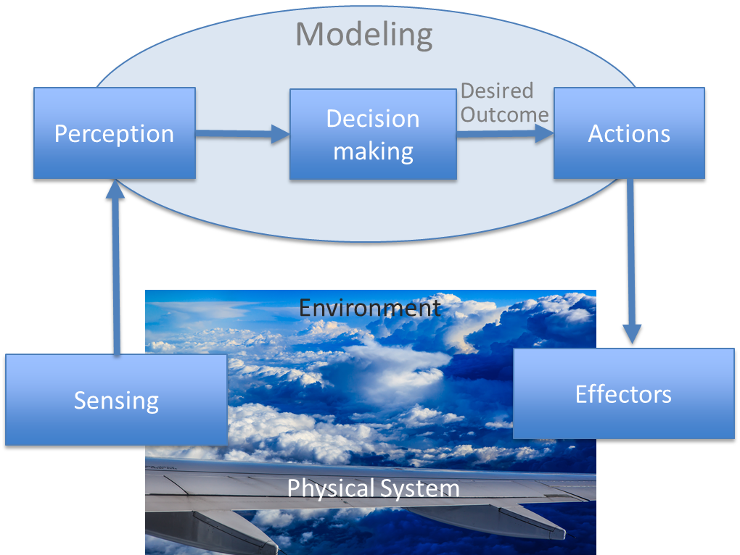
Model of intelligent control process
Automation enables varying levels of human involvement
In-the-loop; human is the performer
On-the-loop, human sets goals, monitors and switches to in-the-loop if required or desired; both supervisor
and performer
Over-the-loop, human sets goals, monitors, may be consulted; supervisor only
Out-of-the loop, human has no responsibility or authority
The Loop…

Slide 5
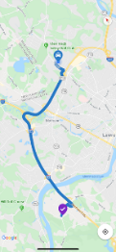
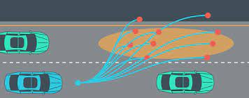
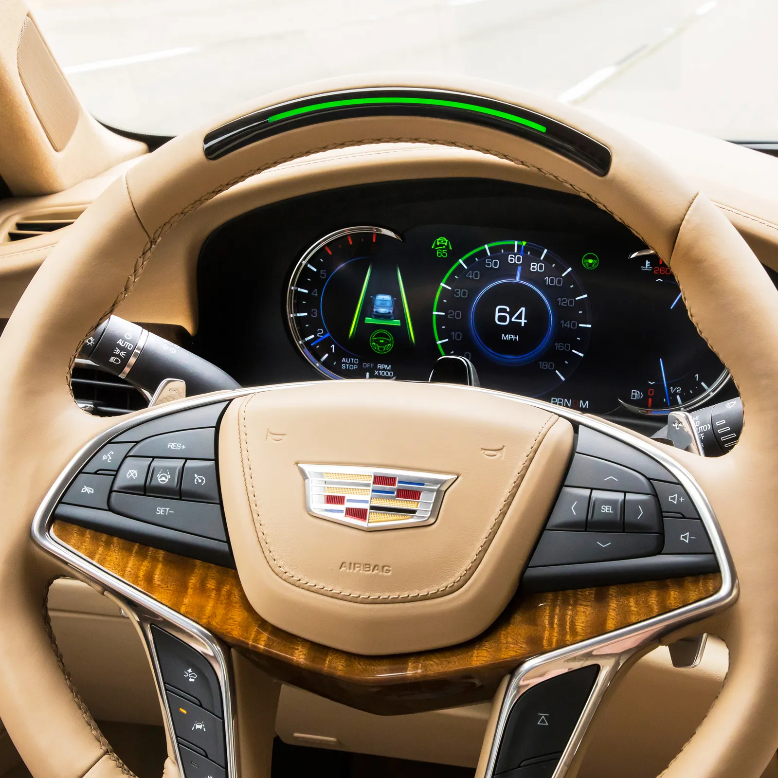
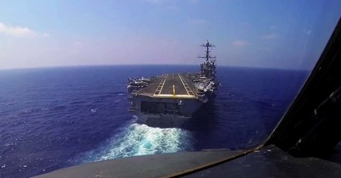
Multi-loop Model of Vehicle Operation
Perceptions
Intent
Mission Planning (performance)
Strategic awareness
Contingency plans (e.g. reach safe harbor)
Plan through destination
Maneuver planning (kinematics)
Tactical awareness
Hazard avoidance
Tactical objectives (e.g. merge and exit)
Desired, implementable trajectory
relative to real-time situation
Execution (dynamics)
Corrections to capture & follow plan
Desired instantaneous states
Limiting /protections
Stability augmentation
Physical inputs
Conditional,
Occasional
Trip
Plan
Continuous,
medium
Situated
Action
Plan
Continuous,
Reactive,
fast
Guidance
&control
Internal
External
Failures
Sensors
Effectors
Outcomes
Disturbances
Actions

Slide 6
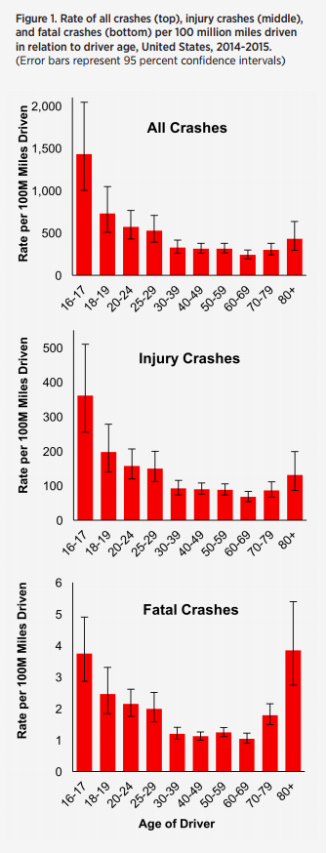
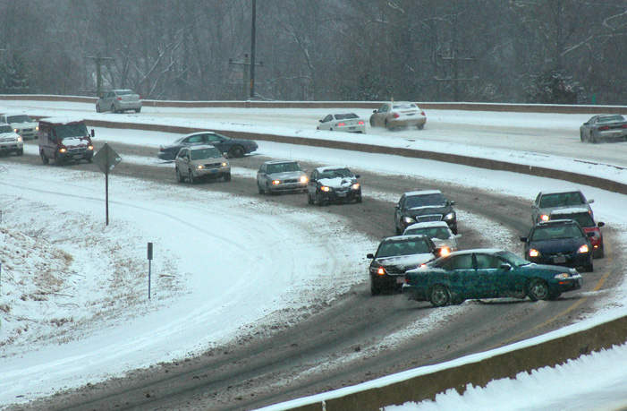
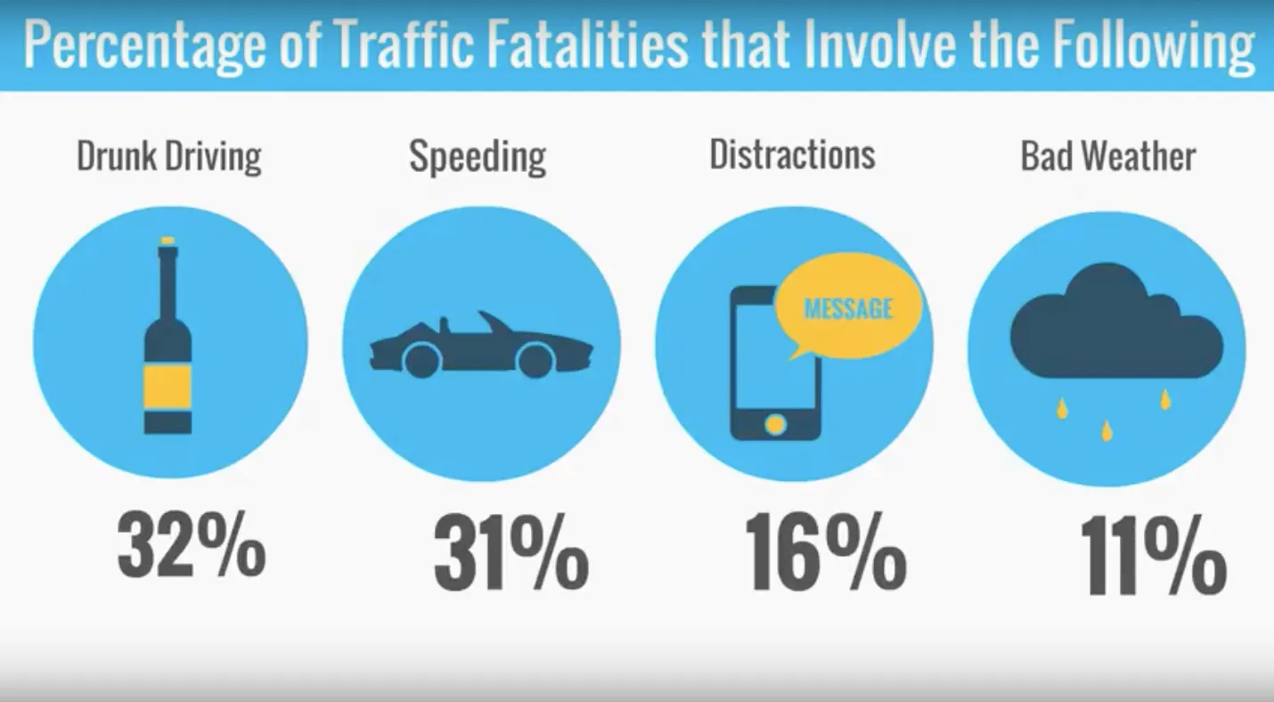
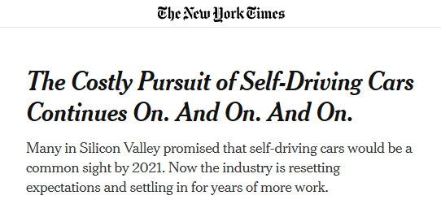
Lessons From Driving
Most US adults become successful drivers, but…
Not overnight
Not always simple
AAA Foundation
Not perfect
Completely eliminating human roles still speculative
Distraction
Judgement lapses
Skill errors
Inattention
Etc…

Slide 7
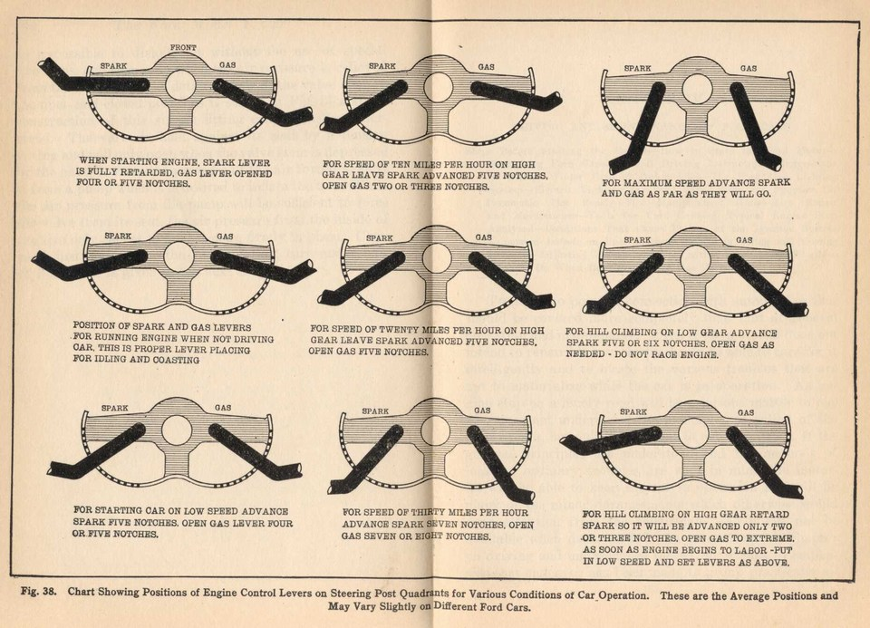
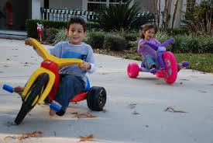
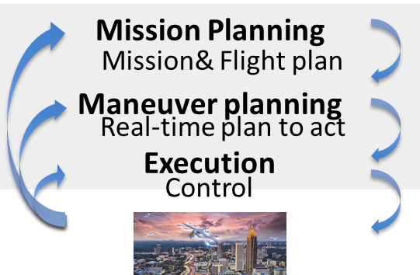
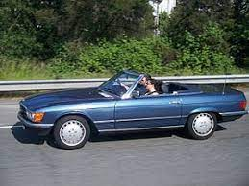
Lessons From Driving (cont.)
Technology has eliminated and simplified many of the secondary tasks of driving
Lateral and longitudinal control dynamics in normal operations are consistent with our 2D lives, relatively simple, decoupled, and have limited external disturbances
Spark advance management, 1926 Model T
Automatic transmission
Engine control unit/EFI
Anti-lock brakes
Traction, stability control
Lane departure
Autonomous emergency braking
Active driving assistance systems?
(safe harbor in
< 15 seconds)

Slide 8
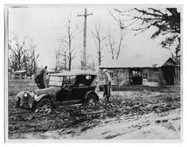
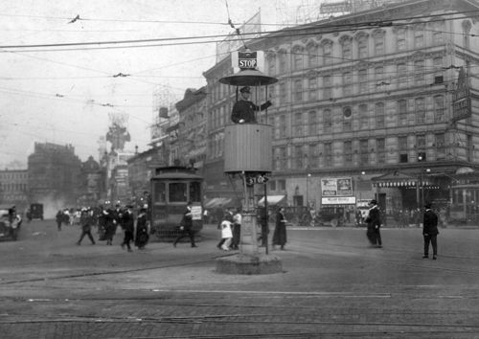
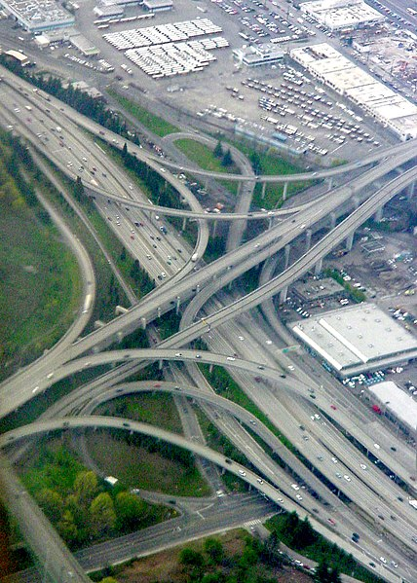
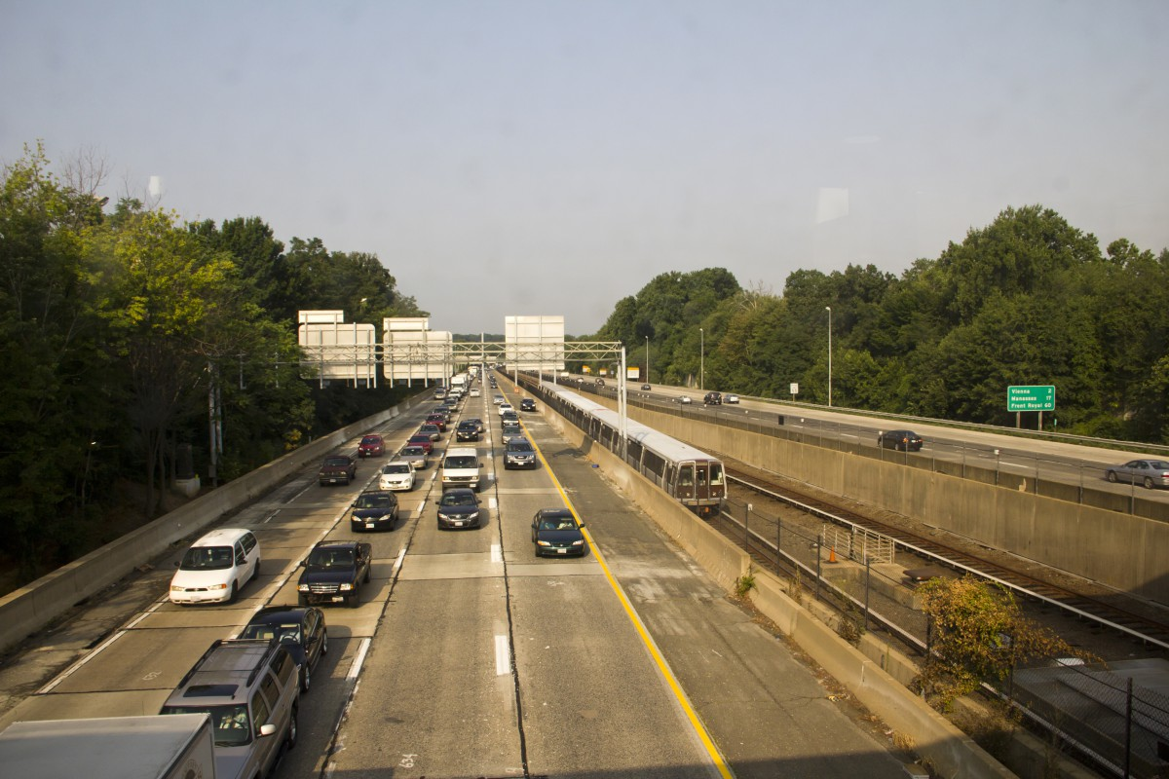
Lessons From Driving (cont.)
Infrastructure and operational rules are vital to safe, simplified operations
Standardize
Organize
Segregate
Integrate

Slide 9
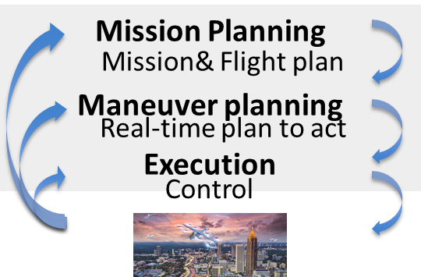
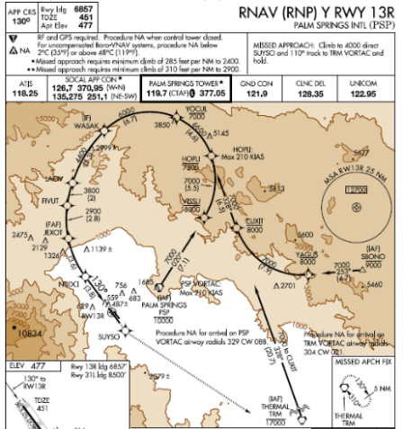
Lessons applied to Advanced Air Mobility ( …caution, opinions)
While SVO needs to be more fully defined, some concepts include
Vehicle Automation
Pilot authority
Automation enables pilot to command and supervise rather than physically control
Pilot responsible for tactical and strategic planning
  Automation supports perception, analysis, protections
  Operations control center shares responsibility as appropriate
But, experience, training still essential
On-loop w/
Protections
On-loop w/
Protections
Over-loop
Flight and airspace procedures and infrastructure developed for increasingly automated systems, with human supervision
Not without risks and challenges:
Technologies must be reliable, otherwise human still must backstop—safety, performance, and training consequences
Automation changes the roles and tasks of humans, including creation of new tasks and hazards
Automation may reduce flexibility in unexpected situations—early AAM is likely to evolve rapidly
Design requirements and practices must be updated and refined to reflect these realities

Slide 10
Regulatory Considerations
Airworthiness (§ Parts 21, 23, 27, etc…)
Pilot Training (§ Part 61)
Operations (§ Parts 91, 135, etc.)
The challenges of the next couple of decades likely center on interpretation of:
  § 91.3 Responsibility and authority of the Pilot in Command
    The pilot in command of an aircraft is directly responsible for, and is the final authority as to, the operation of that aircraft.

Slide 11
Backup

Slide 12
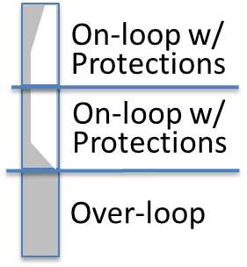
Lessons applied to Advanced Air Mobility ( …caution, opinions)
While SVO needs to be more fully defined, some concepts include
Vehicle Automation
Automation enables pilot to command and supervise rather than physical control
Pilot responsible for tactical and strategic planning
  Automation provides perception, analysis, protections
  Operations control center shares responsibility as appropriate
But, experience, training still essential
Operational procedures and infrastructure designed around increasingly automated system with human supervision
Not without risks and challenges:
Technologies must be reliable, otherwise human still must backstop—safety, performance, and training consequences
Automation changes the roles and tasks of humans, including creation of new tasks and hazards
Automation may reduce flexibility in unexpected situations—early AAM is likely to evolve rapidly
Design requirements and practices must be updated and refined to reflect these realities

