Slide 1

Denver, Colorado
92nd Aerospace Medical Assoc Annual Meeting
01 September 2021
Death in Space: Forensic Pathology
Edward L. Mazuchowski, MD, PhD Lt Col, USAF, MC
Chief, Forensic Services AFMES-JTS Liaison NASA-JTS Liaison
Regional Armed Forces Medical Examiner

Slide 2
Disclosure Information
91st Annual Scientific Meeting
Edward L. Mazuchowski, MD, PhD, Lt Col, USAF, MC
I have no financial relationships to disclose
I will not discuss off-label use and/or investigational use in my presentation.

Slide 3
Disclaimer
The opinions or assertions presented hereafter are the private views of the speaker and should not be construed as official or as reflecting the views of the Department of Defense, its branches, the Defense Health Agency or the National Aeronautics and Space Administration.

Slide 4
Contributors
Philip Stepaniak, MD
Kathleen Mcmonigal, MD
Joan Bytheway, PhD
Kjell Lindgren, MD
Ann Tsung, MD
Travis Houser, MA
Steven Uhl, RN
Rachel Richardson BSN, RN, CEN, CPEN
Lorraine Benavides Gibson, BS
Michael Misoira, BS

Slide 5

Background
4

Slide 6
Forensic Pathology
Identify the fatalities
Determine the Cause of Death
Determine the Manner of Death
Autopsy Examination Report

Slide 7
Cause of Death
The disease or injury that produces a physiologic derangement that results in death.
Disease – categories can be named by system (e.g. cardiovascular, respiratory, central nervous).
Injury – categories include blast injury, gunshot wound, and multiple/blunt force injury.
A firearm causes a gunshot wound.
An improvised explosive device causes blast injury.
6

Slide 8
Manner of Death
How the death came about (circumstances).
Natural – disease process
Accident – injury with no volitional act to harm
Suicide – injury from volitional act to harm oneself
Homicide – injury from volitional act to harm another
Undetermined – body not recovered/inadequate info
7

Slide 9
Challenges
Forensically trained individuals
Weightlessness
Validated procedures
Unknown decomposition rate
Disposition of remain

Slide 10
Forensic Examination
Photographic documentation
Removal of personal effects and clothing
Forensic sample collection and storage
Preparation of the body
Human remains containment unit (HRCU)

Slide 11
Forensic Samples
Hair and nails
Urine
Blood
Vitreous humor

Slide 12
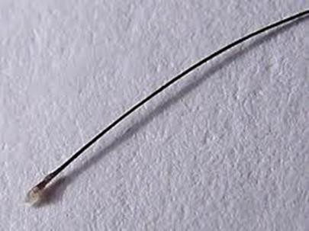
Hair Sample

Slide 13
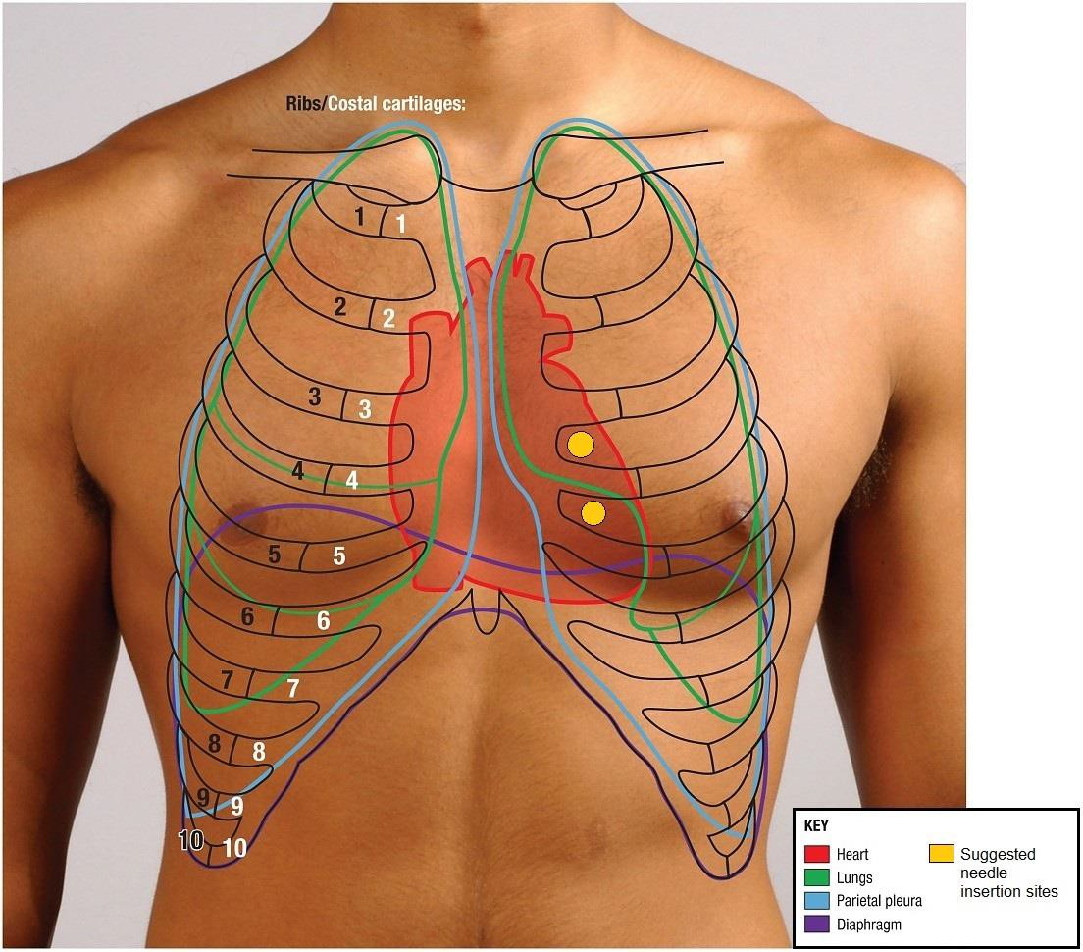
Blood Samples

Slide 14
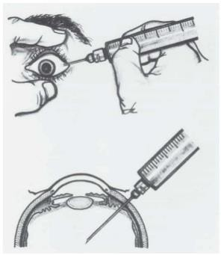
Vitreous humor

Slide 15
Preparation of Remains
Placement of gauze in oral and nasal cavities
Absorbent undergarment
Abdominal puncture
Human remains containment unit

Slide 16
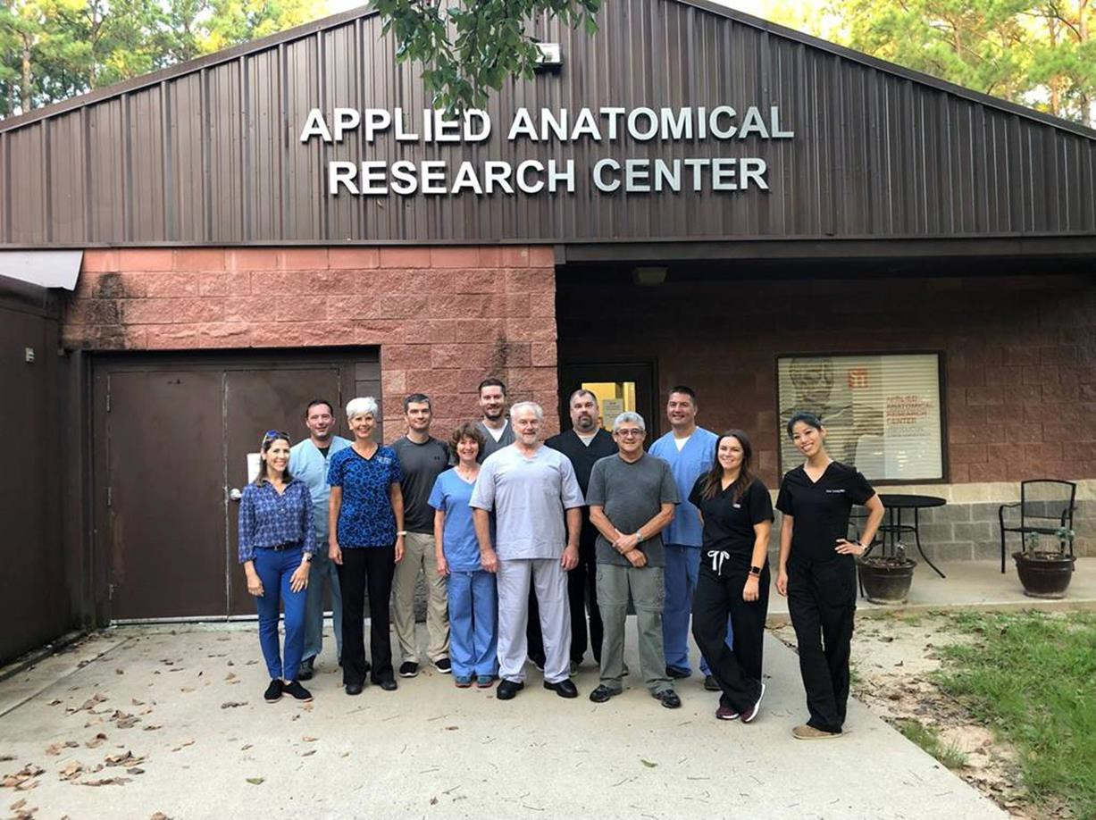
Research Team

Slide 17
Results
Validation of post-mortem forensic sampling (24-25 Sep 2019)
Mid-fresh stage of decomposition within two days
Early stage of decomposition within six days
HRCU contained liquids and gases for 43 days (25 Sep – 7 Nov 2019)

Slide 18
Conclusions
Space presents unique forensic pathology challenges
Validated procedures for obtaining forensic samples
Validated HRCU

Slide 19
Questions?
“Make Good from the Bad”
- Harcke 2005

