Slide 1
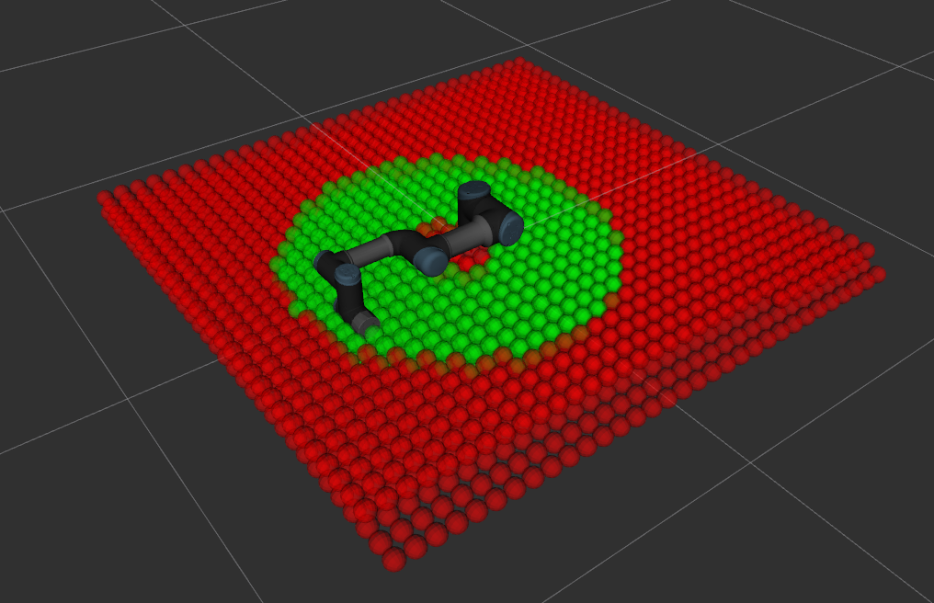
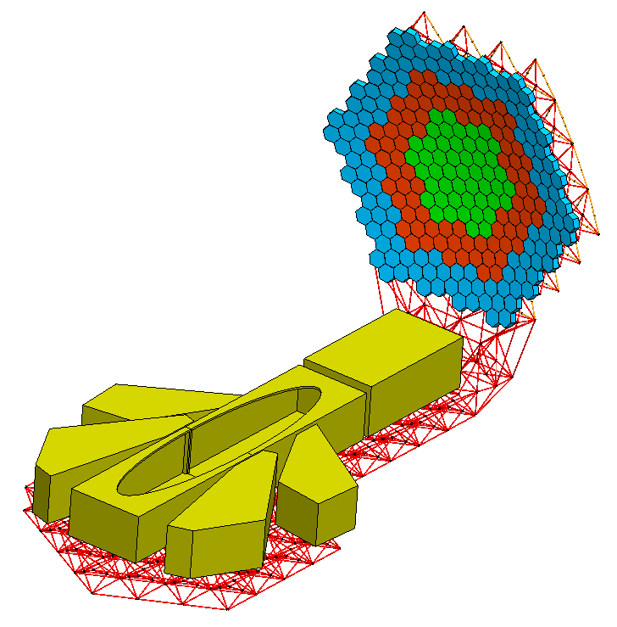
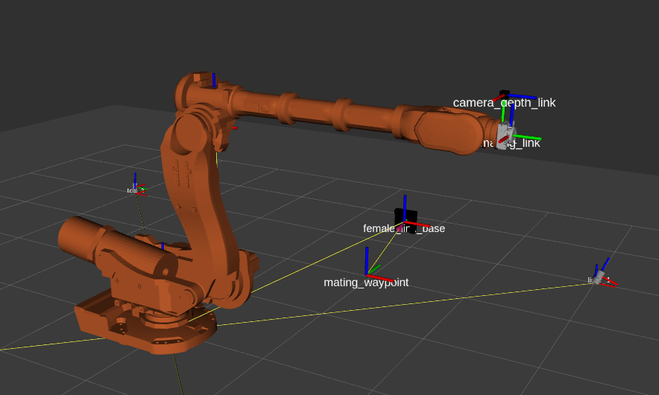
NASA OSAM Autonomy
(On-orbit Servicing Assembly and Manufacturing)
PASS
(Precision Assembled Space Structure)
Collaborative Effort Between
NASA Game Changing Development (GCD) Program
July PMR Update
TOSS
Trajectory Optimization for dynamic tool Systems Swapping:
Dominic Bisio
dominic.bisio@nasa.gov
Walter Waltz
walter.j.waltz@nasa.gov
All images are NASA created
Notes:
introductions

Slide 2
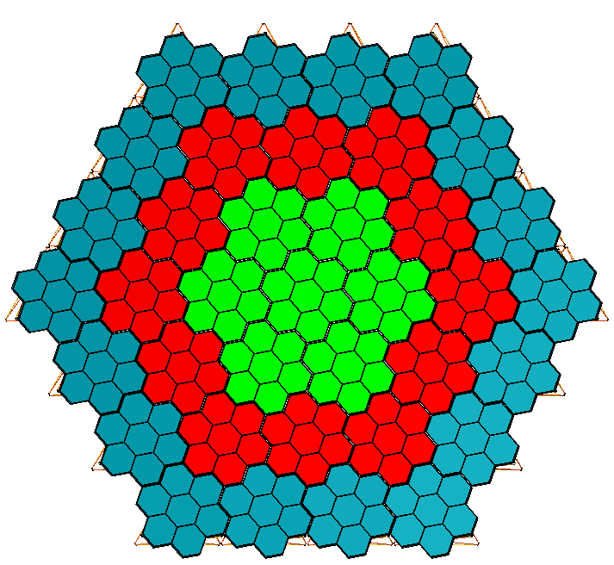
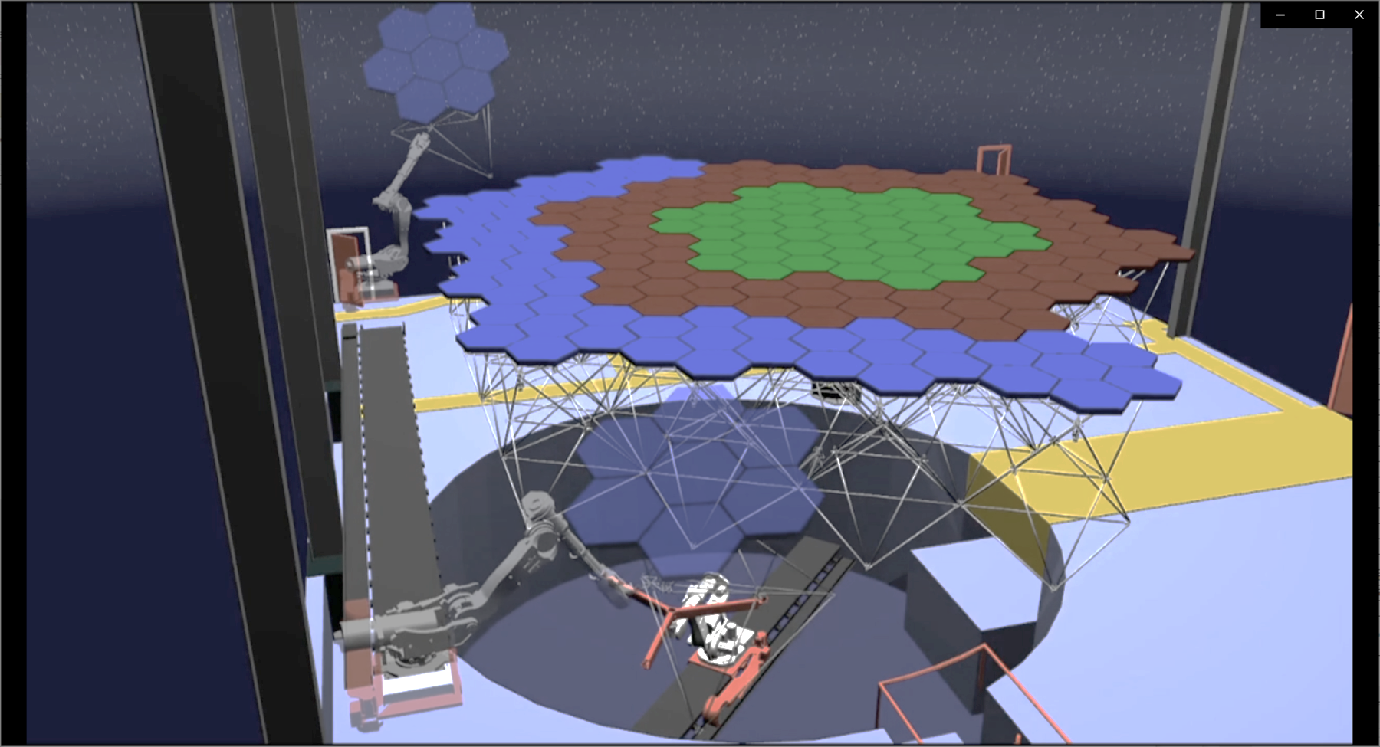
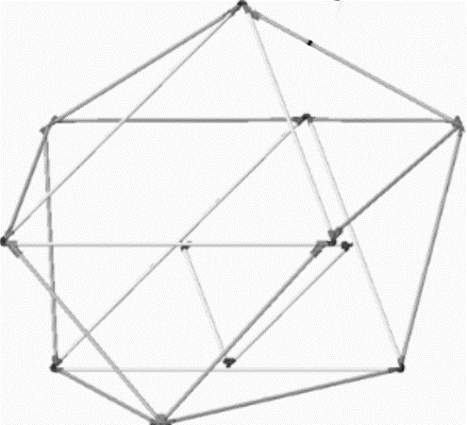
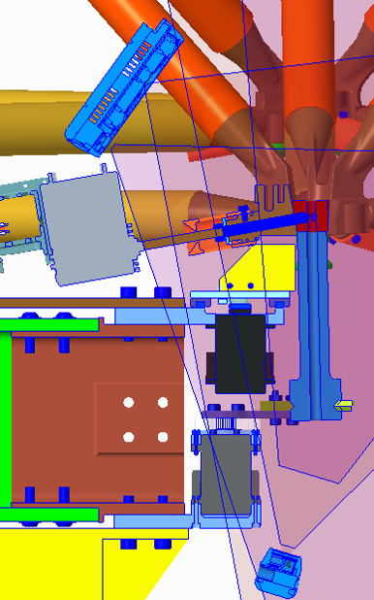
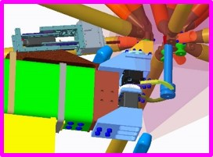
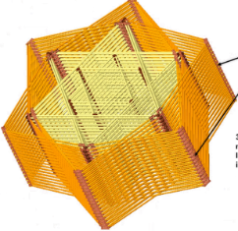
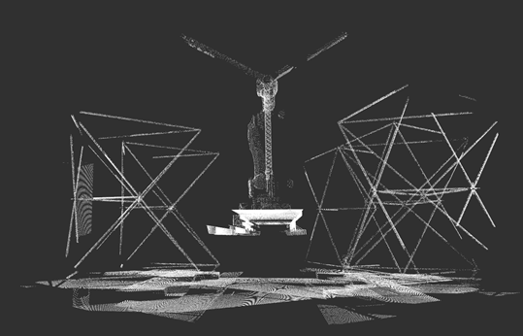
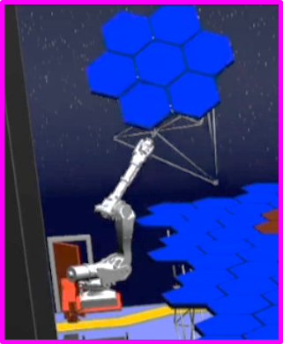
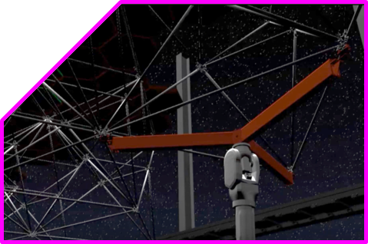
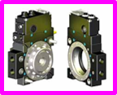
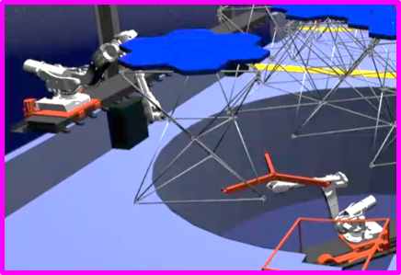
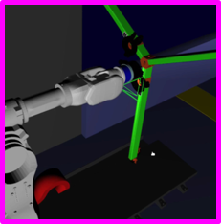
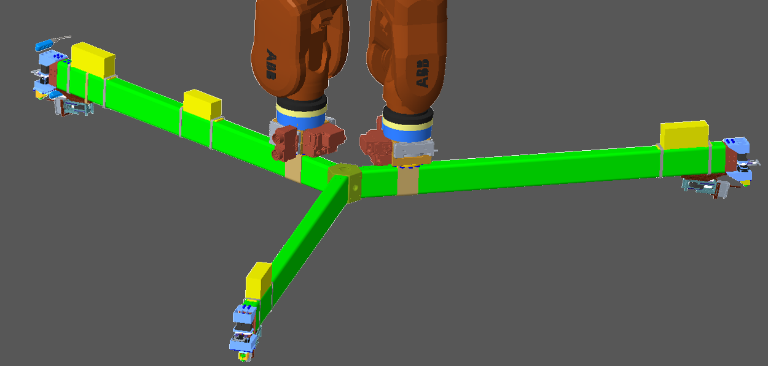
Truss Deployment
PASS
Metrology
Fine Placement and assembly
Asset identification and localization
Coarse Placement
Quick Change
Collaborative handoff to Course Placement Agent
Grapple Tool

Slide 3
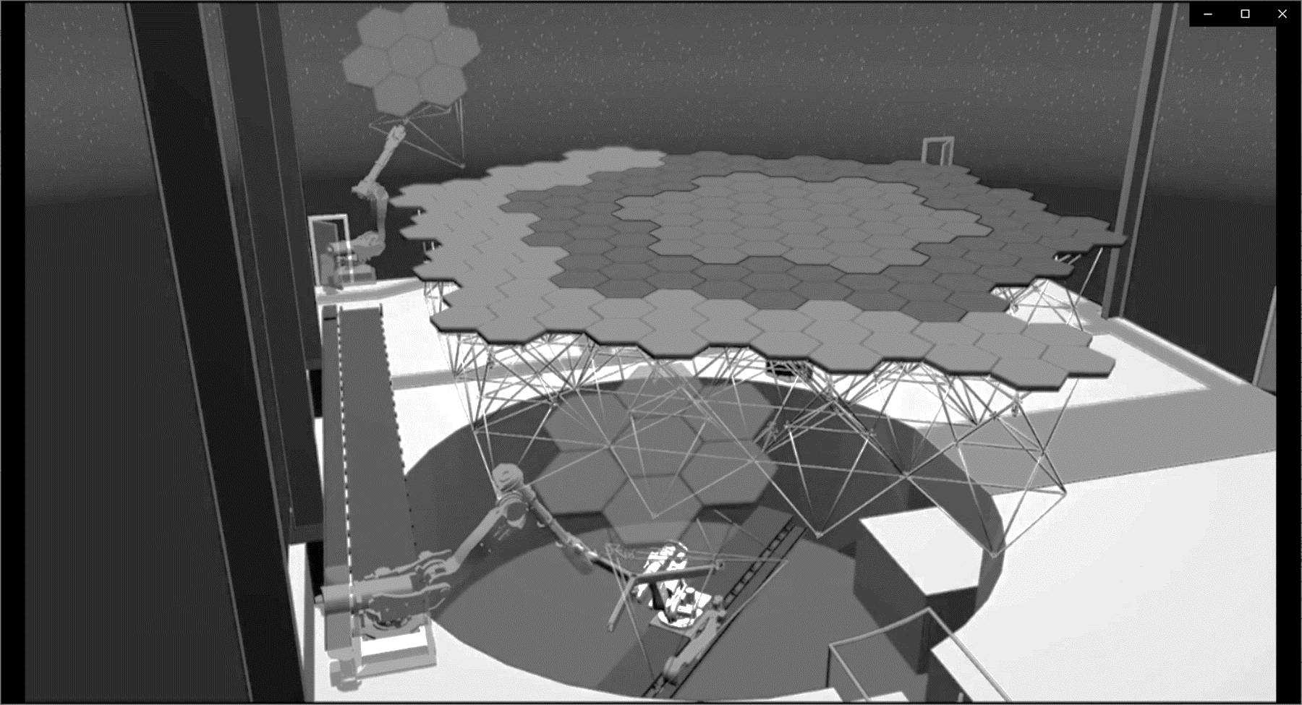
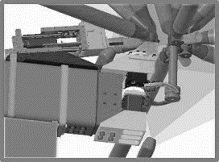
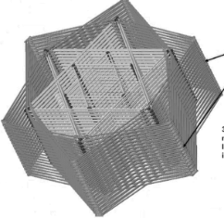

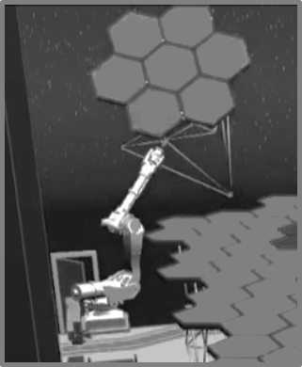
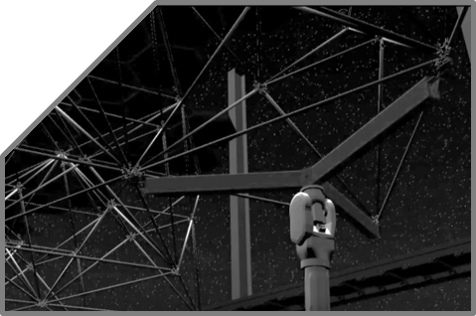

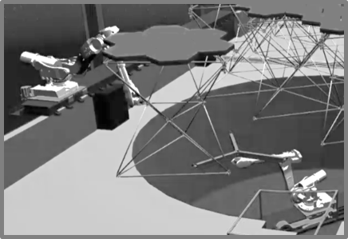

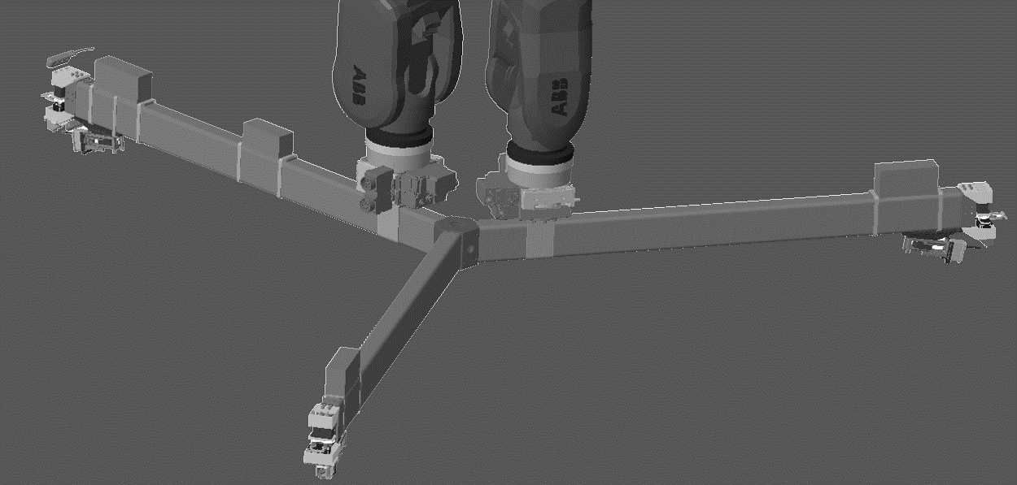
Truss Deployment
PASS
Metrology
Fine Placement and assembly
Asset identification and localization
Coarse Placement
Quick Change
Collaborative handoff to Course Placement Agent
Grapple Tool
Grapple Tool

Slide 4
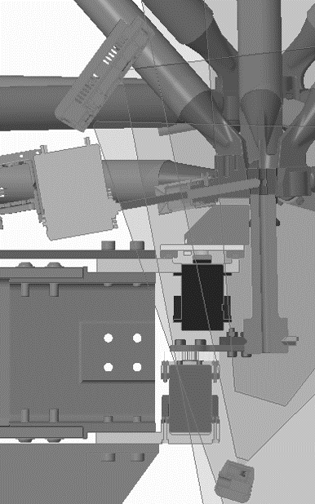
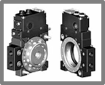

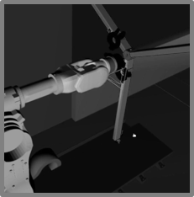
Truss Deployment
PASS
Metrology
Fine Placement and assembly
Asset identification and localization
Coarse Placement
Quick Change
Collaborative handoff to Course Placement Agent
Grapple Tool

Slide 5
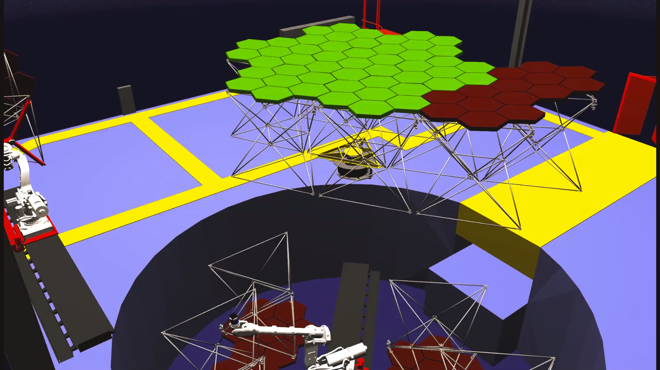
Multi-Agent Collaborative Hand-off Concept

Slide 6
Truss Deployment
What is TOSS?
Trajectory Optimization for dynamic tool Systems Swapping
PASS
Metrology
Fine Placement and assembly
Asset identification and localization
Develop capability to reliably execute a handoff of the grapple tool between two robot arms in difficult environments
Goals for the end of summer include evaluating different approaches to state estimation and determine optimal handoff poses based on a given scene.
Coarse Placement
Quick Change
Collaborative handoff to Course Placement Agent
Grapple Tool

Slide 7

TOSS
What do we want to do?
  Develop the robust capability to perform the truss hand-off operation and swap end-effectors
  Mating the quick-change halves within specified tolerances
What are the challenges?
  Goal pose is unknown and dynamic
  Calculating the path and executing the dexterous trajectory to mate the halves
  Estimating the pose of the decoupled quick change half
Notes:
Dynamic = obstacle / collision avoidance
Workspace analysis*
Add picture
Crowded environment causes difficulty with path planning and can occlude Vicon markers
Size of workspace results in a large solution space of handoff poses
ABB arm parameters are a black box and limits simulation fidelity

Slide 8
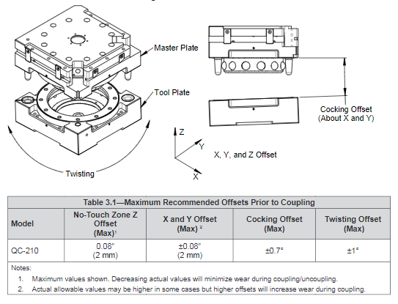
Quick-Change System Tolerances
Small mating features mean misalignment could significantly damage the quick changer, end-effector, system, or operators.
Position and orientation requirements are too tight to reliably meet without robust metrology and estimation.
Notes:
Fix Animations

Slide 9
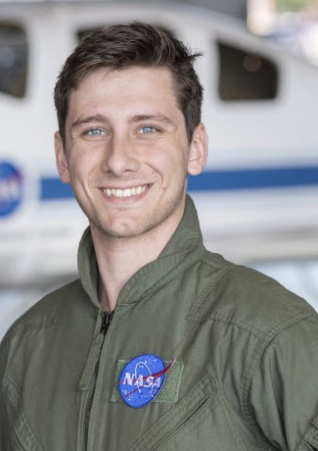
Intern Presenter Introduction
Mechanical Engineer from Virginia Tech. Graduated in May of 2021
Spent 3 years of undergrad working as a research assistant with Erik Komendera for the Field and Space Experimental Robotics (FASER) Lab at Virginia Tech
3 internships at NASA Langley, projects included mobile manipulator development for the Electronic Systems Branch, Assemblers, and now Persistently Assembled in Spaces Structures (PASS)
In my free time I enjoy sailing, skiing, and rugby
Notes:
Not necessarily sure where I should add this, If its before Ben’s overview I introduce myself and then don’t speak for a while and if its after I feel like it breaks the flow of the presentation – Dominic

Slide 10
Initial Research Stage
Key Points
Develop a sensor fusion pipeline to support state estimation
Supporting Papers
Optimal Sensor Data Fusion Architecture for Object Detection in Adverse Weather Conditions, Pfeuffer et al.
Inverse reachability analysis to optimally place the base of the manipulator for a given task
Workspace Analysis for Planning Human-Robot Interaction Tasks, Vahrenkamp et al.
Need to accurately estimate pose of both end effector halves
Learning Pose Estimation for High-Precision Robotic Assembly Using Simulated Depth Images, Litvak et al.
Determine a sufficient and optimal sensor configuration
SuperGlue: Learning Feature Matching with Graph Neural Networks, Sarlin et al.
Notes:
Determine what stage of sensor fusion will work best for out application, early middle or late. Sensor fusion paper provides a good taxonomy on the different types. Its for a specific problem but the general idea works best. Type of fusion might be something we can parameterize

Slide 11
Initial Research Stage
Key Points
Develop a sensor fusion pipeline to support state estimation
Supporting Papers
Optimal Sensor Data Fusion Architecture for Object Detection in Adverse Weather Conditions, Pfeuffer et al.
Inverse reachability analysis to optimally place the base of the manipulator for a given task
Workspace Analysis for Planning Human-Robot Interaction Tasks, Vahrenkamp et al.
Need to accurately estimate pose of both end effector halves
Learning Pose Estimation for High-Precision Robotic Assembly Using Simulated Depth Images, Litvak et al.
Determine a sufficient and optimal sensor configuration
SuperGlue: Learning Feature Matching with Graph Neural Networks, Sarlin et al.
Notes:
Workspace attenuation through assembly process. One prescribed pose wont work for the entire assembly scenario and need to develop capability to determine optimal pose online

Slide 12
Initial Research Stage
Key Points
Develop a sensor fusion pipeline to support state estimation
Supporting Papers
Optimal Sensor Data Fusion Architecture for Object Detection in Adverse Weather Conditions, Pfeuffer et al.
Inverse reachability analysis to optimally place the base of the manipulator for a given task
Workspace Analysis for Planning Human-Robot Interaction Tasks, Vahrenkamp et al.
Need to accurately estimate pose of both end effector halves
Learning Pose Estimation for High-Precision Robotic Assembly Using Simulated Depth Images, Litvak et al.
Determine a sufficient and optimal sensor configuration
SuperGlue: Learning Feature Matching with Graph Neural Networks, Sarlin et al.
Notes:
Pose estimation paper fits very cleanly into our problem, SuperGlue is a neural network approach for finding keypoints on an image. Is more robust in indoor scenes and scenes with a lot of self similarity which is what kind of environment our task operates in. Can be used for feature matching algorithms for pose estimation. Define terms used, RANSAC.

Slide 13
Initial Research Stage
Key Points
Develop a sensor fusion pipeline to support state estimation
Supporting Papers
Optimal Sensor Data Fusion Architecture for Object Detection in Adverse Weather Conditions, Pfeuffer et al.
Inverse reachability analysis to optimally place the base of the manipulator for a given task
Workspace Analysis for Planning Human-Robot Interaction Tasks, Vahrenkamp et al.
Need to accurately estimate pose of both end effector halves
Learning Pose Estimation for High-Precision Robotic Assembly Using Simulated Depth Images, Litvak et al.
Determine a sufficient and optimal sensor configuration
SuperGlue: Learning Feature Matching with Graph Neural Networks, Sarlin et al.
Notes:
Need to balance complexity and robustness of sensor fusion algorithms and improve on the method defined in the pose estimation paper

Slide 14
TOSS Software Architecture
Integrate and control execution of the project
commander
gazebo
Motion planning request, monitoring, and trajectory execution
Object detection and pose determination
move_group
perception
sensor_fusion
Combine data to reduce uncertainty
(Consider state estimation here)
sensors
Sensor data and simulation
Sensor drivers and data published on topics

Slide 15
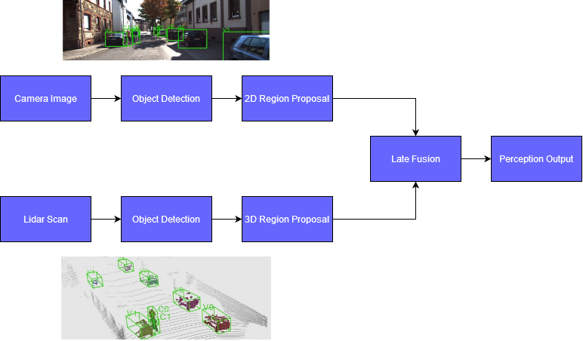
Sensor Fusion Paradigms: Late Fusion
Takes advantage of prior knowledge and hand engineered features
Traditional approach, Kalman filters fall into this category
Main advantage is recall, typically will detect every target in the scene
Processes each sensor separately and then combines their predictions

Slide 16
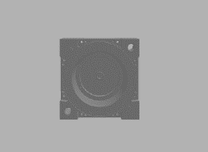
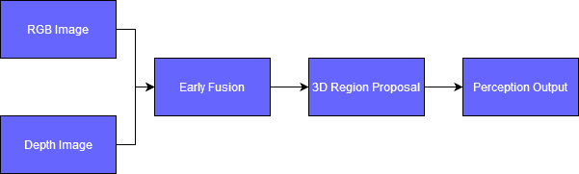
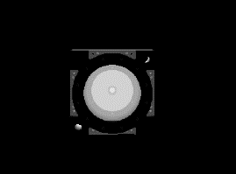
Sensor Fusion Paradigms: Early Fusion
Combines the raw sensor data and then makes predictions on the fused data
Gained popularity due to the rise of Neural Networks (NN)
Typically uses a NN to combine and learn the strengths and weaknesses of each sensor
Main advantage is precision, typically will detect only what you want it to

Slide 17
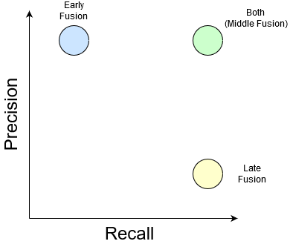
Sensor Fusion Paradigms: Middle Fusion
Late Fusion
High Recall
Comes at the cost of an increase in false positives
Early Fusion
High precision
Comes at the cost of not detecting every target
Middle Fusion
Early and Late fusion approaches are not mutually exclusive, in fact they are complimentary
Combining approaches will increase robustness at the cost of model complexity

Slide 18
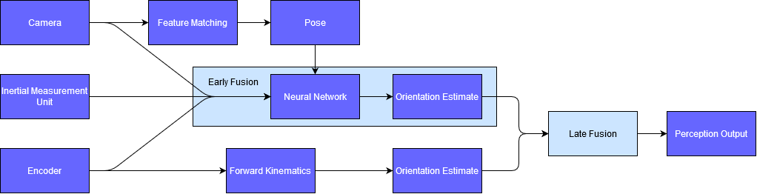
Middle Fusion applied to TOSS
Conceptually combining the Early and Late paradigms might seem straightforward. However, it is noticeably more complex.
On top of having to train a neural network with multiple branches, the Early fusion stage cannot be designed in isolation of the Late fusion stage. The information being fused Later must have similar dimensionality to each other.
Notes:
Color code ‘middle fusion’ and what is ‘different.’
Roadmap?
Considering diagramming late/early fusion and differences.
Produce compatible data from early fusion stage. Complexity.
Examples of how a Late Sensor fusion pipeline might work. Emphasize that the added model complexity might not be worth the increase in performance depending on the performance gains. We are not ruling out Early and Late, that is part of the research, determining what is sufficient without going too overboard.

Slide 19
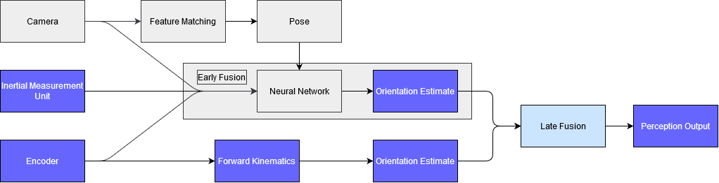
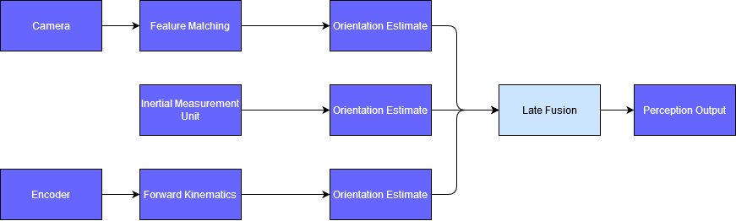
Late Fusion applied to TOSS
Notes:
Examples of how a Late Sensor fusion pipeline might work. Emphasize that the added model complexity might not be worth the increase in performance depending on the performance gains. We are not ruling out Early and Late, that is part of the research, determining what is sufficient without going too overboard.

Slide 20
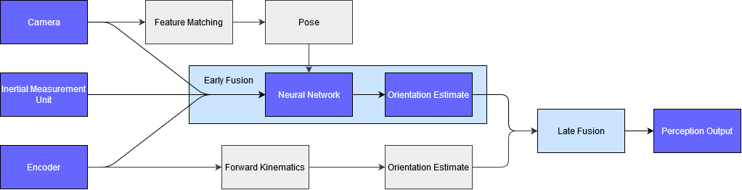
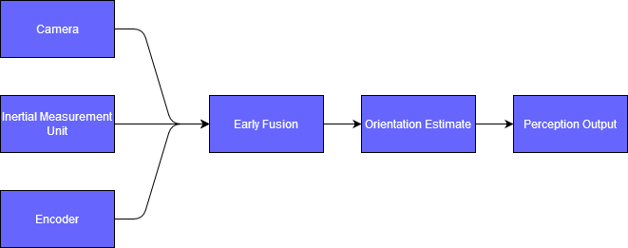
Early Fusion applied to TOSS
Notes:
Even further highlight how much more complex a middle fusion approach is

Slide 21
TOSS Software Architecture
Integrate and control execution of the project
commander
gazebo
Motion planning request, monitoring, and trajectory execution
Object detection and pose determination
move_group
perception
sensor_fusion
Combine data to reduce uncertainty
(Consider state estimation here)
sensors
Sensor data and simulation
Sensor drivers and data published on topics
Notes:
Wrong animations

Slide 22
Workspace Analysis
Focuses on developing representations of a manipulator's capabilities within a region of space, the most fundamental of which is called a reachability map
A reachability map represents all possible positions and orientations that are reachable by a given robot
Can be extended to capture other metrics. A Capability map encodes dexterity and what directions a region can be entered from

Slide 23
Generating a Reachability Map
Forward Kinematics
Randomly samples the workspace
A large change in joint space can result in a small change in end effector position
Results in oversampling around kinematic singularities
Not guaranteed to sample entire workspace
Inverse Kinematics
Generates a voxelated workspace
Computes IK for each voxel and all poses within each voxel
Is guaranteed to sample entire workspace but is slower than FK
Hybrid Approach
Generates a voxelated workspace
Uses FK approach until a certain percentage of new poses sampled are in already sampled voxels
Switches to IK and fills the remaining under sampled voxels

Slide 24
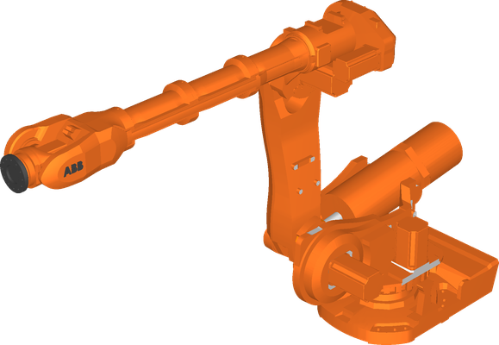
Workspace Analysis Applied to TOSS
Due to the dynamic nature of the workspace, a single handoff pose will not work in all environment configurations
In determining the intersection of the two robot's capability maps we generate what is called an Interaction map
Using the Interaction map we can dynamically determine the optimal handoff pose
Circles are poses the arms can reach
Arrows represent the approach vector needed to reach each pose

Slide 25



Main TOSS Software Components
ROS
Open-source framework for writing robotic software
Very mature ecosystem allows for rapid development using existing tools
Robotic manipulation framework built on top of ROS
Out of the box, state of the art, collision checking and path planning
Gazebo
Simulation software that is well integrated with ROS and MoveIt
Can quickly reconfigure an environment
Notes:
Integration of AEON and BEAM are not within scope of summer work. However due to ROS2 being DDS based the integration process should be straightforward

Slide 26
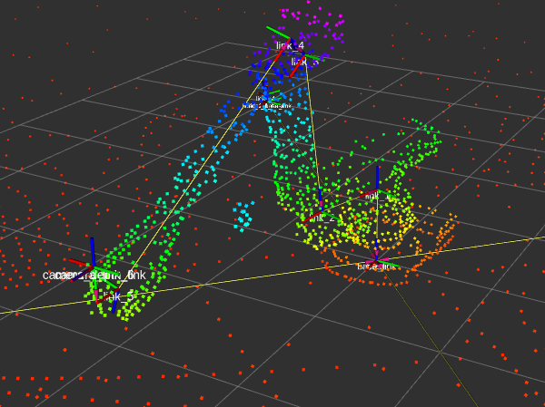
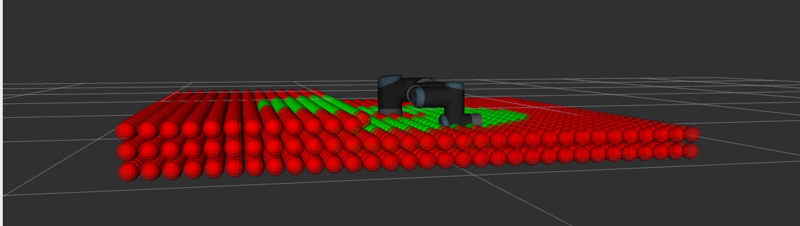
TOSS Current Status
MoveIt, ROS, and Gazebo are integrated together and can quickly be reconfigured
Development is beginning on sensor fusion and workspace algorithms
Able to query goal pose and plan with constraints. Perception components used are
  Point cloud
  Depth images
  IMUs
  Lidar
Planning integration to LARC’s AINE pipeline. Gives TOSS access to an accurate assembly environment

Slide 27
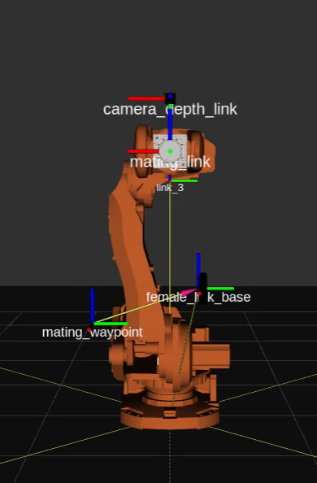
Expected Outcome
Verify robustness through simulation
  Characterize the uncertainty when planning to a given pose to determine go/no go
COVID impacts
  Hardware testing (scale/full)
  Unable to get accurate ABB parameters for simulation fidelity. Ideally, TOSS would perform system identification
Integrate work into AINE pipeline (in progress)
Workspace analysis capability
Tuning of perception algorithms
  Develop a pipeline that can support different algorithms
Final Demonstration
  Simulation performing handoff with developed capability

Slide 28

Questions?
OSAM Autonomy Team:
Danette Allen
Thea Avila
Dominic Bisio
Ben Kelley
Kyle Mcquarry
Andrew Miloslavsky
Javier Puig Navarro
Sherif Shazly
Robert Slick
Matt Vaughan
Walter Waltz
Ralph Williams
Models courtesy of Structures Team
Notes:
Conclude with a video showing the truss handoff between manipulators.
Also like to thank all those involved in this effort to include the OSAM Autonomy Team and the Structures team.
Thank team for diagrams, drawings, simulations, and photos.
Any questions?

