Slide 1



AIAA Forum 360 Panel
August 3, 2021
William N. Chan, Project Manager
Kurt Swieringa, Deputy Project Manager for Technology

Slide 2
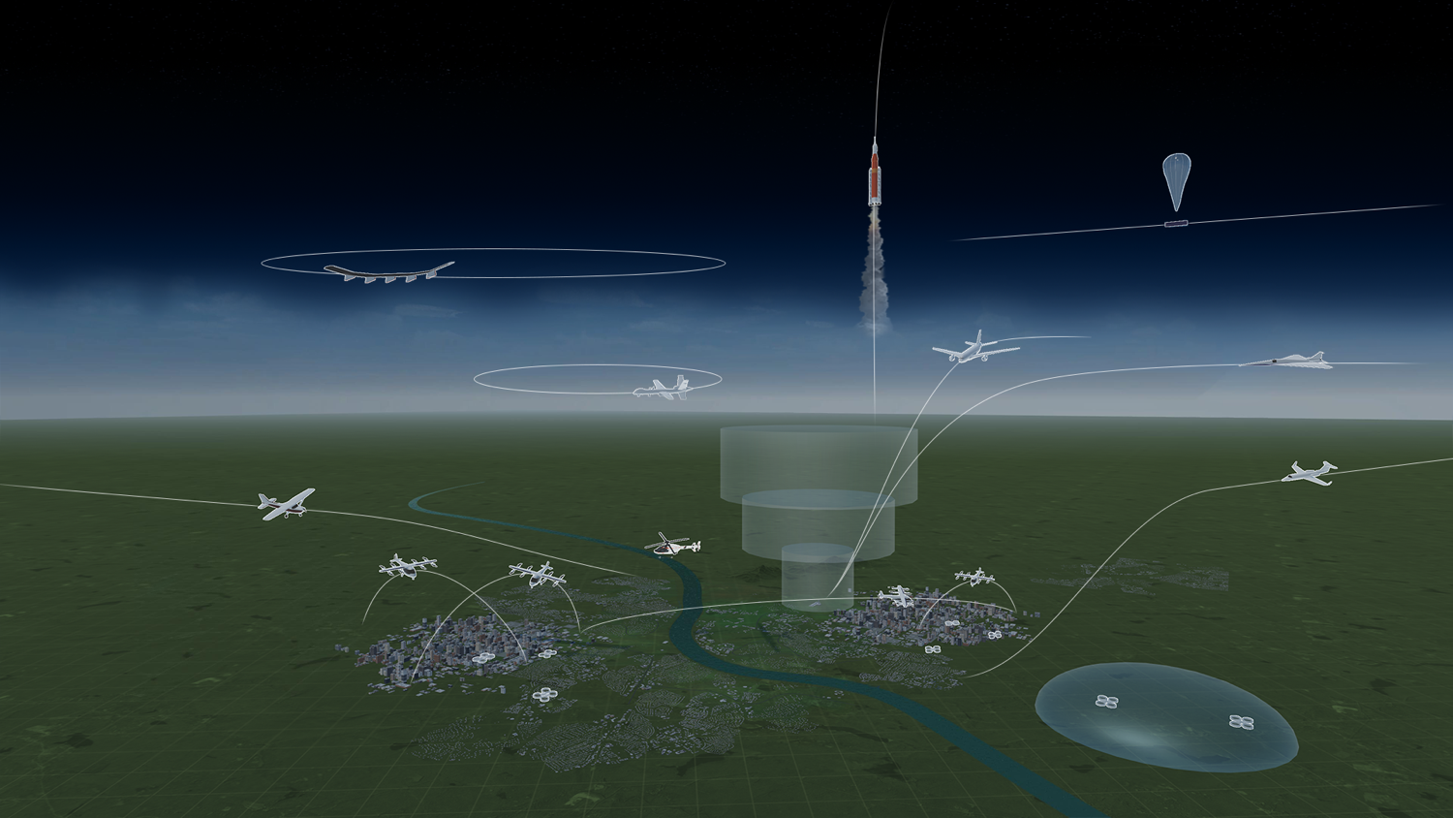
A More Complicated Airspace
Space Launch Operations
High Altitude
Increasingly Autonomous Aircraft
Commercial
Supersonic
General Aviation
Regional
UAM
sUAS

Slide 3
ATM-X Vision and Goal
Vision: Accelerate transformation to a digitally-integrated air transportation system that enables access and increases mobility for all users
Goal: Catalyze the community to provide an all-access, safe, and efficient airspace system through innovative solutions that remove barriers
Notes:
Technology and procedure barriers.

Slide 4
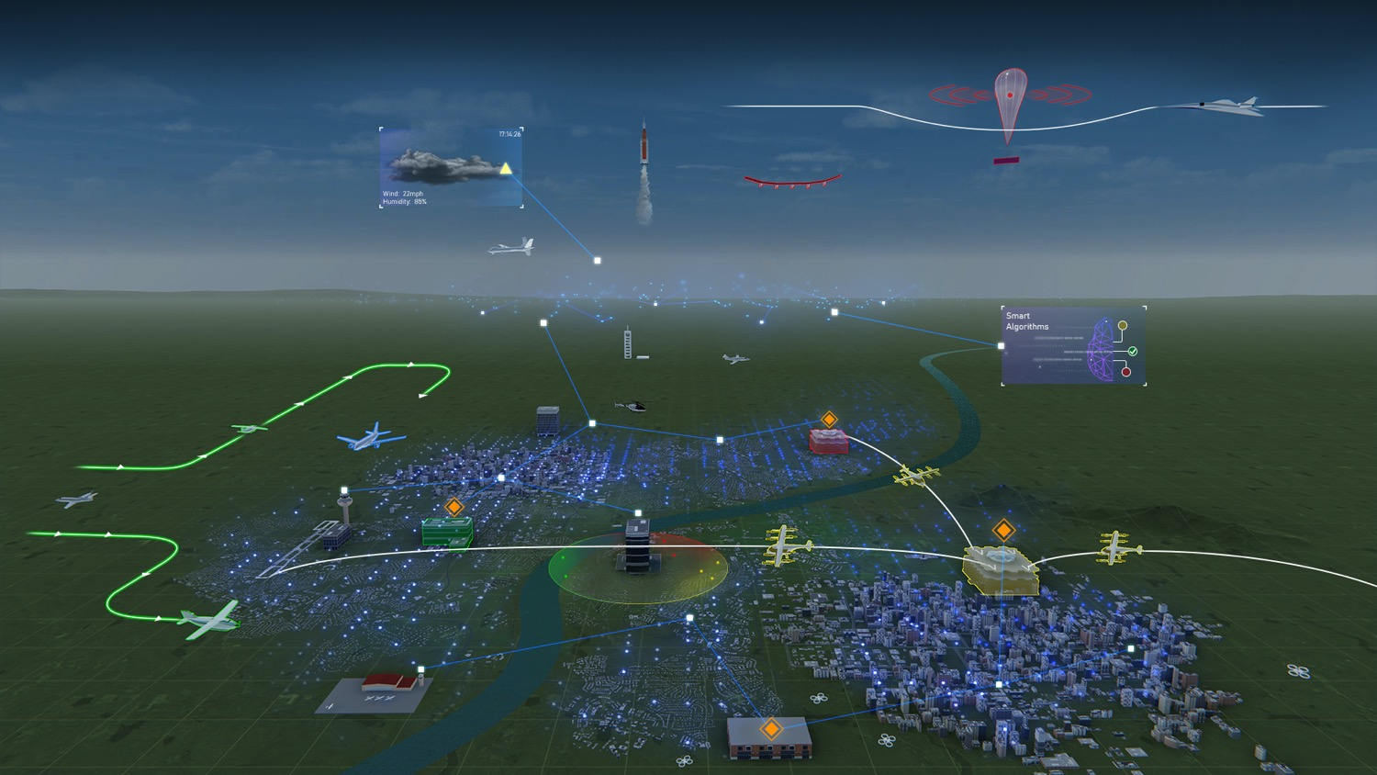

ATM-X PROJECTS AREAS
DIP
Digital Information
Platform
xTM
Extensible Traffic Management
Open-architecture for advanced data-driven services for traditional operations and new entrants
Collaborative distributed service-based ATM decision-making
PAAV
Pathfinding for Airspace
with Autonomous Vehicles
Seamless, scalable, and robust airspace integration of increasingly autonomous operations
UAM
Urban Air Mobility
Collaborative distributed service-based ATM decision-making for
UAM traffic management
Collaborative Traffic Management Framework

