Slide 1
Lunar Simulant Deposition for Evaluating Adhesion
Lopamudra Das¹ and Christopher J. Wohl^{2,*}
¹National Institute of Aerospace, Hampton, VA 23666, USA
²NASA Langley Research Center, Hampton, VA 23681, USA
Lunar Surface Science Workshop Virtual Session 10:
Fundamental and Applied Lunar Surface Research in Physical Sciences
August 18-19, 2021
*Corresponding Author: c.j.wohl@nasa.gov
**All images are credited to NASA unless otherwise indicated

Slide 2
The rest of the “Langley Lunar Dust Brigade”
Valerie L. Wiesner¹
Keith L. Gordon¹
Glen C. King¹
Sang H. Choi¹
Jonathan J. Hernandez²
Kathryn M. Crossett³
Researchers at nearly every NASA Center and throughout academia and private industry
Place Photo Here*
*Remote work makes group photos tough
¹NASA Langley Research Center, Hampton, VA 23681, USA
²National Institute of Aerospace, Hampton, VA, 23666, USA
³NASA NIFS Intern, NASA Langley Research Center, Hampton, VA 23681, USA

Slide 3
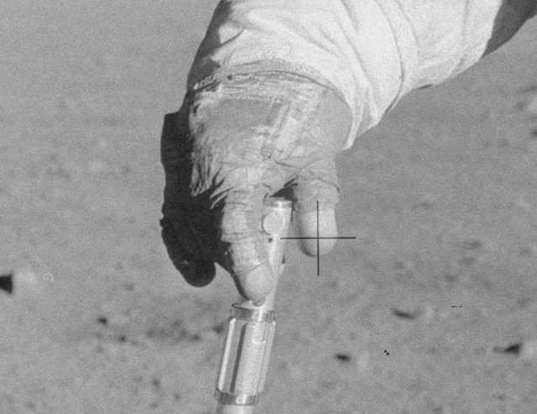
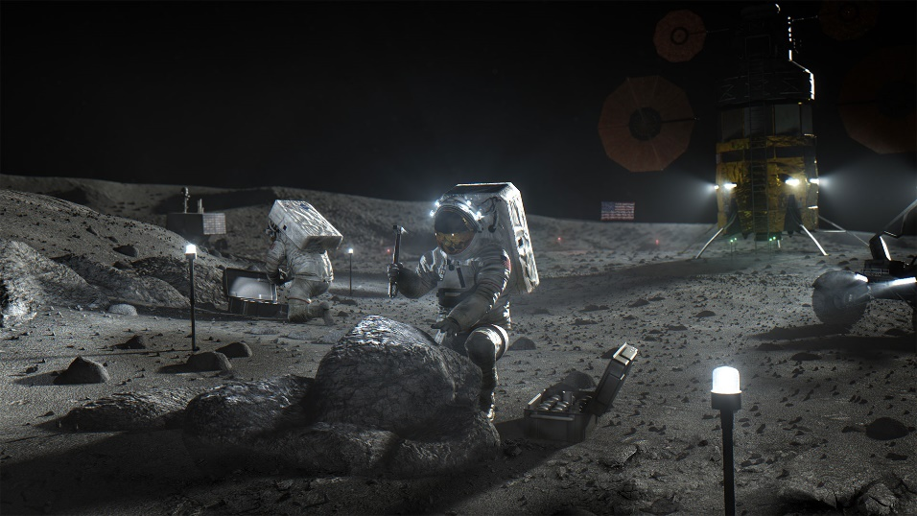

Evaluating passive dust mitigation materials
What do we want to study?
Artemis
Dust Particle ………………..
Interaction
Forces …………………………….
?
Candidate
Materials
Technology …………
Apollo astronaut glove covered in lunar dust
Image credit: NASA
Image credit: modified from NASA source
Flanagan and Goree, Dust release from surfaces exposed to plasma, Physics of Plasma 13, 123504, 2006. Schwan, J., et al., The charge state of electrostatically transported dust on regolith surfaces, Geophy. Res. Lett., 44, 3059, 2017. Godyak. V,. Ferromagnetic enhanced inductive plamsa source. J. Phys. D: Appl. Phys., 46, 283001, 2013. Wang. X et al. https://sservi.nasa.gov/articles/video-dust-charging-and-mobilization/

Slide 4
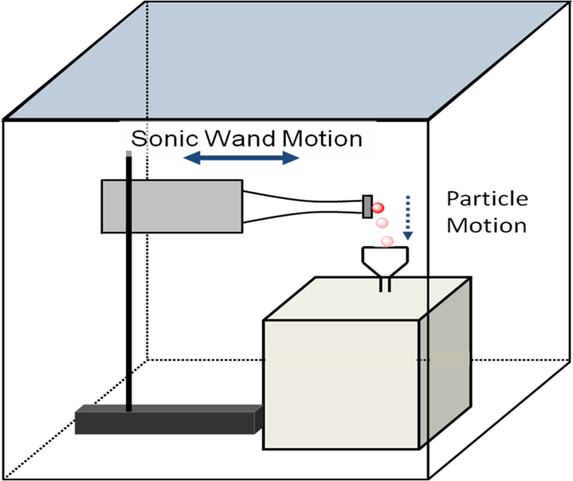
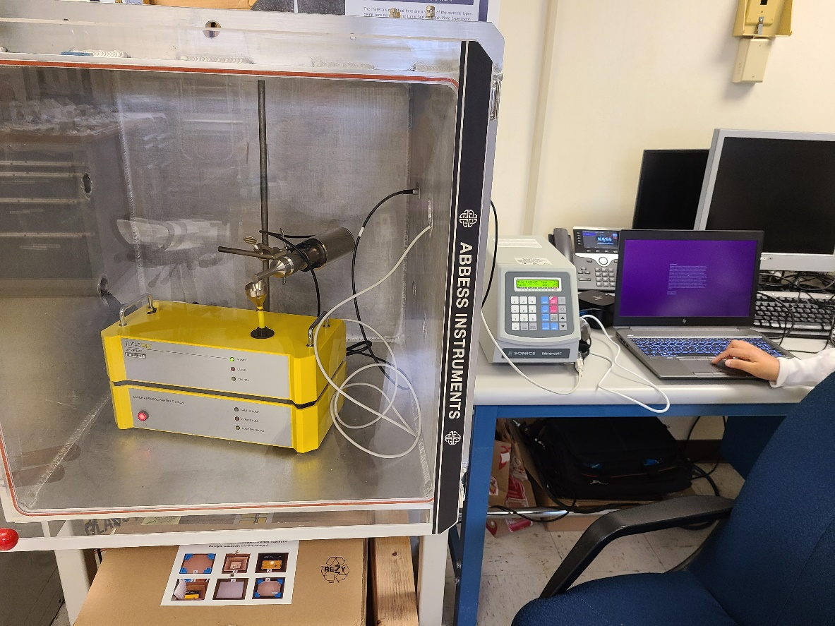
How will adhesion force be characterized?
Schematic
Actual Instrument

Slide 5
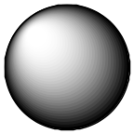
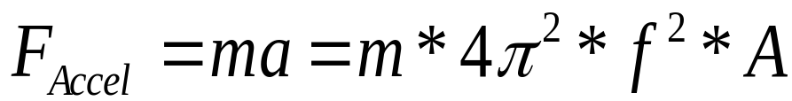
How will adhesion force be characterized?
Sonic Wand Motion
F_{Adh}
F_{Accel}
F_{mg}
Particle will detach when F_{Accel} is ≥ F_{Adh}
m = particle mass
a = acceleration
f = sonic wand frequency
A = sonic wand amplitude

Slide 6
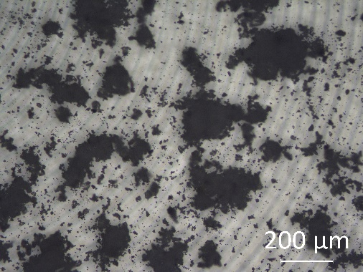
What is an ideal system to study?
Ideal case: isolated particle
Actual case: aggregated particles
Hypothetical case: particle monolayer
☑
Adhesion forces
Van der Waals
Electrostatic
Magnetic
Chemical
Mechanical
☒
Contributing forces
Cohesion force
Mechanical interlocking
Deformation
☒
Contributing forces
Cohesion force
Mechanical interlocking
☒
Contributing forces
Gravitation (Earth)
Capillary (ambient atmosphere)

Slide 7
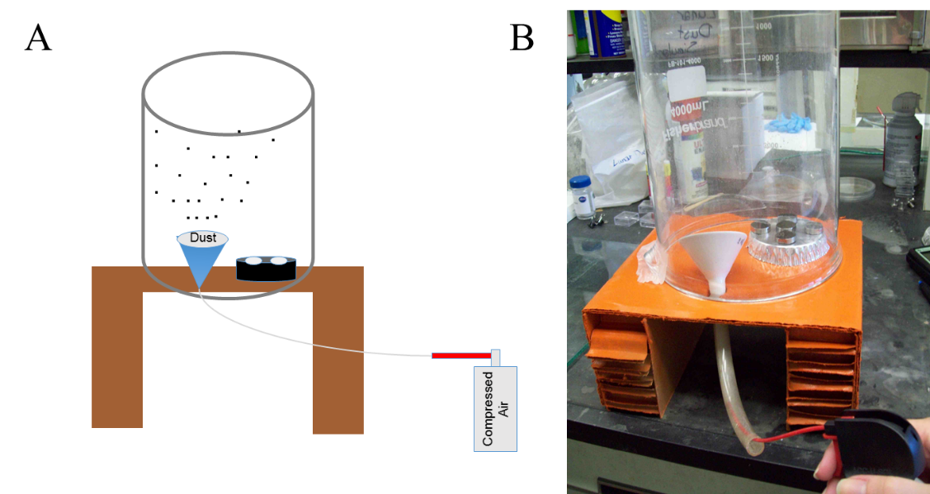
Surface simulant contamination techniques
Aerosolization
Vibratory filtration
Schematic
Schematic
Vibratory motion
Tapping
motion
Simulant
Sieve

Slide 8
Simulant deposition through aerosolization
Sample preparation
  Weigh simulant to be dispersed in aerosolization chamber (50-250 mg)
  Pour simulant onto ceramic Hirsch funnel positioned within the aerosolization chamber
  Place samples in aerosolization chamber
  Aerosolize simulant with two short bursts from compressed air canister
  Wait for simulant to settle before removing samples and collecting microscopy images

Slide 9
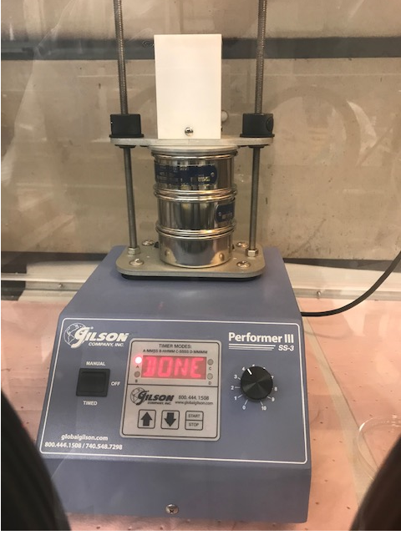
Simulant deposition through vibratory filtration
Sample preparation
  Weigh simulant to be dispersed in vibratory sieve shaker (0.2-2 g)
  Pour simulant onto sieve
    Sieve No #450 (32 μm openings)
    Sieve No #500 (50 μm openings)
  Assemble sieve(s) and samples, and areal screen in shaker system
  Adjust sieve amplitude settings
  Run shaker system for specific number of tapping sequences
  Wait for simulant to settle before removing samples and collecting microscopy images

Slide 10
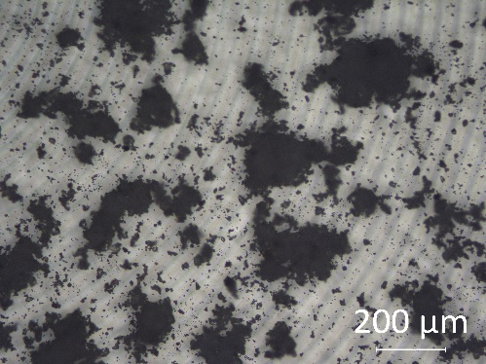
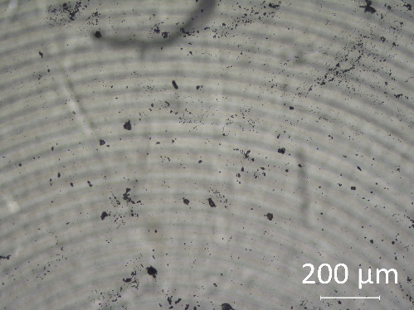
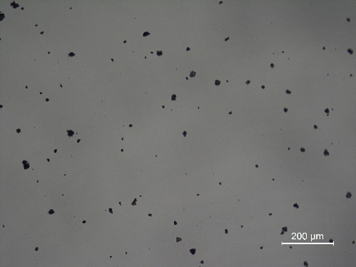
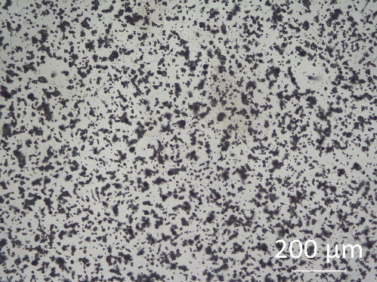
Surface simulant contamination techniques
Aerosolization*
Vibratory filtration*
Sample # 39
Sample # 42
Sample # 10
Sample # 35
Sample # | 39 | 42
Simulant mass | 250 mg | 50 mg
Sample # | 10 | 35
Simulant mass | 1 g | 1 g
Number of sieves | 2 (#450 and #500) | 2 (#450 and #500)
Amplitude | 5 | 4
Number of taps | 20 | 300
*All substrates were glass

Slide 11
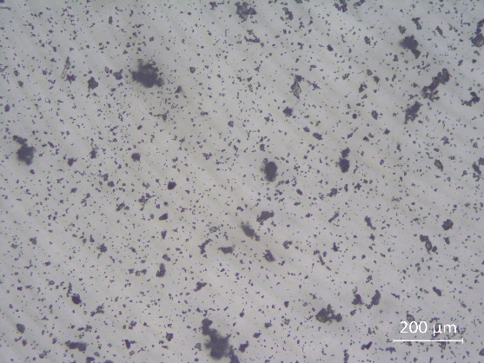
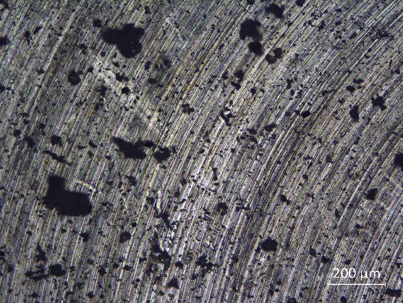
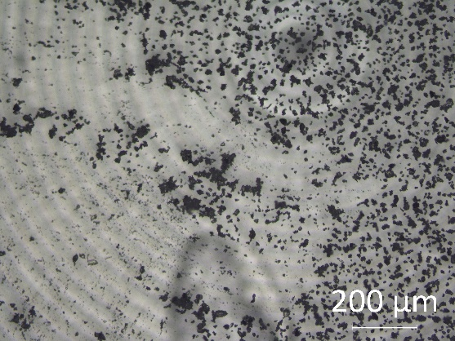
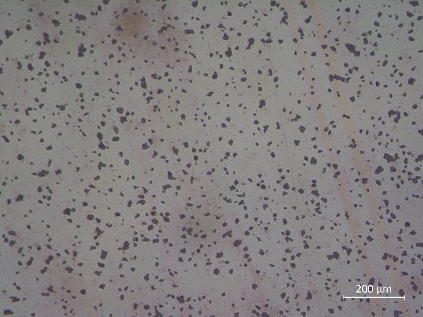
Surface simulant contamination techniques
Aerosolization
Vibratory filtration
Sample # 49
Sample # 50
Sample # 36
Sample # 44
Sample | 49 | 50
Simulant mass | 150 mg | 150 mg
Substrate | Glass | Titanium
Simulant mass | 1 g
Number of sieves | 2 (#450 and #500)
Amplitude | 4
Number of taps | 300

Slide 12
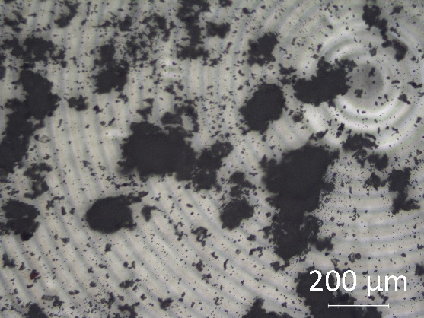
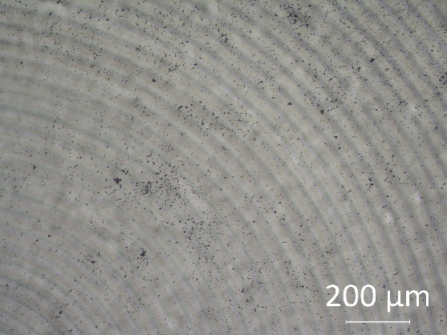
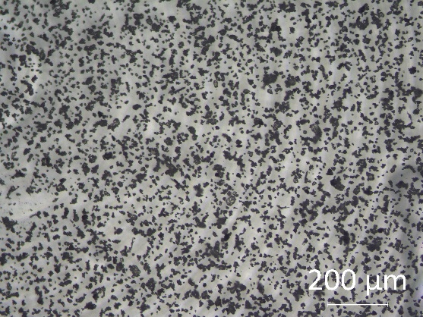
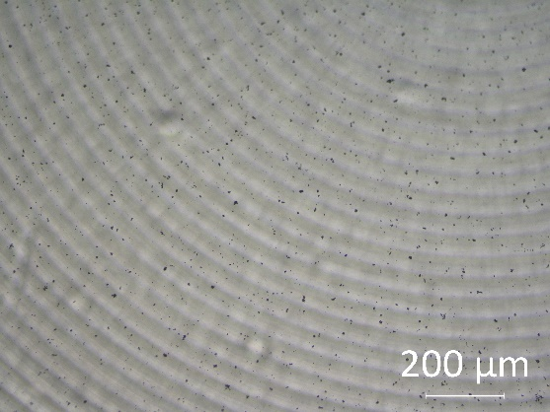
Surface simulant contamination techniques
Aerosolization
Vibratory filtration
Before sonication prep
After sonication prep
Before sonication prep
After sonication prep
Simulant mass | 250 mg
Simulant mass | 1 g
Number of sieves | 2 (#450 and #500)
Amplitude | 4
Number of taps | 300

Slide 13

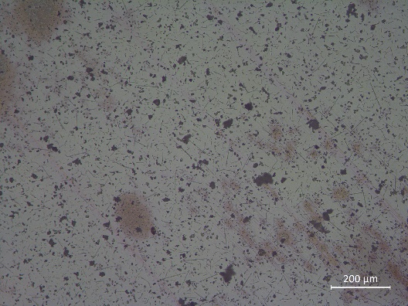
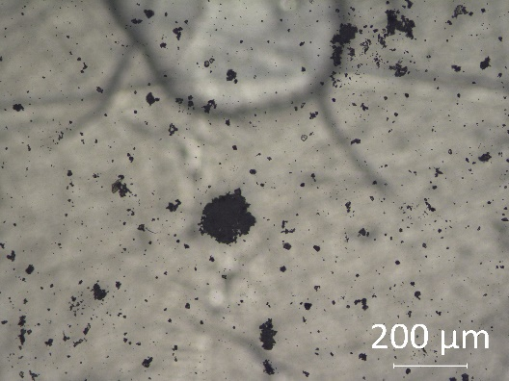
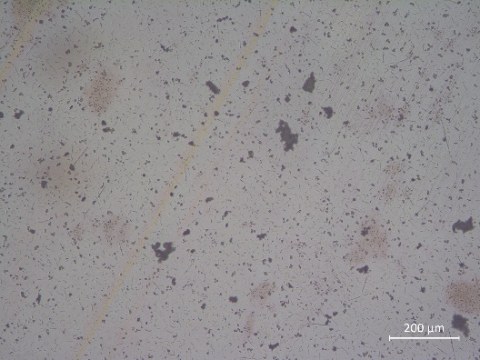
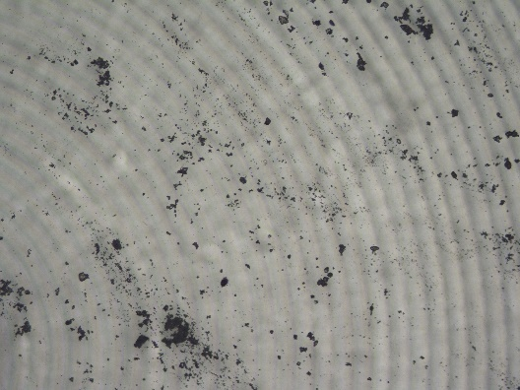
Aerosolization technique: simulant mass study
Sample # 39
Sample # 45
Sample # 40
Sample # 46
Sample # 42
250 mg
150 mg
100 mg
75 mg
50 mg
Increasing simulant mass
Decreasing clusters (generally)

Slide 14
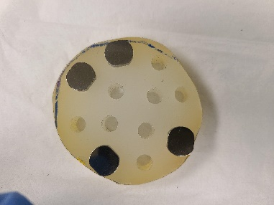
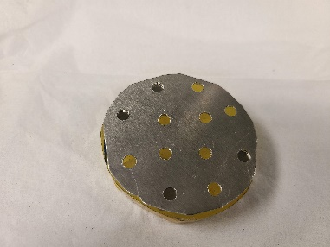
Determined ideal approach to simulant surface contamination for adhesion study
Step 1. Prepare samples
Step 2. Deposit simulant
Step 3. Resolve cohesion
Sonic wand samples on sample holder
Low displacement sonication
Sample deposition screen
Aerosolization technique selected

Slide 15

Acknowledgements
Advanced Materials and Processing Branch
  John W. Connell
NASA Lunar Surface Innovation Initiative
  Niki WerkHeiser, Michael Johansen, Erica Montbach, Kristen John, Cameron Hartman
NASA Internship, Fellowship, Scholarship (NIFS) /STEM Takes Flight (STF) Programs
Next passive mitigation technology evaluation laboratory
Image credit: NASA

