Slide 1


L’RALPH’S ADVANCED THERMAL MODEL CORRELATION USING VERITREK
Daniel Bae, NASA Goddard Space Flight Center
Jacob Moulton and Derek Hengeveld, Redwire
TFAWS Passive Thermal Paper Session
Presented By
Daniel Bae and Derek Hengeveld
Thermal & Fluids Analysis Workshop
TFAWS 2021
August 24-26, 2021
Virtual Conference

Slide 2
Thermal Model Correlation
Thermal models predict hardware performance
  Across a broad range of operating conditions
Thermal models based on uncertain inputs
  E.g., conductance, estimated e*, etc.
Correlation improves thermal model predictions
  Compare thermal model to test results
  Adjust uncertain inputs until model matches test (within margin)
  Often time-consuming, iterative process
Reduced-order model correlation
  Developed by Redwire
  Provides fast, automated, and repeatable correlation
  Applied to real-world example (NASA GSFC)

Slide 3
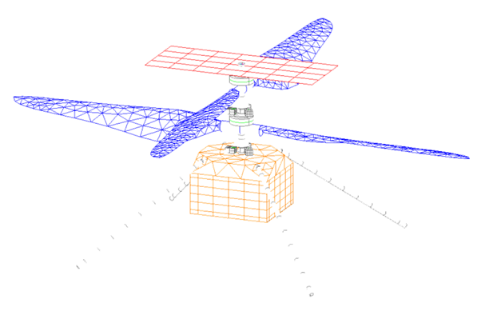
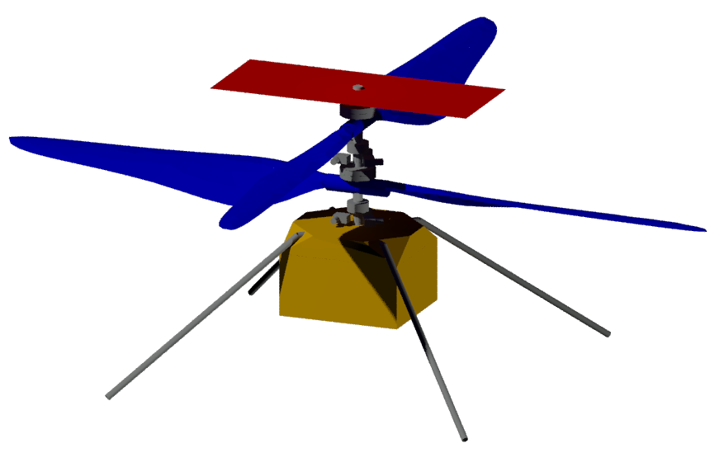



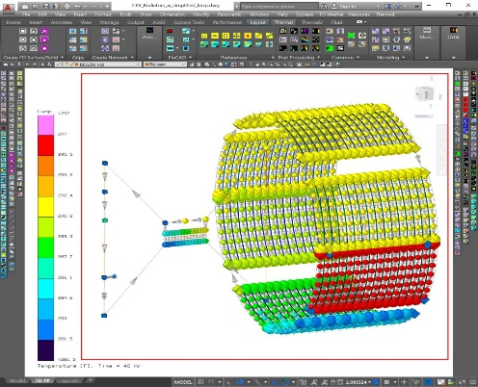
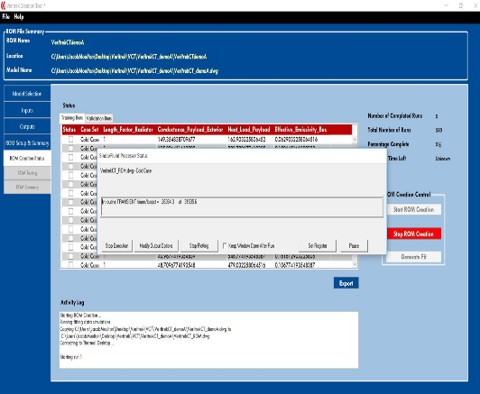
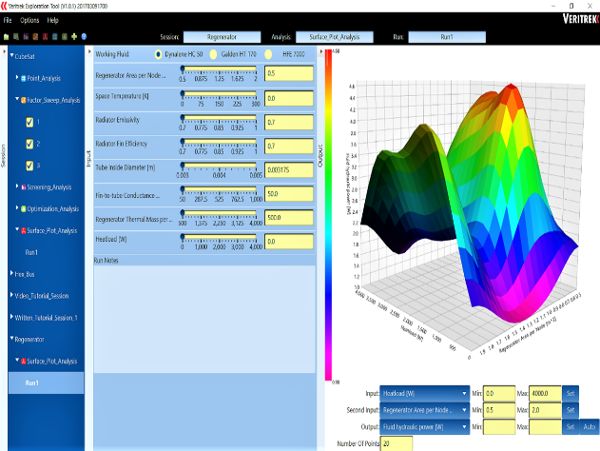

ROM Thermal Model Correlation
Surrogates of high-fidelity thermal model
  Near real-time simulations
  Based on sampling and data-fitting
Success Stories
  Mars 2020 Helicopter
  SNC Dream Chaser
  NASA MSFC Lunar Lander
STEP 1
Select Model.
STEP 2
Convert to ROM.
STEP 3
1000s of results in seconds.

Slide 4
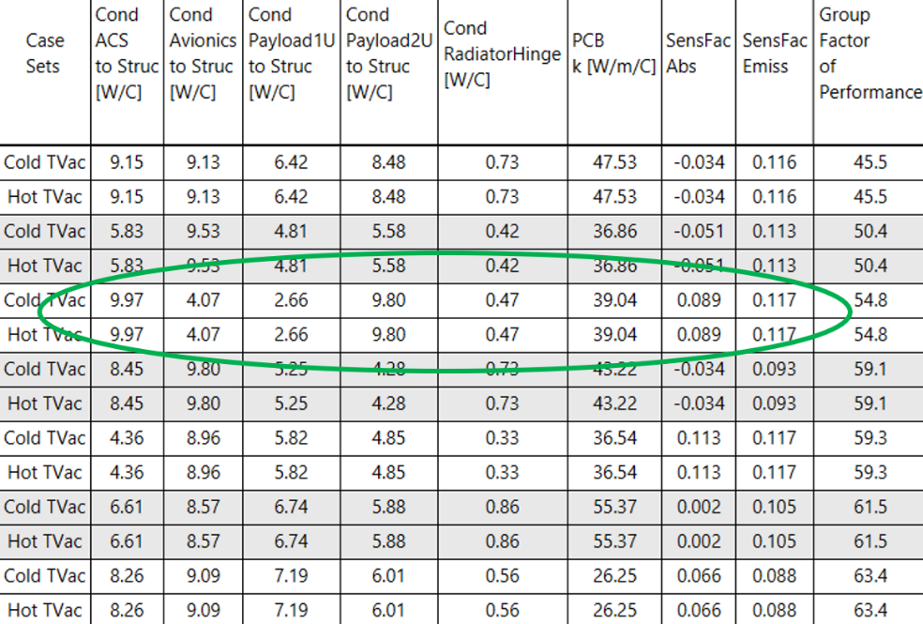
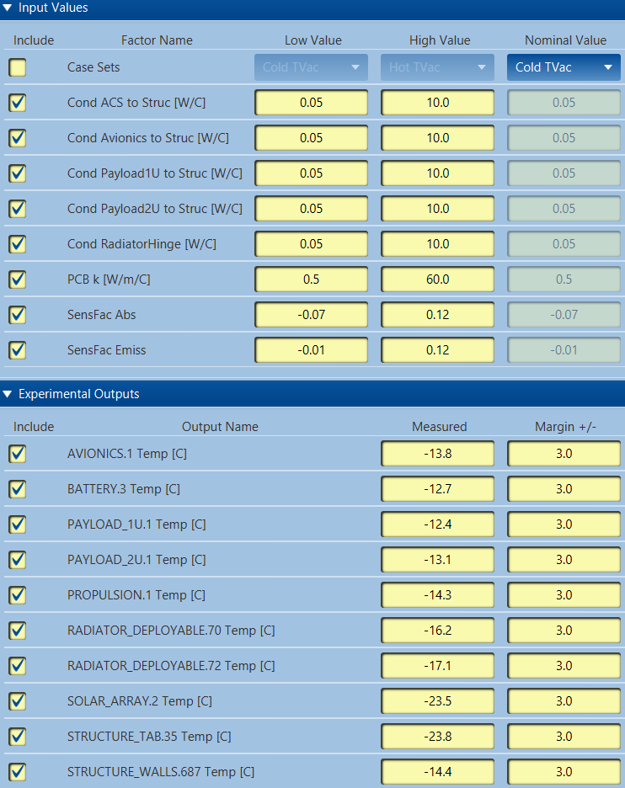
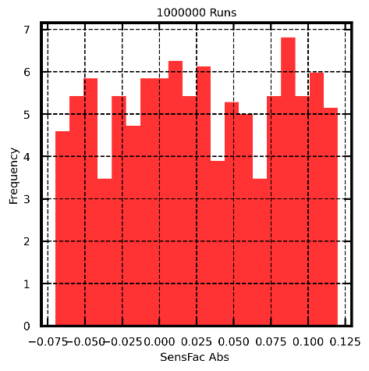
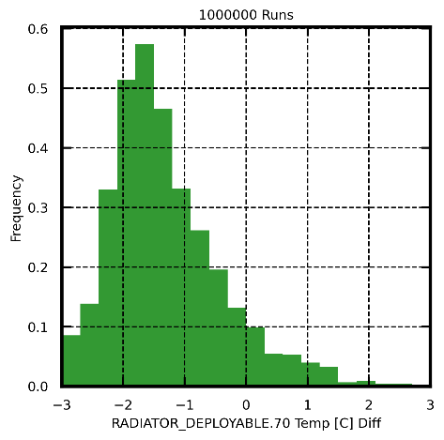
ROM Thermal Model Correlation
Evaluate thousands of input combinations in seconds.
Leads to collection of solutions.
And input/output distributions

Slide 5
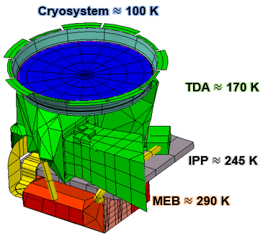
L’Ralph Overview
LUCY: the first mission to Jupiter’s Trojans
  Trojans: may be remnants of the primordial material that formed the outer planets
  Launching in October 2021!
  Has three instruments
    L’Ralph
    L’ORRI
    L’TES
L’Ralph: Cryogenic imaging instrument
  LEISA: IR detector ~100 K
  MVIC: VIS detector ~170 K
  Sensitive to heat flows!
    Need good correlation to ensure good spaceflight temperature conditions

Slide 6
Motivation for Alternative Correlation Methodologies
Time
  Model correlation requires many iterations of running the thermal model
Accuracy
Easy integration with the thermal model
  If alternative methods can easily interact with the existing thermal model (in my case, thermal desktop model), that can facilitate the correlation process
Veritrek looked like a good fit:
  Generates reduced order model (ROM) for quick correlation
    Using ROM methods can significantly cut down the model run time (though you will incur accuracy penalty)
  Interfaces with thermal desktop models and automates ROM generation
    Less work I have to, the better!
  Questions to explore:
    How much time is needed to generate a good enough ROM for correlation purposes, and how easy and valuable was it to use ROM for correlation purposes?
The following results are based on Veritrek Demo at the end of 2020

Slide 7
ROM Generation for L’Ralph
Biggest hurdle for using ROM is the initial investment for # of training points needed for ROM creation
  # of training points heavily depends on the output response
For the L’Ralph TVAC model, we wanted to correlate 15 input factors
  We only needed about 125 training runs to get an accurate ROM:
    For correlation, the design space is fairly small such that the output responses would be usually monotonic and/or be close to 1st order behavior
  L’Ralph TVAC model takes about 12 minutes on average to run, meaning 125 runs would take about 25 hours
    The ROM generation process was automated, so it was 25 unengaged hours

Slide 8
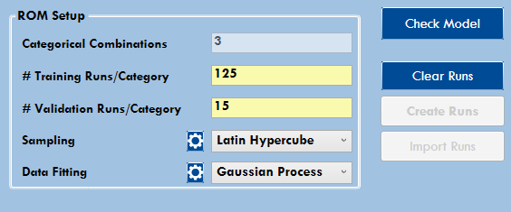
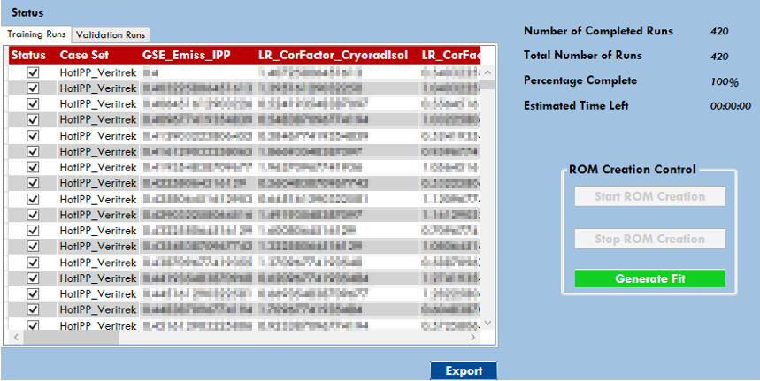
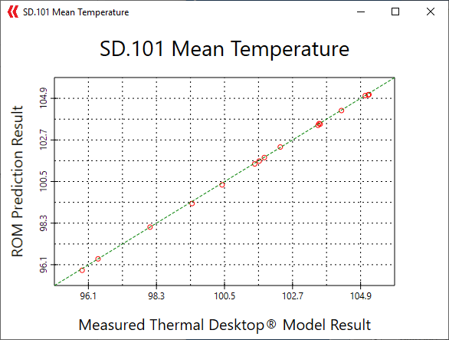
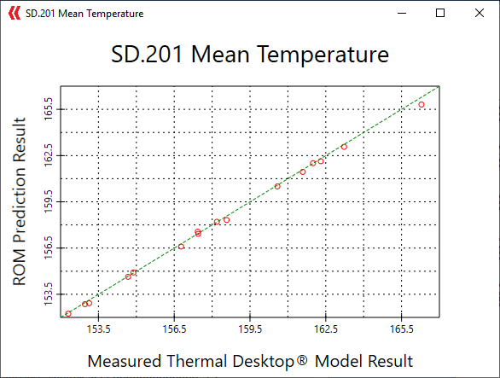
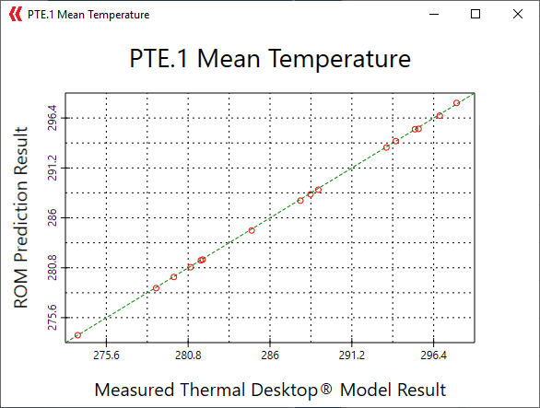
L’Ralph ROM Accuracy and Improvements
Three temperature zones of interest
  SD.101: LEISA (100 K Detector) temperature
  SD.201: MVIC (170 K Detector) temperature
  PTE.1: MEB (electronic box) temperature
For L’Ralph, all the output responses (~60) had standard deviation of less than 0.2 K, meaning ROM matches the model’s result closely
  This is good news for correlation; we need ROM to be close to the actual; otherwise, we would be adding more uncertainty to the correlation process

Slide 9
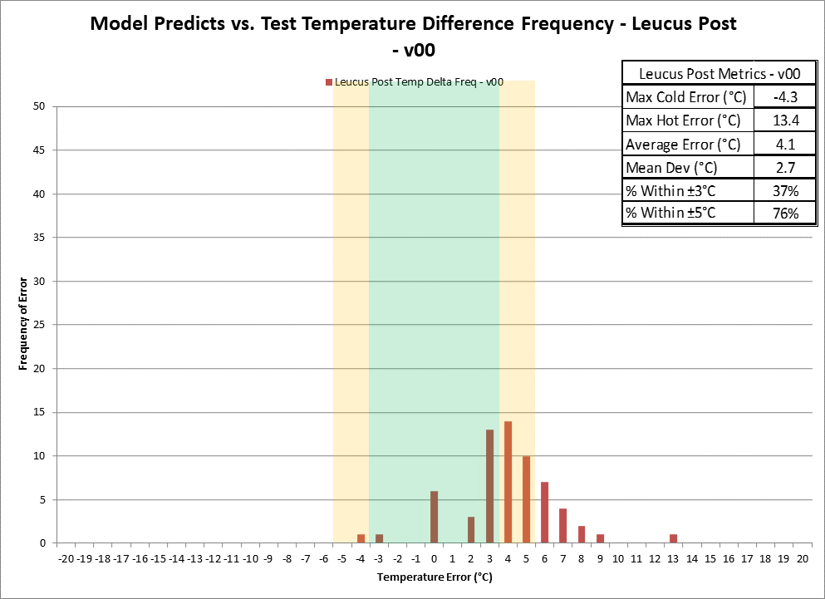
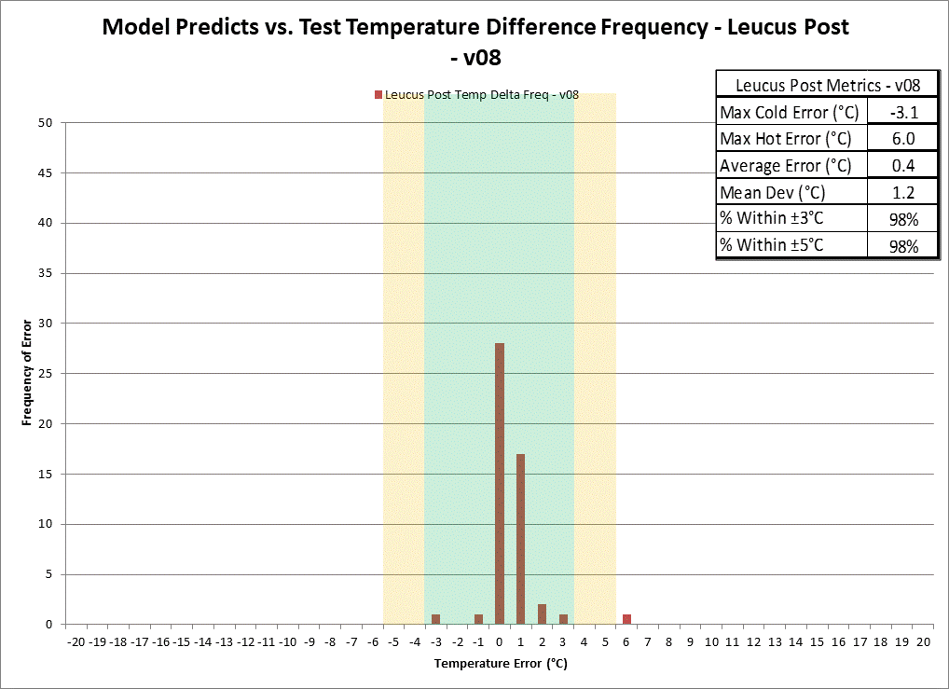
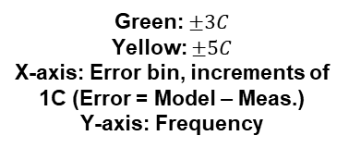
L’Ralph Model Correlation
Model – Test Data error criteria:
  LEISA (100 K zone) < 1.3K
  MVIC (170 K zone) < 3K
  MEB (room temp zone) < 5K
Manual correlation process:
  Identify where significant output errors are
  Identify which parameters affect which outputs
  Iteratively modify the parameters until all the errors are within acceptable range
  Basically, we are manually running optimization algorithm with the thermal model as a “black box” that does input/output calculator”
Automating this process can significantly save time
  ROM replaces the “black box” with a much more time efficient process
  Veritrek has tools to automate the entire correlation process
    Allows individualized correlation goals (i.e. temperature error allowable) per output response
    User simply has to specify a range of plausible values for the inputs
      i.e. Z93C55 white paint IR emittance: 0.8~0.9 @ 100 K
Before Correlation
Green: $±3C$
Yellow: $±5C$
X-axis: Error bin, increments of 1C (Error = Model – Meas.)
Y-axis: Frequency
After Correlation

Slide 10
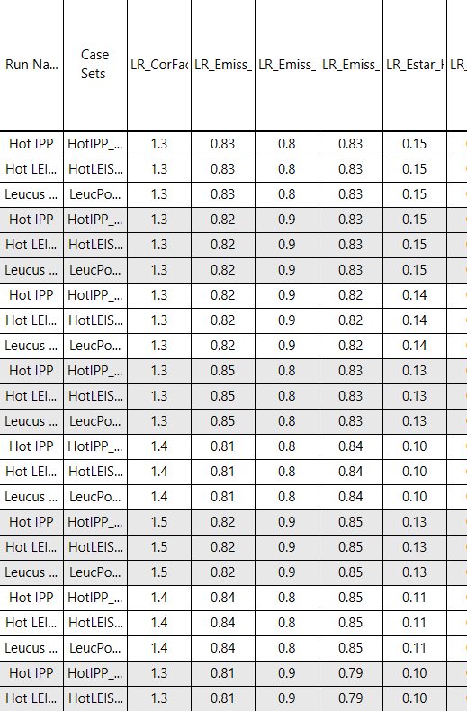
Veritrek Correlation Output
Veritrek correlation tool outputs combinations of input values that satisfy the output correlation criteria
  Outputs Group Factor of Performance (sum of RMS error from the measured value)
    The best GFP value is the best correlation solution if and only if:
      Errors are normally distributed
      Dataset is a determined set (same number of unknowns as linearly independent data set)
What if the data set is underdetermined?
  Fairly typical for a system level test due to schedule and testing constraints
    Not enough time to get more data points
    Not enough accessibility to provide linearly independent data points (i.e. lack of thermal control of a boundary or insufficient access to put a heater/cold plate)
  This can lead to several input combinations that can yield good GFP values
What if the measured values have errors that are non-normal?
  Systematic errors in measurements can bias exact values to be consistently higher or lower than measured
  Best GFP might not actually be the best solution
List of input variable combinations that fit the correlation criteria, with lowest (best) GFP up top

Slide 11
Exploring the Correlation Result with ROM
ROM is extremely fast (thousands of data points within seconds)
  Tons of data can be generated to identify multiple solutions that satisfy the correlation criteria
By specifying and enforcing certain probability density functions (PDF) for the inputs, we can generate PDFs of valid solutions
  The resulting plot can tell us the confidence level for the obtained correlated solution; we can have three types of outputs:
    Indeterministic
    Partially Deterministic
    Deterministic
To better understand the methodology, here are some simple examples…

Slide 12
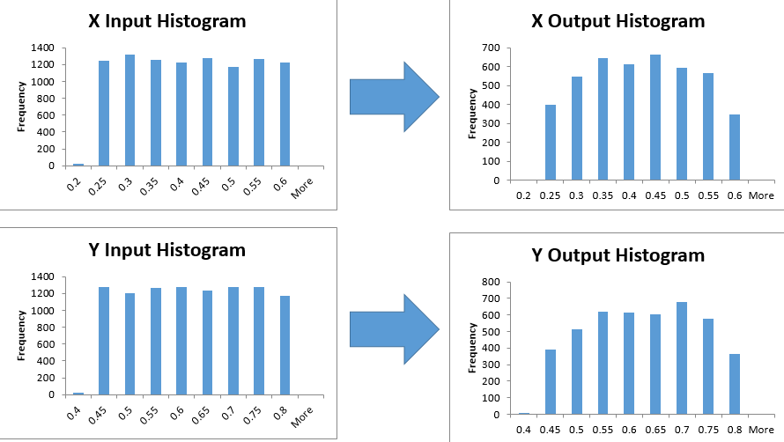
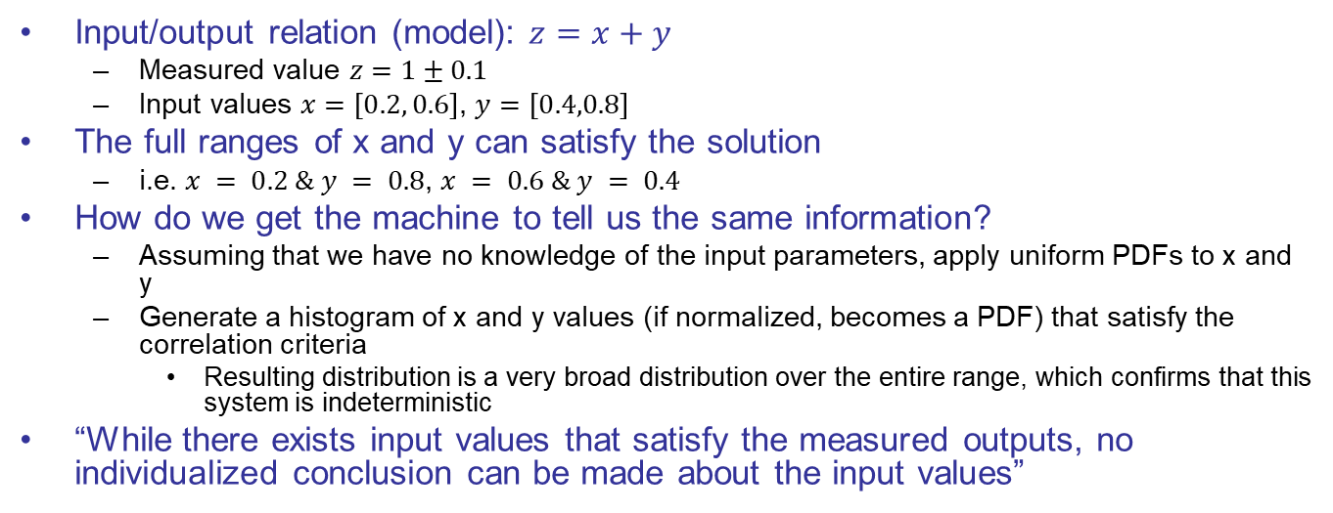
Indeterministic Solutions
Input/output relation (model): $z=x+y$
  Measured value $z=1±0.1$
  Input values $x=\left[0.2, 0.6\right]$, $y=\left[0.4,0.8\right]$
The full ranges of x and y can satisfy the solution
  i.e. $x = 0.2 \& y = 0.8$, $x = 0.6 \& y = 0.4$
How do we get the machine to tell us the same information?
  Assuming that we have no knowledge of the input parameters, apply uniform PDFs to x and y
  Generate a histogram of x and y values (if normalized, becomes a PDF) that satisfy the correlation criteria
    Resulting distribution is a very broad distribution over the entire range, which confirms that this system is indeterministic
“While there exists input values that satisfy the measured outputs, no individualized conclusion can be made about the input values”
Correlation Operation (model run + criteria check)
Notes:
We can easily see that the full ranges of x and y can satisfy the solution…. How do we get a machine to tell us the same information? Test multiple input values at random and see what input values satisfy the correlation criteria

Slide 13
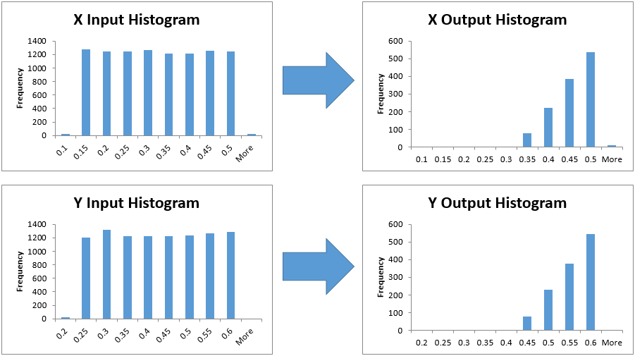
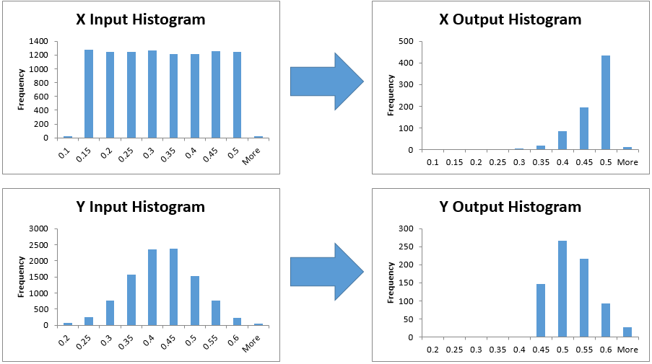
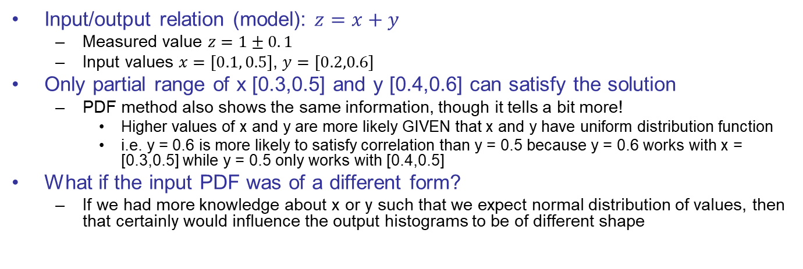
Partially Deterministic Solutions
Input/output relation (model): $z=x+y$
  Measured value $z=1±0. 1$
  Input values $x=\left[0.1, 0.5\right]$, $y=\left[0.2,0.6\right]$
Only partial range of x [0.3,0.5] and y [0.4,0.6] can satisfy the solution
  PDF method also shows the same information, though it tells a bit more!
    Higher values of x and y are more likely GIVEN that x and y have uniform distribution function
    i.e. y = 0.6 is more likely to satisfy correlation than y = 0.5 because y = 0.6 works with x = [0.3,0.5] while y = 0.5 only works with [0.4,0.5]
What if the input PDF was of a different form?
  If we had more knowledge about x or y such that we expect normal distribution of values, then that certainly would influence the output histograms to be of different shape
Uniform distribution of inputs
“engineer has no idea what value to expect for neither of the correlation variables”
Normal distribution for y
“engineer doesn’t know what x is, but has some knowledge of y”
Correlation Operation
Correlation Operation

Slide 14
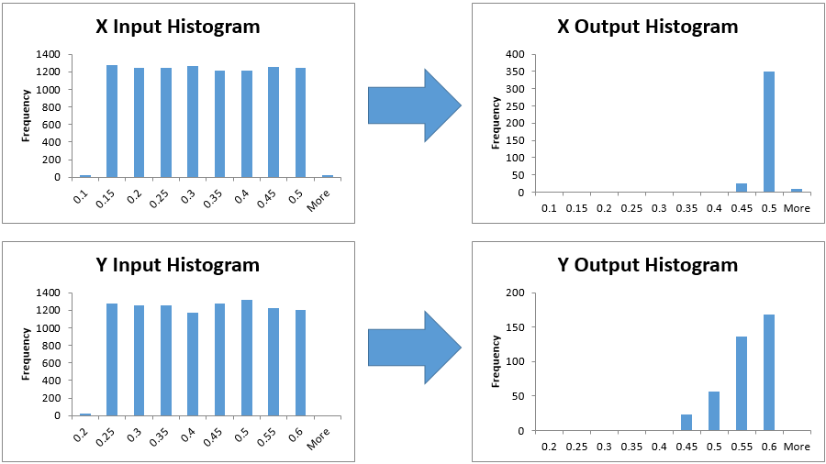
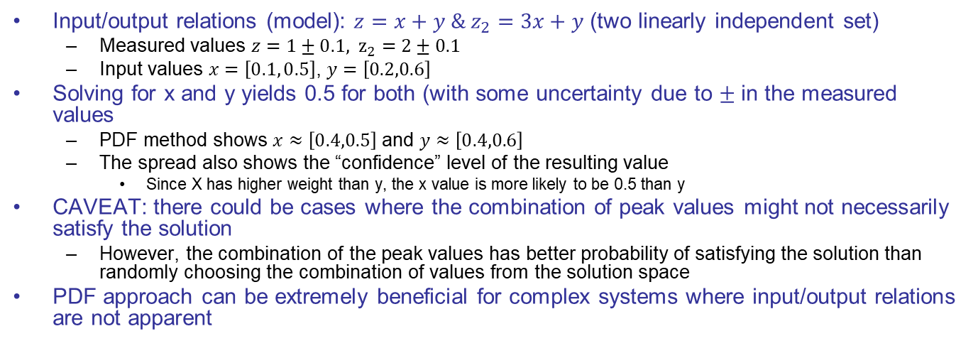
Deterministic Solutions
Input/output relations (model): $z=x+y \& z_{2}=3x+y$ (two linearly independent set)
  Measured values $z=1±0.1, z_{2}=2±0.1$
  Input values $x=\left[0.1, 0.5\right]$, $y=\left[0.2,0.6\right]$
Solving for x and y yields 0.5 for both (with some uncertainty due to $±$ in the measured values
  PDF method shows $x≈\left[0.4,0.5\right]$ and $y≈\left[0.4,0.6\right]$
  The spread also shows the “confidence” level of the resulting value
    Since X has higher weight than y, the x value is more likely to be 0.5 than y
CAVEAT: there could be cases where the combination of peak values might not necessarily satisfy the solution
  However, the combination of the peak values has better probability of satisfying the solution than randomly choosing the combination of values from the solution space
PDF approach can be extremely beneficial for complex systems where input/output relations are not apparent
Correlation Operation

Slide 15
Application to L’Ralph Correlation
Solution obtained using Veritrek based on three thermal balance points
What can we do with this information?
  Informs us of which variables need closer look
  If there were any testing surprises, these plots can help us figure out where the issue is
    manual correlation could lead to investigation in wrong variables
Partially deterministic Variable
Deterministic Variable
Indeterministic Variable

Slide 16
Conclusion
Reduced order model (ROM) approach can find answers that fit the correlation criteria within seconds
  Caveat: ROM needs to be accurate for the solutions to be valid
ROM approach allows the analyst to see how deterministic the correlated values are by generating solution distribution
  Identifying many answers allows the thermal engineer to explore the uncertain parameters further (i.e. do I need more thermal data to hone in on the harness conductance value?)
  Manually finding all the answers can be an arduous/impossible task
Initial investment in generating L’Ralph’s ROM was not bad
  About 125 training runs were needed to get good enough accuracy
  Caveat: Veritrek’s ROM needs to be regenerated if:
    non-symbol/register driven parameters need to be changed during the thermal model correlation (i.e. geometric representation needs update)
    Unspecified inputs/outputs needs to be added to the ROM (i.e. user forgot to include bolt conductance to the input)

