Slide 1
Bending Stiffness in Prepreg Composites
Matthew Orrell
Chris Wohl, Robert Edahl
2021 Summer Student Research Symposium
All Images are credited to NASA
Notes:
Hello My name is Matthew Orrell, I worked with my mentors Chris Wohl and Robert Edahl this summer studying bending stiffness in prepreg composites.

Slide 2
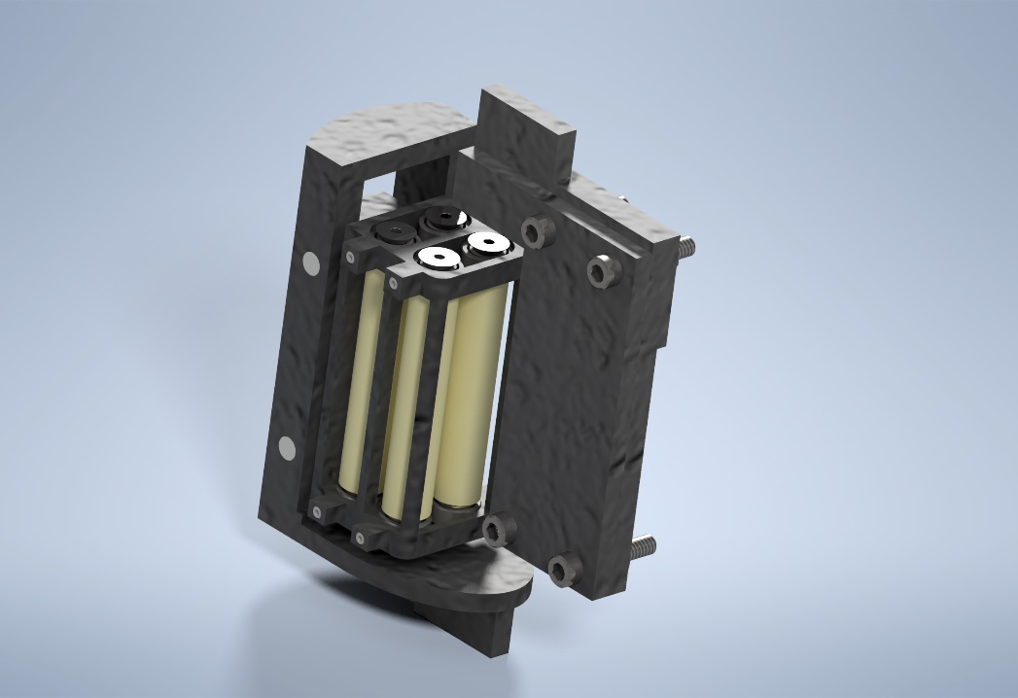
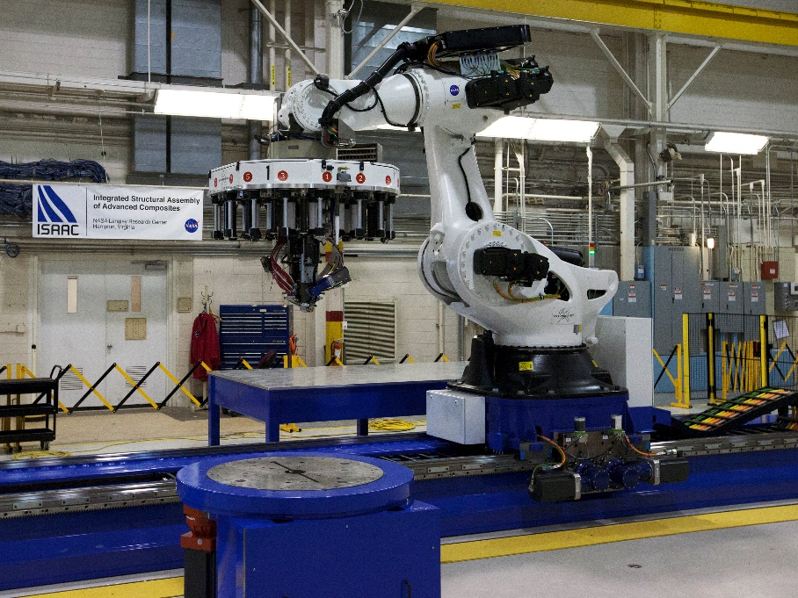
Overview
High-Rate Composite Manufacturing
(HiCAM)
Tool Design
ISACC PHOTO
Notes:
High-Rate composite manufacturing is a current project within NASA. It specializes in rapid automated manufacturing, specifically in aircraft and aerospace applications. One of the key items in this project is the ability to use automated fiber placement,( AFP )as tool to accomplish this goal. Automated fiber placement lays down individual tows of pre-impregnated composite to create parts. With this novel field understanding how prepreg moves and reacts when being placed is essential to the success of the part. This is where my project comes in. This summer I worked on designing a tool to help find the bending stiffness in prepreg composites.

Slide 3
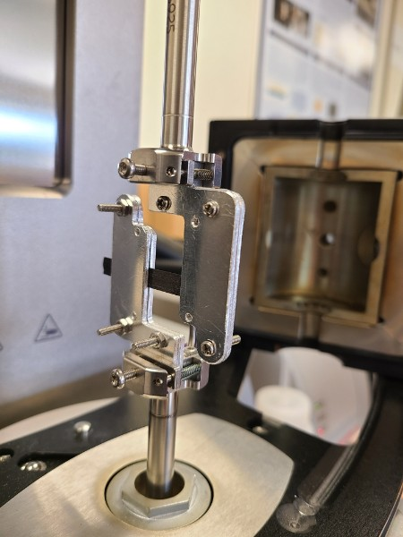

History of the project
Other modes of testing
- Dynamic Mechanical Analysis (DMA)
- Dynamic Mechanical Thermal Analysis (DMTA)
Notes:
Dynamic mechanical Analysis and Dynamic mechanical Thermal Analysis are styles of frequency testing. Traditional methods of testing for bending stiffness and other properties require a more uniform material like steel or plastics. With prepreg composites a different approach would be required. Based on literature of similar tests we developed our own fixtures to accomplish our goal of a pure bending moment applied to a sample of prepreg composite.

Slide 4
Height: 3”
Length: 2.36”
Width: 1.96”
Lengthy setup
Introduced play
Inconsistent
Applied tensile force
Applied shear force
FIXED
Notes:
The beginning of my summer project began with this fixture. This fixture mounts inside an Anton Parr MCR 502 rheometer, in this tool there is an enclosure around the fixture with an approximate size of 3 inches tall and a radius of 2 inches, this will be important to keep in mind as we design our improved fixtures.
The fixture works by mounting a sample in-between two plates on each side. The “bottom” fixture is fixed and does not rotate. The “upper” fixture rotates. The fixture will bend the sample to a set deflection and relax. As the material relaxes to its initial state this information would be recorded. However, this design introduced an array of issues that would affect the data. These issues to solve are the: lengthy and inconsistent setup process, the play in the system, and an applied a tensile and shearing force to the sample.

Slide 5
The Approach
Problem
Goal
Sketch
Model
Feedback
PRODUCT
Notes:
My approach to the problem started with meeting with my mentor to discuss the issues of his current tool and his end goal. Once those were established, I sketched up some thoughts to help visualize the problem both on paper and in 3d modeling software, in my case Autodesk Inventor. This process of using a physical means of paper then refining in 3d will be repeated for each major iteration of the fixture. In addition to modelling, I conducted some research on what parts to use so they could handle the potentially harsh settings inside the enclosure. By working with the High-Rate composites manufacturing team and others at NASA I would receive feedback and make changes. We will go more in depth in the next few slides.

Slide 6
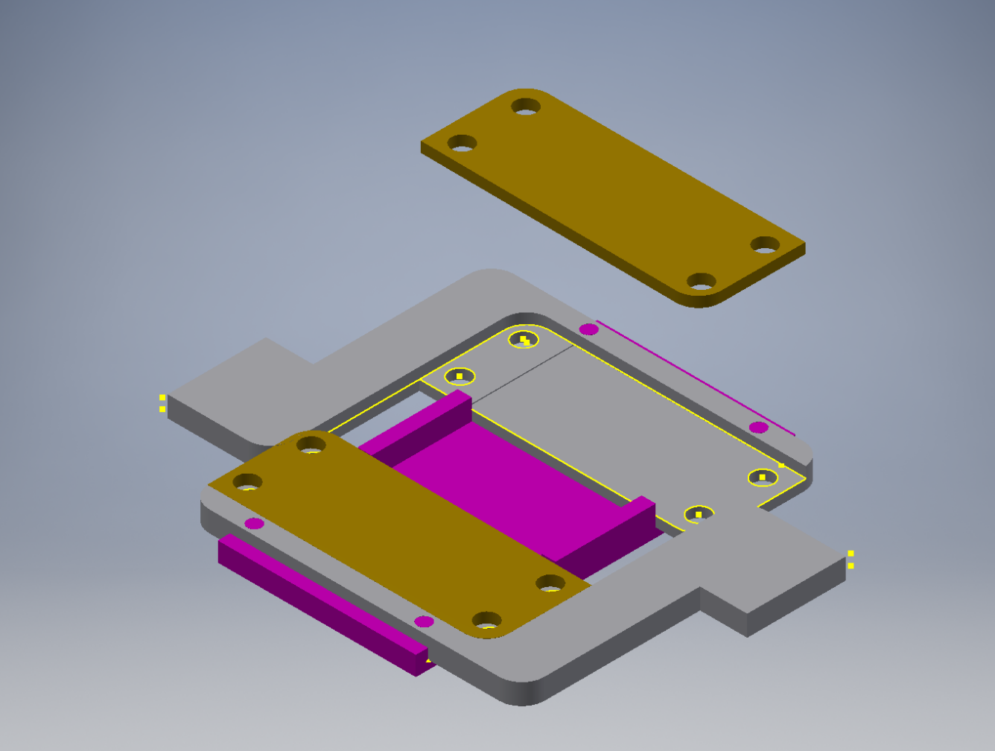
Iteration 1
Lengthy setup
Introduced play
Inconsistent
Applied tensile force
Applied shear force
Rotating
Alignment/sample prep
Fixed
Notes:
This was one of the first designs I made. This setup served as an improvement of the first design by solving some of the issues. By using an alignment tool (shown in magenta) and recesses on the two plates (shown in gray) the issue of alignment along with the lengthy setup would be eliminated. By allowing the operator to setup everything outside of the machine, no “awkward” positioning of material would be required for resetting the test. The fixture operates in the same manner as the previous, so the unwanted tensile and shear forces are still there.

Slide 7
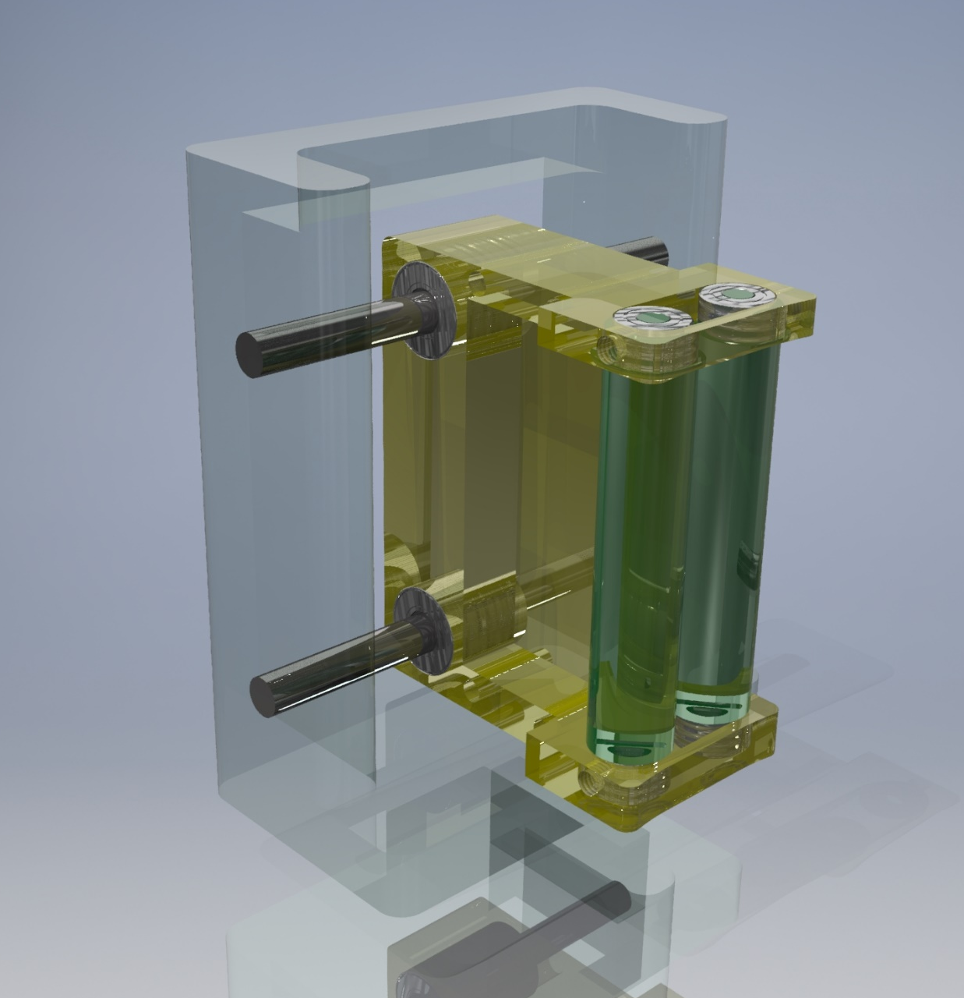
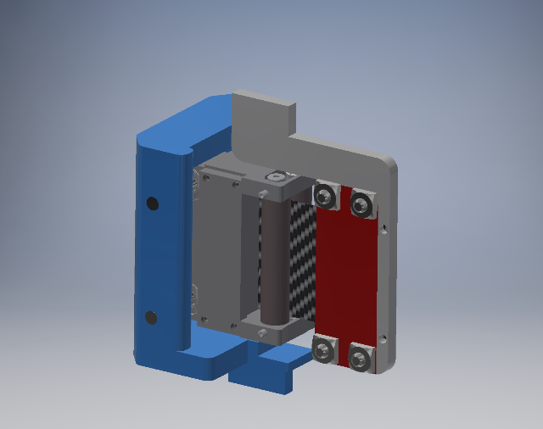
Iteration 2
Lengthy setup
Introduced play
Inconsistent
Applied tensile force
Applied shear force
Carriage Motion
Material motion
Generalized design
Visualization of concept
Notes:
To overcome the issues involved with Iteration 1 we revisited the problem and took notes from other tests and literature. To solve our issues a redesign of the fixed portion was chosen. To obtain a pure bending moment a series of rollers were attached to a linear carriage. This enables the material to be aligned and a bending force applied without any unwanted forces. This will isolate that desired bending stiffness of the prepreg material.

Slide 8

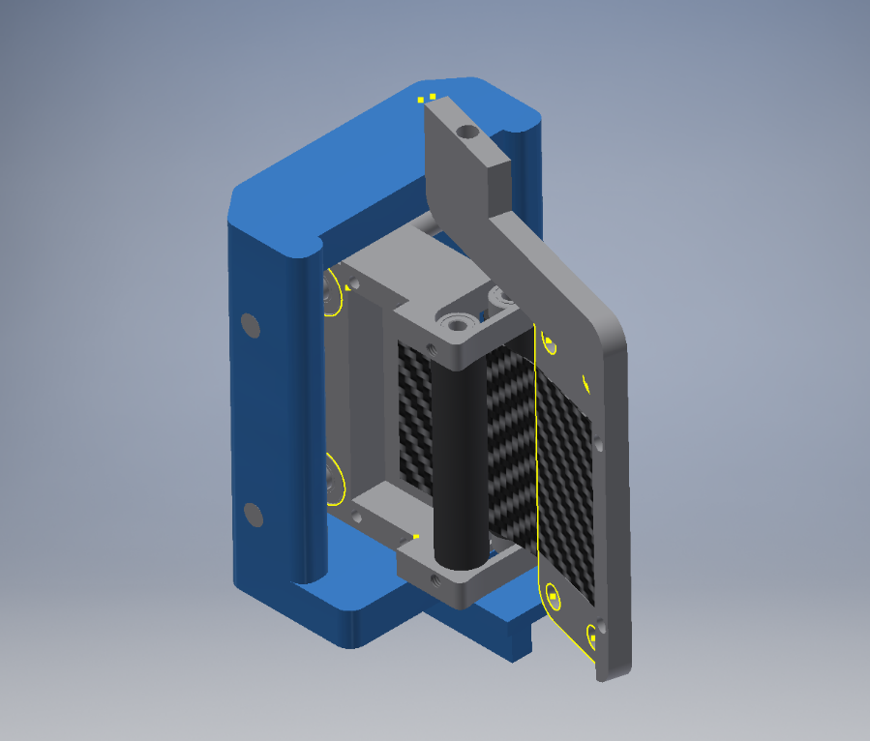
Motion
X
Roller
Z
Y
SHIM
SHIM
Y
X
Z
M
Y
X
Notes:
(use laser pointer!!!), Shown above is a breakdown of how the motion is perceived. The rheometer rotates the upper fixture shown here(top right->bottom right) this bending force bends the sample. Since rollers are in place the material is not bound on one end preventing any tensioning in the material other than the bending moment applied. Meanwhile to prevent a noticeable shear force on the sample the entire roller carriage will translate on the YZ plane. So, to recap as the fixture rotates the sample slides out (point) then any shear force applied will be negated by the linear bearings causing the carriage to move.

Slide 9

Iteration 3
Lengthy setup
Introduced play
Inconsistent
Applied tensile force
Applied shear force
More Rollers
Full materials list
Designed for 3D printing
Allows for improvement without major redesign
Notes:
This is the Last iteration of the test fixture. The design has more rollers to help better accommodate the sample sliding in and out of the fixture. It also features a superior form factor than other iterations allowing for future modifications to be made without redesigning or ordering significant amounts of hardware. This model is optimized for 3d printing so it can be checked for fitment of parts and its ease of use on the rheometer.

Slide 10
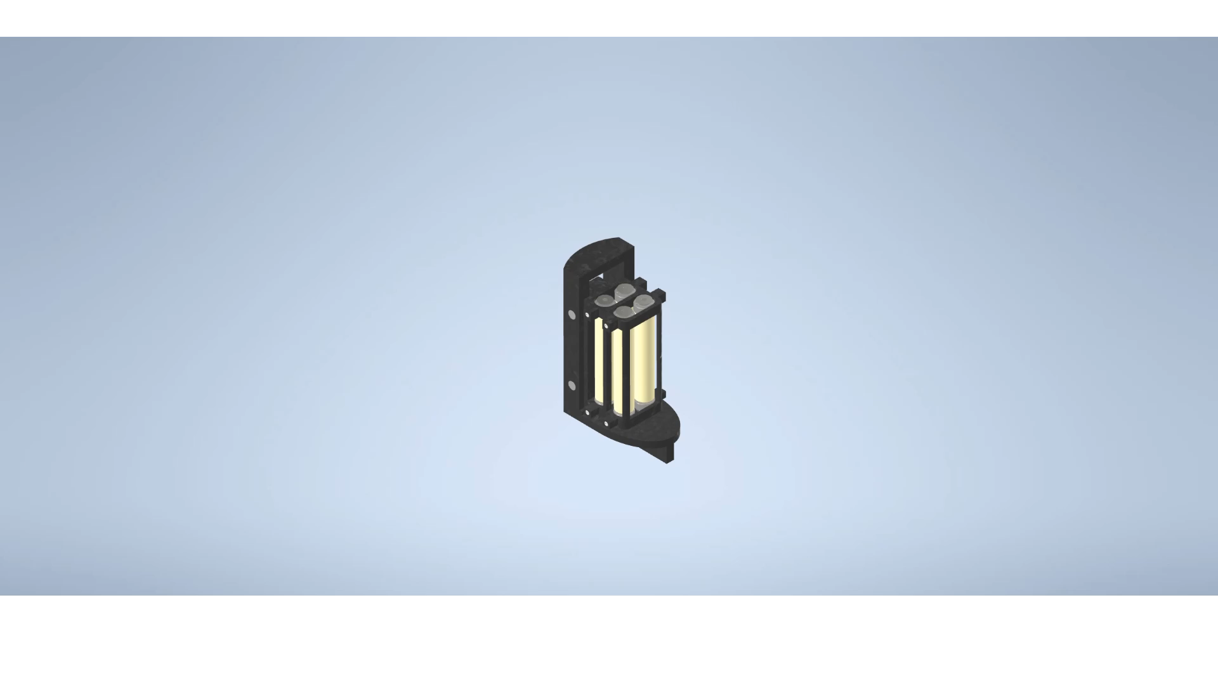
Notes:
In this virtual environment I had to remember that I was not there to assemble the fixture or make improvements on it. So, It brought me to do some “future proofing”. shown here is a little video with all of the steps to install the pieces. I also had to leave some room for other ideas mentioned during meetings that did not have enough time or priority for this iteration. This taught me a new skill in inventor and helped me realize some new concepts in designing/manufacturing parts.

Slide 11



Summary
Teamwork
New and old modelling techniques
Thinking through the process
Notes:
So, in summary this summer I assisted in analyzing the bending stiffness of prepreg tack by designing a fixture to apply a pure bending moment to a sample of prepreg composite. This will help the overall goal of High-Rate composite manufacturing. I accomplished my goal by working with the wonderful people here at NASA, using a combination of on paper diagrams, 3d modelling, and thinking through the individual processes within the fixture.

Slide 12
Acknowledgements
LARC Advanced Materials and Processing Branch – Chris Wohl, Thammaia Sreekantamurthy, Chris Stelter, Robert Edahl, Brian Grimsley, Bryce Horvath, Samantha Applin, Miranda Beaudry
VSGC – Deborah Murray, Nicole Shaw
All Images are credited to NASA
Notes:
I would like to thank Dr. Wohl for all your help, this has been my second summer working with you and I have greatly appreciated your hard work and advice throughout my time here with NASA. I would also like to thank Tham, Mr. Stelter, Mr. Horvath, Mrs. Applin , Mrs. Beaudry, Mr. Edahl, and Mr. Grimsley for your advice, input and hands on expertise in this field.
For the Virginia Space Grant Consortium, I would like to thank Mrs. Shaw and Mrs. Murray for providing us with this opportunity and your support in our future careers!

